Slide 1
Data Structures
Lecture 4
Red-Black Trees
Haim Kaplan and Uri Zwick November 2012

Slide 2
Red-Black trees [Bayer 1972] [Guibas-Sedgewick 1978]
External leaves

Slide 3
Red-Black trees
Binary search tree with external leaves
Each node is colored red or black
Each root to leaf path contains the same number of black nodes
The parent of a red node must be black
The root and external leaves are black

Slide 4
Red-Black trees
Paths from each node to the leaves have the same length

Slide 5
Red-Black trees
What is the maximal height of a Red-Black tree containing n nodes?

Slide 6
Height and Black height
2
4
1
1
2
3
0
0
1
1
1
2
0
0
0
0
1
1
0
0
Black height - Number of black nodes on paths from the node to the external leaves (excluding the node)
Height ≤ 2 × black height

Slide 7
Height of Red-Black trees
Lemma: The subtree of a a node of black height k contains at least 2^{k}−1 nodes
Corollary: The black height of a Red-Black tree containing n nodes is at most log₂(n+1)
Corollary: The height of a Red-Black tree containing n nodes is at most 2 log₂(n+1)

Slide 8
Height of Red-Black trees
Lemma: The subtree of a a node of black height k contains at least 2^{k}−1 nodes
k
0
k or k−1
k or k−1
1

Slide 9
Fold red nodes into their parents
Red-Black trees → 2-4 trees

Slide 10
Fold red nodes into their parents
Red-Black trees → 2-4 trees

Slide 11
Red-Black trees → 2-4 trees
Height of 2-4 tree = black height of Red-Black tree

Slide 12
Red-Black trees have logarithmic height

Slide 13
Rotations
y
x
Right rotate
x
C
y
A
A
B
C
B
Left rotate

Slide 14
Insert

Slide 15
Insert (cont.)

Slide 16
Insert (cont.)

Slide 17
Insert (cont.)

Slide 18
Use rotations
x
y
<===>
y
C
A
x
A
B
B
C
y
x
===>
y
z
x
z

Slide 19
Insert (cont.)
x
y
z
====>
y
z
x

Slide 20
Insert (cont.)

Slide 21
Insert (cont.)

Slide 22
Insert (cont.)

Slide 23
Insert (cont.)

Slide 24
Insert: Case 1a
z’s uncle w is red, z is a right child
C
new z
C
y
A
D
A
D
z
z
α
δ
ε
α
δ
ε
B
B
β
γ
β
γ
Recolor z’s parent, uncle and grandparent
Black heights do not change
Red rule violation resolved or moved up the tree

Slide 25
Insert: Case 1b
z’s uncle w is red, z is a left child
new z
C
C
y
y
A
D
A
D
z
z
α
δ
ε
α
δ
ε
B
B
β
γ
β
γ
Symmetric

Slide 26
Insert: Case 2
z’s uncle w is black, z is a right child
C
C
A
δ
B
δ
z
α
z
γ
B
A
β
γ
α
β
Use a left rotation to convert to case 3
Black heights do not change
Note: the roots of α,β,γ,δ are black

Slide 27
Insert: Case 3
z’s uncle w is black, z is a left child
C
B
B
δ
A
C
z
γ
α
β
γ
δ
A
α
β
Use a right rotation to resolve
Note: the roots of α,β,γ,δ are black

Slide 28
All cases covered?
In all cases above, z’s parent is a left child
Case 1: z’s uncle is red
Case 2: z’s uncle is black and z is a right child
Case 3: z’s uncle is black and z is a left child
The other cases (z’s parent is a right child) are mirror images of the cases shown

Slide 29
Fixing a Red-Black Tree after insertion
Can only loop in Case 1
Case 1
Case 2
Case 3
finish

Slide 30
Insert - analysis
Find insertion point – O(log n) time
Insert – O(1) time
Fix the tree – O(log n) time
Fixing the tree:
At most 2 rotations
O(1) amortized time
Total time spend on fixing the tree while inserting n elements is O(n)

Slide 31
Amortized analysis of Fixing the tree
Inserted nodes are colored red
Case 1 is the only non-terminal case
In Case 1:
2 red + 1 black → 1 red + 2 black
Number of red nodes decreases by 1
In n insertions Case 1 can be executed at most n times!
Φ = #red nodes
Total fix-up time in n insertions = O(n)

Slide 32
Red-Black trees - Implementation
x
parent
info
key
left
right
color

Slide 33
Red-Black trees - Implementation
T
∞
x
parent
info
key
left
right
color
Add a dummy root (sentinel)
The dummy root is black and has key ∞
The real root is the left child of the dummy root

Slide 34
Red-Black trees - Implementation
T
Replace all external leaves by another sentinel, called NULL
∞
NULL is a black Tree-Node
Writing to NULL.parent is harmless
NULL

Slide 35
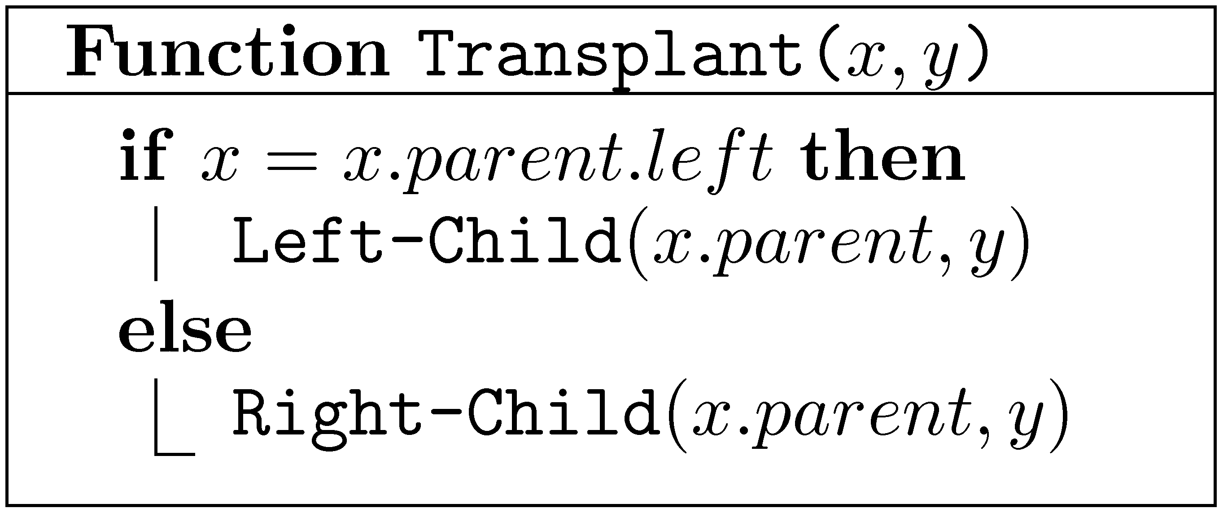
Basic operations
Transplant – Replace the subtree of x by the subtree of y
Replace – Replace x by y
y may be NULL
x may be the root

Slide 36
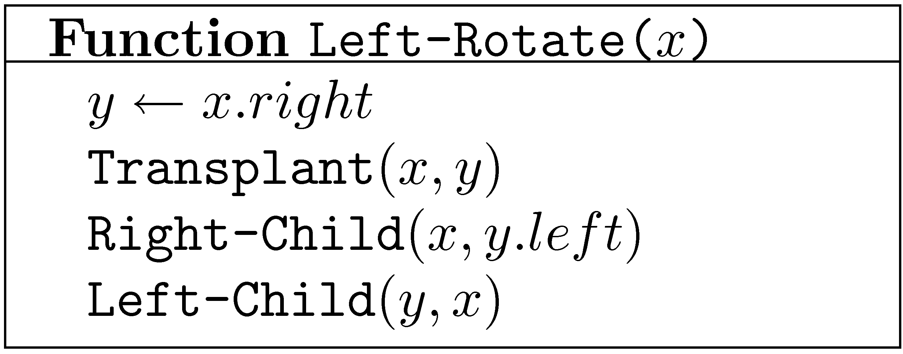
Left Rotation
x
y
α
γ
y
x
β
γ
α
β
All special cases handled automatically!
α,β,γ may be NULL. x may be the root.

Slide 38
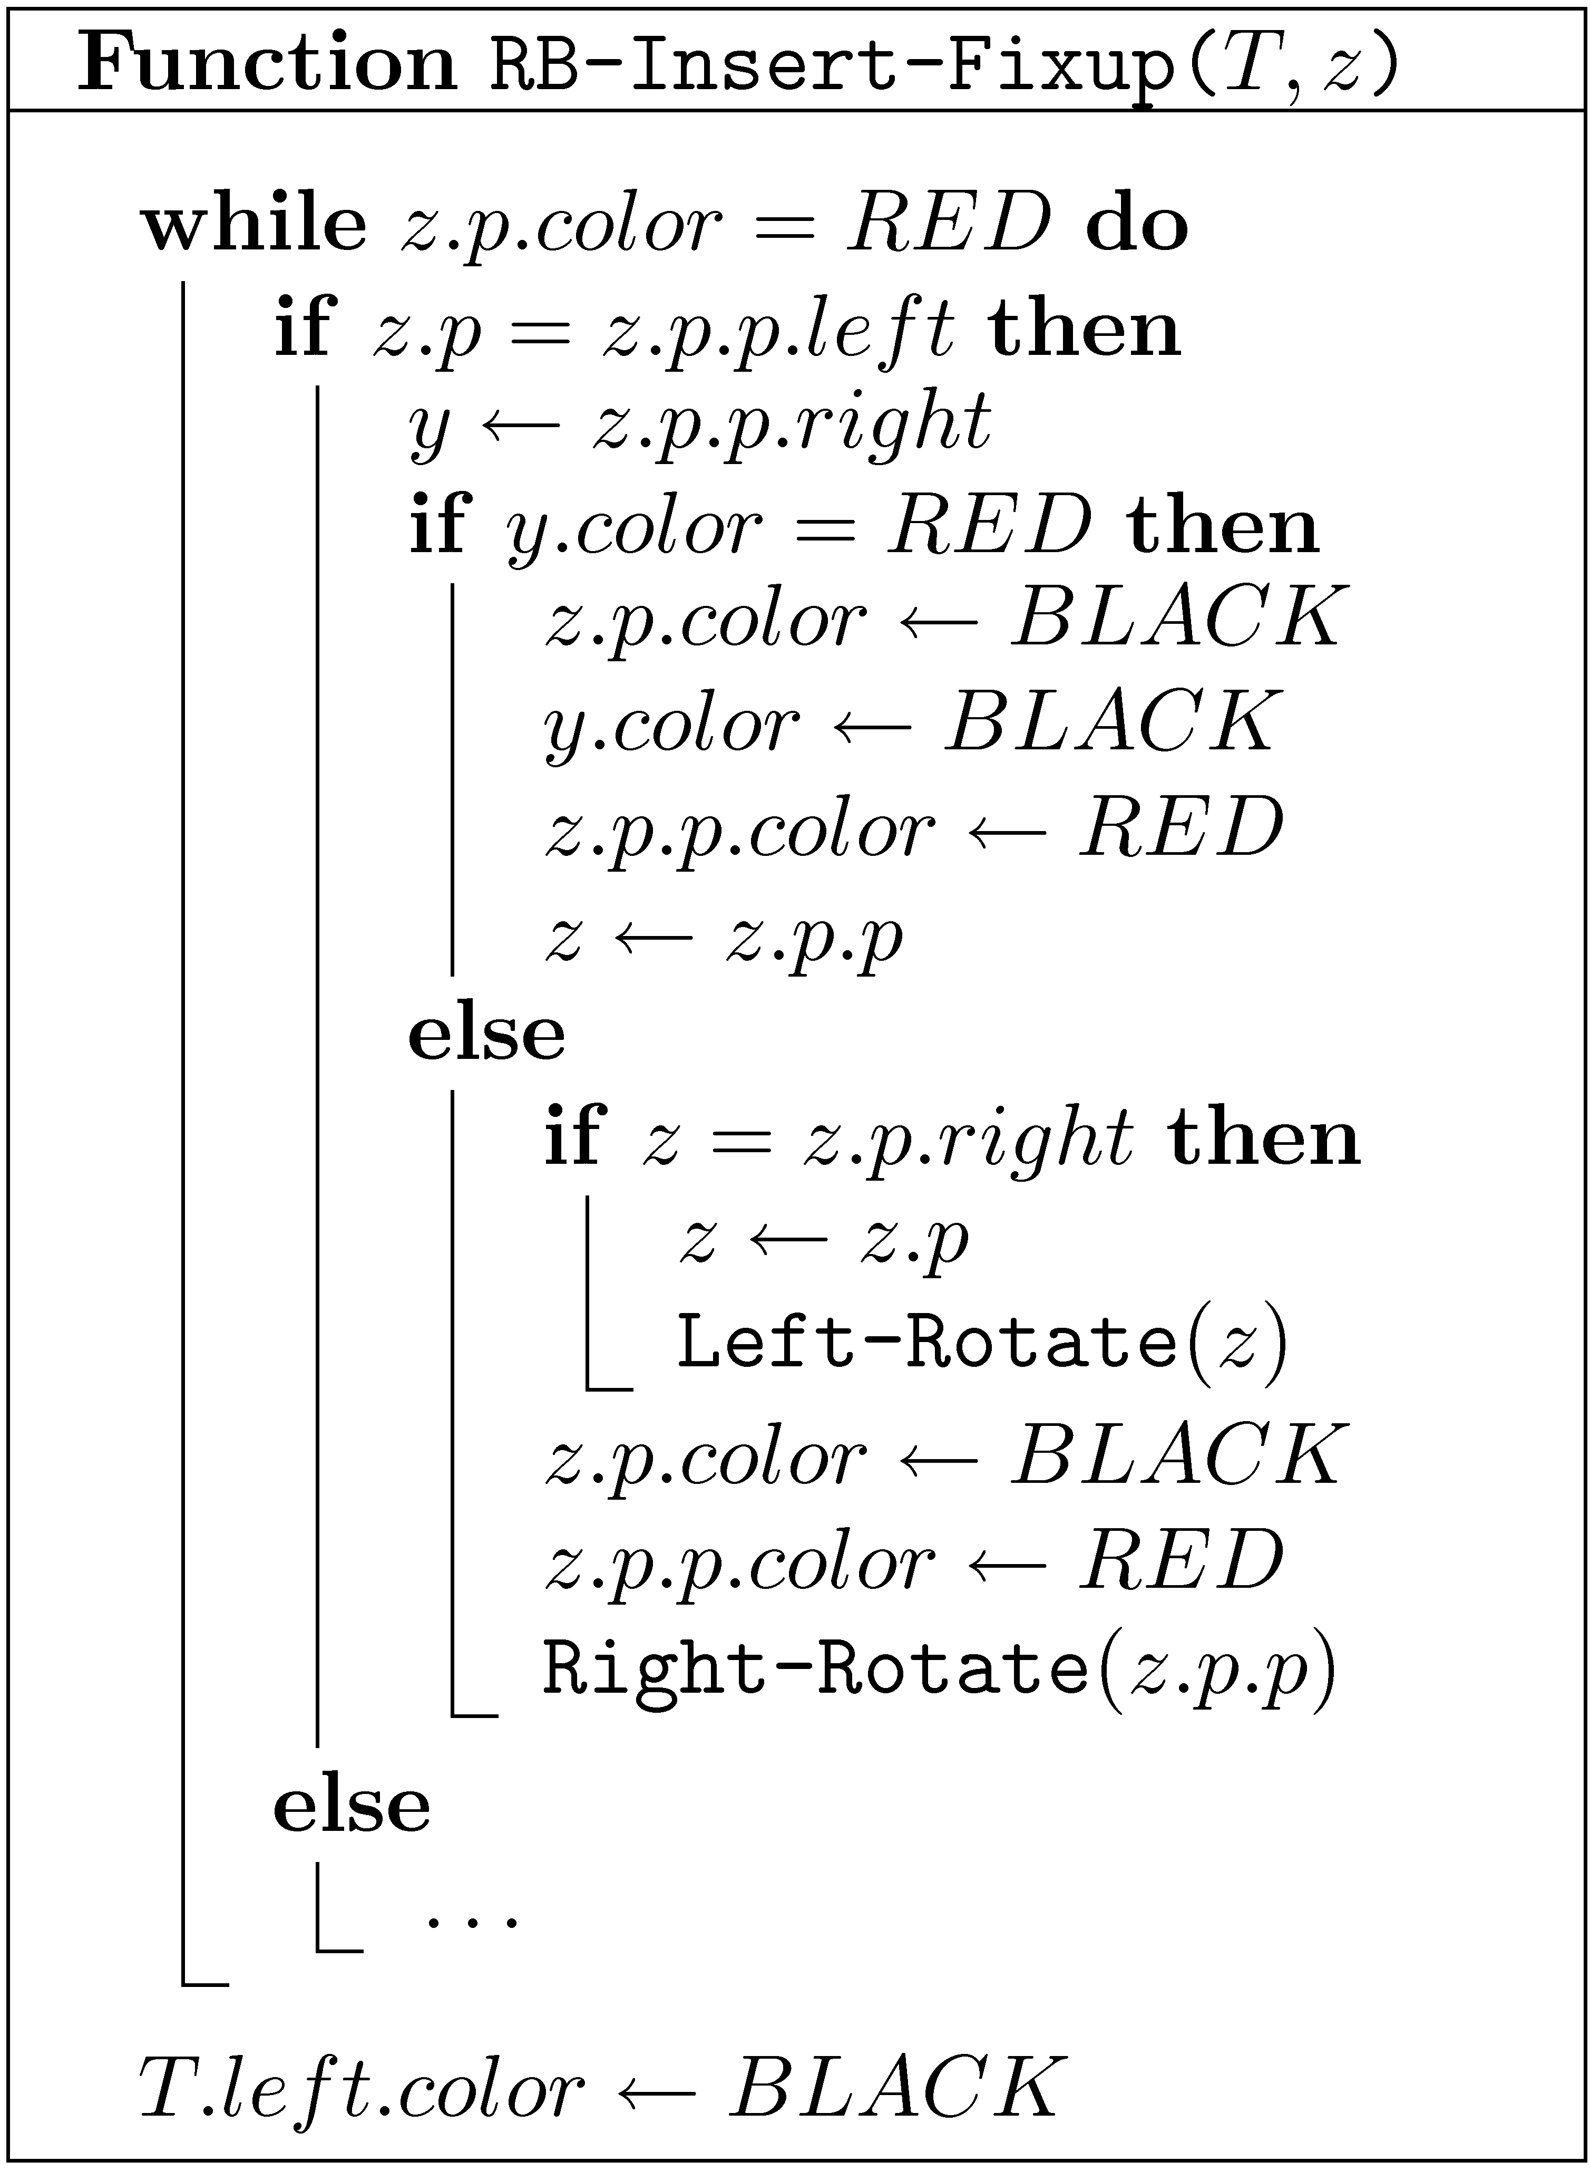
See also CLRS Chapter 13
Case 1
Case 2
Case 3
p ≡ parent

Slide 39
Deletions from Red-Black trees
Similar in nature to insertions
Slightly more complicated
If the node to be deleted has two children, we again delete its successor from the tree and use it to replace the node to be deleted
Let’s see some examples…

Slide 40
Delete

Slide 41
Delete

Slide 42
Delete

Slide 43
Delete

Slide 44
Delete (cont.)

Slide 45
Delete (cont.)

Slide 46
Delete (cont.)

Slide 47
Delete (cont.)

Slide 48
Delete (cont.)

Slide 49
Delete (cont.)

Slide 50
Deleting a node from a Red-Black tree
Remove the node from the tree
If it was red or had a red child we are done
Otherwise we get a node with “extra blackness”
Apply a transformation that either moves the “extra blackness” up the tree, or gets rid of it
An “extra blackness” at the root may be removed

Slide 51
Delete: Case 1
B
D
x
A
D
w
E
B
α
β
ε
ζ
x
C
A
C
E
ζ
α
β
γ
δ
γ
δ
ε
x’s sibling w is red

Slide 52
Delete: Case 1
x’s sibling w is red
B
C
x
A
C
w
B
δ
α
β
x
γ
δ
A
γ
α
β
“Extra-blackness” went down
This can only happen once

Slide 53
Delete: Case 2
x’s sibling w is black, and both children of w are black
B
new x
B
x
A
D
w
A
D
w
α
β
α
β
C
E
C
E
γ
δ
ε
ζ
γ
δ
ε
ζ
If B is red, it is made black and we are done

Slide 54
Delete: Case 3
x’s sibling w is black, w’s left child is red, and w’s right child is black
B
B
x
A
D
w
x
A
C
new w
α
β
α
C
E
β
γ
D
γ
δ
ε
ζ
δ
E
ε
ζ

Slide 55
Delete: Case 4
x’s sibling w is black, and w’s right child is red
B
D
x
A
D
w
E
B
α
β
ε
ζ
C
E
C
A
ζ
α
β
γ
δ
γ
δ
ε
“Extra-blackness” disappeared!

Slide 56
Deletions from Red-Black Tree
Case 1
Case 3
All cases above
Case 2r
Case 4
Finish
Can only loop in Case 2b
Case 2b

Slide 57
Delete - analysis
Find the successor (if needed) – O(log n) time
Delete – O(1) time
Fix the tree – O(log n) time
Fixing the tree:
At most 3 rotations
O(1) amortized time
Total time spend on fixing the tree while performing a sequence of n insert and delete operations is O(n)

Slide 58
Delete + Insert – Non-terminal cases
Insert: Case 1a
Delete: Case 2
Φ =
#(
)
+
2 #(
)

Slide 59
Joining two Red-Black trees
x
T₁
T₂
Join(T₁,x,T₂)
Suppose that all keys in T₁ are less than x.key and that all keys in T₂ are greater than x.key
Simply joining them would create a very unbalanced tree
Black rule may be violated

Slide 60
Joining two Red-Black trees
T₂
Assume bh(T₁) ≤ bh(T₂)
T₁
y
Join(T₁,x,T₂)
x
z
Find a black node z on the left spine of T₂ with the same black height as the black height of the root of T₁
Color x red
Fix red rule as in insert
O(log n) time
O(bh(T₂)−bh(T₁)+1) time, if bh’s maintained explicitly

Slide 61
Splitting
a
a
b
E
b
E
x
c
F
d
F
A
d
H
G
c
e
G
e
A
B
f
B
f
C
x
C
D
D
H

Slide 62
Balanced and Efficient Splitting
y
x
O(log n) time!
Suppose we join T₁ ,T₂ ,…,T_{k} where bh(T₁) ≥ bh(T₂) ≥ … ≥ bh(T_{k})

Slide 63
Additional dictionary operations
Select(D,i) – Return the i-th largest item in D (indices start from 0)
Rank(D,x) – Return the rank of x in D, (i.e., the number of items x is larger than)
Can we still use Red-Black trees?
Keep sub-tree sizes!

Slide 64
10
3
6
1
1
3
2
1
1
1
x.size = x.left.size + x.right.size + 1

Slide 65
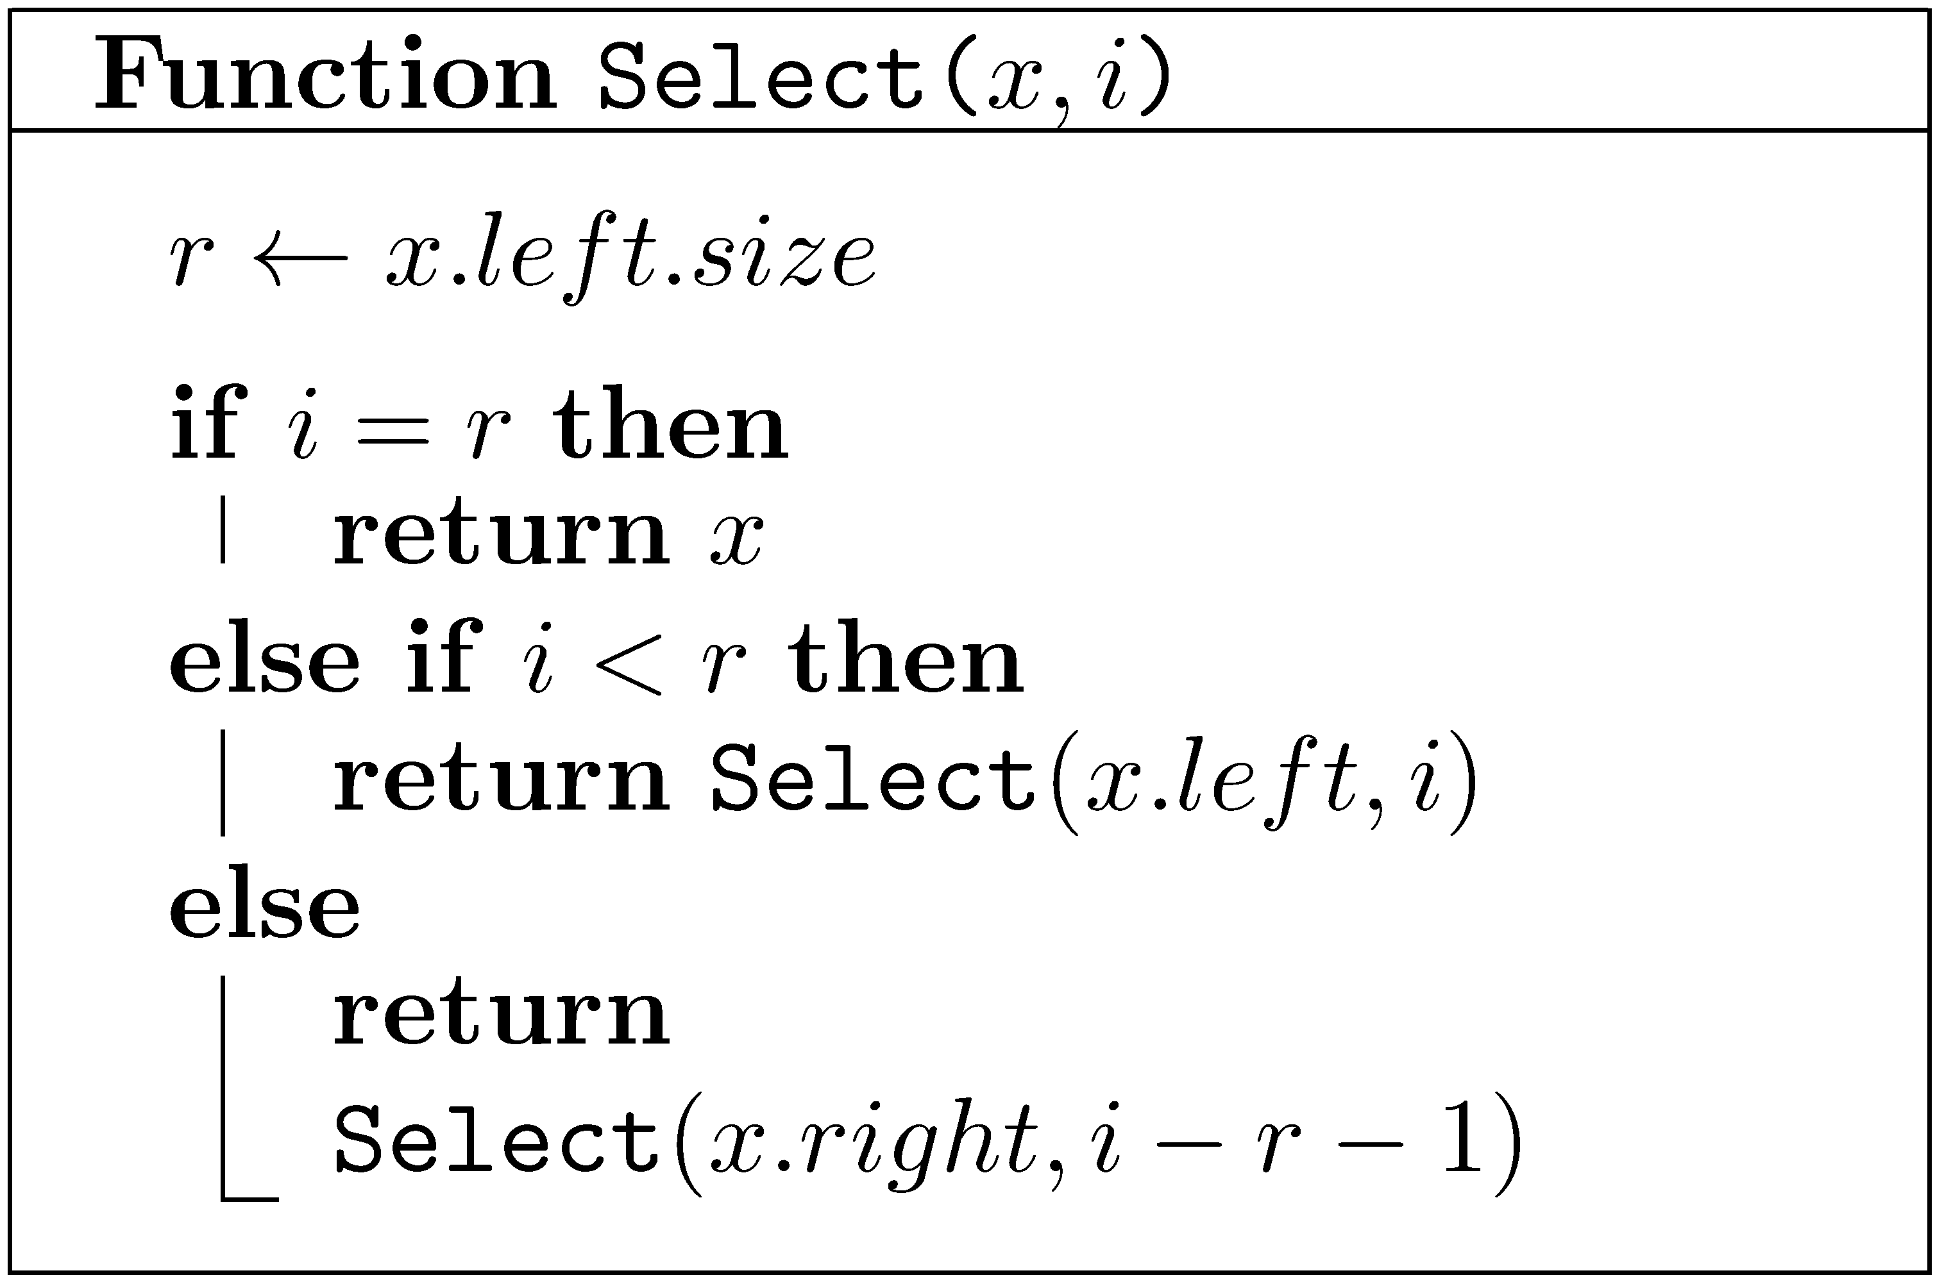
Selection
Note: 0 ≤ i < n

Slide 66
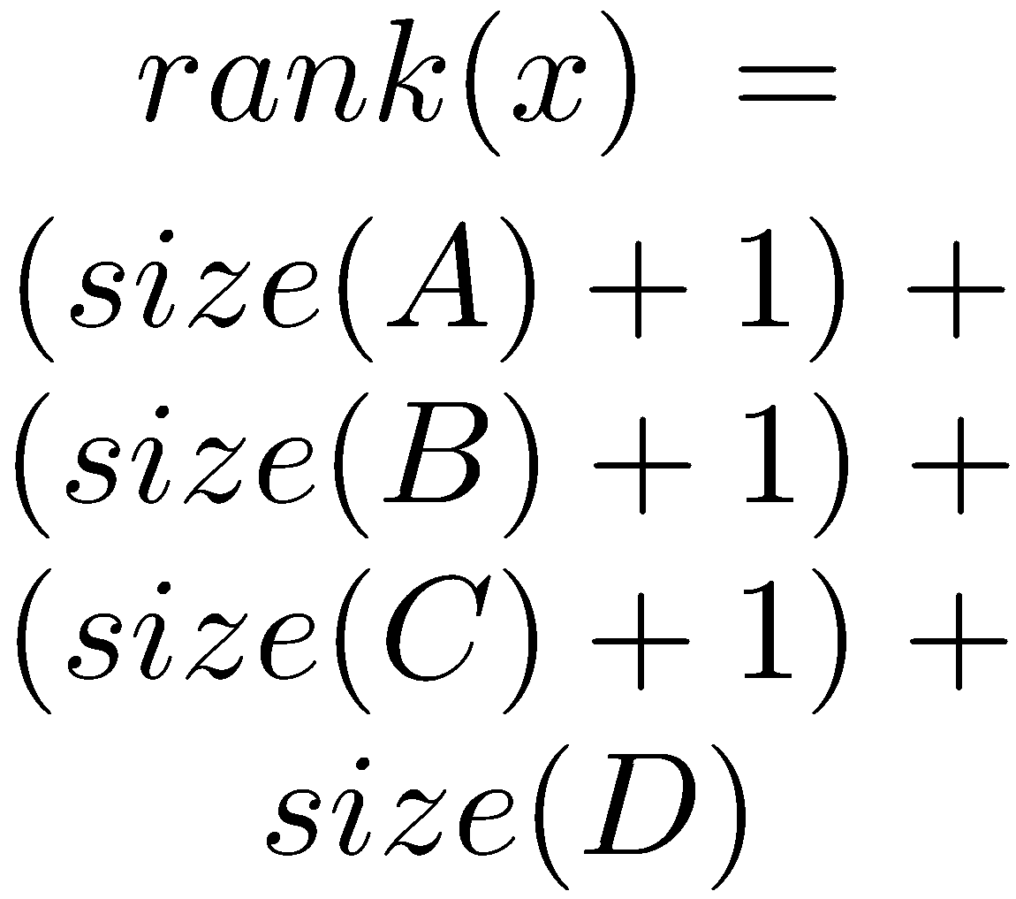
Rank
a
b
E
c
F
A
d
e
G
B
f
C
x
D
H

Slide 67
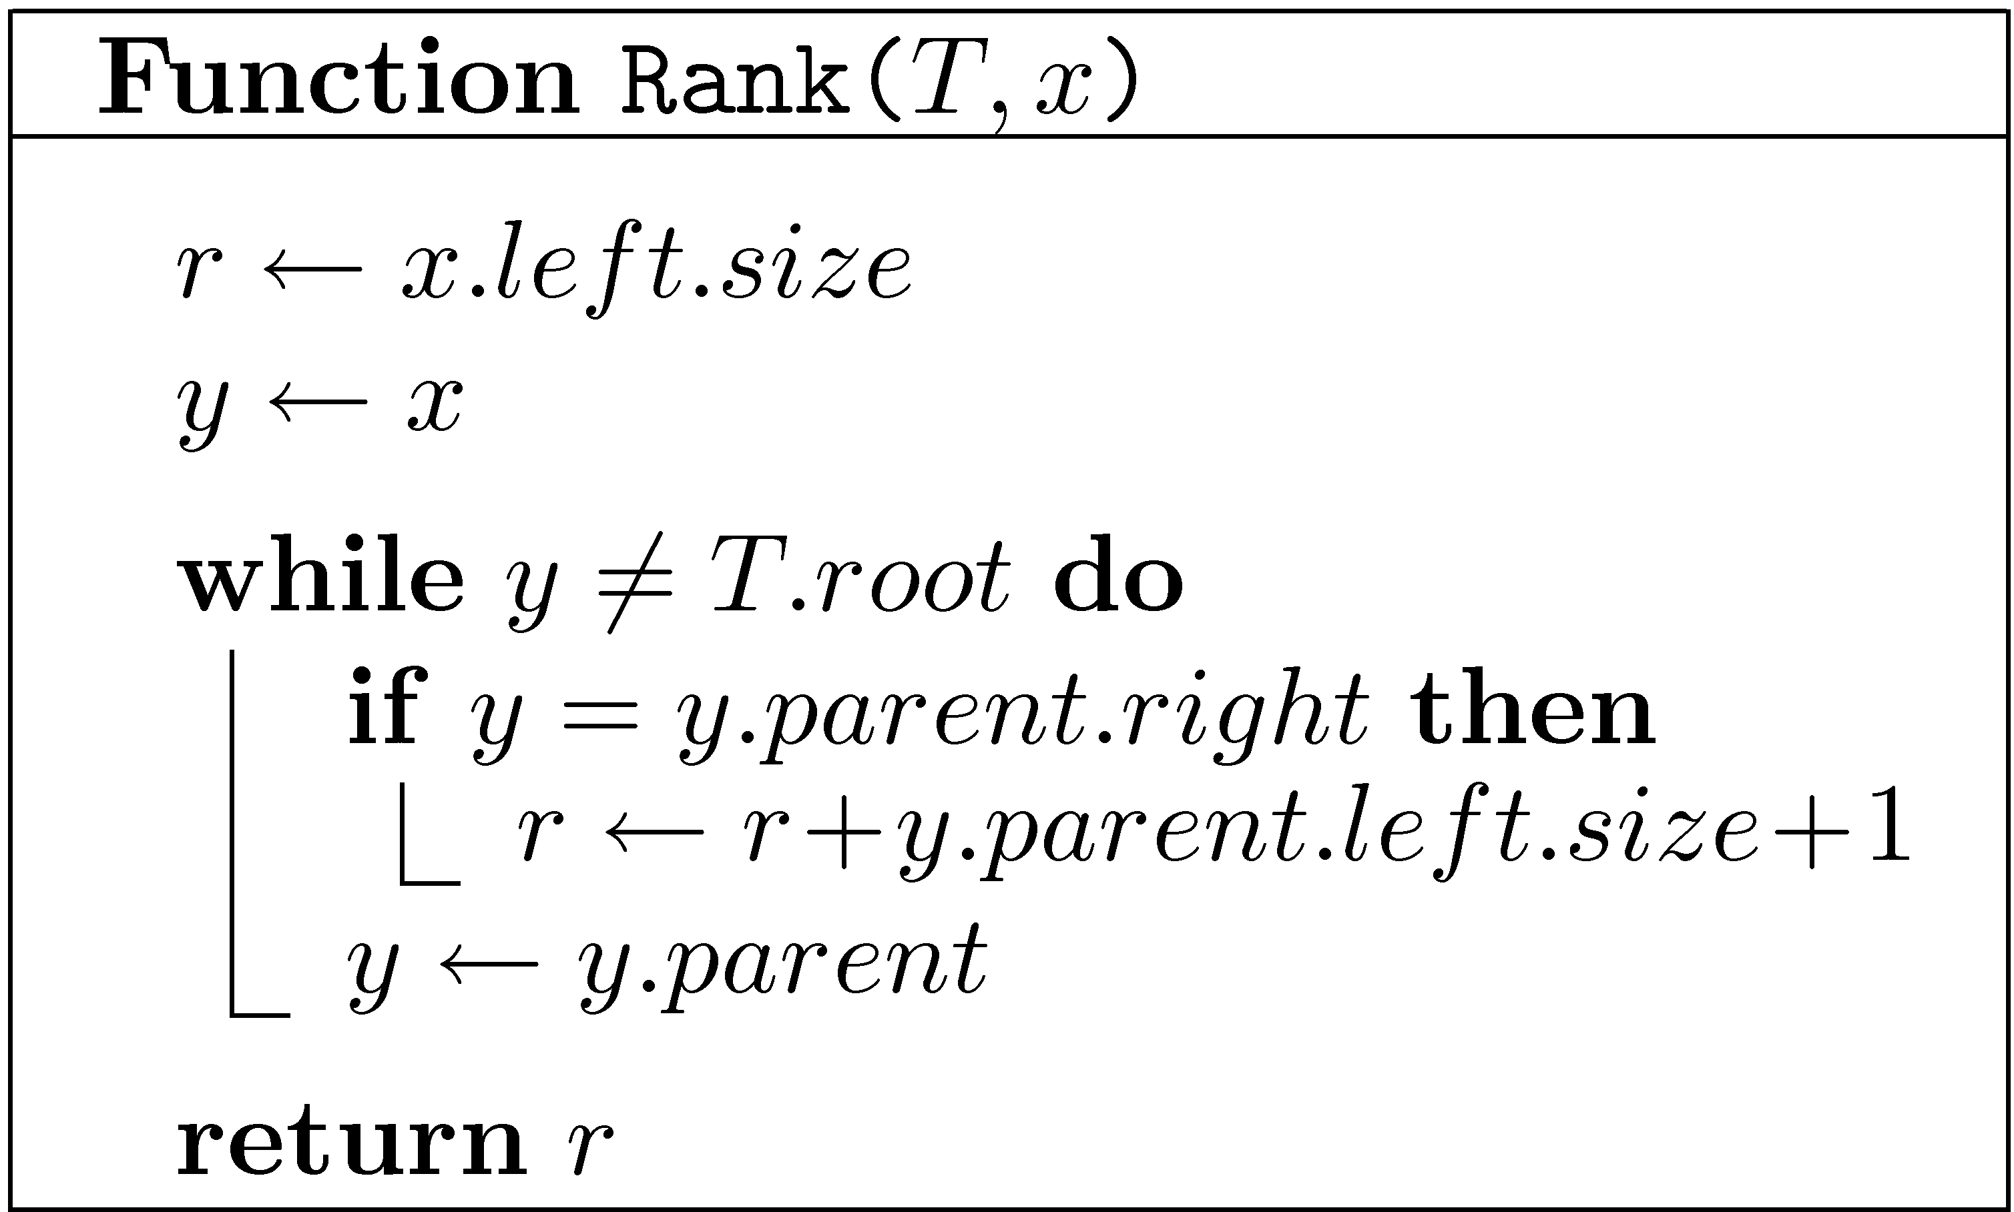
Rank
Assume NULL.size=0

Slide 68
Easy to maintain sizes
y
x
Right rotate
x
c
a
y
C
A
a
b
b
c
A
B
C
B

Slide 69
Finger Search trees
Maintain a pointer to the minimum element
Select(T,k) in O(log k) time
T

Slide 70
Lists as Trees
[ a b c d e ]
3
d
0
a
1
b
4
e
1
b
0
a
c
5
f
4
e
2
3
d
5
f
2
c

Slide 71
Lists as Trees
Maintain the items in a tree: i-th item in node of rank i
List-Node → Tree-Node
Tree-Nodes have no explicit key (Implicitly maintained ranks play the role of keys)
Retrieve(L,i) → Select(L,i)
Select, Insert-Fixup and Delete-Fixup do not use keys

Slide 72
Lists as Trees: Insert
To insert a node z in the i-th position, where i<n:
Find the current node of rank i.
If it has no left child, make z its left child.
Otherwise, find its predecessor
and make z its right child.
To insert a node z in the last position (i=n):
Find the last node and
make z its left child
Fix the tree (Insert-Fixup)

Slide 73
Lists as Trees: Delete
Delete a node z in the same way a node is removed from a search tree

Slide 74
Implementation of lists
 | Circular arrays | Doubly Linked lists | Red-Black Trees
Insert/Delete-First Insert/Delete-Last | O(1) | O(1) | O(log n)
Insert/Delete(i) | O(i+1) | O(i+1) | O(log n)
Retrieve(i) | O(1) | O(i+1) | O(log n)
Concat | O(n+1) | O(1) | O(log n)

Slide 75
AVL trees G.M. Adelson-Velskii and E.M. Landis (1962)
k
The depth of two siblings differs by at most 1
k−1
k−2
Need only one extra bit per node

Slide 76
AVL trees G.M. Adelson-Velskii and E.M. Landis (1962)
k
S_{k} – minimal number of nodes in an AVL tree of depth k
k−1
k−2
Balance maintained through rotations

Slide 77
Splay Trees (Self-adjusting trees) Sleator and Tarjan (1983)
Do not maintain any balance!
When a node is accessed, splay it to the root
A node is splayed using a sequence of zig-zig and zig-zag steps
Amortized cost of each operation is O(log n)
Total cost of n operation is O(n log n)
Many other amazing properties

Slide 78
Zig-Zig
z
x
y
D
y
A
x
C
z
B
A
B
D
C
Rotate y-z left, then rotate x-y left

Slide 79
Zig-Zag
z
x
y
A
z
y
D
x
A
B
C
D
C
B
Rotate x-y right, then rotate x-z left

Slide 80
Splaying (example)
i
i
i
h
J
h
J
h
J
g
I
g
I
g
I
f
H
f
H
f
H
A
e
A
e
A
a
d
G
d
G
d
e
B
c
B
a
B
b
F
G
C
b
F
b
c
E
D
a
c
E
C
D
E
F
D
C

Slide 81
Splaying (example cont)
i
i
h
a
J
h
J
g
I
h
a
I
f
f
H
g
i
f
A
d
e
H
I
J
A
a
g
e
B
b
F
G
d
e
A
d
H
F
G
c
E
b
F
G
B
b
B
c
C
D
c
E
E
C
D
C
D

Slide 82
Splay Trees (Self-adjusting trees) Sleator and Tarjan (1983)
Amortized cost of each operation is O(log n)
Total cost of n operation is O(n log n)
Many other amazing properties
Some intriguing open problems
Play with them yourself:
http://webdiis.unizar.es/asignaturas/EDA/AVLTree/avltree.html

