Slide 1
Algorithms in Action
The Multiplicative Weights Update Method
Haim Kaplan, Uri Zwick
Tel Aviv University
May 2016
Last updated: December 9, 2020

Slide 2
“Using expert advice”
A basic binary setting
On each on of $T$ days:
We need to make a binary decision (Up/Down).
$n$ “experts” give us their prediction (Up/Down).
Based on their advice, we make a choice.
We then find out whether our choice is correct.
If our choice is wrong, we pay a penalty of 1.
If our choice is right, we do not pay anything.
Our goal, of course, is to pay as little as possible.

Slide 3
“Using expert advice”
A basic binary setting
Days
 | 1 | 2 | 3 | 4 | 5 | Cost
Expert 1 | U | U | U | U | D | 2
Expert 2 | D | D | U | D | D | 3
Expert 3 | U | D | D | U | D | 4
Our decision | U | D | U | U | D | 3
Outcome | U | U | U | D | U

Slide 4
“Using expert advice”
A basic binary setting
Days
1
2
3
4
5
Cost
Expert
1
U
U
D
U
U
1
Expert
2
D
D
D
D
D
3
Expert
3
U
D
U
U
D
4
Our decision
U
D
D
U
U
2
Outcome
U
U
D
D
U

Slide 5
“Using expert advice”
A basic binary setting
How well can we do?
If all “experts” are bad,
we cannot do too well.
We would like to do
almost as well as the best expert,
with hindsight.

Slide 6
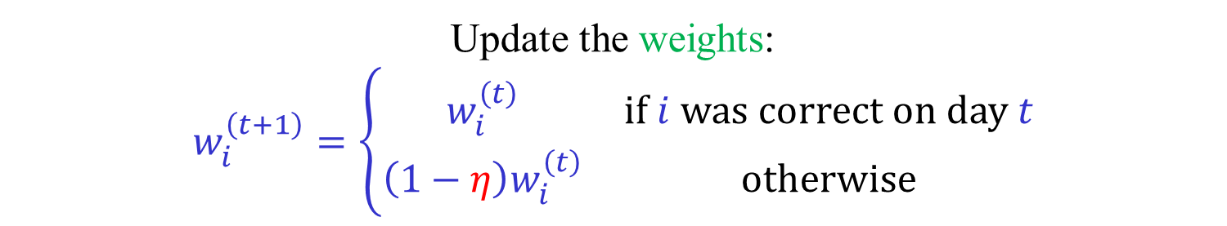



The Weighted Majority algorithm
[Littlestone-Warmuth (1994)]
Choose a parameter $0<η≤\frac{1}{2}$.
Assign each expert a weight.
The weight of the $i$-th expert at day $t$ is $w_{i}^{\left(t\right)}$.
On day 1, all weights are 1: $w_{i}^{\left(1\right)}=1$ , $i=1,2,…,n$.
At day $t$, predict Up or Down according to
the weighted majority of the experts.
Predict Up, if $\sum_{i∈U^{\left(t\right)}}{w_{i}^{\left(t\right)}}≥\sum_{i∈D^{\left(t\right)}}{w_{i}^{\left(t\right)}}$,
$U^{(t)},D^{(t)}$ – sets of experts predicting Up/Down at day $t$.
Update the weights:
$$w_{i}^{\left(t+1\right)}=\left\{\begin{matrix}w_{i}^{\left(t\right)} & if i was correct on day t \\ {\left(1−η\right)w}_{i}^{\left(t\right)} & otherwise\end{matrix}\right.$$

Slide 7
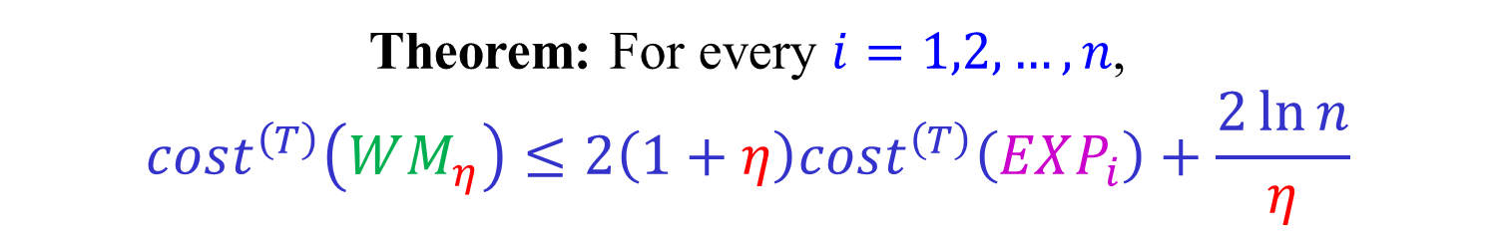
The Weighted Majority algorithm
[Littlestone-Warmuth (1994)]
$cost^{\left(T\right)}(WM_{η})$ – Number of mistakes of $WM_{η}$ up to time $T$.
$cost^{\left(T\right)}(EXP_{i})$ – Number of mistakes of $EXP_{i}$ up to time $T$.
Theorem: For every $i=1,2,…,n$,
$$cost^{\left(T\right)}\left(WM_{η}\right)≤2\left(1+η\right)cost^{\left(T\right)}\left(EXP_{i}\right)+\frac{2\ln{n}}{η}$$
In particular, the inequality holds for the best expert.
Thus, the cost of the Weighted Majority algorithm is only
slightly larger than twice the cost of the best expert!
(We can do even better using a randomized algorithm.)

Slide 8

The Weighted Majority algorithm
[Littlestone-Warmuth (1994)]
Theorem: For every $i=1,2,…,n$,
$$cost^{\left(T\right)}\left(WM_{η}\right)≤2\left(1+η\right)cost^{\left(T\right)}\left(EXP_{i}\right)+\frac{2\ln{n}}{η}$$
Proof:
Let $W^{\left(t\right)}=\sum_{i=1}^{n}{w_{i}^{\left(t\right)}}$. Clearly, $W^{\left(1\right)}=n$.
If $WM_{η}$ makes a mistake in day $t$, then
$W^{\left(t+1\right)}≤\left(\frac{1}{2}+\frac{1}{2}\left(1−η\right)\right)W^{\left(t\right)}=\left(1−\frac{η}{2}\right)W^{\left(t\right)}$.
$W^{\left(T+1\right)}≤{n\left(1−\frac{η}{2}\right)}^{cost^{\left(T\right)}\left(WM_{η}\right)}$
$${W^{\left(T+1\right)} ≥ w}_{i}^{\left(T+1\right)} ={ \left(1−η\right)}^{cost^{\left(T\right)}\left(EXP_{i}\right)}$$

Slide 9
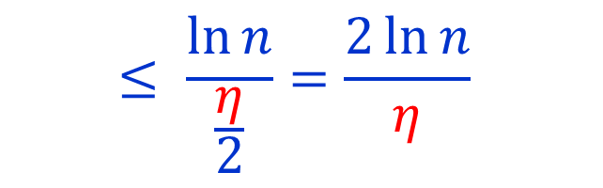
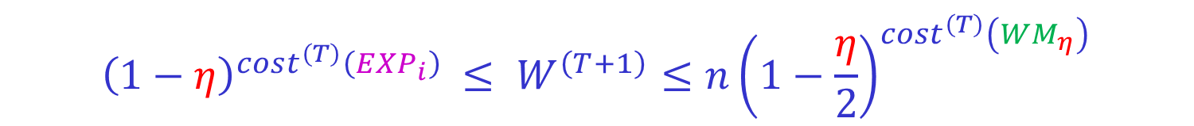
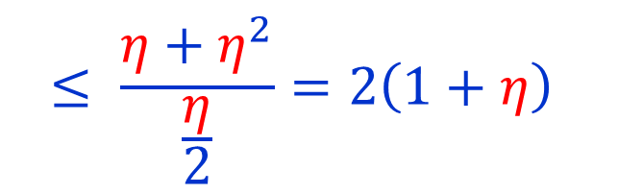
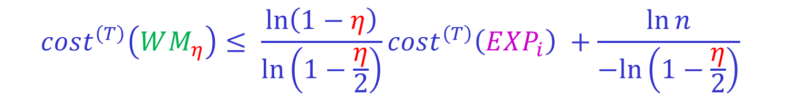
The Weighted Majority algorithm
[Littlestone-Warmuth (1994)]
$${ \left(1−η\right)}^{cost^{\left(T\right)}\left({EXP}_{i}\right)} ≤ W^{\left(T+1\right)}≤{n\left(1−\frac{η}{2}\right)}^{cost^{\left(T\right)}\left(WM_{η}\right)}$$
$$cost^{\left(T\right)}\left({EXP}_{i}\right)\ln\left(1−η\right) ≤cost^{\left(T\right)}\left(WM_{η}\right)\ln\left(1−\frac{η}{2}\right)+\ln{n}$$
$$cost^{\left(T\right)}\left(WM_{η}\right)≤ \frac{\ln\left(1−η\right)}{\ln\left(1−\frac{η}{2}\right)}cost^{\left(T\right)}\left({EXP}_{i}\right) +\frac{\ln{n}}{−ln\left(1−\frac{η}{2}\right)}$$
$$≤ \frac{η+η^{2}}{\frac{η}{2}}=2\left(1+η\right)$$
$$≤ \frac{\ln{n}}{\frac{η}{2}}=\frac{2\ln{n}}{η}$$
Using $x≤−ln\left(1−x\right)≤x+x^{2}$, for $x≤\frac{1}{2}$.

Slide 10
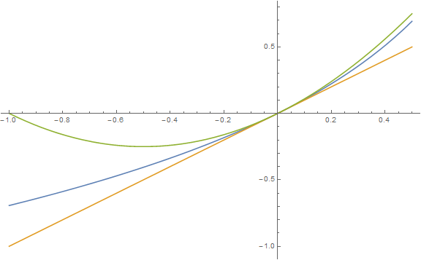



$$x+x^{2}$$
$$−ln\left(1−x\right)$$
$$x$$
$x≤−ln\left(1−x\right)≤x+x^{2}$ , for $x≤\frac{1}{2}$.

Slide 11

“Using expert advice”
A more general setting
On each on of $T$ days:
(Each one of $n$ “experts” suggests a course of action.)
We choose a (probability) distribution over the experts.
The costs of choosing each expert are revealed.
All costs are in $[−1,1]$.
We pay the average cost according to the distribution chosen.
Our goal is to minimize our total cost.
Alternative interpretation: On each day a random expert is drawn according to the distribution chosen. We pay the expected cost.

Slide 12
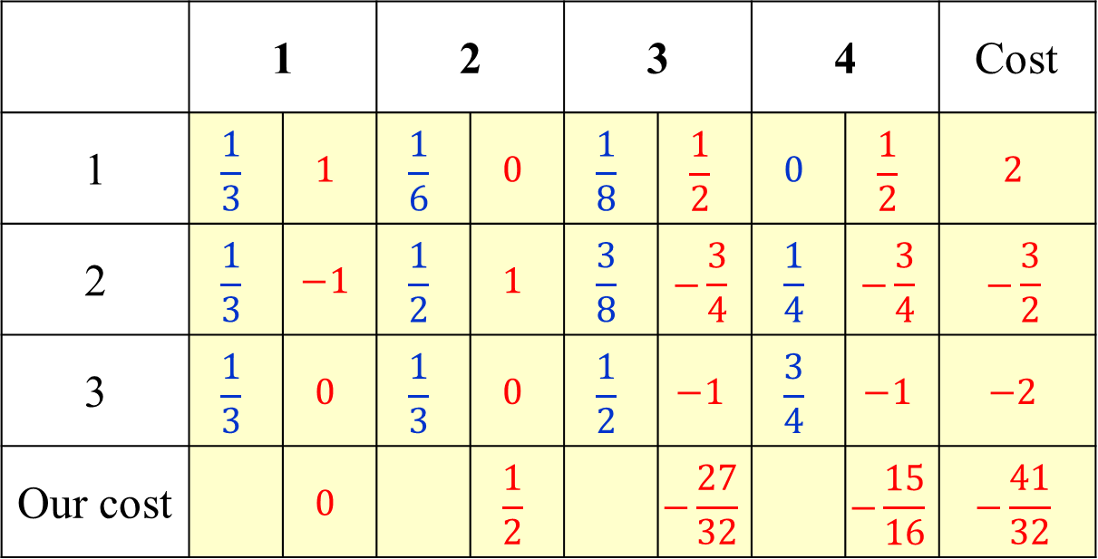
“Using expert advice”
A more general setting
Days
 | 1 |  | 2 |  | 3 |  | 4 |  | Cost
1 | $$\frac{1}{3}$$ | $$1$$ | $$\frac{1}{6}$$ | $$0$$ | $$\frac{1}{8}$$ | $$\frac{1}{2}$$ | $$0$$ | $$\frac{1}{2}$$ | $$2$$
2 | $$\frac{1}{3}$$ | $$−1$$ | $$\frac{1}{2}$$ | $$1$$ | $$\frac{3}{8}$$ | $$−\frac{3}{4}$$ | $$\frac{1}{4}$$ | $$−\frac{3}{4}$$ | $$−\frac{3}{2}$$
3 | $$\frac{1}{3}$$ | $$0$$ | $$\frac{1}{3}$$ | $$0$$ | $$\frac{1}{2}$$ | $$−1$$ | $$\frac{3}{4}$$ | $$−1$$ | $$−2$$
Our cost |  | $$0$$ |  | $$\frac{1}{2}$$ |  | $$−\frac{27}{32}$$ |  | $$−\frac{15}{16}$$ | $$−\frac{41}{32}$$
Experts

Slide 13
“Using expert advice”
A more general setting
Days
1
2
3
4
Cost
1
Experts
2
3
Our cost

Slide 14



The Multiplicative Weights algorithm
[Cesa-Bianchi, Mansour, Stoltz (2007)]
Choose a parameter $0<η≤\frac{1}{2}$.
The weight of expert $i$ at day $t$ is $w_{i}^{\left(t\right)}$.
$w_{i}^{\left(1\right)}=1$ , $i=1,2,…,n$.
At day $t$ use the distribution:
$$p^{\left(t\right)}=\frac{\left(w_{1}^{\left(t\right)},w_{2}^{\left(t\right)},…,w_{n}^{\left(t\right)}\right)}{W^{\left(t\right)}}$$
$$W^{\left(t\right)}=\sum_{i=1}^{n}{w_{i}^{\left(t\right)}}$$
Let $m^{\left(t\right)}=\left(m_{1}^{\left(t\right)},m_{2}^{\left(t\right)},…,m_{n}^{\left(t\right)}\right)$ be the costs at day $t.$
Update the weights:
$$w_{i}^{\left(t+1\right)}=w_{i}^{\left(t\right)}\left(1−η m_{i}^{\left(t\right)}\right)$$

Slide 15

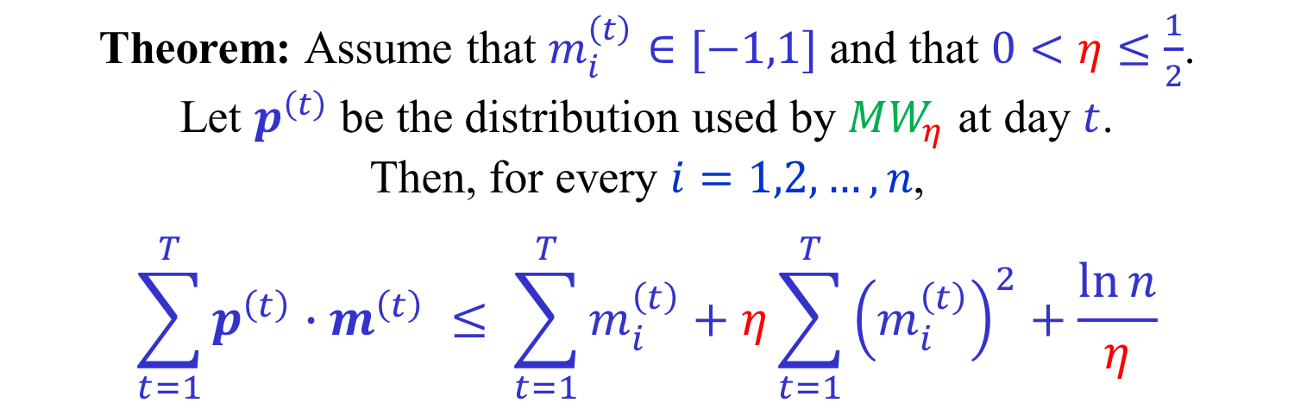
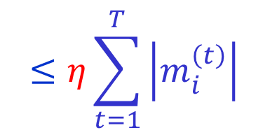

The Multiplicative Weights algorithm
[Cesa-Bianchi, Mansour, Stoltz (2007)]
Theorem: Assume that $m_{i}^{\left(t\right)}∈[−1,1]$ and that $0<η≤\frac{1}{2}$.
Let $p^{\left(t\right)}$ be the distribution used by $MW_{η}$ at day $t$.
Then, for every $i=1,2,…,n$,
$$\sum_{t=1}^{T}{p^{\left(t\right)}{∙m}^{\left(t\right)}} ≤ \sum_{t=1}^{T}{m_{i}^{\left(t\right)}}+η\sum_{t=1}^{T}{{\left(m_{i}^{\left(t\right)}\right)}^{2}}+\frac{\ln{n}}{η}$$
$$cost^{\left(T\right)}(MW_{η})$$
$$cost^{\left(T\right)}\left({EXP}_{i}\right)$$
$$≤η\sum_{t=1}^{T}{\left|m_{i}^{\left(t\right)}\right|}$$

Slide 16

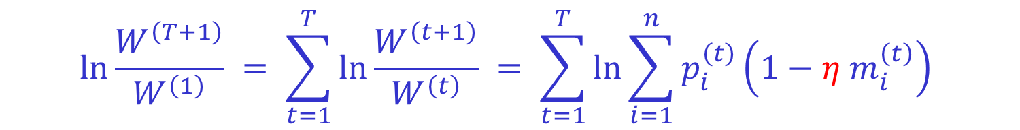

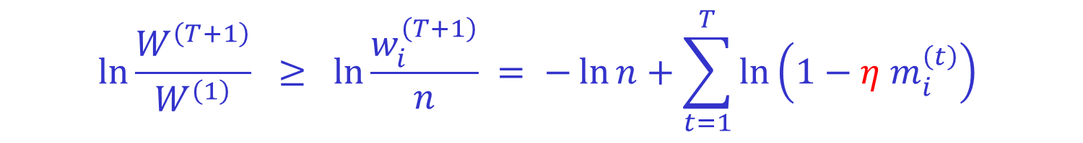
The Multiplicative Weights algorithm
[Cesa-Bianchi, Mansour, Stoltz (2007)]
$$\ln{\frac{W^{\left(T+1\right)}}{W^{\left(1\right)}}} = \sum_{t=1}^{T}{\ln{\frac{W^{\left(t+1\right)}}{W^{\left(t\right)}}}} = \sum_{t=1}^{T}{\ln{\sum_{i=1}^{n}{p_{i}^{\left(t\right)}}\left({1−η m}_{i}^{\left(t\right)}\right)}}$$
$$= \sum_{t=1}^{T}{\ln\left(1−η{ p}^{\left(t\right)}∙m^{\left(t\right)}\right)} ≤ −η\sum_{t=1}^{T}{{ p}^{\left(t\right)}∙m^{\left(t\right)}}$$
$$\ln{\frac{W^{\left(T+1\right)}}{W^{\left(1\right)}}} ≥ \ln{\frac{w_{i}^{\left(T+1\right)}}{n} }= −\ln{n}+\sum_{t=1}^{T}{\ln\left(1−η m_{i}^{\left(t\right)}\right)}$$
$$≥ −\ln{n}−η\sum_{t=1}^{T}{m_{i}^{\left(t\right)}} −η^{2}\sum_{t=1}^{T}{{\left(m_{i}^{\left(t\right)}\right)}^{2}}$$
Using $−x−x^{2} ≤ ln\left(1−x\right)≤ −x$ , for $x≤\frac{1}{2}$.

Slide 17
Applications of the
Multiplicative Weights algorithm
Learning a linear classifier (The Winnow algorithm)
Boosting the performance of weak learners (cf. Adaboost)
Approximately solving 0-sum 2-player games
Approximately solving packing Linear Programs
Approximately solving covering Linear Programs
Special case: Multicommodity flow
Approximately solving Semidefinte Programs
Special case: SDP relaxation of MAX CUT
…

Slide 18



Learning a Linear Classifier
$$ε$$
$$x$$
Assume, w.l.o.g., that the hyperplane passes through
the origin and that $x∈{\left(ℝ^{+}\right)}^{n}$, $1⋅x=1$.

Slide 19





Learning a Linear Classifier
$$ε$$
$$x$$
Let $a_{1},a_{2},…,a_{m}∈ℝ^{n}$,
Assume there exists $x∈{\left(ℝ^{+}\right)}^{n}$, $1⋅x=1$,
such that $a_{j}⋅x≥ε$, for $j∈[m]$.
Find $x′∈{\left(ℝ^{+}\right)}^{n}$, $1⋅x′=1$,
such that $a_{j}⋅x′≥0$, for $j∈[m]$.
Let $ρ=\max_{j}{{\left\|a_{j}\right\|}_{∞}}$.

Slide 20
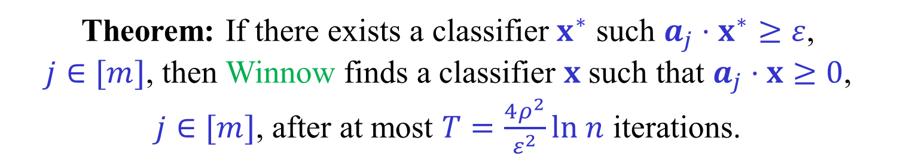
Learning a Linear Classifier -
The Winnow algorithm [Littlestone (1987)]
Experts correspond coordinates (also known as features).
Run $MW_{ η}$ with $η=ε/2ρ$.
In each iteration, if $p^{\left(t\right)}$ is a good classifier, stop.
Otherwise, let $j$ be such that $p^{(t)}⋅a_{j}<0$.
Let $m^{(t)}=−a_{j}/ρ$. Note that $m^{(t)}∈{\left[−1,1\right]}^{n}$.
Theorem: If there exists a classifier $x^{∗}$ such $a_{j}⋅x^{∗}≥ε$,
$j∈[m]$, then Winnow finds a classifier $x$ such that $a_{j}⋅x≥0$,
$j∈[m]$, after at most $T=\frac{4ρ^{2}}{ε^{2}}ln n$ iterations.

Slide 21
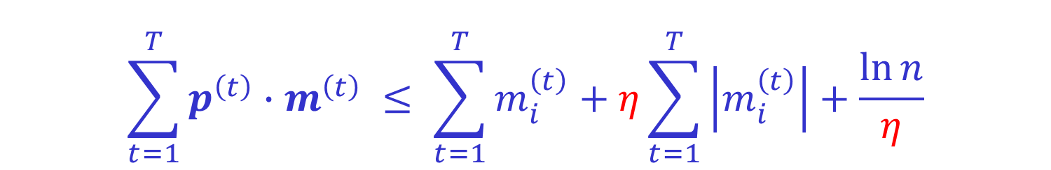
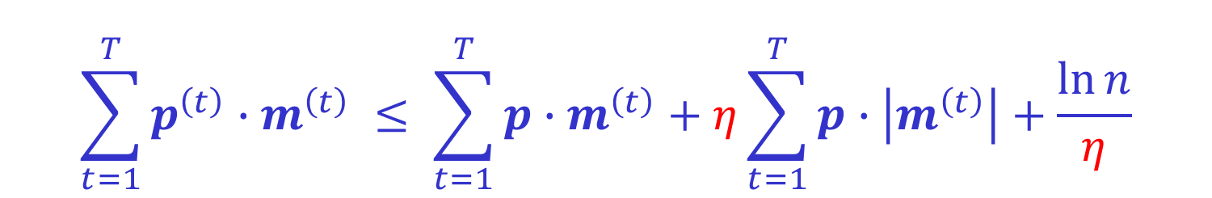
Learning a Linear Classifier -
The Winnow algorithm [Littlestone (1987)]
For every coordinate (expert) $i$ we have:
$$\sum_{t=1}^{T}{p^{\left(t\right)}{∙m}^{\left(t\right)}} ≤ \sum_{t=1}^{T}{m_{i}^{\left(t\right)}}+η\sum_{t=1}^{T}{\left|m_{i}^{\left(t\right)}\right|}+\frac{\ln{n}}{η}$$
Thus, for every distribution $p$ we have:
$$\sum_{t=1}^{T}{p^{\left(t\right)}{∙m}^{\left(t\right)}} ≤ \sum_{t=1}^{T}{p{∙m}^{\left(t\right)}}+η\sum_{t=1}^{T}{p∙\left|m^{\left(t\right)}\right|}+\frac{\ln{n}}{η}$$
We choose $p=x^{∗}$.

Slide 22

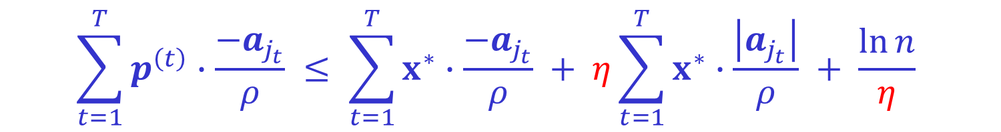

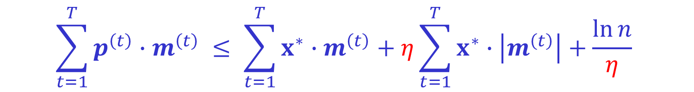
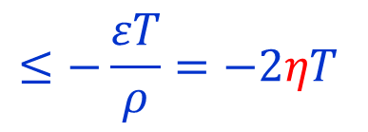


The Winnow algorithm [Littlestone (1987)]
$$\sum_{t=1}^{T}{p^{\left(t\right)}∙m^{\left(t\right)}} ≤ \sum_{t=1}^{T}{x^{∗}{∙m}^{\left(t\right)}}+η\sum_{t=1}^{T}{x^{∗}∙\left|m^{\left(t\right)}\right|}+\frac{\ln{n}}{η}$$
$m^{\left(t\right)}=\frac{−a_{j_{t}}}{ρ}$ , for some $j_{t}$ such that $a_{j_{t}}∙p^{\left(t\right)}<0$.
$$\sum_{t=1}^{T}{p^{\left(t\right)}∙\frac{−a_{j_{t}}}{ρ}} ≤ \sum_{t=1}^{T}{x^{∗}∙\frac{−a_{j_{t}}}{ρ}} + η\sum_{t=1}^{T}{x^{∗}∙\frac{\left|a_{j_{t}}\right|}{ρ}} + \frac{\ln{n}}{η}$$
$$0<$$
$$≤−\frac{εT}{ρ}=−2ηT$$
$$≤ηT$$
$$ηT ≤ \frac{\ln{n}}{η}$$
$$T ≤\frac{\ln{n}}{η^{2}} = {\left(\frac{2ρ}{ε}\right)}^{2}\ln{n}$$

Slide 23

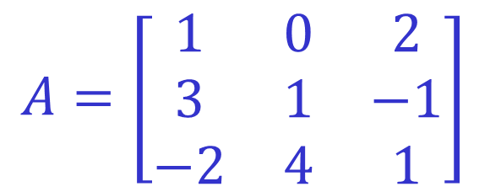


0-sum 2-player matrix games
$$A=\left[\begin{matrix}1 & 0 & 2 \\ 3 & 1 & −1 \\ −2 & 4 & 1\end{matrix}\right]$$
ROW chooses a row $i$.
COLUMN chooses a column $j$.
ROW pays COLUMN $A[i,j]$.
$$2=\min_{i}{\max_{j}{A[i,j]} > \max_{j}{\min_{i}{A\left[i,j\right]=0}}}$$
No player wants to go first…
Suppose the players play simultaneously.
Playing deterministically is similar to playing first.
Use randomized (mixed) strategies.

Slide 24




0-sum 2-player matrix games
Randomized (mixed) strategy for ROW:
A distribution $p$ over the rows of $A$.
Randomized (mixed) strategy for COLUMN:
A distribution $q$ over the columns of $A$.
If ROW uses $p$and COLUMN uses $q$,
the expected payoff is:
$$A\left[p,q\right]=\sum_{i,j}{p_{i}q_{j}A[i,j]}=p^{T}Aq$$

Slide 25


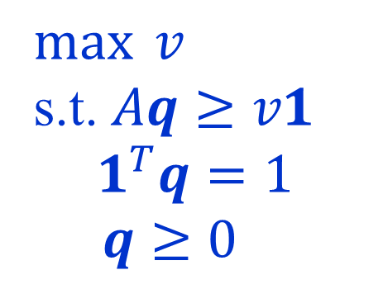
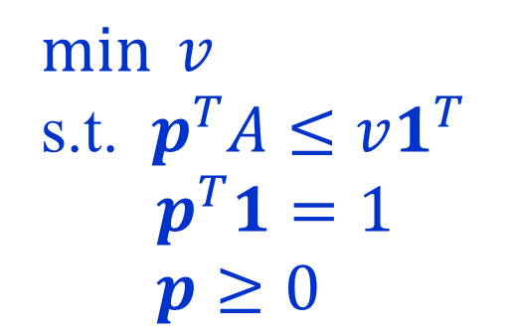



0-sum 2-player matrix games
Von Neumann’s min-max theorem:
$$\min_{p}{\max_{q}{A\left[p,q\right]} = \max_{q}{\min_{p}{A\left[p,q\right]}}}$$
$$=$$
$$=$$
$$\min_{p}{\max_{j}{A\left[p,j\right]}}$$
$$\max_{q}{\min_{i}{A\left[i,q\right]}}$$
$$=$$
$$=$$
$\min{v}$
s.t. $p^{T}A≤v1^{T}$
$p^{T}1=1$
$p≥0$
$\max{v}$
s.t. $Aq≥v1$
$$1^{T}q=1$$
$q≥0$
$$=$$
LP
Duality

Slide 26
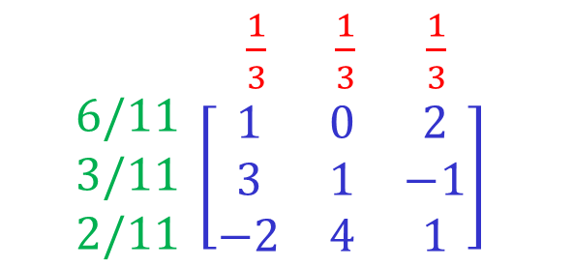
0-sum 2-player matrix games
$$A=\left[\begin{matrix}1 & 0 & 2 \\ 3 & 1 & −1 \\ −2 & 4 & 1\end{matrix}\right]$$
ROW chooses a row $i$.
COLUMN chooses a column $j$.
ROW pays COLUMN $A[i,j]$.
$$2=\min_{i}{\max_{j}{A[i,j]} > \max_{j}{\min_{i}{A\left[i,j\right]=0}}}$$
What is the value and what are the optimal strategies?
$\begin{matrix}\frac{1}{3} & \frac{1}{3} & \frac{1}{3}\end{matrix}$
$$\begin{matrix}6/11 \\ 3/11 \\ 2/11\end{matrix} \left[\begin{matrix}1 & 0 & 2 \\ 3 & 1 & −1 \\ −2 & 4 & 1\end{matrix}\right]$$
value = 1

Slide 27


Solving 0-sum games approximately
Value and optimal strategies can be found by solving an LP.
Can be done in polynomial time, but relatively slowly.
In many situations a good approximation is sufficient.
W.l.o.g., assume that all entries of $A$ are in $[0,1]$.
Let $v^{∗}=val(A)$ be the value of $A$. Let $ε>0$.
$p$ and $q$ are $ε$-optimal strategies iff:
$$\max_{j}{A\left[p,j\right]≤v^{∗}+ε}$$
$$\min_{i}{A\left[i,q\right]}≥v^{∗}−ε$$

Slide 28
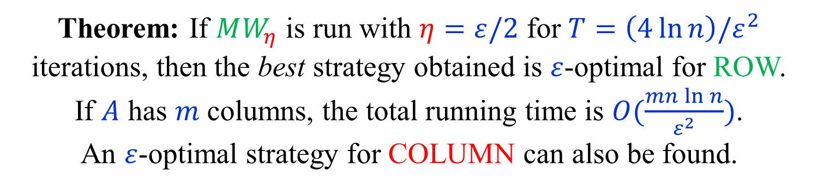
0-sum games using Multiplicative Updates
[Freund-Schapire (1999)]
Experts correspond to the $n$ rows of $A$.
A distribution over the experts is a mixed strategy for ROW.
In iteration $t$, the algorithm produces a distribution $p^{\left(t\right)}.$
The cost vector $m^{\left(t\right)}$ is the column $j^{\left(t\right)}$ of $A$ maximizing $A[p^{\left(t\right)},j]$.
Note that $p^{\left(t\right)}⋅m^{\left(t\right)}=A\left[p^{\left(t\right)},j^{\left(t\right)}\right]≥v^{∗}$.
Theorem: If $MW_{η}$ is run with $η=ε/2$ for $T=\left(4\ln{n}\right)/ε^{2}$ iterations, then the best strategy obtained is $ε$-optimal for ROW.
If $A$ has $m$ columns, the total running time is $O(\frac{mn\ln{n}}{ε^{2}})$.
An $ε$-optimal strategy for COLUMN can also be found.

Slide 29

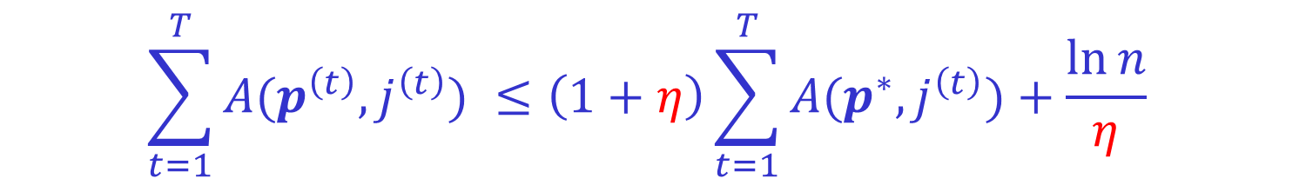

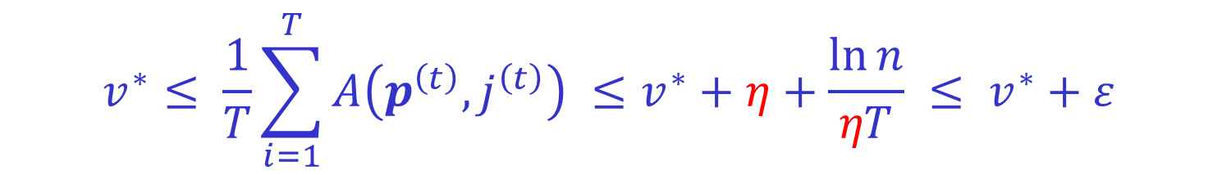




0-sum games using Multiplicative Updates
[Freund-Schapire (1999)]
For any distribution $p$, and in particular $p=p^{∗}$, we have
$$\sum_{t=1}^{T}{A(p^{\left(t\right)},j^{\left(t\right)})} ≤\left(1+η\right)\sum_{t=1}^{T}{A(p^{∗},j^{\left(t\right)})}+\frac{\ln{n}}{η}$$
$$v^{∗}≤$$
$${≤v}^{∗} ≤1$$
$$v^{∗}≤ \frac{1}{T}\sum_{i=1}^{T}{A\left(p^{\left(t\right)},j^{\left(t\right)}\right)} ≤v^{∗}+η+\frac{\ln{n}}{ηT} ≤ v^{∗}+ε$$
$$=\frac{ε}{2}$$
$η=ε/2$
$$≤\frac{ε}{2}$$
$$T=\left(4\ln{n}\right)/ε^{2}$$

Slide 30


0-sum games using Multiplicative Updates
[Freund-Schapire (1999)]
$$v^{∗} ≤ \frac{1}{T}\sum_{t=1}^{T}{A\left(p^{\left(t\right)},j^{\left(t\right)}\right)} ≤ v^{∗}+ε$$
For at least one $t$ we have:
$$A\left(p^{\left(t\right)},j^{\left(t\right)}\right)=\max_{j}{A\left(p^{\left(t\right)},j\right)≤v^{∗}+ε}$$
Thus, if $t$ minimizes $A\left(p^{\left(t\right)},j^{\left(t\right)}\right)$,
then $p^{\left(t\right)}$ is $ε$-optimal for ROW.
( $\frac{1}{T}\sum_{t=1}^{T}{p^{\left(t\right)}}$ is also $ε$-optimal for ROW.)

Slide 31

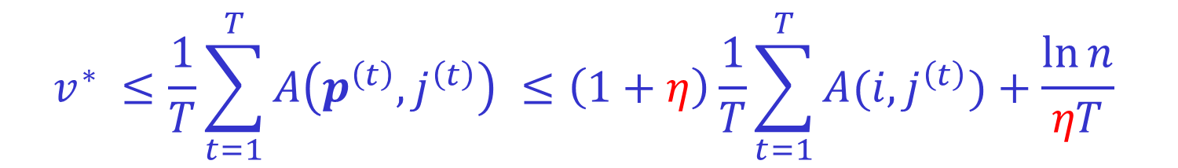
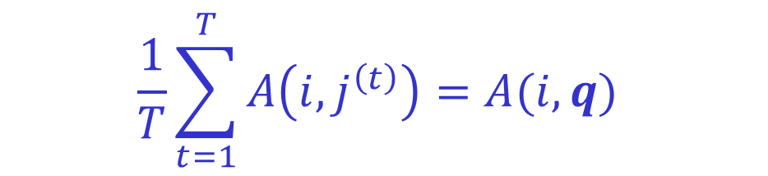


0-sum games using Multiplicative Updates
[Freund-Schapire (1999)]
Let $q$ be such that $q_{j} = \frac{\left|\left\{ 1≤t≤T | j^{\left(t\right)}=j\right\}\right|}{T}$.
$$\frac{1}{T}\sum_{t=1}^{T}{A\left(i,j^{\left(t\right)}\right)=A(i,q)}$$
For every $i$,
$$v^{∗} ≤\frac{1}{T}\sum_{t=1}^{T}{A\left(p^{\left(t\right)},j^{\left(t\right)}\right)} ≤\left(1+η\right)\frac{1}{T}\sum_{t=1}^{T}{A(i,j^{\left(t\right)})}+\frac{\ln{n}}{ηT}$$
$$≤A\left(i,q\right)+ε$$
Hence, $v^{∗}−ε ≤ A(i,q)$, for every $i$,
so $q$ is $ε$-optimal for COLUMN.

Slide 32
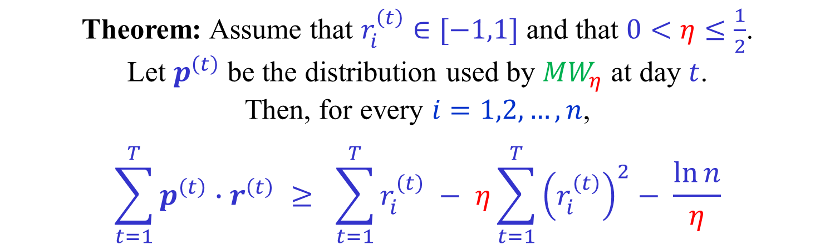

Rewards instead of costs
On day $t$ we get a reward vector $r^{\left(t\right)}$, instead of a cost vector $m^{\left(t\right)}$.
Maximize reward instead of minimizing cost.
Simply let $m^{\left(t\right)}={−r}^{\left(t\right)}$.
Multiplicative weight update:
$$w_{i}^{\left(t+1\right)}=w_{i}^{\left(t\right)}\left(1+η r_{i}^{\left(t\right)}\right)$$
Theorem: Assume that $r_{i}^{\left(t\right)}∈[−1,1]$ and that $0<η≤\frac{1}{2}$.
Let $p^{\left(t\right)}$ be the distribution used by $MW_{η}$ at day $t$.
Then, for every $i=1,2,…,n$,
$$\sum_{t=1}^{T}{p^{\left(t\right)}{∙r}^{\left(t\right)}} ≥ \sum_{t=1}^{T}{r_{i}^{\left(t\right)}} − η\sum_{t=1}^{T}{{\left(r_{i}^{\left(t\right)}\right)}^{2}}− \frac{\ln{n}}{η}$$

Slide 33






Maximum Multicommodity Flow
$$t_{3}$$
11
16
8
$$s_{1}$$
22
17
5
8
1
13
$$t_{2}$$
3
13
18
30
$$s_{2}$$
12
25
9
2
2
2
$$t_{1}$$
15
$$s_{3}$$

Slide 34
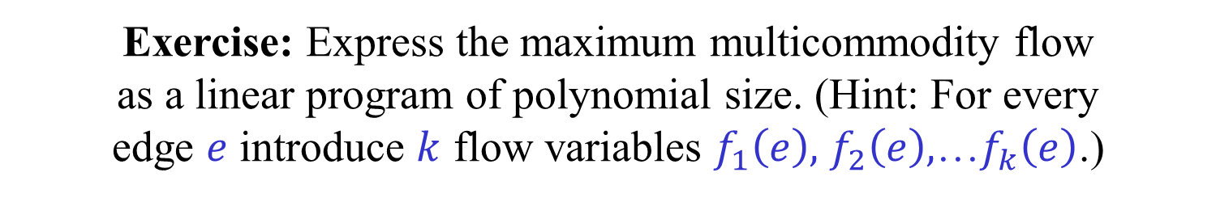
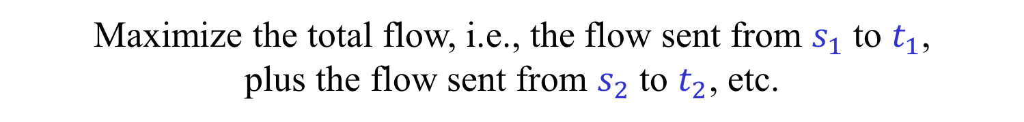
Maximum Multicommodity Flow
$G=(V,E)$ – A directed graph (the flow network)
$c:E→ℝ^{+}$ – A capacity function
$\left(s_{1},t_{1}\right),\left(s_{2},t_{2}\right),…,(s_{k},t_{k})$ - $k$ source-sink pairs.
Maximize the total flow, i.e., the flow sent from $s_{1}$ to $t_{1}$,
plus the flow sent from $s_{2}$ to $t_{2}$, etc.
Different commodities can share the edges of the network.
The total flow on an edge should not exceed its capacity.
Exercise: Express the maximum multicommodity flow
as a linear program of polynomial size. (Hint: For every
edge $e$ introduce $k$ flow variables $f_{1}\left(e\right),$ $f_{2}\left(e\right),$…$f_{k}\left(e\right)$.)

Slide 35
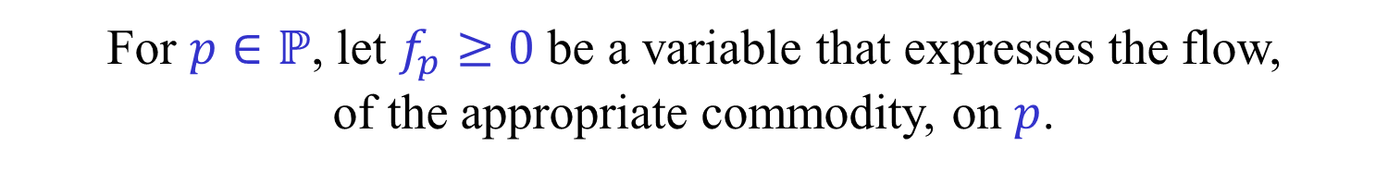
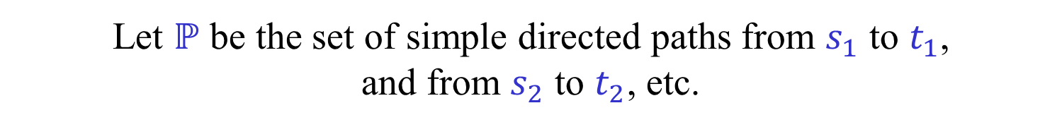
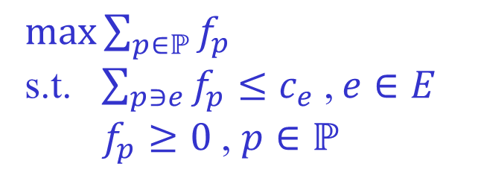
Maximum Multicommodity Flow
We use a different LP formulation of the problem
of possibly exponential size (!)
Let $ℙ$ be the set of simple directed paths from $s_{1}$ to $t_{1}$,
and from $s_{2}$ to $t_{2}$, etc.
For $p∈ℙ$, let $f_{p}≥0$ be a variable that expresses the flow,
of the appropriate commodity, on $p$.
We want to maximize $\sum_{p∈ℙ}{f_{p}}$
subject to $f_{e}=\sum_{p∋e}{f_{p}}≤c_{e}$, for every $e∈E$.
$\max{\sum_{p∈ℙ}{f_{p}}}$
s.t. $\sum_{p∋e}{f_{p}}≤c_{e}$ , $e∈E$
$f_{p}≥0$ , $p∈ℙ$

Slide 36
Maximum Multicommodity flow
[Garg-Könemman (2007)]
A polynomial time $\left(1−ε\right)$-approximation algorithm.
Our presentation follows [Arora-Hazan-Kale (2012)].
Maintain a flow $f=f^{\left(t\right)}$ (may violate the capacity constraints).
Maintain a weight function $w^{\left(t\right)} (\sim { p}^{\left(t\right)})$ on the edges.
Use Multiplicative weight updates with $η=ε/2$.
In each iteration:
Find a shortest path $p^{\left(t\right)}∈ℙ$ w.r.t. $w_{e}^{\left(t\right)}/c_{e}$.
Route $c^{\left(t\right)}$ units of flow on $p^{\left(t\right)}$, where $c^{\left(t\right)}=\min_{e∈p^{(t)}}{c_{e}}$.
Define $r_{e}^{\left(t\right)}={c^{\left(t\right)}}/{c_{e}}∈[0,1]$, if $e∈p^{\left(t\right)}$, and $r_{e}^{\left(t\right)}=0$, otherwise.
Let $f_{e}$ be the total flow so far on $e$. Stop when $∃e f_{e}/c_{e}≥(\ln{m)/η^{2}}$.
Down-scale the flow $f$ to establish all capacity constraints.

Slide 37




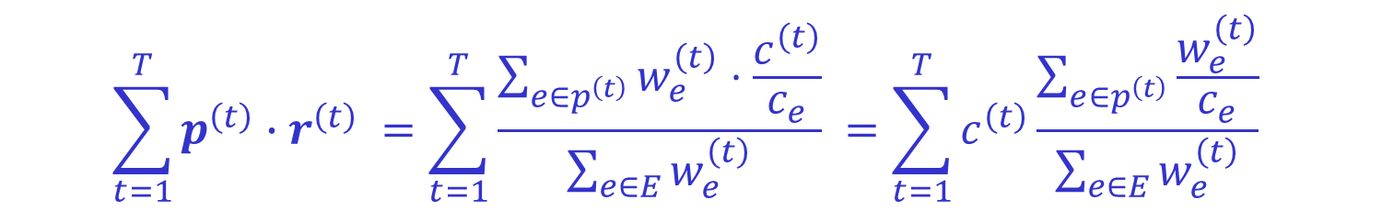
Maximum Multicommodity flow
[Garg-Könemman (2007)]
$$\sum_{t=1}^{T}{p^{\left(t\right)}{∙r}^{\left(t\right)}} ≥ \left(1−η\right)\sum_{t=1}^{T}{r_{e}^{\left(t\right)}} − \frac{\ln{m}}{η} , ∀ e∈E$$
$$=f_{e}/c_{e}$$
(See next slide.)
$$\sum_{t=1}^{T}{p^{\left(t\right)}{∙r}^{\left(t\right)} }=\sum_{t=1}^{T}{\frac{\sum_{e∈p^{\left(t\right)}}{w_{e}^{\left(t\right)}⋅\frac{c^{\left(t\right)}}{c_{e}}}}{\sum_{e∈E}{w_{e}^{\left(t\right)}}}} =\sum_{t=1}^{T}{c^{\left(t\right)}\frac{\sum_{e∈p^{\left(t\right)}}{\frac{w_{e}^{\left(t\right)}}{c_{e}}}}{\sum_{e∈E}{w_{e}^{\left(t\right)}}}}$$
$$≤ \frac{1}{F^{opt}}\sum_{t=1}^{T}{c^{\left(t\right)}} = \frac{F}{F^{opt}}$$
$$≤1/F^{opt}$$
Let $f^{opt}$ be the optimal flow and let $F^{opt}=\sum_{p∈ℙ}{f_{p}^{opt}}$

Slide 38




Maximum Multicommodity flow
[Garg-Könemman (2007)]
Let $f^{opt}$ be the optimal flow and let $F^{opt}=\sum_{p∈ℙ}{f_{p}^{opt}}$
Let $w_{e}$ be arbitrary (non-negative) edge weights.
Let $p∈ℙ$ be a shortest path w.r.t. edge lengths $w_{e}/c_{e}$.
$$\frac{\sum_{e∈E}{w_{e}}}{\sum_{e∈p}{\frac{w_{e}}{c_{e}}}} ≥ \frac{\sum_{e∈E}{w_{e}⋅\sum_{p^{′}∋e}{\frac{f_{p^{′}}^{opt}}{c_{e}}}}}{\sum_{e∈p}{\frac{w_{e}}{c_{e}}}}$$
$$≤1$$
$$= \frac{\sum_{p^{′}∈ℙ}{f_{p^{′}}^{opt}\sum_{e∈p^{′}}{\frac{w_{e}}{c_{e}}}}}{\sum_{e∈p}{\frac{w_{e}}{c_{e}}}} ≥ \sum_{p^{′}∈ℙ}{f_{p^{′}}^{opt}} = F^{opt}$$
$$≥1$$

Slide 39

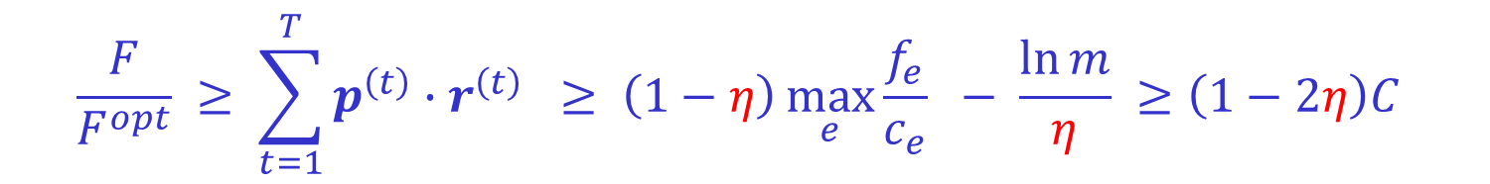

Maximum Multicommodity flow
[Garg-Könemman (2007)]
$$\frac{F}{F^{opt}} ≥ \sum_{t=1}^{T}{p^{\left(t\right)}{∙r}^{\left(t\right)}} ≥ \left(1−η\right)\max_{e}{\frac{f_{e}}{c_{e}}} − \frac{\ln{m}}{η} ≥\left(1−2η\right)C$$
Upon termination:
Maximum congestion
$$=C$$
$$C≥ \frac{\ln{m}}{η^{2}}$$
$$\frac{F}{F^{opt}} ≥ \left(1−2η\right)C$$
Scale down the flow by $C$ :
$$\frac{F}{C} ≥ \left(1−2η\right)F^{opt}=(1−ε)F^{opt}$$
$F/C$ is an $\left(1−ε\right)$-approximate maximal flow!

Slide 40
Maximum Multicommodity flow
[Garg-Könemman (2007)]
How many iterations are needed?
We stop the algorithm when maximum congestion $C≥ \frac{\ln{m}}{η^{2}}$.
Each iteration adds 1 to the congestion of at least one edge.
Thus, number of iterations is at most $m\left\lceil \frac{\ln{m}}{η^{2}}\right\rceil$.
Total running time is $O\left(\frac{m\ln{m} }{ε^{2}} k T_{sp}(m)\right)=\tilde{O}\left(\frac{{k m}^{2}}{ε^{2}}\right)$.
[Fleisher (2000)] reduced the running time to $\tilde{O}\left(\frac{m^{2}}{ε^{2}}\right)$.

Slide 41
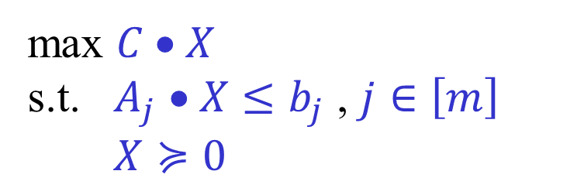
Positive Semidefinite Programming
max $C • X$
s.t. $A_{j} • X≤b_{j}$ , $j∈\left[m\right]$
$X≽0$
$X, A_{1},…,A_{m}∈ℝ^{n×n}$ , $b_{1},…,b_{m}∈ℝ$
$A • B=\sum_{i,j}{a_{i,j}b_{i,j}}$ (matrix inner product)
$A≽0$ ((symmetric) positive semidefinite)
$⟺$ $x^{T}Ax≥0$ for every $x∈ℝ^{n}$
Can also be approximated using multiplicative updates.
Interesting application:
Approximation algorithm for MAX CUT

Slide 42
Bibliography
Sanjeev Arora, Elad Hazan, Satyen Kale,
The Multiplicative Weights Update Method:
A Meta-Algorithm and Applications,
Theory of Computing, Volume 8 (2012), pp. 121-164

Slide 43
Bonus material
Not covered in class this term
“Careful. We don’t want to learn from this.”
(Calvin in Bill Watterson’s “Calvin and Hobbes”)

Slide 44
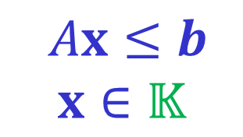


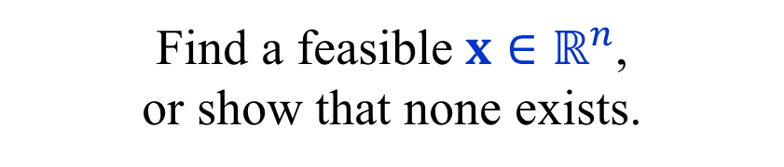
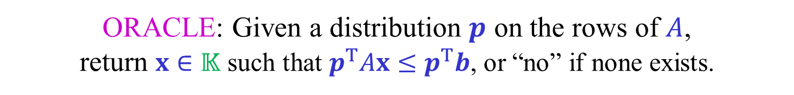
Packing Linear Programs
$Ax≤b$
$$x∈𝕂$$
Find a feasible $x∈ℝ^{n}$,
or show that none exists.
$A∈ℝ^{m×n}$ , $b∈ℝ^{m}$ , $𝕂⊆ℝ^{n}$ is a “simple” convex set
$Ax≥0$, for every $x∈𝕂$.
$$b>0$$
Packing:
By scaling, we sometimes assume that $b=1$.
Willing to settle for $x∈𝕂$ such that $Ax≤b+ε$
ORACLE: Given a distribution $p$ on the rows of $A$,
return $x∈𝕂$ such that $p^{T}Ax≤p^{T}b$, or “no” if none exists.
If ORACLE returns “no” for any distribution $p$,
then the problem is infeasible.

Slide 45

Packing Linear Programs
$Ax≤b$
$$x∈𝕂$$
Find a feasible $x∈ℝ^{n}$,
or show that none exists.
$A∈ℝ^{m×n}$ , $b∈ℝ^{m}$ , $𝕂⊆ℝ^{n}$ is a “simple” convex set
$𝕂⊆ℝ^{n}$ is convex iff
$x,y∈𝕂$ , $0≤α≤1$ → $\left(1−α\right)x+αy∈𝕂$
“Simple” is used informally. The only requirement is
that ORACLE can be efficiently implemented.
Example: $𝕂=\left\{ x∈ℝ^{n} :x≥0 , c^{T}x=f \right\}$.

Slide 46

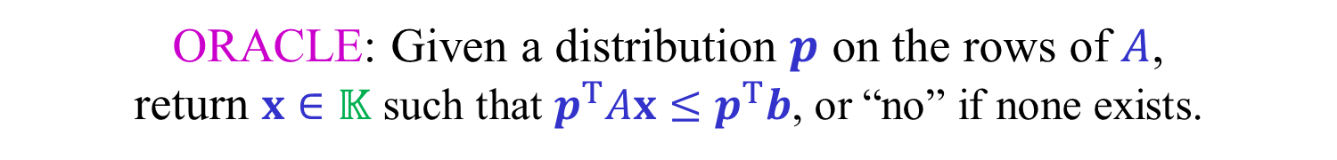
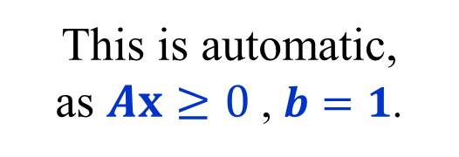
Packing Linear Programs
$Ax≤b$
$$x∈𝕂$$
Find a feasible $x∈ℝ^{n}$,
or show that none exists.
$A∈ℝ^{m×n}$ , $b∈ℝ^{m}$ , $𝕂⊆ℝ^{n}$ is a “simple” convex set
ORACLE: Given a distribution $p$ on the rows of $A$,
return $x∈𝕂$ such that $p^{T}Ax≤p^{T}b$, or “no” if none exists.
ORACLE is $(1,ρ)$-bounded iff
for every point $x∈𝕂$ returned and every $i∈[m]$,
$$−1≤A_{i}x−b_{i}≤ρ$$
This is automatic,
as $Ax≥0$ , $b=1$.
The width.

Slide 47

Packing LPs using multiplicative weights
[Plotkin-Shmoys-Tardos (1995)]
Experts correspond to the $m$ linear constraints (rows of $A$).
A distribution $p$ corresponds to the constraint $p^{T}Ax≤p^{T}b$.
The costs at iteration $t$ are determined by a point $x^{\left(t\right)}∈𝕂$.
$∈{\left[−1,\frac{1}{ρ}\right]}^{m}$
$m^{\left(t\right)}=\frac{1}{ρ} \left({b−Ax}^{\left(t\right)}\right)$
Note: Satisfied constraints are more costly.
Use $MW_{η}$ to produce distributions $p^{\left(1\right)},p^{\left(2\right)},…,p^{\left(T\right)}$.
In iteration $t$ apply ORACLE to $p^{\left(t\right)}$ to obtain $x^{\left(t\right)}$ and $m^{\left(t\right)}$.
If ORACLE returns “no” in any iteration, problem infeasible.
Run for $T=8ρ\ln{m}/ε^{2}$ and return $\overline{x}=\frac{1}{T}\sum_{t}{x^{\left(t\right)}}$.

Slide 48
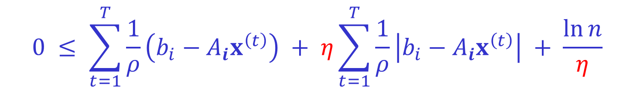
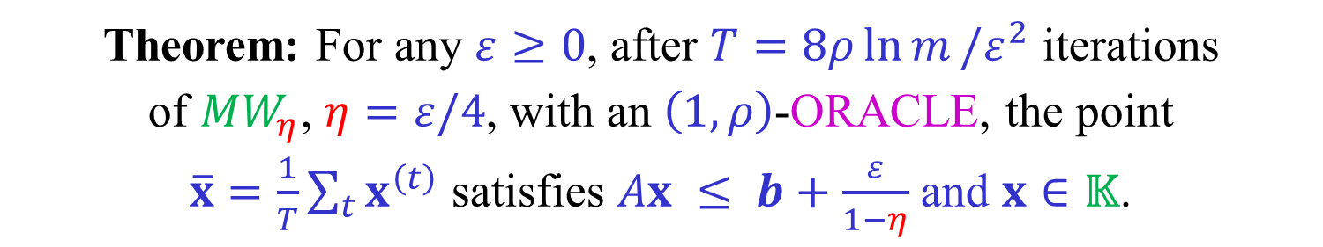
Packing LPs using multiplicative weights
[Plotkin-Shmoys-Tardos (1995)]
Theorem: For any $ε≥0$, after $T=8ρ\ln{m}/ε^{2}$ iterations
of $MW_{η}$, $η=ε/4$, with an $\left(1,ρ\right)$-ORACLE, the point
$\overline{x}=\frac{1}{T}\sum_{t}{x^{\left(t\right)}}$ satisfies $Ax ≤ b+\frac{ε}{1−η}$ and $x∈𝕂$.
As $x^{\left(t\right)}$ is the ORACLE’s response to $p^{\left(t\right)}$, we have:
$$p^{\left(t\right)}⋅m^{\left(t\right)} = \frac{1}{ρ}\left({p^{\left(t\right)}}^{T}b−{p^{\left(t\right)}}^{T}Ax^{\left(t\right)}\right) ≥ 0$$
For every constraint (“expert”) $i$ we have:
$$0 ≤ \sum_{t=1}^{T}{\frac{1}{ρ}\left(b_{i}−A_{i}x^{\left(t\right)}\right)} + η\sum_{t=1}^{T}{\frac{1}{ρ}\left|b_{i}−A_{i}x^{\left(t\right)}\right|} + \frac{\ln{n}}{η}$$

Slide 49

Useful fact:
$$\sum_{t=1}^{T}{x_{t}}+η\sum_{t=1}^{T}{\left|x_{t}\right| =\left(1−η\right)\sum_{t=1}^{T}{x_{t}}+2η}\sum_{t=1}^{T}{{\left(x_{t}\right)}^{+}}$$
$${\left(x_{t}\right)}^{+}=\max{\{0,x_{t}\}}$$

Slide 50

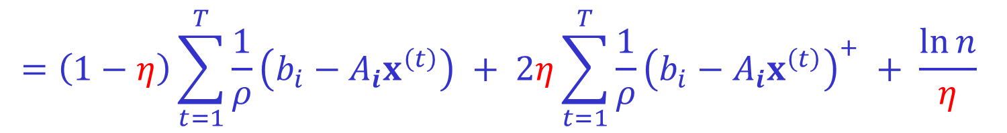

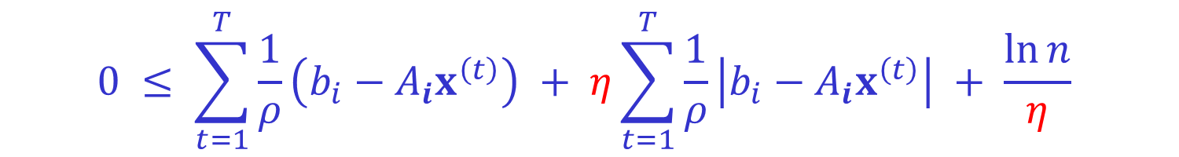


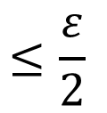
Packing LPs using multiplicative weights
[Plotkin-Shmoys-Tardos (1995)]
$$0 ≤ \sum_{t=1}^{T}{\frac{1}{ρ}\left(b_{i}−A_{i}x^{\left(t\right)}\right)} + η\sum_{t=1}^{T}{\frac{1}{ρ}\left|b_{i}−A_{i}x^{\left(t\right)}\right|} + \frac{\ln{n}}{η}$$
$$=\left(1−η\right)\sum_{t=1}^{T}{\frac{1}{ρ}\left(b_{i}−A_{i}x^{\left(t\right)}\right)} + 2η\sum_{t=1}^{T}{\frac{1}{ρ}{\left(b_{i}−A_{i}x^{\left(t\right)}\right)}^{+}} + \frac{\ln{n}}{η}$$
$$≤1$$
ORACLE is $(1,ρ)$-bounded
$$×\frac{ρ}{T}$$
$$0≤\left(1−η\right)\frac{1}{T}\sum_{t=1}^{T}{\left(b_{i}−A_{i}x^{\left(t\right)}\right)} + 2η + \frac{ρ\ln{n}}{ηT}$$
$$≤\frac{ε}{2}$$
$$≤\frac{ε}{2}$$
$$=b_{i}−A_{i}\overline{x}$$

Slide 51
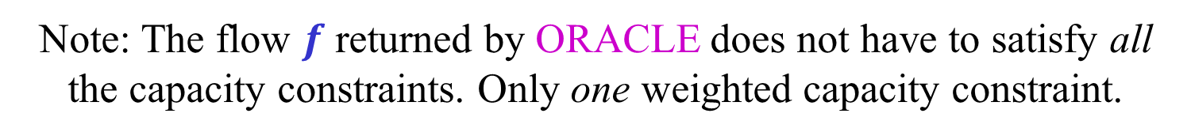

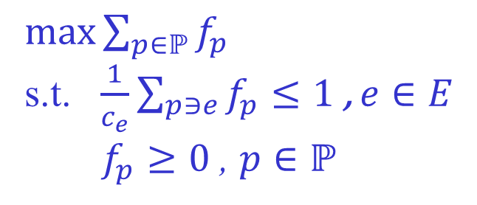
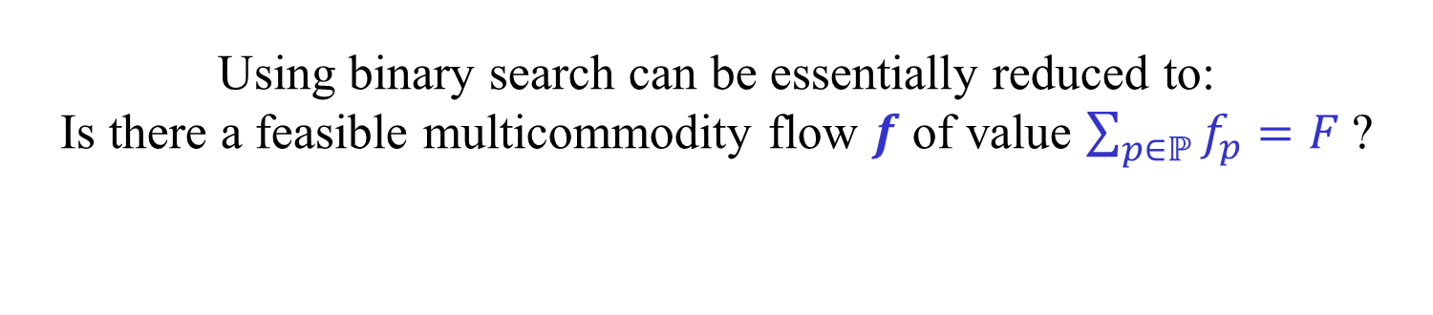
Maximum Multicommodity Flow
$\max{\sum_{p∈ℙ}{f_{p}}}$
s.t. $\frac{1}{c_{e}}\sum_{p∋e}{f_{p}}≤1$ , $e∈E$
$f_{p}≥0$ , $p∈ℙ$
Using binary search can be essentially reduced to:
Is there a feasible multicommodity flow $f$ of value $\sum_{p∈ℙ}{f_{p}}=F$?
$𝕂=\left\{ f :f≥0 , \sum_{p∈ℙ}{f_{p}}=F \right\}$
This is now a packing problem.
ORACLE is given a weight $w_{e}≥0$ for each edge
and has to find a flow $f$, if there is one, such that
$\sum_{e}{w_{e}\frac{1}{c_{e}}}\sum_{p∋e}{f_{p}}≤\sum_{e}{w_{e}} , \sum_{p∈ℙ}{f_{p}}=F$
Note: The flow $f$ returned by ORACLE does not have to satisfy all
the capacity constraints. Only one weighted capacity constraint.

Slide 52


Maximum Multicommodity flow
$\frac{1}{c_{e}}\sum_{p∋e}{f_{p}}≤1$ , $e∈E$
$f∈𝕂=\left\{ f :f≥0 , \sum_{p∈ℙ}{f_{p}}=F \right\}$
ORACLE is given a weight $w_{e}≥0$ for each edge
and has to find a flow $f$, if there is one, such that
$\sum_{e}{w_{e}\frac{1}{c_{e}}}\sum_{p∋e}{f_{p}} ≤ \sum_{e}{w_{e}} , \sum_{p∈ℙ}{f_{p}}=F$
$\sum_{e}{w_{e}\frac{1}{c_{e}}}\sum_{p∋e}{f_{p}}=\sum_{p∈ℙ}{f_{p}}\sum_{e∈p}{\frac{w_{e}}{c_{e}}}$
Find a path $p∈ℙ$ that minimizes $\sum_{e∈p}{\frac{w_{e}}{c_{e}}}$.
If $F\sum_{e∈p}{\frac{w_{e}}{c_{e}}}≤ \sum_{e}{w_{e}}$, send $F$ units of flow on $p$, i.e., $f_{p}=F$.
Otherwise, return “no”.
ORACLE just needs to solve $k$ shortest paths problems.

Slide 53

Maximum Multicommodity flow
How good is the algorithm obtained using the framework?
Number of iterations is $T=8ρ\ln{m}/ε^{2}$
In each iteration, solve $k$ shortest paths problems in $\tilde{O}\left(mk\right)$ time.
We also need to multiply by the cost of the binary search.
ORACLE is $(1,ρ)$-bounded iff
for every point $x∈𝕂$ returned and every $i∈[m]$,
$$−1≤A_{i}x−b_{i}≤ρ$$
In our case: $ρ≤ \frac{F}{c_{min}}−1$, where $c_{min}=\min_{e∈E}{c_{e}}$
The running time is $\tilde{O}\left(\frac{F∙mk}{ε^{2}c_{min}}\right)$
The running time is not polynomial!

