Slide 1

Information Security – Theory vs. Reality
0368-4474, Winter 2015-2016
Lecture 5:
Side channels: memory, taxonomy
Lecturer:
Eran Tromer

Slide 2
More architectural side channels +
Example of a non-cryptographic attack
TENEX directory password validation, inside a system call:
check_password(char* given_pass) {
…
for (i=0; i<=strlen(correct_pass); i++)
if (correct_pass[i] != given_pass[i]) {
sleep (3);
return EACCESS; // access denied
}
return 0;
}
Attack each byte at a turn, by placing given_pass on a page boundary.
Timing due to page fault
Timing due to TLB miss
Crash due to page fault
Leftover page status after page fault
Notes:
Actually the system call was CNDIR, not chdir().

Slide 3
Information leakage from memory and storage

Slide 4
Bypassing memory/storage access controls
While system operates, DRAM is protected by CPU and OS. Can be circumvented by:
Hardware snooping
Data remanence:
accessing residual data after
  system shutdown
  (attempted) logical erasure
  (attempted) physical erasure

Slide 5
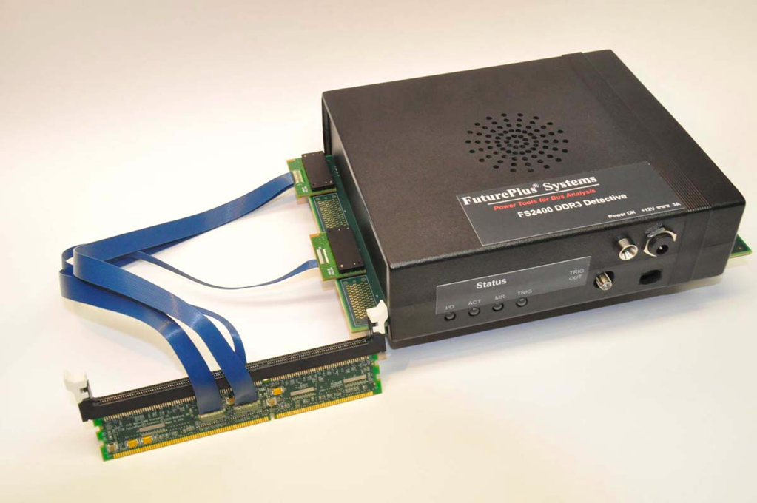
DRAM memory bus analyzers

Slide 6
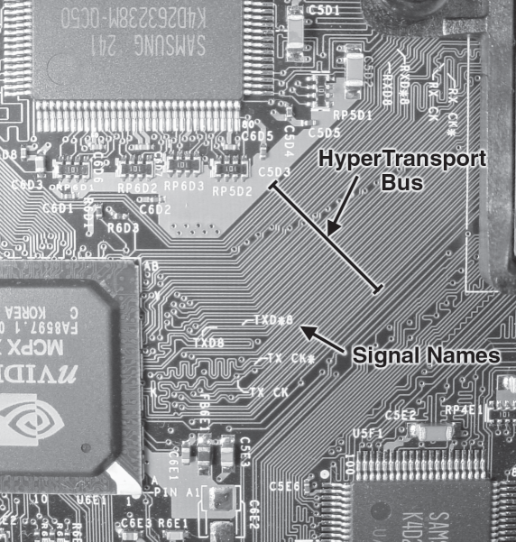
Tapping bus lines on printed circuit boards
Xbox HyperTransport bus traces
[Andrew “bunnie” Huang”, Hacking the Xbox]

Slide 7
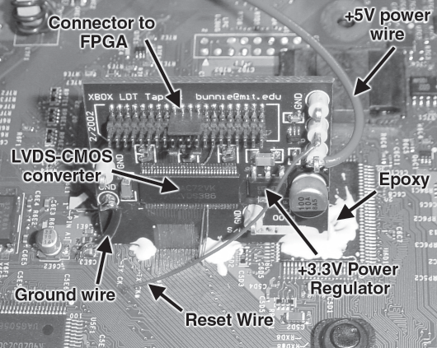
Tapping bus lines on printed circuit boards (cont.)
HyperTransport tap board mounted on the Xbox motherboard.
[Andrew “bunnie” Huang”, Hacking the Xbox]

Slide 8
Directly reading non-volatile memory chips
(ROM, EPROM, EEPROM, flash)
Removing the Xbox FLASH ROM with a tweezer-style soldering iron.
[Andrew “bunnie” Huang”, Hacking the Xbox]
Notes:
EPROM, EEPROM and Flash
widely used in microcontrollers and smartcards
use floating-gate transistors for storage, 10³ – 10⁵ e⁻

Slide 9
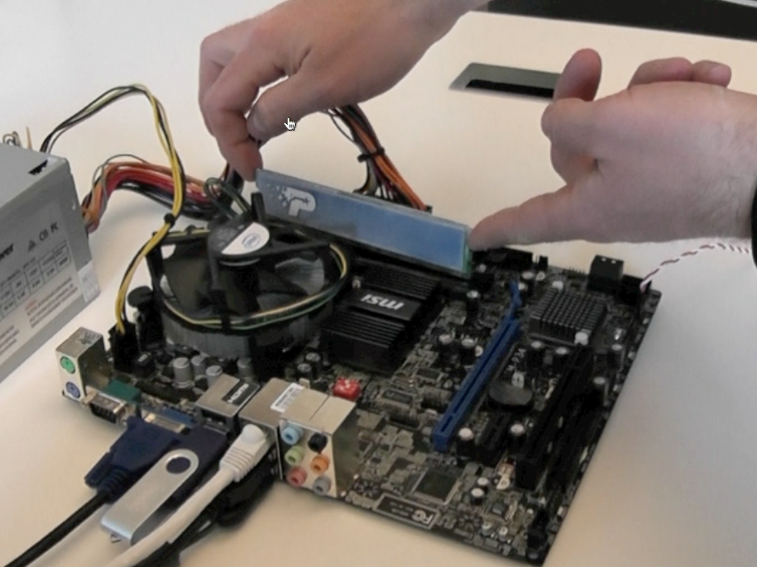
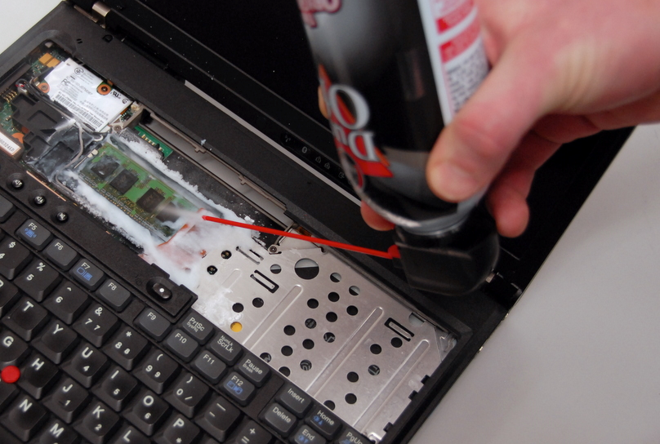
DRAM data remanence (“cold boot” attack)
Freeze the state of volatile DRAM and read it on a different machine
  Cold boot attack (literally freeze)
  Keep power using capacitor
[Halderman et al., Lest We Remember: Cold Boot Attacks on Encryption Keys, 2008]

Slide 10
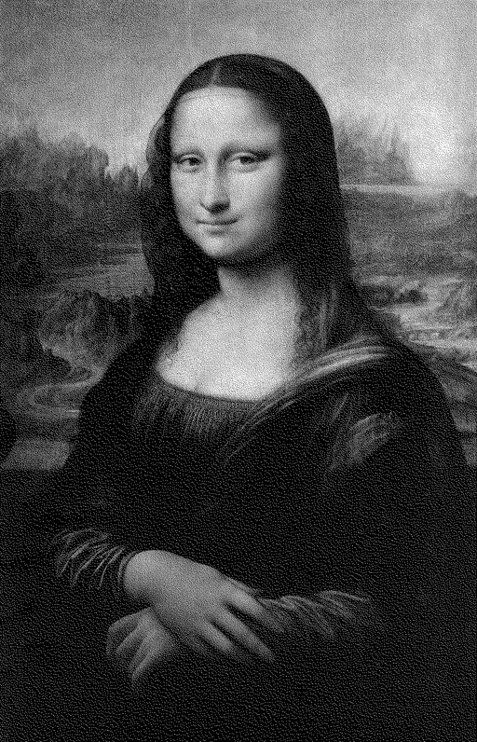

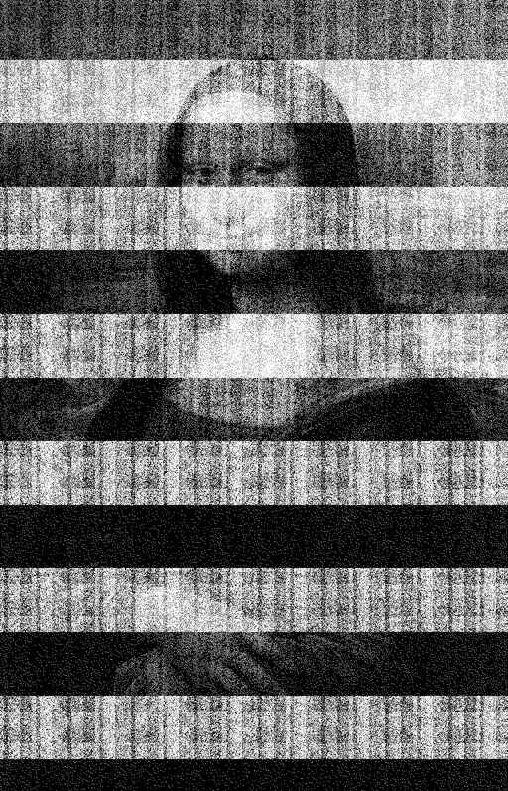

DRAM data remanence (“cold boot” attack), example of memory decay
5 seconds
30 seconds
60 seconds
5 minutes
[Halderman et al., Lest We Remember: Cold Boot Attacks on Encryption Keys, 2008]
Notes:
The horizontal bars result from the design of this memory chip, which represents some “1″ bits by the presence of charge and some by the absence of charge

Slide 11
SRAM data remanence
Data remanence in SRAM
  Low temperature data remanence is dangerous to tamper resistant devices which store keys and secret data in a battery backed-up SRAM
  Long period of time data storage causes the data to be “burned-in” and likely to appear after power up; dangerous to secure devices which store keys at the same memory location for years
Experimental example
Eight SRAM samples were tested at different conditions
  at room temperature the retention time varies from 0.1 to 10 sec
  cooling down to −20ºC increases the retention time to 1…1000 sec, while at −50ºC the data retention time is 10 sec to 10 hours
  grounding the power supply pin reduces the retention time

Slide 12
Data remanence: continued
Remanence in magnetic hard disk
Residual bias in magnetic field
Imperfect alignment of write head on track
→ using high-precision equipment, can peel current data layer and access prior data.
Aided by error-correcting codes.
Notes:
Possible outcomes
circumvention of security in microcontrollers, FPGAs, smartcards
information leakage through shared EEPROM and Flash areas between different applications in secure chips

Slide 13
Remanence at higher levels
Memory cell
Smart memory
  Flash Translation Layer
  Bad-sector handling
  Hardware buffers
  Battery-backed buffers
  Hybrid disks (HDD+SSD)
Filesystem (undelete an erased file)‏
Application-level (backups, revisions)`
Notes:
Possible outcomes
circumvention of security in microcontrollers, FPGAs, smartcards
information leakage through shared EEPROM and Flash areas between different applications in secure chips

Slide 14
Taxonomy of side/covert channels

Slide 15
Side/covert channels: physical
Electromagnetic
(radiated emanations)
  Computation
  Peripherals
  CRT screen electron gun (van Eck), CRT/LCD screen cable, keyboards, printers
Electric
(conducted emanations)
  Power
  Ground
  (chassis, shields, cables,
  adjacent wall socket)
Mechanical
  Acoustic
    Voltage regulators
    Peripherals (keyboards, printers)
  Vibrations
    On-screen keyboards
Thermal
  Between cores
  Between computers
Optical
  Status LEDs
  CRT screens

Slide 16
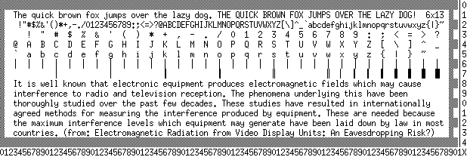
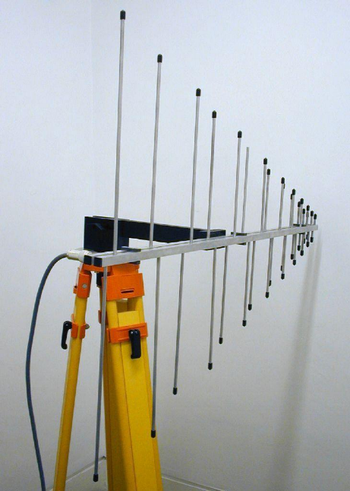
Electromagnetic “van Eck” attack on analog CRT screen
[Markus Kuhn, Compromising emanations: eavesdropping risks of computer displays, 2003]
3m distance

Slide 17
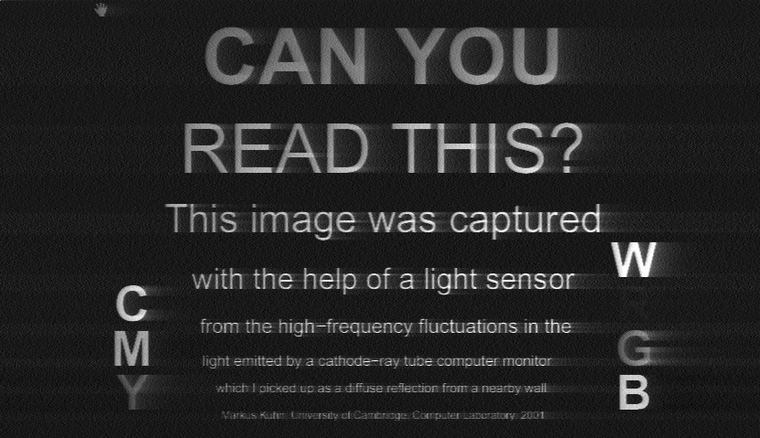
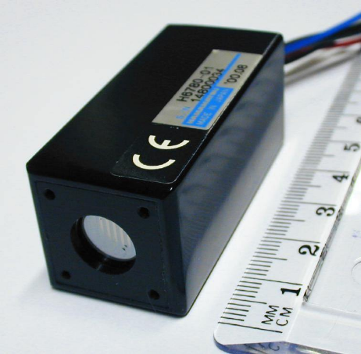
Reflected optical emanations from CRT
[Markus Kuhn, Compromising emanations: eavesdropping risks of computer displays, 2003]
CRT 1m from wall,
photodetector 1.5m from wall

Slide 18
Side/covert channels: (micro)architecture
Data cache
Instruction cache
DRAM contention
Branch predictor
Functional units
  ALU
Paging mechanism
  Page faults
  Table Lookaside Buffer
Memory prefetching
Hard disks
  Contention
  Head movement

Slide 19
Side/covert channels: OS / VMM / storage virtualization
Scheduler
  Assists other attacks
  (e.g., temporal resolution for cache attack)
  Directly exploitable
Deduplication
  Assists other attacks
  Directly exploitable
  (example: cloud storage dedup)

Slide 20
Side/covert channels: other
Data remanence
  Hard disks magnetic remnants
  DRAM/SRAM cells persistance
  Block remapping
Timing
  Nominal computation
    Optimizations
    Contention and variable-time operations
  Error handling
  Often can be done over a network.
Communication (nominally or by other channels)
  Data
  Metadata
    source, destination
    flags
    timing
    size
      after compression…
  Protocol recognition
  Deanonymization
    Tor

