Slide 1
Lecture 6:
Smart Phone Security Application security in a world of sensitive capabilities
Information Security – Theory vs. Reality
0368-4474-01, Winter 2011
Guest Lecturer: Roei Schuster

Slide 2
Introduction to Smart Phone Security, Application security in a world of sensitive capabilities
Roei Schuster

Slide 3
Order of Business
Part I: Introduction to Smartphone Security
  Why is phone security interesting?
  Contemporary and future platforms
  Define and discuss smart phone App Security Models.
  Case-studying iPhone vs. Android.
Part II: Application Security In a World of Sensitive Capabilities
  Capabilities, permissions, requirements for better application permission expressiveness
  Contemporary efforts in applying information flow control

Slide 4
Introduction to Smart Phone Security
Part I

Slide 5
Why are phones interesting?
(How are they different?)
A Phone has:
  A Microphone
  A Camera
  Touch Screen
  GPS
  Accelerometer/Gyroscope
  Digital compass
  Battery
  Proximity Sensor
  …?
Having access to your phone enables eavesdropping on everything you do.
Notes:
Touch screen: one idea is to use information retrieved from touch screen in order to learn things about the user (his health, obesity for example)…
-Location information is relevant to “brick and mortar” businesses
-Foursquare! http://en.wikipedia.org/wiki/Foursquare_(social_network)
-http://en.wikipedia.org/wiki/Proximity_marketing
-http://www.barabasilab.com/pubs/CCNR-ALB_Publications/201002-19_Science-Predictability/201002-19_Science-Predictability.pdf – Barabasi’s research about human mobility patterns and their whereabouts’ predictability
Location information is relevant to building a consumer profile for almost any kind of merchandise.
http://en.wikipedia.org/wiki/Power_analysis - battery is a side-channel itself.

Slide 6
Phone Data
Phone calls
SMSs
Pictures & videos taken
Contacts
E-mails, social network accounts…
Calendar (events, meetings…)
Bank accounts, stock exchange...
Browser history
Phone details (phone number, IMSI…)
…?

Slide 7
Phone Attack Vectors
Connectivity:
  Radio Interface
    Internet
    SMS
    Interfaces with network entities
  Bluetooth
  IR
  Wifi
    Internet
Applications
Software updates…?

Slide 8
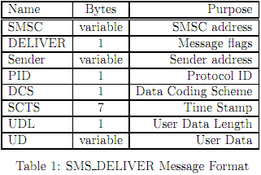
SMS Fuzzing
By fuzzing various fields (including application ports, DCS, PID, etc…) researchers managed to:
  Crash/DoS iPhone
  Disconnect iPhone
  Lock your SIM card
  on Android
"Fuzzing the Phone in your Phone", BH USA '09, Mulliner
Notes:
3G vulnerabilities: SMS fuzzing: https://www.blackhat.com/presentations/bh-usa-09/MILLER/BHUSA09-Miller-FuzzingPhone-PAPER.pdf
results: crash iPhone, disconnect iPhone, Android: lock SIM until PIN is entered

Slide 9
Android malware
Android/jmsonez.A, Android/Smsecap.A, Android/DroidKungFu, Android/DrdDreamLite – the famous families of Android malware
Their purpose is to make your phone… Send SMSs?
  To premium rate numbers…
  No need for credit card theft, you can pay for stuff with your GSM credentials
Notes:
McAffee threats report 2011 q2: http://www.mcafee.com/us/resources/reports/rp-quarterly-threat-q2-2011.pdf

Slide 10
Bluetooth Vulnerability
(‘09, Alberto Moreno Talbado)
Applies to HTC Smartphones running Windows Mobile 6/6.1
Bluetooth attack enables full file system access
  directory traversal
  download files (incl. contacts, mail…)
  upload files (“trojan.exe” to \Windows\Startup)
Notes:
Bluetooth attack: http://www.pcworld.com/businesscenter/article/168358/htc_smartphones_left_vulnerable_to_bluetooth_attack.html
Bluetooth attack enables full file system access – directory traversal, download files (incl. contacts, mail…) and upload files (“trojan.exe” to \Windows\Startup)

Slide 11
Bluetooth Vulnerability (Cont.)
“Users worried about the vulnerability should avoid pairing their phones with an untrusted handset or computer. They may also want to delete any devices that are already paired with their phones”

Slide 12
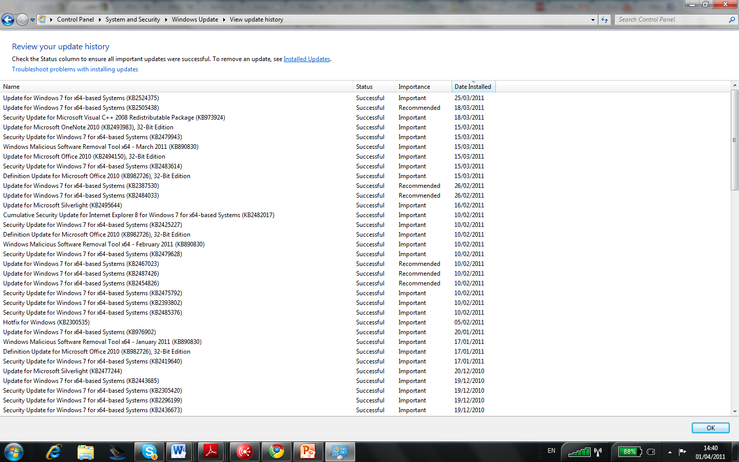
Notes:
Windows update history on my own computer.

Slide 13
Android Security Updates
From the Android Security FAQ:
  “The manufacturer of each device is responsible for distributing software upgrades for it, including security fixes. Many devices will update themselves automatically with software downloaded "over the air", while some devices require the user to upgrade them manually.”
  De facto updates?
Notes:
http://developer.android.com/resources/faq/security.html

Slide 14
Other Mobile Platforms
iOS: About twelve updates in 2011 so far (slide updated Nov. 26th, 2011).
Windows Phone 7: Five updates in 2011 so far.
RIM: Twelve updates in 2011 so far.
In all of them: have to plug in to the PC to update (Microsoft promises a better infrastructure in the future).
Notes:
http://uk.blackberry.com/ataglance/security/news.jsp
http://www.microsoft.com/windowsphone/en-us/howto/wp7/basics/update-history.aspx
http://en.wikipedia.org/wiki/IOS_version_history#4.3.1

Slide 15
Who owns our intimate information?
Government’s powers
  Any data transmitted over the mobile network exposes this data to the government via LI mechanisms.
Phone provider’s powers
  iOS updates delete data for jailbroken phones
  Amazon “Big Brother” Kindle
  iOS and Android’s location recording scandal
  Legal issues, technical non-issues
Notes:
http://en.wikipedia.org/wiki/Lawful_interception
http://news.cnet.com/8301-13860_3-10289983-56.html

Slide 16
One could argue…
“Phones are just like computers. The real question is why after decades of research, we still build new platforms with old problems.”
Key differences, security-wise, in my view:
  Your phone is (almost) always with you, and (almost) only with you.
    Prediction: Computers will become less and less user-affiliated, while phones will become more and more so (your e-wallet, entry key to your cloud account…).
But the question above remains valid…
Notes:
- Alexei wasn’t convinced by the previous slides, stating that all of these alleged differences will be gone with time.
- The battery conservation makes phones less liable to attacks demanding constant internet connectivity such as botnet trojans.
The limited UI makes it less likely to find large documents (although there’s Kindle…) such as your work. Most of all documents you edit.
These technical limitations will decrease with time!!!
The fact that the phone is always and only with you means:
It’s your main window to the world?
The data on it is “sound and complete”, in the sense that it is YOUR data and ALL of your data (i.e. ALL contacts, calls, SMSs, emails, facebook info, etc…).
We still build old platforms with new problems simply because it sells.
Android’s insecure features are well-known, and still the decision to market it so soon (as opposed to WP) was probably wise.

Slide 17
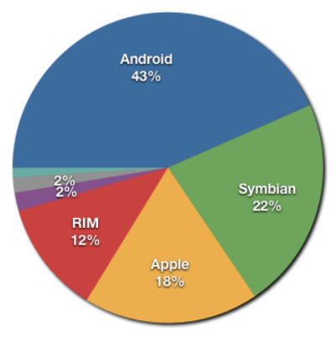
Focus – What (or who) are we dealing with?
Worldwide 2011 Q2 smartphone sales by OS
(Microsoft and Bada have the 2% shares)
Still a very unstable market! Things change rapidly.
Notes:
http://en.wikipedia.org/wiki/File:Smartphone_share_current.png

Slide 18
Market Leaders (1)
Symbian
  Open Source
  Origins: Firmware
  SDK: C++, Qt. Also: Python, Java ME, Adobe Flash
  Only digitally signed apps can waste your money.
  Cabir – Bluetooth worm (later upgraded to exploit MMSs)
  RIP (Feb. 11, 2011)
Notes:
ARM processor for most
Symbian will be replaced by Windows Phone 7
Cabir did not do anything (just multiply, scanning for devices)
http://en.wikipedia.org/wiki/Symbian

Slide 19
Market Leaders (2)
Windows Phone 7
  Small current share of the market.
  Will replace Symbian (~22% of the 2011q2 market)
  Apps: XNA or Silverlight only.
    Sandboxing
      Launchers and Choosers
    Isolated Storage (and no inter-app communication)
  Pre-use permissions
  App verification

Slide 20
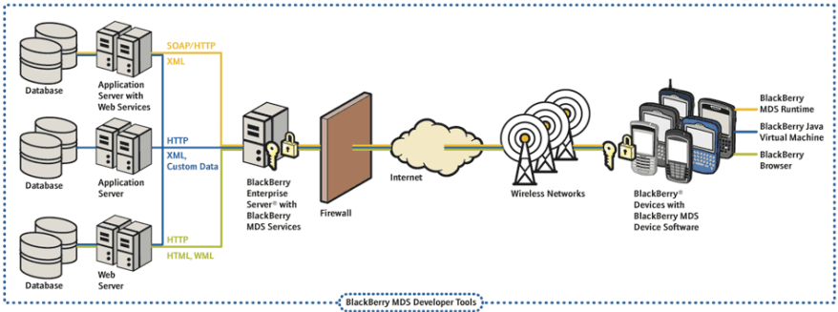
Market Leaders (3)
BlackBerry
  Closed-source, only for RIM devices
  Entire infrastructure supporting businesses’ security.
Encryption between device and BES (but not inside organization’s network)
"BlackBerry Security Model", Schiffman

Slide 21
BlackBerry (cont.)
IT Policy (if you belong to an organization)
  Mandatory and prohibited apps
  Updates OTA must be signed with master key
  Controls browsers, I/O, user security settings (passswords etc.), firewall….
Apps run in JVM
  Code signing by RIM for “Core BB apps”
  MIDP and CLDC open, rest APIs closed (app must be signed)
Notes:
http://www.cse.psu.edu/~enck/cse597a-s09/slides/security_blackberry.pdf
IDF must replace MIRS with BB, ASAP (for security reasons!)

Slide 22
BlackBerry (cont.)
All of user’s data can be encrypted while device is locked
  If it isn’t then remote/delayed/password retrials wipes are possible
Data may be backed up on BES
Communication between BES and device is encrypted.
Can only be as secure as the internal organization network itself.

Slide 23
Market Leaders (4)
Android
  Small startup bought by Google in 2008
  Patched Linux Kernel, open source user space
  Can run on many devices
iOS
  “The trendsetter”
  Closed, proprietary source
  Supports Apple devices only
We will discuss their security issues soon.

Slide 24
A word on Tablets
Half-phones half-laptops.
  Some closer to smart phones
    Run iOS/Android…
  Some closer to laptops
    i.e. run Windows 7
  They are supposedly always with you.
    Contain very sensitive information.
  But you usually don’t make phone calls with them.
    Are still somewhat limited.
Notes:
- Sales increasing, some projections say they will continue to increase and tablets will become one of the most significant communication tool.
(I don’t think so.. But that’s completely irrelevant)

Slide 25
What we had so far…
Motivation – why are phones interesting?
  Hardware and software differences from PCs
  Conceptual differences
Short introduction of market trends and important actors.
Next: Dig further into 3rd party applications and application security models.

Slide 26
“App Attack”
Apps may need to have access to sensitive information (call history, bank account, etc..).
Some apps don’t need it (e.g. Angry Birds).
Calls for a special security mechanism – or does it?
You needn’t be Microsoft/Adobe to build one that people will use
  New, unexploited, easy-to-implement ideas.
  App Stores – more equal exposure, easy to access.
"App Attack", Mahhaffey & Herring
Notes:
https://media.blackhat.com/bh-us-10/presentations/Mahaffey_Hering/Blackhat-USA-2010-Mahaffey-Hering-Lookout-App-Genome-slides.pdf
For example tweetpark, foursquare, apps like iBooks (documentation viewers), Wayz, etc… all NEW 3rd party applications

Slide 27
Advertisement SDKs
3rd party (Actually, 4th party) components piggy-backed on an application.
Developers don’t know the code inside their own application.
SDKs will always want to perform targeted marketing…

Slide 28
Defense advantages
App Stores and Markets
  Choke point for distribution
Less code to verify (?)
App Security Models

Slide 29
Application Security Models
Sandboxing
  Permissions
  Isolation
App stores verification
  Open or disclosed source
  Apps must prove themselves secure
    It’s no longer enough to just be secure
  Vendors must prove themselves trustworthy
  Sometimes signed (BB/Symbian/iOS/Android..)

Slide 30
Android Application Security Model

Slide 31
Android Application Security Model
Applications run in a virtual machine called Dalvik
  Java → Java Byte Code → Dalvik Byte Code
Dalvik itself is no sandbox
  Sandboxing at process level
  Each app process has a distinct UID, GID, and belongs to some groups.
Notes:
http://www.youtube.com/watch?v=byFTAhXVF7k
http://developer.android.com/guide/topics/security/security.html
http://images.apple.com/iphone/business/docs/iPhone_Security.pdf

Slide 32
Android Application Security Model (Cont.)
AndroidManifest.xml
  Declares app permissions (Read contacts, Send SMS, Read Logs, Internet, etc… and user-defined)
    <uses-permission android:name="android.permission.RECEIVE_SMS" />
  Other static metadata about components.
Apps must be signed by developer (but not by anyone else)
  Allows sig-level permission granting
  Apps with same key can request the same gid/uid
Notes:
…. http://developer.android.com/reference/android/Manifest.permission.html
Any attempt to breach permissions will result in run-time failure, usually logged but not necessarily crashes the application…
Other static security data
Actions to listen to.
UID sharing
Permissions…

Slide 33
Android Security User Experience
First, obvious problem: users treat permission prompting similar to browser pop-up warnings.
  They just don’t care. “Want to get pony wallpapers now.”

Slide 34
Android Application Security Model (Cont.)
How does Android enforce permissions?
Two enforcement mechanisms:
  System level (files, I/O…)
    Some behavior inherited from Linux
    The kernel is patched in some places s.t. process group list is checked in some system calls. This is similar to Linux capabilities (only for non-root processes, and with no one reference monitor).
  ICC level
    Google’s own implementation
“Understanding Android Security”
Enck, Ongtang & McDaniel
Notes:
http://www.patrickmcdaniel.org/pubs/sp09.pdf Is the source of the next few slides

Slide 35
Android ICC
Component (defined in manifest.xml)
    Activity – UI behavior.
    Service – Background operation.
    Content Provider – A data service.
    Broadcast Receiver – “mailbox”
Intent - “A single, focused thing a user can do”
    Intents are used to invoke activities, services and to broadcast events.
Notes:
Defines the syntax used to invoke components. Main parts: “Action” and “Data”.
startActivity(Intent) is similar to broadcast(Intent) in that it selects the activity using Intent-Filters…

Slide 36
A Component Defines
Intent Filters
    What intents invoke a component.
Permissions – Who may invoke it
    Normal – permission use must be declared
    Signature – permission only by apps signed by same key
    Dangerous – explicit permission from user required

Slide 37
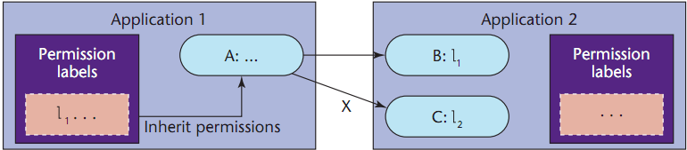
ICC Security - The Basic Idea
Per-application permission granting
  Granted by user or declaring application
  App’s components use them
Component-specific permission requirements
  Enforced when trying to access/invoke a component
Sensitive data (location, contacts) is usually accessed through a dedicated component.

Slide 38
How this looks in AndroidManifest.xml - Use Permission
‘string’ can be –
Or permissions defined by applications.
<manifest>
…
<uses-permission android:name="string" />
…
</manifest>
SEND_SMS, ACCESS_WIFI_STATE, BATTERY_STATS, GET_TASKS, CLEAR_APP_CACHE, HARDWARE_TEST, MODIFY_AUDIO_SETTINGS, MOUNT_FORMAT_FILESYSTEM, RECORD_AUDIO, INTERNET………

Slide 39
How this looks in AndroidManifest.xml – Define Permission
<manifest xmlns:android="http://schemas.android.com/apk/res/android"
package="com.me.app.myapp" >
<permission android:name="com.me.app.myapp.permission.DEADLY_ACTIVITY"
android:label="@string/permlab_deadlyActivity"
android:description="@string/permdesc_deadlyActivity"
android:permissionGroup="android.permission-group.COST_MONEY"
android:protectionLevel="dangerous" />
...
</manifest>

Slide 40
How this looks in AndroidManifest.xml (Cont.)
<manifest>
….
<activity|service|broadcastReceiver|provider ➔ component
android:name=“unique name”
android:permission=“permission string”> → Only one
<intent-filter>
<action />
<data />
</intent-filter>
</ activity|service|broadcastReceiver|provider >
…
</manifest>

Slide 41
ICC Security Expressiveness
Microphone AND web access == permission to record you and send it home?
User can’t add/remove permissions after install
  Permissions are absolute upon granting. An app can’t request one-time permission for specific operations.

Slide 42
Refinements to ICC Security
Problem:
  Imagine a social network app using location services
  FriendTracker – a service polling a web service for friends nearby.
  FriendNear - An broadcast receiver logging friend’s proximities.
  sendBroadcast(Intent(LOC_ACTION,friend’s location))
  Who will receive this intent?
    Solution: sendBroadcast(Intent, permission)

Slide 43
Refinements to ICC Security (Cont.)
More problems:
  Permission to use a service is granted at component granularity – all or nothing.
    No way to allow one binding process to use only specific RPC calls.
  Every component requires max. one permission
    What If a component usage allows camera AND web access?
    What If a component can read the logs OR get battery stats to provide the service it provides?
  Solution: checkCallingPermission(permission)

Slide 44
Refinements to ICC Security (Cont.)
Content Providers:
  Separate Read/Write permissions
  URI Permissions
    Y wants to present a text file from provider X, but Notepad doesn’t have permissions.
    Y starts an activity with a VIEW intent with a special flag allowing a one-time access to X.
    The VIEW intent is intercepted by notepad which is the appropriate app to read text files.

Slide 45
ICC Security - Conclusion
Android does not prevent inter-process communication.
  An inherent security problem (why?)
  In fact, Android supports it with an elaborate infrastructure.
  Security concerns are complicated.
    The need to have good understanding of what you’re doing when using ICC.
  Has many built-in vulnerabilities (next slide).
Notes:
Vulnerability taken from http://www.defcon.org/images/defcon-18/dc-18-presentations/Lineberry/DEFCON-18-Lineberry-Not-The-Permissions-You-Are-Looking-For.pdf

Slide 46
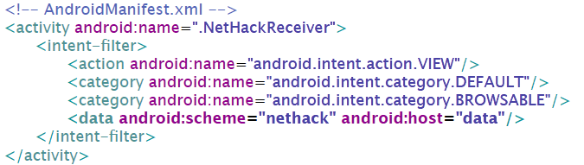
"These aren't the Permissions You're Looking For", Lineberry, Richardson & Wyatt
Upload secret content:
Download a response:
Redirect mysite.com/data to:
nethack:data?param=server_data
Notes:
Each time a browser opens a webpage an intent with scheme “http” is raised...
Google Maps use “Geo” scheme to automatically launch their app. We will do the same here.

Slide 47
How is This Fixable?
Browser app must add permissions to it’s launch activity
Must add permissions to the intent broadcast by browser opening a URI.

Slide 48
Chin Felt Greenwood Wagner 2011 - Analyzing Inter-process Communication in Android
Characterize types of IPC vulnerabilities:
  Unauthorized Intent Receipt:
    Broadcast Theft
    Activity Hijacking
    Service Hijacking
  Intent Spoofing:
    Malicious Broadcast Injection
    Malicious Activity Launch
    Malicious Service Launch
For each – specify how it can happen, how to avoid it.
  Avoidance complexity varies.

Slide 49
Chin Felt Greenwood Wagner 2011 - Analyzing Inter-process Communication in Android
ComDroid: Analyzed 100 applications to identify suspicious IPC implementation (e.g. not declaring permissions to use a broadcast receiver..). Outputted warnings.
Manually examined 20 applications for:
  Vulnerabilities (e.g. sensitive information exposure)
  Spoofing Vulnerabilities (security depends on user’s choices in activity intent-resolution dialog)
  Unintentional bugs (ignoring good code convention)

Slide 50
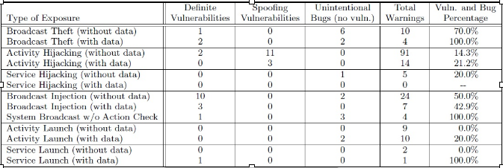
Results
Results show that the Android permission system is confusing to developers, and they misuse it.

Slide 51
Android Application Security Model - Conclusions
IPC and shared resources (logs, internet) are a major security issue.
Protection of application and user is the developer’s responsibility
  Any form of ICC/shared resources should be carefully examined.
  In real life, this does not happen. Many apps expose their (and your) secret information through these mechanisms. This includes Android’s built-in applications (e.g. browser).

Slide 52
Android’s Application Security Model – Conclusions (Cont.)
Protection of user’s data is his own responsibility
  Security vs. Usability
  Users don’t understand security concerns
    What does CLEAR_APP_CACHE mean?
Android’s permission model lacks important expressiveness
Android’s Open-Market App Security Model is an extreme and unique choice.

Slide 53
iOS Application Security Model

Slide 54
iOS Application Security Model
To use an application on your own iOS device you must have a special Developer Account
  You yourself have to be approved
    Costs 99$ ☹
    Takes time
  Still does not mean you can get it on the App Store.
Notes:
http://en.wikipedia.org/wiki/App_Store
This slide and the following ones lean heavily on this lecture: http://seriot.ch/resources/talks_papers/iPhonePrivacy.pdf

Slide 55
Apple developer program enrollment
Dear Troy Hakala,
We are currently in the process of reviewing your iPhone Developer Program enrollment information.
Please fax one of the following forms of identity for your business based on your company form. To assist with this process, please ensure your business documents match your Enrollment information.
…
Please include your main company corporate telephone number with your faxed documents.
…
…
Articles of incorporation
Business license
Certificate of Formation
DBA (Doing Business As…)
Fictitious name statement
Registration of trademark
Charter documents
Partnership papers
Reseller or vendor license
…
Thank you,
iPhone Developer Program

Slide 56
iOS Application Security Model (Cont.)
“Let us see for ourselves”.
  Can’t get an app on App Store without verifying it.
  Not 100% effective. Pulled back:
    Flashlight kid
    Aurora Faint – contact emails, 20M downloads
    MogoRoad – Sent phone numbers, customers got commercial calls
  “Polymorphic” apps (change at runtime)
  10K apps submitted per week, 10% of rejections related to malware
"iPhone Privacy", Seriot
Notes:
“Flashlight kid” – A 15 year-old (“SRSLY”) who built a flashlight app, which opens up your phone for tethering.

Slide 57
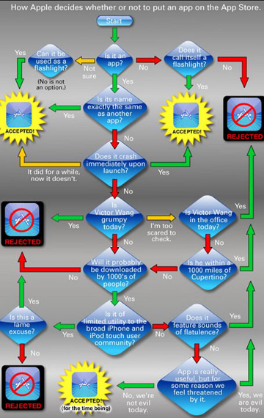
Guesswork –
App Store review process
Static analysis looking
for particular strings,
API calls etc..
Dynamic analysis
  Sniffing
  Monitor I/O, API calls
  “Fuzzing”
Lots of innocent apps
punished

Slide 58
iOS Application Security Model (Cont.)
Permissions:
  No pre-install user prompting
  Only one type of exercise-time prompting – “app wants to use your location”
Every app is completely isolated from others
  If an IPC hack exists, it will probably not be “Apple-Approved”
Hidden APIs exist.

Slide 59
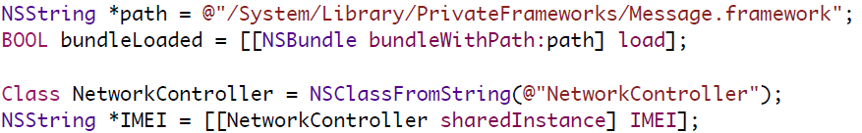
iOS Application Security Model (Cont.)
What happens without App-Store protection?
A jailbroken iPhone is not protected by the App-Store.
  But you can get more apps for free.
What can be done with private APIs?
    Strings can be obfuscated or set remotely…

Slide 60
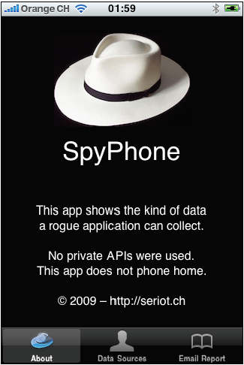
iOS Application Security Model (Cont.)
What can be done without private APIs?
SpyPhone Capabilities:
  Safari/YouTube search history
  E-mail account
  Phone Number, IMSI…
  E-mail contacts
  Keyboard cache
  Wifi information
  Current GPS location

Slide 61
iOS Application Security Model (Cont.)
Conclusion:
  Automatic sandboxing in iOS does not work.
  Privacy and security leans mainly on “manual” sandboxing.
    App Store approval.
    Fact that developers are (hopefully) not anonymous.

Slide 62
Empiric Results – App Safety in Android and iPhone

Slide 63
The App Genome Project
iPhone App Store & Android Market
Analyzed nearly 100,000 free apps
Enables identifying “threats in the wild”
  Examine what apps are actually doing vs. what they say they’re doing.
"App Attack", Mahhaffey & Herring

Slide 64
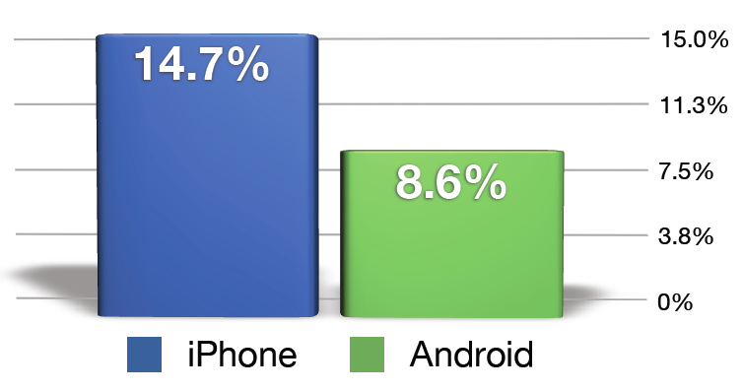
Free Apps Reading Contacts

Slide 65
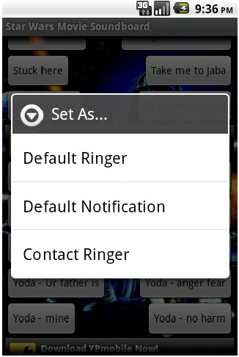
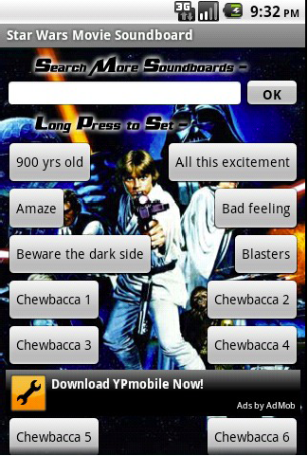
Why are apps reading my contacts?!
Why would a soundboard?
To set custom ringers..

Slide 66
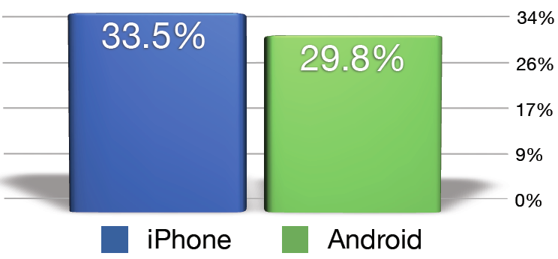
Free Apps Accessing Location

Slide 67
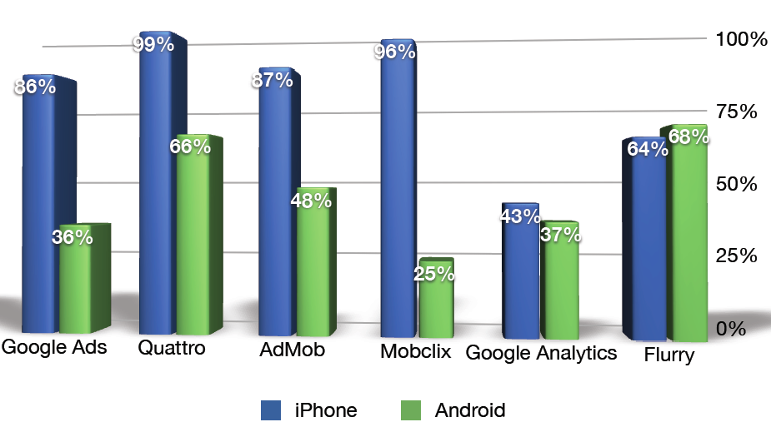
Why are apps using my location?!
Advertisement SDKs - Conditional likelihood to access location

Slide 68
Key Insights
On Android, if a developer brings in an ad SDK but doesn’t request location permissions, the app can’t access location.
On iPhone, an application will only be allowed to use location if Apple deems it appropriate.
  “If your app uses location-based information primarily to enable mobile advertisers to deliver targeted ads based on a user's location, your app will be returned to you by the App Store Review Team for modification before it can be posted to the App Store."

Slide 69
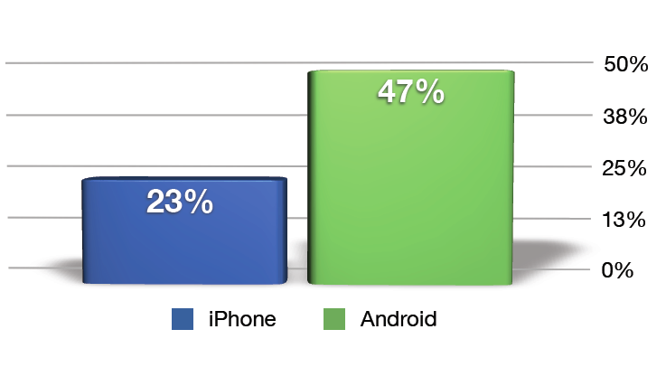
3rd Party Code Prevalence

Slide 70
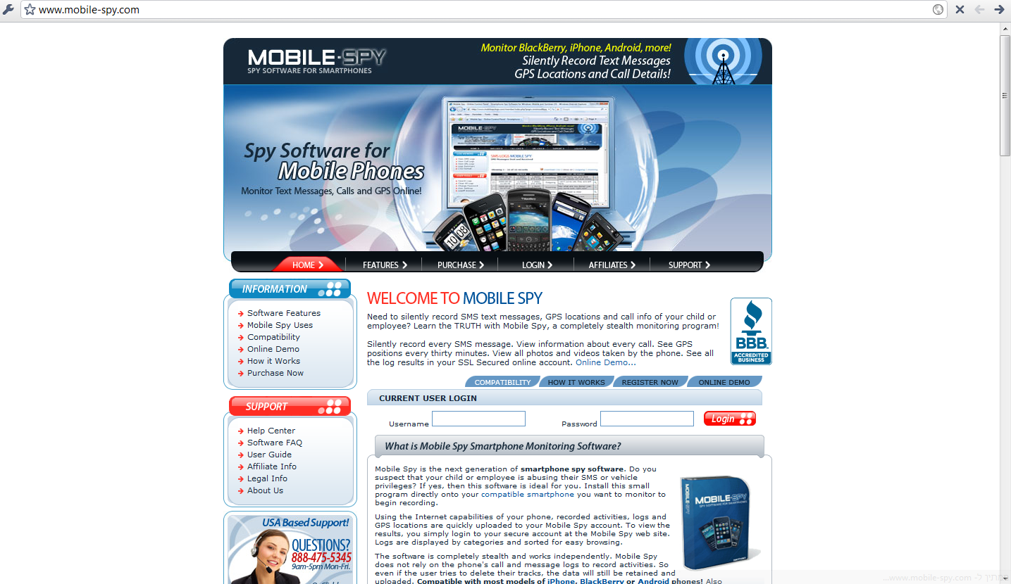
Caught by App Genome Project
Many applications by developer “RXS” access a lot of sensitive data. Many had innocuous names and described themselves as a “System Utility”.
But really, they just send data to mobilespy.com.

Slide 71
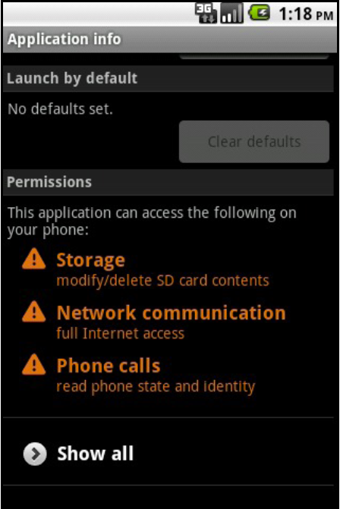
Caught by App Genome Project (Cont.)
Lots of wallpaper apps
Accessing IMEI, IMSI,
Phone number…
AND internet…
Don’t hide that they do.

Slide 72
Wiresharked – HTTP POST
POST /api/wallpapers/log/device_info?locale=enrUS&
version_code=422&w=320&h=480&uniquely_code=000000000000000&api_key=CIEhu15fY4bO4SGcGTq6g&nonc
e=9fe79a6119a9c650eb8f9615e2b88a8d&timestamp=1279591671671&api_sig=11404ee56654c3ad52649fb1e0589e5f
HTTP/1.1
Content-Length: 1146
Content-Type: application/x-www-form-urlencoded
Host: www.imnet.us
Connection: Keep-Alive
User-Agent: Apache-HttpClient/UNAVAILABLE (java 1.4)
Expect: 100-Continue
HTTP/1.1 100 Continue
uniquely_code=000000000000000&device_info=device_id%3D000000000000000%26device_software_version%3Dnull
%26build_board%3Dunknown%26build_brand%3Dgeneric%26build_device%3Dgeneric%26build_display%3Dsdk-eng
+2.2+FRF42+36942+test-keys%26build_fingerprint%3Dgeneric%2Fsdk%2Fgeneric%2F
%3A2.2%2FFRF42%2F36942%3Aeng%2Ftest-keys%26build_model%3Dsdk%26build_product%3Dsdk%26build_tags
%3Dtest-keys%26build_time%3D1273720406000%26build_user%3Dandroid-build%26build_type%3Deng%26build_id
%3DFRF42%26build_host%3De-honda.mtv.corp.google.com%26build_version_release%3D2.2%26build_version_sdk_int
%3D8%26build_version_incremental%3D36942%26density%3D1.0%26height_pixels%3D480%26scaled_density
%3D1.0%26width_pixels%3D320%26xdpi%3D160.0%26ydpi%3D160.0%26line1_number
%3D15555218135%26network_country_iso%3Dus%26network_operator%3D310260%26network_operator_name
%3DAndroid%26network_type%3D3%26phone_type%3D1%26sim_country_iso%3Dus%26sim_operator
%3D310260%26sim_operator_name%3DAndroid%26sim_serial_number%3D89014103211118510720%26sim_state
%3D5%26subscriber_id%3D310260000000000%26voice_mail_number%3D%2B15552175049%26imsi_mcc
%3D310%26imsi_mnc%3D260%26total_mem%3D35885056

Slide 73
Digging in…
Two different developers
  “jackeey,wallpaper" → 76 apps
  "IceskYsl@1sters!" → 8 apps
Applications from each developer have a common service called “SyncDeviceInfosService” (same name for both developers)
Reverse-Engineered: contains API calls
  E.g. “invoke-virtual {v8}, android/telephony/TelephonyManager;->getLine1Number()Ljava/lang/String”

Slide 74
Whois imnet.us
Administrative Contact City: shenzhen
Administrative Contact State/Province: guangdong
Administrative Contact Country: China
Registrant Email: iceskysl@__REMOVED__.com

Slide 75
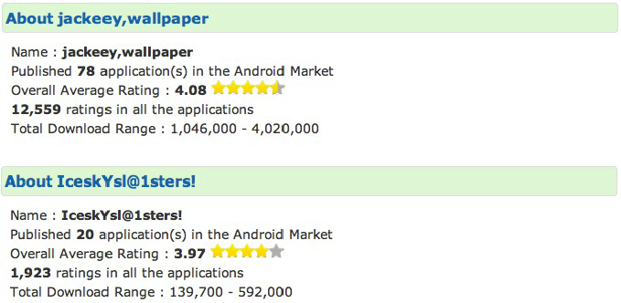
Attack success
Recall that the applications explicitly ask user for suspicious permissions.
Together those applications are estimated to have between 1.1 and 4.6 million downloads.
www.androlib.com

Slide 76
Conclusions – iPhone vs Android
App Store verification vs. user permission granting:
  They are both very much exposed to a less-than-sophisticated attacker.
    There are known “weaknesses” not attended by these mechanisms, easily exploitable.
  The only advantage an app store truly has is lack of developer anonymity.
    People can fake/steal documents as well.
    People can use stolen accounts.
  Wouldn’t hurt to use both… (and Microsoft does!)
  Both aren’t quite enough, or at least… this is what we would have expected…

Slide 77
Conclusions – iPhone vs Android (Cont.)
Application isolation vs. IPC support.
  Ultimately, Android’s ICC mechanism is a much desired feature.
  It enables modularity that iPhone applications simply don’t have.
    Launch Google Maps when stumbling upon a location URI.
    Efficiency & reuse – one application can use another’s service instead of implementing it all over again.
    Using data from multiple content providers.
    …
  Challenge: How to make it safe?

Slide 78
Summary
Phone security is an important evolving front.
  Phones contain extremely sensitive data.
  Basic problems aren’t yet completely resolved, like software updates and legal data ownership issues.
3rd side application security is an important part of protecting our phone.
  Their numbers continue to grow rapidly.
Vendors of the most popular platforms adopt very different approaches in dealing with this challenge. Lots of work yet to be done on the matter.

Slide 79
Application security in a world of sensitive capabilities
Part II

Slide 80
Order of Business
Introduction – world of sensitive capabilities
Permissions Today
Permissions of tomorrow (?)
  Information Flow Control
  Reduced Permission Granularity
Information Flow Control – current efforts in applying it.
IPC
Declassification
Summary

Slide 81
Assumptions
Application operates in an environment which contains sensitive information (e.g. contacts) and sensitive operations (e.g. send SMS, waste money).
A “user” wants to limit the operations an application can perform, so that it can operate without the ability to harm him.
  User can be an app-store verifier or an end-user.
No IPC/IAC (will be relaxed later).

Slide 82
Some (Natural) Definitions
Capability – the ability of an application to do something or access some resource. Three types of capabilities:
  Not the capability from previous lessons!
  Information sinks
    Output channels
    Can be very dangerously used (delete all contacts, send SMS, waste battery, waste money)
  Information Sources
    Input channels
    Can contain sensitive information
Permission – permission granted by the user to exercise certain capabilities in a certain manner.

Slide 83
Permissions Today
Permission granted by the user to exercise a certain capability ies in a certain manner.
Design:
  User is prompted to “permit” exercising a capability for an application.
    For example, in Android the capabilities accessing location, camera, record audio, internet, send/receive sms, sms database, contacts database, etc… all demand user permission.
  Phones are built to block non permitted access.
But… why would the user even care?

Slide 84
Permissions Today (cont.)
  If the capability is an information sink, it is obvious why the user would want to be prompted for approval to exercise it.
    Remember using sinks is dangerous.
  But why should the user care if an application can access your photo gallery or location?
    He shouldn’t, if the application doesn’t actually do anything bad with his information…
  Definition: Secrecy is the assurance that information from a source does not leak to a sink without user’s approval.

Slide 85
Integrity
The user would like to be prompted for permission to use a sink.
But he would also want to be warned about, e.g., the possible attackers of this application and their ability to exercise this operation.
If application A can send SMS, and it receives input from app B which cannot, B might still be able to send it through A.
Definition: Integrity is the assurance that information flowing to sinks comes from trusted sources.
We will leave this issue for later.

Slide 86
Permissions of tomorrow (?) requirement #1: Information Flow Control
“Permission to send location data by SMS.”
“Permission to send application logs to the internet.”
User will still be interested in non-flow permissions to sinks (“Permission to send SMS”).
It is possible app-store verifiers are already denying application because of “bad flows”.

Slide 87
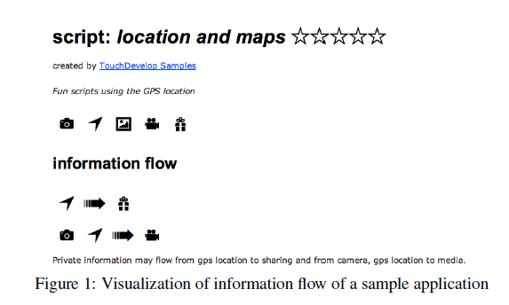
UI might look something like this:
Xiao Tillmann Fahndrich Halleux Moskai 2011 --- Transparent Privacy Control via Static Information Flow Analysis

Slide 88
Permissions of Tomorrow Requirement #2: Finer Capability Granularity
Capability granularity is often too coarse. We would like user to approve much more informative permissions:
Permission to send location data by SMS by SMS, if the user has approved it.
Permission to send application logs to the internet the developer’s e-mail address.

Slide 89
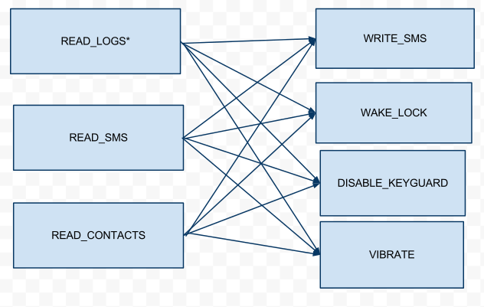
SMSPopup – An Android Application
Currently, the user has to approve these information flows at install-time:

Slide 90
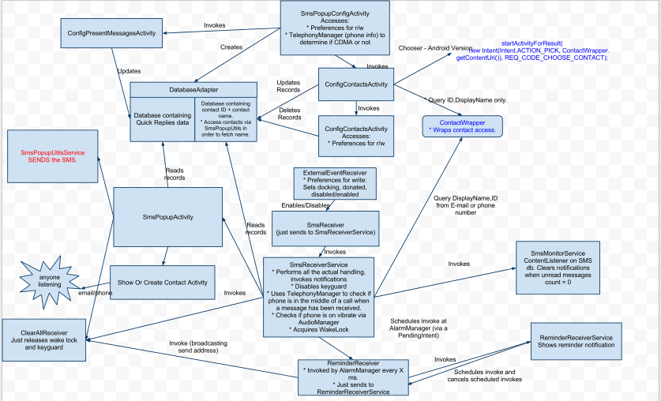
SMSPopup (Cont.) - internals

Slide 91
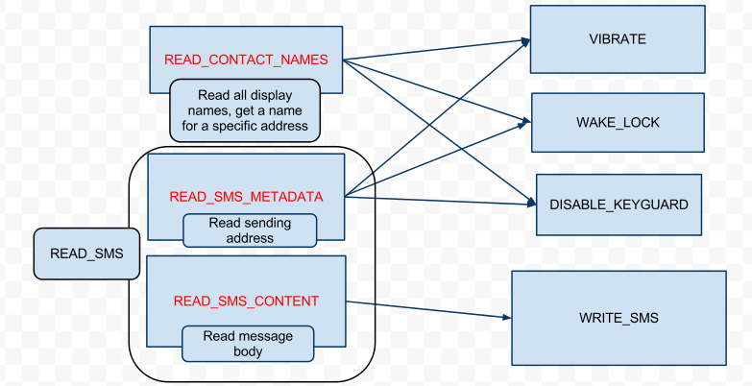
SMSPopup (Cont.)
By manually examining the application, we have identified the only de-facto flows are (or should be):
* The permission “Read Logs” is never even used

Slide 92
Information Flow Control Characteristics
For user-granted-permissions, the user might be prompted at install-time or run-time (upon capability exercise) to allow/deny flows.
The developer can explicitly declare the information flows in his application or not.
In any case, what the user knows about the flows must be verified or enforced (nobody can trust the developer, not even he himself).

Slide 93
Information Flow Control - Enforcement Mechanisms
Today, it is possible that enforcement of IFC is done by app-store verifiers.
Developer does not explicitly declare (and could be unaware of) flows inside his own application.
→Methodology: Identify all information flows inside an application before it reaches the end-user (using designated tools), then it’s easy (for the verifier/user) to approve/deny them.
  “Pre-installation identification”

Slide 94
Pre-installation identification
Researchers have proposed several methods to identify flows in Open Market applications for Android
Could be similar to the tools which Apple uses for App-store verification

Slide 95
Pre-installation identification (Cont.)
Static Analysis of source code:
  Identifying capability exercising and classify to source/sink.
    Not necessarily easy
  Then identify all flows from sources to sinks.
    Necessarily not easy
  Very unsound (lots of false alarms)
Dynamic Analysis of application:
  Instrument permission-checks in OS code, then:
    Fuzz Application UI
    Manually invoke use-cases
  Very incomplete (lots of flows missed)

Slide 96
Pre-installation identification (Cont.)
None of the methods can find 100% of flows (dangerous to rely on).
All of them require manual verification of identified flows (costs).

Slide 97
Information Flow Control - Enforcement Mechanisms (cont.)
Pre-installation identification proposes decent means for a developer or a verifier to identify information flows inside an application, but currently fails as an enforcement mechanism.
Assume we want to enforce the (permitted) identified flows at runtime.
  Makes things more complex for developer
  Runtime failures
  How do we do it?
    “Run-time enforcement”

Slide 98
Taint Enforcement
TaintDroid: Android Taint Analysis.
  Does not cover implicit flows.
  Processor performance hit of ~14%.
  Notifies user of tainted (sensitive) data leaving the device.
AppFence: IFC over TaintDroid.
  Instead of notify, block.

Slide 99
Inter-Application-Communication
Hard to know what happens with information when we assume it remains inside one application. What happens when information can cross application boundaries?
WP/iOS just prevent this.
  But communication is still possible through shared resources such as internet access.
Android heavily relies on IPC, provides an impressive API for IPC between 3rd party applications.

Slide 100
Inter-Application-Communication (Cont.)
The device is even more exposed – all it takes for your location to leak is the cooperation of two applications, each with no ability to leak it (e.g. one has access to your contacts, one to the internet).
Easily accomplished: a lot of applications use Ad SDKs from the same developer…
In this case, the user can not be expected to have any idea the flow is even possible.

Slide 101
Back to Capability Granularity
Remember WP Launchers and Choosers.
Consider an application which needs internet access only to send the developer its logs (by e-mail).
Many other examples... (e.g. SMSPopup)
A trusted application can expose to other applications a smaller interface for a resource than it has itself.
  We call this a “declassifier”.

Slide 102
Android Declassifiers
In Android, applications can define their own permissions (or: declassified sources).
How to make declassifiers trusted?
  Open source
  Small code
  Strict standards
  Peer review
Currently this feature of Android development is not utilized.

Slide 103
Example – Hiding Content Provider Columns
public Cursor query(Uri uri, String[] projection, String selection,
String[] selectionArgs, String sortOrder) {
// Completely ignore any arguments, return all declassified data.
ContentResolver contentResolver = getContext().getContentResolver();
Cursor cursor =
contentResolver.query(
getContentUri(),
getBasePeopleProjection(),
null,
null,
null);
return cursor;
}

Slide 104
Other Examples
COUNT_PACKETS instead of FULL_INTERNET_ACCESS
SEND_MAIL_TO_<X>
URL_<X>_INTERNET_ACCESS – only communicate over SSL with this URL.
SEND_KNOWN_MAIL – send mail only after user has seen it.
  Can easily be bypassed.
  Solution?

Slide 105
Summary
Applying information flow control is a difficult task, not proven to be possible as defined here
  Future platforms will probably get closer than those which exist today
Reducing capability granularity, on the other hand, is easier, and possible even today
  The real challenge is UI (lots of permission types → user effort)

