Slide 1
Information Security – Theory vs. Reality 0368-4474-01, Winter 2011 Lecture 10: Trusted Computing Architecture
Eran Tromer
Slides credit: Dan Boneh, Stanford course CS155

Slide 2
Background
TCG consortium. Founded in 1999 as TCPA.
Main players (promotors): (>200 members) AMD, HP, IBM, Infineon, Intel, Lenovo, Microsoft, Sun
Goals:
Hardware protected (encrypted) storage:
Only “authorized” software can decrypt data
e.g.: protecting key for decrypting file system
Secure boot: method to “authorize” software
Attestation: Prove to remote server what software is running on my machine.

Slide 3
Secure boot
History of BIOS/EFI malware:
CIH (1998): CIH virus corrupts system BIOS
Heasman (2007):
System Management Mode (SMM) “rootkit” via EFI
Sacco, Ortega (2009): infect BIOS LZH decompressor
CoreBOOT: generic BIOS flashing tool
Main point: BIOS runs before any defenses (e.g. antivirus)
Proposed defense: lock system configuration (BIOS + OS)
Today: TCG approach
Notes:
SMM: runs privileged code with no interrupts, not even from OS

Slide 4
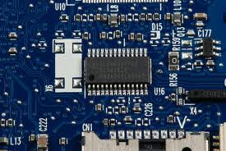
TCG: changes to PC
Extra hardware: TPM
Trusted Platform Module (TPM) chip
Single 33MhZ clock.
TPM Chip vendors: (~.3$)
Atmel, Infineon, National, STMicro
Intel D875GRH motherboard
Software changes:
BIOS, EFI (UEFI)
OS and Apps
Notes:
7$ for TPM from National Semiconductors (per 1000 units)

Slide 5
TPMs in the real world
TPMs widely available on laptops, desktops and some servers
Software using TPMs:
File/disk encryption: BitLocker, IBM, HP, Softex
Attestation for enterprise login: Cognizance, Wave
Client-side single sign on: IBM, Utimaco, Wave
Notes:
This stuff is real and getting deployed

Slide 6
TPM 101
What the TPM does
How to use it

Slide 7
Components on TPM chip
Non Volatile Storage (> 1280 bytes)
Other Junk
PCR Registers
(≥16 registers)
LPC bus
I/O
API calls
Crypto Engine:
RSA, SHA-1, HMAC, RNG
RSA: 1024, 2048 bit modulus
SHA-1: Outputs 20 byte digest

Slide 8
Non-volatile storage
1. Endorsement Key (EK) (2048-bit RSA)
Created at manufacturing time. Cannot be changed.
Used for “attestation” (described later)
2. Storage Root Key (SRK) (2048-bit RSA)
Used for implementing encrypted storage
Created after running
TPM_TakeOwnership( OwnerPassword, … )
Can be cleared later with TPM_ForceClear from BIOS
3. OwnerPassword (160 bits) and persistent flags
Private EK, SRK, and OwnerPwd never leave the TPM
Notes:
TPM_ForceClear requires “proof of presence,” namely holding down the Fn key

Slide 9
PCR: the heart of the matter
PCR: Platform Configuration Registers
Lots of PCR registers on chip (at least 16)
Register contents: 20-byte SHA-1 digest (+junk)
Updating PCR #n :
TPM_Extend(n,D): PCR[n] ← SHA-1 ( PCR[n] || D )
TPM_PcrRead(n): returns value(PCR(n))
PCRs initialized to default value (e.g. 0) at boot time
TPM can be told to restore PCR values in NVRAM via
TPM_SaveState and TPM_Startup(ST_STATE)
for system suspend/resume
Notes:
TPM_SaveState stores PCR values in NV-RAM

Slide 10
Using PCRs: the TCG boot process
BIOS boot block executes
Calls TPM_Startup (ST_CLEAR) to initialize PCRs to 0
Calls PCR_Extend( n, <BIOS code> )
Then loads and runs BIOS post boot code
BIOS executes:
Calls PCR_Extend( n, <MBR code> )
Then runs MBR (master boot record), e.g. GRUB.
MBR executes:
Calls PCR_Extend( n, <OS loader code, config> )
Then runs OS loader
… and so on
Notes:
0. During boot TPM receives a TPM_Init signal from LPC bus
1. TMP_Startup: does one of three things: (1) deactivates TPM, (2) resets PCRs, or (3) restores PCR values from data created with TPM_SaveState --- used for resume
2. TPM_Startup can only be called once after power-up (sets postInitialise flag to True)
3. Note: MBR is GRUB Stage 1

Slide 11
In a diagram
Hardware
BIOS
boot
block
OS
loader
BIOS
OS
Application
Root of trust in integrity measurement
measuring
TPM
Extend PCR
Root of trust in integrity reporting
After boot, PCRs contain hash chain of booted software
Collision resistance of SHA1 (?) ensures commitment
Notes:
Single PCR can identify entire platform

Slide 12
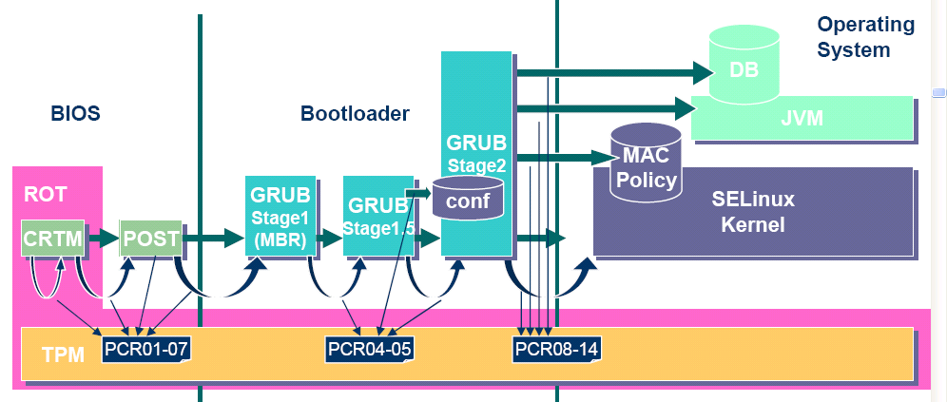
Example: Trusted GRUB (IBM’05)
What PCR # to use and what to measure specified in GRUB config file

Slide 13
Using PCR values after boot
Application 1: encrypted (a.k.a sealed) storage.
Step 1: TPM_TakeOwnership( OwnerPassword, … )
Creates 2048-bit RSA Storage Root Key (SRK) on TPM
Cannot run TPM_TakeOwnership again without OwnerPwd:
Ownership Enabled Flag ← False
Done once by IT department or laptop owner.
(optional) Step 2: TPM_CreateWrapKey / TPM_LoadKey
Create more RSA keys on TPM protected by SRK
Each key identified by 32-bit keyhandle
Notes:
OwnerPassword can later be used to change owner and remove SRK
SRK key handle ID is 0x40000000

Slide 14
Protected Storage
Main Step: Encrypt data using RSA key on TPM
TPM_Seal (some) Arguments:
keyhandle: which TPM key to encrypt with
KeyAuth: Password for using key `keyhandle’
PcrValues: PCRs to embed in encrypted blob
data block: at most 256 bytes (2048 bits)
Used to encrypt symmetric key (e.g. AES)
Returns encrypted blob.
Main point: blob can only be decrypted with TPM_Unseal when PCR-reg-vals = PCR-vals in blob.
TPM_Unseal will fail othrwise
Notes:
TPM_Seal: allows to specify arbitrary PCR values for unseal.

Slide 15
Protected Storage
Embedding PCR values in blob ensures that only certain apps can decrypt data.
e.g.: Messing with MBR or OS kernel will change PCR values.

Slide 16
Sealed storage: applications
Lock software on machine:
OS and apps sealed with MBR’s PCR.
Any changes to MBR (to load other OS) will prevent locked software from loading.
Prevents tampering and reverse engineering
Web server: seal server’s SSL private key
Goal: only unmodified Apache can access SSL key
Problem: updates to Apache or Apache config
General problem with software patches:
Patch process must re-seal all blobs with new PCRs
Notes:
Reverse engineering requires messing with BIOS boot block

Slide 17
A cloud application [JPBM’10]
cloud
servers
Client
VM
sealed
to VMM
VMM
TPM
VMM
TPM
Client seals VM to VMM measurement
VM code and data is encrypted
Can only be decrypted on valid cloud server
Cloud operator cannot easily access data

Slide 18
Security?
Can attacker disable TPM until after boot, then extend PCRs with whatever he wants?
Root of trust: BIOS boot block
Defeated with one byte change to boot block [K’07]
Resetting TPM after boot (by sending TPM_Init on LPC bus) allows arbitrary values to be loaded onto PCR.
Other problems: role-back attack on encrypted blobs
e.g. undo security patches without being noticed.
Can be mitigated using Data Integrity Regs (DIR)
Need OwnerPassword to write DIR
Notes:
K’07: Kauer, Usenix Security 2007.
Need owner password to write to DIR. Anyone can read DIR. Stored in NV RAM.

Slide 19
Better root of trust
DRTM – Dynamic Root of Trust Measurement
AMD: skinit Intel: senter
Atomically does:
Reset CPU. Reset PCR 17 to 0.
Load given Secure Loader (SL) code into I-cache
Extend PCR 17 with SL
Jump to SL
BIOS boot loader is no longer root of trust
Avoids TPM_Init attack: TPM_Init sets PCR 17 to -1

Slide 20
BitLocker drive encryption
tpm.msc: utility to manage TPM (e.g TakeOwnership)
Auto generates 160-bit OwnerPassword
Stored on TPM and in file computer_name.tpm
Volume Master Key (VMK) encrypts disk volume key
VMK is sealed (encrypted) under TPM SRK using
BIOS, extensions, and optional ROM (PCR 0 and 2)
Master boot record (MBR) (PCR 4)
NTFS Boot Sector and block (PCR 8 and 9),
NTFS Boot Manager (PCR 10), and
BitLocker Access Control (PCR 11)
Notes:
Configurable PCR policy: user can choose what PCRs to use. The PCRs described above at the default policy.

Slide 21
BitLocker
Many options for VMK recovery
Disk, USB, paper (all encrypted with password)
Recovery needed after legitimate system change:
Moving disk to a new computer
Replacing system board containing TPM
Clearing TPM
At system boot (before OS boot)
Optional: BIOS requests PIN or USB key from user
TPM unseals VMK, if PCR and PIN are correct
TPM defends against dictionary attack on PIN
Notes:
Dictionary attack mitigation by locking up or slowing down response after several failures.

Slide 22
TPM Counters
TPM must support at least four hardware counters
Increment rate: every 5 seconds for 7 years.
Applications:
Provide time stamps on blobs.
Supports “music will pay for 30 days” policy.

Slide 23
Attestation

Slide 24
Attestation: what it does
Goal: prove to remote party what software is running on my machine.
Good applications:
Bank allows money transfer only if customer’s machine runs “up-to-date” OS patches.
Enterprise allows laptop to connect to its network only if laptop runs “authorized” software
Quake players can join a Quake network only if their Quake client is unmodified.
DRM:
MusicStore sells content for authorized players only.

Slide 25
Attestation: how it works
Recall: EK private key on TPM.
Cert for EK public-key issued by TPM vendor.
Step 1: Create Attestation Identity Key (AIK)
Details not important here
AIK Private key known only to TPM
AIK public cert issued only if EK cert is valid
Notes:
TPM can store multiple AIKs (for multiple identities)

Slide 26
Attestation: how it works
Step 2: sign PCR values (after boot)
Call TPM_Quote (some) Arguments:
keyhandle: which AIK key to sign with
KeyAuth: Password for using key `keyhandle’
PCR List: Which PCRs to sign.
Challenge: 20-byte challenge from remote server
Prevents replay of old signatures.
Userdata: additional data to include in sig.
Returns signed data and signature.
Notes:
TPM_Quote actually doesn’t take usedata argument. Instead one could do chal = Hash(chal,user-data)

Slide 27
Attestation: how it (should) work
Attestation Request (20-byte challenge)
Generate pub/priv key pair
TPM_Quote(AIK, PcrList, chal, pub-key)
Obtain cert
App
Validate:
Cert issuer,
PCR vals in cert
(SSL) Key Exchange using Cert
OS
Communicate with app
using SSL tunnel
TPM
PC
Remote Server
Attestation must include key-exchange
App must be isolated from rest of system
Notes:
Focus on interactive applications such as Quake and network access control.
For non interactive applications (e.g. music distribution) there is no need for an SSL key exchange since pub-key is quoted.

Slide 28
Using Attestation

Slide 29
Attesting to VMs: Terra [SOSP’03]
TVMM Provides isolation between attested applications
application: secure login into a corporate network

Slide 30
Nexus OS (Sirer et al. ’06)
Problem: attesting to hashed application/kernel code
Too many possible software configurations
Better approach: attesting to properties
Example: “application never writes to disk”
Supported in Nexus OS (Sierer et al. ’06)
General attestation statements:
“TPM says that it booted Nexus, Nexus says that it ran checker with hash X, checker says that IPD A has property P”
Notes:
IPD: Isolation Protection Domain

Slide 31
EFF: Owner Override
TCG attestation:
The good: enables user to prove to remote bank that machine is up-to-date
The bad: content owners can release decryption key only to machines running “authorized” software.
Stifles innovation in player design
EFF: allow users to inject chosen values into PCRs.
Enables users to conceal changes to their computing environment
Defeats malicious changes to computing platform

Slide 32
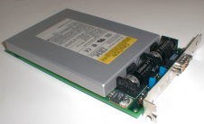
TCG Alternatives
IBM CryptoProcessor 4758: Supports all TCG functionality and more.
Tamper resistant 486 100MhZ PCI co-processor.
Programmable.
… but expensive ~ $2000
AEGIS System: Arbaugh, Farber, Smith ’97:
Secure boot with BIOS changes only.
Cannot support sealed storage.
Phoenix TrustConnector 2
SWATT: Seshadri et al., 2004
Attestation w/o extra hardware
Server must know precise HW configuration

Slide 33
Attestation: challenges

Slide 34
1. Attesting to Current State
Attestation only attests to what code was loaded.
Does not say whether running code has been compromised.
Problem: what if Quake vulnerability exploited after attestation took place?
Can we attest to the current state of a running system?
… or is there a better way?

Slide 35
2. Encrypted viruses
Suppose malicious music file exploits bug in Windows Media Player.
Music file is encrypted.
TCG prevents anyone from getting music file in the clear.
Can anti-virus companies block virus without ever seeing its code in the clear?

Slide 36
3. TPM Compromise
Suppose one TPM Endorsement Private Key is exposed
Destroys all attestation infrastructure:
Embed private EK in TPM emulator.
Now, can attest to anything without running it.
⇒ Certificate Revocation is critical for TCG Attestation.

Slide 37
4. Private attestation
Attestation should not reveal platform ID.
Recall Intel CPU-ID fiasco.
Private attestation:
Remote server can validate trustworthiness of attestation
… but cannot tell what machine it came from.
TCG Solutions:
Privacy CA: online trusted party
Group sigs: privacy without trusted infrastructure

