Slide 1
Characterizing Propositional Proofs as Non-Commutative Formulas
Iddo Tzameret Royal Holloway, University of London
Based on Joint work Fu Li (Texas Austin) and Zhengyu Wang (Harvard)

Slide 2
Sketch

Slide 3
Lower bounds on non-commutative formulas for certain polynomials
Lower bounds on Frege proof sizes

Slide 4
Frege Proofs

Slide 5
Frege Proofs
Any standard textbook proof system for propositional tautologies
Start from axioms and derive, using derivation rules/axioms, new tautologies, all written as Boolean formulas:
$A→(B→A)$
$$\left(¬A→¬B\right)→\left(\left(¬A→B\right)→A\right)$$
$$\left(A→\left(B→C\right)\right)→\left(\left(A→B\right)→\left(A→C\right)\right)$$
If $A$ and $A→B$ then $B$

Slide 6
Frege Proofs
$A→(B→A)$
$$\left(¬A→¬B\right)→\left(\left(¬A→B\right)→A\right)$$
$$\left(A→\left(B→C\right)\right)→\left(\left(A→B\right)→\left(A→C\right)\right)$$
If $A$ and $A→B$ then $B$
$$\left[x→(\left(x→x\right)→x)\right]→\left(x→(x→x\right))→\left(x→x\right) x→((x→x)→x)$$
$\left(x→\left(x→x\right)\right)→(x→x)$ $x→(x→x)$
$x→x$

Slide 7
Frege Proofs
Frege system is complete & sound
$¬\left(¬x→y\right)≡x∧y$
Assume we know $x∧y$ and we wish to “commute it”: $y∧x$
We need to explicitly derive it.
By completeness there’s a constant size proof of this.

Slide 8
Frege: Formal Definition
Finite many rules:
From $A_{1}\left(\overline{x}\right),…,A_{k}\left(\overline{x}\right)$ derive $A_{0}\left(\overline{x}\right)$
For $k$ a constant ≥ 0, and $A_{i}^{′}s\left(\overline{x}\right)$ are Boolean formulas ($k=0$is an “axiom”)
The rules are closed under substitution of formulas in the $x_{i}^{′}s$
A Frege proof of F: DAG whose sink is F, and each node is a formula derived from its incoming nodes by a rule, or is an axiom
We require: strong completeness: if T logically implies F, then there’s a Frege proof of F from axioms T

Slide 9
Size of Proofs
Size of proof = number of symbols it takes to write down the proof (= total number of logical gates + variables in proof)
Example: size = 41
$$\left[x→(\left(x→x\right)→x)\right]→\left(x→(x→x\right))→\left(x→x\right) x→((x→x)→x)$$
$\left(x→\left(x→x\right)\right)→(x→x)$ $x→(x→x)$
$x→x$

Slide 10
Can we prove super-polynomial size lower bounds on Frege proofs?
Major open question: prove that there is a family { f₁, f₂, f₃, …} of tautologies such that for no polynomial p(∙), the minimal propositional-calculus proof size of f_{n} is at most p(|f_{n}|)

Slide 11
Non-Commutative Formulas

Slide 12
Fix a field 𝔽 (e.g., ℚ).
Non-commutative functions: e.g., compute a function of matrices over 𝔽
f (X,Y):=X•Y – 2Y•X
This is a non-commutative formula (tree)
Size = number of nodes
output
+
Depth can be assumed
O(log n), for n number of variables
(By our variant of Hrubes & Wigderson’14)
˟
˟
-2
˟
X
Y
Y
X

Slide 13
Non-Commutative Formulas Lower Bounds
Nisan ‘91: determinant and
permanent require
non-commutative formulas
of 2^{Ω(n)} size
Proof: We’ve seen before (partial derivatives method)
output
+
˟
˟
-2
˟
X
Y
Y
X
Notes:
1. Parallel computation

Slide 14
Main Theorem

Slide 15
Thm [Li, T., Wang’15]: Exists a natural map between tautological formulas 𝑇 to non-commutative polynomials 𝑝, such that:
And conversely, when T is a DNF:
𝑇 has a polynomial-size Frege
𝑝 has a polynomial-size non-commutative formula
𝑝 has a polynomial-size non-commutative formula (over GF(2))
𝑇 has a quasi-polynomial size Frege (n^{O(log n)})

Slide 16
The Argument: We shall characterize a proof as a single non-commutative formula by introducing a non-commutative version of the IPS [following the (commutative) IPS of Grochow-Pitassi’14]

Slide 17
The Non-Commutative Ideal Proof System

Slide 18
Map between tautologies T and non-commutative polynomials p: First, a CNF’s x₁ ⋁ ¬ x₂ , ¬ x₂ ⋁ ¬ x₁ , x₂ (1) as non-commutative polynomial equations: (1-x₁) x₂ = 0 , x₂ x₁ = 0 , 1-x₂ = 0 (2) So (1) is satisfied by a given 0-1 assignment iff (2) is.
Non-commutative Ideal Proof System (IPS):
Let be a system of unsatisfiable non-commutative polynomial equations and assume the following are part of the F_{i}’s ($\overline{x}=$ {x₁,…, x_{n}}) :
A non-commutative IPS refutation of the F_{i}’s is a non-commutative polynomial such that:

Slide 19
Why do we need the commutator axioms $x_{i}x_{j}−x_{j}x_{i}$ ?
Answer: for completeness. Without commutators can’t prove non-commutative formulas equal 1 for 0/1 assignments (e.g., can’t refute $x_{i}x_{j}−x_{j}x_{i}+1=0$)

Slide 20
Example: x₁ ⋁ ¬ x₂ , ¬ x₂ ⋁ ¬ x₁ , x₂ (1)
Transform to non-commutative polynomials:
(1-x₁) x₂ = 0 , x₂ x₁ = 0 , 1-x₂ = 0 (2)
So (1) is satisfied by a given 0-1 assignment iff (2) is.
Non-commutative IPS refutation:
(1-x₁) x₂ + x₂ x₁ + 1-x₂ + x₁x₂ - x₂ x₁ =
x₂ - x₁x₂ + x₂ x₁ + 1-x₂ + x₁x₂ - x₂ x₁ = 1
So, non-commutative IPS refutation is: y₁+y₂+y₃+y₄
(1-x₁) x₂ + x₂ x₁ + 1-x₂ + x₁x₂ - x₂ x₁
y₁ + y₂ + y₃ + y₄
From (Raz and Shpilka ‘05) PIT for non-coomutative formulas: non-commutative IPS is polynomially chekable.

Slide 21
Non-Commutative IPS Simulates Frege

Slide 22
Non-commutative IPS simulates Frege
Start with a Frege proof:
We use the following translation of Boolean formulas to arithmetic formulas:
We can translate the Frege proofs with this translation applied on every proof-line (with some additional rules, and proof-lines): this gives us an ”algebraic version of Frege’’.
But it’s easier to use algebraic inference rules instead of logical inference rules…
$A→(B→A)$ $\left(¬A→¬B\right)→\left(\left(¬A→B\right)→A\right)$
$\left(A→\left(B→C\right)\right)→\left(\left(A→B\right)→\left(A→C\right)\right)$If $A$ and $A→B$ then $B$

Slide 23
First Attempt for Algebraic Version of Frege:
x₁ ⋁ ¬ x₂ , ¬ x₂ ⋁ ¬ x₁ , x₂
Transform to polynomials:
(1-x₁) x₂ = 0 , x₂ x₁ = 0 , 1-x₂ = 0
And add Boolean axioms: x_{i}(1-x_{i}) = 0, for all i=1,…,n
Formulas in propositional proofs are syntactic terms
i.e., need to add rules for deriving two (syntactically) different formulas that compute the same polynomial:
Example of rewrite rule: G[t·s] → G[s·t]
(1-x₁) x₂ = 0
x₂ x₁ = 0
+
1-x₂ = 0
x₂ = 0
+
1 = 0

Slide 24
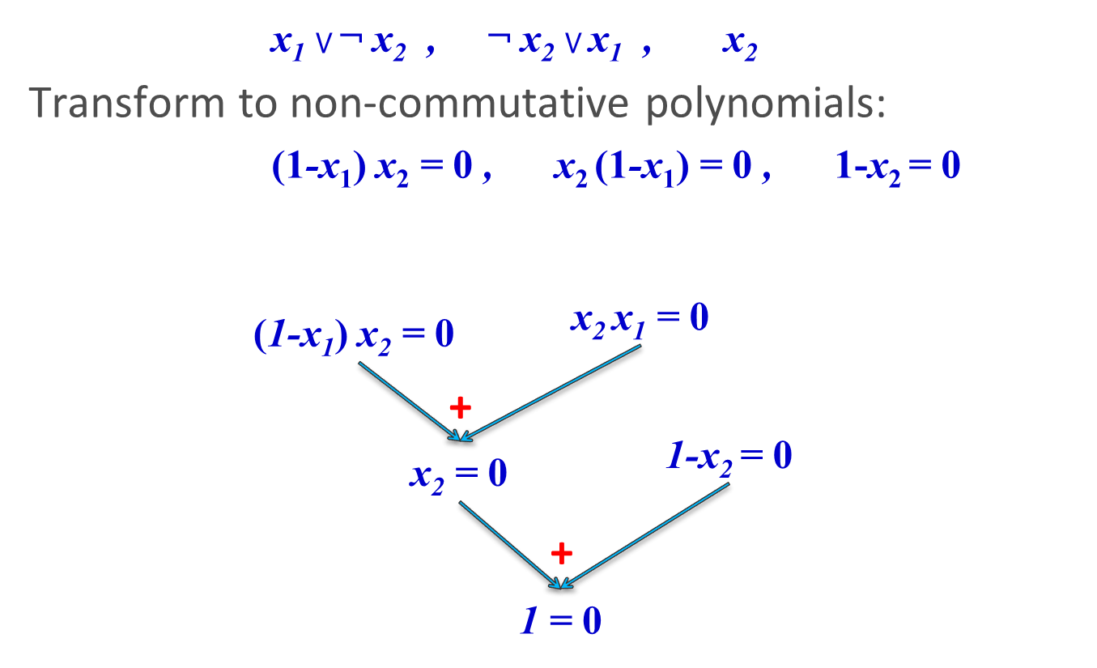
Polynomial Calculus (PC) over Formulas
[Grigoriev and Hirsch 2003]:
(1-x₁) x₂ = 0
x₂ x₁ = 0
+
(1-x₁) x₂ + x₂ x₁ = 0
rewrite
x₂ - x₁x₂ + x₂ x₁ = 0
rewrite
x₂ - x₁x₂+ x₁x₂ = 0
rewrite
x₂ + x₁x₂(-1+1) = 0
rewrite
1-x₂ = 0
x₂ + x₁x₂ •0 = 0
rewrite
x₂ = 0
+
1+x₂-x₂ = 0
Skipping some rules…
1 = 0

Slide 25
PC over Formulas: Formal Definition
Two rules:
Addition: From $f\left(\overline{x}\right)=0 and g\left(\overline{x}\right)=0$
derive $af\left(\overline{x}\right)+bg\left(\overline{x}\right)=0$,
for $f\left(\overline{x}\right), g(\overline{x})∈$𝔽[$\overline{x}$] and $a,b∈𝔽$.
Product: From $f\left(\overline{x}\right)=0$ derive $x_{i}f\left(\overline{x}\right)=0$, for any $i∈[n]$
Axioms: $x_{i}^{2}−x_{i}=0$, for any $i∈[n]$
Rewriting rules: $G\left[0∙f\right]↭G\left[0\right]$, $G\left[fg\right]↭G\left[gf\right]$
Associativity, distributivity, unit rule…
A PC over Formulas proof of F is a DAG whose sink is F, and each node is either an axiom or was derived from its incoming nodes by a rule, a rewrite rule or is an axiom

Slide 26
Converting the Proof DAG into a Tree
Thm (Krajicek ’95): Frege proof DAGs can be transformed into proof-trees with only a polynomial increase in size.

Slide 27
Small PC over formulas proof of G ➔ Small non-commutative IPS proof of tr(G)
Proof. By induction on proof length.
We construct the non-commutative formula based on the ``skeleton’’ of the (``arithmetized”) propositional proof.
Case 1: The product rule:
Original proof:
Simulation by induction hypothesis:
G = P(x₁,…,x_{n} ,F₁,…,F_{m} )
So we define P’:=x_{j} ∙P and we have:
P’(x₁,…,x_{n} ,0...0)=0 and P’(x₁,…,x_{n} ,F₁,…,F_{m})=x_{j}G
G
x_{j}∙G
x_{j}
⨯

Slide 28
Simulation Cont.
Case 2: The addition rule: similiar.
Case 3: Rewrite rules: don’t change the computed non-commutative polynomial, except for the commutativity rewrite rule. Nothing to simulate.
Case 4: Commutativity rewrite rule $G\left[f∙g\right]↭G\left[g∙f\right]$:
Simulation is done by using the commutator axioms.

Slide 29
2nd Direction of Simulation
𝑇 has a quasi-polynomial size Frege proof (n^{O(log n)})
𝑝 has a polynomial-size non-commutative formula (over GF(2))
The proof: Consists of many simulations.
Uses structural results in algebraic circuit complexity
A reflection principle for non-commutative IPS in propositional proofs:
A propositional proof of:
“(F has a non-commutative IPS-proof) ➔ F ”

Slide 30
Conclusions & Open Problems
Corollary: Every non-commutative polynomial identity (over GF(2)) of size s has a quasi-polynomial in s Frege proof (when considered as a Boolean tautology).
Open problem: prove lower bounds on non-commutative IPS?

Slide 31
Thank You !

