Slide 1
Predicting PBM binding from HT-SELEX data Workshop Project
Yaron Orenstein
22 October 2013

Slide 2
Outline
1. Some background again…
2. The project

Slide 3
1. Background
Slides with Ron Shamir and Chaim Linhart

Slide 4
Gene: from DNA to protein
DNA
Pre-mRNA
Mature mRNA
protein
transcription
splicing
translation

Slide 5
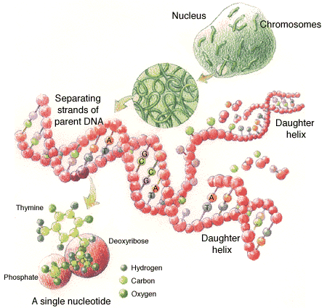
DNA
DNA: a “string” over the alphabet of 4 bases (nucleotides): { A, C, G, T }
Resides in chromosomes
Complementary strands: A-T ; C-G
Forward/sense strand: AACTTGCG
Reverse-complement/anti-sense strand: TTGAACGC
Directional: from 5’ to 3’:
(upstream) AACTTGCGATACTCCTA (downstream)
5’ end
3’ end

Slide 6
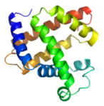
Gene structure (eukaryotes)
Promoter
DNA
Coding strand
Transcription start site (TSS)
Transcription (RNA polymerase)
Pre-mRNA
Exon
Intron
Exon
Splicing (spliceosome)
5’ UTR
3’ UTR
Mature mRNA
Start codon
Stop codon
Coding region
Translation (ribosome)
Protein

Slide 7
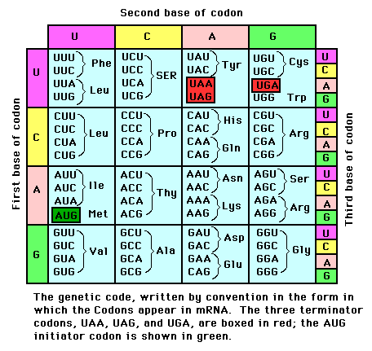
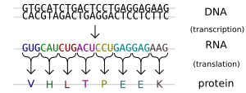
Translation
Codon - a triplet of bases, codes a specific amino acid (except the stop codons); many-to-1 relation
Stop codons - signal termination of the protein synthesis process
http://ntri.tamuk.edu/cell/ribosomes.html

Slide 8
Genome sequences
Many genomes have been sequences, including those of viruses, microbes, plants and animals.
Human:
23 pairs of chromosomes
3+ Gbps (bps = base pairs) , only ~3% are genes
~25,000 genes
Yeast:
16 chromosomes
20 Mbps
6,500 genes

Slide 9
Regulation of Expression
Each cell contains an identical copy of the whole genome - but utilizes only a subset of the genes to perform diverse, unique tasks
Most genes are highly regulated –
their expression is limited to specific tissues, developmental stages, physiological condition
Main regulatory mechanism – transcriptional regulation

Slide 10
Transcriptional regulation
Transcription is regulated primarily by transcription factors (TFs) – proteins that bind to DNA subsequences, called binding sites (BSs)
TFBSs are located mainly (not always!) in the gene’s promoter – the DNA sequence upstream the gene’s transcription start site (TSS)
BSs of a particular TF share a common pattern, or motif
Some TFs operate together – TF modules
TF
TF
5’
3’
BS
BS
Gene
TSS

Slide 11
TFBS motif models - strings
Consensus (“degenerate”) string:
A C
ACT
C G
T
gene 1
AACTGT
gene 2
CACTGT
gene 3
CACTCT
gene 4
CACTGT
gene 5
gene 6
gene 7
gene 8
AACTGT
gene 9
gene 10
List of k-mers (weighted or unweighted).

Slide 12
TFBS models - PWM
Position weight matrix (PWM): each position has weights for the 4 possible letters (A, C, G, T).
For example:
Logo format:
6 | 5 | 4 | 3 | 2 | 1
0 | 0.2 | 0.7 | 0 | 0.8 | 0.1 | A
0.6 | 0.4 | 0.1 | 0.5 | 0.1 | 0 | C
0.1 | 0.4 | 0.1 | 0.5 | 0 | 0 | G
0.3 | 0 | 0.1 | 0 | 0.1 | 0.9 | T

Slide 13
Protein Binding Microarrays Berger et al, Nat. Biotech 2006
13
Generate an array of double-stranded DNA with all possible k-mers
Detect TF binding to specific k-mers
Notes:
13

Slide 14
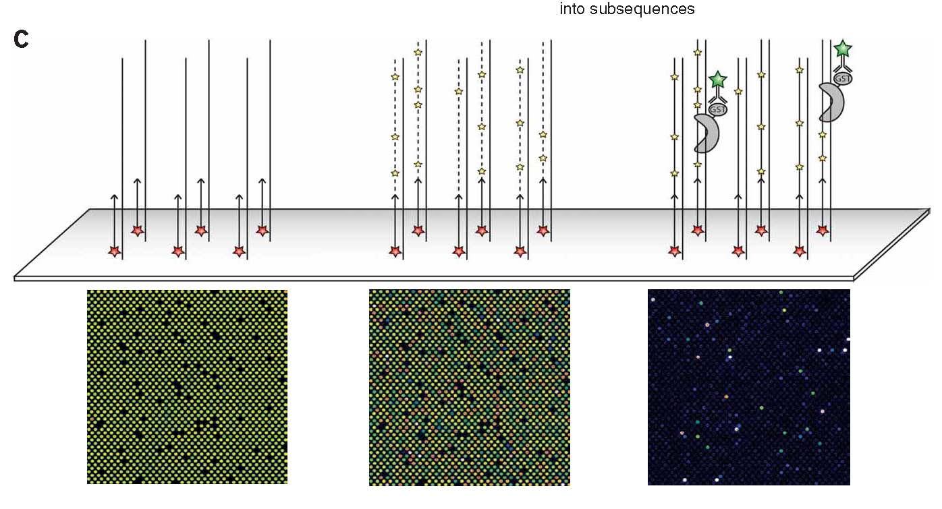
PBM (2)
14
Notes:
14

Slide 15
PBM - implementation
15
Use 60-mers (Agilent): 24nt constant primer + 36nt variable region
De Bruijn seq of all 10-mers (4¹⁰ long) split into 36nt long fragments with 9nt overlap
~40K probes
Notes:
15

Slide 16
High-throughput SELEX Zhao, Granas and Stormo, Plos Comp. Bio. 2009 Jolma et al, Genome Research 2010 Slattery et al, Cell 2011
Start with a pool of random oligos.
Repeat:
Let the protein bind to the oligos.
Filter out bound oligos.
Sequence them.
Amplify them and set as the new pool of oligos.
16
Notes:
16

Slide 17
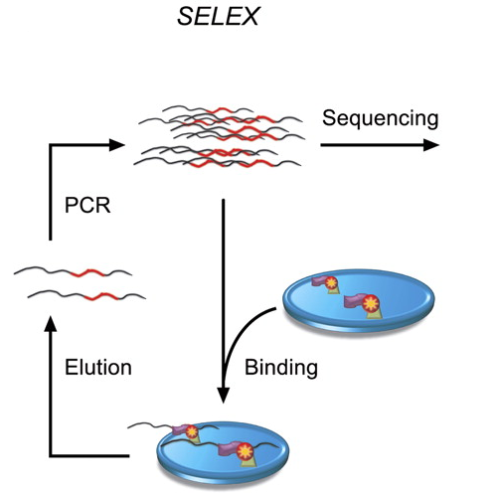
High-throughput SELEX

Slide 18
The computational challenge
Input: HT-SELEX data (4-6 sequence files) of one TF and a list of PBM probes (1 sequence file).
Goal: Rank PBM probes according to binding intensity.
Intuition: learning a binding model in one technology to predict binding in another.

Slide 19
The project

Slide 20
General goals
Research
- Learn about known solutions
- Trial and error with training data
Develop software from A-Z:
Design
Implementation (Optimization)
Execution & analysis of test data
A taste of bioinformatics
Have fun
Get credit…

Slide 21
The computational task
Given a set of HT-SELEX data of different TFs.
Learn a binding model for each TF and use it to rank PBM probes.
Main challenges:
Performance (time, memory)
Accuracy

Slide 22
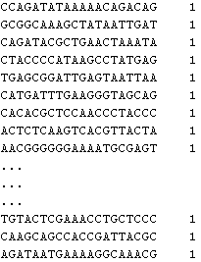
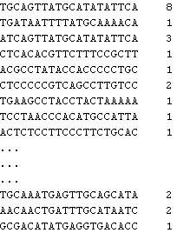
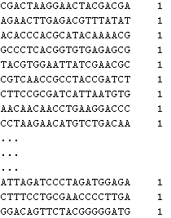
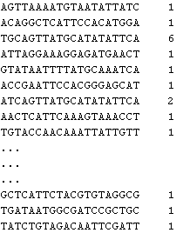
HT-SELEX Input
4-6 sequence files with hundred of thousands of lines, each containing oligo sequence and its number of occurrences.
<sequence 14/20/30/40 bp> \t <count> \n
Cycle 1
Cycle 3
Cycle 0
Cycle 2

Slide 23
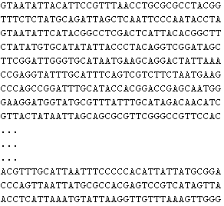
PBM Input
File with ~41K lines, each containing a probe sequence of length 36.
<sequence 36bp> \n
The training file will be sorted according to binding intensity.
The output is a file with the same sequences, only sorted.

Slide 24
Input schedule
You will be given:
Week 1: 50 training sets (HT-SELEX data + sorted PBM probes data).
Week 8: 50 test1 sets (HT-SELEX data + unsorted PBM file). You have to sort the PBM probes.
Week 13: 50 test2 sets (HT-SELEX data + unsorted PBM file). You have to sort the PBM probes.
Week 13: In the final project presentation, you will be given 12 online test sets and your software will be applied to it.

Slide 25
Output
A sorted PBM file –same sequences as in the input, only sorted.
A logo format of your model (i.e. displayed on the screen).
The file logo.zip contains a java package with the code that will easily display your motif.
bits = 2 - entropy

Slide 26
Ranking k-mers
One possible way to start: rank the k-mers in some way. Scores for example:
1. Frequency in some cycle.
2. Ratio: freq. in cycle i / freq. in cycle (i-1).
You can think of other scores that incorporate more information, aggregate cycles, correct for biases.
This is just an example. You can think of other ways to start.

Slide 27
Alignment procedure
Then, you can align the significant k-mers.
You may take into account the relative score.
Don’t forget about the reverse complement!
Example: Cebpb TF

Slide 28
Deciding the length of the motif
Another challenge is to decide the length of the motif.
Most binding site are 6-12 bp long.
You should consider the information each position contains and decide on the length accordingly.
Consider also the read coverage of the experiment.

Slide 29
The goal
To rank high the top 100 PBM probes in the PBM file (= positive probes). Return a file with all PBM probes ranked.
For a point in the ranked list we can define:
Precision = (# positives above the point) / (location of point)
Recall = (# positive above the points) / (# positives)

Slide 30
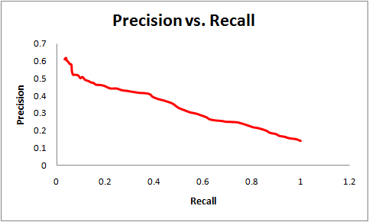
AUC of Precision-Recall
Precision = # positives above the point / location of point
Recall = # positive above the point / # positives
PR curve = move the threshold over the list, each time calculating new precision and recall (the points of the curve).
AUC = area under the curve.

Slide 31
Scoring PBM probes
Several scores are available, e.g. score each k-mer and take maximum/sum.
Scoring a k-mer according to a model:
PWM: multiply probabilities.
K-mers: assign the value accordingly.
You can suggest new scores and models.

Slide 32
Implementation
Java (Eclipse) ; Linux (Other languages are possible, but will not participate in bonus).
Input: the 1st argument is the PBM filename, and 4-6 filenames of SELEX files.
Output: 1) ranked PBM file; 2) model presented in logo format.
A package for motif logo will be supplied.
Time performance will be measured.
Reasonable documentation.
Separate packages for data-structures, scores, GUI, I/O, etc.

Slide 33
Submission
Printed design document.
Printed code – for comments and remarks.
Printed results document – for each test set the model in logo format.
50 ranked PBM files, e.g. TF_32.pbm (submitted by email) (for test1 and test2, separately).
Executable for the online test.

Slide 34
Grade
15% for the design
25% for the implementation (10% for modularity, clarity, documentation, f(r,k)*15% for efficiency)
20% for the final report and presentation
f(r,k)*50% for the accuracy of the test results
f(r,k)*15% for test 1
f(r,k)*20% for test 2
f(r,k)*15% for test 3
Where
r = group’s rank in test out of k groups (top rank r=k)
f(r,k) = 0.5+0.5*r/k
So a uniformly top ranking group can get 110, and uniformly least ranking can get 82.
Ties will be scored לבית הילל

Slide 35
Schedule
First progress report 19/11 (meetings)
Test1 10/12 (submission)
Design document 24/12 (submission)
Test2 + executable 14/1 (submission)
Final presentation 18/2 (meeting)
We shall meet with each group on the meetings dates – mark your calendars!
Schedule can be made earlier if you are ready.
You are always welcome to meet us. Contact us by email.

Slide 36
Design document
Due in week 10 (24/12).
3-5 pages (Word), Hebrew/English
Briefly describe main goal, input and output of program
Describe main data structures, algorithms, and scores.
Meet with me before submission.

Slide 37
References
HT-SELEX:
Zhao Y, Granas D and Stormo GD. Inferring binding energies from selected binding sites. PLoS Computational Biology. 2009;5(12):e1000590.
Jolma A, Kivioja T, Toivonen J, Cheng L, Wei GH, Enge M, Taipale M, Vaquerizas JM, Yan J, Sillanpaa MJ, Bonke M, Palin K, Talukder S, Hughes TR, Luscombe NM, Ukkonen E and Taipale J. Multiplexed massively parallel SELEX for characterization of human transcription factor binding specificities. Genome Research. 2010;20:861-873
Slattery M, Riley T, Liu P, Abe N, Gomez-Alcala P, Dror I, Zhou T, Rohs R, Honig B, Bussemaker HJ and Mann RS. Cofactor binding evokes differences in DNA binding specificity between Hox proteins. Cell. 2011;147:1270-1282.
PBM:
Berger MF, Philippakis AA, Quershi AM, He FS, EstepIII PW, Bulyk ML. Compact, universal DNA microarrays to comprehensively determine transcription-factor binding site specificities. Nature biotechnology. 2006;338:1429-1435.

Slide 38
Fin

