Slide 1
SPARCLE = SPArse ReCovery of Linear combinations of Expression
Presented by: Daniel Labenski
Seminar in Algorithmic Challenges in Analyzing Big Data in Biology and Medicine; Prof. Ron Shamir
Tel Aviv University

Slide 2
Outline
Introduction
The SPARCLE representation method
SPARCLE-based learning
Results
Discussion
Conclusions

Slide 3
Introduction

Slide 4
Introduction
Large-scale RNA expression measurements produce enormous amounts of data.
Many methods were developed for extracting insights regarding the interrelationships between genes.
We do not know yet the function of all genes.
Motivation:
Find functional associations between genes
Notes:
on a genome-wide scale

Slide 5
Introduction
Key idea:
Gene regulatory network is sparsely structured:
the expression of any gene is directly regulated by only a few other genes.
Look for a concise representation of genes that explain the differential phenomena in gene expression
For example, genes that regulate specific pathways would correlate linearly with their targets.
Notes:
Many known methods that have yielded meaningful biological insights in fact seek geometric or algebraic features of these vectors.

Slide 6
SPARCLE
The SPARCLE representation method

Slide 7
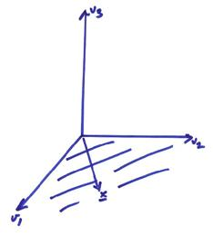
Sparse Representation Of Expression
The Goal:
Discover linear dependencies within groups of expression profiles
SPARCLE’s Ambition:
For each gene $b$ in the genome:
find the smallest number of profiles, whose linear span contains the expression profile of $b$.

Slide 8
Sparse Representation Of Expression
Formally,
$$min{\left\|x\right\|}_{0 }$$
$$s.t. Ax=b$$
where
$A∈ ℝ^{d×n}$ - matrix of RNA expression levels of $n$ genes measured in the$d$ experiments.
$b∈ ℝ^{d}$ - vector of expression levels of the objective gene in $d$ experiments.
$x∈ ℝ^{n}$ - vector of the $n$ coefficients corresponding to the $n$ genes
$$(P_{0})$$
Notes:
n is the entire genome excluding the objective gene

Slide 9
Linear Algebra Reminder
Objective gene
Coefficients‘ variables
Other genes in the genome
Notes:
systems of linear equations with fewer equations than
unknowns.

Slide 10
SPARCLE illustration

Slide 11
Sparse Representation Of Expression
We wish to find:
$$min{\left\|x\right\|}_{0 }$$
$$s.t. Ax=b$$
But this problem is NP-hard!
Fortunately, we can get a good approximation by:
$$min{\left\|x\right\|}_{1 }$$
$$s.t. Ax=b$$
Now it is efficiently solvable by linear programing.
$$(P_{0})$$
$$(P_{1})$$

Slide 12
Sparse Representation Of Expression
The biological data is very noisy,
So we use a relaxed form of P₁:
$$min{\left\|x\right\|}_{1 }$$
$$s.t. {\left\|Ax−b\right\|}_{1}≤ ε$$
$$(P_{ε})$$

Slide 13
Robustness test of expression profile representations
Each dataset was divided into two sets of experiments:
Matrix A for unsupervised learning of sparse representations
Matrix A’ for a cross-validation test of robustness
$$for each column \left(gene\right)Ai in A:$$
$b = Ai$
$P_{ε} is solved using a linear programing solver$($ε$ was set to 0.5)
$x^{∗}− solution of the optimization$
$b’ =A^{′}i$
$ε′{=\left\|A^{′}x^{∗}−b′\right\|}_{1}$

Slide 14
Robustness test of expression profile representations
$ε′$ is the degree of approximation on the unseen data
We asses the quality of $ε^{′}$ by two tests:
Random support set of the same size
Choosing a random support set of the size of ||x*||₀
Solving $\min_{x}{\left\|Ax−b\right\|}_{1} s.t. x$ is all zeros but at the support’s coordinates
Finding $ε′$ as before (for x)
Repeating 10,000 times to estimate the background distribution of $ε′$
Finding P-value for $ε′$

Slide 15
Robustness test of expression profile representations
Reduce A to contain only $d$ random genes
$\hat{A}∈ ℝ^{d×d} is the reduced matrix$
Solve $min{\left\|x\right\|}_{1 } s.t. {\left\|\hat{A}x−b\right\|}_{1}≤0.5$
Finding $ε′$ as before (for x)
Repeating 1,000 times to estimate the background distribution of $ε′$
Finding P-value for $ε′$
$$(P_{\hat{A}})$$

Slide 16
SPARCLE-based learning

Slide 17
Prediction of Pairwise associations between genes
We want to use the results from the sparse reconstruction in order to reveal associated gene function
Represented by Gene Ontology annotations
Represented by PPI map
Step #1: run SPARCLE on the dataset
Step #2: for each pair of genes, create a feature vector from the sparse representations found by SPARCLE
Step #3: use the feature vectors to create a training model with AdaBoost.
Step #4: predict the relationships between genes.

Slide 18
Extraction of feature vectors
The following features were extracted:
Coefficient of each gene in the other’s SPARCLE representation.
The number of genes in the intersection of the genes’ support sets
The number of support sets containing both of the genes
The L₁ distance of each gene’s expression from the convex hull of the other genes’ vectors
The Euclidean distance of the expression profile each gene from the subspace spanned by the other’s supporting set.

Slide 19
Extraction of feature vectors
Support size for each gene
Number of appearances of each gene in the other supports of each genes (entire genome)
Average and Standard Deviation of features 1-7 over 20 perturbation runs of SPARCLE on the same data (25% genes were randomly removed)
Pearson’s correlation between the two genes expression profiles (normalized and unnormalized)
Mean, median and SD of Pearson’s correlation of each gene with the other genes in the genome

Slide 20
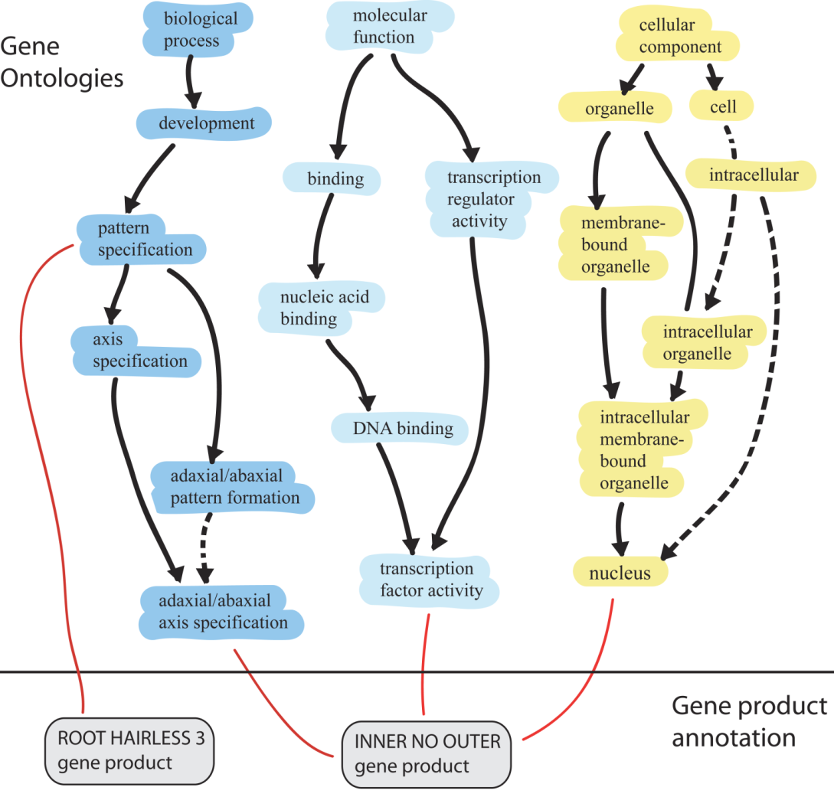
GO Annotations
Set of biological phrases (terms) which are applied to genes
GO is structured as 3 directed acyclic graphs
Deeper =>
higher resolution
(more specific annotation)
is_a
Part_of

Slide 21
GO Annotations
In order to compare between the genes’ GO annotations, we need to choose the resolution of interest
lower resolution depth and high resolution depth were selected.

Slide 22
AdaBoost (adaptive boosting)
A supervised Machine-Learning algorithm.
A general method for generating a strong classifier out of a set of weak classifiers.
It is an iterative algorithm.
During each round of training:
a new weak learner is added to the ensemble.
a weighting vector is adjusted to focus on examples that were misclassified in previous rounds.

Slide 23
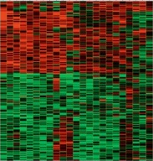
SPARCLE-based learning algorithm overview

Slide 24
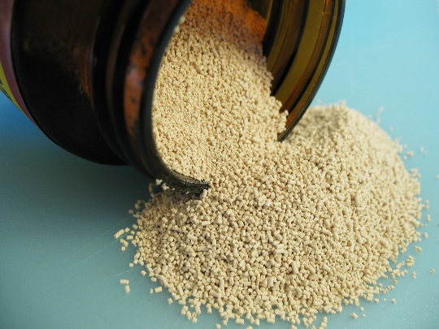
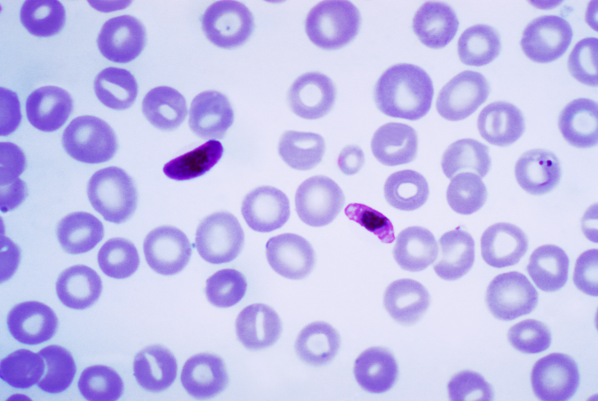
Datasets
The methods were applied on two datasets:
Saccharomyces cerevisiae Plasmodium Falciparum
The Gene expression measurements were extracted from the GEO database.

Slide 25
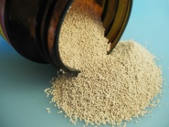
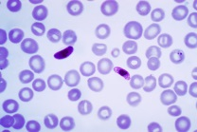
Datasets
Saccharomyces Cerevisiae
Plasmodium Falciparum
A species of yeast.
170 experiments
6254 genes
knowledge-rich
A parasite (causes malaria)
208 experiments
4365 genes
poorly annotated

Slide 26
Results

Slide 27
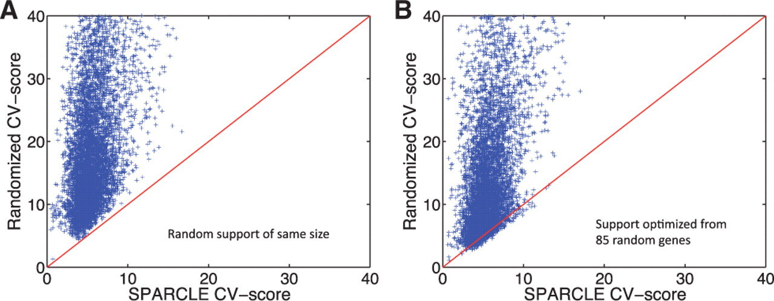
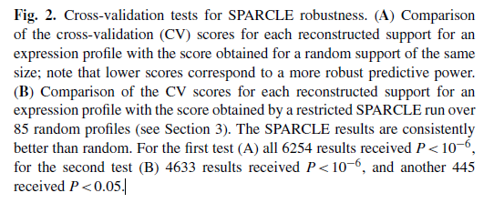

Slide 28
Sparse reconstruction of yeast genes expression profiles by SPARCLE.
(A) Support sizes of the solutions to the SPARCLE optimization
problem (the number of genes used to reconstruct each particular gene), for
all 6254 yeast genes analyzed.

Slide 29
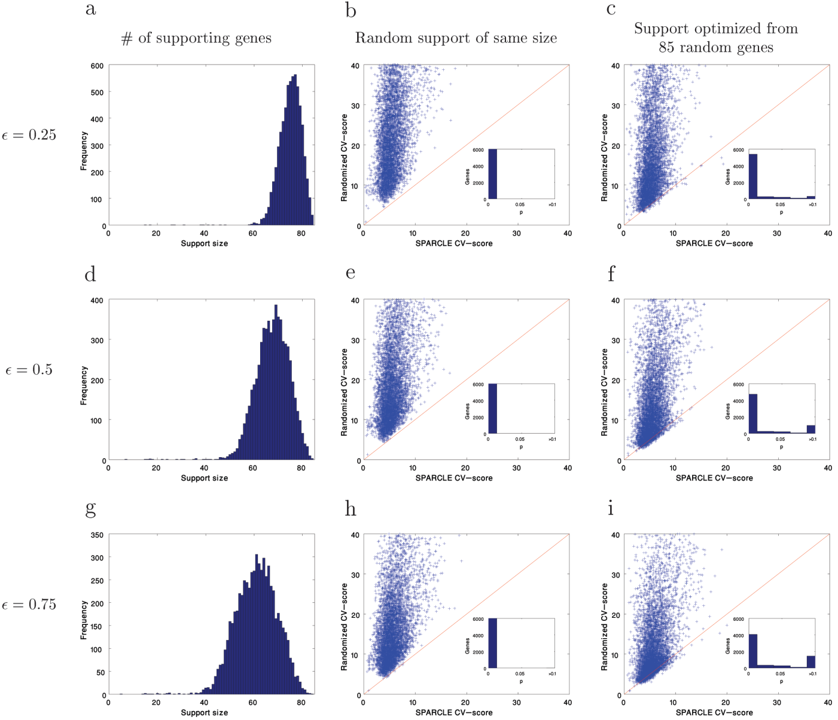
Understanding
The noise parameter ε
. Cross-validation test for SPARCLE robustness. Support sizes of the solutions to the SPARCLE optimization problem (number of non-zero entries in the solution) of the yeast measurements, for (a) ε=0.25, (d) ε=0.5, and (g) ε=0.75. The cross-validation (CV) scores for each reconstructed support for an expression profile are plotted against the score obtained for a random support of the same size for (b) ε=0.25, (e) ε=0.5, and (h) ε=0.75. The cross-validation scores for each reconstructed support for an expression profile are plotted against the score obtained by a restricted SPARCLE run over 85 random profiles for (c) ε=0.25, (f) ε=0.5, and (i) ε=0.75; see Methods for details. Inset: Histogram of p-values for the SPARCLE CV scores.

Slide 30
Sparse reconstruction of yeast genes expression profiles by SPARCLE.
(C) Genes in the support of MEP1. The
objective gene (MEP1) is indicated by a red square. Note that the majority
of the genes are part of a PPI network.

Slide 31
Sparse reconstruction of yeast genes expression profiles by SPARCLE.
(D) Sample of four objective genes
(marked by red squares) whose supports are indicated by poor connectivity
and a fragmented PPI network. PPI connectivity is retrieved from the BioGrid
(http://thebiogrid.org/) repository. Graphics are based on Pathway Palette
(Askenazi et al., 2010).

Slide 32
Prediction of PPI and GO annotations
(B) Prediction of PPI, as represented
by the STRING database, by supervised learning from SPARCLE results
(SPARCLE+AB).Accuracy is traded off with coverage by applying certainty
thresholds on the classifier output. Other methods for predicting genes
interrelationships are as follows: Pearson’s correlation of the expression
profiles (Correlations), and a transitive correlations method (SPath, see
Section 2). (C) Prediction of associations for the GO Slim annotations,
covering CC ontology.

Slide 33
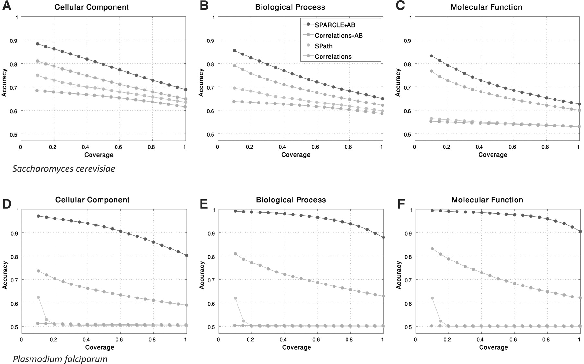
Prediction of genes’ associations according to GO
A comparison of SPARCLE-based AdaBoost
learning (SPARCLE+AB), correlation-based AdaBoost learning (Correlations+AB), correlations-based shortest path (SPath) (Zhou et al., 2002) and pairwise
correlations for the raw data (Correlations) for S.cerevisiae (A–C) and P.falciparum (D–F) transcriptomes. The ontology branches CC (A–D), BP (B–E)
and MF (C–F) were examined.

Slide 34
Discussion
The method was not compared with clustering methods.
The biological interpretation of the support sets was mostly indirect.
The correlation measure performed very poorly on the malaria data and somewhat better on the yeast data.
Notes:
seemingly exhausted problem

Slide 35
Conclusion
We introduced a natural, yet unexplored, approach for the problem of gene expression analysis.
Geometrically, we uncovered linear subspaces that are overpopulated with expression profiles in the multidimensional space of the experiments set.
The sparse representation is general and proved to be robust.
The high performance of SPARCLE-based AdaBoost learning should be considered as evidence for the principal information that is embedded in the geometric properties of the data.

Slide 36
Questions?

Slide 37
Bibliography
Y. Prat, M. Fromer, N. Linial, M. Linial, Recovering key biological constituents through sparse representation of gene expression. Bioinformatics 27, 655 (2011).
B. Berger, J. Peng, M. Singh, Computational solutions for
omics data, Nature 14, 343 (2013)

Slide 38
Thank you!

