Slide 1
Simultaneous Clustering of Multiple Gene Expression and Physical Interaction Datasets Manikandan Narayanan, Adrian Vetta, Eric E. Schadt, Jun Zhu PLoS Computational Biology 2010
Presented by: Tal Saiag
Seminar in Algorithmic Challenges in Analyzing Big Data* in Biology and Medicine; With Prof. Ron Shamir @TAU

Slide 2
Outline
Basic Terminology
Introduction
JointCluster: A simultaneous clustering algorithm
Results
Discussion
Conclusion

Slide 3
Basic Terminology

Slide 4
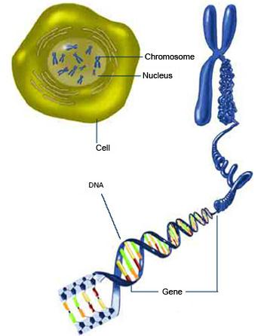
Basic Terminology
Cell – building block of life
Contains nucleus
Chromosome – genetic material
Forms the genome – DNA
Gene – Stretch of DNA
Proteins – multi functional workers
Notes:
להגדיר:
תא כחלק מיצור חי
The cell is the basic structural, functional and biological unit of all known living organisms. It is the smallest unit of life that is classified as a living thing, and is often called the building block of life.
DNA בתוך התא
גן – חלק מ-DNA בעל פונקציה באורגניזם
פרוטאין כמווסת תהליכים, נוצר מ-DNA
Proteins are large biological molecules consisting of one or more chains of amino acids. Proteins perform a vast array of functions within living organisms, including catalyzing metabolic reactions, replicating DNA, responding to stimuli, and transporting molecules from one location to another. Proteins differ from one another primarily in their sequence of amino acids, which is dictated by the nucleotide sequence of their genes, and which usually results in folding of the protein into a specific three-dimensional structure that determines its activity.

Slide 5
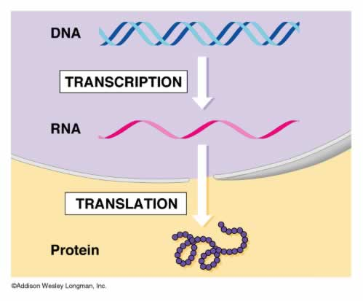
Basic Terminology
Gene expression: from gene to protein
Transcription
RNA
Translation
Transcription factor
Notes:
להגדיר:
תהליכים בתא: Gene expression
Transcription into mRNA - Transcription is the process of converting the genetic information stored in DNA to messenger RNA (mRNA)
Translation of mRNA
Transcription factor - הוא חלבון הנקשר לרצף DNA ספציפי, הנמצא לפני החלק המקודד של הגן, ובכך משפיע על שעתוק הגן ל-mRNA. מהווה חלק מהבסיס לרשת הוויסות והבקרה הגנטית. that activate or repress gene expression DNA-PROTEIN INTERACTIONS

Slide 6
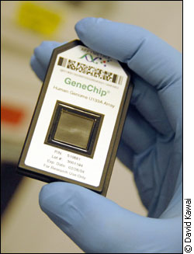
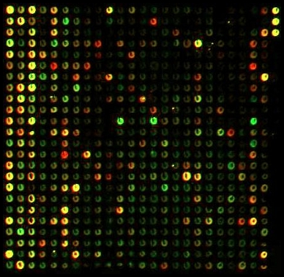
Basic Terminology
DNA microarray / chips
Measures expression of genes
Condition specific
Notes:
להגדיר:
תחת תנאים שונים
expression levels
DNA chips / Microarrays

Slide 7
Introduction

Slide 8
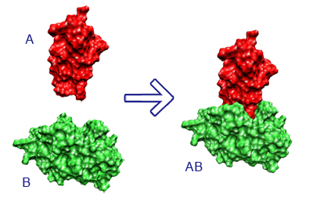
Introduction
Genome-wide datasets provide different views of the biology of a cell.
Physical interactions (protein-protein) and regulatory interactions (protein-DNA) maintain and regulate the cell's processes.
Expression of molecules (proteins or transcripts of genes) provide a snapshot of the cell’s state.
Researchers have exploited the complementarity of both.
Notes:
Heterogeneous genome-wide datasets provide different views of the biology of a cell, and their rapid accumulation demands integrative approaches that exploit the diversity of views.
Data on physical interactions such as interactions between two proteins (protein-protein), or regulatory interactions between a protein and a gene via binding to upstream regions of the gene (protein-DNA) inform how various molecules within a cell interact with each other to maintain and regulate the processes of a living cell.
On the other hand, data on the abundances or expression of molecules such as proteins or transcripts of genes provide a snapshot of the state of a cell under a particular condition.
For instance, a network of coexpression relations between gene pairs is typically built using expression data of a population of samples, and a network of physical interactions between protein or gene pairs is typically built by testing each interaction in a specific individual or in-vitro condition.
These two data sources on physical interaction and molecular abundance provide complementary views, as the former captures the wiring diagram or static logic of the cell, and the latter the state of the cell at a time-point in a condition-dependent, dynamic execution of this logic.
Researchers have fruitfully exploited this complementarity by studying the topological patterns of physical interaction among genes [with expression profiles that are condition-specific, periodic, or correlated]; and similarity of the expression profiles of genes with regulatory, physical, or metabolic interactions among them.

Slide 9
Introduction
Integrating the physical and expression datasets.
Developing efficient solution for combined analysis of multiple networks.
Goal: find common clusters of genes supported by all of the networks of interest.
Computationally intractable for large networks.
Theoretical guarantees (reasonably approximates the optimal clustering).
Notes:
Another line of research focuses on integrating the physical and expression datasets to chart out clusters or modules of genes involved in a specific cellular pathway.
Methods were developed to search for physically interacting genes that have condition-specific expression (i.e., differential expression when comparing two or more conditions, as in ‘‘active subnetworks’’), or correlated expression (eg. subnetworks in the network of physical interactions that are coherently expressed in a given expression dataset).
Towards addressing this challenge, we propose an efficient solution to a well-defined computational framework for combined analysis of multiple networks, each describing pairwise interactions or coexpression relationships among genes.
The problem is to find common clusters of genes supported by all of the networks of interest, using quality measures that are normalized and comparable across heterogeneous networks.
I will show the algorithm that solves this problem using techniques that permit certain theoretical guarantees (approximation guarantees) on the quality of the output clustering relative to the optimal clustering. That is, we prove these guarantees to show that the clustering found by the algorithm on any set of networks reasonably approximates the optimal clustering, finding which is computationally intractable for large networks.
JointCluster enables integration of multiple expression datasets with one or more physical networks, and hence more flexible than other approaches that integrate a single coexpression or similarity network with a physical network, or multiple, possibly cross-species, expression datasets without a physical network.
JointCluster seeks clusters preserved in multiple networks so that the genes in such a cluster are more likely to participate in the same biological process.

Slide 10
JointCluster: A simultaneous clustering algorithm

Slide 11
Declarations
A cut refers to a partition of nodes in a graph into two sets.
A cut is called sparse-enough in a graph if the ratio of edges crossing the cut in the graph to the edges incident at the smaller side of the cut is smaller than a threshold specific to the graph.
Inter-cluster edges: edges with endpoints in different clusters.
Connectedness of a cluster in a graph: the cost of a set of edges is the ratio of their weight to the total edge weight in the graph.
Notes:
A cut refers to a partition of nodes in a graph into two sets.
A cut is called sparse-enough in a graph if the ratio of edges crossing the cut in the graph to the edges incident at the smaller side of the cut is smaller than a threshold specific to the graph.
Inter-cluster edges: edges with endpoints in different clusters.
Connectedness of a cluster in a graph: the cost of a set of edges is the ratio of their weight to the total edge weight in the graph.
To integrate the information in multiple physical interaction and gene expression datasets, we first represent each dataset as a network or graph whose nodes are the genes of interest and edges indicate relations between gene pairs such as physical interaction between genes or gene products in physical networks, or transcriptional correlation between genes in coexpression networks.
Simultaneous clustering is a clustering or partition of the nodes such that nodes within each set or cluster in the partition are well connected in each graph, and the total cost of inter-cluster edges is low.

Slide 12
Algorithm outline
Approximate the sparsest cut in each input graph using a spectral method.
Choose among them any cut that is sparse-enough in the corresponding graph yielding the cut.
Recurse on the two node sets of the chosen cut.
Until well connected node sets with no sparse-enough cuts are obtained.
Notes:
ALGO:
Approximate the sparsest cut in each input graph using a spectral method
Choose among them any cut that is sparse-enough in the corresponding graph yielding the cut
Recurse on the two node sets of the chosen cut
Until well connected node sets with no sparse-enough cuts are obtained.
JointCluster implementation employs a novel scaling heuristic to reduce the inter-cluster edge cost even further in practice.

Slide 13
Definitions
Graph $G=\left(V,a\right)$
$a\left(u,v\right)≥0$ for any node pair $\left(u,v\right)∈V×V$
Total weight of any edge set $Y$: $a\left(Y\right)=\sum_{\left(u,v\right)∈Y}{a\left(u,v\right)}$
For any node sets $S,T⊆V$: $a(S,T)=\sum_{u∈S,v∈T}{a\left(u,v\right)}$
Define $a\left(S\right)=a\left(S,V\right)$
Total edge weight in the graph: a(V)/2
Singletons: $a\left(\left\{u\right\}\right)=a\left(u\right)$
Notes:
Consider a graph $G=\left(V,a\right)$, where $V$ is the set of nodes and $a$ is a non-negative edge weight function.
Singletons: $a\left(\left\{u\right\}\right)=a\left(u\right)$, sums up the weights of edges incident at node u.

Slide 14
The Conductance
The conductance of a cut $(S,T=C\backslash S)$ in a node set $C$: $\frac{a\left(S,T\right)}{\min\left(a\left(S\right),a\left(T\right)\right)}$
The inter-cluster edges $X$: $\left(u,v\right)$ where $u$ and $v$ belong to different clusters.
An $(α,ε)$ clustering of $G$ is a partition of its nodes into clusters such that:
The conductance of the clustering is at least $α$, and
The total weight of the inter-cluster edges $X$ is at most an $ε$ fraction of the total edge weight in the graph; i.e., $a\left(X\right)≤\frac{ε}{2}a\left(V\right)$.
Notes:
(with the convention that this ratio is zero if its denominator is zero, since the numerator is also zero then)
By normalizing the sum of edge weights $a\left(S,T\right)$ crossing the cut, the definition captures an intuitive notion of connectivity that is robust and invariant to scaling the edge weight function a by any constant.
To illustrate the intuitive notion, consider a cut separating a single node u from other nodes in a cluster C.
If the conductance of this cut is high, then a large fraction of all edges incident at node u ends at another node in the cluster. Extending this notion, if the conductance of all cuts in C are high, the nodes in C are robustly connected together.
Sparse-enough if the ratio of edges crossing the cut to the edges incident at the smaller side of the cut is smaller than a threshold specific to the graph
When maximizing the conductance of the partition, it is desirable to control the cost of the inter-cluster edges as well. Let $X$ denote the inter-cluster edges, i.e., unordered node pairs $\left(u,v\right)$ where $u$ and $v$ belong to different clusters in the partition.
An $(α,ε)$ clustering of $G$ is a partition of its nodes into clusters such that:
the conductance of the clustering is at least $α$, and
the total weight of the inter-cluster edges $X$ is at most an $ε$ fraction of the total edge weight in the graph; i.e., $a\left(X\right)≤\frac{ε}{2}a(V)$

Slide 15
Approximating the sparsest cut
Since finding the sparsest cut in a graph is a NP-hard problem, an approximation algorithm for the problem is used.
Efficient spectral techniques.
Spectral Algorithm:
Find the top $k$ right singular vectors $v_{1},v_{2},…,v_{k}$ (using SVD).
Let $C$ be the matrix whose $j$th column is given by $Av_{j}$.
Place row $i$ in cluster $j$ if $C_{ij}$ is the largest entry in the $i$th row of $C$.
Notes:
Note that clustering a graph by minimizing e for a given a is also NP-hard by a reduction from the sparsest cut problem.
The repeated removal of sparsest cuts is done until the pieces or clusters become well connected with no sparse cuts left in them.
Roughly speaking, spectral clustering is the technique of partitioning the rows of a matrix according to their components in the top few singular vectors of the matrix.

Slide 16
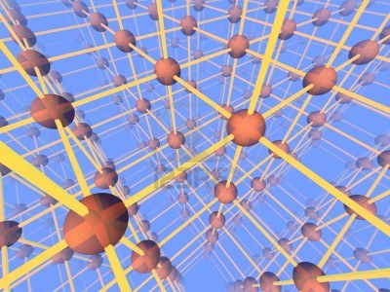
Multiple Graphs
Consider $p$ graphs ${\left\{G_{i}=\left(V,a_{i}\right)\right\}}_{i=1}^{p}$
An $\left(\left\{α_{i}\right\},ε\right)$ simultaneous clustering:
The conductance of the clustering is at least $α_{i}$ in graph $G_{i}$ for all $i$, and
The total weight of the inter-cluster edges $X$ is at most an $ε$ fraction of the total edge weight in all graphs; i.e., $\sum_{i}{a_{i}\left(X\right)}≤\frac{ε}{2} \sum_{i}{a_{i}\left(V\right)}$.
Inter-cluster edge cost: $\frac{2\sum_{i}{a_{i}\left(X\right)}}{\sum_{i}{a_{i}\left(V\right)}}$.
A cut in $G_{i}$ is sparse enough if the conductance of the cut is at most $α_{i}^{∗}$.
Notes:
Consider $p$ graphs ${\left\{G_{i}=\left(V,a_{i}\right)\right\}}_{i=1}^{p}$ over the same nodes $V$ and different non-negative edge weight functions $\left\{a_{i}\right\}$.
The conductance thresholds ${\left\{α_{i}\right\}}_{i=1}^{p}$ are graph-specific to enable search for clusters of varying quality in heterogeneous graphs.
Inter-cluster edge cost is [not the sum of graph-specific costs]: $\frac{2\sum_{i}{a_{i}\left(X\right)}}{\sum_{i}{a_{i}\left(V\right)}}$.
This scale-invariance of conductance comes from the normalization factor in its definition as mentioned before.

Slide 17
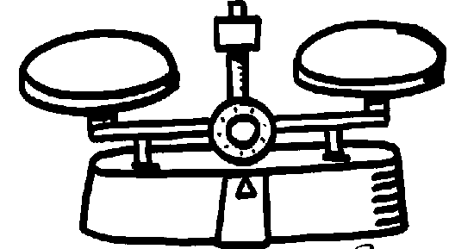
Scaling Heuristic
Mixture graph $H_{i}^{k}$ for graph $G_{i}$ at scale $k$ has a weight function:
$$b_{i}^{k}\left(u,v\right)=a_{i}\left(u,v\right)+2^{−k}\sum_{j!=i}{a_{j}\left(u,v\right)}$$
The heuristic finds sparsest cuts in mixture graphs.
The heuristic starts with the sum graph to control edges lost in all graphs, and transitions through a series of mixture graphs that approach the individual graphs to refine the clusters.
Notes:
A mixture graph $H_{i}^{k}$ for a given scale $k$ is a scaled sum graph with the edge weight function $b_{i}^{k}\left(u,v\right)=a_{i}\left(u,v\right)+2^{−k}\sum_{j!=i}{a_{j}\left(u,v\right)}$ for every edge $\left(u,v\right)∈V×V$.
The scaling heuristic starts with $k=0$ to work with the sum graph, and increments $k$ until it reaches a large value.
Downscaling: The mixture graph with unit downscaling is the sum graph whose edge weights are the sum of weights of the corresponding edges in all input graphs, and the mixture graphs with very large downscaling approaches the original input graphs.
Instead of finding sparsest cuts in input graphs separately as in the basic algorithm, the heuristic finds sparsest cuts in mixture graphs that are obtained from adding each input graph to a downscaled sum of the other input graphs.
The heuristic starts with mixture graphs with small downscaling to help control inter-cluster edges lost in all graphs. [the resulting clusters are coarse (eg. clusters well connected in some graphs but split into smaller clusters in the rest are not resolved further)]
The heuristic then refines such coarse clusters at the expense of more inter-cluster edges by increasing the downscaling factor.
Since the chosen cut is sparse in the graph yielding the cut, we are able to bound the edges crossing the cut in this graph, but not necessarily the other graphs. In order to control the edges discarded in all graphs, we could approximate the sparsest cut in the sum graph.
Working with the sum graph alone would yield coarse clusters though (eg. clusters well connected in some graphs but split into smaller clusters in the rest are not refined further).
In these definitions, a input or mixture graph refers actually to a subgraph of the graph induced over the current nodeset $W⊆V$ in the recursion call.

Slide 18
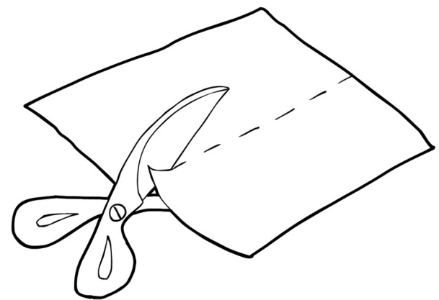
Cut Selection Heuristic
Combine a cut selection heuristic.
Choose the cut that is sparse-enough in the most number of input graphs.
Notes:
The scaling heuristic works best when combined with a cut selection heuristic:
if for a particular downscaling, more than one mixture graph yields a sparse-enough cut, choose among them the cut that is sparse-enough in the most number of input graphs (breaking ties toward the cut with the least cost of edges crossing the cut in all graphs).
Our method runs in an unsupervised fashion since algorithm parameters such as graph-specific thresholds are learnt automatically.

Slide 19
Overview

Slide 20
Overview
Notes:
The algorithm starts with V as the current node set.
For each graph, the algorithm finds an approximate sparsest cut in the current node set, using the graph-specific edge weight function to measure conductance.
The algorithm chooses among them any cut that is sparse enough,
and recurses on the two pieces (node sets) induced by this cut.
If no cuts get chosen for the current node set, the node set is output as a well connected cluster in all graphs.
Improving the chosen cut in the pseudocode refers to improvement of its conductance using a flow-based algorithm.

Slide 21
Overall framework
The modularity score of a cluster in a graph is: fraction of edges contained within the cluster minus the fraction expected by chance.
The partition of $V$ that respects the clustering tree and optimizes the min–modularity score can be found by dynamic programming.
$$OPT\left(D\right) =\operatorname{argmax}\left({min−modularity\left(D\right), \atop min−modularity\left(OPT\left(D_{l}\right)∪OPT\left(D_{r}\right) \right)} \right)$$
Ordered by the min-modularity scores of clusters.
Notes:
The overall framework of JointCluster: the learning of parameters, producing the clustering tree and parsing it into clusters.
The recursive cuts made by our algorithm naturally lead to a hierarchical clustering tree, which is then parsed objectively to produce the final clusters using a modularity score function.
The modularity score of a cluster in a graph is the fraction of edges contained within the cluster minus the fraction expected by chance in a randomized graph obtained from degree-preserved shuffling of the edges in the original graph.
Degree-preserved shuffling - ?
To aggregate the scores of a cluster across multiple graphs, we take their minimum and use this min-modularity score as the cluster score.
The (min-modularity) score of a clustering $C$ is then the sum of the (min-modularity) scores of the constituent clusters.
The partition of $V$ that respects the clustering tree and optimizes the min–modularity score can be found by dynamic programming.
$$OPT\left(D\right) =\operatorname{argmax}\left(min−modularity\left(D\right),min−modularity\left(OPT\left(D_{l}\right)∪OPT\left(D_{r}\right) \right) \right)$$
To enable a fair comparison of JointCluster with other methods, we needed a size limit on the clusters.
(maximum size at 100 nodes & minimum size at least 10 nodes)
Ordered by the min-modularity scores of clusters.
Parameter learning will be discussed later on…

Slide 22
Parameter learning
We desire an unsupervised method for learning the related conductance threshold $α_{i}^{∗}$ for each network of interest $G_{i}$.
Algorithm for each graph $G_{i}$:
Cluster only $G_{i}$ using JointCluster, without loss of generality set $α_{i}^{∗}$ to maximum possible value $1$.
Set $α_{i}^{∗}$ to the minimum conductance threshold that would result in the same set of clusters $\left\{C_{t}\right\}$.
Goal: automatically choose a threshold that is sufficiently low and sufficiently high.
Notes:
We saw how graph-specific conductance thresholds $\{α_{i}\}$ accommodate the varying extents to which different graphs can be clustered.
We desire an unsupervised method for learning the related conductance threshold $α_{i}^{∗}$ for each network of interest $G_{i}$ from the inherent cluster structure present in the network.
To do so, we repeat the following procedure separately for each graph $G_{i}$:
Cluster only $G_{i}$ using JointCluster, without loss of generality set $α_{i}^{∗}$ to maximum possible value $1$.
Set $α_{i}^{∗}$ to the minimum conductance threshold that would result in the same set of clusters $\left\{C_{t}\right\}$.
This value is determined from the clustering tree by selecting the tree vertices to which the clusters $\left\{C_{t}\right\}$ are mapped to, and taking the maximum of the conductance of all cuts made by the algorithm in resolving the clustering tree to the selected vertices.
The rationale behind the above heuristic is to automatically choose a threshold that is both sufficiently low to enable simultaneous clustering with the scaling heuristic, and sufficiently high to provide a clustering tree that is at least as resolved as the single-graph clustering trees.

Slide 23
Results

Slide 24
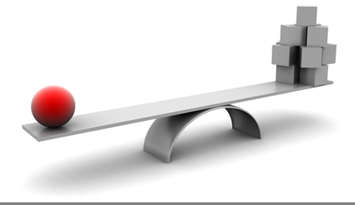
Benchmarking JointCluster on simulated data
Alternative algorithms:
$G_{i}$ Tree: Choose one of the input graphs $G_{i}$ as a reference, cluster this single graph using an efficient spectral clustering method to obtain a clustering tree, and parse this tree into clusters using the min-modularity score computed from all graphs.
Coassociation: Cluster each graph separately using a spectral method, combine the resulting clusters from different graphs into a coassociation graph, and cluster this graph using the same spectral method.
$k_{out}$ Parametr
Notes:
We used simulated datasets to benchmark JointCluster against other alternatives:
The simulated test data was generated under the assumption that the true classification of genes into clusters is known.
One random instance involved generating two test graphs $G_{1}$, $G_{2}$ over 128 nodes each, and implanting in each graph the same "true" clustering of 4 equal sized clusters.
A parameter $k_{out}$ controlled the noise level in the simulated graphs by controlling the average number of intercluster edges incident at a node.
The average number of total edges incident at a node was set at 16, so $k_{out}/16$ measures the false positive rate in a simulated graph.

Slide 25
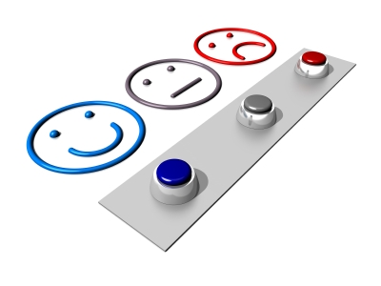
Evaluation measures
Intra-cluster are a pair of elements that belong to a single cluster.
Jaccard Index =
$\frac{\text{\#}\text{element} \text{pairs} \text{that} \text{are} \text{intra}\text{−}\text{cluster} \text{wrt} \text{both} \text{clusterings}}{\text{\#}\text{element} \text{pairs} \text{that} \text{are} \text{intra}\text{−}\text{cluster} \text{wrt} \text{either} \text{of} \text{the} \text{clusterings}}$
Notes:
Given a clustering (partition) of a set of elements into clusters, a pair of elements that belong to a single cluster is denoted as intra-cluster wrt this clustering.
Jaccard Index between two clusterings of the same set of elements is the ratio between the number of element pairs that are intra-cluster wrt (with respect to) both clusterings and the number of element pairs that are intra-cluster wrt either of the clusterings.

Slide 26
Benchmarking JointCluster on simulated data
Notes:
We used the standard Jaccard index, which ranges from 0 to 1, to measure the degree of overlap between the true clustering and the clustering detected by the methods.
Averaged over 100 random instances of $G_{1}$, $G_{2}$ for each value of the noise level parameter $k_{out}$.
When the noise level is low ($0≤k_{out}≤4$ or false positive rate at most 25%), the clusters output by all methods are close to the true set of clusters (a Jaccard index close to 100%).
But when the noise level is high ($5≤k_{out}≤8$ or false positive rate 25%–50%), the cluster structure becomes subtler, and JointCluster starts to outperform other methods and achieves the best improvement in Jaccard index over other methods at $k_{out}=6,7,8$.
Note that values $k_{out}>8$ where false positive rates are above 50% do not lead to a meaningful cluster structure, and are only shown for context.
To simulate real-world scenarios where the integrated networks could’ve different reliabilities, we benchmarked the methods on clustering graphs with different noise levels. Instead of varying the common $k_{out}$ value of the $G_{1}$, $G_{2}$ graphs as above, we fixed the noise level $k_{out}$ of $G_{1}$ at 6 and varied the $k_{out}$ of the other graph $G_{2}$ from 0 to 16.
JointCluster integrated the information in the two graphs to produce a joint clustering tree, which when parsed yielded better clusters than Coassociation and single tree clusters for a larger range of the parameter values.

Slide 27
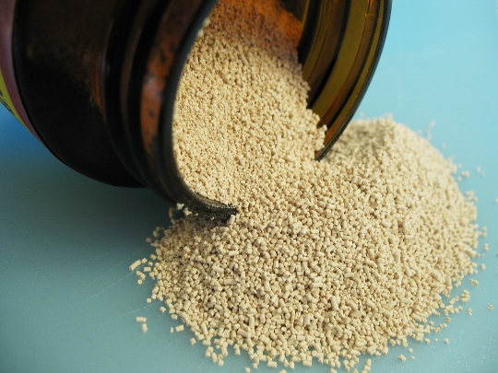
Systematic evaluation of the methods using diverse reference classes in yeast
Two yeast strains grown under two conditions where glucose or ethanol was the predominant carbon source.
Coexpression networks using all 4,482 profiled genes as nodes.
Weight of an edge as the absolute value of the Pearson's correlation coefficient between the expression profiles of the two genes.
Physical gene-protein interactions (from various interaction databases): total of 41,660 non-redundant interactions.
Notes:
The biological significance of detected clusters were assessed using reference sets of yeast genes belonging to different classes.
The results are summarized using standard performance measures, sensitivity and specificity, both reported as percentages for each reference class.

Slide 28
Different classes of yeast genes
GO Process: Genes in each reference set in this class are annotated to the same GO Biological Process term.
TF (Transcription Factor) Perturbations: Genes in each set have altered expression when a TF is deleted or overexpressed.
Compendium of Perturbations: Genes in each set have altered expression under deletions of specific genes, or chemical perturbations.
TF Binding Sites: Genes in a set have binding sites of the same TF in their upstream genomic regions, with sites predicted using ChIP binding data.
eQTL Hotspots: Certain genomic regions exhibit a significant excess of linkages of expression traits to genotypic variations.
Notes:
Assessed the biological significance of the detected clusters using reference sets of genes collected from various published sources.

Slide 29
Evaluation measures [cont.]
Intra-cluster are a pair of elements that belong to a single cluster.
Jaccard Index =
$\frac{\text{\#}\text{element} \text{pairs} \text{that} \text{are} \text{intra}\text{−}\text{cluster} \text{wrt} \text{both} \text{clusterings}}{\text{\#}\text{element} \text{pairs} \text{that} \text{are} \text{intra}\text{−}\text{cluster} \text{wrt} \text{either} \text{of} \text{the} \text{clusterings}}$
Sensitivity: the fraction of reference sets that are enriched for genes belonging to some cluster output by the method. [coverage]
Specificity: the fraction of clusters that are enriched for genes belonging to some reference set. [accuracy]
Notes:
Sensitivity and specificity measure how well the clusters produced by a clustering method align with reference sets of a specific class.
Sensitivity is the fraction of reference sets that are enriched for genes belonging to some cluster output by the method.
Specificity is the fraction of clusters that are enriched for genes belonging to some reference set.
The sensitivity measures the “coverage” of different biological processes by the clusters, and the specificity the ‘‘accuracy’’ of the clusters.

Slide 30
Systematic evaluation of the methods using diverse reference classes in yeast
Notes:
To provide context, we present results from clustering each network separately using the single graph method.
Physical Only performs better than the other two methods wrt (with respect to) GO Process and TF Binding Sites,
and Glucose/Ethanol Only fare well wrt eQTL Hotspots.
This relative performance is not surprising due to the varying levels of bias in the reference classes, and the different data sources used to construct the networks.
Though physical interactions between genes or gene products are known to be predictive of shared GO annotations, certain GO annotations inferred from physical interactions introduce bias.
The same ChIP binding data was used to predict TF binding sites and protein-DNA interactions, so validation of clusters derived from the physical network using TF Binding Sites is biased.
Finally, the same expression data underlying the coexpression networks was used with the independent genotype data to define the eQTL hotspots.
Hence the eQTL Hotspots class does not by itself provide a convincing validation of the coexpression clusters; however it can be used to understand the extent of genetic control of coordinated transcription and to validate clusters derived from networks comprising only physical interactions.
The reference classes offering truly independent validation of clusters are TF Perturbations and Compendium of Perturbations, and the three single graph methods perform similarly in these perturbation classes.
To help interpret these performance measures properly, information such as coverage of genes (# of genes in detected clusters) and average size of a cluster (average # of genes in a cluster with error bars indicating standard deviation) are also shown. All reported results focus only on clusters with at least 10 genes.
Integration of the yeast physical network with the glucose/ethanol coexpression networks was done to find sets of genes that clustered reasonably well in all three networks.
JointCluster performed a better integration of these networks than Coassociation for all reference classes except eQTL Hotspots.
The enrichment results of single tree methods in Figure B followed a trend similar to the single graph methods in Figure A, reflecting the bias in the reference classes.
In the two truly independent perturbation classes, JointCluster showed better sensitivity than the other methods at comparable or better specificity.
In summary, though different single graph and single tree methods were best performers in different reference classes JointCluster was more robust and performed well across all reference classes characterizing diverse cellular processes in yeast.

Slide 31
JointCluster yields better coverage of genes than a competing method
Comparing JointCluster against methods that integrate only a single coexpression network with a physical network.
Combined <glucose+ethanol> coexpression network and the physical network.
Comparing on fair terms for all algorithms:
Setting minimum cluster size parameter in Matisse to 10.
Size limit of 100 genes for JointCluster .
Co-clustering didn't have a parameter to directly limit cluster size.
Notes:
To compare JointCluster against methods that integrate only a single coexpression network with a physical network, such as Matisse and Co-clustering, we considered joint clustering of a combined <glucose+ethanol> coexpression network and the physical network.
The <glucose+ethanol> network refers to the single coexpression network built from expression data that is obtained by concatenating the normalized expression profiles of genes under the glucose and ethanol conditions.
Making the terms fair for all algorithms:
Since our results focus on clusters with at least 10 genes, we set the minimum cluster size parameter in Matisse to 10.
The default size limit of 100 genes for Matisse clusters was used for JointCluster as well to enable a fair comparison.
Co-clustering didn't have a parameter to directly limit cluster size.
Co-clustering detected very few (26) clusters of size at least 10 genes, half of which were large with more than 100 genes.
So Co-clustering achieves greater specificity than other methods at the expense of a coarser clustering comprising few large clusters.

Slide 32
JointCluster yields better coverage of genes than a competing method
Notes:
JointCluster has sensitivity and specificity that is comparable or slightly lower than Matisse across all reference classes except TF Binding Sites.
However, JointCluster produces clusters that cover significantly more genes than Matisse.
Matisse assumes that the physical network is of better quality, and searches for coexpression clusters that are each connected in the physical network.
This connectivity constraint excludes genes whose physical interactions are poorly studied or untested.
JointCluster does not use such a constraint when parsing the clustering tree into clusters, and hence identifies clusters supported to varying extents in the two networks, including ones with weak support in the physical network.
This could be a huge advantage in organisms such as human and mouse where the knowledge of physical interactions is far less complete than in yeast, especially for interactions that are tissue-specific or condition-specific.
The extreme examples among the roughly 1500 genes excluded by Matisse clusters were the 134 physically isolated genes (i.e., genes that do not interact with any of the other 4482 profiled genes in the physical network).
JointCluster used connectivity in the coexpression network to include 129 physically isolated genes in its clusters, and 84 of these genes were significantly correlated with more than half of the genes in their assigned cluster.
We see that the inclusive criteria used in JointCluster is preferable when the integrated physical network is not comprehensive.

Slide 33
Discussion

Slide 34
Discussion
Heterogeneous large-scale datasets are accumulating at a rapid pace.
Efforts to integrate them are intensifying.
JointCluster provides a versatile approach to integrating any number of heterogeneous datasets.
Natural progression from clustering of single to multiple datasets.
Notes:
Heterogeneous large-scale datasets capturing diverse aspects of the biology of a cell are accumulating at a rapid pace, and efforts to integrate them into a coherent view of cell regulation are intensifying.
This integration could greatly facilitate a genome-wide model of the cell that could predict cellular response to various environmental and genetic perturbations.
The simultaneous clustering algorithm proposed here provides a versatile approach to integrating any number of heterogeneous datasets that could be represented as networks among genes, and summarizes the result as a collection of clusters supported by multiple networks.
Since its early applications to classifying cancer subtypes, clustering has rapidly become a standard analysis of expression datasets.
We believe that simultaneous clustering is a natural progression in the application of clustering from single to multiple expression and interaction datasets.

Slide 35
Discussion
Testing JointCluster algorithm on simulated datasets.
Testing JointCluster on yeast empirical datasets.
More flexible than two-network clustering methods.
Consistent with known biology, extend our knowledge.
JointCluster can handle multiple heterogeneous network.
Enables better coverage of genes especialy when knowledge of physical interactions is less complete.
Unsupervised and exploratory approach to data integration.
Notes:
We demonstrated the utility of a combined analysis by applying our JointCluster algorithm on simulated and empirical datasets.
We found the clusters produced by JointCluster on yeast physical and glucose/ethanol coexpression networks to be comparably or more consistently enriched for reference classes that reflect various aspects of yeast biology, in comparison to other methods of integrating the networks.
The clusters detected by JointCluster from the yeast physical and expression datasets are consistent with known biology, and importantly extend our knowledge by highlighting biological processes, that may not have been completely characterized despite intense efforts to dissect them.
Further, JointCluster can handle multiple heterogeneous networks, and hence more flexible than two-network clustering methods such as Matisse that search for coexpression clusters that are each connected in the physical network.
This flexibility enables JointCluster to yield better coverage of genes, and to be broadly applicable in human or other organisms where the knowledge of physical interactions is less complete than in yeast.
In the future, the framework could be extended to scale networks of different interaction types by different factors before integration.
Simultaneous clustering offers an unsupervised and exploratory approach to data integration, and hence complementary to supervised approaches that train machine-learning models on multiple data types to make directed predictions.

Slide 36
Conclusion

Slide 37
Conclusion
The challenge: integrating multiple datasets in order to study different aspects of biological systems.
Proposed simultaneous clustering of multiple networks.
Efficient solution that permits certain theoretical guarantees
Effective scaling heuristic
Flexibility to handle multiple heterogeneous networks
Results of JointCluster:
More robust, and can handle high false positive rates.
More consistently enriched for various reference classes.
Yielding better coverage.
Agree with known biology of yeast.
Notes:
Many genome-wide datasets are routinely generated to study different aspects of biological systems, but integrating them to obtain a coherent view of the underlying biology remains a challenge.
We proposed simultaneous clustering of multiple networks as a framework to integrate large-scale datasets on the interactions among and activities of cellular components.
Specifically, we develop an algorithm JointCluster that finds sets of genes that cluster well in multiple networks of interest, such as coexpression networks summarizing correlations among the expression profiles of genes and physical networks describing protein-protein and protein-DNA interactions among genes or gene-products.
Our algorithm provides an efficient solution to a well-defined problem of jointly clustering networks, using techniques that permit certain theoretical guarantees on the quality of the detected clustering relative to the optimal clustering.
These guarantees coupled with an effective scaling heuristic and the flexibility to handle multiple heterogeneous networks make our method JointCluster an advance over earlier approaches.
Simulation results showed JointCluster to be more robust than alternate methods in recovering clusters implanted in networks with high false positive rates.
In systematic evaluation of JointCluster and some earlier approaches for combined analysis of the yeast physical network and two gene expression datasets under glucose and ethanol growth conditions, JointCluster discovers clusters that are more consistently enriched for various reference classes capturing different aspects of yeast biology or yield better coverage of the analysed genes.
These robust clusters, which are supported across multiple genomic datasets and diverse reference classes, agree with known biology of yeast under these growth conditions, elucidate the genetic control of coordinated transcription, and enable functional predictions for a number of uncharacterized genes.

Slide 38
Questions?

Slide 39
Questions?
Bibliography:
Manikandan Narayanan, Adrian Vetta, Eric E. Schadt, Jun Zhu (2010), PLoS Computational Biology.
Simultaneous Clustering of Multiple Gene Expression and Physical Interaction Datasets.
Supplementary Text for “Simultaneous clustering of multiple gene expression and physical interaction datasets”.
CPP Source code
Kannan R, Vempala S, Vetta A (2000), Proceedings Annual IEEE Symposium on Foundations of Computer Science (FOCS). pp 367–377.
On clusterings - good, bad and spectral.
Shi J, Malik J (2000), IEEE Transactions on Pattern Analysis and Machine Intelligence (TPAMI) 22: 888–905.
Normalized cuts and image segmentation.
Andersen R, Lang KJ (2008), Proceedings Annual ACM-SIAM Symposium on Discrete Algorithms (SODA). pp 651–660.
An algorithm for improving graph partitions.

Slide 40
Thanks!

