Slide 1
Co-clustering of biological networks and gene expression data Hanisch et al. This paper appears in: bioinformatics 2002 – an oxford journal Presented by: Ohad Shai – Big data seminar 2013

Slide 2
Agenda
Introduction
Constructing biological networks graph
Constructing gene’s expression graph
Combining both into a single graph
Divide nodes to groups using hierarchical clustering
Decide the number of clusters by statistical measures with biological meaning
Validate process using the yeast diauxic shift
Conclusions

Slide 3
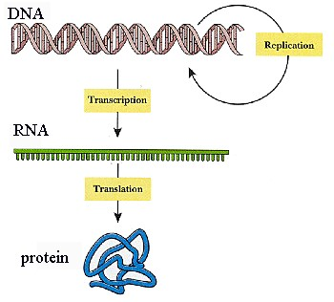
What is gene expression
Genes are sequences in the DNA
Genes are the recipe for creating Proteins

Slide 4
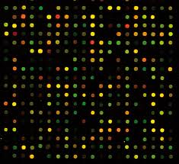
What is gene expression
Genes are sequences in the DNA
Genes are the recipe for creating Proteins
DNA chips / Microarrays tools used to measure gene expression in cellular processes

Slide 5
What is gene expression
Genes are sequences in the DNA
Genes are the recipe for creating Proteins
DNA chips / Microarrays tools used to measure gene expression in cellular processes
Cluster by:
Genes: find related genes, predict function of genes
Samples: find related samples (as in previous paper)

Slide 6
What is gene expression
Genes are sequences in the DNA
Genes are the recipe for creating Proteins
DNA chips / Microarrays tools used to measure gene expression in cellular processes
Cluster by:
Genes: find related genes, predict function of genes
Samples: find related samples (as in previous paper)
Sequential evaluation is sub-optimal (also seen in previous paper)

Slide 7
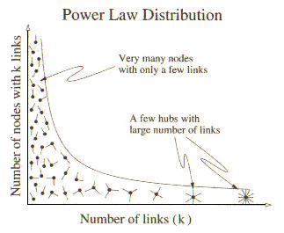
What is biological network
A graph that describe biological features / processes
Bioinformatics has increasingly shifted its focus from individual genes and proteins to large-scale networks
Network topology might be similar to other non-biological networks such as the Internet
For example: Scale free network - a network whose degree distribution follows a power law
Small amount of nodes
with many connections (hubs)

Slide 8
Metabolic networks
Metabolism is the set of life-sustaining chemical transformations within the cells of living organisms
These reactions allow organisms to grow and reproduce, maintain their structures, and respond to their environments
Catalyzed by enzymes
Enzyme is a protein that accelerate metabolic reactions (ie: change one chemical to another)
Each reaction:
Educt
Product
Enzyme

Slide 9
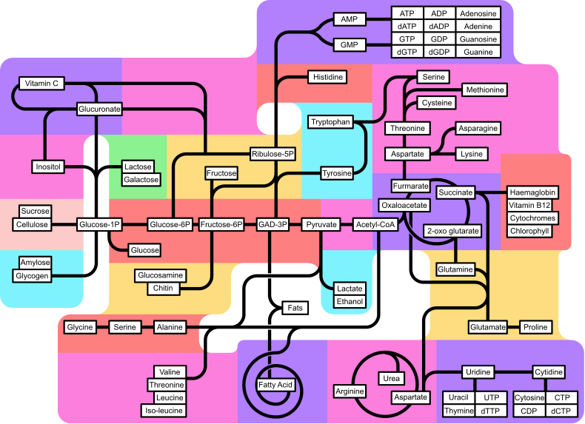
Metabolic networks
In the paper, KEGG database’ metabolic networks were used
Not only humans metabolism

Slide 10
Previous evaluation methods
The goal is to find genes, enzymes and metabolites related to a biological process (pathway)
Sequential evaluation is sub-optimal (also seen in previous paper)
Pathway scoring is used to add data
Previous techniques suffers from combinatorial explosion or static analysis of data

Slide 11
Agenda
Introduction
Constructing biological networks graph
Constructing gene’s expression graph
Combining both into a single graph
Divide nodes to groups using hierarchical clustering
Decide the number of clusters by statistical measures with biological meaning
Validate process using the yeast diauxic shift
Conclusion

Slide 12
Transform metabolic network to graph
Assemble set of reactions into a Petri-net
A bi-partite graph
Molecules (metabolites and enzymes) on one side
Chemical reactions on the other side
Enzyme can have more than one vertex
Related according to proximity

Slide 13
Transform metabolic network to graph
Assemble set of reactions into a Petri-net
A bi-partite graph
Molecules (metabolites and enzymes) on one side
Chemical reactions on the other side
Enzyme can have more than one vertex
Related according to proximity
The graph is undirected
Each edge has weight w
The graph is the weighted distance graph, only with vertices that have gene expression data
How to do that?

Slide 14
How to create
Remove vertices without expression data O(V^2)
Modify edges weight to all pair of vertices that are connected by removed vertex, if the connection has lower weight
Run Floyd-Warshall on remaining vertices O(W^3)

Slide 15
Floyd-Warshall
Uses dynamic programming
Algorithm:

Slide 16
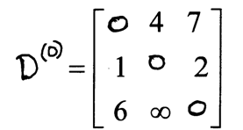
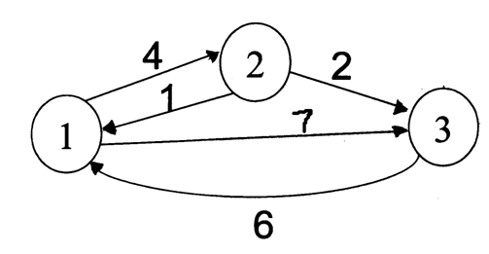
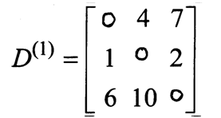
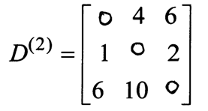
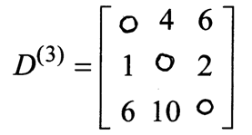
Floyd Warshall Algorithm - Example
Original weights.
Consider Vertex 1:
D(3,2) = D(3,1) + D(1,2)
Consider Vertex 2:
D(1,3) = D(1,2) + D(2,3)
Consider Vertex 3:
Nothing changes.

Slide 17
Floyd-Warshall
Uses dynamic programming
Algorithm:

Slide 18
How to create
Remove vertices without expression data O(V^2)
Modify edges weight to all pair of vertices that are connected by removed vertex, if the connection has lower weight
Run Floyd-Warshall on remaining vertices O(W^3)
Alternatively, can use Dijkstra on all vertices O(WVlogV+WE)
Has better worse-time but actual run was slower
The number of interesting vertices is relatively small

Slide 19
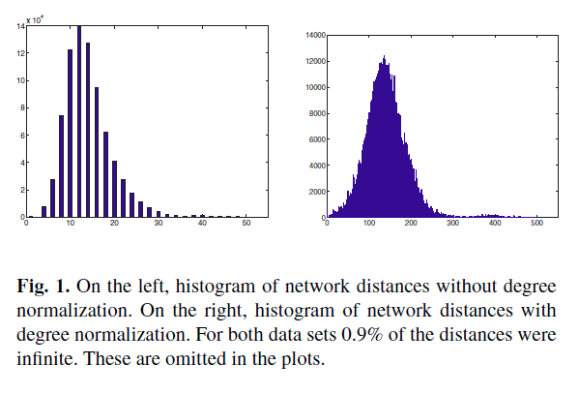
Weight of edges (distance function)
2 alternatives suggested
Fixed weight
Normalized by degree
The weight is decided by the degree of the molecule vertex
since the graph is “scale free” (ie: few hubs), that weighting prevents exploiting hubs

Slide 20
Next step
Calculated graph
Calculate weight
Remove unneeded vertices
Run Floyd-Warshall to calculate min distance for all pairs
Now we need to calculate gene expression graph…

Slide 21
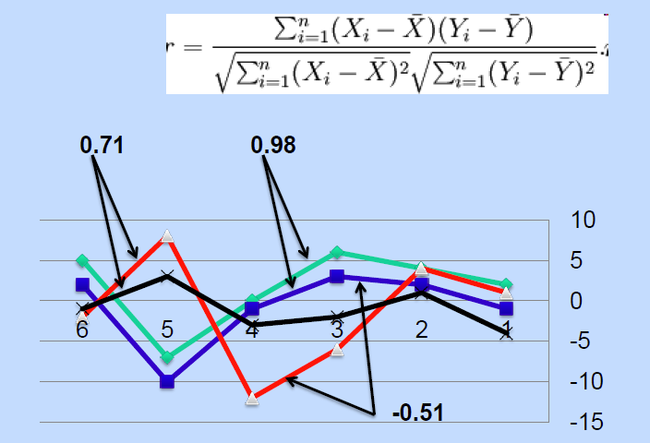
Gene expression graph
The distance (weight) is calculated by Pearson correlation coefficient between time courses of gene expression levels
This was explained in previous class
Gik – The value for gene Gi in time k

Slide 22
Gene expression graph
The distance (weight) is calculated by Pearson correlation coefficient between time courses of gene expression levels
This was explained in previous class
The authors used log of the ratio (the values range is 0-2)
Anti-correlated genes are most distant
The graph notation is

Slide 23
Co-Clustering
Create 2 graphs
Gene expression distance
Metabolic distance
Combine them to one graph
For that a mapping of genes<->enzymes is required

Slide 24
Mapping
genes<->enzymes mapping is required
For yeast, mapping is taken from MIPS database
The mapping is *not* one to one
Each new object representation consists of: Protein, Enzyme classification and Reaction
For example: (HXK1, EC 2.7.1.1/R01786)
There is a translation between each object to enzyme and gene.
Now we have to calculate a distance function

Slide 25
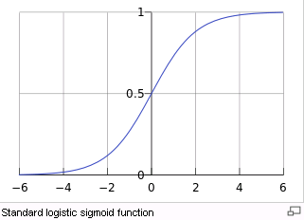
Combined distance function
It should match defined properties
Perfect correlation should not result very small distance
Missing links should not lead to very high distances
Sum of 2 logistic curves was selected
Logistic curve:
The initial stage of growth is approximately exponential; then, as saturation begins, the growth slows, and at maturity, growth stops.

Slide 26
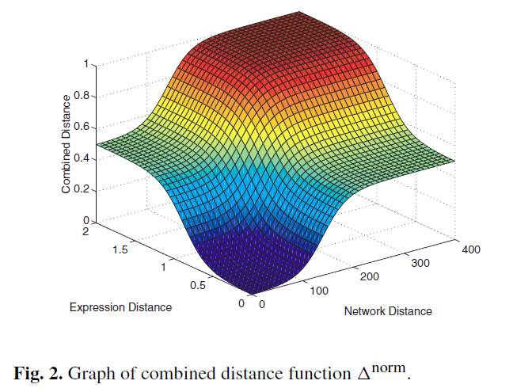
Combined distance function
Sum of 2 logistic curves was selected

Slide 27
Co-Clustering
Create 2 graphs
Gene expression distance
Metabolic distance
Combine them to one graph
For that a mapping of genes<->enzymes is required
Cluster the graph

Slide 28
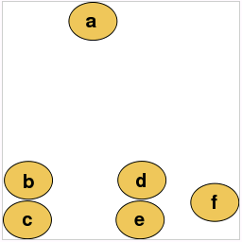
Clustering
Hierarchical average linkage clustering (UPGMA)
The result is a binary tree
Each node is a join step
The distance between nodes is pair-wise average of weights
It might be time consuming (not mentioned in the paper)

Slide 29
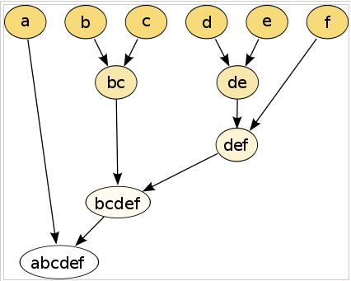
Clustering
Hierarchical average linkage clustering (UPGMA)
The result is a binary tree
Each node is a join step
The distance between nodes is pair-wise average of weights
It might be time consuming (not mentioned in the paper)

Slide 30
Clustering – determine # of clusters
We want to select # of clusters, such that clusters will have biological meaning
Used measures are separation and tightness
Calculated by silhouette-coefficient

Slide 31
silhouette-coefficient
i – node in cluster A
Average distance from A
Average distance from Other nearest cluster
Silhouette coefficient
Range [-1,1]

Slide 32
silhouette-coefficient
i – node in cluster A
Average distance from A
Average distance from Other nearest cluster
Silhouette coefficient
Range [-1,1]

Slide 33
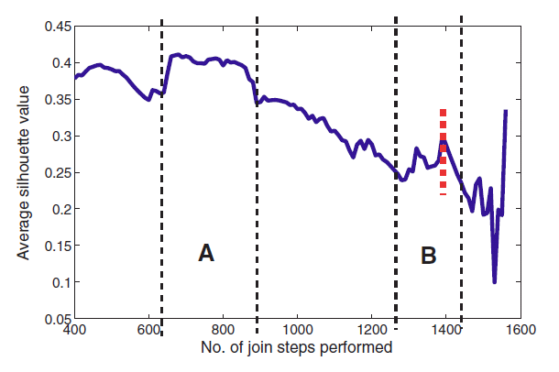
silhouette-coefficient
Silhouette coefficient
Range [-1,1]

Slide 34
Co-Clustering
Create 2 graphs
Gene expression distance
Metabolic distance
Combine them to one graph
For that a mapping of genes<->enzymes is required
Cluster the graph
Decide number of clusters by silhouette-coefficient
Analyze the results

Slide 35
Results
Used data of diauxic shift of yeast
Yeast transforms into a sugar-rich medium
7 time points for gene expression
Expect that the co-clustering will detect relations in that metabolic process

Slide 36
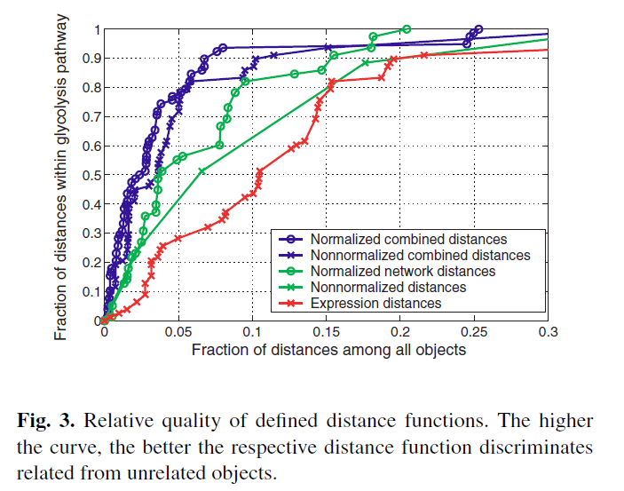
Results
The glycolysis pathway is much closer (less distant) than average – hence it will cluster together

Slide 37
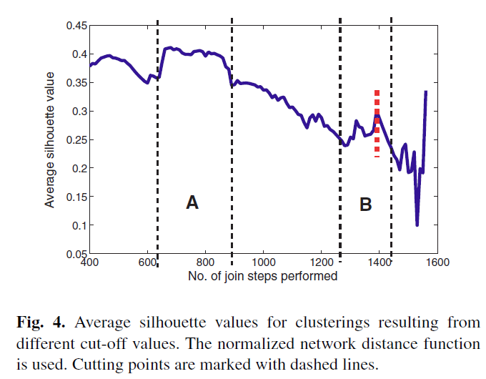
Results
silhouette-coefficient
A – same EC number
B – pathway like
clusters

Slide 38
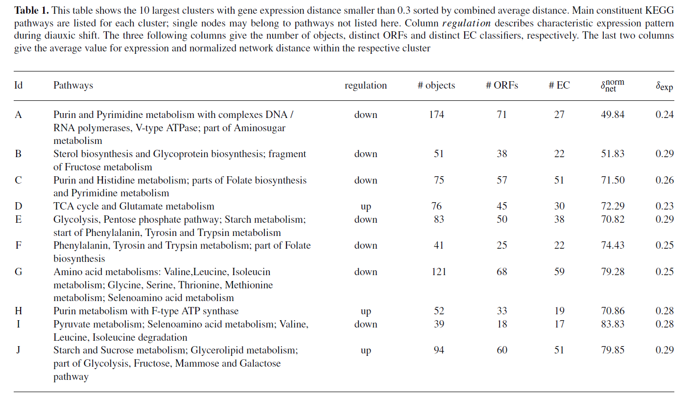
Results

Slide 39
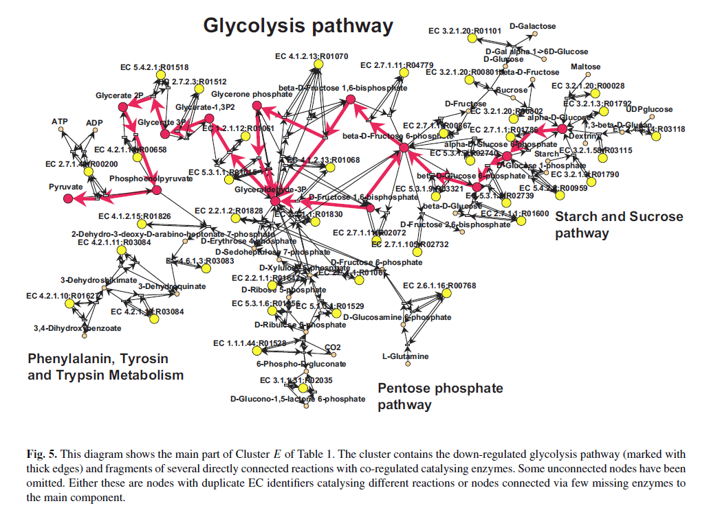
Results

Slide 40
Conclusion – Co-clustering
Create 2 graphs with distance function
Normalized # of connections in metabolic network (and Floyd-Warshall)
PCC in gene expression network
Join them
Mapping to objects
Distance is sum of 2 logistic curve
Cluster by hierarchical average linkage clustering
Decide number of clusters using silhouette coefficient
Can be elaborated to other networks
Outperform other pathway scoring methods

Slide 41
Questions?

Slide 42
Thank you!

