Slide 1
Strong and weak ties
Based on chapter 3 in Networks, Crowds and markets (by Easley and Kleinberg)
Roy Mitz
Supervised by: Prof. Ronitt Rubinfeld
November 2014

Slide 2
Outline
Theory
Real data examples
Some more structural observations

Slide 3
Preface
We will try to discuss the following questions:

Slide 4
Flow of information
How information flows through social networks?

Slide 5
Structural difference
How different nodes can play structurally distinct roles in this process?

Slide 6
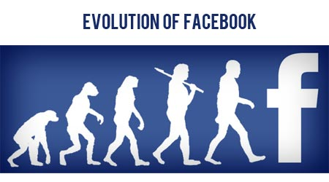
Evolution of a network
How these structural considerations shape the evolution of the network itself over time?

Slide 7
Theory

Slide 8
Starting point: Strength of weak ties
Granovetter, 60’s:
Many people learned information leading to their current jobs through personal contacts.
Is that surprising?

Slide 9
Starting point: Strength of weak ties
These personal contacts were often described by interview subjects as acquaintances rather than close friends
Is that surprising?

Slide 10
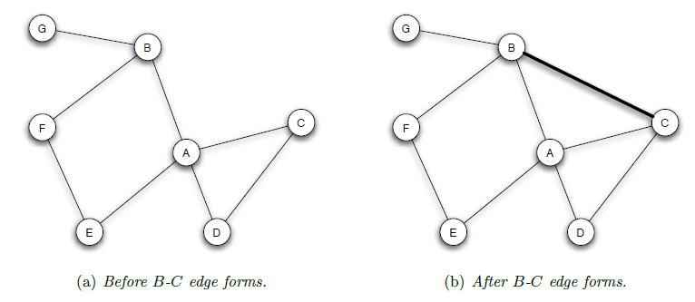
Triadic closure principle
If two people in a social network have a friend in common, then there is an increased likelihood that they will become friends themselves at some point in the future

Slide 11
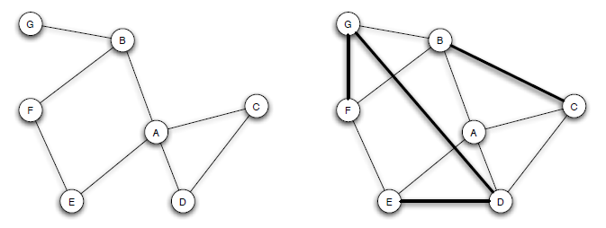
Evolution and triadic closure
Over time we expect to see the formation of such edges

Slide 12
Clustering coefficient
The clustering coefficient of a node A is defined as the probability that two randomly selected friends of A are friends with each other.

Slide 13
Clustering coefficient (example)

Slide 14
Motivation for triadic closure
Opportunity
Basis for trusting
Incentive

Slide 15
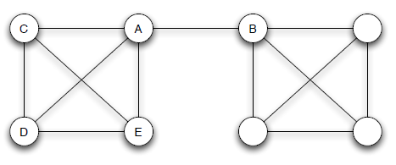
Bridges and local bridges
Structural peculiarity of link to B translates into differences in the role it plays in A’s life?

Slide 16
Bridges and local bridges
tightly-knit nodes A, C,D, and E exposed to similar opinions /sources of information,
A’s link to B offers access to new things

Slide 17
Bridges
edge e= (A,B) is a bridge if deleting e would cause A and B to lie in two different components.

Slide 18
Bridges and local bridges
“Real” bridges are presumably extremely rare in real social networks.

Slide 19
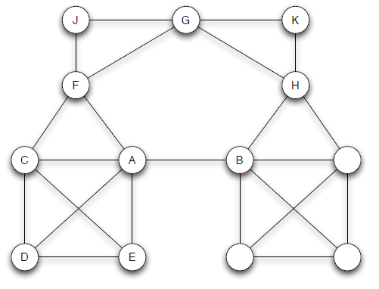
Local bridges
We say that an edge E=(A,B) in a graph is a local bridge if A and B have no friends in common.

Slide 20
Local bridges
In other words, if deleting the edge would increase the distance between A and B to a value strictly more than two.

Slide 21
Bridges and local bridges
Local bridges provide their endpoints with access to parts of the network, and hence sources of information, that they would otherwise be far away from.

Slide 22
Local bridges vs. triadic closure
An edge is a local bridge precisely when it does not form a side of any triangle in the graph

Slide 23
Strength of weak ties revisited
We might expect that if a node is going to get truly new information, (e.g., new job leads), it might come unusually often from a friend connected by a local bridge.

Slide 24
Classification of links into strong and weak ties
We’ll categorize all links in the social network as
belonging to one of two types:

Slide 25
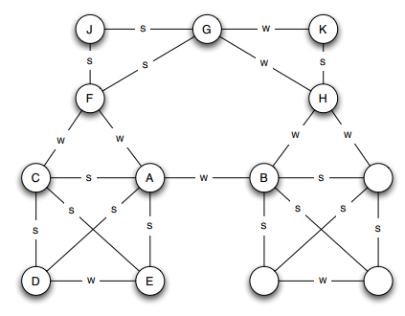
Classification of links into strong and weak ties
Strong ties (the stronger links, corresponding to friends)
Weak ties (the weaker links, corresponding to acquaintances)

Slide 26
Strong Triadic Closure Property
Node A violates the Strong Triadic Closure Property if it has strong ties to two other nodes B and C, and there is no edge at all (either a strong or weak tie) between B and C.
We say that a node A satisfies the Strong Triadic Closure Property if it does not violate it.

Slide 27
Strong Triadic Closure Property
The Strong Triadic Closure Property is too extreme for us to expect it hold across all nodes of a large social network.
However, it is a useful step as an abstraction to reality.

Slide 28
Local Bridges and Weak Ties
Claim:
If a node A in a network satisfies the Strong Triadic Closure Property and is involved in at least two strong ties, then any local bridge it is involved in must be a weak tie.

Slide 29
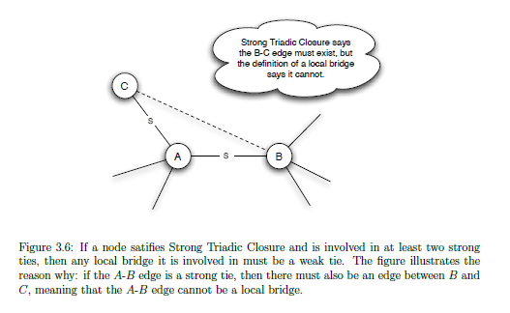
Local Bridges and Weak Ties
Proof:

Slide 30
Local Bridges and Weak Ties
In other words, assuming the Strong Triadic Closure Property and a sufficient number of strong ties, the local bridges in a network are necessarily weak ties.

Slide 31
Conclusions in real life
The assumptions we made are simplified
Making sense as qualitative conclusions that hold in approximate forms

Slide 32
Local bridges in real life
Local bridge between nodes A,B tends to be weak tie.

Slide 33
Local bridges in real life
Otherwise, triadic closure tends to produce short-cuts to A and B that eliminates its role as a local bridge.

Slide 34
The strength of weak ties
Local bridges → connect us to new sources of information and new opportunities
Local bridges → weakness as social ties
This dual role as weak connections but also valuable conduits to hard-to-reach parts of the network — this is the surprising strength of weak ties.

Slide 35
Real data analysis

Slide 36
Cell-phone network (Onnela et al.)
A cell-phone provider that covered roughly 20% of the national population
The nodes correspond to cell-phone users, and there is an edge joining two nodes if they made phone calls to each other in both directions over an 18-week observation period.
Features of a natural social network, such as a giant component.

Slide 37
Generalizing the Notions of Weak Ties
The strength of an edge
we can make it a numerical quantity, defining it to be the total number of minutes spent on phone calls between the two ends of the edge.

Slide 38
Generalizing the Notions of Local Bridges
Neighborhood overlap of an edge connecting
we can make it a numerical quantity, defining it to be the total number of minutes spent on phone calls between the two ends of the edge.

Slide 39
Generalizing the Notions of Local Bridges
This ratio in question is 0 precisely when the numerator is 0, and hence when the edge is a local bridge.

Slide 40
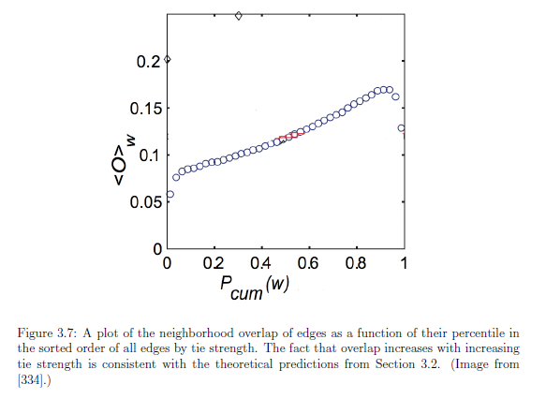
Empirical result 1
How much it is a local bridge?
Strength of a tie

Slide 41
Empirical result 1
The weaker the tie is, the more it functions as a local bridge!
How much it is a local bridge?
Strength of a tie

Slide 42
Empirical result 2
We saw that weak ties serve to link together different
tightly-knit communities that each contain a large number of stronger ties.
Can we test that empirically?

Slide 43
Empirical result 2
Starting from removing the strongest edge, edge by edge, the giant component shrank steadily

Slide 44
Empirical result 2
Starting from removing the weakest edge, the giant component shrank more rapidly, and moreover that its remnants broke apart abruptly once a critical number of weak ties had been removed.

Slide 45
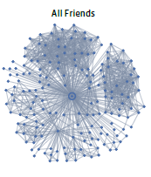
Tie Strength on Facebook (Cameron, Marlow et al)
All friends:
Three categories of links based on usage over a one-month observation period:

Slide 46
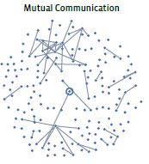
Reciprocal (mutual) communication
The user both sent messages to the friend at the other end of the link, and also received messages from them during the observation period

Slide 47
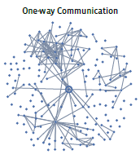
one-way communication
The user sent one or more messages to the friend at the other end of the link

Slide 48
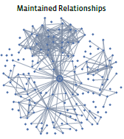
Maintained relationship
The user sent one or more messages to the friend at the other end of the link

Slide 49
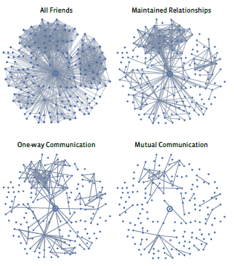
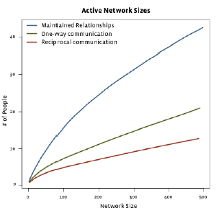
All types of relationships

Slide 50
Conclusions
1) Even for users who report very large numbers of friends on their profile pages, the number with whom they actually communicate is generally between 10 and 20.

Slide 51
Conclusions
2) Passive engagement: passive network occupies an interesting middle ground between the strongest ties maintained by regular communication and the weakest ties preserved only in lists on social-networking profile pages.

Slide 52
Some more structural observations

Slide 53
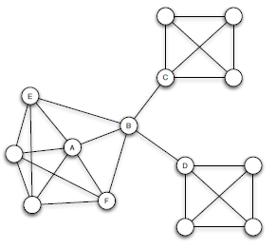
Different experiences that nodes have in a network, based on their environments

Slide 54
Embeddedness
The embeddedness of an edge in a network is the number of common neighbors the two endpoints have.

Slide 55
Embeddedness
Let’s discuss A.
All of his edges have significant embeddedness

Slide 56
Embeddedness
Sociology: if two individuals are connected by an embedded edge, then this makes it easier for them to trust one another
Sanctions

Slide 57
Structural holes (Burt)
Is B poor?

Slide 58
Structural holes (Burt)
B has early access to information originating in multiple, non-interacting parts of the network
Experience from many domains suggests that innovations often arise from the unexpected synthesis of multiple ideas
Gate keeping (power in the organization?)

Slide 59
To conclude
Novel measures of properties of a social network must be introduced
The strength of weak ties

Slide 60
Thank you.

