Slide 1
2007 NIPS Tutorial on:
Deep Belief Nets
Geoffrey Hinton
Canadian Institute for Advanced Research
&
Department of Computer Science
University of Toronto

Slide 2
Some things you will learn in this tutorial
How to learn multi-layer generative models of unlabelled data by learning one layer of features at a time.
  How to add Markov Random Fields in each hidden layer.
How to use generative models to make discriminative training methods work much better for classification and regression.
  How to extend this approach to Gaussian Processes and how to learn complex, domain-specific kernels for a Gaussian Process.
How to perform non-linear dimensionality reduction on very large datasets
  How to learn binary, low-dimensional codes and how to use them for very fast document retrieval.
How to learn multilayer generative models of high-dimensional sequential data.

Slide 3
A spectrum of machine learning tasks
Typical Statistics------------Artificial Intelligence
Low-dimensional data (e.g. less than 100 dimensions)
Lots of noise in the data
There is not much structure in the data, and what structure there is, can be represented by a fairly simple model.
The main problem is distinguishing true structure from noise.
High-dimensional data (e.g. more than 100 dimensions)
The noise is not sufficient to obscure the structure in the data if we process it right.
There is a huge amount of structure in the data, but the structure is too complicated to be represented by a simple model.
The main problem is figuring out a way to represent the complicated structure so that it can be learned.

Slide 4
Historical background:
First generation neural networks
Perceptrons (~1960) used a layer of hand-coded features and tried to recognize objects by learning how to weight these features.
  There was a neat learning algorithm for adjusting the weights.
  But perceptrons are fundamentally limited in what they can learn to do.
Bomb
Toy
output units e.g. class labels
non-adaptive
hand-coded
features
input units e.g. pixels
Sketch of a typical perceptron from the 1960’s

Slide 5
Second generation neural networks (~1985)
Compare outputs with correct answer to get error signal
Back-propagate error signal to get derivatives for learning
outputs
hidden layers
input vector

Slide 6
A temporary digression
Vapnik and his co-workers developed a very clever type of perceptron called a Support Vector Machine.
  Instead of hand-coding the layer of non-adaptive features, each training example is used to create a new feature using a fixed recipe.
    The feature computes how similar a test example is to that training example.
  Then a clever optimization technique is used to select the best subset of the features and to decide how to weight each feature when classifying a test case.
    But its just a perceptron and has all the same limitations.
In the 1990’s, many researchers abandoned neural networks with multiple adaptive hidden layers because Support Vector Machines worked better.

Slide 7
What is wrong with back-propagation?
It requires labeled training data.
  Almost all data is unlabeled.
The learning time does not scale well
  It is very slow in networks with multiple hidden layers.
It can get stuck in poor local optima.

Slide 8
Overcoming the limitations of back-propagation
Keep the efficiency and simplicity of using a gradient method for adjusting the weights, but use it for modeling the structure of the sensory input.
  Adjust the weights to maximize the probability that a generative model would have produced the sensory input.
  Learn p(image) not p(label | image)
    If you want to do computer vision, first learn computer graphics
What kind of generative model should we learn?

Slide 9
Belief Nets
A belief net is a directed acyclic graph composed of stochastic variables.
We get to observe some of the variables and we would like to solve two problems:
The inference problem: Infer the states of the unobserved variables.
The learning problem: Adjust the interactions between variables to make the network more likely to generate the observed data.
stochastic
hidden cause
visible
effect
We will use nets composed of layers of stochastic binary variables with weighted connections. Later, we will generalize to other types of variable.

Slide 10
Stochastic binary units
(Bernoulli variables)
These have a state of 1 or 0.
The probability of turning on is determined by the weighted input from other units (plus a bias)
1
0
0

Slide 11
Learning Deep Belief Nets
It is easy to generate an unbiased example at the leaf nodes, so we can see what kinds of data the network believes in.
It is hard to infer the posterior distribution over all possible configurations of hidden causes.
It is hard to even get a sample from the posterior.
So how can we learn deep belief nets that have millions of parameters?
stochastic
hidden cause
visible
effect

Slide 12
The learning rule for sigmoid belief nets
Learning is easy if we can get an unbiased sample from the posterior distribution over hidden states given the observed data.
For each unit, maximize the log probability that its binary state in the sample from the posterior would be generated by the sampled binary states of its parents.
j
i
learning rate

Slide 13
Explaining away (Judea Pearl)
Even if two hidden causes are independent, they can become dependent when we observe an effect that they can both influence.
  If we learn that there was an earthquake it reduces the probability that the house jumped because of a truck.
-10
-10
truck hits house
earthquake
posterior
20
20
p(1,1)=.0001
p(1,0)=.4999
p(0,1)=.4999
p(0,0)=.0001
-20
house jumps

Slide 14
Why it is usually very hard to learn sigmoid belief nets one layer at a time
To learn W, we need the posterior distribution in the first hidden layer.
Problem 1: The posterior is typically complicated because of “explaining away”.
Problem 2: The posterior depends on the prior as well as the likelihood.
  So to learn W, we need to know the weights in higher layers, even if we are only approximating the posterior. All the weights interact.
Problem 3: We need to integrate over all possible configurations of the higher variables to get the prior for first hidden layer. Yuk!
hidden variables
hidden variables
prior
hidden variables
likelihood
W
data

Slide 15
Two types of generative neural network
If we connect binary stochastic neurons in a directed acyclic graph we get a Sigmoid Belief Net (Radford Neal 1992).
If we connect binary stochastic neurons using symmetric connections we get a Boltzmann Machine (Hinton & Sejnowski, 1983).
  If we restrict the connectivity in a special way, it is easy to learn a Boltzmann machine.

Slide 16
Restricted Boltzmann Machines
(Smolensky ,1986, called them “harmoniums”)
We restrict the connectivity to make learning easier.
  Only one layer of hidden units.
    We will deal with more layers later
  No connections between hidden units.
In an RBM, the hidden units are conditionally independent given the visible states.
  So we can quickly get an unbiased sample from the posterior distribution when given a data-vector.
  This is a big advantage over directed belief nets
hidden
j
i
visible

Slide 17
The Energy of a joint configuration
(ignoring terms to do with biases)
binary state of visible unit i
binary state of hidden unit j
Energy with configuration v on the visible units and h on the hidden units
weight between units i and j

Slide 18
Weights → Energies → Probabilities
Each possible joint configuration of the visible and hidden units has an energy
  The energy is determined by the weights and biases (as in a Hopfield net).
The energy of a joint configuration of the visible and hidden units determines its probability:
The probability of a configuration over the visible units is found by summing the probabilities of all the joint configurations that contain it.

Slide 19
Using energies to define probabilities
The probability of a joint configuration over both visible and hidden units depends on the energy of that joint configuration compared with the energy of all other joint configurations.
The probability of a configuration of the visible units is the sum of the probabilities of all the joint configurations that contain it.
partition function

Slide 20
A picture of the maximum likelihood learning algorithm for an RBM
j
j
j
j
a fantasy
i
i
i
i
t = 0 t = 1 t = 2 t = infinity
Start with a training vector on the visible units.
Then alternate between updating all the hidden units in parallel and updating all the visible units in parallel.

Slide 21
A quick way to learn an RBM
j
j
Start with a training vector on the visible units.
Update all the hidden units in parallel
Update the all the visible units in parallel to get a “reconstruction”.
Update the hidden units again.
i
i
t = 0 t = 1
data
reconstruction
This is not following the gradient of the log likelihood. But it works well. It is approximately following the gradient of another objective function (Carreira-Perpinan & Hinton, 2005).

Slide 22
How to learn a set of features that are good for reconstructing images of the digit 2
50 binary feature neurons
50 binary feature neurons
Increment weights between an active pixel and an active feature
Decrement weights between an active pixel and an active feature
16 x 16 pixel image
16 x 16 pixel image
data (reality)
reconstruction (better than reality)

Slide 23
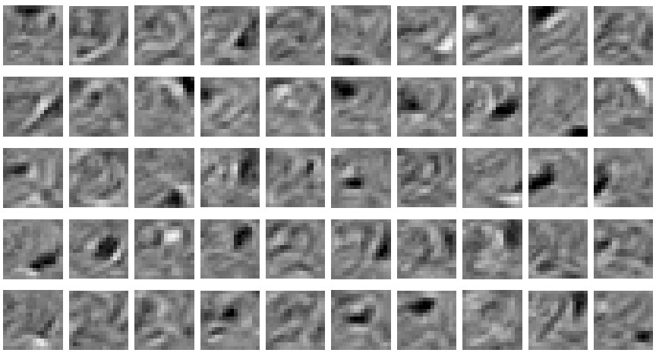
The final 50 x 256 weights
Each neuron grabs a different feature.

Slide 24
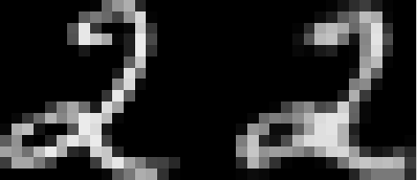
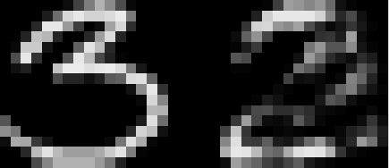
How well can we reconstruct the digit images from the binary feature activations?
Reconstruction from activated binary features
Reconstruction from activated binary features
Data
Data
New test images from the digit class that the model was trained on
Images from an unfamiliar digit class (the network tries to see every image as a 2)

Slide 25
Three ways to combine probability density models (an underlying theme of the tutorial)
Mixture: Take a weighted average of the distributions.
  It can never be sharper than the individual distributions. It’s a very weak way to combine models.
Product: Multiply the distributions at each point and then renormalize.
  Exponentially more powerful than a mixture. The normalization makes maximum likelihood learning difficult, but approximations allow us to learn anyway.
Composition: Use the values of the latent variables of one model as the data for the next model.
  Works well for learning multiple layers of representation, but only if the individual models are undirected.

Slide 26
Training a deep network
(the main reason RBM’s are interesting)
First train a layer of features that receive input directly from the pixels.
Then treat the activations of the trained features as if they were pixels and learn features of features in a second hidden layer.
It can be proved that each time we add another layer of features we improve a variational lower bound on the log probability of the training data.
  The proof is slightly complicated.
  But it is based on a neat equivalence between an RBM and a deep directed model (described later)

Slide 27
The generative model after learning 3 layers
To generate data:
  Get an equilibrium sample from the top-level RBM by performing alternating Gibbs sampling for a long time.
  Perform a top-down pass to get states for all the other layers.
  So the lower level bottom-up connections are not part of the generative model. They are just used for inference.
h3
h2
h1
data

Slide 28
Why does greedy learning work? An aside: Averaging factorial distributions
If you average some factorial distributions, you do NOT get a factorial distribution.
  In an RBM, the posterior over the hidden units is factorial for each visible vector.
  But the aggregated posterior over all training cases is not factorial (even if the data was generated by the RBM itself).

Slide 29
Why does greedy learning work?
Each RBM converts its data distribution into an aggregated posterior distribution over its hidden units.
This divides the task of modeling its data into two tasks:
  Task 1: Learn generative weights that can convert the aggregated posterior distribution over the hidden units back into the data distribution.
  Task 2: Learn to model the aggregated posterior distribution over the hidden units.
  The RBM does a good job of task 1 and a moderately good job of task 2.
Task 2 is easier (for the next RBM) than modeling the original data because the aggregated posterior distribution is closer to a distribution that an RBM can model perfectly.
Task 2
aggregated posterior distribution on hidden units
Task 1
data distribution on visible units

Slide 30
Why does greedy learning work?
The weights, W, in the bottom level RBM define p(v|h) and they also, indirectly, define p(h).
So we can express the RBM model as
If we leave p(v|h) alone and improve p(h), we will improve p(v).
To improve p(h), we need it to be a better model of the aggregated posterior distribution over hidden vectors produced by applying W to the data.

Slide 31
Which distributions are factorial in a directed belief net?
In a directed belief net with one hidden layer, the posterior over the hidden units for each visible vector is non-factorial (due to explaining away).
  The aggregated posterior is factorial if the data was generated by the directed model.
    It’s the opposite way round from an undirected model.
    The intuitions that people have from using directed models are very misleading for undirected models.

Slide 32
Why does greedy learning fail in a directed module?
A directed module also converts its data distribution into an aggregated posterior
  Task 1 is now harder because the posterior for each training case is non-factorial.
  Task 2 is performed using an independent prior. This is a bad approximation unless the aggregated posterior is close to factorial.
A directed module attempts to make the aggregated posterior factorial in one step.
  This is too difficult and leads to a bad compromise. There is no guarantee that the aggregated posterior is easier to model than the data distribution.
Task 2
aggregated posterior distribution on hidden units
Task 1
data distribution on visible units

Slide 33
A model of digit recognition
The top two layers form an associative memory whose energy landscape models the low dimensional manifolds of the digits.
The energy valleys have names
2000 top-level neurons
10 label neurons
500 neurons
The model learns to generate combinations of labels and images.
To perform recognition we start with a neutral state of the label units and do an up-pass from the image followed by a few iterations of the top-level associative memory.
500 neurons
28 x 28 pixel image

Slide 34
Fine-tuning with a contrastive version of the “wake-sleep” algorithm
After learning many layers of features, we can fine-tune the features to improve generation.
1. Do a stochastic bottom-up pass
  Adjust the top-down weights to be good at reconstructing the feature activities in the layer below.
Do a few iterations of sampling in the top level RBM
  -- Adjust the weights in the top-level RBM.
Do a stochastic top-down pass
  Adjust the bottom-up weights to be good at reconstructing the feature activities in the layer above.

Slide 35
Show the movie of the network generating digits
(available at www.cs.toronto/~hinton)

Slide 36
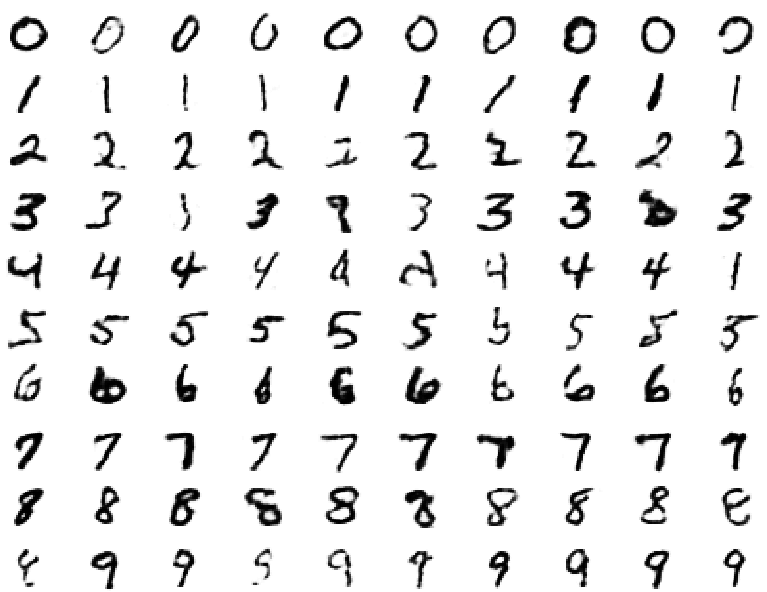
Samples generated by letting the associative memory run with one label clamped. There are 1000 iterations of alternating Gibbs sampling between samples.

Slide 37
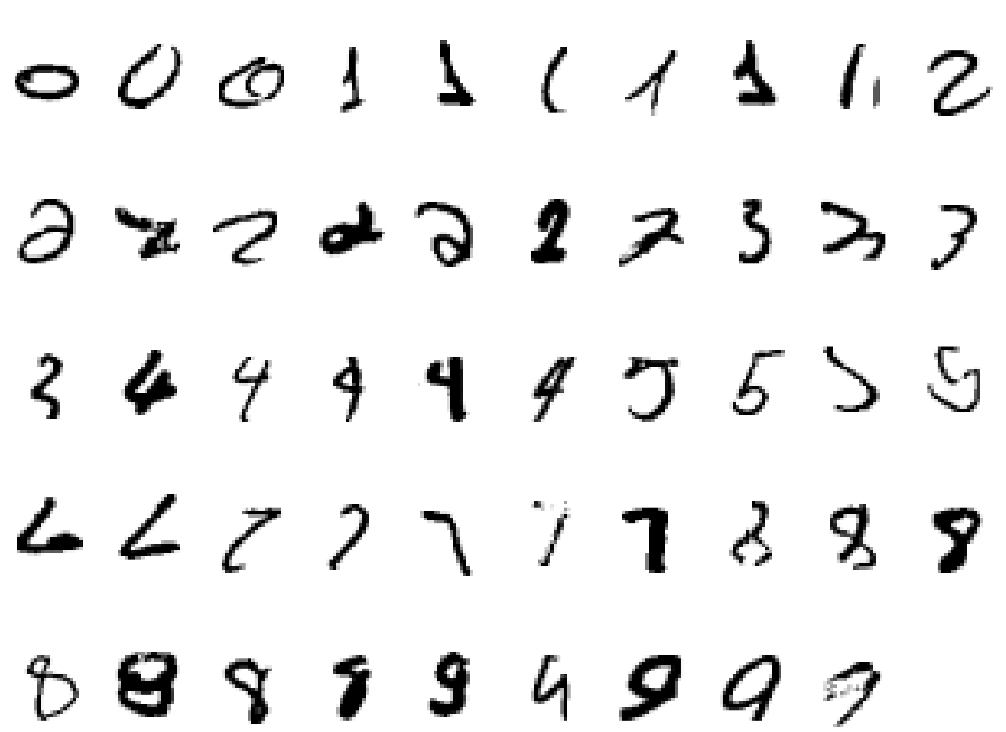
Examples of correctly recognized handwritten digits that the neural network had never seen before
Its very good

Slide 38
How well does it discriminate on MNIST test set with no extra information about geometric distortions?
Generative model based on RBM’s 1.25%
Support Vector Machine (Decoste et. al.) 1.4%
Backprop with 1000 hiddens (Platt) ~1.6%
Backprop with 500 -->300 hiddens ~1.6%
K-Nearest Neighbor ~ 3.3%
See Le Cun et. al. 1998 for more results
Its better than backprop and much more neurally plausible because the neurons only need to send one kind of signal, and the teacher can be another sensory input.

Slide 39
Unsupervised “pre-training” also helps for models that have more data and better priors
Ranzato et. al. (NIPS 2006) used an additional 600,000 distorted digits.
They also used convolutional multilayer neural networks that have some built-in, local translational invariance.
Back-propagation alone: 0.49%
Unsupervised layer-by-layer
pre-training followed by backprop: 0.39% (record)

Slide 40
Another view of why layer-by-layer learning works
There is an unexpected equivalence between RBM’s and directed networks with many layers that all use the same weights.
  This equivalence also gives insight into why contrastive divergence learning works.

Slide 41
An infinite sigmoid belief net that is equivalent to an RBM
etc.
h2
The distribution generated by this infinite directed net with replicated weights is the equilibrium distribution for a compatible pair of conditional distributions: p(v|h) and p(h|v) that are both defined by W
  A top-down pass of the directed net is exactly equivalent to letting a Restricted Boltzmann Machine settle to equilibrium.
  So this infinite directed net defines the same distribution as an RBM.
v2
h1
v1
h0
v0

Slide 42
Inference in a directed net with replicated weights
etc.
h2
The variables in h0 are conditionally independent given v0.
  Inference is trivial. We just multiply v0 by W transpose.
  The model above h0 implements a complementary prior.
  Multiplying v0 by W transpose gives the product of the likelihood term and the prior term.
Inference in the directed net is exactly equivalent to letting a Restricted Boltzmann Machine settle to equilibrium starting at the data.
v2
h1
v1
+
+
h0
+
+
v0

Slide 43
etc.
The learning rule for a sigmoid belief net is:
With replicated weights this becomes:
h2
v2
h1
v1
h0
v0

Slide 44
Learning a deep directed network
etc.
First learn with all the weights tied
  This is exactly equivalent to learning an RBM
  Contrastive divergence learning is equivalent to ignoring the small derivatives contributed by the tied weights between deeper layers.
h2
v2
h1
v1
h0
h0
v0
v0

Slide 45
Then freeze the first layer of weights in both directions and learn the remaining weights (still tied together).
  This is equivalent to learning another RBM, using the aggregated posterior distribution of h0 as the data.
etc.
h2
v2
h1
v1
v1
h0
h0
v0

Slide 46
How many layers should we use and how wide should they be?
(I am indebted to Karl Rove for this slide)
How many lines of code should an AI program use and how long should each line be?
  This is obviously a silly question.
Deep belief nets give the creator a lot of freedom.
  How best to make use of that freedom depends on the task.
  With enough narrow layers we can model any distribution over binary vectors (Sutskever & Hinton, 2007)
If freedom scares you, stick to convex optimization of shallow models that are obviously inadequate for doing Artificial Intelligence.

Slide 47
What happens when the weights in higher layers become different from the weights in the first layer?
The higher layers no longer implement a complementary prior.
  So performing inference using the frozen weights in the first layer is no longer correct.
  Using this incorrect inference procedure gives a variational lower bound on the log probability of the data.
    We lose by the slackness of the bound.
The higher layers learn a prior that is closer to the aggregated posterior distribution of the first hidden layer.
  This improves the network’s model of the data.
    Hinton, Osindero and Teh (2006) prove that this improvement is always bigger than the loss.

Slide 48
A stack of RBM’s
(Yee-Whye Teh’s idea)
Each RBM has the same subscript as its hidden layer.
Each RBM defines its own distribution over its visible vectors
Each RBM defines its own distribution over its hidden vectors
hL
h2
h1
v

Slide 49
The variational bound
Each time we replace the prior over the hidden units by a better prior, we win by the difference in the probability assigned
Now we cancel out all of the partition functions except the top one and replace log probabilities by goodnesses using the fact that:
This has simple derivatives that give a more justifiable fine-tuning algorithm than contrastive wake-sleep.

Slide 50
Summary so far
Restricted Boltzmann Machines provide a simple way to learn a layer of features without any supervision.
  Maximum likelihood learning is computationally expensive because of the normalization term, but contrastive divergence learning is fast and usually works well.
Many layers of representation can be learned by treating the hidden states of one RBM as the visible data for training the next RBM (a composition of experts).
This creates good generative models that can then be fine-tuned.
  Contrastive wake-sleep can fine-tune generation.

Slide 51
Overview of the rest of the tutorial
How to fine-tune a greedily trained generative model to be better at discrimination.
How to learn a kernel for a Gaussian process.
How to use deep belief nets for non-linear dimensionality reduction and document retrieval.
How to use deep belief nets for sequential data.
How to learn a generative hierarchy of conditional random fields.

Slide 52
BREAK

Slide 53
Fine-tuning for discrimination
First learn one layer at a time greedily.
Then treat this as “pre-training” that finds a good initial set of weights which can be fine-tuned by a local search procedure.
  Contrastive wake-sleep is one way of fine-tuning the model to be better at generation.
Backpropagation can be used to fine-tune the model for better discrimination.
  This overcomes many of the limitations of standard backpropagation.

Slide 54
Why backpropagation works better after greedy pre-training
Greedily learning one layer at a time scales well to really big networks, especially if we have locality in each layer.
We do not start backpropagation until we already have sensible weights that already do well at the task.
  So the initial gradients are sensible and backprop only needs to perform a local search.
Most of the information in the final weights comes from modeling the distribution of input vectors.
  The precious information in the labels is only used for the final fine-tuning. It slightly modifies the features. It does not need to discover features.
  This type of backpropagation works well even if most of the training data is unlabeled. The unlabeled data is still very useful for discovering good features.

Slide 55
First, model the distribution of digit images
The top two layers form a restricted Boltzmann machine whose free energy landscape should model the low dimensional manifolds of the digits.
2000 units
500 units
The network learns a density model for unlabeled digit images. When we generate from the model we get things that look like real digits of all classes.
But do the hidden features really help with digit discrimination?
Add 10 softmaxed units to the top and do backpropagation.
500 units
28 x 28 pixel image

Slide 56
Results on permutation-invariant MNIST task
Very carefully trained backprop net with 1.6% one or two hidden layers (Platt; Hinton)
SVM (Decoste & Schoelkopf, 2002) 1.4%
Generative model of joint density of 1.25% images and labels (+ generative fine-tuning)
Generative model of unlabelled digits 1.15% followed by gentle backpropagation (Hinton & Salakhutdinov, Science 2006)

Slide 57
Combining deep belief nets with Gaussian processes
Deep belief nets can benefit a lot from unlabeled data when labeled data is scarce.
  They just use the labeled data for fine-tuning.
Kernel methods, like Gaussian processes, work well on small labeled training sets but are slow for large training sets.
So when there is a lot of unlabeled data and only a little labeled data, combine the two approaches:
  First learn a deep belief net without using the labels.
  Then apply Gaussian process models to the deepest layer of features. This works better than using the raw data.
  Then use GP’s to get the derivatives that are back-propagated through the deep belief net. This is a further win. It allows GP’s to fine-tune complicated domain-specific kernels.

Slide 58
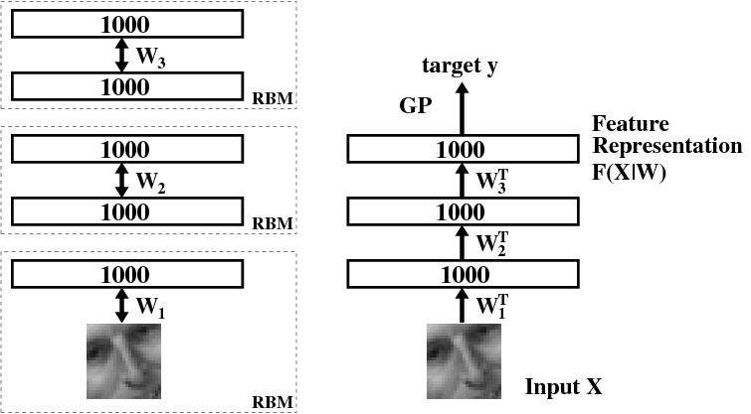
Learning to extract the orientation of a face patch (Salakhutdinov & Hinton, NIPS 2007)

Slide 59
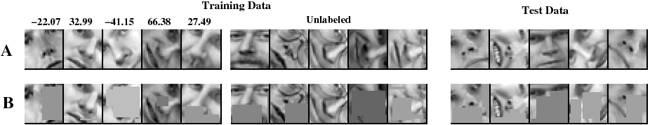
The training and test sets
100, 500, or 1000 labeled cases
11,000 unlabeled cases
face patches from new people

Slide 60
The root mean squared error in the orientation when combining GP’s with deep belief nets
GP on the pixels
GP on top-level features
GP on top-level features with fine-tuning
100 labels
500 labels
1000 labels
22.2 17.9 15.2
17.2 12.7 7.2
16.3 11.2 6.4
Conclusion: The deep features are much better than the pixels. Fine-tuning helps a lot.

Slide 61
Modeling real-valued data
For images of digits it is possible to represent intermediate intensities as if they were probabilities by using “mean-field” logistic units.
  We can treat intermediate values as the probability that the pixel is inked.
This will not work for real images.
  In a real image, the intensity of a pixel is almost always almost exactly the average of the neighboring pixels.
  Mean-field logistic units cannot represent precise intermediate values.

Slide 62
The free-energy of a mean-field logistic unit
In a mean-field logistic unit, the total input provides a linear energy-gradient and the negative entropy provides a containment function with fixed curvature.
So it is impossible for the value 0.7 to have much lower free energy than both 0.8 and 0.6. This is no good for modeling real-valued data.
energy
F→
- entropy
0 output-> 1

Slide 63
An RBM with real-valued visible units
Using Gaussian visible units we can get much sharper predictions and alternating Gibbs sampling is still easy, though learning is slower.
E →
parabolic containment function
energy-gradient produced by the total input to a visible unit
Welling et. al. (2005) show how to extend RBM’s to the exponential family. See also Bengio et. al. 2007)

Slide 64
Deep Autoencoders
(Hinton & Salakhutdinov, 2006)
28x28
1000 neurons
They always looked like a really nice way to do non-linear dimensionality reduction:
  But it is very difficult to optimize deep autoencoders using backpropagation.
We now have a much better way to optimize them:
  First train a stack of 4 RBM’s
  Then “unroll” them.
  Then fine-tune with backprop.
500 neurons
250 neurons
30
linear units
250 neurons
500 neurons
1000 neurons
28x28

Slide 65
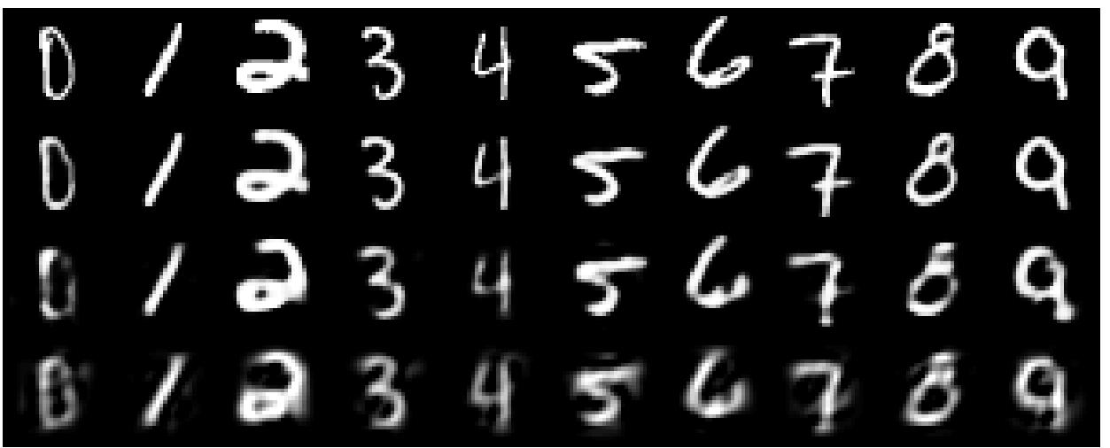
A comparison of methods for compressing digit images to 30 real numbers.
real data
30-D deep auto
30-D logistic PCA
30-D PCA

Slide 66
Do the 30-D codes found by the deep autoencoder preserve the class structure of the data?
Take the 30-D activity patterns in the code layer and display them in 2-D using a new form of non-linear multi-dimensional scaling
  The method is called UNI-SNE (Cook et. al. 2007).
  It keeps similar patterns close together and tries to push dissimilar ones far apart.
Does the learning find the natural classes?

Slide 67
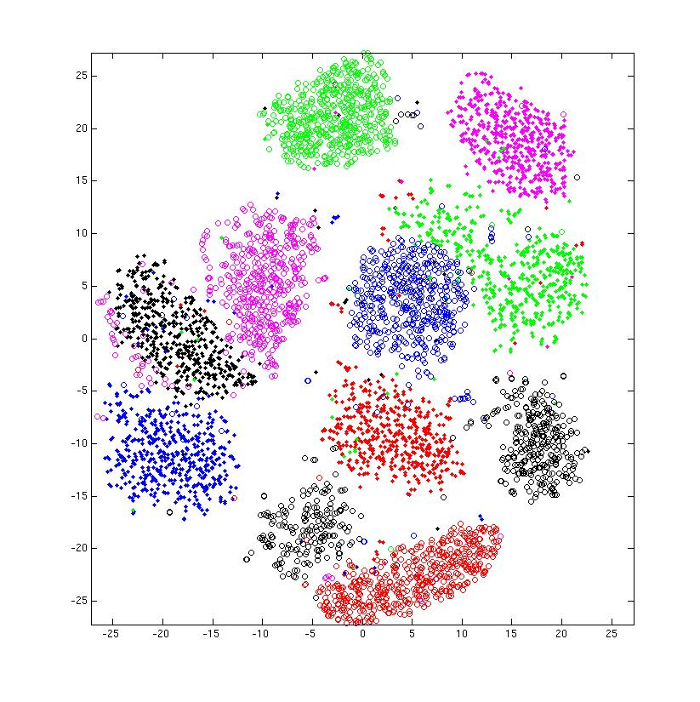
entirely unsupervised except for the colors

Slide 68
Retrieving documents that are similar to a query document
We can use an autoencoder to find low-dimensional codes for documents that allow fast and accurate retrieval of similar documents from a large set.
We start by converting each document into a “bag of words”. This a 2000 dimensional vector that contains the counts for each of the 2000 commonest words.

Slide 69
How to compress the count vector
output vector
2000 reconstructed counts
500 neurons
We train the neural network to reproduce its input vector as its output
This forces it to compress as much information as possible into the 10 numbers in the central bottleneck.
These 10 numbers are then a good way to compare documents.
250 neurons
10
250 neurons
500 neurons
2000 word counts
input vector

Slide 70
Performance of the autoencoder at document retrieval
Train on bags of 2000 words for 400,000 training cases of business documents.
  First train a stack of RBM’s. Then fine-tune with backprop.
Test on a separate 400,000 documents.
  Pick one test document as a query. Rank order all the other test documents by using the cosine of the angle between codes.
  Repeat this using each of the 400,000 test documents as the query (requires 0.16 trillion comparisons).
Plot the number of retrieved documents against the proportion that are in the same hand-labeled class as the query document.

Slide 71
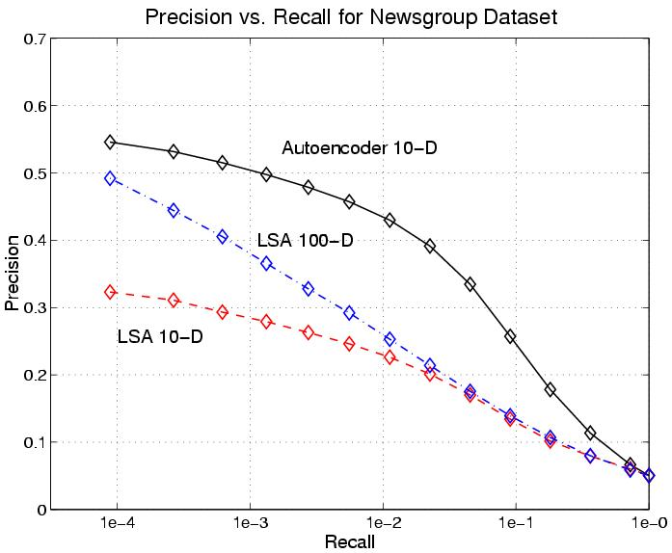
Proportion of retrieved documents in same class as query
Number of documents retrieved

Slide 72
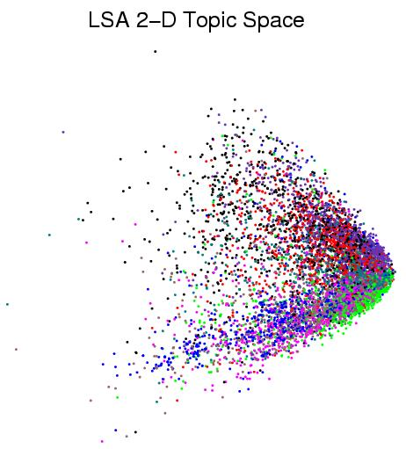
First compress all documents to 2 numbers using a type of PCA Then use different colors for different document categories

Slide 73
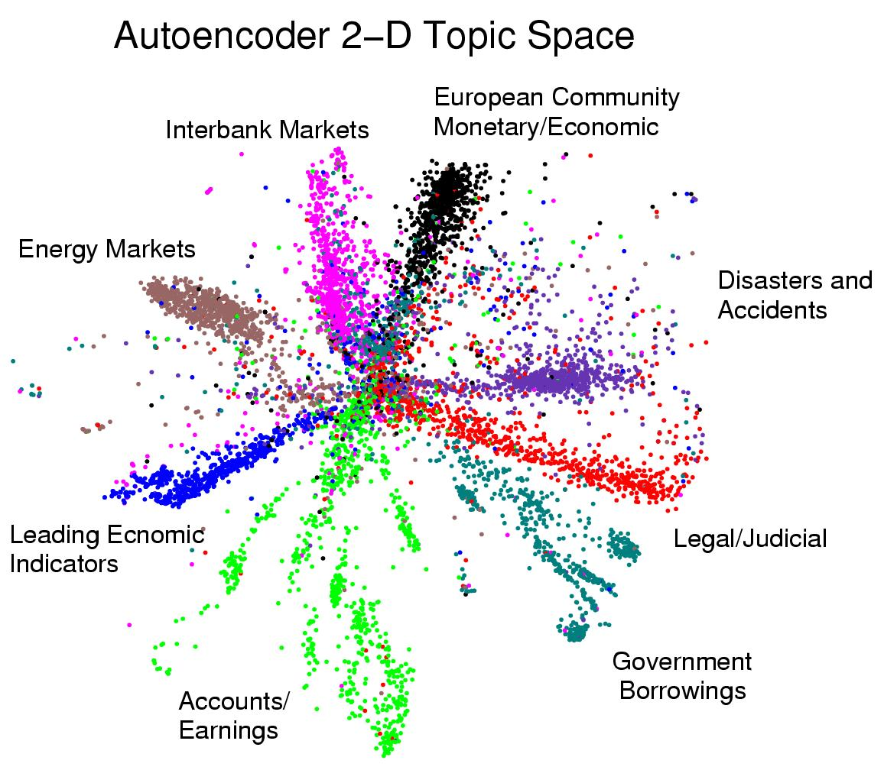
First compress all documents to 2 numbers. Then use different colors for different document categories

Slide 74
Finding binary codes for documents
2000 reconstructed counts
Train an auto-encoder using 30 logistic units for the code layer.
During the fine-tuning stage, add noise to the inputs to the code units.
  The “noise” vector for each training case is fixed. So we still get a deterministic gradient.
  The noise forces their activities to become bimodal in order to resist the effects of the noise.
  Then we simply round the activities of the 30 code units to 1 or 0.
500 neurons
250 neurons
30
noise
250 neurons
500 neurons
2000 word counts

Slide 75
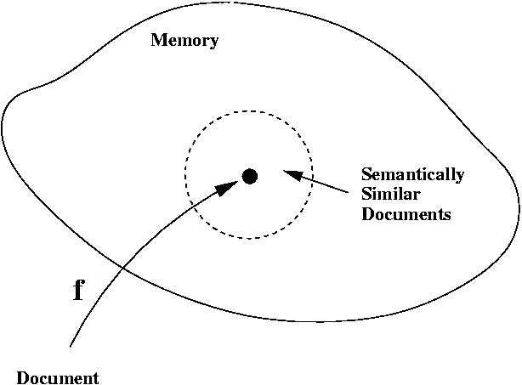
Semantic hashing: Using a deep autoencoder as a hash-function for finding approximate matches (Salakhutdinov & Hinton, 2007)
hash function
“supermarket search”

Slide 76
How good is a shortlist found this way?
We have only implemented it for a million documents with 20-bit codes --- but what could possibly go wrong?
  A 20-D hypercube allows us to capture enough of the similarity structure of our document set.
The shortlist found using binary codes actually improves the precision-recall curves of TF-IDF.
  Locality sensitive hashing (the fastest other method) is 50 times slower and has worse precision-recall curves.

Slide 77
Time series models
Inference is difficult in directed models of time series if we use non-linear distributed representations in the hidden units.
  It is hard to fit Dynamic Bayes Nets to high-dimensional sequences (e.g motion capture data).
So people tend to avoid distributed representations and use much weaker methods (e.g. HMM’s).

Slide 78
Time series models
If we really need distributed representations (which we nearly always do), we can make inference much simpler by using three tricks:
  Use an RBM for the interactions between hidden and visible variables. This ensures that the main source of information wants the posterior to be factorial.
  Model short-range temporal information by allowing several previous frames to provide input to the hidden units and to the visible units.
This leads to a temporal module that can be stacked
  So we can use greedy learning to learn deep models of temporal structure.

Slide 79
The conditional RBM model
(Sutskever & Hinton 2007)
Given the data and the previous hidden state, the hidden units at time t are conditionally independent.
  So online inference is very easy
Learning can be done by using contrastive divergence.
  Reconstruct the data at time t from the inferred states of the hidden units and the earlier states of the visibles.
  The temporal connections can be learned as if they were additional biases
t
t-2 t-1 t

Slide 80
Why the autoregressive connections do not cause problems
The autoregressive connections do not mess up contrastive divergence learning because:
  We know the initial state of the visible units, so we know the initial effect of the autoregressive connections.
  It is not necessary for the reconstructions to be at equilibrium with the hidden units.
  The important thing for contrastive divergence is to ensure the hiddens are in equilibrium with the visibles whenever statistics are measured.

Slide 81
Generating from a learned model
t
The inputs from the earlier states of the visible units create dynamic biases for the hidden and current visible units.
Perform alternating Gibbs sampling for a few iterations between the hidden units and the current visible units.
  This picks new hidden and visible states that are compatible with each other and with the recent history.
t-2 t-1 t

Slide 82
Stacking temporal RBM’s
Treat the hidden activities of the first level TRBM as the data for the second-level TRBM.
  So when we learn the second level, we get connections across time in the first hidden layer.
After greedy learning, we can generate from the composite model
  First, generate from the top-level model by using alternating Gibbs sampling between the current hiddens and visibles of the top-level model, using the dynamic biases created by the previous top-level visibles.
  Then do a single top-down pass through the lower layers, but using the autoregressive inputs coming from earlier states of each layer.

Slide 83
An application to modeling motion capture data
(Taylor, Roweis & Hinton, 2007)
Human motion can be captured by placing reflective markers on the joints and then using lots of infrared cameras to track the 3-D positions of the markers.
Given a skeletal model, the 3-D positions of the markers can be converted into the joint angles plus 6 parameters that describe the 3-D position and the roll, pitch and yaw of the pelvis.
  We only represent changes in yaw because physics doesn’t care about its value and we want to avoid circular variables.

Slide 84
Modeling multiple types of motion
We can easily learn to model walking and running in a single model.
  This means we can share a lot of knowledge.
  It should also make it much easier to learn nice transitions between walking and running.
    In a switching mixture of dynamical systems its hard to get the latent variables to join up nicely when we switch from one system to another.
Because we can do online inference (slightly incorrectly), we can fill in missing markers in real time.

Slide 85
Show Graham Taylor’s movies available at www.cs.toronto/~hinton

Slide 86
Generating the parts of an object
One way to maintain the constraints between the parts is to generate each part very accurately
  But this would require a lot of communication bandwidth.
Sloppy top-down specification of the parts is less demanding
  but it messes up relationships between features
  so use redundant features and use lateral interactions to clean up the mess.
Each transformed feature helps to locate the others
  This allows a noisy channel
“square”
+
pose parameters
sloppy top-down activation of parts
features with top-down support
clean-up using known interactions
Its like soldiers on a parade ground

Slide 87
Semi-restricted Boltzmann Machines
We restrict the connectivity to make learning easier.
Contrastive divergence learning requires the hidden units to be in conditional equilibrium with the visibles.
  But it does not require the visible units to be in conditional equilibrium with the hiddens.
  All we require is that the visible units are closer to equilibrium in the reconstructions than in the data.
So we can allow connections between the visibles.
hidden
j
i
visible

Slide 88
Learning a semi-restricted Boltzmann Machine
1. Start with a training vector on the visible units.
2. Update all of the hidden units in parallel
3. Repeatedly update all of the visible units in parallel using mean-field updates (with the hiddens fixed) to get a “reconstruction”.
4. Update all of the hidden units again.
j
j
i
k
i
k
i
k
i
k
t = 0 t = 1
data
reconstruction
update for a lateral weight

Slide 89
Learning in Semi-restricted Boltzmann Machines
Method 1: To form a reconstruction, cycle through the visible units updating each in turn using the top-down input from the hiddens plus the lateral input from the other visibles.
Method 2: Use “mean field” visible units that have real values. Update them all in parallel.
  Use damping to prevent oscillations
damping
total input to i

Slide 90
Results on modeling natural image patches using a stack of RBM’s (Osindero and Hinton)
Stack of RBM’s learned one at a time.
400 Gaussian visible units that see whitened image patches
  Derived from 100,000 Van Hateren image patches, each 20x20
The hidden units are all binary.
  The lateral connections are learned when they are the visible units of their RBM.
Reconstruction involves letting the visible units of each RBM settle using mean-field dynamics.
  The already decided states in the level above determine the effective biases during mean-field settling.
1000 top-level units. No MRF.
Undirected Connections
Hidden MRF with 500 units
Directed Connections
Hidden MRF with 2000 units
Directed Connections
400 Gaussian units

Slide 91
Without lateral connections
real data
samples from model

Slide 92
With lateral connections
real data
samples from model

Slide 93
A funny way to use an MRF
The lateral connections form an MRF.
The MRF is used during learning and generation.
The MRF is not used for inference.
  This is a novel idea so vision researchers don’t like it.
The MRF enforces constraints. During inference, constraints do not need to be enforced because the data obeys them.
  The constraints only need to be enforced during generation.
Unobserved hidden units cannot enforce constraints.
  This requires lateral connections or observed descendants.

Slide 94
Why do we whiten data?
Images typically have strong pair-wise correlations.
Learning higher order statistics is difficult when there are strong pair-wise correlations.
  Small changes in parameter values that improve the modeling of higher order statistics may be rejected because they form a slightly worse model of the much stronger pair-wise statistics.
So we often remove the second-order statistics before trying to learn the higher-order statistics.

Slide 95
Whitening the learning signal instead of the data
Contrastive divergence learning can remove the effects of the second-order statistics on the learning without actually changing the data.
  The lateral connections model the second order statistics
  If a pixel can be reconstructed correctly using second order statistics, its will be the same in the reconstruction as in the data.
  The hidden units can then focus on modeling high-order structure that cannot be predicted by the lateral connections.
    For example, a pixel close to an edge, where interpolation from nearby pixels causes incorrect smoothing.

Slide 96
Towards a more powerful, multi-linear stackable learning module
So far, the states of the units in one layer have only been used to determine the effective biases of the units in the layer below.
It would be much more powerful to modulate the pair-wise interactions in the layer below. (A good way to design a hierarchical system is to allow each level to determine the objective function of the level below.)
  For example, a vertical edge represents a breakdown in the usual correlational structure of the pixels: Horizontal interpolation does not work, so it needs to be turned off, but interpolation parallel to the edge is OK.
To modulate pair-wise interactions we need higher-order Boltzmann machines.

Slide 97
Higher order Boltzmann machines (Sejnowski, ~1986)
The usual energy function is quadratic in the states:
But we could use higher order interactions:
Unit k acts as a switch. When unit k is on, it switches in the pairwise interaction between unit i and unit j.
  Units i and j can also be viewed as switches that control the pairwise interactions between j and k or between i and k.

Slide 98
A picture of a conditional, higher-order Boltzmann machine
(Hinton & Lang,1985)
object-based features
viewing transform
We can view it as a Boltzmann machine in which the inputs create interactions between the other variables.
  This type of model is now called a conditional random field.
  It is hard to learn with two hidden groups.
retina-based features

Slide 99
Using conditional higher-order Boltzmann machines to model image transformations (Memisevic and Hinton, 2007)
A transformation unit specifies which pixel goes to which other pixel.
Conversely, each pair of similar intensity pixels, one in each image, votes for all the compatible transformation units.
image transformation
image(t)
image(t+1)

Slide 100
Readings on deep belief nets
A reading list (that is still being updated) can be found at
www.cs.toronto.edu/~hinton/csc2515/deeprefs.html

