Slide 1
Code Generation for OO programs
Mooly Sagiv
http://ellcc.org/demo/index.cgi
llvm.org
Chapter 6.2.9
https://www.cis.upenn.edu/~stevez/ CS341

Slide 2
Outline
Iterative vs. Recursive Programing Quiz
Compiling function calls
Compiling OO Programs

Slide 3
Recursive Fibonacci
define i32 @rfib(i32) #0 {
%2 = alloca i32, align 4
%3 = alloca i32, align 4
store i32 %0, i32* %3, align 4
%4 = load i32, i32* %3, align 4
%5 = icmp eq i32 %4, 0
br i1 %5, label %6, label %7
; <label>:6:
store i32 0, i32* %2, align 4
br label %19
; <label>:7:
%8 = load i32, i32* %3, align 4
%9 = icmp eq i32 %8, 1
br i1 %9, label %10, label %11
; <label>:10:
store i32 1, i32* %2, align 4
br label %19
; <label>:11:
%12 = load i32, i32* %3, align 4
%13 = sub nsw i32 %12, 2
%14 = call i32 @rfib(i32 %13)
%15 = load i32, i32* %3, align 4
%16 = sub nsw i32 %15, 1
%17 = call i32 @rfib(i32 %16)
%18 = add nsw i32 %14, %17
store i32 %18, i32* %2, align 4
br label %19
; <label>:19:
%20 = load i32, i32* %2, align 4
ret i32 %20
}
int rfib(int n) {
if (n==0) return 0;
else if (n==1) return 1;
else return rfib(n-2) + rfib(n-1) ;
}

Slide 4
Iterative Fibonacci
%8 = icmp sgt i32 %7, 1
br i1 %8, label %9, label %17
; <label>:9:
%10 = load i32, i32* %3, align 4
%11 = load i32, i32* %4, align 4
%12 = add nsw i32 %10, %11
store i32 %12, i32* %5, align 4
%13 = load i32, i32* %4, align 4
store i32 %13, i32* %3, align 4
%14 = load i32, i32* %5, align 4
store i32 %14, i32* %4, align 4
%15 = load i32, i32* %2, align 4
%16 = add nsw i32 %15, -1
store i32 %16, i32* %2, align 4
br label %6
; <label>:17:
%18 = load i32, i32* %4, align 4
ret i32 %18
}
define i32 @ifib(i32) #0 {
%2 = alloca i32, align 4
%3 = alloca i32, align 4
%4 = alloca i32, align 4
%5 = alloca i32, align 4
store i32 %0, i32* %2, align 4
store i32 0, i32* %3, align 4
store i32 1, i32* %4, align 4
br label %6
; <label>:6:
%7 = load i32, i32* %2, align 4
int ifib(int n) {
int prev, current;
prev = 0;
current = 1;
while (n>1) {
int new ;
new = prev + current;
prev = current;
current = new;
n--;
}
return current;
}

Slide 5
Generating Code to Compute R-values (Prev. Lecture)
Reclusively traverse the tree
Load R-values of variables and constants into new symbolic register
Store each subtree into a new symbolic registers

Slide 6
Pseudocode R -Value(Prev. Lecture)
register rvalue(e: expression) { new: register = newRegister()
switch e {
case number(n: integer): { emit(%new = load i32 n, align 4) }
case localVariable(v: symbol): {
r: register = registerOf(v)
emit(%new= load i32* r, align 4) }
case e1: expression PLUS e2: expression: {
l: register = rvalue(e1) // Generate code for lhs into l
r: register = rvalue(e2) // Generate code for rhs into r
emit(%new = add nsw i32 l, r)
}
return new;
}

Slide 7
Pseudocode R -Value
register rvalue(e: expression) { new: register = newRegister()
switch e {
…
case call f(e1: expression, e2: expression, …, ek: expression): { for i=1 to k do {
ri: register = rvalue(ei) // Generate code for first arg into r1
} // assembly code is more complex
emit(%new = call f(r1, r2, …, rk))
}
return new;
}

Slide 8
Pseudocode R -Value
register rvalue(e: expression) { new: register = newRegister()
switch e {
…
case call f(e1: expression, e2: expression, …, ek: expression): {
r1: register=newRegister()
r2: register=newRegister()
…
}
return new;
}

Slide 9
Indirect Calls(1)
#include <stdio.h>
void printNumber(int nbr)
{
printf("%d\n", nbr);
}
void myFunction(void (*f)(int))
{
for(int i = 0; i < 5; i++)
{
(*f)(i);
}
}
int main(void)
{
myFunction(printNumber);
return (0);
}
@.str = private unnamed_addr constant [4 x i8] c"%d\0A\00", align 1
define void @printNumber(i32) #0 {
%2 = alloca i32, align 4
store i32 %0, i32* %2, align 4
%3 = load i32, i32* %2, align 4
%4 = call i32 (i8*, ...) @printf(i8* getelementptr inbounds ([4 x i8], [4 x i8]* @.str, i32 0, i32 0), i32 %3)
ret void
}

Slide 10
define void @myFunction(void (i32)*) #0 {
%2 = alloca void (i32)*, align 8
%3 = alloca i32, align 4
store void (i32)* %0, void (i32)** %2, align 8
store i32 0, i32* %3, align 4
br label %4
; <label>:4:
%5 = load i32, i32* %3, align 4
%6 = icmp slt i32 %5, 5
br i1 %6, label %7, label %13
; <label>:7:
%8 = load void (i32)*, void (i32)** %2, align 8
%9 = load i32, i32* %3, align 4
call void %8(i32 %9)
br label %10
; <label>:10:
%11 = load i32, i32* %3, align 4
%12 = add nsw i32 %11, 1
store i32 %12, i32* %3, align 4
br label %4
; <label>:13:
ret void
}
#include <stdio.h>
void printNumber(int nbr)
{
printf("%d\n", nbr);
}
void myFunction(void (*f)(int))
{
for(int i = 0; i < 5; i++)
{
(*f)(i);
}
}
int main(void)
{
myFunction(printNumber);
return (0);
}

Slide 11
Compiling Structs
void foo() {
struct {
int f1;
int f2;
} tuple;
tuple.f1 = 5;
tuple.f2=7;
}
%struct.anon = type { i32, i32 }
define void @foo() #0 {
%1 = alloca %struct.anon, align 4
%2 = getelementptr inbounds %struct.anon, %struct.anon* %1, i32 0, i32 0
store i32 5, i32* %2, align 4
%3 = getelementptr inbounds %struct.anon, %struct.anon* %1, i32 0, i32 1
store i32 7, i32* %3, align 4
ret void
}

Slide 12
Compiling Object Oriented Programs
Mooly Sagiv
Chapter 6.2.9

Slide 13
Subjects
OO programs
Objects Types
Features of OO languages
Optimizations for OO languages
Summary

Slide 14
Object Oriented Programs
Objects (usually of type called class)
Code
Data
Naturally supports Abstract Data Type implementations
Information hiding
Evolution & reusability
Examples: Simula, Smalltalk, Modula 3, C++, Java, C#, Python

Slide 15
A Simple Example
class Vehicle extends object {
int position = 10;
void move(int x)
{
position = position + x ;
}
class Truck extends Vehicle {
void move(int x)
{
if (x < 55)
position = position+x;
}
t
class main extends object {
void main() {
Truck t = new Truck();
Car c = new Car();
Vehicle v = c;
c. move(60);
v.move(70);
c.await(t);}
}
Truck
class Car extends Vehicle {
int passengers = 0 ;
void await(vehicle v) {
if (v.position < position)
v.move(position-v.position);
else this.move(10);
}
position=10

Slide 16
A Simple Example
class Vehicle extends object {
int position = 10;
void move(int x)
{
position = position + x ;
}
class Truck extends Vehicle {
void move(int x)
{
if (x < 55)
position = position+x;
}
t
class main extends object {
void main() {
Truck t = new Truck();
Car c = new Car;
Vehicle v = c;
c. move(60);
v.move(70);
c.await(t); }}
Truck
class Car extends Vehicle {
int passengers = 0 ;
void await(vehicle v) {
if (v.position < position)
v.move(position-v.position);
else this.move(10);
}
position=10
Car
position=10
passengers=0
c

Slide 17
A Simple Example
class Vehicle extends object {
int position = 10;
void move(int x)
{
position = position + x ;
}
class Truck extends Vehicle {
void move(int x)
{
if (x < 55)
position = position+x;
}
t
class main extends object {
void main() {
Truck t = new Truck();
Car c = new Car();
Vehicle v = c;
c. move(60);
v.move(70);
c.await(t);}}
Truck
class Car extends Vehicle {
int passengers = 0 ;
void await(vehicle v) {
if (v.position < position)
v.move(position-v.position);
else this.move(10);
}
position=10
Car
position=10
passengers=0
v
c

Slide 18
A Simple Example
class Vehicle extends object {
int position = 10;
void move(int x)
{
position = position + x ;
}
class Truck extends Vehicle {
void move(int x)
{
if (x < 55)
position = position+x;
}
t
class main extends object {
void main() {
Truck t = new Truck();
Car c = new Car();
Vehicle v = c;
c. move(60);
v.move(70);
c.await(t);}}
Truck
class Car extends Vehicle {
int passengers = 0 ;
void await(vehicle v) {
if (v.position < position)
v.move(position-v.position);
else this.move(10);
}
position=10
Car
70
position=10
passengers=0
v
c

Slide 19
A Simple Example
class Vehicle extends object {
int position = 10;
void move(int x)
{
position = position + x ;
}
class Truck extends Vehicle {
void move(int x)
{
if (x < 55)
position = position+x;
}
t
class main extends object {
void main() {
Truck t = new Truck();
Car c = new Car();
Vehicle v = c;
c. move(60);
v.move(70);
c.await(t);}}
Truck
class Car extends Vehicle {
int passengers = 0 ;
void await(vehicle v) {
if (v.position < position)
v.move(position-v.position);
else this.move(10);
}
position=10
Car
140
position=70
passengers=0
v
c

Slide 20
A Simple Example
class Vehicle extends object {
int position = 10;
void move(int x)
{
position = position + x ;
}
class Truck extends Vehicle {
void move(int x)
{
if (x < 55)
position = position+x;
}
t
class main extends object {
void main() {
Truck t = new Truck();
Car c = new Car();
Vehicle v = c;
c. move(60);
v.move(70);
c.await(t);
}}
Truck
class Car extends Vehicle {
int passengers = 0 ;
void await(vehicle v) {
if (v.position < position)
v.move(position-v.position);
else this.move(10);
}
position=10
Car
position=140
passengers=0
v
c

Slide 21
A Simple Example
class Vehicle extends object {
int position = 10;
void move(int x)
{
position = position + x ;
}
class Truck extends Vehicle {
void move(int x)
{
if (x < 55)
position = position+x;
}
t
class main extends object {
void main() {
Truck t = new Truck();
Car c = new Car();
Vehicle v = c;
c. move(60);
v.move(70);
c.await(t);
}}
Truck
class Car extends Vehicle {
int passengers = 0 ;
void await(vehicle v) {
if (v.position < position)
v.move(position-v.position);
else this.move(10);
}
position=10
Car
position=140
passengers=0
v
c

Slide 22
Translation into C (Vehicle)
class Vehicle extends object {
int position = 10;
void move(int x)
{
position = position + x ;
}
struct Vehicle {
int position ;
}
void New_V(struct Vehicle *this)
{
this→position = 10;
}
void move_V(struct Vehicle *this, int x)
{
this→position=this→position + x;
}

Slide 23
Translation into C(Truck)
class Truck extends Vehicle {
void move(int x)
{
if (x < 55)
position = position+x;
}
struct Truck {
int position ;
}
void New_T(struct Truck *this)
{
this→position = 10;
}
void move_T(struct Truck *this, int x)
{
if (x <55)
this→position=this→position + x;
}

Slide 24
Naïve Translation into C(Car)
class Car extends Vehicle {
int passengers = 0 ;
void await(vehicle v) {
if (v.position < position)
v.move(position-v.position);
else this.move(10);
}
struct Car {
int position ;
int passengers; }
void New_C(struct Car *this)
{ this→position = 10;
this →passengers = 0; }
void await_C(struct Car *this, struct Vehicle *v)
{ if (v→position < this →position )
move_V(this →position - v→position )
else Move_C(this, 10) ;}
Notes:
The above translation is incorrect since it does not handle dynamic method binding
It is possible to avoid duplicating the code of move

Slide 25
Naïve Translation into C(Main)
class main extends object {
void main(){
Truck t = new Truck();
Car c = new Car();
Vehicle v = c;
c. move(60);
v.move(70);
c.await(t);}}
void main_M()
{
struct Truck *t = malloc(1, sizeof(struct Truck));
struct Car *c= malloc(1, sizeof(struct Car));
struct Vehicle *v = (struct Vehicle*) c;
move_V((struct Vehicle*) c, 60);
move_V(v, 70);
await_C(c,(struct Vehicle *) t);
}

Slide 26
Compiling Simple Classes
Fields are handled as records
Methods have unique names
Runtime object
Compile-Time Table
class A {
field a1;
field a2;
method m1() {…}
method m2(int i) {…}
}
a1
m1_A
a2
m2_A
void m2_A(class_A *this, int i)
{
Body of m2 with any object field x as this →x
}
a.m2(5)
m2_A(&a, 5)

Slide 27
Features of OO languages
Inheritance
Method overriding
Polymorphism
Dynamic binding

Slide 28
Handling Single Inheritance
Simple type extension
Type checking module checks consistency
Use prefixing to assign fields in a consistent way
class A {
field a1;
field a2;
method m1() {…}
method m2() {…}
}
class B extends A {
field a3;
method m3() {…}
}
Runtime object
Compile-Time Table
a1
m1_A
Runtime object
Compile-Time Table
a2
m2_A
a1
m1_A
a3
m3_B
a2
m2_A

Slide 29
Method Overriding
Redefines functionality
class A {
field a1;
field a2;
method m1() {…}
method m2() {…}
}
class B extends A {
field a3;
method m2() {…}
method m3() {…}
}
m2 is redefined
m2 is declared and defined

Slide 30
Method Overriding
Redefines functionality
Affects semantic analysis
class A {
field a1;
field a2;
method m1() {…}
method m2() {…}
}
class B extends A {
field a3;
method m2() {…}
method m3() {…}
}
Runtime object
Compile-Time Table
a1
m1_A_A
Runtime object
Compile-Time Table
a2
m2_A_B
a1
m1_A_A
a3
m3_B_B
a2
m2_A_A

Slide 31
Method Overriding
class A {
field a1;
field a2;
method m1() {…}
method m2() {…}
}
class B extends A {
field a3;
method m2() {…}
method m3() {…}
}
Runtime object
Compile-Time Table
Runtime object
Compile-Time Table
a1
m1_A_A
a1
m1_A_A
a2
m2_A_B
a2
m2_A_A
a3
m3_B_B
a.m2 () // class(a)=A
a.m2 () // class(a)=B
⇓
⇓
m2_A_A (&a)
m2_A_B (&a)

Slide 32
Method Overriding (C)
struct class_B {
field a1;
field a2;
field a3;
}
void m2_A_B(class_B *this, int x) {…}
void m3_B_B(class B *this) {…}
}
struct class_A {
field a1;
field a2;
}
void m1_A_A(class_A *this) {…}
void m2_A_A(class_A *this, int x) ) {…}
Runtime object
Compile-Time Table
Runtime object
Compile-Time Table
a1
m1_A_A
a1
m1_A_A
a2
m2_A_B
a2
m2_A_A
a3
m3_B_B
a.m2 (5) // class(a)=A
a.m2 (5) // class(a)=B
⇓
⇓
m2_A_A (&a, 5)
m2_A_B (&a, 5)

Slide 33
Abstract Methods
Declared separately
Defined in child classes
Java abstract classes
Handled similarly
Textbook uses “Virtual” for abstract

Slide 34
Handling Polymorphism
When a class B extends a class A
variable of type pointer to A may actually refer to object of type B
Upcasting from a subclass to a superclass
Prefixing guarantees validity
class B *b = …;
class A *a = b ;
⇒
class A *a=convert_ptr_to_B_to_ptr_A(b) ;
Pointer to B
a1
Pointer to A inside B
a2
b1

Slide 35
Dynamic Binding
An object o of class A can refer to a class B
What does ‘o.m()’ mean?
Static binding
Dynamic binding
Depends on the programming language rules
How to implement dynamic binding?
The invoked function is not known at compile time
Need to operate on data of the B and A in consistent way

Slide 36
Conceptual Implementation of Dynamic Binding
struct class_A {
field a1;
field a2;
}
void m1_A_A(class_A *this) {…}
void m2_A_A(class_A *this, int x) ) {…}
struct class_B {
field a1;
field a2;
field a3;
}
void m2_A_B(class_B *this, int x) {…}
void m3_B_B(class B *this) {…}
}
Runtime object
Compile-Time Table
Runtime object
Compile-Time Table
a1
m1_A_A
a1
m1_A_A
a2
m2_A_A
a2
m2_A_B
a3
m3_B_B
switch(dynamic_type(p) {
case Dynamic_class_A: m2_A_A(p, 3);
case Dynamic_class_B:m2_A_B(convert_ptr_to_A_to_ptr_B(p), 3);
}
p.m2(3);

Slide 37
More efficient implementation
Apply pointer conversion in sublasses void m2_A_B(class A *this_A, int x) { Class_B *this = convert_ptr_to_A_ptr_to_A_B(this_A); … }
Use dispatch table to invoke functions
Similar to table implementation of case

Slide 38
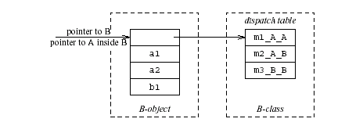
struct class_B {
field a1;
field a2;
field a3;
}
void m2_A_B(class_A *this_A, int x) {
Class_B *this = convert_ptr_to_A_to_ptr_to_B(this_A);
…}
void m3_B_B(class A *this_A) {…}
}
struct class_A {
field a1;
field a2;
}
void m1_A_A(class_A *this) {…}
void m2_A_A(class_A *this, int x) ) {…}
p.m2(3);
p→dispatch_table→m2_A(p, 3);

Slide 39
struct class_B {
field a1;
field a2;
field a3;
}
void m2_A_B(class_A *this_A, int x) {
Class_B *this = convert_ptr_to_A_to_ptr_to_B(this_A);
…}
void m3_B_B(class A *this_A) {…}
}
struct class_A {
field a1;
field a2;
}
void m1_A_A(class_A *this) {…}
void m2_A_A(class_A *this, int x) ) {…}
p.m2(3); // p is a pointer to B
m2_A_B(convert_ptr_to_B_to_ptr_to_A(p), 3);

Slide 40
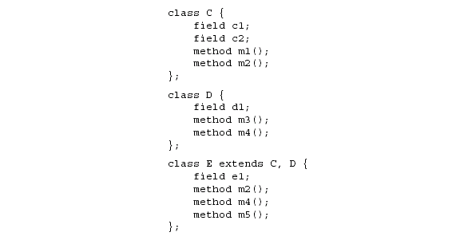
Multiple Inheritance
c1
c2
d1

Slide 41
Multiple Inheritance
Allows unifying behaviors
But raises semantic difficulties
Ambiguity of classes
Repeated inheritance
Hard to implement
Semantic analysis
Code generation
Prefixing no longer work
Need to generate code for downcasts
Hard to use

Slide 42
A simple implementation
Merge dispatch tables of superclases
Generate code for upcasts and downcasts

Slide 43
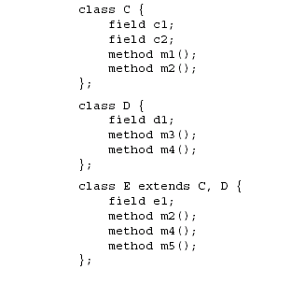
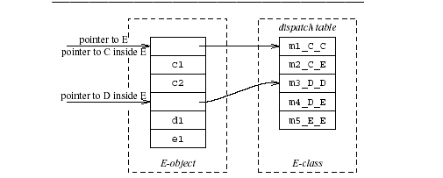
A simple implementation

Slide 44
A simple implementation (downcasting)
convert_ptr_to_E_to_ptr_to_C(e) = e;
convert_ptr_to_E_to_ptr_to_D(e) = e + sizeof(C);

Slide 45
A simple implementation (upcasting)
convert_ptr_to_C_to_ptr_to_E(c) = c;
convert_ptr_to_D_to_ptr_to_E(d) = d - sizeof(C);

Slide 46
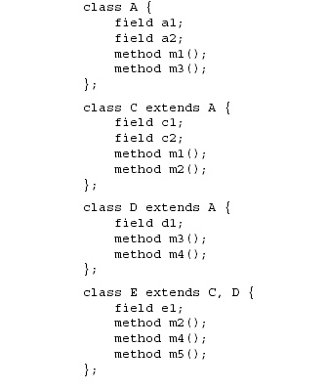
Dependent Multiple Inheritance

Slide 47
Dependent Inheritance
The simple solution does not work
The positions of nested fields do not agree

Slide 48
David Wheeler 1926-2004
“All problems in computer science can be solved by another level of indirection”

Slide 49
Implementation
Use an index table to access fields
Access offsets indirectly
Some compilers avoid index table and use register allocation techniques to globally assign offsets

Slide 50
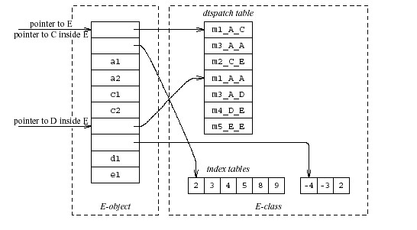

Slide 51
Class Descriptors
Runtime information associated with instances
Dispatch tables
Invoked methods
Index tables
Shared between instances of the same class

Slide 52
Interface Types
Java supports limited form of multiple inheritance
Interface consists of several methods but no fields
A class can implement multiple interfaces public interface Comparable {
public int compare(Comparable o); }
Simpler to implement/understand/use
A separate dispatch table per interface specification which refers to the implemented method

Slide 53
Dynamic Class Loading
Supported by some OO languages (Java)
At compile time
the actual class of a given object at a given program point may not be known
Some addresses have to be resolved at runtime
Compiling c.f() when f is dynamic:
Fetch the class descriptor d at offset 0 from c
Fetch p the address of the method-instance f from (constant) f offset at d
Jump to the routine at address p (saving return address)

Slide 54
Other OO Features
Information hiding
private/public/protected fields
Semantic analysis (context handling)
Testing class membership

Slide 55
Optimizing OO languages
Hide additional costs
Replace dynamic by static binding when possible
Eliminate runtime checks
Eliminate dead fields
Simultaneously generate code for multiple classes
Code space is an issue

Slide 56
Summary
OO features complicates compilation
Semantic analysis
Code generation
Runtime
Memory management
Understanding compilation of OO can be useful for programmers

