Slide 1
Lexical Analysis
Textbook:Modern Compiler Design
Chapter 2.1

Slide 2
A motivating example
Create a program that counts the number of lines in a given input text file

Slide 3
Solution (Flex)
int num_lines = 0;
%%
\n ++num_lines;
. ;
%%
main()
{
yylex();
printf( "# of lines = %d\n", num_lines);
}

Slide 4
Solution(Flex)
initial
\n
int num_lines = 0;
%%
\n ++num_lines;
. ;
%%
main()
{
yylex();
printf( "# of lines = %d\n", num_lines);
}
newline
other
;

Slide 5
JLex Spec File
Possible source of javac errors down the road
User code
Copied directly to Java file
%%
DIGIT= [0-9]
LETTER= [a-zA-Z]
YYINITIAL
JLex directives
Define macros, state names
%%
Lexical analysis rules
Optional state, regular expression, action
How to break input to tokens
Action when token matched
{LETTER} ({LETTER}|{DIGIT})*

Slide 6
Jlex linecount
File: lineCount
import java_cup.runtime.*;
%%
%cup
%{
private int lineCounter = 0;
%}
%eofval{
System.out.println("line number=" + lineCounter);
return new Symbol(sym.EOF);
%eofval}
NEWLINE=\n
%%
{NEWLINE} {
lineCounter++;
}
[^{NEWLINE}] { }

Slide 7
Outline
Roles of lexical analysis
What is a token
Regular expressions
Lexical analysis
Automatic Creation of Lexical Analysis
Error Handling

Slide 8
Basic Compiler Phases
Source program (string)
Front-End
lexical analysis
Tokens
syntax analysis
Abstract syntax tree
semantic analysis
Annotated Abstract syntax tree
Back-End
Fin. Assembly

Slide 9
Example Tokens
Type | Examples
ID | foo n_14 last
NUM | 73 00 517 082
REAL | 66.1 .5 10. 1e67 5.5e-10
IF | if
COMMA | ,
NOTEQ | !=
LPAREN | (
RPAREN | )

Slide 10
Example Non Tokens
Type | Examples
comment | /* ignored */
preprocessor directive | #include <foo.h>
 | #define NUMS 5, 6
macro | NUMS
whitespace | \t \n \b

Slide 11
Example
void match0(char *s) /* find a zero */
{
if (!strncmp(s, “0.0”, 3))
return 0. ;
}
VOID ID(match0) LPAREN CHAR DEREF ID(s)
RPAREN LBRACE IF LPAREN NOT ID(strncmp) LPAREN ID(s) COMMA STRING(0.0) COMMA NUM(3)
RPAREN RPAREN RETURN REAL(0.0) SEMI RBRACE EOF

Slide 12
Lexical Analysis (Scanning)
input
program text (file)
output
sequence of tokens
Read input file
Identify language keywords and standard identifiers
Handle include files and macros
Count line numbers
Remove whitespaces
Report illegal symbols
[Produce symbol table]

Slide 13
Why Lexical Analysis
Simplifies the syntax analysis
And language definition
Modularity
Reusability
Efficiency

Slide 14
What is a token?
Defined by the programming language
Can be separated by spaces
Smallest units
Defined by regular expressions

Slide 15
A simplified scanner for C
Token nextToken()
{
char c ;
loop: c = getchar();
switch (c){
case ` `:goto loop ;
case `;`: return SemiColumn;
case `+`: c = getchar() ;
switch (c) {
case `+': return PlusPlus ;
case '=’ return PlusEqual;
default: ungetc(c);
return Plus; }
case `<`:
case `w`:
}

Slide 16
Regular Expressions
Basic patterns | Matching
x | The character x
. | Any character expect newline
[xyz] | Any of the characters x, y, z
R? | An optional R
R* | Zero or more occurrences of R
R+ | One or more occurrences of R
R₁R₂ | R₁ followed by R₂
R₁|R₂ | Either R₁ or R₂
(R) | R itself

Slide 17
Escape characters in regular expressions
\ converts a single operator into text
a\+
(a\+\*)+
Double quotes surround text
“a+*”+
Esthetically ugly
But standard

Slide 18
Ambiguity Resolving
Find the longest matching token
Between two tokens with the same length use the one declared first

Slide 19
The Lexical Analysis Problem
Given
A set of token descriptions
Token name
Regular expression
An input string
Partition the strings into tokens (class, value)
Ambiguity resolution
The longest matching token
Between two equal length tokens select the first

Slide 20
A Jlex specification of C Scanner
import java_cup.runtime.*;
%%
%cup
%{
private int lineCounter = 0;
%}
Letter= [a-zA-Z_]
Digit= [0-9]
%%
”\t” { }
”\n” { lineCounter++; }
“;” { return new Symbol(sym.SemiColumn);}
“++” {return new Symbol(sym.PlusPlus); }
“+=” {return new Symbol(sym.PlusEq); }
“+” {return new Symbol(sym.Plus); }
“while” {return new Symbol(sym.While); }
{Letter}({Letter}|{Digit})*
{return new Symbol(sym.Id, yytext() ); }
“<=” {return new Symbol(sym.LessOrEqual); }
“<” {return new Symbol(sym.LessThan); }

Slide 21
Jlex
Input
regular expressions and actions (Java code)
Output
A scanner program that reads the input and applies actions when input regular expression is matched
regular expressions
Jlex
input program
scanner
tokens

Slide 22
Ambiguity Resolving Rules
Between two tokens with the same length use the one declared first
Find the longest matching token
“while” {return(while);}
[a-zA-Z][a-zA-Z0-9]* {return(ID);}
Is that regular?

Slide 23
How to implement ambiguity resolving

Slide 24
Pseudo Code for Scanner
Token nextToken()
{
lastFinal = 0;
currentState = 1 ;
inputPositionAtLastFinal = input;
currentPosition = input;
while (not(isDead(currentState))) {
nextState = edges[currentState][*currentPosition];
if (isFinal(nextState)) {
lastFinal = nextState ;
inputPositionAtLastFinal = currentPosition; }
currentState = nextState;
advance currentPosition;
}
input = inputPositionAtLastFinal ;
return action[lastFinal];
}

Slide 25
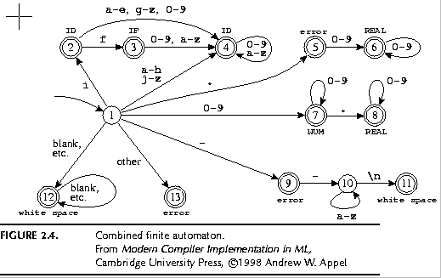
Pathological Example
if { return IF; }
[a-z][a-z0-9]* { return ID; }
[0-9]+ { return NUM; }
[0-9]”.”[0-9]*|[0-9]*”.”[0-9]+ { return REAL; }
(\-\-[a-z]*\n)|(“ “|\n|\t) { ; }
. { error(); }

Slide 26
int edges[][256] ={ /* …, 0, 1, 2, 3, ..., -, e, f, g, h, i, j, ... */
/* state 0 */ {0, ..., 0, 0, …, 0, 0, 0, 0, 0, ..., 0, 0, 0, 0, 0, 0}
/* state 1 */ {13, ..., 7, 7, 7, 7, …, 9, 4, 4, 4, 4, 2, 4, ..., 13, 13}
/* state 2 */ {0, …, 4, 4, 4, 4, ..., 0, 4, 3, 4, 4, 4, 4, ..., 0, 0}
/* state 3 */ {0, …, 4, 4, 4, 4, …, 0, 4, 4, 4, 4, 4, 4, , 0, 0}
/* state 4 */ {0, …, 4, 4, 4, 4, ..., 0, 4, 4, 4, 4, 4, 4, ..., 0, 0}
/* state 5 */ {0, …, 6, 6, 6, 6, …, 0, 0, 0, 0, 0, 0, 0, …, 0, 0}
/* state 6 */ {0, …, 6, 6, 6, 6, …, 0, 0, 0, 0, 0, 0, 0, ..., 0, 0}
/* state 7 */
...
/* state 13 */ {0, …, 0, 0, 0, 0, …, 0, 0, 0, 0, 0, 0, 0, …, 0, 0}

Slide 27
Pseudo Code for Scanner
Token nextToken()
{
lastFinal = 0;
currentState = 1 ;
inputPositionAtLastFinal = input;
currentPosition = input;
while (not(isDead(currentState))) {
nextState = edges[currentState][*currentPosition];
if (isFinal(nextState)) {
lastFinal = nextState ;
inputPositionAtLastFinal = currentPosition; }
currentState = nextState;
advance currentPosition;
}
input = inputPositionAtLastFinal ;
return action[lastFinal];
}

Slide 28
Example
Input: “if --not-a-com”

Slide 29
final | state | input
0 | 1 | if --not-a-com
2 | 2 | if --not-a-com
3 | 3 | if --not-a-com
3 | 0 | if --not-a-com
return IF

Slide 30
final | state | input
0 | 1 | --not-a-com
12 | 12 | --not-a-com
12 | 0 | --not-a-com
found whitespace

Slide 31
final | state | input
0 | 1 | --not-a-com
9 | 9 | --not-a-com
9 | 10 | --not-a-com
9 | 10 | --not-a-com
9 | 10 | --not-a-com
9 | 0 | --not-a-com
error

Slide 32
final | state | input
0 | 1 | -not-a-com
9 | 9 | -not-a-com
9 | 0 | -not-a-com
error

Slide 33
Efficient Scanners
Efficient state representation
Input buffering
Using switch and gotos instead of tables

Slide 34
Constructing Automaton from Specification
Create a non-deterministic automaton (NDFA) from every regular expression
Merge all the automata using epsilon moves (like the | construction)
Construct a deterministic finite automaton (DFA)
State priority
Minimize the automaton starting with separate accepting states

Slide 35
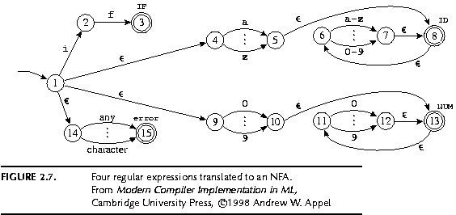
NDFA Construction
if { return IF; }
[a-z][a-z0-9]* { return ID; }
[0-9]+ { return NUM; }

Slide 36
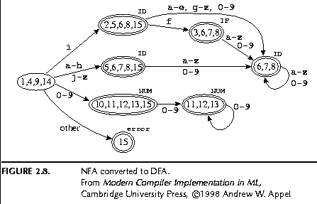
DFA Construction

Slide 37
Minimization

Slide 38
Comments
/\*.* \*/
/\*(.|[ \t\n])* \*/
start_code();
/* First comment */
more_code();
/* Second comment */
end_code();

Slide 39
Comments
/\*.* \*/
/\*(.|[ \t\n])* \*/
/\*([^*]|[\r\n])*\*/
/*
* Common multi-line comment style.
*/
/* Second comment */

Slide 40
Start States
It may be hard to specify regular expressions for certain constructs
Examples
Strings
Comments
Writing automata may be easier
Can combine both
Specify partial automata with regular expressions on the edges
No need to specify all states
Different actions at different states

Slide 41
Comments with Start States
%state comment
%%
<YYINITIAL>/\* {YYBEGIN(comment);}
;
<comment>\*/ {YYBEGIN(YYINITIAL); }
<comment>.|[ \t\n] ;

Slide 42
Do start states add expressive power?

Slide 43
Automaton with Start states
comment
/*
initial

Slide 44
Nested Comments?

Slide 45
NestedComments with Start States
static int nestedCount =0;
%state comment
%%
<YYINITIAL>/\* {nestedCount++;
YYBEGIN(comment);}
;
<comment>\*/ { if (--nestedCount==0) { YYBEGIN(YYINITIAL);
}
}
<comment>.|[ \t\n] ;

Slide 46
Missing
Creating a lexical analysis by hand
Table compression
Symbol Tables
Handling Macros

Slide 47
Summary
For most programming languages lexical analyzers can be easily constructed automatically
Exceptions:
Fortran
PL/1
Lex/Flex/Jlex are useful beyond compilers

