Slide 1
Memory Management Chapter 5
Mooly Sagiv

Slide 2
Announcements
Sample exams end of the week
Hazara class & advanced topics next week
Next week recitation solve sample exams
Extra office hours TBD

Slide 3
Topics
Heap allocation
Manuel heap allocation
Automatic memory reallocation (GC)

Slide 4
Limitations of Stack Frames
A local variable of P cannot be stored in the activation record of P if its duration exceeds the duration of P
Example: Dynamic allocation int * f() { return (int *) malloc(sizeof(int)); }

Slide 5
Currying Functions
int (*)() f(int x)
{
int g(int y)
{
return x + y;
}
return g ;
}
int (*h)() = f(3);
int (*j)() = f(4);
int z = h(5);
int w = j(7);

Slide 6
Browser events (Javascript)
Mouse event causes page-defined function to be called
<script type="text/JavaScript">
function whichButton(event) {
if (event.button==1) {
alert("You clicked the left mouse button!") }
else {
alert("You clicked the right mouse button!")
}}
</script>
…
<body onmousedown="whichButton(event)">
…
</body>

Slide 7
Static Scope for Function Argument
{ var x = 4;
{ function f(y) {return x*y};
{ function g(h) {
int x=7;
return h(3) + x;
};
g(f);
} } }
x
4
Code
for f
f
g
Code
for g
g(f)
h
x
7
h(3)
y
3
x * y
local var
follow access link
How is access link for h(3) set?

Slide 8
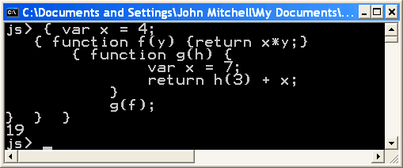
Result of function call

Slide 9
Closures
Activation records in the heap
Function value is pair closure = ⟨env, code ⟩
When a function represented by a closure is called,
Allocate activation record for call (as always)
Set the access link in the activation record using the environment pointer from the closure

Slide 10
Function Results and Closures
JS
function mk_counter (init) {
var count = init;
function counter(inc) {count=count+inc; return count};
return counter};
var c = mk_counter(1);
c(2) + c(2);
mk_c
Code for
mk_counter
access
c
mk_counter(1)
access
init
1
count
1
3
counter
c(2)
access
inc
2
Code for
counter

Slide 11
Duration
The duration of a variable is the interval of time in which its value persist
Examples
Automatic variables in C [block entry, block exit]
Frames in C
Frames in JS

Slide 12
Program Runtime State
Code
segment
Stack
segment
Data
Segment
fixed
heap
Machine
Registers

Slide 13
Data Allocation Methods
Explicit deallocation
Automatic deallocation

Slide 14
Explicit Deallocation
Pascal, C, C++
Two basic mechanisms
void * malloc(size_t size)
void free(void *ptr)
Part of the language runtime
Expensive
Error prone
Different implementations

Slide 15
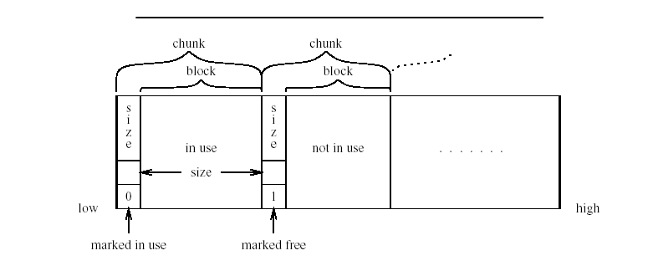
Memory Structure used by malloc()/free()
Notes:
Allignment

Slide 16
Memory Structure used by malloc()/free()
1KB/0
p= malloc(100)
100/1
896/0
q= malloc(100)
100/1
100/1
792/0
free(p)
100/0
100/1
792/0
Notes:
Allignment

Slide 17
Simple Implementation (Init)
first Chunk
Pointer
size
free
size
last Chunk Pointer

Slide 18
malloc implementation
function malloc(size) returning a polymorphic block pointer
pointer = next_free_block(size)
if pointer ≠ null return pointer
coalesce_free_chunks()
pointer = next_free_block(size)
if pointer ≠ null return pointer
return a solution to out of memory with size

Slide 19
Next Free Block
function next_free_block(size) returning a polymorphic block pointer
pointer = first_chunk_pointer
requested_size = size + administration_size;
while pointer ≤ last_chunk_pointer do
if pointer.free && pointer.size ≥ requested_size
split(pointer, requested_size)
pointer.free = false;
return pointer + administrative_size
pointer = pointer + pointer.size
od
return null
size
free
size
free
size
free

Slide 20
Splitting Chunks
split(pointer, requsted_size)
leftover_size = pointer.size – requested_size
if leftover_size > administrative_size
pointer.size = requested_size
leftover_pointer = pointer + requested_size
leftover_pointer.free = true
leftover_pointer.size = leftover_sizs
requested_size

Slide 21
Coalescing Chunks
coalesce_free_chunks
pointer = first_chunk_pointer
while pointer ≤ last_chunk_pointer do
if pointer.free coelsce_with_followers(pointer)
pointer = pointer + pointer.size
size
free
size
free
coalesce_with_followers(pointer)
next_pointer = pointer +pointer.size
while next_pointer ≤ last_chunk_pointer
and next_pointer.free do
pointer.size = pointer_size + next_pointer_size
next_pointer = next_pointer + next_pointer.size
size
free

Slide 22
Implementing Free
free(pointer)
chunk_pointer = pointer – administrative_size
chunk_pointer.free = true

Slide 23
Drawbacks of the simple implementation

Slide 24
Fragmentation
External
Too many small chunks
Internal
A use of too big chunk without splitting the chunk
Freelist may be implemented as an array of lists

Slide 25
Summary Explicit Allocation/Free
Considerable overhead
Sophisticated implementations
Fragmentation
Locality of references

Slide 26
Garbage Collection
ROOT SET
HEAP
a
b
c
d
e
f
Stack +Registers

Slide 27
Garbage Collection
ROOT SET
HEAP
a
b
c
d
e
f
Stack +Registers

Slide 28
What is garbage collection
The runtime environment reuse chunks that were allocated but are not subsequently used
garbage chunks
not live
It is undecidable to find the garbage chunks:
Decidability of liveness
Decidability of type information
conservative collection
every live chunk is identified
some garbage runtime chunk are not identified
Find the reachable chunks via pointer chains
Often done in the allocation function

Slide 29
typedef struct list {struct list *link; int key} *List;
typedef struct tree {int key;
struct tree *left:
struct tree *right} *Tree;
foo() { List x = cons(NULL, 7);
List y = cons(x, 9);
x->link = y;
}
void main() {
Tree p, r; int q;
foo();
p = maketree(); r = p->right;
q= r->key;
showtree(r);}
stack
heap
p
q
r
link
x
y
7
link
9

Slide 30
typedef struct list {struct list *link; int key} *List;
typedef struct tree {int key;
struct tree *left:
struct tree *right} *Tree;
foo() { List x = cons(NULL, 7);
List y = cons(x, 9);
x->link = y;
}
void main() {
Tree p, r; int q;
foo();
p = maketree(); r = p->right;
q= r->key;
showtree(r);}
stack
heap
p
q
r
link
x
y
7
key
link
key
9

Slide 31
typedef struct list {struct list *link; int key} *List;
typedef struct tree {int key;
struct tree *left:
struct tree *right} *Tree;
foo() { List x = create_list(NULL, 7);
List y = create_list(x, 9);
x->link = y;
}
void main() {
Tree p, r; int q;
foo();
p = maketree(); r = p->right;
q= r->key;
showtree(r);}
12
left
p
q
37
right
15
r
left
right
link
7
37
left
right
59
left
20
right
left
link
right
9

Slide 32
Outline
Why is it needed?
Why is it taught?
Reference Counts
Mark-and-Sweep Collection
Copying Collection
Generational Collection
Incremental Collection
Interfaces to the Compiler
Tracing

Slide 33
A Pathological C Program
a = malloc(…) ;
b = a;
free (a);
c = malloc (…);
if (b == c) printf(“unexpected equality”);

Slide 34
Garbage Collection vs. Explicit Memory Deallocation
Faster program development
Less error prone
Can lead to faster programs
Can improve locality of references
Support very general programming styles, e.g. higher order and OO programming
Standard in ML, Java, C#
Supported in C and C++ via separate libraries
May require more space
Needs a large memory
Can lead to long pauses
Can change locality of references
Effectiveness depends on programming language and style
Hides documentation
More trusted code

Slide 35
Interesting Aspects of Garbage Collection
Data structures
Non constant time costs
Amortized algorithms
Constant factors matter
Interfaces between compilers and runtime environments
Interfaces between compilers and virtual memory management

Slide 36
Reference Counts
Maintain a counter per chunk
The compiler generates code to update counter
Constant overhead per instruction

Slide 37
12
1
left
p
q
37
right
15
1
r
left
right
link
1
7
37
2
left
right
59
1
left
1
20
right
left
link
1
right
9

Slide 38
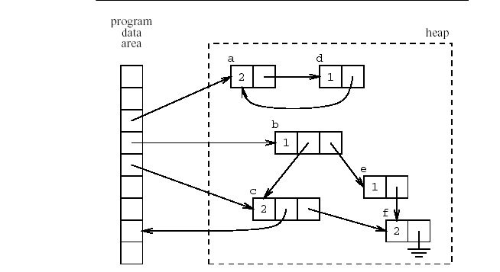
Another Example
x

Slide 39
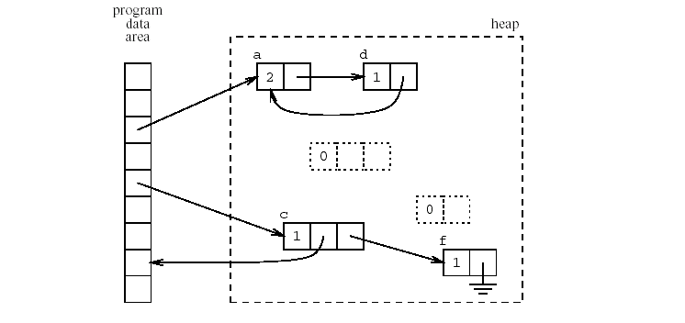
Another Example (x→b=NULL)
x

Slide 40
Code for p := q
if points to the heap q increment q’s reference count
if points to the heap p decrement p’s reference count
if p’s reference count becomes zero then recursively free

Slide 41
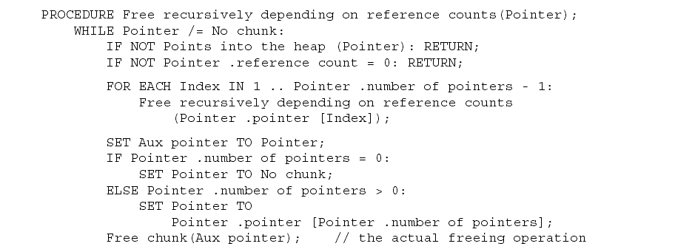
Recursive Free

Slide 42
Asymptotic Complexity
Reference counting can be implemented with constant overhead
How?

Slide 43
Lazy Reference Counters
Free one element
Free more elements when required
Constant time overhead
But may require more space

Slide 44
Reference Counts (Summary)
Fixed but big constant overhead
Fragmentation
Cyclic Data Structures
Compiler optimizations can help
Can delay updating reference counters from the stack
Implemented in libraries and file systems
No language support
But not currently popular
Will it be popular for large heaps?

Slide 45
Mark-and-Sweep(Scan) Collection
Mark the chunks reachable from the roots (stack, static variables and machine registers)
Sweep the heap space by moving unreachable chunks to the freelist (Scan)

Slide 46
The Mark Phase
for each root v
DFS(v)
function DFS(x)
if x is a pointer and chunk x is not marked
mark x
for each reference field f_{i} of chunk x
DFS(x.f_{i})

Slide 47
The Sweep Phase
p := first address in heap
while p < last address in the heap
if chunk p is marked
unmark p
else let f₁ be the first pointer reference field in p
p.f₁ := freelist
freelist := p
p := p + size of chunk p

Slide 48
12
Mark
left
p
q
37
right
15
r
left
right
link
7
37
left
right
59
left
20
right
left
link
right
9

Slide 49
12
Sweep
left
p
q
37
right
15
r
left
right
link
7
37
left
freelist
right
59
left
20
right
left
link
right
9

Slide 50
12
left
p
q
37
right
15
r
left
right
link
7
37
left
freelist
right
59
left
20
right
left
link
right
9

Slide 51
Cost of GC
The cost of a single garbage collection can be linear in the size of the store
may cause quadratic program slowdown
Amortized cost
collection-time/storage reclaimed
Cost of one garbage collection
c₁ R + c₂ H
H - R Reclaimed chunks
Cost per reclaimed chunk
(c₁ R + c₂ H)/ (H - R)
If R/H > 0.5
increase H
if R/H < 0.5
cost per reclaimed word is c₁ + 2c₂ ~16
There is no lower bound

Slide 52
The Mark Phase
for each root v
DFS(v)
function DFS(x)
if x is a pointer and chunk x is not marked
mark x
for each reference field f_{i} of chunk x
DFS(x.f_{i})

Slide 53
Efficient implementation of Mark(DFS)
Explicit stack
Parent pointers
Pointer reversal
Other data structures

Slide 54
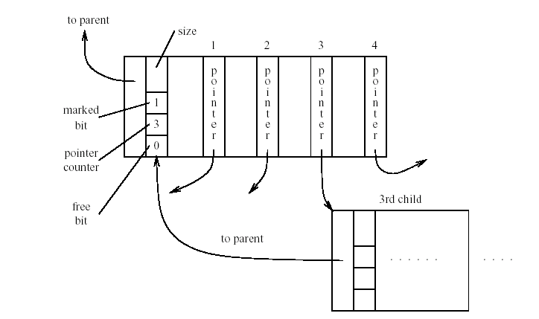
Adding Parent Pointer

Slide 55
Avoiding Parent Pointers (Deutch-Schorr-Waite)
Depth first search can be implemented without recursion or stack
Maintain a counter of visited children
Observation:
The pointer link from a parent to a child is not needed when it is visited
Temporary store pointer to the parent (instead of the field)
Restore when the visit of child is finished

Slide 56
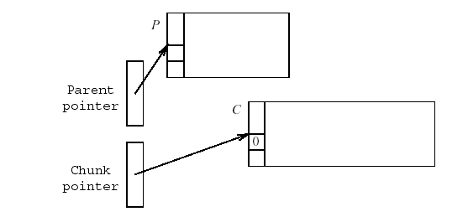
Arriving at C

Slide 57
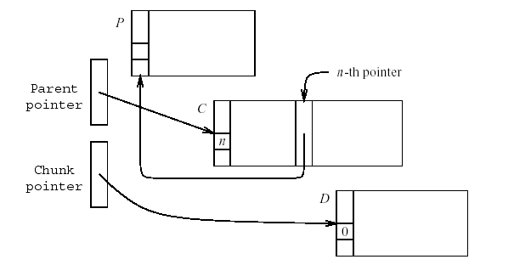
Visiting n-pointer field D
SET old parent pointer TO parent pointer ;
SET Parent pointer TO chunk pointer ;
SET Chunk pointer TO n-th pointer field of C;
SET n-th pointer field in C TO old parent pointer;

Slide 58
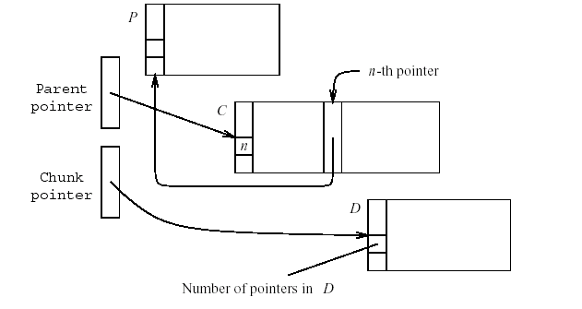
About to return from D
SET old parent pointer TO Parent pointer ;
SET Parent pointer TO n-th pointer field of C ;
SET n-th pointer field of C TO chunk pointer;
SET chunk pointer TO old parent pointer;

Slide 59
Compaction
The sweep phase can compact adjacent chunks
Reduce fragmentation

Slide 60
Copying Collection
Maintains two separate heaps
from-space
to-space
pointer next to the next free chunk in from-space
A pointer limit to the last chunk in from-space
If next = limit copy the reachable chunks from from-space into to-space
set next and limit
Switch from-space and to-space
Requires type information
From-space
To-Space
next
limit

Slide 61
Breadth-first Copying Garbage Collection
next := beginning of to-space
scan := next
for each root r
r := Forward(r)
while scan < next
for each reference field f_{i} of chunk at scan
scan.f_{i} := Forward(scan.f_{i})
scan := scan + size of chunk at scan

Slide 62
The Forwarding Procedure
function Forward(p)
if p points to from-space
then if p.f₁ points to to-space
return p.f₁
else for each reference field f_{i} of p
next.f_{i} := p.f_{i}
p.f₁ := next
next := next size of chunk p
return p.f₁
else return p

Slide 63
A Simple Example
From-Space
stack
struct DL{
int data;
struct DL* f;
struct DL *b
}
f400
17
f400
f800
0
b
f
f800
13
0
f400

Slide 64
Before Forward(f400)
From-Space
stack
to-Space
scan
f400
17
f400
t600
next
f800
0
b
f
f800
13
0
f400

Slide 65
After Forward(f400) before Forward(f800)
From-Space
stack
to-Space
scan
f400
17
t600
17
t600
t600
f
f800
0
0
b
f
next
f800
13
0
f400

Slide 66
After Forward(f800) Before Forward(0)
From-Space
stack
to-Space
scan
f400
17
f
t600
17
t600
t600
t612
0
b
0
f
b
t612
13
0
f800
13
f400
t612
next
f400

Slide 67
After Forward(0) Before Forward(0)
From-Space
stack
to-Space
f400
17
t600
17
t600
f
t600
t612
0
b
0
f
scan
b
t612
13
0
f800
13
f400
t612
next
f400

Slide 68
After Forward(0) Before Forward(f400)
From-Space
stack
to-Space
f400
17
t600
17
t600
t600
f
t612
0
b
0
f
scan
b
t612
13
0
f800
13
f400
t612
next
f400

Slide 69
After Forward(f400)
From-Space
stack
to-Space
f400
17
t600
17
t600
t600
f
t612
0
0
f
b
b
13
t612
0
f800
13
t600
scan
t612
next
f400

Slide 70
12
left
p
right
q
37
15
r
left
right
link
7
37
left
right
59
left
20
right
left
link
right
9

Slide 71
12
scan
15
left
left
right
p
right
next
q
37
left
r
right
link
7
37
left
right
59
left
20
right
left
link
right
9

Slide 72
12
scan
15
left
left
right
p
right
q
37
37
left
r
left
right
right
next
link
7
left
right
59
left
20
right
left
link
right
9

Slide 73
scan
15
left
left
right
p
right
q
37
37
left
r
left
right
right
link
12
7
left
37
right
left
next
right
59
left
20
right
left
link
right
9

Slide 74
12
15
left
left
right
p
right
q
37
scan
37
left
r
left
right
right
link
12
7
left
37
right
left
next
right
59
left
20
right
left
link
right
9

Slide 75
Amortized Cost of Copy Collection
c₃R / (H/2 - R)

Slide 76
Locality of references
Copy collection does not create fragmentation
Cheney's algorithm may lead to subfields that point to far away chunks
poor virtual memory and cache performance
DFS normally yields better locality but is harder to implement
DFS may also be bad for locality for chunks with more than one pointer fields
A compromise is a hybrid breadth first search with two levels down (Semi-depth first forwarding)
Results can be improved using dynamic information

Slide 77
The New Forwarding Procedure
function Chase(p)
repeat
q := next
next := next +size of chunk p
r := null
for each reference field f_{i} of p
q.f_{i} := p.f_{i}
if q.f_{i} points to from-space and q.f_{i}.f₁ does not point to to-space
then r := q.f_{i}
p.f₁ := q
p := r
until p = null
function Forward(p)
if p points to from-space
then if p.f₁ points to to-space
return p.f₁
else Chase(p); return p.f₁
else return p

Slide 78
Summary Copy Garbage Collection
Pros
Cons
Compact
Can improve memory locality
Cost proportional to reachable heap
Especially good when large amounts of garbage exist when gc is called
Requires type information
May affect memory locality

Slide 79
Generational Garbage Collection
Newly created objects contain higher percentage of garbage
Partition the heap into generations G₁ and G₂
First garbage collect the G₁ heap
chunks which are reachable
After two or three collections chunks are promoted to G₂
Once a while garbage collect G₂
Can be generalized to more than two heaps
But how can we garbage collect in G₁?

Slide 80
Scanning roots from older generations
remembered list
The compiler generates code after each destructive update b.f_{i} := a to put b into a vector of updated objects scanned by the garbage collector
remembered set
remembered-list + “set-bit”
Card marking
Divide the memory into 2^{k} cards
Page marking
k = page size
virtual memory system catches updates to old-generations using the dirty-bit

Slide 81
Incremental Collection
Even the most efficient garbage collection can interrupt the program for quite a while
Under certain conditions the collector can run concurrently with the program (mutator)
Need to guarantee that mutator leaves the chunks in consistent state, e.g., may need to restart collection
Two solutions
compile-time
Generate extra instructions at store/load
virtual-memory
Mark certain pages as read(write)-only
a write into (read from) this page by the program restart mutator

Slide 82
Tricolor marking
Generalized GC
Three kinds of chunks
White
Not visited (not marked or not copied)
Grey
Marked or copied but children have not been examined
Black
Marked and their children are marked

Slide 83
Basic Tricolor marking
while there are any grey objects
select a grey chunk p
for each reference field f_{i} of chunk p
if chunk p.f_{i} is white
color chunk p.f_{i} grey color chunk p black
Invariants
No black points to white
Every grey is on the collector's (stack or queue) data structure

Slide 84
Establishing the invariants
Dijkstra, Lamport, et al
Mutator stores a white pointer a into a black pointer b
color a grey (compile-time)
Steele
Mutator stores a white pointer a into a black pointer b
color b grey (compile-time)
Boehm, Demers, Shenker
All black pages are marked read-only
A store into black page mark all the objects in this page grey (virtual memory system)
Baker
Whenever the mutator fetches a pointer b to a grey or white object
color b grey (compile-time)
Appel, Ellis, Li
Whenever the mutator fetches a pointer b from a page containing a non black object
color every object on this page black and children grey (virtual memory system)

Slide 85
Interfaces to the Compiler
The semantic analysis identifies chunk fields which are pointers and their size
Generate runtime descriptors at the beginning of the chunks
Can employ different allocation/deallocation functions
Pass the descriptors to the allocation function
The compiler also passes pointer-map
the set of live pointer locals, temporaries, and registers
Recorded at ?-time for every procedure

Slide 86
Summary
Garbage collection is an effective technique
Leads to more secure programs
Tolerable cost
But is not used in certain applications
Realtime
Generational garbage collection works fast
Emulates stack
But high synchronization costs
Compiler can allocate data on stack sometimes
Escape analysis
May be improved

