Slide 1
Assembler/Linker/Loader
Mooly Sagiv
html://www.cs.tau.ac.il/~msagiv/courses/wcc20.html
Chapter 4.3
J. Levine: Linkers & Loaders
http://linker.iecc.com/

Slide 2
Outline
Where does it fit into the compiler
Functionality
“Backward” description
Assembler design issues
Linker design issues

Slide 3
Compiler Phases
Syntax errors
Semantic errors
Program
text
AST
Semantic
Analysis
Annotated
AST
Parser
Code Generation
IR
IR
Code
Generation
assembly
Optimizer

Slide 4
Assembler
Generate executable code from assembly
Yet another compiler
One-to one translation
Resolve external references
Relocate code
How does it fit together?
Is it really part of the compiler?

Slide 5
Program Runtime State
Code
segment
Stack
segment
Data
Segment
Machine
Registers

Slide 6
Program Run
Operating System
.EXE
Code
segment
Code
segment
Loader
Stack
segment
Data
Segment
Data
Segment
Initial stack size
Machine
Registers
Start address
Debug

Slide 7
Program Run
.EXE
Code
segment
Code
segment
Stack
segment
Data
Segment
Data
Segment
Initial stack size
Machine
Registers
Start address

Slide 8
Loader (Summary)
Part of the operating system
Does not depend on the programming language
Privileged mode
Initializes the runtime state
Invisible activation record

Slide 9
Linker
External Symbol Table
Code Segment
Relocation Bits
Data
Segment
0
100
0
Code Segment
0
101
Data
Segment

Slide 10
Linker
Merge several executables
Resolve external references
Relocate addresses
User mode
Provided by the operating system
But can be specific for the compiler
More secure code
Better error diagnosis

Slide 11
Relocation information
How to change internal addresses
Positions in the code which contains addresses (data/code)
Two implementations
Bitmap
Linked-lists

Slide 12
External References
The code may include references to external names (identifiers)
Library calls
External data
Stored in external symbol table

Slide 13
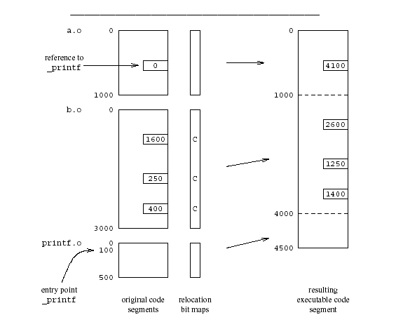
Example

Slide 14
Recap
Assembler generates binary code
Unresolved addresses
Relocatable addresses
Linker generates executable code
Loader generates runtime states (images)

Slide 15
Assembler Design Issues
Converts symbolic machine code to binary
One to one conversion addl %edx, %ecx ⇒ 000 0001 11 010 001 = 01 D1 (Hex)
Some assemblers support overloading
Different opcodes based on types
Format conversions
Handling internal addresses

Slide 16
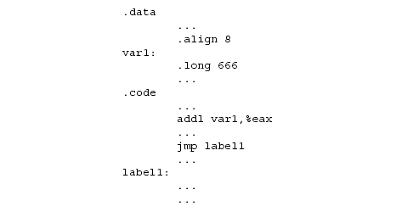
Handling Internal Addresses

Slide 17
Resolving Internal Addresses
Two scans of the code
Construct a table label → address
Replace labels with values
Backpatching
One scan of the code
Simultaneously construct the table and resolve symbolic addresses
Maintains list of unresolved labels
Useful beyond assemblers

Slide 18
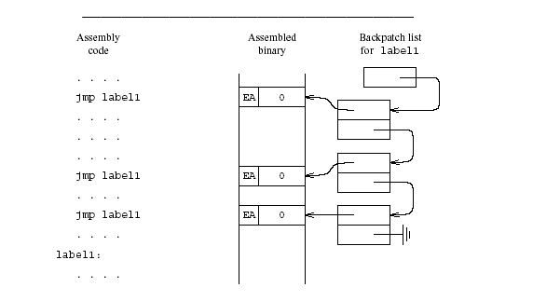
Backpatching

Slide 19
Handling External Addresses
Record symbol table in external table
Produce binary version together with the code and relocation bits
Output of the assembly
Code segment
Data segment
Relocation bits
External table

Slide 20
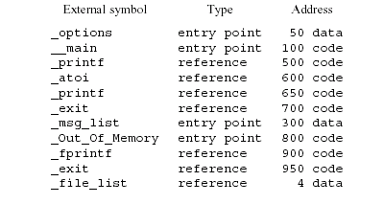
Example of External Symbol Table

Slide 21
Example

Slide 22
Summary
Code generation yields code which is still far from executable
Delegate to existing assembler
Assembler translates symbolic instructions into binary and creates relocation bits
Linker creates executable from several files produced by the assembly
Loader creates an image from executable
Missing: Dynamic loading

