Slide 1
X86 Assembly
Mooly Sagiv
http://www.egr.unlv.edu/~ed/assembly64.pdf
https://godbolt.org/
‪https://www.cis.upenn.edu/~stevez/ CS341

Slide 2
Compiler Phases
Syntax errors
Semantic errors
Program
text
AST
Semantic
Analysis
Annotated
AST
Parser
Code Generation
IR
IR
Code
Generation
assembly
Optimizer

Slide 3
Outline
X86 history
Memory hierarchy
Stack frames
Compiling a simple example
Running a simple example

Slide 4
Intel’s X86 Architecture

Slide 5
X86 history
Year | Invention
1978 | Intel introduces 8086
1982 | 80186, 80286
1985 | 80386
1989 | 80486 (100MHz, 1μm)
1993 | Pentium
1995 | Pentium Pro
1997 | Pentium II/III
2003 | Pentium M(Banias), Intel Core
2006 | Intel Core 2
2008 | Intel Core i3/i5/i7
2011 | SandyBridge / IvyBridge
2013 | Haswell
2014 | Broadwell
2015 | Skylake (core i3/i5/i7/i9) (2.4GHz, 14nm)
2016 | Xeon Phi

Slide 6
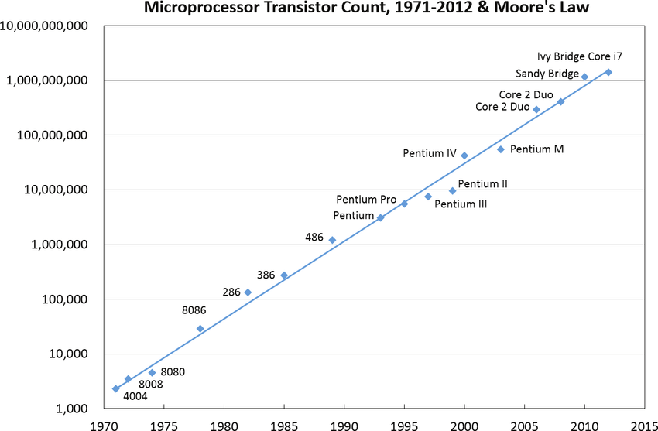

Slide 7
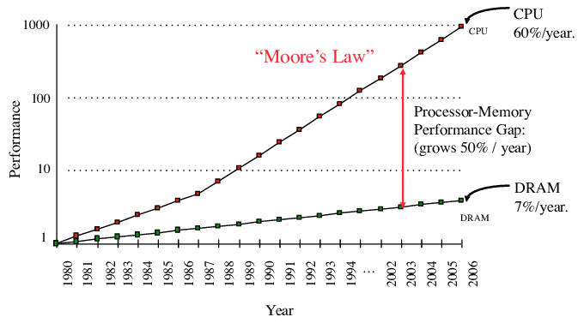
Memory vs. CPU Speed

Slide 8
Solutions
Architecture & Compiler
  Machine registers utilized by compiler
Explore locality

Slide 9
Memory Hierarchy
1.Smaller
2. Faster
3. More expensive
Registers
Cache
RAM
Secondary Storage
(disk drive, SSID)
Tertiary Storage
(Remote storage, optical)

Slide 10
Stack Frames
Allocate a separate space for every procedure incarnation
Relative addresses
Provide a simple mean to achieve modularity
Supports separate code generation of procedures
Naturally supports recursion
Efficient memory allocation policy
  Low overhead
  Hardware support may be available
LIFO policy
Not a pure stack
  Non local references
  Updated using arithmetic

Slide 12
A Typical Stack Frame
previous frame
higher addresses
outgoing parameters
argument 2
argument 1
lexical pointer
return address
administrative
dynamic link
frame pointer
registers
locals
temporaries
frame size
current frame
outgoing parameters
argument 2
argument 1
stack pointer
next frame
lower addresses

Slide 13
Pascal 80386 Frame
higher addresses
argument 1
previous frame
argument 2
lexical pointer
return address
rbp
previous ebp
locals
temporaries
current frame
saved registers
argument 1
lower addresses
outgoing parameters
argument 2
rsp
lexical pointer
next frame

Slide 14
Compiling a simple example
.LC0:
.string "factorial(2)=%d"
main:
push rbp
mov rbp, rsp
mov edi, 2
call factorial(int)
mov esi, eax
mov edi, OFFSET FLAT:.LC0
mov eax, 0
call printf
mov eax, 0
pop rbp
ret
#include <stdio.h>
main() {
printf("factorial(2)=%d", factorial(2));
}

Slide 15
Compiling factorial
. factorial(int):
push rbp
mov rbp, rsp
sub rsp, 16
mov DWORD PTR [rbp-4], edi
cmp DWORD PTR [rbp-4], 1
jne .L2
mov eax, 1
jmp .L3
.L2:
mov eax, DWORD PTR [rbp-4]
sub eax, 1
mov edi, eax
call factorial(int)
imul eax, DWORD PTR [rbp-4]
.L3:
leave
ret
int factorial(int num) {
if (num == 1) return 1 ;
else return num * factorial(num -1 );
}

Slide 16
Code/Data
Stack
factorial(int):
…
.LC0:
.string "factorial(2)=%d"
main:
push rbp
mov rbp, rsp
mov edi,2
call factorial(int)
mov esi, eax
mov edi, OFFSET FLAT:.LC0
mov eax, 0
call printf
mov eax, 0
pop rbp
ret
rsp
777777777
rbp

Slide 17
Code/Data
Stack
factorial(int):
…
.LC0:
.string "factorial(2)=%d"
main:
push rbp
mov rbp, rsp
mov edi, 2
call factorial(int)
mov esi, eax
mov edi, OFFSET FLAT:.LC0
mov eax, 0
call printf
mov eax, 0
pop rbp
ret
rsp
777777777
777777777
rbp

Slide 18
Code/Data
Stack
factorial(int):
…
.LC0:
.string "factorial(2)=%d"
main:
push rbp
mov rbp, rsp
mov edi, 2
call factorial(int)
mov esi, eax
mov edi, OFFSET FLAT:.LC0
mov eax, 0
call printf
mov eax, 0
pop rbp
ret
rsp
777777777
777777777
rbp

Slide 19
Code/Data
Stack
factorial(int):
…
.LC0:
.string "factorial(2)=%d"
main:
push rbp
mov rbp, rsp
mov edi, 2
call factorial(int)
L4: mov esi, eax
mov edi, OFFSET FLAT:.LC0
mov eax, 0
call printf
mov eax, 0
pop rbp
ret
edi
2
rsp
777777777
rbp
777777777

Slide 20
Code/Data
Stack
factorial(int):
…
.LC0:
.string "factorial(2)=%d"
main:
push rbp
mov rbp, rsp
mov edi, 2
call factorial(int)
L2: mov esi, eax
mov edi, OFFSET FLAT:.LC0
mov eax, 0
call printf
mov eax, 0
pop rbp
ret
edi
2
rsp
777777777
rbp
777777777

Slide 21
Code/Data
Stack
factorial(int):
push rbp
mov rbp, rsp
sub rsp, 16
mov DWORD PTR [rbp-4], edi
cmp DWORD PTR [rbp-4], 1
jne .L2
mov eax, 1
jmp .L3
.L2:
mov eax, DWORD PTR [rbp-4]
sub eax, 1
mov edi, eax
call factorial(int)
imul eax, DWORD PTR [rbp-4]
.L3:
leave
ret
…
edi
2
L4
rsp
777777777
rbp
777777777

Slide 22
Code/Data
Stack
factorial(int):
push rbp
mov rbp, rsp
sub rsp, 16
mov DWORD PTR [rbp-4], edi
cmp DWORD PTR [rbp-4], 1
jne .L2
mov eax, 1
jmp .L3
.L2:
mov eax, DWORD PTR [rbp-4]
sub eax, 1
mov edi, eax
call factorial(int)
imul eax, DWORD PTR [rbp-4]
.L3:
leave
ret
…
edi
2
777777777
rsp
L4
777777777
rbp
777777777

Slide 23
Code/Data
Stack
factorial(int):
push rbp
mov rbp, rsp
sub rsp, 16
mov DWORD PTR [rbp-4], edi
cmp DWORD PTR [rbp-4], 1
jne .L2
mov eax, 1
jmp .L3
.L2:
mov eax, DWORD PTR [rbp-4]
sub eax, 1
mov edi, eax
call factorial(int)
imul eax, DWORD PTR [rbp-4]
.L3:
leave
ret
…
edi
2
777777756
777777777
rsp
L4
777777777
rbp
777777777

Slide 24
Code/Data
Stack
factorial(int):
push rbp
mov rbp, rsp
sub rsp, 16
mov DWORD PTR [rbp-4], edi
cmp DWORD PTR [rbp-4], 1
jne .L2
mov eax, 1
jmp .L3
.L2:
mov eax, DWORD PTR [rbp-4]
sub eax, 1
mov edi, eax
call factorial(int)
imul eax, DWORD PTR [rbp-4]
.L3:
leave
ret
…
edi
2
777777740
rsp
777777756
777777777
L4
777777777
rbp
777777777

Slide 25
Code/Data
Stack
factorial(int):
push rbp
mov rbp, rsp
sub rsp, 16
mov DWORD PTR [rbp-4], edi
cmp DWORD PTR [rbp-4], 1
jne .L2
mov eax, 1
jmp .L3
.L2:
mov eax, DWORD PTR [rbp-4]
sub eax, 1
mov edi, eax
call factorial(int)
imul eax, DWORD PTR [rbp-4]
.L3:
leave
ret
…
edi
2
777777740
2
rsp
777777756
777777777
L4
777777777
rbp
777777777

Slide 26
Code/Data
Stack
factorial(int):
push rbp
mov rbp, rsp
sub rsp, 16
mov DWORD PTR [rbp-4], edi
cmp DWORD PTR [rbp-4], 1
jne .L2
mov eax, 1
jmp .L3
.L2:
mov eax, DWORD PTR [rbp-4]
sub eax, 1
mov edi, eax
call factorial(int)
imul eax, DWORD PTR [rbp-4]
.L3:
leave
ret
…
edi
2
cr
NE
777777740
2
rsp
777777756
777777777
L4
777777777
rbp
777777777

Slide 27
Code/Data
Stack
factorial(int):
push rbp
mov rbp, rsp
sub rsp, 16
mov DWORD PTR [rbp-4], edi
cmp DWORD PTR [rbp-4], 1
jne .L2
mov eax, 1
jmp .L3
.L2:
mov eax, DWORD PTR [rbp-4]
sub eax, 1
mov edi, eax
call factorial(int)
imul eax, DWORD PTR [rbp-4]
.L3:
leave
ret
…
edi
2
777777740
2
rsp
777777756
777777777
L4
777777777
rbp
777777777

Slide 28
Code/Data
Stack
factorial(int):
push rbp
mov rbp, rsp
sub rsp, 16
mov DWORD PTR [rbp-4], edi
cmp DWORD PTR [rbp-4], 1
jne .L2
mov eax, 1
jmp .L3
.L2:
mov eax, DWORD PTR [rbp-4]
sub eax, 1
mov edi, eax
call factorial(int)
imul eax, DWORD PTR [rbp-4]
.L3:
leave
ret
…
edi
2
eax
2
777777740
2
rsp
777777756
777777777
L4
777777777
rbp
777777777

Slide 29
Code/Data
Stack
factorial(int):
push rbp
mov rbp, rsp
sub rsp, 16
mov DWORD PTR [rbp-4], edi
cmp DWORD PTR [rbp-4], 1
jne .L2
mov eax, 1
jmp .L3
.L2:
mov eax, DWORD PTR [rbp-4]
sub eax, 1
mov edi, eax
call factorial(int)
imul eax, DWORD PTR [rbp-4]
.L3:
leave
ret
…
edi
2
eax
1
777777740
2
rsp
777777756
777777777
L4
777777777
rbp
777777777

Slide 30
Code/Data
Stack
factorial(int):
push rbp
mov rbp, rsp
sub rsp, 16
mov DWORD PTR [rbp-4], edi
cmp DWORD PTR [rbp-4], 1
jne .L2
mov eax, 1
jmp .L3
.L2:
mov eax, DWORD PTR [rbp-4]
sub eax, 1
mov edi, eax
call factorial(int)
imul eax, DWORD PTR [rbp-4]
.L3:
leave
ret
…
edi
1
eax
1
777777740
2
rsp
777777756
777777777
L4
777777777
rbp
777777777

Slide 31
Code/Data
Stack
factorial(int):
push rbp
mov rbp, rsp
sub rsp, 16
mov DWORD PTR [rbp-4], edi
cmp DWORD PTR [rbp-4], 1
jne .L2
mov eax, 1
jmp .L3
.L2:
mov eax, DWORD PTR [rbp-4]
sub eax, 1
mov edi, eax
call factorial(int)
L5: imul eax, DWORD PTR [rbp-4]
.L3:
leave
ret
…
edi
1
eax
1
L5
rsp
777777740
2
777777756
777777777
L4
777777777
rbp
777777777

Slide 32
Code/Data
Stack
factorial(int):
push rbp
mov rbp, rsp
sub rsp, 16
mov DWORD PTR [rbp-4], edi
cmp DWORD PTR [rbp-4], 1
jne .L2
mov eax, 1
jmp .L3
.L2:
mov eax, DWORD PTR [rbp-4]
sub eax, 1
mov edi, eax
call factorial(int)
L5: imul eax, DWORD PTR [rbp-4]
.L3:
leave
ret
…
edi
1
eax
1
777777756
rsp
L5
777777740
2
777777756
777777777
L4
777777777
rbp
777777777

Slide 33
Code/Data
Stack
factorial(int):
push rbp
mov rbp, rsp
sub rsp, 16
mov DWORD PTR [rbp-4], edi
cmp DWORD PTR [rbp-4], 1
jne .L2
mov eax, 1
jmp .L3
.L2:
mov eax, DWORD PTR [rbp-4]
sub eax, 1
mov edi, eax
call factorial(int)
L5: imul eax, DWORD PTR [rbp-4]
.L3:
leave
ret
…
edi
2
eax
2
777777732
777777756
rsp
777777736
L5
777777740
2
777777756
777777777
L4
777777777
rbp
777777777

Slide 34
Code/Data
Stack
factorial(int):
push rbp
mov rbp, rsp
sub rsp, 16
mov DWORD PTR [rbp-4], edi
cmp DWORD PTR [rbp-4], 1
jne .L2
mov eax, 1
jmp .L3
.L2:
mov eax, DWORD PTR [rbp-4]
sub eax, 1
mov edi, eax
call factorial(int)
L5: imul eax, DWORD PTR [rbp-4]
.L3:
leave
ret
…
edi
1
eax
1
777777716
1
777777732
777777756
rsp
777777736
L5
777777740
2
777777756
777777777
L4
777777777
rbp
777777777

Slide 35
Code/Data
Stack
factorial(int):
push rbp
mov rbp, rsp
sub rsp, 16
mov DWORD PTR [rbp-4], edi
cmp DWORD PTR [rbp-4], 1
jne .L2
mov eax, 1
jmp .L3
.L2:
mov eax, DWORD PTR [rbp-4]
sub eax, 1
mov edi, eax
call factorial(int)
L5: imul eax, DWORD PTR [rbp-4]
.L3:
leave
ret
…
edi
1
eax
1
cr
E
777777716
1
777777732
777777756
rsp
777777736
L5
777777740
2
777777756
777777777
L4
777777777
rbp
777777777

Slide 36
Code/Data
Stack
factorial(int):
push rbp
mov rbp, rsp
sub rsp, 16
mov DWORD PTR [rbp-4], edi
cmp DWORD PTR [rbp-4], 1
jne .L2
mov eax, 1
jmp .L3
.L2:
mov eax, DWORD PTR [rbp-4]
sub eax, 1
mov edi, eax
call factorial(int)
L5: imul eax, DWORD PTR [rbp-4]
.L3:
leave
ret
…
edi
1
eax
1
777777716
1
777777732
777777756
rsp
777777736
L5
777777740
2
777777756
777777777
L4
777777777
rbp
777777777

Slide 37
Code/Data
Stack
factorial(int):
push rbp
mov rbp, rsp
sub rsp, 16
mov DWORD PTR [rbp-4], edi
cmp DWORD PTR [rbp-4], 1
jne .L2
mov eax, 1
jmp .L3
.L2:
mov eax, DWORD PTR [rbp-4]
sub eax, 1
mov edi, eax
call factorial(int)
L5: imul eax, DWORD PTR [rbp-4]
.L3:
leave
ret
…
edi
1
eax
1
777777716
1
777777732
777777756
rsp
777777736
L5
777777740
2
777777756
777777777
L4
777777777
rbp
777777777

Slide 38
Code/Data
Stack
factorial(int):
push rbp
mov rbp, rsp
sub rsp, 16
mov DWORD PTR [rbp-4], edi
cmp DWORD PTR [rbp-4], 1
jne .L2
mov eax, 1
jmp .L3
.L2:
mov eax, DWORD PTR [rbp-4]
sub eax, 1
mov edi, eax
call factorial(int)
L5: imul eax, DWORD PTR [rbp-4]
.L3:
leave
ret
…
edi
1
eax
1
777777716
1
777777732
777777756
rsp
777777736
L5
777777740
2
777777756
777777777
L4
777777777
rbp
777777777

Slide 39
Code/Data
Stack
factorial(int):
push rbp
mov rbp, rsp
sub rsp, 16
mov DWORD PTR [rbp-4], edi
cmp DWORD PTR [rbp-4], 1
jne .L2
mov eax, 1
jmp .L3
.L2:
mov eax, DWORD PTR [rbp-4]
sub eax, 1
mov edi, eax
call factorial(int)
L5: imul eax, DWORD PTR [rbp-4]
.L3:
leave
ret
…
edi
1
eax
1
777777716
1
777777732
777777756
rsp
777777736
L5
777777740
2
777777756
777777777
L4
777777777
rbp
777777777

Slide 40
Code/Data
Stack
factorial(int):
push rbp
mov rbp, rsp
sub rsp, 16
mov DWORD PTR [rbp-4], edi
cmp DWORD PTR [rbp-4], 1
jne .L2
mov eax, 1
jmp .L3
.L2:
mov eax, DWORD PTR [rbp-4]
sub eax, 1
mov edi, eax
call factorial(int)
L5: imul eax, DWORD PTR [rbp-4]
.L3:
leave
ret
…
edi
1
eax
1
777777716
1
777777732
777777756
777777736
L5
rsp
777777740
2
777777756
777777777
L4
777777777
rbp
777777777

Slide 41
Code/Data
Stack
factorial(int):
push rbp
mov rbp, rsp
sub rsp, 16
mov DWORD PTR [rbp-4], edi
cmp DWORD PTR [rbp-4], 1
jne .L2
mov eax, 1
jmp .L3
.L2:
mov eax, DWORD PTR [rbp-4]
sub eax, 1
mov edi, eax
call factorial(int)
L5: imul eax, DWORD PTR [rbp-4]
.L3:
leave
ret
…
edi
1
eax
1
777777716
1
777777732
777777756
777777736
777777740
rsp
2
777777756
777777777
L4
777777777
rbp
777777777

Slide 42
Code/Data
Stack
factorial(int):
push rbp
mov rbp, rsp
sub rsp, 16
mov DWORD PTR [rbp-4], edi
cmp DWORD PTR [rbp-4], 1
jne .L2
mov eax, 1
jmp .L3
.L2:
mov eax, DWORD PTR [rbp-4]
sub eax, 1
mov edi, eax
call factorial(int)
L5: imul eax, DWORD PTR [rbp-4]
.L3:
leave
ret
…
edi
1
eax
2
777777716
1
777777732
777777756
777777736
777777740
rsp
2
777777756
777777777
L4
777777777
rbp
777777777

Slide 43
Code/Data
Stack
factorial(int):
push rbp
mov rbp, rsp
sub rsp, 16
mov DWORD PTR [rbp-4], edi
cmp DWORD PTR [rbp-4], 1
jne .L2
mov eax, 1
jmp .L3
.L2:
mov eax, DWORD PTR [rbp-4]
sub eax, 1
mov edi, eax
call factorial(int)
L5: imul eax, DWORD PTR [rbp-4]
.L3:
leave
ret
…
edi
1
eax
2
777777716
1
777777732
777777756
777777736
777777740
rsp
2
777777756
777777777
L4
777777777
rbp
777777777

Slide 44
Code/Data
Stack
factorial(int):
…
.LC0:
.string "factorial(3)=%d"
main:
push rbp
mov rbp, rsp
mov edi, 3
call factorial(int)
L4: mov esi, eax
mov edi, OFFSET FLAT:.LC0
mov eax, 0
call printf
mov eax, 0
pop rbp
ret
edi
1
eax
2
777777716
1
777777732
777777756
777777736
777777740
rsp
2
777777756
777777777
777777777
rbp
777777777

Slide 45
Code/Data
Stack
factorial(int):
…
.LC0:
.string "factorial(2)=%d"
main:
push rbp
mov rbp, rsp
mov edi, 2
call factorial(int)
L4: mov esi, eax
mov edi, OFFSET FLAT:.LC0
mov eax, 0
call printf
mov eax, 0
pop rbp
ret
edi
1
eax
2
esi
2
777777716
1
777777732
777777756
777777736
777777740
rsp
2
777777756
777777777
777777777
rbp
777777777

Slide 46
Code/Data
Stack
factorial(int):
…
.LC0:
.string "factorial(3)=%d"
main:
push rbp
mov rbp, rsp
mov edi, 3
call factorial(int)
L4: mov esi, eax
mov edi, OFFSET FLAT:.LC0
mov eax, 0
call printf
mov eax, 0
pop rbp
ret
edi
LC0
eax
2
esi
2
777777716
1
777777732
777777756
777777736
777777740
rsp
2
777777756
777777777
777777777
rbp
777777777

Slide 47
Code/Data
Stack
factorial(int):
…
.LC0:
.string "factorial(3)=%d"
main:
push rbp
mov rbp, rsp
mov edi, 3
call factorial(int)
L4: mov esi, eax
mov edi, OFFSET FLAT:.LC0
mov eax, 0
call printf
mov eax, 0
pop rbp
ret
edi
LC0
eax
0
esi
2
777777716
1
777777732
777777756
777777736
777777740
rsp
2
777777756
777777777
777777777
rbp
777777777

Slide 48
Summary
Pentium X86 is a powerful CISC architecture
Stack frames provide memory locality
  Simple allocation/deallocation
  Efficient even for recursive calls
  Architecture support may help
Understanding compiler generated code is not easy

