Slide 1
Eran Yahav Technion
Recent Developments in the Real World

Slide 2
Meanwhile, In the real world
new hardware
Multi-core, GPU, Accelerators
new compilers for new languages
new compilers for old languages
e.g., Java->JavaScript
new uses of compiler technology
new performance criteria

Slide 3
Google Web Toolkit
Compiler
Java
code
txt
Javascript
code
js
Frontend
(analysis)
Semantic
Representation
Backend
(synthesis)

Slide 4
GWT Compiler Optimization
public class ShapeExample implements EntryPoint {
private static final double SIDE_LEN_SMALL = 2;
private final Shape shape = new SmallSquare();
public static abstract class Shape {
public abstract double getArea();
}
public static abstract class Square extends Shape {
public double getArea() { return getSideLength() * getSideLength(); }
public abstract double getSideLength();
}
public static class SmallSquare extends Square {
public double getSideLength() { return SIDE_LEN_SMALL; }
}
public void onModuleLoad() {
Shape shape = getShape();
Window.alert("Area is " + shape.getArea());
}
private Shape getShape() { return shape; }
(source: http://dl.google.com/io/2009/pres/Th_1045_TheStoryofyourCompile-ReadingtheTeaLeavesoftheGWTCompilerforanOptimizedFuture.pdf)

Slide 5
GWT Compiler Optimization
public class ShapeExample implements EntryPoint {
public void onModuleLoad() {
Window.alert("Area is 4.0");
}
(source: http://dl.google.com/io/2009/pres/Th_1045_TheStoryofyourCompile-ReadingtheTeaLeavesoftheGWTCompilerforanOptimizedFuture.pdf)

Slide 6
Adobe ActionScript
First introduced in Flash Player 9, ActionScript 3 is an object-oriented programming (OOP) language based on ECMAScript—the same standard that is the basis for JavaScript—and provides incredible gains in runtime performance and developer productivity. ActionScript 2, the version of ActionScript used in Flash Player 8 and earlier, continues to be supported in Flash Player 9 and Flash Player 10.
ActionScript 3.0 introduces a new highly optimized ActionScript Virtual Machine, AVM2, which dramatically exceeds the performance possible with AVM1. As a result, ActionScript 3.0 code executes up to 10 times faster than legacy ActionScript code.
(source: http://www.adobe.com/devnet/actionscript/articles/actionscript3_overview.html)

Slide 7
Adobe ActionScript
Compiler
AS
code
txt
AVM
bytecode
swf
Frontend
(analysis)
Semantic
Representation
Backend
(synthesis)

Slide 8
Adobe ActionScript: Tamarin
The goal of the "Tamarin" project is to implement a high-performance, open source implementation of the ActionScript™ 3 language, which is based upon and extends ECMAScript 3rd edition (ES3). ActionScript provides many extensions to the ECMAScript language, including packages, namespaces, classes, and optional strict typing of variables. "Tamarin" implements both a high-performance just-in-time compiler and interpreter. The Tamarin virtual machine is used within the Adobe® Flash® Player and is also being adopted for use by projects outside Adobe. The Tamarin just-in-time compiler (the "NanoJIT") is a collaboratively developed component used by both Tamarin and Mozilla TraceMonkey. The ActionScript compiler is available as a component from the open source Flex SDK.

Slide 9
Mozilla SpiderMonkey
SpiderMonkey is a fast interpreter
runs an untyped bytecode and operates on values of type jsval—type-tagged double-sized values that represent the full range of JavaScript values.
SpiderMonkey contains two JavaScript Just-In-Time (JIT) compilers, a garbage collector, code implementing the basic behavior of JavaScript values…
SpiderMonkey's interpreter is mainly a single, tremendously long function that steps through the bytecode one instruction at a time, using a switch statement (or faster alternative, depending on the compiler) to jump to the appropriate chunk of code for the current instruction.
(source: https://developer.mozilla.org/En/SpiderMonkey/Internals)

Slide 10
Mozilla SpiderMonkey: Compiler
consumes JavaScript source code
produces a script which contains bytecode, source annotations, and a pool of string, number, and identifier literals. The script also contains objects, including any functions defined in the source code, each of which has its own, nested script.
The compiler consists of
a random-logic rather than table-driven lexical scanner
a recursive-descent parser that produces an AST
a tree-walking code generator
The emitter does some constant folding and a few codegen optimizations
(source: https://developer.mozilla.org/En/SpiderMonkey/Internals)

Slide 11
Mozilla SpiderMonkey
SpiderMonkey contains a just-in-time trace compiler that converts bytecode to machine code for faster execution.
The JIT works by detecting commonly executed loops, tracing the executed bytecodes in those loops as they run in the interpreter, and then compiling the trace to machine code.
See the page about the Tracing JIT for more details.
The SpiderMonkey GC is a mark-and-sweep, non-conservative (exact) collector.
(source: https://developer.mozilla.org/En/SpiderMonkey/Internals)

Slide 12
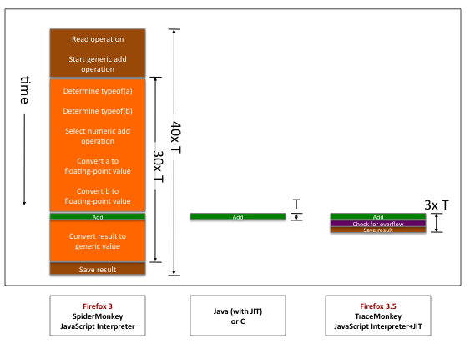
Mozilla TraceMonkey
(source: http://hacks.mozilla.org/2009/07/tracemonkey-overview/)

Slide 13
Mozilla TraceMonkey
Goal: generate type-specialized code
Challenges
no type declarations
statically trying to determine types mostly hopeless
Idea
run the program for a while and observe types
use observed types to generate type-specialized code
compile traces
Sounds suspicious?

Slide 14
Mozilla TraceMonkey
Problem 1: “observing types” + compiling possibly more expensive than running the code in the interpreter
Solution: only compile code that executes many times
“hot code” = loops
initially everything runs in the interpreter
start tracing a loop once it becomes “hot”

Slide 15
Mozilla TraceMonkey
Problem 2: past types do not guarantee future types… what happens if types change?
Solution: insert type-checks into the compiled code
if type-check fails, need to recompile for new types
code with frequent type changes will suffer some slowdown

Slide 16
Mozilla TraceMonkey
function addTo(a, n) {
for (var i = 0; i < n; ++i)
a = a + i;
return a;
}
var t0 = new Date();
var n = addTo(0, 10000000);
print(n);
print(new Date() - t0);
a = a + i; // a is an integer number (0 before, 1 after)
++i; // i is an integer number (1 before, 2 after)
if (!(i < n)) // n is an integer number (10000000)
break;
trace_1_start:
++i; // i is an integer number (0 before, 1 after)
temp = a + i; // a is an integer number (1 before, 2 after)
if (lastOperationOverflowed())
exit_trace(OVERFLOWED);
a = temp;
if (!(i < n)) // n is an integer number (10000000)
exit_trace(BRANCHED);
goto trace_1_start;

Slide 17
Mozilla TraceMonkey
System | Run Time (ms)
SpiderMonkey (FF3) | 990
TraceMonkey (FF3.5) | 45
Java (using int) | 25
Java (using double) | 74
C (using int) | 5
C (using double) | 15

Slide 18
Static Analysis Tools
Coverity
SLAM
ASTREE
…

Slide 19
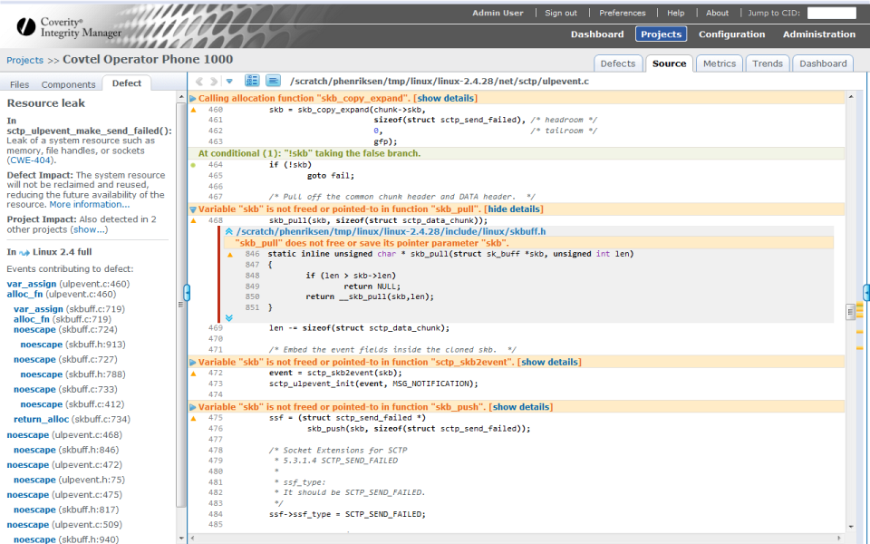

Slide 20
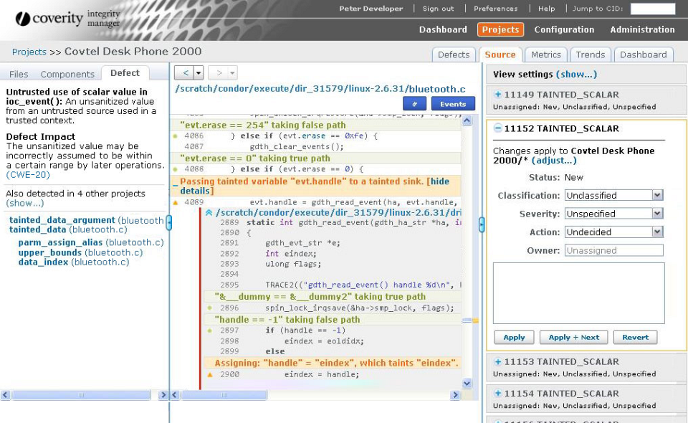

Slide 21
Lots and lots of research
Program Analysis
Program Synthesis
…

