Slide 1
Some Principles of Induction
Mooly Sagiv msagiv@acm.org Tuesday 11-13, Schriber 317
TA: Yotam Feldman Email:
yotam.feldman@gmail.com
http://www.cs.tau.ac.il/~msagiv/courses/pl19.html

Slide 2
Goals
Mathematical Induction
Inductively Defined Sets
Derivation Trees
Structural Induction

Slide 3
Syntax vs. Semantics
The pattern of formation of sentences or phrases in a language
Examples
Regular expressions
Context free grammars
The study or science of meaning in language
Examples
Interpreter
Compiler
Better mechanisms will be given in the course

Slide 4
Induction in Programming Languages
The syntax of programing languages is inductively defined
A number is expression
If e₁ and e₂ are expressions to so is e₁ + e₂
Types are inductively defined
int is a type
if t₁, t₂, …, t_{k} are types then struct { t₁ i₁; t₂ i₂; …, t_{k} i_{k};} is a type where i₁, i₂, …, i_{k} are identifiers
Recursive functions
fac(n) = if n = 1 then 1 else n * fac(n-1) fac₁=1, facn=n*fac_{n-1}
Semantics is inductively defined

Slide 5
Mathematical Induction
P(n) is a property of natural number n
To show that P(n) holds for every n, it suffices to show that:
P(0) is true
If P(m) is true then P(m+1) is true for every number m
In logic
(P(0) ∧∀m ∈N. P(m)⇒ P(m+1)) ⇒ ∀n ∈N. P(n)
P(0)
P(m)
P(m+1)
0
m
m+1

Slide 6
Simple Example
Show that 0 + 1 + 2 + … + n = n (n + 1)/2

Slide 7
Fibonachi Numbers
A sequence
fib₀=1
fib₁ =1
fib_{n} = fib_{n-2}+fib_{n-1}
1
1
2
3
5

Slide 8
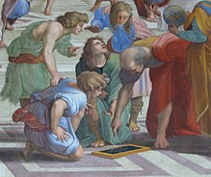
The Golden Ratio
fib(n) = (a^{n} –b^{n})/(a-b) where a=(1+ $√5)/2$ and b=(1- $√5)/2$
How can this be proved?

Slide 9
Course of values Induction
P(n) is a property of natural number n
To show that P(n) holds for every n, it suffices to show that for all m if for all k <m, P(k) holds then P(m)
In logic
∀m ∈N. (∀k < m. P(k))⇒ P(m)) ⇒ ∀n ∈N. P(n)
P(0)
P(1)
P(k)
P(m)
0
1
k
m

Slide 10
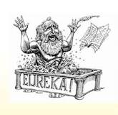
The Induction Hypothesis
The art of inductive proofs is coming up with induction hypothesis
Given a property Q find a stronger property P which is inductive P ⇒Q or P ⊆Q

Slide 11
Induction on a ball game
Four players pass a ball:
A will pass to C
B will pas to D
C will pass to A
D will pass to B
The ball starts at player A
Can the ball get to D?
A
B
C
D

Slide 12
Induction on a ball game
Four players pass a ball:
A will pass to C
B will pas to D
C will pass to A
D will pass to B
The ball starts at player A
Can the ball get to D?
A
B
C
D

Slide 13
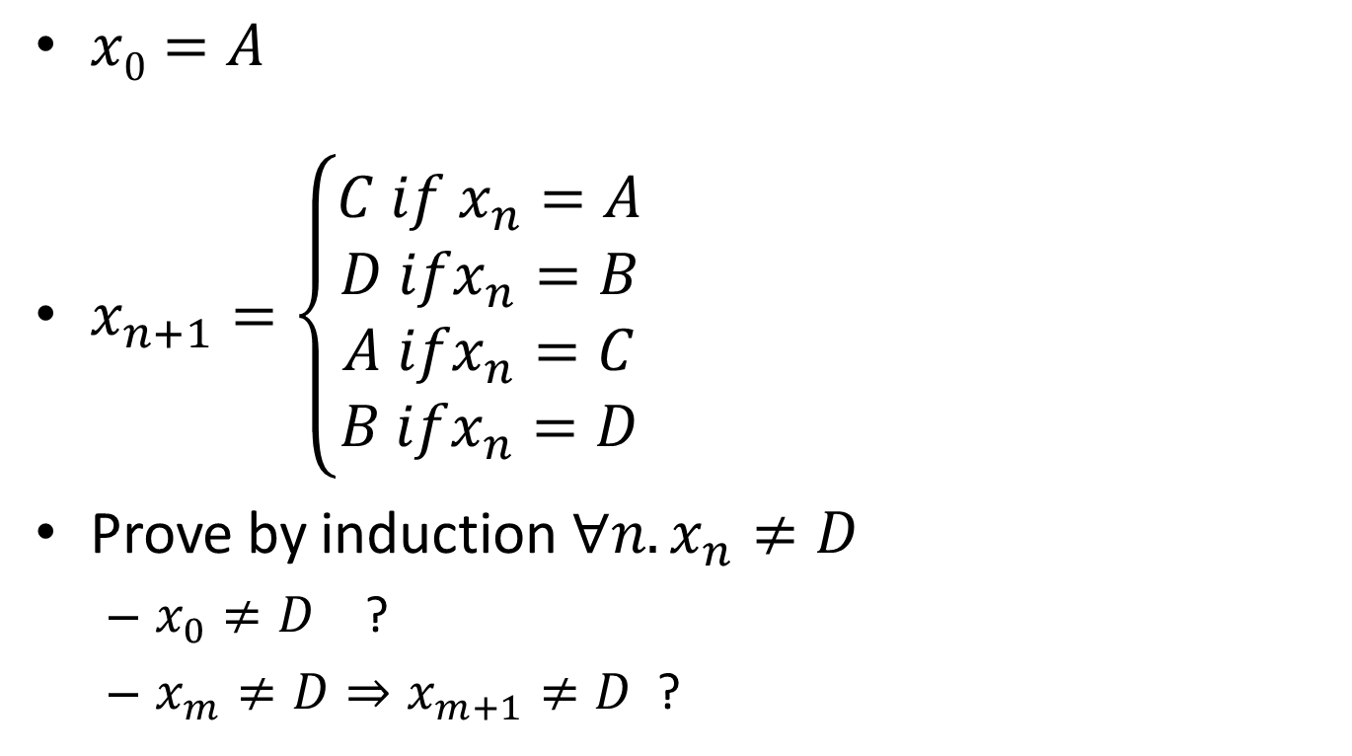
Formalizing with induction
$x0=A$
$x_{n+1}=\left\{\begin{aligned}C if x_{n}=A \\ D ifx_{n}=B \\ A ifx_{n}=C \\ B ifx_{n}=D\end{aligned}\right.$
Prove by induction $∀n.x_{n}≠D$
$x_{0}≠D$ ?
$x_{m}≠D⇒x_{m+1}≠D$ ?
A
B
C
D

Slide 14
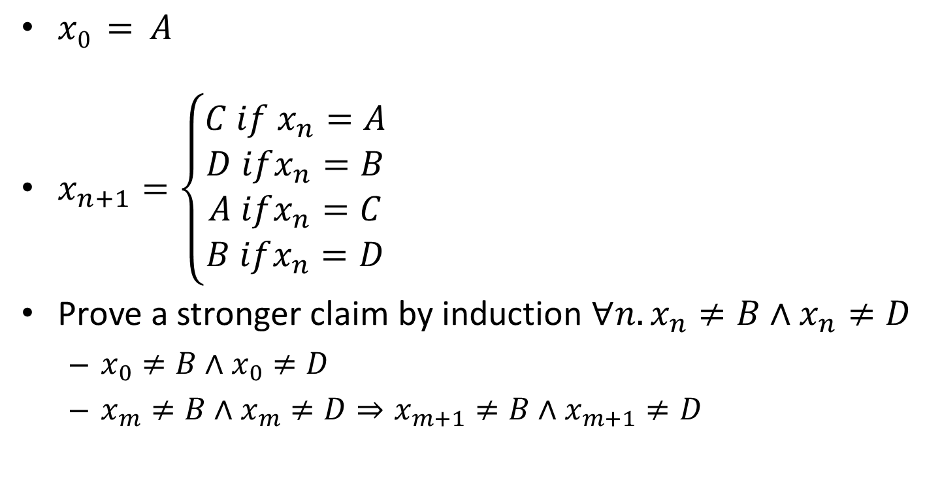
Formalizing with induction
$x0 = A$
$x_{n+1}=\left\{\begin{aligned}C if x_{n}=A \\ D ifx_{n}=B \\ A ifx_{n}=C \\ B ifx_{n}=D\end{aligned}\right.$
Prove a stronger claim by induction $∀n.x_{n}≠B∧x_{n}≠D$
$x_{0}≠B∧x_{0}≠D$
$x_{m}≠B∧x_{m}≠D⇒x_{m+1}≠B∧x_{m+1}≠D$
A
B
C
D

Slide 15
Simple Program
Consider the sequence
x₀ = 0, y₀=0
x_{n} = x_{n-1} + y_{n-1}, y_{n} = y_{n-1}+2
How can we show that for all n: x_{n} is even
What is the inductive claim?
{
x =0, y =0;
while (1) {
assert x%2 =0 ;
x = x + y;
y = y + 2;
}
}

Slide 16
Inductively Defined Sets

Slide 17
Inductively Defined Sets
It is convenient to define sets by rules
Base elements
Inference rules for more elements
Define the minimal set that is closed under rule application

Slide 18
The Natural Numbers
zero-axiom
0 ∈ N
succ-rule
m ∈ N
succ(m) ∈ N

Slide 19
The Even Numbers
zero-even
0 ∈ Even
even-rule
m ∈ Even
succ(succ(m)) ∈ Even
How can we show that “6” ∈ Even
How can we show that “3” ∉ Even

Slide 20
Driven (Proof) Tree
A proof that element is inductive set
The leafs are axioms
Internal nodes are inference rules

Slide 21
A Proof Tree for “6” ∈Even
zero-even
0 ∈ Even
even-rule
succ(succ(0)) ∈ Even
even-rule
succ(succ(succ(succ(0)))) ∈ Even
even-rule
succ(succ(succ(succ(succ(succ(0)))))) ∈ Even
root

Slide 22
Proving that “3”∉ Even

Slide 23
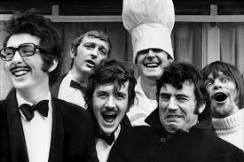
Why is this relevant to programming languages?

Slide 24
Expression Definition
A number is an expression
If e is an expression then so is (e)
If e1 and e2 are expressions then e1+e2 is an expression
This is an inductively defined set

Slide 25
Rules for expressions
exp-num-axiom
number ∈ Exp
e ∈ Exp
exp-paren
(e) ∈ Exp
e₁∈ Exp e₂∈ Exp
exp-plus
e₁+e₂∈ Exp

Slide 26
Example 5 + (7+3)
exp-num-axiom
exp-num-axiom
7 ∈Exp
3 ∈ Exp
exp-plus
7+3∈Exp
exp-num-axiom
exp-paren
5∈Exp
(7+3) ∈Exp
exp-plus
5+(7+3) ∈Exp

Slide 27
Benefits of formal definitions
Intellectual
Better understanding
Formal proofs
Mechanical checks by computer
Tool generation
Consistency
Entailment
Query evaluation

Slide 28
What is a good formal definition?
Natural
Concise
Easy to understand
Permits effective mechanical reasoning

Slide 29
Benefits of formal syntax for programming language
Intellectual
Simplicity
Better understanding
Interaction between different parts
Abstraction
Portability
Tool generations
Parser

Slide 30
How can the syntax of programming language be formally defined?

Slide 31
Tokens
Basic units of the programming language
Usually defined by regular expressions
Good tools: lex, awk
Regexp | action
[0-9]+ | printf(“number”);
“if” | printf(“if”);
lex
C code

Slide 32
Example Tokens
Keywords
“if”
“while”
Identifier {letter}({letter}|{digit}|_)*
Numbers [0-9]+

Slide 33
Example Tokens
Type | Examples
ID | foo n_14 last
NUM | 73 00 517 082
REAL | 66.1 .5 10. 1e67 5.5e-10
IF | if
COMMA | ,
NOTEQ | !=
LPAREN | (
RPAREN | )

Slide 34
Example Non Tokens
Type | Examples
comment | /* ignored */
preprocessor directive | #include <foo.h>
 | #define NUMS 5, 6
macro | NUMS
whitespace | \t \n \b

Slide 35
Recursive Syntax Definitions
The syntax of programming languages is naturally defined recursively
Can be also defined using inductive definitions
Valid program are represented as syntax trees

Slide 36
Expression Definitions
Every identifier is an expression
If E1 and E2 are expressions and op is a binary operation then so is ‘E₁ op E₂’ is an expression
<E>→ id | <E> <op> <E>
<op> → + | - | * | /
plus-ax
id-E
id ∈ ID
+ ∈ Op
id ∈ E
minus-ax
- ∈ Op
e₁ ∈ E e₂ ∈ E op ∈Op
mul-ax
bin-E
* ∈ Op
e₁ op e₂ ∈ E
div-ax
/ ∈ Op

Slide 37
Statement Definitions
If id is a identifier and E is an expression then ‘id := E’ is a statement
If S₁ and S₂ are statements and E is an expression then
‘S₁ ; S₂’ is a statement
‘if (E) S₁ else S₂’ is a statement
<S>→ id := <E>
<S> → <S> ; <S>
<S> → if (<E>) <S> else <S>
S₁ ∈ S S₂ ∈S
id ∈ Id, e ∈E
seq-s
assign-rule
S₁ ; S₂ ∈ S
id := E∈ S
e ∈E S₁ ∈ S S₂ ∈S
conditional-s
if (E) S₁ else S₂ ∈ S

Slide 38
C Example
match0
<Proc>
void match0(char *s) /* find a zero */
{
if (!strcmp(s, “0.0”))
return 0 ;
}
ID
Type
<S>
<ArgList>
void
<Arg>
<E>
Type
ID
char
*
s
!
<E>
<S>
ID
<Exp-List>
<E>
strcmp
return
NUM
<E>
<Exp-List>
ID
FNUM
Exp
s
“0.0”
“0”

Slide 39
Context Free Grammars
Non-terminals
Start non-terminal
Terminals (tokens)
Context Free Rules <Non-Terminal> → Symbol Symbol … Symbol

Slide 40
Example Context Free Grammar
1 <S> → <S> ; <S>
2 <S> → id := <E>
3 <S> → print (<L>)
4 <E> → id
5 <E> → num
6 <E> → <E> + <E>
7 <E> → (<S>, <E>)
8 <L> → <E>
9 <L> → <L>, <E>

Slide 41
Derivations
Show that a sentence is in the grammar (valid program)
Start with the start symbol
Repeatedly replace one of the non-terminals by a right-hand side of a production
Stop when the sentence contains terminals only
Rightmost derivation
Leftmost derivation

Slide 42
Parse Trees
The trace of a derivation
Every internal node is labeled by a non-terminal
Each symbol is connected to the deriving non-terminal

Slide 43
Example Parse Tree
<<S>>
<S>.
<S> ; <S>
<S> ; id := E
<S>
;
<S>
id := <E> ; id := <E>
id
:=
<E>
id
:=
<E>
id := num ; id := <E>
id := num ; id := <E> + <E>
num
<E>
+
<E>
id := num ; id := <E> + num
id := num ; id :=num + num
num
num

Slide 44
Ambiguous Grammars
Two leftmost derivations
Two rightmost derivations
Two parse trees

Slide 45
A Grammar for Arithmetic Expressions
1 <E> → <E> + <E>
2 <E> → <E> * <E>
3 <E> → id
4 <E> → (<E>)

Slide 46
Drawbacks of Ambiguous Grammars
Ambiguous semantics
Parsing complexity
But how can we express the syntax of PL using non-ambiguous grammars?

Slide 47
Non Ambiguous Grammar for Arithmetic Expressions
Ambiguous grammar
1 <E> → <E> + <E>
2 <E> → <E> * <E>
3 <E> → id
4 <E> → (<E>)
1 <E> → <E> + <T>
2 <E> → <T>
3 <T> → <T> * <F>
4 <T> → <F>
5 <F> → id
6 <F> → (<E>)
How do we show that the above grammars are the same?

Slide 48
Non Ambiguous Grammars for Arithmetic Expressions
Ambiguous grammar
1 <E> → <E> + <E>
2 <E> → <E> * <E>
3 <E> → id
4 <E> → (<E>)
1 <E> → <E> + <T>
2 <E> → <T>
3 T → <T> * <F>
4 T → <F>
5 F → id
6 F → (<E>)
1 <E> → <E> * <T>
2 <E> → <T>
3 <T> → <F> + <T>
4 <T> → <F>
5 <F> → id
6 <F> → (<E>)

Slide 49
Language Equivalence
What does it mean for two grammars to be equivalent?
How do we show that two grammars are equivalent?

Slide 50
Structural Induction
Prove that the property holds for all simple trees
Prove that the property holds for all composite trees using the fact that it holds for subtress
For each rule assume that the property holds for its premises (induction hypothesis) and prove it holds for the conclusion of the rule

Slide 51
Rule Induction
Prove that the property holds for all simple derivation trees by showing it holds for axioms
Prove that the property holds for all composite trees:
For each rule assume that the property holds for its premises (induction hypothesis) and prove it holds for the conclusion of the rule

Slide 52
Inductive Rules for Interpretation
Operational Semantics

Slide 53
Expression Evaluation
The rules for expression evaluation can also be defined inductively
Val ⊆ Exp × Int
Denote e,k ∈ Val by e → k
Leads to simple evaluation rules
Easy to implement

Slide 54
Rules for expression evaluation
vexp-num-ax
number→ number
vexp-paren
e → v
(e)→ v
e₁→ v₁ e₂→v₂
vexp-plus
e₁+e₂→ v₁+v₂

Slide 55
Example 2+3
vexp-num-ax
vexp-num-ax
2→ 2
3→3
vexp-plus
2+3→5

Slide 56
Theorem: Values are deterministic
For every expression e ∈ Exp and values v₁, v₂ ∈Int
If e →v₁ and e→ v₂ then v₁ = v₂

Slide 57
Well Founded Induction
Inductive arguments work since they cannot go forever
Eventually we reach the basis

Slide 58
Well Founded Relations
A binary relation  on a set A is well founded if there are no infinite descending chains …  a_{i}  …  a₁  a₀
Examples
A=N and x  y if y =x+1
A=N and x  y if x <y
A is set of strings and x  y if x is a prefix of y, i.e. there exists w such that x.w=y
A is set of strings and x  y if y is a prefix of x, i.e. there exists w such that y.w=x

Slide 59
Minimal Elements
A binary relation  on a set A is well founded if and only if every non-empty subset Q of A has a minimal element m such that
m ∈Q ∧ ∀b. b m ⇒ b ∉Q

Slide 60
The Principle of Well-Founded Induction
Let  be a well-founded relation on a set A and P be a property then ∀a. P(a) iff ∀c. [∀b. (b  c ∧P(b)) ⇒P(c)]
Examples
For A=N and x  y if we y = x+1 we get mathematical induction
For A=N and x  y if we x <y we get Course of values Induction
For A = Derivation Trees and x  y if x is a subtree of y we get structural induction

Slide 61
Further Reading
Winskel: The formal semantics of programming languages: Chapter 3

Slide 62
Summary
Induction is powerful
Mathematical
Course of values
Rule induction
Structural
Well Founded
Coming up with induction hypothesis may be hard
Induction is a key technique in programming languages

