Slide 1

The Blockchain Technology
Mooly Sagiv
Tel Aviv University
http://www.cs.tau.ac.il/~msagiv/courses/blockchain.html
msagiv@acm.org

Slide 2



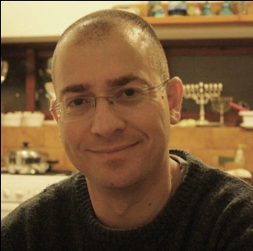

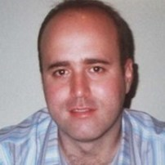



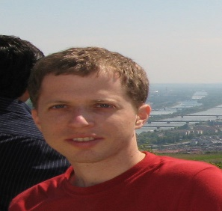
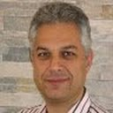


Advisory Board
Shelly Grossman
Noam Rinetzky
Ittai Abraham
Guy Golan-Gueta
Yan Michalevsky
Orr Tamir Eran Tromer
Ittay Eyal
Benny Pinkas

Slide 3
Outline
Formalities
  Prerequisites
  Course Goals
  Course Requirements
  Tentative Schedule
A gentle introduction
  A better one next week by Ittay Eyal (Tehnion)
Guides to presentation (short)

Slide 4
Prerequisites
Computational Models
One of the following
  Logics in Computer Science
  Cryptography

Slide 5
Tentative Schedule
March 4: Overview and Introduction
March 11: Ittay Eyal, Technion: Basics of mining and incentives
April 4: Ittai Abraham, Vmware and Hebrew University: The Bitcoin Blockchain and Nakamoto Consensus
April 22: Yonathan Sompolisky, Hebrew University: TBD
Presentations by Students

Slide 6
Seminar Goals
Learn how to read a scientific article in computer science
  Not necessarily practical for Blockchain
  Not self contained
  Critical thinking
  >100 hours
Learn how to prepare a high quality presentation
  Help from Instructor
  A lot of good advise in the Internet
  > 150 hours
Read introductory material
Meet the instructor twice (at least)
Participate in 11 lectures

Slide 7

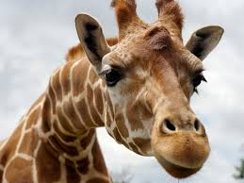
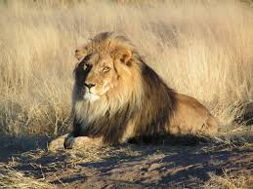
Traditional Online Transactions
Trusted third party
Yup! He sent the money
$10,000
Validate entries
Safeguard entries
Preserve historic records
Expensive
Slow
Subjects to frauds

Slide 8
Questions
Can we permanently store assets globally with trust?
Single ownerships
Identity management
Easy transfer of assets
Create the illusion of a single global computer

Slide 9


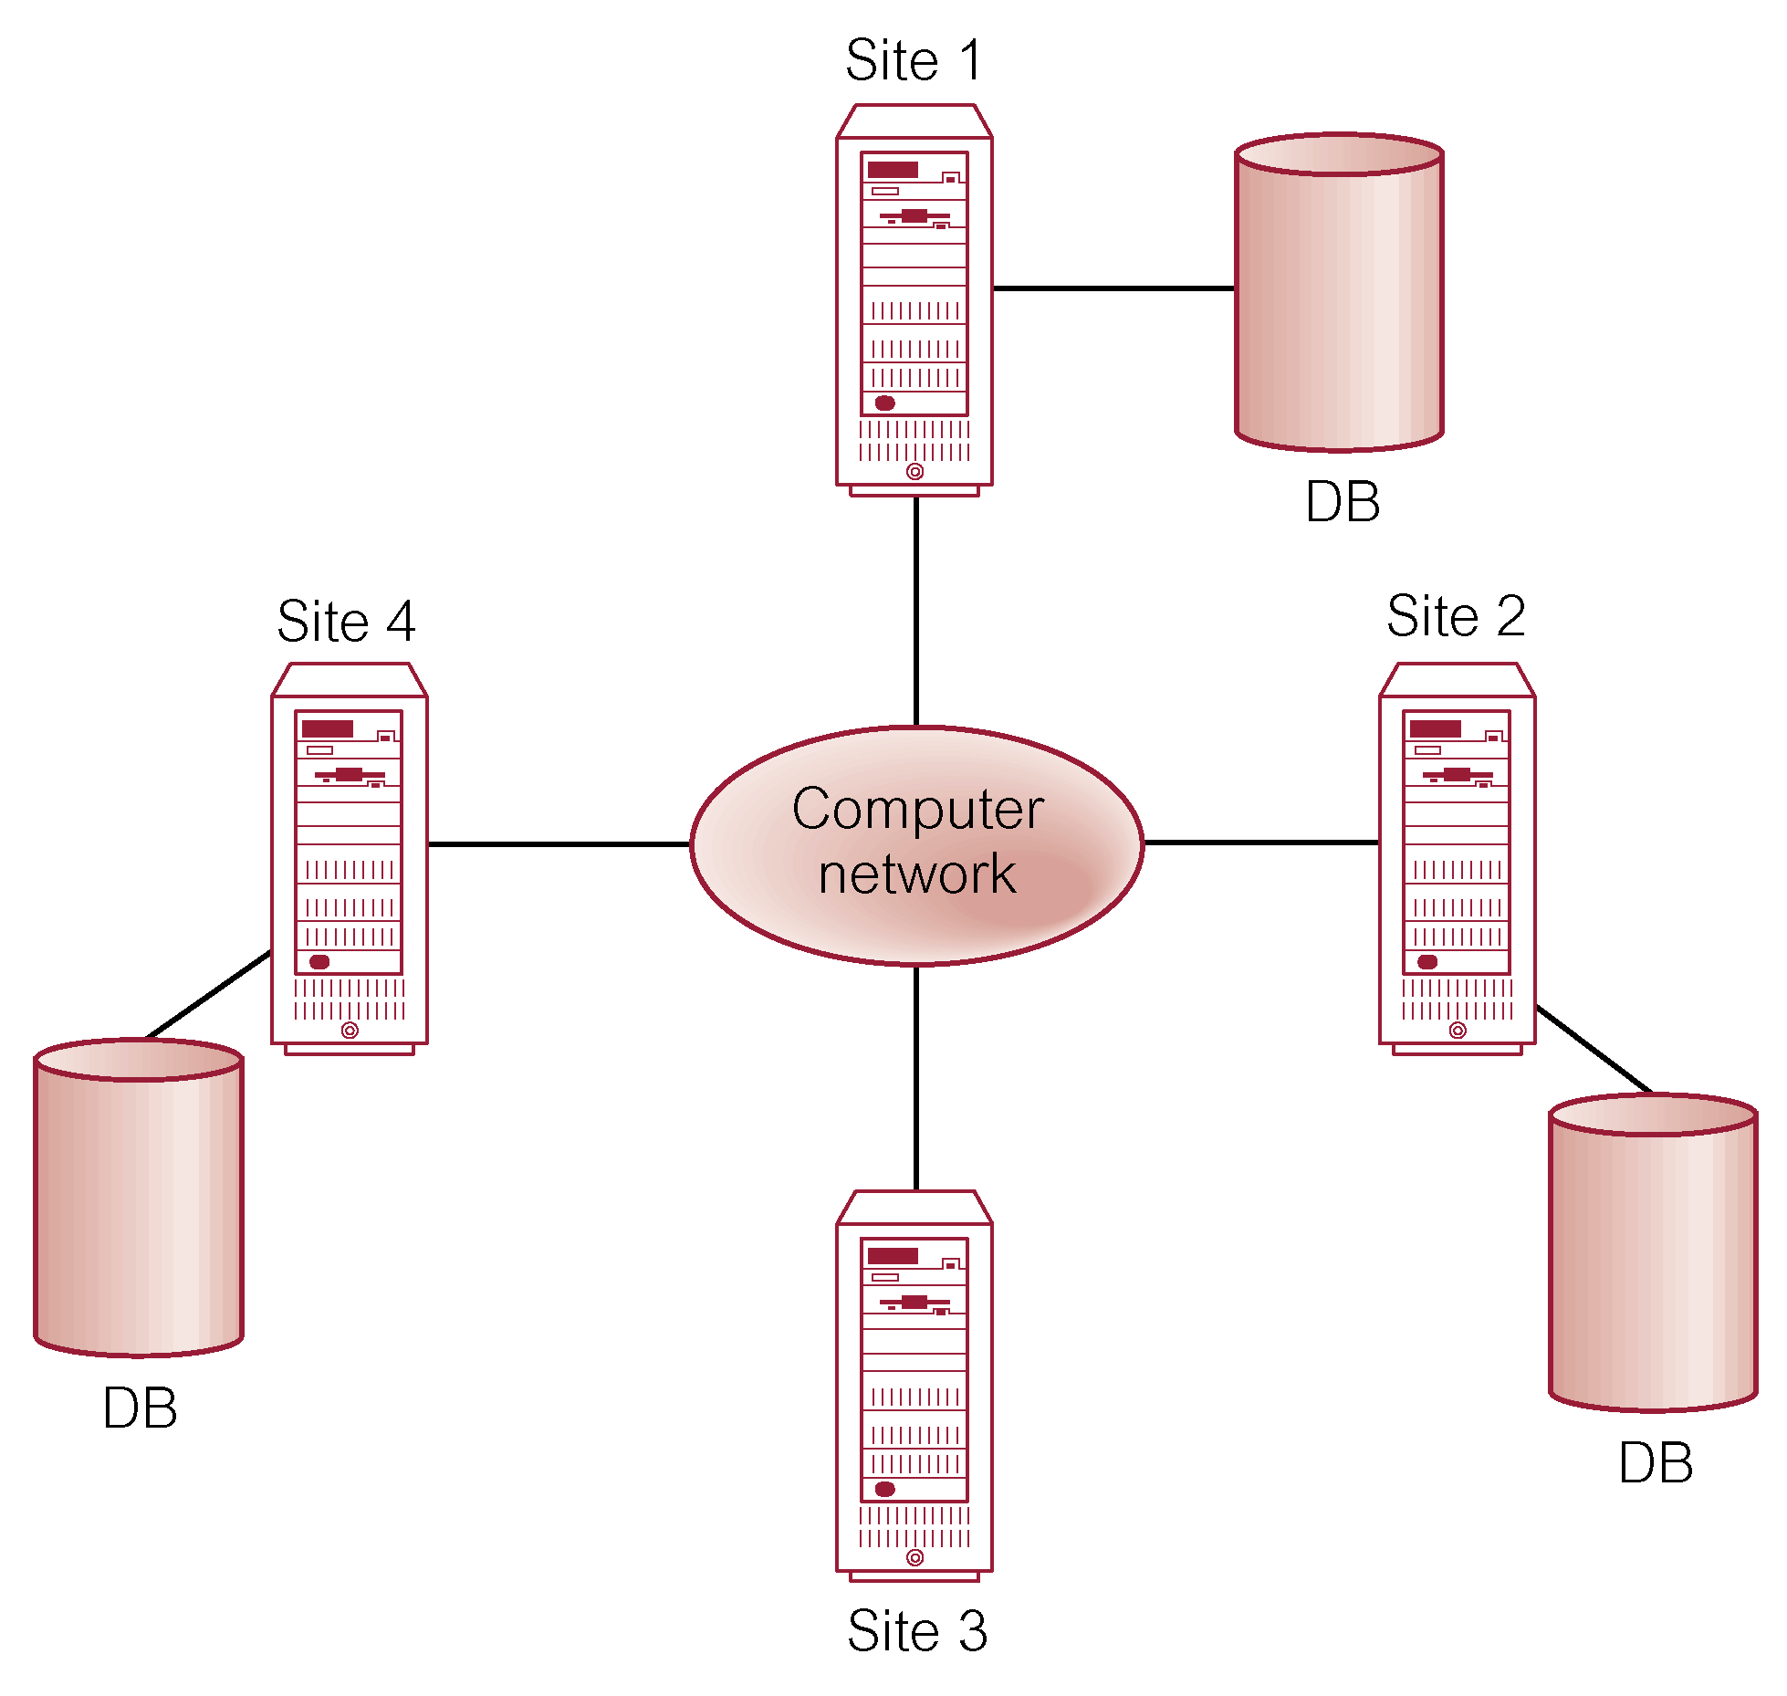

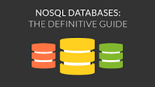
Distributed DBMS

Slide 10
Limitations of Distributed Databases
Centralized
Complexity & Costs
Trust the database company

Slide 11


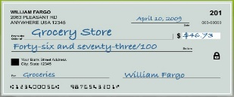







How Blockchain works?
A wants to send money to B
The transaction is
represented as block
The block is broadcast to every node in the network
?
?
?
?
?
A
Sufficient miners approve the transaction
The transaction is added
to Blockchain
B receives the money
 ☑
 ☑
 ☑
B

Slide 12
Replicated Transaction Log
A
B
C
A
B
C
A
B
D
A
B

Slide 13




Public vs. Private Blockchains
Public blockchains
Private blockchains
  Anyone can participate
Participants are known and trusted
  An industry group, or a group of companies owned by an umbrella company
  Many of the mechanisms aren’t needed – or rather they are replaced with legal contracts

Slide 14
The Bitcoin Blockchain

Slide 15
Bitcoin
The first realization of the Blockchain Technology
2008
  August 18 Domain name "bitcoin.org" registered
  October 31 Bitcoin design paper published
  November 09 Bitcoin project registered at SourceForge.net
2009
  January 3 Genesis block established at 18:15:05 GMT
  January 9 Bitcoin v0.1 released and announced on the cryptography mailing list
  January 12 First Bitcoin transaction, in block 170 from Satoshi to Hal Finney

Slide 16
The essence of bitcoin
A protocol that supports decentralized anonymous peer-to-peer digital currency
A publicly disclosed ledger of transactions
A reward driven system for achieving consensus (mining) based on
  "Longest chain for consensus”
  “Proofs of Work” for helping to secure the network
A “scare token” economy with an eventual cap of about 21M bitcoins

Slide 17
The Bitcoin Blockchain
The header of the block contains unique hash
Refer to prev blocks

Slide 18
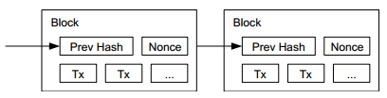
Bitcoin Blockchain
Every viable transaction is stored in a public ledger
Transactions are placed in blocks, which are linked by SHA256 hashes
https://blockchain.info

Slide 19
Proof of Work [Naor&Dwork 92]
Make it harder for dishonest miners to create blocks
Make sure that miners solve computationally hard problems when a block is created
  But validation is easy
  A guessing game where block-makers need to guess a number, which when crunched with the rest of the block data contents, results in a hash / fingerprint that is smaller than a certain number

Slide 20
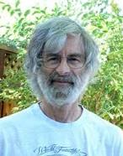
The Consensus Problem[Lamport]
How to reach an agreement in a distributed system?
Every node votes on a value
The nodes exchanges messages until they reach consensus
Correctness properties
  Non-triviality: Only proposed values can be learned
  Safety: At most one value can be learned
    two different learners cannot learn different values
  Liveness: If value C has been proposed, then eventually learner L will learn some value
    if sufficient processors remain non-faulty

Slide 21



The FLP Theorem 1985
In the asynchronous setting no live consensus exists

Slide 22
Consensus in Bitcoin
Not aiming for fully correct consensus
No need for message exchange
Several mechanisms used to ensure well behaved programs under certain assumptions
  Longest chain

Slide 23
Longest Chain
Block 81a
Block 78
Block 79
Block 80
Block 81b
Block 81c
Which one should be used?
They contain different transactions
They contain different rewards

Slide 24
Longest Chain
Mine a new block assuming 81a
Block 78
Block 79
Block 80
Block 81a
Block 82a
Block 81b
Block 82b
If you see 82b switch to blue

Slide 25
The effects of the longest chain rule
Consensus with high probability
  Because creating blocks is hard
The number of miners does not effect the results
Transactions can be revoked

Slide 26
Bitcoin Main Features
Question | Bitcoin | Other ways
How should data be stored? | Blockchain | Distributed database
How should new data be distributed? | Peer-to-Peer | Client-Server hierarchical
Resolving conflicts (Consensus) | Longest chain rule | Other consensus protocols
Adding/Changing rules | BIP for writing rules Vote for hashing power | Centralized updates Contextual obligations
Who can submit transactions? | Open anonymous | Trusted pre-vetted
Who can validate transactions | Open anonymous | Trusted pre-vetted
Who can add blocks? | Open anonymous | Trusted pre-vetted
Preventing bad behaviors | Proof of work | Poof of Stake or trusted
Incentivize block makers | Coins | 3rd party

Slide 27
The Ethereum Blockchain

Slide 28
Smart Contracts
Transactions in bitcoin are limited
  Transfer ‘X’ bitcoins from ‘Y’ to ‘Z’
More powerful transactions
  Exchange
  Auction
  Games
  Bets
  Legal agreements
Solution
  Store smart contracts on the blockchain
  Computer programs implement transactions
  Immutability guarantees persistence

Slide 29
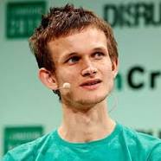

Ethereum
A decentralized platform that runs smart contracts
Proposed in late 2013 by Vitalik Buterin
Released 2015
Supports Turning complete smart contracts (Solidity)
A virtual machine for cryptocurrency (Ethereum Virtual Machine)
  Creating new currencies
  Guaranteeing certain currency consistency
But has all bad features of computer programs (DAO, Parity, …)

Slide 30


How to steal $50M – the DAO bug
_{DAO::withdraw(to) {}
_{if shares[to] > 0 {}
_{transferTo(to, shares[to]);}
_{shares[to] = 0;}
}
}
coins[Thief]=7
shares[Thief]=100
Notes:
Let’s delve deeper. I’ll show you how the thief was able to steal potentially all of the DAO’s reserve.
The DAO had one vulnerable function called withdraw, receiving the name of the investor who wishes his coins back.
It checks if there are coins, and transfers them. Then it nullifies the number of coins in the shares map.

Slide 31
How to steal $50M – the DAO bug
_{DAO::withdraw(to) {}
_{if shares[to] > 0 {}
_{transferTo(to, shares[to]);}
_{shares[to] = 0;}
}
}
coins[Thief]=7
shares[Thief]=100

Slide 32
How to steal $50M – the DAO bug
_{DAO::withdraw(to) {}
_{if shares[to] > 0 {}
_{transferTo(to, shares[to]);}
_{shares[to] = 0;}
}
}
_{Thief::uponTransfer(a) {}
_{DAO::withdraw(Thief)}
}
coins[Thief]=107
shares[Thief]=100
Notes:
For more expressive contracts, it is allowed to register a special event that will fire-up when coins are transferred.
Naïve example: Suppose that each time that I get a coin, I check if I have enough coins to order a pizza.
So our clever thief wrote the following event: upon receiving coins, the thief calls withdraw again.

Slide 33
How to steal $50M – the DAO bug
_{DAO::withdraw(to) {}
_{if shares[to] > 0 {}
_{transferTo(to, shares[to]);}
_{shares[to] = 0;}
}
}
_{Thief::uponTransfer(a) {}
_{DAO::withdraw(Thief)}
}
coins[Thief]=107
shares[Thief]=100
Notes:
Withdraw is executed again – we call this A Callback

Slide 34
How to steal $50M – the DAO bug
_{DAO::withdraw(to) {}
_{if shares[to] > 0 {}
_{transferTo(to, shares[to]);}
_{shares[to] = 0;}
}
}
_{Thief::uponTransfer(a) {}
_{DAO::withdraw(Thief)}
}
coins[Thief]=207
shares[Thief]=100
Notes:
Repeat until DAO cannot transfer another 100 coins

Slide 35
Final Comments

Slide 36
Something Completely Different OS
App 1
App 2
App 3
Guaranteed semantic isolation
Operating System
Process
Virtual Memory
Hardware
CPU
Memory

Slide 37
Blockchain
Wallet
Auction
Supply chain
Guaranteed global view for isolated users
Protocol
Transaction types
Bitcoin, Ether, Dollar, Smart Contract
Append-only shared log

Slide 38


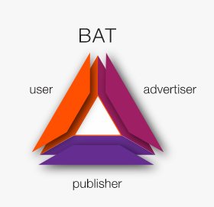
Some Early Applications of Blockchain
Banking services for those who are not eligible for bank accounts in their country
Music sales
Smarter web advertisements
protecting user anonymity
UN’s World Food Programm uses blockchain to eliminate costs related to fair distribution of food and supplies to Syrian refugees
Applications of private blockchains to replace databases

Slide 39
Challenges
How does the sender prevent others to receive the money?
Who guarantees that the sender has the money and prevents double spending due to network delays?
How can new money created?
What are the exchange rules?
Cryptography checks
The miners
Rewards for mining
Determined by smart contracts

Slide 40
Blockchain is interdisciplinary
Theoretical
Computer
Science
Distributed
Computing
Formal
Methods
Cryptography &
Security
Programming
Languages
Databases

Slide 41
Useful Techniques

Slide 42
Distributed Computing & Databases
Distributed systems
Communication models
Failure models
Fault tolerance
Replicated transaction log
Replicated state machine

Slide 43
Replicated Transaction Log
The information is stored at every node
A consensus algorithm builds the log
Distributed database builds replicated logs
A
B
C
A
B
C
A
B
D
A
B

Slide 44
Failure Models - How can a node fail
Byzantine or arbitrary failures
  Nodes can lie, forge messages, lie about others
Authentication detectable byzantine failures
  Node can lie about their values but cannot lie about facts sent by other nodes
Performance failures
  Messages arrive early or late
Omission failures
  Messages never arrive
Crash failures
  No messages and no response
Fail-stop failures

Slide 45
Fault Tolerance
How to continue after a faliure

Slide 46
Cryptography and Security
Private keys
Public keys
Homomorphic encryption
Ideal functionality
Authenticated data structures
Zero knowledge

Slide 47
Programming
Syntax
Semantics
Interpreter
Compiler
Virtual machine
Correctness
Invariants
Formal verification
Testing

Slide 48
Foundational Work
1977 RSA: Mention currency an early proposed application
1978 Lamport: Consensus
1982 Chaum: Anonymous cryptocurrency introduced
1993 Dwork and Naor: Proofs of work introduced (w/o the name)
1996 Rivest and Shamir: proof-of-work-based cryptocurrency
2002: Vivek Vishnumurthy, Sangeeth Chandrakumar and Emin Gun Sirer: P2P Currency

Slide 49
What do you have to do if you are registered?
Attend the 2nd lecture on presentations (short)
Select three articles from the web by March 11 and email titles to instructor
Read chapters 1 & 2 of “Bitcoin and Cryptocurrency Technologies” by March 18t
Receive topic and date
Meet the instructor twice before the lecture

Slide 50
Acknowledgments
The noun project
David V Duccini
Antony Lewis
http://scet.berkeley.edu/blockchain-lab/
The IC3 project Cornell

Slide 51
For more information
http://www.cs.tau.ac.il/~msagiv/courses/blockchain.html
https://crypto.stanford.edu/cs251/

