Slide 1







Trusted bulletin-board emulation
Stefan Dziembowski
the “ideal” world
a protocol that emulates the ideal world
Main difficulty: Some parties can cheat.
Classical result: simulation is possible if the “majority is honest”.
For example for 5 players we can tolerate at most 2 “cheaters”.

Slide 2

Formally Verifying
Smart Contracts
Mooly Sagiv
Tel Aviv University

Slide 3











And also…
Shelly Grossman
Shachar Itzhaky
Ittai Abraham
David Dill
Yan Michalevsky
Noam Rinetzky
Guy Golan-Gueta
Yoni Zohar

Slide 4
Smart Contracts
Transactions in bitcoin are limited
  Transfer ‘X’ bitcoins from ‘Y’ to ‘Z’
More powerful transactions
  Exchange
  Auction
  Games
  Bets
  Legal agreements
Solution
  Store smart contracts on the blockchain
  Computer programs implement transactions
  Immutability guarantees persistence

Slide 5
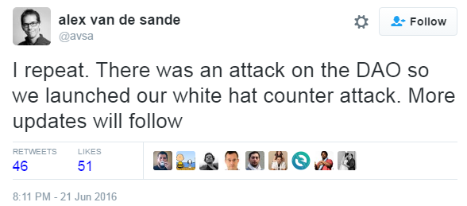
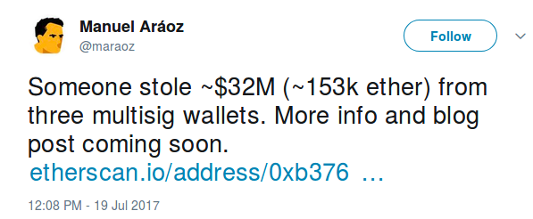
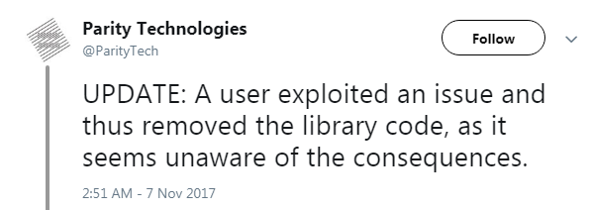
Massive Losses due to Bugs
THE PROBLEM

Slide 6



CURRENT SOLUTIONS
Manual
Costly
Incomplete
Auditing
Testing

Slide 7
AUDITING IS INSUFFICIENT
From “A Postmortem on the Parity Multi-Sig
Library Self-Destruct”:
… multi-sig wallet code was created and audited by the Ethereum Foundation’s DEV team, Parity technology and others in the community

Slide 8
Automatic software verification
Program P
Desired Property ϕ
Solver
Is there a behavior
of P that violates ϕ?
Y
N
Counterexample
Proof
Notes:
The dream of program verification is to build a Solver (algorithm) which checks correctness at compile-time

Slide 9
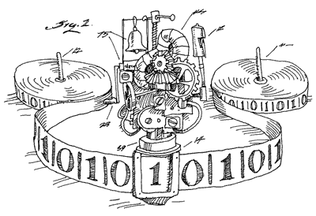


Disillusionment in program verification 80’s
Program P
Safety
Property ϕ
Rice’s Theorem ➔
Verification
Is there a behavior
of P that violates ϕ?
I can’t decide!
“Program verification is the holy grail of computer science; always was; always will be” Chet Murthy
Counterexample
Unknown
Proof
[POPL’78, CACM’79] R.A. DeMillo, R.J. Lipton, A. J. Perlis:
Social Processes and Proofs of Theorems and Programs
Notes:
The dream of program verification is to build a Solver (algorithm) which checks correctness at compile-time
Program = infinite state system
Unbounded heap
Unbounded variables (integers)
Program assertions = safety property
Program verification = safety verification
Representing states and transitions with logic allows using existing tools (e.g Z3, used by Dafny)

Slide 10
Challenges in program verification
Specifying program behavior
Complexity of program verification
  The halting problem
  Rice theorem
  The ability of simple programs to represent complex behaviors
Complexity of realistic systems
  Huge code
  Heterogeneous code
  Missing code

Slide 11
The SAT Problem
Given a propositional formula (Boolean function)
  ϕ = (a ∨ b) ∧(¬ a∨ ¬b ∨ c)
Determine if ϕ is satisfiable
  Find a satisfying assignment or report that such does not exist
For n variables, there are 2^{n} possible truth assignments to be checked
Tools exist: Z3, Yices, CVC, …
a
0
1
b
b
0
1
0
1
c
c
c
c
0
1
0
1
0
1
0
1

Slide 12
Verification by reductions to SAT
Program P
Desired Property ϕ
Front-End
Formula
←P→ ∧¬ ϕ
SAT Solver
Counterexample
Proof
Notes:
The dream of program verification is to build a Solver (algorithm) which checks correctness at compile-time

Slide 13
Verification by reduction to SAT
a
0
1
SAT Query:
((a ∧ x)∨(¬a ∧ ¬ x))
∧
((b ∧ y)∨(¬b ∧ ¬ y))
∧
((x ∧¬y) ∨(¬x ∧y)
?
SAT Answer:
Satisfiable by a=0, b = 1
x:=0
x:=1
b
0
1
y:=0
y:=1
assert x==y

Slide 14
Verification by reduction to SAT
a
0
1
SAT Query:
((a ∧ x ∧b)∨(¬a ∧ ¬ x ∧ ¬ b))
∧
((b ∧ y)∨(¬b ∧ ¬ y))
∧
((x ∧¬y) ∨(¬x ∧y)
?
x:=0;b:=0
x:=1;b:=1
b
SAT Answer:
Unsatisfiable
0
1
y:=0
y:=1
assert x==y

Slide 15
The SMT(Sat Modulo Theory) Problem
Given a ground first order formula over theories(Boolean function)
  ϕ = ∃x, y: 2x + y ≥ 5 ∧ y < 3
Determine if ϕ is satisfiable
  Find a satisfying assignment or report that such does not exist
Satisfiability becomes harder
But tools exist: Yices, Z3, CVC, …

Slide 16
Verification by reductions to SMT
Program P
Desired Property ϕ
Front-End
Formula
←P→ ∧¬ ϕ
SMT Solver
Counterexample
Proof
Notes:
The dream of program verification is to build a Solver (algorithm) which checks correctness at compile-time

Slide 17
Simple Example Token (buggy)
balance[to]=balance[to]-fee
balance[to]>=amount?
SMT Answer:
Satisfiable by balance[to]=10,
fee=5,
amount=6
balance[from]=100
F
T
balance[to]=balance[to]-amount
balance[from]=balance[from]+amount
∀x. (x≠to ∧ x≠ from) ⇒ b’[x]=b[x] ∧
b[to] ≥amount+fee ⇒(b’[to]=b[to]-amount-fee ∧ b’[from]=b[from]+amount) ∧
b[to]<amount+fee ⇒(b’[to]=b[to] ∧ b’[from]=b[from])
assert

Slide 18
Simple Example Token (corrected)
F
balance[to]≥amount+fee?
T
SAT Answer:
Unsatisfiable
balance[to]=balance[to]-amount-fee
balance[from]=balance[from]+amount
assert
∀x. (x≠to ∧ x≠ from) ⇒ b’[x]=b[x] ∧
b[to] ≥amount+fee ⇒(b’[to]=b[to]-amount-fee ∧ b’[from]=b[from]+amount) ∧
b[to]<amount+fee ⇒(b’[to]=b[to] ∧ b’[from]=b[from])
assert

Slide 19
More interesting contracts
Unbounded participants
Complicated specifications
  Higher order reasoning
Need to handle loops

Slide 20
Minting Tokens - buggy
Σbalance=totalSupply?
SAT Answer:
Satisfiable by
Σbalance=10,
totalSupply=10,
amount=5
F
T
totalSupply=totalSupply+amount
assert
Σbalance’=totalSupply’ ∧ totalSupply’=totalSupply+amount
assert

Slide 21
Minting Tokens - corrected
Σbalance=totalSupply?
SAT Answer:
Unsatisfiable
F
T
totalSupply=totalSupply+amount
balance[bank]=balance[bank]+amount
Σbalance’=totalSupply’ ∧ totalSupply’=totalSupply+amount
assert
assert

Slide 22
The “Parity” Wallet Example
newMoneyRequest
init
Init
2 out of 3
#confirmers=0 out of 3
#confirmers=1 out of 3
confirm
confirm
money request
approved
init
Init
3 out of 3
#confirmers=0 out of 3
#confirmers=1 out of 3
#confirmers=2 out of 3
new
init
…
init
…
#confirmers=k
Init
k out of n
#confirmers=0 out of n
#confirmers=1 out of n
#confirmers=2 out of n
new
init
Init
2 out of 1
new
#confirmers=0 out of 1
Some init states are bad
Not live

Slide 23
Parity wallet buggy initialization code
ownersMap=∅ ∧ required=0
SAT Answer:
Satisfiable by
y=2,
owners={x0}
required=y
for (x:owners) { ownersMap[x]=true }
Loops
|{x. ownersMap’[x]}|>=y => (required’=y
∧ ownersMap’=owners)
∧ |{x. ownersMap’[x]}|<y => (required’=0 ∧ ownersMap’= ∅)
assert
Higher order reasoning (cardinality)

Slide 24
Parity wallet simplified initialization code
ownersMap=∅ ∧ required=0
Loop → comprehension:
ownersMap=owners
required=y
for (x:owners) { ownersMap[x]=true }
Higher order reasoning (cardinality):
if ownersMap[x]=false ->|ownersMap|= |ownersMap|+1
|{x. ownersMap’[x]}|>=y => (required’=y
∧ ownersMap’=owners)
∧ |{x. ownersMap’[x]}|<y => (required’=0 ∧ ownersMap’= ∅)
assert

Slide 25
Parity wallet fixed
ownersMap=∅ && count=0 && required=0
required=y
¬ ownersMap[x]
Y
for (x:owners)
ownersMap[x]=true
Count>y
N
abort
N
count=count+1
Y
assert
count>=y => (required’=y
∧ ∀x. x∈owners <-> ownersMap’[x]=true)
∧ count<y => (required’=0 ∧ ownersMap’= ∅)

Slide 26
Parity wallet
newMoneyRequest
#confirmers=0
out of 3
#confirmers=1 out of 3
money request
approved
confirm
confirm

Slide 27
Challenge Higher Order Specification

Slide 28
Challenge: Handling Loops
Bounded loop instantiation
  CBMC
  Scaling
User specified loop invariants
  Powerful
  But requires careful insights
Automatic loop invariants inference
  Ultimately limited
  Even when checking is possible
Limited loops

Slide 29
Summary thus far
Program verification is powerful
But hard to apply to complicated systems
Modularity helps

Slide 30
Runtime Monitoring
Enforce correctness at runtime
Especially useful with generic required properties
Java properties
  No out of bound array accesses
  No null dereferences
  ….
Can we do the same for contracts?

Slide 31

MOTIVATION: EXISTING VM
Blockchain
Withdraw(100$)
VM
Ledger:
Beneficiary Money
Alice 2100
Bob 400
…
DAO
DAO State:
Balance=2600
Beneficiary Money
Alice 2000
Bob 500
Thief 100
DAO State:
Balance=0
Beneficiary Money
Alice 2000
Bob 500
Thief 0

Slide 32
Quality VM
Blockchain
Rule violation
Rules
QVM
Withdraw(100$)
Ledger:
Beneficiary Money
Alice 2100
Bob 400
…
DAO
DAO State:
Balance=2600
Beneficiary Money
Alice 2000
Bob 500
Thief 100

Slide 33
Some Generic Correctness Rules
Effectively Callback Free (ECF) transactions
  Eliminate the DAO bug
Immutable Ownership
  Parity #1
Prevent Bad upgrades
  Monitor code changes and signed whitelists
  Parity #2
A flexible framework for arbitrary rules

Slide 34

Effective Callback Freedom – the DAO bug
_{DAO::withdraw(to) {}
_{if b[to] > 0 {}
_{sendMoney(to, b[to]);}
_{b[to] = 0;}
}
}
_{Thief::uponTransfer(a) {}
_{DAO::withdraw(Thief)}
}
coins[Thief]=205
b[Thief]=100
Notes:
Repeat until DAO cannot transfer another 100 coins

Slide 35
EFFECTIVE CALLBACK FREEDOM (ECF)
For every path there is a path without callbacks with same effect
$100
$0
$5
$105
Withdraw start
sendMoney start
…
b > 0
t
Call Withdraw
f
b = 0
Call sendMoney
Return from Withdraw
Return from sendMoney
…
sendMoney end
Withdraw end

Slide 36
GIST OF DAO ATTACK
For every path there is a path without callbacks with same effect
$100
$5
$105
$205
Withdraw start
sendMoney start
…
b > 0
t
Call Withdraw
f
Call sendMoney
Return from Withdraw
Return from sendMoney
ECF Could have prevented the DAO bug without human intervention!
…
b = 0
sendMoney end
Withdraw end

Slide 37
Ethereum (7/2015 — 6/2017)
Empirical Results (POPL’18)
Blockchain | Contracts | Executions | Non-ECF (%)
Ethereum | 342K | 96M | 3,321 (0.003%)
Ethereum Classic | 91K | 32M | 2,288 (0.007%)
Each Non-ECF is an actual attack (0% False positive)
Miniscule performance overhead*
Could have prevented the DAO bug without human intervention!
*3.38% in time executing EVM alone – drops further in real settings

Slide 38
Contract Verification != Software Verification
THE THREE ENABLERS
Relatively small number of generic required properties are needed
    Not per-contract
Restricted domain
  Small contracts
  Modularity due to ECF
Feasibility of defensive checking

Slide 39
Complementary Approaches
Concolic execution
Restricted programs

Slide 40
Summary
Virtualization is powerful
Program verification is powerful
Program verification is expensive
Few Success stories
  Hardware Verification
  Operating System
  Device drivers
  Packet Filters
  Distributed protocols
Contract verification
Higher order programming reduces errors and enables verification

