Slide 1
Types and Type Inference
Mooly Sagiv
Slides by Kathleen Fisher and John Mitchell
Reading: “Concepts in Programming Languages”,
Revised Chapter 6 - handout on Web!!

Slide 2
Outline
General discussion of types
What is a type?
Compile-time versus run-time checking
Conservative program analysis
Type inference
Discuss algorithm and examples
Illustrative example of static analysis algorithm
Polymorphism
Uniform versus non-uniform implementations

Slide 3
Language Goals and Trade-offs
Thoughts to keep in mind
What features are convenient for programmer?
What other features do they prevent?
What are design tradeoffs?
Easy to write but harder to read?
Easy to write but poorer error messages?
What are the implementation costs?
Architect
Programmer
Programming Language
Q/A
Tester
Compiler,
Runtime environ-ment
DiagnosticTools

Slide 4
What is a type?
A type is a collection of computable values that share some structural property.
Examples
Non-examples
Integer
String
Int → Bool
(Int → Int) → Bool
[a] → a
[a] × a → [a]
{3, True, \x->x}
Even integers
{f:Int → Int | x>3 =>
f(x) > x *(x+1)}
Distinction between sets of values that are types and sets that are not types is language dependent
Notes:
Miranda has only a single type of integer, of arbitrary precision, so the set of integers representable in 32 bits is not a type.
In contrast, languages in development now have dependent type systems in which it is possible to represent types such as the “even” integers. Often such languages require the programmer to provide a proof that a given expression will be even, however, or permit the type system to be undecidable.

Slide 5
Advantages of Types
Program organization and documentation
Separate types for separate concepts
Represent concepts from problem domain
Document intended use of declared identifiers
Types can be checked, unlike program comments
Identify and prevent errors
Compile-time or run-time checking can prevent meaningless computations such as 3 + true – “Bill”
Support optimization
Example: short integers require fewer bits
Access components of structures by known offset
Notes:
What is a type error?

Slide 6
What is a type error?
Whatever the compiler/interpreter says it is?
Something to do with bad bit sequences?
Floating point representation has specific form
An integer may not be a valid float
Something about programmer intent and use?
A type error occurs when a value is used in a way that is inconsistent with its definition
Example: declare as character, use as integer
Notes:
But how does the compiler know when to issue a type error?
But sometimes we have different types that share the same representation: Student IDs and phone numbers, as a possible example.
High level definition: how can you tell what is consistent with definition?

Slide 7
Type errors are language dependent
Array out of bounds access
C/C++: runtime errors
Haskell/Java: dynamic type errors
Null pointer dereference
C/C++: run-time errors
Haskell/ML: pointers are hidden inside datatypes
Null pointer dereferences would be incorrect use of these datatypes, therefore static type errors

Slide 8
Compile-time vs Run-time Checking
JavaScript and Lisp use run-time type checking
f(x) Make sure f is a function before calling f
Haskell and Java use compile-time type checking
f(x) Must have f :: A → B and x :: A
Basic tradeoff
Both kinds of checking prevent type errors
Run-time checking slows down execution
Compile-time checking restricts program flexibility
JavaScript array: elements can have different types
Haskell list: all elements must have same type
Which gives better programmer diagnostics?

Slide 9
Expressiveness
In JavaScript, we can write a function like
Some uses will produce type error, some will not
Static typing always conservative
Cannot decide at compile time if run-time error will occur!
function f(x) { return x < 10 ? x : x(); }
if (complicated-boolean-expression)
then f(5);
else f(15);

Slide 10
Relative Type-Safety of Languages
Not safe: BCPL family, including C and C++
Casts, unions, pointer arithmetic
Almost safe: Algol family, Pascal, Ada
Dangling pointers
Allocate a pointer p to an integer, deallocate the memory referenced by p, then later use the value pointed to by p
Hard to make languages with explicit deallocation of memory fully type-safe
Safe: Lisp, Smalltalk, ML, Haskell, Java, JavaScript
Dynamically typed: Lisp, Smalltalk, JavaScript
Statically typed: ML, Haskell, Java
If code accesses data, it is handled with the type associated with the creation and previous manipulation of that data
Notes:
Why does pointer arithmetic make a language unsafe?

Slide 11
Type Checking vs Type Inference
Standard type checking:
Examine body of each function
Use declared types to check agreement
Type inference:
Examine code without type information
Infer the most general types that could have been declared
int f(int x) { return x+1; };
int g(int y) { return f(y+1)*2; };
int f(int x) { return x+1; };
int g(int y) { return f(y+1)*2; };
ML and Haskell are designed to make type inference feasible

Slide 12
Why study type inference?
Types and type checking
Improved steadily since Algol 60
Eliminated sources of unsoundness
Become substantially more expressive
Important for modularity, reliability and compilation
Type inference
Reduces syntactic overhead of expressive types
Guaranteed to produce most general type
Widely regarded as important language innovation
Illustrative example of a flow-insensitive static analysis algorithm

Slide 13
History
Original type inference algorithm
Invented by Haskell Curry and Robert Feys for the simply typed lambda calculus in 1958
In 1969, Hindley
extended the algorithm to a richer language and proved it always produced the most general type
In 1978, Milner
independently developed equivalent algorithm, called algorithm W, during his work designing ML
In 1982, Damas proved the algorithm was complete.
Currently used in many languages: ML, Ada, Haskell, C# 3.0, F#, Visual Basic .Net 9.0. Have been plans for Fortress, Perl 6, C++0x,…

Slide 14
uHaskell
Subset of Haskell to explain type inference.
Haskell and ML both have overloading
Will not cover type inference with overloading
<decl> ::= [<name> <pat> = <exp>]
<pat> ::= Id | (<pat>, <pat>) | <pat> : <pat> | []
<exp> ::= Int | Bool | [] | Id | (<exp>)
| <exp> <op> <exp>
| <exp> <exp> | (<exp>, <exp>)
| if <exp> then <exp> else <exp>

Slide 15
Type Inference: Basic Idea
Example
What is the type of f?
+ has type: Int → Int → Int
2 has type: Int
Since we are applying + to x we need x :: Int
Therefore f x = 2 + x has type Int → Int
f x = 2 + x
> f :: Int -> Int

Slide 16
Type Inference: Basic Idea
Another Example
f (g, h) = g (h(0))
> f :: (a -> b, Int -> a) -> b

Slide 17
Imperative Example
x := b[z] a [b[y]] := x

Slide 18
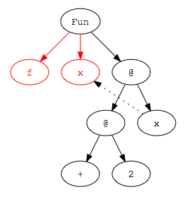
Step 1: Parse Program
Parse program text to construct parse tree
f x = 2 + x
Infix operators are converted to Curied function application during parsing:
2 + x ➔ (+) 2 x

Slide 19
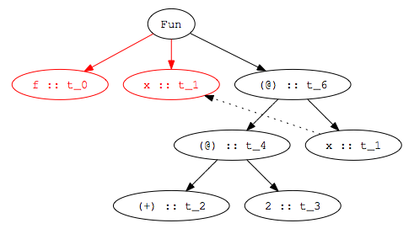
Step 2: Assign type variables to nodes
f x = 2 + x
Variables are given same type as binding occurrence

Slide 20
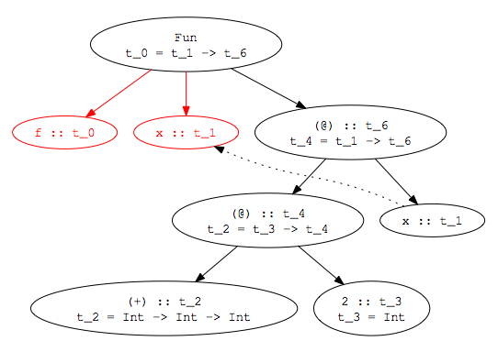
Step 3: Add Constraints
f x = 2 + x
t_0 = t_1 -> t_6
t_4 = t_1 -> t_6
t_2 = t_3 -> t_4
t_2 = Int -> Int -> Int
t_3 = Int
Notes:
Some constraints come from the environment. We know that 2 has type Int, for example, and (+) has type Int -> Int -> Int (at least in uHaskell!)
Other constraints come from the structure of the parse tree. If we have an application node (@), for example, then we know the first child has to be a function. Furthermore, the type of the argument to the function must be the type of the second child of the application node. The type of the application node itself must be the same as the return type of the function.

Slide 21
Step 4: Solve Constraints
t_0 = t_1 -> t_6
t_4 = t_1 -> t_6
t_2 = t_3 -> t_4
t_2 = Int -> Int -> Int
t_3 = Int
t_3 -> t_4 = Int -> (Int -> Int)
t_0 = t_1 -> t_6
t_4 = t_1 -> t_6
t_4 = Int -> Int
t_2 = Int -> Int -> Int
t_3 = Int
t_3 = Int
t_4 = Int -> Int
t_1 -> t_6 = Int -> Int
t_0 = Int -> Int
t_1 = Int
t_6 = Int
t_4 = Int -> Int
t_2 = Int -> Int -> Int
t_3 = Int
t_1 = Int
t_6 = Int

Slide 22
Step 5: Determine type of declaration
t_0 = Int -> Int
t_1 = Int
t_6 = Int -> Int
t_4 = Int -> Int
t_2 = Int -> Int -> Int
t_3 = Int
f x = 2 + x
> f :: Int -> Int

Slide 23
Unification
Given two type terms t₁, t₂
Compute the most general unifier of t₁ and t₂
A mapping m from type variables to typed terms such that
t₁ {m } == t₂ {m}
Every other unifier is a refinement of m
Example mgu(t_3 -> t_4, Int -> (Int -> Int)= [t_3  Int, t_4 Int -> Int]=

Slide 24
Type Inference Algorithm
Parse program to build parse tree
Assign type variables to nodes in tree
Generate constraints:
From environment: literals (2), built-in operators (+), known functions (tail)
From form of parse tree: e.g., application and abstraction nodes
Solve constraints using unification
Determine types of top-level declarations

Slide 25
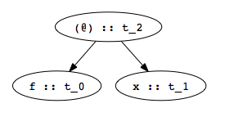
Constraints from Application Nodes
f x
t_0 = t_1 -> t_2
Function application (apply f to x)
Type of f (t_0 in figure) must be domain → range
Domain of f must be type of argument x (t_1 in fig)
Range of f must be result of application (t_2 in fig)
Constraint: t_0 = t_1 -> t_2

Slide 26
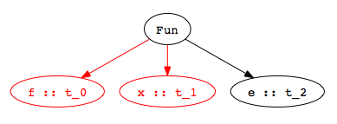
Constraints from Abstractions
f x = e
Function declaration:
Type of f (t_0 in figure) must domain → range
Domain is type of abstracted variable x (t_1 in fig)
Range is type of function body e (t_2 in fig)
Constraint: t_0 = t_1 -> t_2
t_0 = t_1 -> t_2

Slide 27
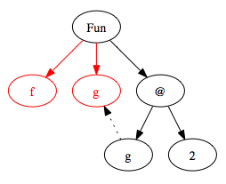
Inferring Polymorphic Types
f g = g 2
> f :: (Int -> t_4) -> t_4
Example:
Step 1: Build Parse Tree
Notes:
Try building the parse tree yourself.

Slide 28
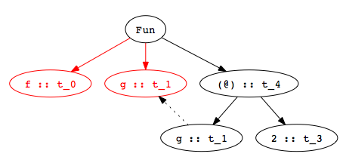
Inferring Polymorphic Types
f g = g 2
> f :: (Int -> t_4) -> t_4
Example:
Step 2: Assign type variables

Slide 29
Inferring Polymorphic Types
f g = g 2
> f :: (Int -> t_4) -> t_4
Example:
Step 3: Generate constraints
t_0 = t_1 -> t_4
t_1 = t_3 -> t_4
t_3 = Int
Notes:
Try generating constraints yourself.

Slide 30
Inferring Polymorphic Types
f g = g 2
> f :: (Int -> t_4) -> t_4
Example:
Step 4: Solve constraints
t_0 = t_1 -> t_4
t_1 = t_3 -> t_4
t_3 = Int
t_0 = (Int -> t_4) -> t_4
t_1 = Int -> t_4
t_3 = Int

Slide 31
Inferring Polymorphic Types
f g = g 2
> f :: (Int -> t_4) -> t_4
Example:
Step 5: Determine type of top-level declaration
Unconstrained type variables become polymorphic types
t_0 = (Int -> t_4) -> t_4
t_1 = Int -> t_4
t_3 = Int

Slide 32
Using Polymorphic Functions
f g = g 2
> f :: (Int -> t_4) -> t_4
Function:
Possible applications:
add x = 2 + x
> add :: Int -> Int
f add
> 4 :: Int
isEven x = mod (x, 2) == 0
> isEven:: Int -> Bool
f isEven
> True :: Bool

Slide 33
Recognizing Type Errors
f g = g 2
> f :: (Int -> t_4) -> t_4
Function:
Incorrect use
Type error: cannot unify Bool → Bool and Int → t
not x = if x then True else False
> not :: Bool -> Bool
f not
> Error: operator and operand don’t agree
operator domain: Int -> a
operand: Bool -> Bool

Slide 34
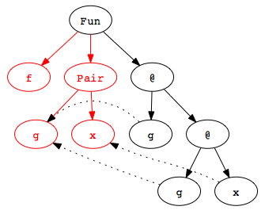
Another Example
f (g,x) = g (g x)
> f :: (t_8 -> t_8, t_8) -> t_8
Example:
Step 1: Build Parse Tree
Notes:
This example shows how the pair pattern is handled in type inference.

Slide 35
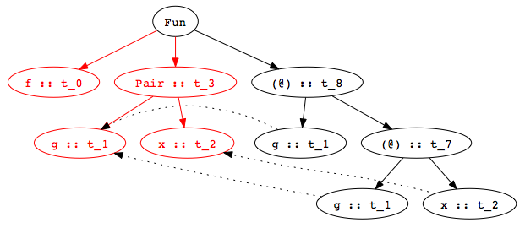
Another Example
f (g,x) = g (g x)
> f :: (t_8 -> t_8, t_8) -> t_8
Example:
Step 2: Assign type variables

Slide 36
Another Example
f (g,x) = g (g x)
> f :: (t_8 -> t_8, t_8) -> t_8
Example:
Step 3: Generate constraints
t_0 = t_3 -> t_8
t_3 = (t_1, t_2)
t_1 = t_7 -> t_8
t_1 = t_2 -> t_7

Slide 37
Another Example
f (g,x) = g (g x)
> f :: (t_8 -> t_8, t_8) -> t_8
Example:
Step 4: Solve constraints
t_0 = t_3 -> t_8
t_3 = (t_1, t_2)
t_1 = t_7 -> t_8
t_1 = t_2 -> t_7
t_0 = (t_8 -> t_8, t_8) -> t_8
Notes:
t_0 = (t_1, t_2) -> t_8
t_7 = t_2
t_8 = t_8
so, t_0 = (t_8 -> t_8, t_8) -> t_8

Slide 38
Another Example
f (g,x) = g (g x)
> f :: (t_8 -> t_8, t_8) -> t_8
Example:
Step 5: Determine type of f
t_0 = t_3 -> t_8
t_3 = (t_1, t_2)
t_1 = t_7 -> t_8
t_1 = t_2 -> t_7
t_0 = (t_8 -> t_8, t_8) -> t_8
Notes:
t_0 = (t_1, t_2) -> t_8
t_7 = t_2
t_8 = t_8
so, t_0 = (t_8 -> t_8, t_8) -> t_8

Slide 39
Polymorphic Datatypes
Functions may have multiple clauses
Type inference
Infer separate type for each clause
Combine by adding constraint that all clauses must have the same type
Recursive calls: function has same type as its definition
length [] = 0
length (x:rest) = 1 + (length rest)

Slide 40
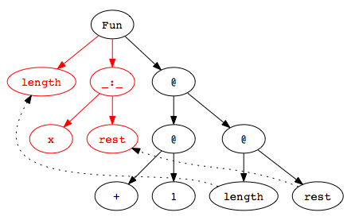
Type Inference with Datatypes
Example:
Step 1: Build Parse Tree
length (x:rest) = 1 + (length rest)

Slide 41
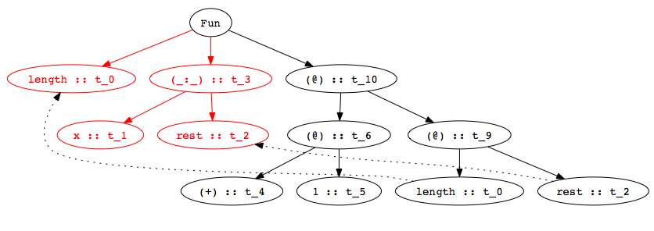
Type Inference with Datatypes
Example:
Step 2: Assign type variables
length (x:rest) = 1 + (length rest)

Slide 42
Type Inference with Datatypes
Example:
Step 3: Generate constraints
length (x:rest) = 1 + (length rest)
t_0 = t_3 -> t_10
t_3 = t_2
t_3 = [t_1]
t_6 = t_9 -> t_10
t_4 = t_5 -> t_6
t_4 = Int -> Int -> Int
t_5 = Int
t_0 = t_2 -> t_9

Slide 43
Type Inference with Datatypes
Example:
Step 3: Solve Constraints
length (x:rest) = 1 + (length rest)
t_0 = t_3 -> t_10
t_3 = t_2
t_3 = [t_1]
t_6 = t_9 -> t_10
t_4 = t_5 -> t_6
t_4 = Int -> Int -> Int
t_5 = Int
t_0 = t_2 -> t_9
t_0 = [t_1] -> Int
Notes:
Note that this same procedure handles recursive function invocations with no special cases…

Slide 44
Multiple Clauses
Function with multiple clauses
Infer type of each clause
First clause:
Second clause:
Combine by equating types of two clauses
append ([],r) = r
append (x:xs, r) = x : append (xs, r)
> append :: ([t_1], t_2) -> t_2
> append :: ([t_3], t_4) -> [t_3]
> append :: ([t_1], [t_1]) -> [t_1]

Slide 45
Most General Type
Type inference produces the most general type
Functions may have many less general types
Less general types are all instances of most general type, also called the principal type
map (f, [] ) = []
map (f, x:xs) = f x : map (f, xs)
> map :: (t_1 -> t_2, [t_1]) -> [t_2]
> map :: (t_1 -> Int, [t_1]) -> [Int]
> map :: (Bool -> t_2, [Bool]) -> [t_2]
> map :: (Char -> Int, [Char]) -> [Int]

Slide 46
Type Inference Algorithm
When Hindley/Milner type inference algorithm was developed, its complexity was unknown
In 1989, Kanellakis, Mairson, and Mitchell proved that the problem was exponential-time complete
Usually linear in practice though…
Running time is exponential in the depth of polymorphic declarations

Slide 47
Information from Type Inference
Consider this function…
… and its most general type:
What does this type mean?
reverse [] = []
reverse (x:xs) = reverse xs
> reverse :: [t_1] -> [t_2]
Reversing a list should not change its type, so there must be an error in the definition of reverse!

Slide 48
Type Inference: Key Points
Type inference computes the types of expressions
Does not require type declarations for variables
Finds the most general type by solving constraints
Leads to polymorphism
Sometimes better error detection than type checking
Type may indicate a programming error even if no type error
Some costs
More difficult to identify program line that causes error
Natural implementation requires uniform representation sizes
Complications regarding assignment took years to work out
Idea can be applied to other program properties
Discover properties of program using same kind of analysis

Slide 49
Haskell Type Inference
Haskell uses type classes
supports user-defined overloading, so the inference algorithm is more complicated
ML restricts the language
to ensure that no annotations are required
Haskell provides additional features
like polymorphic recursion for which types cannot be inferred and so the user must provide annotations
Notes:
Tool for doing type inference for uHaskell programs will be available on the pod machines shortly. It can generate the various parse trees we’ve been seeing in the slides, so you can use it to play with how type inference works. In addition, the tool is written in Haskell itself, so you can look at it as an example of a small but real program written in the language. I’ll post information about where it is, etc on courseware. It is work in progress, so if you find bugs, feel free to send me email reporting them.

Slide 50
Parametric Polymorphism: Haskell vs C++
Haskell polymorphic function
Declarations (generally) require no type information
Type inference uses type variables to type expressions
Type inference substitutes for type variables as needed to instantiate polymorphic code
C++ function template
Programmer must declare the argument and result types of functions
Programmers must use explicit type parameters to express polymorphism
Function application: type checker does instantiation

Slide 51
Example: Swap Two Values
Haskell
C++
swap :: (IORef a, IORef a) -> IO ()
swap (x,y) = do {
val_x <- readIORef x; val_y <- readIORef y;
writeIORef y val_x; writeIORef x val_y;
return () }
template <typename T>
void swap(T& x, T& y){
T tmp = x; x=y; y=tmp;
}
Declarations both swap two values polymorphically, but they are compiled very differently

Slide 52
Implementation
Haskell
swap is compiled into one function
Typechecker determines how function can be used
C++
swap is compiled differently for each instance
(details beyond scope of this course …)
Why the difference?
Haskell ref cell is passed by pointer. The local x is a pointer to value on heap, so its size is constant
C++ arguments passed by reference (pointer), but local x is on the stack, so its size depends on the type

Slide 53
Another Example
C++ polymorphic sort function
What parts of code depend on the type?
Indexing into array
Meaning and implementation of operator <
template <typename T>
void sort( int count, T * A[count ] ) {
for (int i=0; i<count-1; i++)
for (int j=i+1; j<count-1; j++)
if (A[j] < A[i]) swap(A[i],A[j]);
}

Slide 54
Polymorphism vs Overloading
Parametric polymorphism
Single algorithm may be given many types
Type variable may be replaced by any type
if f::t→t then f::Int→Int, f::Bool→Bool, ...
Overloading
A single symbol may refer to more than one algorithm
Each algorithm may have different type
Choice of algorithm determined by type context
Types of symbol may be arbitrarily different
In ML, + has types int*int→int, real*real→real, no others

Slide 55
Varieties of Polymorphism
Parametric polymorphism A single piece of code is typed generically
Imperative or first-class polymorphism
ML-style or let-polymorphism
Ad-hoc polymorphism The same expression exhibit different behaviors when viewed in different types
Overloading
Multi-method dispatch
Intentional polymorphism
Subtype polymorphism A single term may have many types using the rule of subsumption allowing to selectively forget information

Slide 56
Summary
Types are important in modern languages
Program organization and documentation
Prevent program errors
Provide important information to compiler
Type inference
Determine best type for an expression, based on known information about symbols in the expression
Polymorphism
Single algorithm (function) can have many types

