Slide 1
Minimal MapReduce Algorithms
By Yufei Tao, Wenqing Lin, Xiaokui Xia
Edited by Tuval Rotem

Slide 2
First topic: What is MapReduce
But first…

Slide 3
Regular day at work
You’re doing your regular work while suddenly your boss, comes to your office and says:
“We’re going to be hog-nasty rich! We just need a program to search for strings in text files...”
Input: <search_term>, <files>
Output: list of files containing <search_term>

Slide 4
First solution
public class StringFinder {
int main(…) {
foreach(File f in getInputFiles()) {
if(f.contains(searchTerm))
results.add(f.getFileName());
}
}
System.out.println(“Files:” + results.toString());
} }
“But, uh, marketing says we have to search a lot of files.
More than will fit on one disk…”

Slide 5
Quick! Call the IT!
Throw hardware at the problem!
Use your StringFinder class as is…
get lots of disks!
“But, uh, well, marketing says it’s too slow… and besides, we need it to work on the web…”

Slide 6
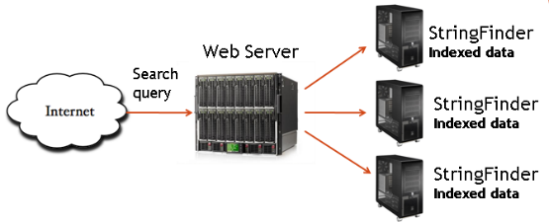
Third Time’s a charm
How do we distribute the searchable files on our machines?
What if our webserver goes down?
What if a StringFinder machine dies? How would you know it was dead?
What if..
“well guess want, marketing came, and they also want to show pictures of the earth from space too! Ooh..and the moon too!”

Slide 7
StringFinder was the easy part!
What you really need is a general infrastructure.
Many different tasks
Want to use hundreds or thousands of PC’s
Continue to function if something breaks
Must be easy to program…
MapReduce addresses this problems!

Slide 8
StringFinder was the easy part!
Programming model + infrastructure
Enables every programmer to write programs that run on lots of machines
Gives Automatic parallelization and distribution
Has great Fault-tolerance
Handles scheduling, status and monitoring for you

Slide 9
MapReduce origin: Lisp and functional based languages
Anonymous functions: function(x) { alert(“this function does something with " + x) }
Doing something on every element in the array: var a = [1,2,3];
for (i=0; i<a.length; i++)
{
a[i] = a[i] * 2;
}
var a = [1,2,3];
for (i=0; i<a.length; i++)
{
a[i] = a[i]/ a.length }
In General:
function map(func, a)
{
for (i = 0; i < a.length; i++)
{
a[i] = func(a[i]);
}
}
Key
value
var a = [1,2,3];
map( function(x){return x*2;}, a ); map( function(x){return x/a.length;}, a );

Slide 10
MapReduce origin: Lisp and functional based languages
Combining all the elements in the array in some way function sum(a) {
var s = 0;
for (i = 0; i < a.length; i++)
s += a[i];
return s;
} alert(sum([1,2,3]));
function join(a)
{
var s = "";
for (i = 0; i < a.length; i++)
s += a[i];
return s;
}
alert(join(["a","b","c"]));
In General:
function reduce(fn, a, init)
{
var s = init;
for (i = 0; i < a.length; i++)
s = fn( s, a[i] );
return s;
}
function sum(a)
{
return reduce( function(a, b){ return a + b; }, a, 0 );
}
function join(a)
{
return reduce( function(a, b){ return a + b; }, a, "" );
}

Slide 11
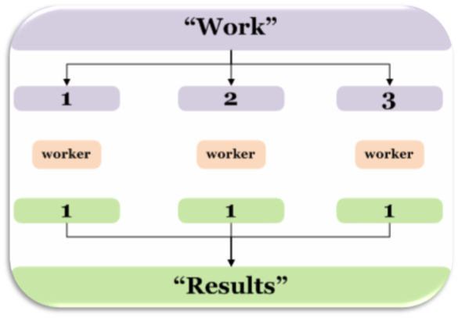
Mechanism
Divide and Conquer

Slide 12
MapReduce Programming Model
Input & Output: sets of <key, value> pairs
Programmer writes 2 functions:
map(key, val) is run on each item in set
emits new-key / new-val pairs
Called intermediate pairs
reduce(key, vals) is run for each unique key emitted by map()
emits final output

Slide 13
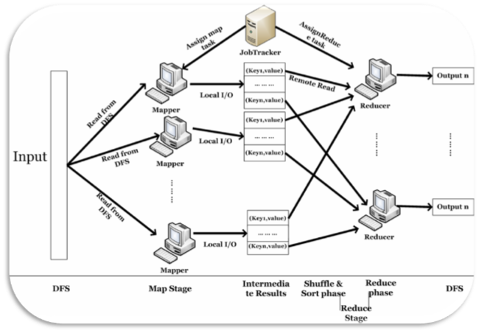
How does parallelization work?
keeps several data structures for each map and reduce task. (State, worker Id)
pings every worker periodically to see who failed
The input is divided equaly between the mappers
Sort/Shuffle is determined by the key

Slide 14
All you have to do now…
Make all your programs into MapReduce algorithms…
Can we really make any program this way?
MapReduce is Turing complete

Slide 15
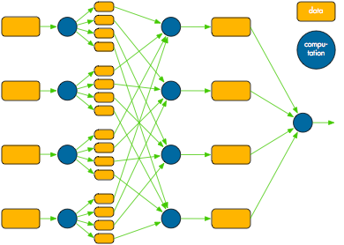
Mapreduce overview
Iteration
Sort/Shuffle is determined by the key
Map
Shuffle/Sort
Reduce

Slide 17
MapReduce Programming Model
Input consists of (line number, contents) pairs
map(key=line number, val=contents):
For each word w in contents, emit (w, “1”)
reduce(key=word, values=“1”’s list):
Sum all “1”s in values list
Emit result “(word, sum)”

Slide 19
Line1
Line2
Line3
Key
Value
Key
Value

Slide 20
(Shuffle)

Slide 21
Sorting Algorithm
Key
Value
Key
List of Values

Slide 23
Reduce Algorithm

Slide 24
Combiners
Sits between the map and the shuffle
Do some of the reducing while you’re waiting for other stuff to happen
Avoid moving all of that data over the network
Only applicable when
order of reduce values doesn’t matter
effect is cumulative
Often the combiner is the reducer.
like for word count
but not always

Slide 25
Advantages of MapReduce
Simple: one only needs to define two functions
no need to worry about how the data is stored, distributed and how the operations are scheduled
scalability: a large number of low end machines
scale out (scale horizontally): adding a new computer to a distributed software application; lost-cost “commodity”
scale up (scale vertically): upgrade, add (costly) resources to a single node
independence: it can work with various storage layers
flexibility: independent of data models or schema
Fault tolerance: why?

Slide 26
Fault Tolerance
How big of a deal is it really?
A huge deal. In a distributed environment disks fail ALL THE TIME.
Large scale systems must assume that any process can fail at any time.
It may be much cheaper to make the software run reliably on unreliable hardware than to make the hardware reliable..”
What will you do when a task fails?
Start a backup process
What’s the difference between slow and dead?
Who cares? Start a backup process.
If the process is slow because of machine issues, the backup may finish first
If it’s slow because you poorly partitioned your data... waiting is your punishment

Slide 27
Fault Tolerance
But what about my data?
If a disk fails you can lose some intermediate output
Ignoring the missing data could give you wrong answers
backup processes + backup copies of the intermediate data also

Slide 28
Fault Tolerance
<k1, v1>
<k1, v1>
<k1, v1>
<k1, v1>
triplicated
mapper
mapper
mapper
<k2, v2>
<k2, v2>
<k2, v2>
Detecting failures and reassigning the tasks of failed nodes to healthy nodes
reducer
reducer
<k3, v3>
<k3, v3>

Slide 29
Second topic: What is “Minimal MapReduce” + introducing TeraSort and Sliding aggregates

Slide 30
MapReduce Simplified view
S
|S|=n
<k₁, v₁>
<k₂, v₂>
<k₃, v₃>
<k_{n}, v_{n}>
M₁
M₂
M₃
M_{t}
<k’₁, v’₁>
<k’₂, v’₂>
<k’₃, v’₃>
<k_{t}, v_{t}>
Reducer is determined by key value
R₁
R₂
R_{t}
<k*₁, v*₃>
<k*₂, v*₂>
<k*_{j}, v*_{j}>

Slide 31
MapReduce Simplified view
S
|S|=n
<k₁, v₁>
<k₂, v₂>
<k₃, v₃>
<k_{n}, v_{n}>
M₁
M₂
M₃
M_{t}
k_{t}
MapShuffle
k₁
M₁
M₂
M₃
M_{t}
<k*₁, v*₃>
<k*₂, v*₂>
<k*_{j}, v*_{j}>

Slide 32
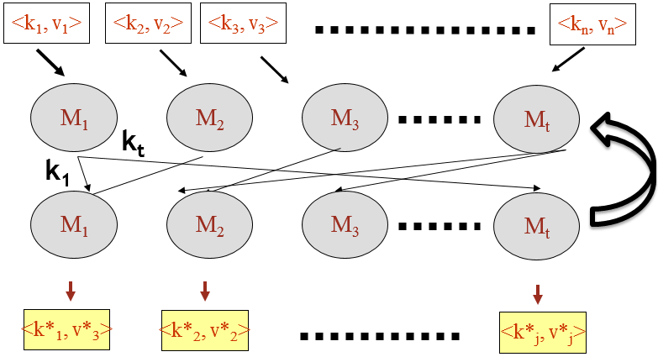
Minimal MapReduce
S
|S|=n
T machines

Slide 33
Minimal MapReduce
S
|S|=n
T machines
Use O(m) space
Denote m=n/t - the number of objects per machine when s is evenly distributed 1. Minimum footprint: at all times – each machine uses only O(m) space

Slide 34
Minimal MapReduce
S
|S|=n
receives O(m) words
T machines
Use O(m) space
sends O(m) words
Denote m=n/t - the number of objects per machine when s is evenly distributed 1. Minimum footprint: at all times – each machine uses only o(m) space
2. Bounded net-traffic: in each round every machine send and receives at most O(m) words

Slide 35
Minimal MapReduce
S
|S|=n
receives O(m) words
T machines
c
Use O(m) space
sends O(m) words
Denote m=n/t - the number of objects per machine when s is evenly distributed 1. Minimum footprint: at all times – each machine uses only o(m) space
2. Bounded net-traffic: in each round every machine send and receives at most O(m) words
3. constant round: the algorithm must terminate after constant number of rounds

Slide 36
Minimal MapReduce
input
M
output
T_{seq} time
S
|S|=n
receives O(m) words
T machines
c
Use O(m) space
Total O(T_{seq}/t) computations
sends O(m) words
Denote m=n/t - the number of objects per machine when s is evenly distributed 1. Minimum footprint: at all times – each machine uses only o(m) space
2. Bounded net-traffic: in each round every machine send and receives at most O(m) words
3. constant round: the algorithm must terminate after constant number of rounds
4. Optimal computation: every machine performs only O(T_{seq}/t) amout of computation total when T_{seq} = time to solve the same problem on single sequential computer means the algorithm would get a speedup of t by using t machines in parallel

Slide 37
Minimal MapReduce
input
M
output
Distributed File System (DFS)
T_{seq} time
S
|S|=n
receives O(m) words
T machines
c
Use O(m) space
Total O(T_{seq}/t) computations
sends O(m) words
Minimal MapReduce advantages:
Each machine using O(m) in each phase = O(1/t) of S – prevent partition skew
Bounded net traffic – O(m) words ensures that each shuffle phase transfer at most o(n) words
Due to parallelization: The duration of each phase is $≈$ the time for a machine to send and receive O(m) words. Good for building stateless algorithm - improve the system’s robustness
Constant rounds = O(n) word traffic overall
Optimal computation – the very original motivation of MapReduce – do things faster

Slide 38
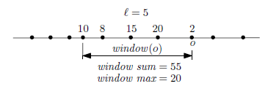
Not minimal MapReduce algorithms:
Sliding aggregation
Terasort for sorting
Not close to being minimal “notoriously difficult”.
Ordered Domain
Ordered Domain
Close to being minimal
S:= {o} with w weight function
S (|S|=n)
Window size Integer l<=n
AGG - Aggregate function
Max, sum, min, avg, etc…
Sliding aggregation MR algorithm
Sorting MR algorithm
$$∀o∈S.AGG\left(window\left(o\right)\right)$$ when window (o) = l largest objects in S not exceeding o
S sorted

Slide 39
Third topic: TeraSort ➔ minimal TeraSort

Slide 40
TeraSort(p)
MapShuffle1: sends objects to M1 with probability p (S_{samp})
S
Reduce1: Sort S_{samp} and chose boundry objects b₁,…,b_{t-1}
$b_{i}=i\left[\frac{S}{t}\right]$ object in S_{samp}. (split S to t parts)
MapShuffle 2 $$∀o.if in \left(b_{j−1},b_{j}\right] send to M_{j}$$
Where $b_{0}=−∞, b_{t}=∞$
<k₁, v₁>
<k₂, v₂>
Reduce 2 Regular sort
<k₃, v₃>
M₁
M₁
M₁
M₁
All values in $\left(b_{0},b_{1}\right]$ sorted
b₁,…,b_{t-1}
M₂
M₂
M₂
M₂
All values in $\left(b_{1},b_{2}\right]$ sorted
File
M₃
M₃
M₃
M₃
All values in $\left(b_{3},b_{4}\right]$ sorted
M_{t}
M_{t}
M_{t}
M_{t}
All values in $\left(b_{t−1},b_{t}\right]$ sorted
<k_{n}, v_{n}>

Slide 41
How to choose to right p?
Define S_{i} = the group that arrives to machine M_{i} at the second phase
Means $S_{i}=S∩\left(b_{i−1},b_{i}\right]$ for $1≤i≤t$
For Terasort to be minimal we need 2 restrictions:
R1: $\left|S_{samp}\right|=s=O(m)$ Round 1
R2: $∀1≤i≤t. \left|S_{i}\right|=O(m)$ Round 2

Slide 42
Minimal TeraSort Restrictions
R1: $\left|S_{samp}\right|=s=O(m)$
S
R2: $∀1≤i≤t. \left|S_{i}\right|=O(m)$
<k₁, v₁>
<k₂, v₂>
<k₃, v₃>
M₁
M₁
M₁
M₁
All values in $\left(b_{0},b_{1}\right]$ sorted
b₁,…,b_{t-1}
M₂
M₂
M₂
M₂
All values in $\left(b_{1},b_{2}\right]$ sorted
File
M₃
M₃
M₃
M₃
All values in $\left(b_{3},b_{4}\right]$ sorted
M_{t}
M_{t}
M_{t}
M_{t}
All values in $\left(b_{t−1},b_{t}\right]$ sorted
<k_{n}, v_{n}>

Slide 43
How to choose to right p?
Theorem 1: when $m=\frac{n}{t}>tln(nt)$ both R1 & R2 holds with probability $≥1−O\left(\frac{1}{n}\right)$, when setting $p=\frac{1}{m}\ln\left(nt\right)$
When t<9 $m=Ω(n)$ and therefore R1 and R2 holds Trivially
Proof (when $t≥9$):
E[s]= $p∙n=\left[m=\frac{n}{t}\right]=mpt=t∙\ln\left(nt\right)$
Chernoff: $\operatorname{Pr}\left[s≥a\right]≤\frac{E\left[e^{t∙s}\right]}{e^{t∙a}}$
$\operatorname{Pr}\left[R1 fails\right]≤\operatorname{Pr}\left[s>1.6∙t∙\ln\left(nt\right)\right]≤\frac{e^{t∙\ln\left(nt\right)}}{e^{1.6∙t∙\ln\left(nt\right)}}=e^{t∙\ln\left(nt\right)∙\left(−0.6\right)}=\frac{1}{nt}∙e^{0.6t}\overset{when t≥9}{\overbrace{≤}}\frac{1}{n}$
This means that when p=$\frac{1}{m}\ln\left(nt\right)$ R1 fails with probability $≤\frac{1}{n}$

Slide 44
What about R2
8m-16m objects
Bucket b |  | Bucket3 | Bucket2 | Bucket1
b0
b1
b2
bt
$$S_{1}$$
$$S_{2}$$
If we try to divide S (our input) to b=$\left\lfloor t/8\right\rfloor$ buckets as evenly as possible: if $β$ is a bucket best case: if t%8 = 0 and n%b = 0 then each bucket has $\frac{n}{\left\lfloor t/8\right\rfloor }=\frac{8n}{t}$ objects worst case: if t%8 = 7 and n%b$≠$0 then $β$ can hold at most $\frac{n}{t/16}=\frac{16n}{t}$ objects $8m=\frac{8n}{t}≤\left|β\right|≤\frac{16n}{t}≤16m$
Theorem: if after choosing our boundary objects: $b_{0}=−∞,b_{1},…,b_{t−1},b_{t}=∞$ every bucket has at least one $b_{i}$ ➔ R2 will hold because then each $S_{i}$ can contain maximum 2 buckets $≤2∙16m=32m=O(m)$

Slide 45
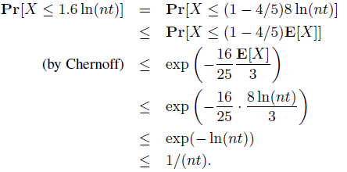
What about R2
If we are in the case that R1 holds – $s≤1.6∙t∙\ln\left(nt\right)$ as before:
If $\left|β\right|≥\frac{s}{t}=1.6ln⁡(nt)$ samples (objects from $S_{samp}$) than
What is the probability that $|β|<$ $1.6ln⁡(nt)$? $∀1≤i≤\left|β\right|. x_{i}=\left\{\begin{matrix}1 & x_{i}∈S_{samp} \\ 0 & x_{i}∉S_{samp}\end{matrix}\right. ⇒ X=\sum_{j=1}^{\left|β\right|}{x_{j}}=\left|β∩S_{samp}\right|$ $\left|β\right|≥8m⇒E\left[X\right]≥8mp=8ln⁡(nt)$
$\operatorname{Pr}\left[β doesn^{′}t conatin any b_{i}\right]≤$
The probability that one bucket fails
We have t/8 buckets the probability that 1+ fails is $≤\frac{1}{8n}$

Slide 46
So in total…
Theorem 1: when $m=\frac{n}{t}>tln(nt)$ both R1 & R2 holds with probability $≥1−O\left(\frac{1}{n}\right)$, when setting $p=\frac{1}{m}\ln\left(nt\right)$
Proof so far: When $m=\frac{n}{t}>tln(nt)$ we saw that:
R1 fails with probability $≤\frac{1}{n}$
When R1 doesn’t fail ($s≤1.6∙t∙\ln\left(nt\right)$) R2 fails with probability $≤\frac{1}{8n}$ $\text{P}\text{[}\text{R}\text{2 }\text{fails}\text{ | }\text{R}\text{1 }\text{holds}\text{]}≤\frac{1}{8n}∙\frac{n−1}{n}≤\frac{9}{8n}$
P[R1 ∨ R2 fails] $=\text{P}\text{[}\text{R}\text{2 }\text{fails}\text{ | }\text{R}\text{1 }\text{holds}\text{]}+\text{P}\text{[}\text{R}\text{2 }\text{fails}\text{ | }\text{R}\text{1 }\text{fail}\text{s}\text{]}≤$ $\text{P}\text{[}\text{R}\text{2 }\text{fails}\text{ | }\text{R}\text{1 }\text{holds}\text{]}+\text{P}\text{[}\text{R}\text{1 }\text{fails}\text{]}≤\frac{9}{8n}+\frac{1}{n}=\frac{17}{8n}$ P[R1 ∧ R2 hold] $≥1−\frac{17}{8n}$ ➔ P[R1 ∧ R2 hold] = $1−O\left(\frac{1}{n}\right)\begin{matrix}n→∞ \\ →\end{matrix} 1$

Slide 47
When R1 & R2 hold - Minimality?
1. Minimum footprint: at all times – each machine uses only o(m) space
2. Bounded net-traffic: in each round every machine send and receives at most O(m) words R1 ensures M1 receives and sends only O(m) in round 1 R2 ensures all M’s receive and send only O(m) in round 2
3. constant round: 2 rounds
4. Optimal computation: every machine performs only O(T_{seq}/t) amout of computation total when T_{seq} = time to solve the same problem on single sequential computer means the algorithm would get a speedup of t by using t machines in parallel Sorting $S_{i}$ in round 2: $O\left(mlogm\right)=O\left(\frac{n}{t}logn\right)=\frac{1}{t}O(nlogn)$
In practice: typically m >> t the memory size of a machine is significantly greater the number of machines m$=O\left(10^{6}\right)$ bytes = O(MB) t = $10^{4}$ machines or lower therefore $m≥tln\left(nt\right)$ is a very reasonable assumption = excellent efficiency in practice

Slide 48
TeraSort – broadcast assumption
S
$$O\left(t^{2}\right)$$ no bounded net traffic Hadoop – remote file
<k₁, v₁>
<k₂, v₂>
<k₃, v₃>
M₁
M₁
M₁
M₁
All values in $\left(b_{0},b_{1}\right]$ sorted
b₁,…,b_{t-1}
M₂
M₂
M₂
M₂
All values in $\left(b_{1},b_{2}\right]$ sorted
M₃
M₃
M₃
M₃
All values in $\left(b_{3},b_{4}\right]$ sorted
M_{t}
M_{t}
M_{t}
M_{t}
All values in $\left(b_{t−1},b_{t}\right]$ sorted
<k_{n}, v_{n}>

Slide 49
Pure TeraSort
S
MapShuffle1: sends objects to all M’s with probability p (S_{samp})
$$O\left(t\right)$$ bounded net traffic
<k₁, v₁>
<k₂, v₂>
<k₃, v₃>
M₁
M₁
b₁,…,b_{t-1}
M₁
M₁
All values in $\left(b_{0},b_{1}\right]$ sorted
$$O\left(t\right)?$$
M₂
M₂
b₁,…,b_{t-1}
M₂
M₂
All values in $\left(b_{1},b_{2}\right]$ sorted
M₃
M₃
b₁,…,b_{t-1}
M₃
M₃
All values in $\left(b_{3},b_{4}\right]$ sorted
M_{t}
M_{t}
b₁,…,b_{t-1}
M_{t}
M_{t}
All values in $\left(b_{t−1},b_{t}\right]$ sorted
<k_{n}, v_{n}>

Slide 50
Pure Terasort - Sending words in round 1
Each sample word is being sent to t machines
Lemma : p[every machine sends O(tln(nt)) words ] $≥1−\frac{1}{n}$
Proof: X – random variable = the number of object sampled from machine M $E\left[X\right]=mp=\ln\left(nt\right)$ Chernoff: $\operatorname{Pr}\left[X≥6\ln\left(nt\right)\right]≤2^{−6\ln\left(nt\right)}≤\frac{1}{nt}$ P[M samples and sends more than $O\left(tln\left(nt\right)\right)$ in round 1] $≤\frac{1}{nt}$ For t machines ➔ 1 machine or more sends more than $O\left(tln\left(nt\right)\right)$ in round 1 with probability $≤\underset{t}{\underbrace{\frac{1}{nt}+…+\frac{1}{nt}}}=\frac{1}{n}$
p[every machine sends O(tln(nt)) words ] $=1−O\left(\frac{1}{n}\right)$
Combining it with the previous calculations – pure TeraSort is minimal with probability $≥1−O\left(\frac{1}{n}\right) when m≥tln(nt)$

Slide 51
Third topic: Using minimal TeraSort to make DB algorithms minimal

Slide 52
Terasort based algorithms in databases
Database algorithms:
Ranking
Group-by
Semi-join
2D-skyline
Etc…
All are O(nlogn) on sequential machine
All includes TeraSort + extra round (MapShuffle + Reduce) where:
Each machine send O(t) words of network traffic
From now on we assume $m≥tln(nt)$ for TeraSort to be minimal

Slide 53
Prefix sum
S
O1 | O2 | O6 | O4 | O3 | O5 | Obj
7 | 4 | 1 | 3 | 2 | 8 | w
S – objects with weight function w
Prefix(o, S) = $\sum_{o′<o}{w(o^{′})}$
O(nlogn) time in sequential machine
$S_{i}$ the numbers on machine $M_{i}$ after sorting
MapShuffle:
$M_{i} computes W_{i}=\sum_{o∈S_{i}}{w(o)}$
$M_{i}$ sends $W_{i}$ to $M_{i+1 },…,M_{t }$
Reduce:
$M_{i}$ computes $V_{i}=\sum_{j<i}{W_{j}}$
$M_{i}$ computes locally $prefix\left(o, S_{i}\right)$
$M_{i}$ computes for each o$∈S_{i}$: $prefix\left(o, S\right)=V_{i}+prefix\left(o, S_{i}\right)$
In MapShuffle $M_{i}$ sends t-i words, and receives in reduce i-1 words = t-1 = O(t) and because $t≤m$ o(m)
S sorted
O6 | O5 | O4 | O3 | O2 | O1 | Obj
1 | 8 | 3 | 2 | 4 | 7 | w
24 | 16 | 13 | 11 | 7 | 0 | PS

Slide 54
Prefix Min
O1 | O2 | O6 | O4 | O3 | O5 | Obj
7 | 4 | 1 | 3 | 2 | 8 | w
S
S – objects with weight function w
Prefix(o, S) = $\sum_{o′<o}{w(o^{′})}$
O(nlogn) time in sequential machine
$S_{i}$ the numbers on machine $M_{i}$ after sorting
MapShuffle:
$M_{i} computes W_{i}=\sum_{o∈S_{i}}{w(o)}$
$M_{i}$ sends $W_{i}$ to $M_{i+1 },…,M_{t }$
Reduce:
$M_{i}$ computes $V_{i}=\sum_{j<i}{W_{j}}$
$M_{i}$ computes locally $prefix\left(o, S_{i}\right)$
$M_{i}$ computes for each o$∈S_{i}$: $prefix\left(o, S\right)=V_{i}+prefix\left(o, S_{i}\right)$
In MapShuffle $M_{i}$ sends t-i words, and receives in reduce i-1 words = t-1 = O(t) and because $t≤m$ o(m)
S sorted
$\min\left\{w\left(o^{′}\right)|o^{′}<o, o^{′}∈S\right\}$
O6 | O5 | O4 | O3 | O2 | O1 | Obj
1 | 8 | 3 | 2 | 4 | 7 | w
2 | 2 | 2 | 4 | 7 | $$∞$$ | PM
$\min\left\{w\left(o\right)|o∈S_{i}\right\}$
$\min\left\{W_{j}|j<i\right\}$
$\min\left(V_{i},prefix\left(o, S_{i}\right)\right)$

Slide 55
Ranking = Prefix sum with w=1
S
O1 | O2 | O6 | O4 | O3 | O5 | Obj
1 | 1 | 1 | 1 | 1 | 1 | w
S sorted
O6 | O5 | O4 | O3 | O2 | O1 | Obj
1 | 1 | 1 | 1 | 1 | 1 | w
5 | 4 | 3 | 2 | 1 | 0 | R

Slide 56
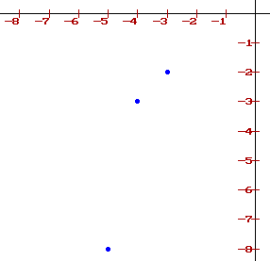
Skyline
S = {(x,y)}
Skylines(S) =$\left\{\text{p}\text{=(}x_{p}\text{,}y_{p}\text{)} | ∀p^{′}≠p∈S.\left(x_{p}>x_{p^{′}}\right) ∨\left(y_{p}>y_{p^{′}}\right)\right\}$
Prefix Min in Disguise:
S = {-$x_{p}$}, w=-$y_{p}$, skylines: all the points such that $w(p)<prefixMin(p)$
(-5,-8) , (-3,-2) , (-4,-3) , (-6,-1) , (-2,-4) , (-1,-7)
S
O1 | O2 | O6 | O4 | O3 | O5 | Obj
7 | 4 | 1 | 3 | 2 | 8 | w
S sorted
O6 | O5 | O4 | O3 | O2 | O1 | Obj
1 | 8 | 3 | 2 | 4 | 7 | w
2 | 2 | 2 | 4 | 7 | $$∞$$ | PM

Slide 57
GroupBy
S where for each o$∈$S – k(o) - key, w(o) – weight, AGG – distributive aggregate function
We want to get $\left\{AGG\left(G_{k}\right) | G_{k}=\left\{o | k\left(o\right)=k\right\}\right\}$
First: TeraSort while sorting objects by keys, breaking ties by id
The main problem: if there is a key k s.t. |G_{k}|>>m and can’t fit in one machine
Lets look on one machine M:
denote $k_{min}\left(M\right),k_{max}(M)$ – smallest and largest keys on M
Every k s.t. $k_{min}\left(M\right)<k<k_{max}(M)$ can be stored and locally computed on M
So at most 2 “problematic” keys per machine ➔ at most 2t overall
Solution: send the problem to M1
MapShuffle: compute $\left(k_{min}\left(M_{i}\right),AGG\left(\left\{o∈M_{i} | k\left(o\right)=k_{min}\left(M_{i}\right)\right\}\right)\right)$ and $\left(k_{max}\left(M_{i}\right),AGG\left(\left\{o∈M_{i} | k\left(o\right)=k_{max}\left(M_{i}\right)\right\}\right)\right)$. send both to M1 (one if $k_{min}\left(M_{i}\right)$=$k_{max}\left(M_{i}\right)$
Reduce on M1: compute $AGG\left(\left\{w_{j} | k_{j}=k\right\}\right)$ $t≤m=\frac{n}{t}⇒O\left(tlog\left(t\right)\right)=O\left(\frac{n}{t}log\left(n\right)\right)$
Can help solve “word count” problem we saw earlier

Slide 58
Semi-Join
R, T two sets from the same domain. Each object has a key. SemiJoin(R,T)=$\left\{o∈R | ∃o^{′}∈T. k\left(o\right)=k(o^{′})\right\}$
Almost like GroupBy
Sort $S=R∪T$ with terasort while saving the source group
MapShuffle - each $M_{i}$ sends $k_{min}\left({T,M}_{i}\right) ,k_{max}\left({T,M}_{i}\right)$ to all machines
Denote : $K\left(T,M_{i}\right)$ -the set of keys of T objects stored in $M_{i}$ $K_{border}$ the set from the previous MapShuffle Reduce: for every R-object o in $M_{i}$ output if $k\left(o\right)∈K\left(T,M_{i}\right)∪K_{border}$
MapShuffle – 2t pairs are sent to all the machine R objects in M are already sorted - Reduce – O(t+mlogm)=$O\left(\frac{n}{t}log\left(n\right)\right)$

Slide 59
Forth topic: Sliding aggregation

Slide 60
Sliding aggregation remainder
Ordered Domain
S:= {o} with w weight function
Integer l<=n
AGG- Aggregate function
(max, sum, min, avg, etc…)
Sliding aggregation MR algorithm
$$∀o∈S.AGG\left(window\left(o\right)\right)$$ when window (o) = l largest objects in S not exceeding o

Slide 61
Before getting started: Sorting with perfect balance
Input : set S where |S|=n.
We assme n%t = 0 so m is an integer – if not pad S with dummy zeros.
What we want in the end: In every machine $M_{i}$ $(1≤i≤t−1)$ there will be exactly $m$ objects their rank range is: $\left[\left(i−1\right)m+1,im\right]$
Sounds very familiar to the ranking problem.
Solved by adding another round after the ranking algorithm: previous reduce : Each machine $M_{i}$ computed rank(o) for each $o∈S_{i}$ MapShuffle: fore each $o∈S_{i}$compute $j=\left\lceil \frac{rank\left(o\right)}{m}\right\rceil$ and send it to $M_{j}$ Reduce: do nothing.
Minimal

Slide 62
Back to Sliding Aggregation
Solved with just one more round after sorting with perfect balance
We got: In every machine $M_{i}$ $(1≤i≤t−1)$ there will be exactly $m$ objects their rank range is: $\left[\left(i−1\right)m+1,im\right]$
$Window\left(o\right)=\left[rank\left(o\right)−l+1,rank\left(o\right)\right]$ if rank(o) = 6, l=3, window(o)={4,5,6}
Therefore objects in the window of o are in machines $M_{α},M_{α+1},…,M_{β}$ where $α =\left\lceil \frac{rank\left(o\right)−l+1}{m}\right\rceil$, $β=\left\lceil \frac{rank\left(o\right)}{m}\right\rceil$
$M_{β}$is where o is currently is - the calculation will be committed there
if $α=β$ AGG(window(o)) can be computed locally on $M_{β}$ – not a problem.
So from no on we focus on $α<β$
If $α<β−1$ then $Window(o)$ includes all objects in machine $α+1,…,β−1$ So if $W_{i}=AGG\left(\left\{o′∈M_{i}\right\}\right)$ we will ensure that every machine knows $W_{1},…,W_{t}$
Now to calculate $AGG\left(window\left(o\right)\right)$ $M_{β}$ only needs is $AGG\left(\left\{o′∈M_{α} | o^{′}∈Window\left(o\right)\right\}\right)$ We call those objects in $M_{α}$ “remotely relevant to $M_{β}$“ If $M_{α}$ stores at least one remotely relevant object to $M_{β}$, $M_{α}$ is “pertinent” to $M_{β}$

Slide 63
Back to Sliding Aggregation
Lemma: every object is remotely relevant to at most 2 machines
Proof – when $o∈M_{i}$ $rank\left(o\right)∈\left[\left(i−1\right)m+1,im\right]$ and $α =\left\lceil \frac{rank\left(o\right)−l+1}{m}\right\rceil$: $\left\lceil \frac{\left(i−1\right)m+1−l+1}{m}\right\rceil ≤α≤\left\lceil \frac{im−l+1}{m}\right\rceil$ using $\left\lceil x−y\right\rceil =x−\left\lfloor y\right\rfloor$ we get : $\left(i−1\right)−\left\lfloor \frac{l−1}{m}\right\rfloor ≤α≤i−\left\lfloor \frac{l−1}{m}\right\rfloor$
Means that only 2 machines can be pertinent to $M_{i}−$ $M_{j_{1}},M_{j_{2}}$ where $j_{1}=\left(i−1\right)−\left\lfloor \frac{l−1}{m}\right\rfloor , j_{2}=i−\left\lfloor \frac{l−1}{m}\right\rfloor$
Objects in machine $M_{i}$ can be remotely relevant only to : (if the machine id >m ignore it)
New MapShuffle (Machine $M_{i}$):
Compute and send $W_{i}$ to all machines
Send all objects in $M_{i}$ to the machines to 1 / 2 machines

Slide 64
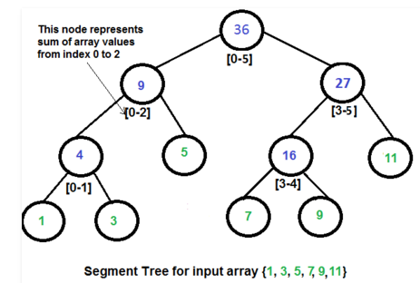
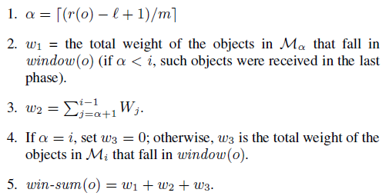
Back to Sliding Aggregation
New MapShuffle (Machine $M_{i}$):
Compute and send $W_{i}$ to all machines
Send all objects in $M_{i}$ to the machines to 1 / 2 machines
New Reduce (Machine $M_{i}$):
Every machine sends and receives O(t+m) = O(m) words in MapShuffle ➔ O(m) storage
Simple augmented binary tree for an N size set T➔ can be built in O(NlogN), and given an interval I can return $AGG\left(S∩I\right)$ in $O\left(logN\right) time.$ In each $M_{i}$ we create a augmented binary tree for: 1. all objects in $M_{i}$ 2. the objects received from at most two machine 3. the set $W_{1},…,W_{t}$ can be built in O(mlogm) time and compute $w_{1},w_{2},w_{3}$ in O(logm) ➔ reduce phase takes O(mlogm) = $O\left(\frac{n}{t}log\left(n\right)\right)$
➔ Minimality

Slide 65
Questions?

