Slide 1
Spark: Cluster Computing with Working Sets
& RDDs: A Fault-Tolerant Abstraction for In-Memory Cluster Computing
Written and presented by Omri Zimbler
Based on Matei Zaharia, Mosharaf Chowdhury, Tathagata Das, Ankur Dave, Justin Ma, Murphy McCauley, Michael J. Franklin, Scott Shenker, Ion Stoica Researches

Slide 2
Today’s session:
RDD (Resilient Distributed Datasets) :
Introduction
Properties
“Transformations” and “actions” (Lazy)
Fault tolerance
persistence(caching)
partitioned
Example (general)
Spark:
Introduction
properties
Examples & Evaluation
Summary

Slide 3
Lets Talk About Strings in JAVA
a
“We_Love_This_Seminar”
String a = “We_Love_This_Seminar”;
String b = a.split(“_”)[1];
b
“Love”
String c = b.concat(“_Summer”);
c
“Love_Summer”
c.toUpperCase()
d
“LOVE_SUMMER”
Return c.length();
11

Slide 4
Lets Talk About Strings in JAVA
Properties:
How do we “make” Strings?
By creating one explicitly on a constant String.
By “transformation” on a existing String.
Immutable (Read-Only)
Can be recover?
a
“We_Love_This_Seminar”
String a = “We_Love_This_Seminar”;
String b = a.split(“_”)[1];
b
“Love”
String c = b.concat(“_Summer”);
c
“Love_Summer”
c.toUpperCase()
d
“LOVE_SUMMER”
Return c.length();
We can make “actions” on Strings
11

Slide 5
RDD’s - Resilient Distributed Datasets
Resilient – בעל יכולת התאוששות מהירה
Distributed - מחולק
Formally, an RDD is a read-only, partitioned collection of records
RDDs can only be created through deterministic operations on either:
data in stable storage
other RDDs (by “transformation”)
Fault tolerance - “Lineage” (שַׁלשֶׁלֶת) – each RDD “remembers” how it was derived from other RDD / stable storage
The user can control its partition
The user can control its persistence (caching)
Transform VS action commands
Lazy
represented as an object

Slide 6
“Read Only”
Base RDD
lines = spark.textFile(“hdfs://...”)
Transformed RDD =
New RDD
errors = lines.filter(_.startsWith(“ERROR”))
Back

Slide 7
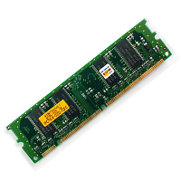
Partitioned
“Worker”
“Driver”
Partition
RDD
“Worker”
Partition
“Worker”
Partition
“Worker”
Partition
Back

Slide 8
Creating RDD
New RDD from data in stable storage
lines = spark.textFile(“hdfs://...”)
errors = lines.filter(_.startsWith(“ERROR”))
messages = errors.map(_.split(‘\t’)(2))
New RDD by transformation
on other RDD
New RDD by transformation
on other RDD
Back

Slide 9
“Lineage” - שַׁלשֶׁלֶת
lines = spark.textFile(“hdfs://...”)
errors = lines.filter(_.startsWith(“ERROR”))
messages = errors.map(_.split(‘\t’)(2))
lines
errors
messages
filter
lines.filter(_.startsWith(“ERROR”))
map
errors.map(_.split(‘\t’)(2))
Back

Slide 10
Fault tolerance
lines = spark.textFile(“hdfs://...”)
errors = lines.filter(_.startsWith(“ERROR”))
messages = errors.map(_.split(‘\t’)(2))
lines
errors
messages
filter
lines.filter(_.startsWith(“ERROR”))
map
errors.map(_.split(‘\t’)(2))
Back

Slide 11
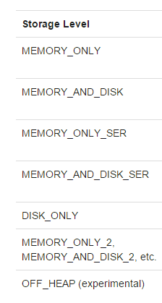
Persistance
lines = spark.textFile(“hdfs://...”)
errors = lines.filter(_.startsWith(“ERROR”))
messages = errors.map(_.split(‘\t’)(2))
cashMsgs = messages.cache()
newVal= oldVal.persist(STORAGE_LEVEL)
Back

Slide 12
Transform & action commands
Transform
Action
Map (f: T -> U ) : RDD[T] -> RDD[U]
Filter (f: T -> bool) :RDD[T] -> RDD[T]
Union : (RDD[T],RDD[T]) -> RDD[T]
Join : …
Sort (c:Comparator) :
RDD[(K,V)] -> RDD[(K,V)]
reduceByKey(f: (V,V)->V) :
RDD[(K,V)] -> RDD[(K,V)]
groupByKey()
…
…
…
Count(): RDD[T] -> Long
Collect(): RDD[T] -> Seq[T]
Reduce(f: (T,T) -> T) : RDD[T] -> T
Save(String path) : saves the RDD to path
first()
take(n)
foreach(func)
…
…
…
Back

Slide 13
Lazy
The transformations are only computed when an action requires a result to be returned to the driver program.
val file = spark.textFile("hdfs://...")
2. val errs = file.filter(_.contains("ERROR"))
3. val ones = errs.map(_ => 1)
4. val count = ones.reduce(_+_)
Nothing happens
Nothing happens
Nothing happens
Will run commands 1,2,3 & 4, and return the result to the driver
Back

Slide 15
What is it good for?
Iterative algorithms
Interactive data mining tools
In both cases, keeping data in memory can improve performance by an order of magnitude
Implemented RDDs in a system called Spark, which we evaluate through a variety of user applications and benchmarks.
 | RDD (Resilient Distributed Datasets) | DSM (distributed shared memory)
Writes | Coarse-grained | fine-grained
Recovery | lineage | Checkpoint
consistency | Trivial | Up to apps

Slide 17
Spark
Software Framework (שלד תוכנה)
Focuses on application that reuse a working set of data across multiple parallel operations
Iterative jobs
Interactive analytics
The main abstraction in Spark is that of a resilient distributed dataset (RDD).
Parallel operations
Shared Variables
Broadcast (מִשְׁדָּר) variables
Accumulators (אוֹגֵר)

Slide 18
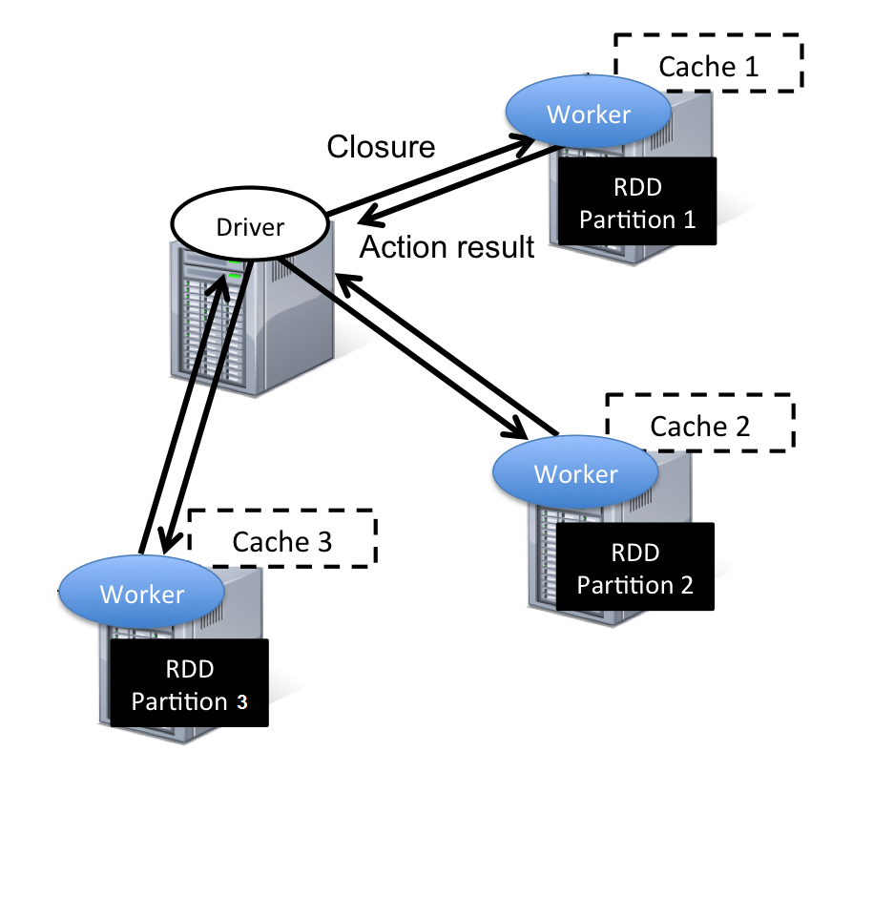
Main Framework

Slide 19
Main Framework
lines = spark.textFile(“hdfs://...”)
2. errors = lines.filter(_.startsWith(“ERROR”))
3. messages = errors.map(_.split(‘\t’)(2))
4. messages.persist()
5. messages.filter(_.contains(“foo”)).count
6. messages.filter(_.contains(“bar”)).count
Back

Slide 20
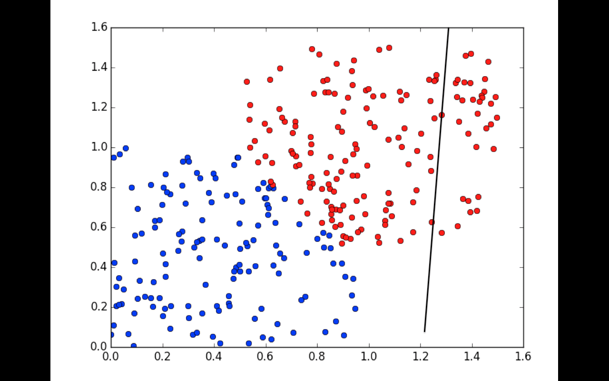
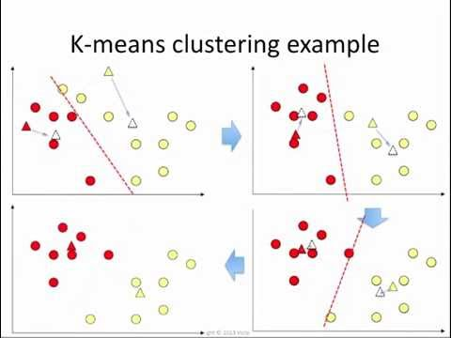
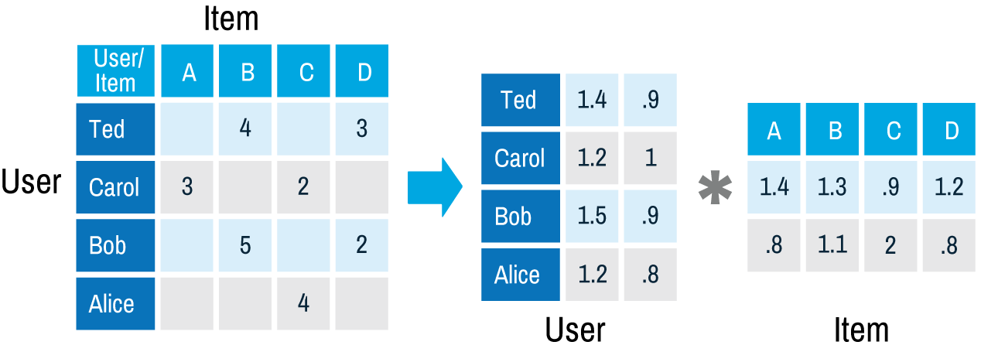
Iterative Jobs
Examples:
gradient descent (Logistic regration)
collaborative filtering
PageRank
K - Means
ALS
Log mining
Back

Slide 21
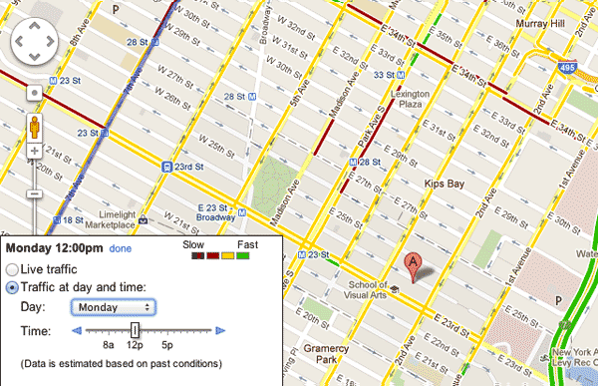
Interactive Analytics
Examples:
Text Search
Crowdsourced traffic estimation
Twitter Spam Detection
More on Jacob’s presentation
Back

Slide 22
Parallel operations
reduce: Combines dataset elements using an associative function to produce a result at the driver program
foreach: Passes each element through a user provided function
collect: Sends all elements of the dataset to the driver program. For example, an easy way to update an array in parallel is to parallelize, map and collect the array
Back

Slide 23
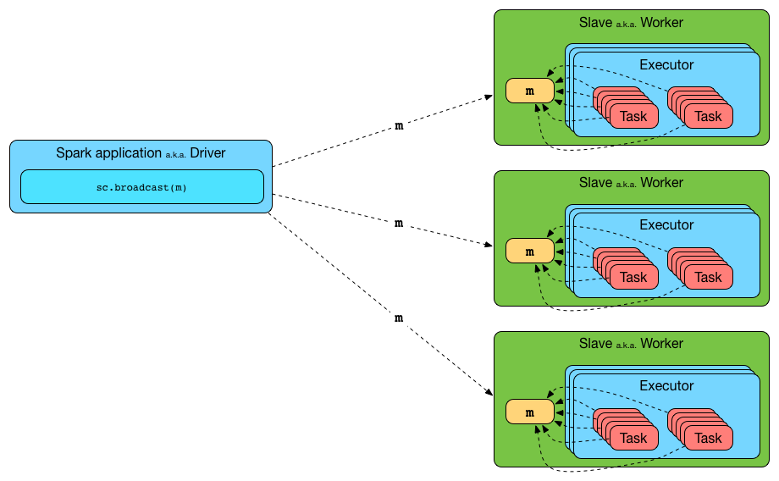
Broadcast variables
If a large read-only piece of data (e.g., a lookup table) is used in multiple parallel operations, it is preferable to distribute it to the workers only once instead of packaging it with every closure.
Back

Slide 24
Accumulators
These are variables that workers can only “add” to using an associative operation, and that only the driver can read. They can be used to implement counters as in MapReduce and to provide a more imperative syntax for parallel sums.
val ac = sc.accumulator(0)
val words = sc.textFile("hdfs://.../words").flatMap(_.split(" "))
words.foreach(w => ac += 1 )
ac.value
driver
worker
ac
worker
worker
Back

Slide 25
Example 1 - Logistic regression
Will the sniper hit the target?
Years of
experience
x2
y= +(1) : sniper hit the target
y=0 : sniper miss the target
+
+
4
+
+
+
3
+
0
+
2
0
+
0
1
+
0
0
0
0
x1
300
800
Range(m)

Slide 26
Example 1
Logistic regression
Years of
experience
x2
Required Line
+
+
4
+
+
+
3
+
0
+
2
0
+
0
1
+
0
0
0
0
x1
300
800
Range(m)

Slide 27
Example 1
Logistic regression
Years of
experience
x2
+
+
4
+
+
+
3
Arbitrary Line
+
0
+
2
0
+
0
1
+
0
0
0
0
x1
300
800
Range(m)

Slide 28
Example 1
For each point:
$$val s= \left(\frac{1}{1+e^{−p.y∗\left(w dot p.x\right)}}−1 \right)∗p.y$$
$$gradient+ =s∗p.x$$
Logistic regression
Years of
experience
x2
+
+
4
+
+
+
3
Arbitrary Line
+
0
+
2
0
+
0
1
+
0
0
0
0
x1
300
800
Range(m)

Slide 29
Example 1
Logistic regression
Years of
experience
$$w− =gradient.value$$
x2
+
+
4
+
+
+
3
Arbitrary Line
+
0
+
2
0
+
0
1
+
0
0
0
0
x1
300
800
Range(m)

Slide 30
Example 1
Logistic regression
Years of
experience
x2
+
+
4
+
+
+
3
Arbitrary Line
+
0
+
2
0
+
0
1
+
0
0
0
0
x1
300
800
Range(m)

Slide 31
Example 1
Logistic regression
Years of
experience
x2
+
+
4
+
+
+
3
Arbitrary Line
+
0
+
2
0
+
0
1
+
0
0
0
0
x1
300
800
Range(m)

Slide 32
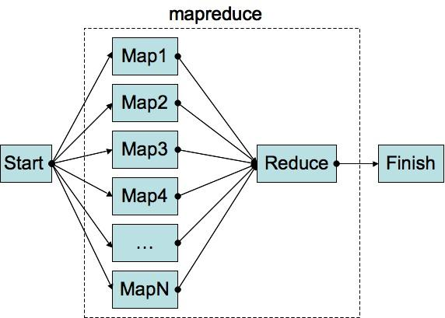
Map Reduce implementation
Reduce: +
Write new vector to disk
Read points
& vector
from disk
Map: <point, f(p)>
$$w− =gradient.value$$
$$f(p)= \left(\frac{1}{1+e^{−p.y∗\left(w dot p.x\right)}}−1 \right)∗p.y$$

Slide 33
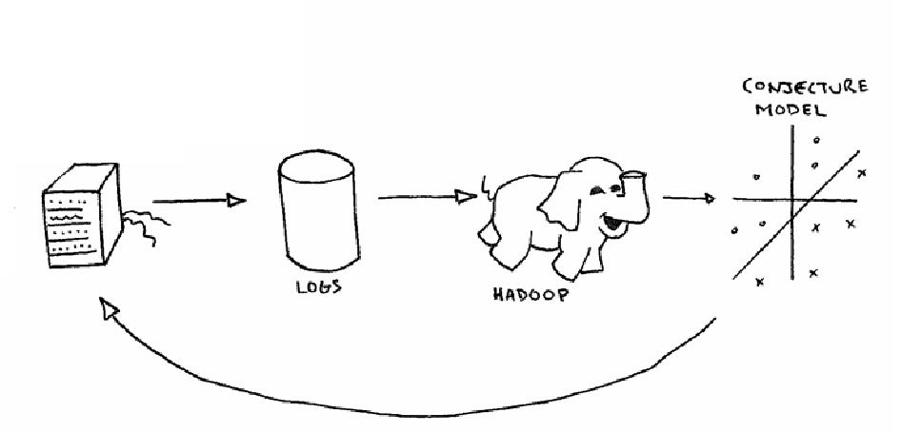
Map Reduce implementation

Slide 34
Spark implementation

Slide 35
Spark implementation
// Read points from a text file and cache them
val points = spark.textFile(...).map(parsePoint).cache()
// Initialize w to random D-dimensional vector
var w = Vector.random(D)
// Run multiple iterations to update w
for (i <- 1 to ITERATIONS) {
val grad = spark.accumulator(new Vector(D))
for (p <- points) { // Runs in parallel
val s = (1/(1+exp(-p.y*(w dot p.x)))-1)*p.y
grad += s * p.x
}
w -= grad.value
}
Reminder: Map (f: T -> U ) : RDD[T] -> RDD[U]

Slide 36
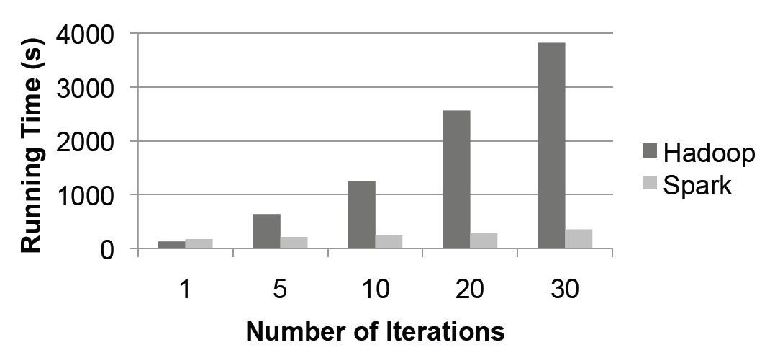
Results
performance of the logistic regression using 29 GB dataset
With Hadoop, each iteration takes 127s, because it runs as an independent
MapReduce job. With Spark, the first iteration takes 174s but each iterations
take only 6s, each because they reuse cached data. This allows the job to
run up to 10x faster

Slide 37
Example 2 - Text Search
How much linker errors and how much compiler errors do we have?
Compiling logs

Slide 38
Spark:
MapReduce:
on Board

Slide 39
Example 2 - code
val file = spark.textFile("hdfs://...")
val errs = file.filter(_.contains("ERROR"))
val cachedErrs = errs.cache()
val linkerErrors = cachedErrs.filter(_.startswith("Linker"))
val ones1 = linkerErrors.map(_ => 1)
val count1 = ones.reduce(_+_)
val compilerErrors = cachedErrs.filter(_.startswith("Compiler"))
val ones2 = compilerErrors.map(_ => 1)
val count2 = ones.reduce(_+_)

Slide 40
Example 3 – PageRank
1/4
A
1/4
1/4
D
B
C
1/4

Slide 41
PR – iteration 1
r = self rank
n = self number of neighbors
on each iteration, each document
sends a contribution of $\frac{r}{n}$
to its neighbors, and then updates
its rank to:
r = $\frac{α}{N}+\left(1−α\right)∗∑c_{i}$
(in this example we will consiser
$α$ as 1/2)
¼
A
1/8
1/8
¼
¼
1/8
1/8
B
D
¼
¼
C
¼

Slide 42
PR – iteration 2
½ * 1/8 + ½ * ¼
A
3/32
1/8
½ * 2/8 + ½ * ¼
½ * 2/8 + ½ * ¼
3/32
1/8
D
B
5/16
2/8
C
½ * 3/8 + ½ * ¼

Slide 43
PR – iteration 2
½ * 1/8 + ½ * ¼
A
½ * 5/16 + ½ * ¼
½ * 7/32 + ½ * ¼
D
B
C
½ * 11/32 + ½ * ¼

Slide 44
Example 3 – Code
// Load graph as an RDD of (URL, outlinks) pairs
val links = spark.textFile(...).map(...).persist()
var ranks = // RDD of (URL, rank) pairs
for (i <- 1 to ITERATIONS) {
// Build an RDD of (targetURL, float) pairs
// with the contributions sent by each page
val contribs = links.join(ranks).flatMap {
(url, (links, rank)) =>
links.map(dest => (dest, rank/links.size))
}
// Sum contributions by URL and get new ranks
ranks = contribs.reduceByKey((x,y) => x+y)
.mapValues(sum => a/N + (1-a)*sum)
}

Slide 45
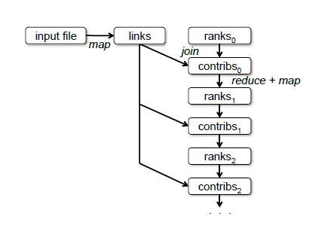
Lineage graph for datasets in PageRank

Slide 46
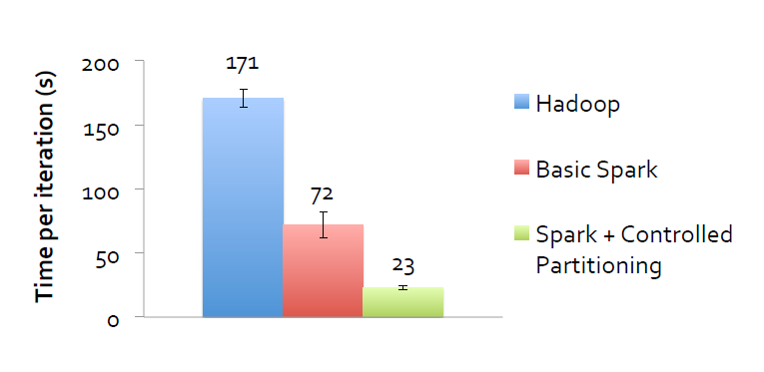
PageRank Performance

Slide 47
Summary
Spark – software framework over MapReduce
Iterative jobs and interactive analytics
RDD, shared variables
100x fater than MapReduce (in memory)
10x faster on disk
All in one
Big community

Slide 48
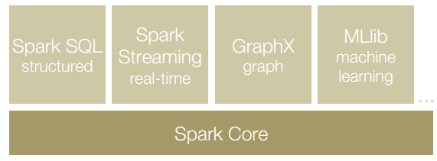
All in One
Standard Libraries included with Spark:
Back

Slide 49
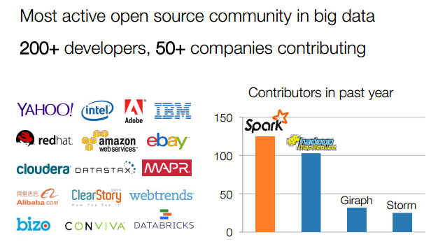
Spark Community
Back

Slide 50
Questions and Answers?
Thank You

