Slide 1
Program Analysis and Verification
0368-4479
Noam Rinetzky
Lecture 2a: Operational Semantics
Slides credit: Tom Ball, Dawson Engler, Roman Manevich, Erik Poll, Mooly Sagiv, Jean Souyris, Eran Tromer, Avishai Wool, Eran Yahav

Slide 2



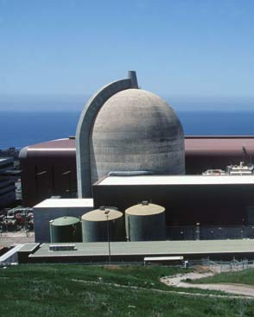


Unreliable Software is Everywhere

Slide 3
What can we do about it?
(Before deploying the program)
Testing
  Concrete
  Symbolic
Static Analysis
Formal Verification
Specification
Notes:
There are several things that we can do as programmer

Slide 4
Testing
Useful and challenging
  Random inputs
    Symbolic testing can help (see later)
  Guided testing (coverage)
  Bug reproducing
But …
  Observe some program behaviors
  What can you say about other behaviors?
Notes:
Not only test case we etie our selves
Random
Coverage
Reproduction of a bug

Slide 5
Formal verification
Mathematical model of software
  State = Var ➔ Integer
  S = [x↦0, y↦1]
Logical specification
  { 0 < x } = { S ∈ State | 0 < S(x) }
Machine checked formal proofs
Q’ → P’
{ P } stmt1 { Q’ }
{ P’ } stmt2 { Q }
{ P } stmt1; stmt2 { Q }

Slide 6
Static Analysis
Lightweight formal verification
Formalize software behavior in a mathematical model (semantics)
Prove (selected) properties of the mathematical model
  Automatically, typically with approximation of the formal semantics

Slide 7
Central idea: use approximation
Over Approximation
Exact set of configurations/
behaviors
Under Approximation
universe

Slide 8
Testing: covers some reachable states
bad
states
reachable
states
initial
states

Slide 9
Analysis: explores program states
bad
states
reachable
states
initial
states

Slide 10
Technique: explore abstract states
bad
states
reachable
states
initial
states

Slide 11
Technique: explore abstract states
bad
states
reachable
states
initial
states

Slide 12
Technique: explore abstract states
bad
states
reachable
states
initial
states

Slide 13
Technique: explore abstract states
bad
states
reachable
states
initial
states

Slide 14
Sound: cover all reachable states
(runs until fixpoint)
bad
states
reachable
states
initial
states

Slide 15
Sound: cover all reachable states
bad
states
reachable
states
initial
states

Slide 16
Incomplete: covers unreachable states
bad
states
reachable
states
initial
states

Slide 17
Verification: covers all reachable states
Expressive abstraction - Not automatic
bad
states
reachable
states
initial
states

Slide 18
Sound SA vs. Formal verification
Sound Static Analysis
Formal verification
Fully automatic
Applicable to a programming language
Can be very imprecise
May yield false alarms
Requires specification and loop invariants
Program specific
Relatively complete
Provides counter examples
Provides useful documentation
Can be mechanized using theorem provers

Slide 19
Semantics: Defines the reachable states
bad
states
reachable
states
initial
states

Slide 20
Operational Semantics

Slide 21
“State transformer” semantics
Main idea: find (properties of) all reachable states*
bad
states
y=3,x=6
reachable
states
y=3,x=6
y=3,x=9
y=4,x=1
y=4,x=8
initial
states
y=4,x=8
y=4…,x=…

Slide 22
“Set-of-states transformer” semantics
Useful to prove analyses correct
bad
states
y=3,x=6
reachable
states
y=3,x=6
y=3,x=9
y=4,x=1
initial
states
y=4,x=1
y=4,x=1

Slide 23
A simple imperative language: While
Abstract syntax:
  a ::= n | x | a₁ + a₂ | a₁ * a₂ | a₁ – a₂
  b ::= true | false
  | a₁ = a₂ | a₁ < a₂ | ¬b | b₁ ∧ b₂
  S ::= x := a | skip | S₁; S₂
  | if b then S₁ else S₂
  | while b do S

Slide 24
Syntactic categories
  n ∈ Num numerals
  x ∈ Var program variables
  a ∈ Aexp arithmetic expressions
  b ∈ Bexp boolean expressions
  S ∈ Stm statements

Slide 25
Semantic categories
  Z Integers {0, 1, -1, 2, -2, …}
  T Truth values {ff, tt}
  State Var → Z
  Example state: s=[x↦5, y ↦ 7, z ↦ 0]
  Lookup: s x = 5
  Update: s[x ↦ 6] = [x ↦ 6, y ↦ 7, z ↦ 0]

Slide 26
Operational semantics
Concerned with how to execute programs
  How statements modify state
  Define transition relation between configurations
Two flavors
  Natural semantics: describes how the overall results of executions are obtained
    So-called “big-step” semantics
  Structural operational semantics: describes how the individual steps of a computations take place
    So-called “small-step” semantics

Slide 27
Natural operating semantics (NS)

Slide 28
Natural operating semantics (NS)
aka “Large-step semantics”
⟨S, s⟩ → s’
all steps

Slide 29
Natural operating semantics
Developed by Gilles Kahn [STACS 1987]
  Configurations
    ⟨S, s⟩ Statement S is about to execute on state s
    s Terminal (final) state
  Transitions
    ⟨S, s⟩ → s’ Execution of S from s will terminate
    with the result state s’
  Ignores non-terminating computations

Slide 30
Natural operating semantics
→ defined by rules of the form
The meaning of compound statements is defined using the meaning immediate constituent statements
side condition
premise
⟨S₁, s₁⟩→s₁’, … , ⟨S_{n}, s_{n}⟩ → s_{n}’
⟨S, s⟩ → s’
if…
conclusion

Slide 31
Natural semantics for While
[ass_{ns}]
⟨x := a, s⟩ → s[x ↦A⟦a⟧s]
axioms
[skip_{ns}]
⟨skip, s⟩→s
⟨S₁, s⟩ → s’, ⟨S₂, s’⟩ → s’’
⟨S₁; S₂, s⟩ → s’’
[comp_{ns}]
⟨S₁, s⟩ → s’
⟨if b then S₁ else S₂, s⟩ → s’
[if^{tt}_{ns}]
  if B ⟦b⟧ s = tt
⟨S₂, s⟩ → s’
⟨if b then S₁ else S₂, s⟩ → s’
[if^{ff}_{ns}]
  if B ⟦b⟧ s = ff

Slide 32
Natural semantics for While
[while^{ff}_{ns}]
⟨while b do S, s⟩ → s
  if B ⟦b⟧ s = ff
Non-compositional
⟨S, s⟩ → s’, ⟨while b do S, s’⟩ → s’’
⟨while b do S, s⟩ → s’’
[while^{tt}_{ns}]
  if B ⟦b⟧ s = tt

Slide 33
Derivation trees
Using axioms and rules to derive a transition ⟨S, s⟩ → s’ gives a derivation tree
  Root: ⟨S, s⟩ → s’
  Leaves: axioms
  Internal nodes: conclusions of rules
    Immediate children: matching rule premises

Slide 34
Top-down evaluation via derivation trees
Given a statement S and an input state s
find an output state s’ such that ⟨S, s⟩→s’
Start with the root and repeatedly apply rules until the axioms are reached
  Inspect different alternatives in order
In While s’ and the derivation tree is unique

Slide 35
Program termination
Given a statement S and input s
  S terminates on s if there exists a state s’ such that
  ⟨S, s⟩ → s’
  S loops on s if there is no state s’ such that
  ⟨S, s⟩ → s’
Given a statement S
  S always terminates if
  for every input state s, S terminates on s
  S always loops if
  for every input state s, S loops on s

Slide 36
Semantic equivalence
S₁ and S₂ are semantically equivalent if
for all s and s’
⟨S₁, s⟩ → s’ if and only if ⟨S₂, s⟩ → s’
Simple example
while b do S
is semantically equivalent to:
if b then (S; while b do S) else skip
  Read proof in pages 26-27

Slide 37
Properties of natural semantics
Equivalence of program constructs
  skip; skip is semantically equivalent to skip
  ((S₁; S₂); S₃) is semantically equivalent to
  (S₁; (S₂; S₃))
  (x:=5; y:=x*8) is semantically equivalent to (x:=5; y:=40)

Slide 38
  Equivalence of (S₁; S₂); S₃ and S₁; (S₂; S₃)

Slide 39
  Equivalence of (S₁; S₂); S₃ and S₁; (S₂; S₃)
Assume ⟨(S₁; S₂); S₃, s⟩ → s’ then the following unique derivation tree exists:
⟨S₁, s⟩ → s₁, ⟨S₂, s₁⟩ → s₁₂
⟨(S₁; S₂), s⟩ → s₁₂, ⟨S₃, s₁₂⟩ → s’
⟨(S₁; S₂); S₃, s⟩ → s’
Using the rule applications above, we can construct the following derivation tree:
⟨S₂, s₁⟩ → s₁₂, ⟨S₃, s₁₂⟩ → s’
⟨S₁, s⟩ → s₁, ⟨(S₂; S₃), s₁₂⟩ → s’
⟨S₁; (S₂; S₃, s⟩ → s’
And vice versa.

Slide 40
Deterministic semantics for While
  Theorem: for all statements S and states s₁, s₂
  if ⟨S, s⟩ → s₁ and ⟨S, s⟩ → s₂ then s₁=s₂
The proof uses induction on the shape of derivation trees (pages 29-30)
  Prove that the property holds for all simple derivation trees by showing it holds for axioms
  Prove that the property holds for all composite trees:
    For each rule assume that the property holds for its premises (induction hypothesis) and prove it holds for the conclusion of the rule
single node
#nodes>1

Slide 41
The semantic function S_{ns}
The meaning of a statement S is defined as a partial function from State to State
S_{ns}: Stm → (State → State)
Examples:
  S_{ns} ⟦skip⟧s = s
  S_{ns} ⟦x:=1 ⟧ s = s [x ↦1]
  S_{ns} ⟦while true do skip ⟧ s = undefined
s’ if ⟨S, s⟩ → s’
undefined otherwise
S_{ns} ⟦S⟧ s =

Slide 42
Structural operating semantics (SOS)

Slide 43
Structural operating semantics (SOS)
aka “Small-step semantics”
⟨S, s⟩ ⇒ ⟨S’, s’⟩
first step

Slide 44
Structural operational semantics
Developed by Gordon Plotkin
  Configurations: γ has one of two forms:
    ⟨S, s⟩ Statement S is about to execute on state s
    s Terminal (final) state
  Transitions ⟨S, s⟩ ⇒ γ
    = ⟨S’, s’⟩ Execution of S from s is not completed and remaining computation proceeds from intermediate configuration γ
    = s’ Execution of S from s has terminated and the final state is s’
  ⟨S, s⟩ is stuck if there is no γ such that ⟨S, s⟩ ⇒ γ
first step
Notes:
PLOTKIN G .D., “A Structural Approach to Operational Semantics”, DAIMI FN-19, Computer Science
Department, Aarhus University, Aarhus, Denmark, September 1981.

Slide 45
Structural semantics for While
[ass_{sos}]
⟨x:=a, s⟩ ⇒ s[x↦A⟦a⟧s]
[skip_{sos}]
⟨skip, s⟩ ⇒ s
⟨S₁, s⟩ ⇒ ⟨S₁’, s’⟩
⟨S₁; S₂, s⟩ ⇒ ⟨S₁’; S₂, s’⟩
[comp¹_{sos}]
When does this happen?
⟨S₁, s⟩ ⇒ s’
⟨S₁; S₂, s⟩ ⇒ ⟨S₂, s’⟩
[comp²_{sos}]
[if^{tt}_{sos}]
⟨if b then S₁ else S₂, s⟩ ⇒ ⟨S₁, s⟩
  if B ⟦b⟧s = tt
[if^{ff}_{sos}]
⟨if b then S₁ else S₂, s⟩ ⇒ ⟨S₂, s⟩
  if B⟦b⟧ s = ff

Slide 46
Structural semantics for While
⟨while b do S, s⟩ ⇒
⟨if b then
S; while b do S)
else
skip, s⟩
[while_{sos}]

Slide 47
Derivation sequences
A derivation sequence of a statement S starting in state s is either
A finite sequence γ₀, γ₁, γ₂ …, γ_{k} such that
  γ₀ = ⟨S, s⟩
  γ_{i} ⇒ γ_{i+1}
  γ_{k} is either stuck configuration or a final state
An infinite sequence γ₀, γ₁, γ₂, … such that
  γ₀ = ⟨S, s⟩
  γ_{i} ⇒ γ_{i+1}
Notations:
  γ₀ ⇒^{k} γ_{k} γ₀ derives γ_{k} in k steps
  γ₀ ⇒* γ γ₀ derives γ in a finite number of steps
For each step there is a corresponding derivation tree

Slide 48
Derivation sequence example
Assume s₀=[x ↦ 5, y ↦ 7, z ↦ 0]
⟨(z:=x; x:=y); y:=z, s₀⟩
⇒ ⟨x:=y; y:=z, s₀[z↦5]⟩
⇒ ⟨y:=z, (s₀[z ↦ 5])[x ↦ 7]⟩
⇒ ((s₀[z ↦ 5])[x ↦ 7])[y ↦ 5]
Derivation tree for first step:
⟨z:=x, s₀⟩ ⇒ s₀[z ↦ 5]
⟨z:=x; x:=y, s₀⟩ ⇒ ⟨x:=y, s₀[z ↦ 5]⟩
⟨(z:=x; x:=y); y:=z, s₀⟩ ⇒ ⟨x:=y; y:=z, s₀[z ↦ 5]⟩

Slide 49
Evaluation via derivation sequences
For any While statement S and state s it is always possible to find at least one derivation sequence from ⟨S, s⟩
  Apply axioms and rules forever or until a terminal or stuck configuration is reached
Proposition: there are no stuck configurations in While

Slide 50
Factorial (n!) example
Input state s such that s x = 3
y := 1; while ¬(x=1) do (y := y * x; x := x – 1)
⟨y :=1 ; W, s⟩
⇒ ⟨W, s[y ↦ 1]⟩
⇒ ⟨if ¬(x =1) then ((y := y * x; x := x – 1); W else skip), s[y ↦ 1]⟩
⇒ ⟨((y := y * x; x := x – 1); W), s[y ↦ 1]⟩
⇒ ⟨(x := x – 1; W), s[y ↦ 3]⟩
⇒ ⟨W , s[y ↦ 3][x ↦ 2]⟩
⇒ ⟨if ¬(x =1) then ((y := y * x; x := x – 1); W else skip), s[y ↦ 3][x ↦ 2]⟩
⇒ ⟨((y := y * x; x := x – 1); W), s[y ↦ 3] [x ↦ 2]⟩
⇒ ⟨(x := x – 1; W) , s[y ↦ 6] [x ↦ 2]⟩
⇒ ⟨W, s[y ↦ 6][x ↦ 1]⟩
⇒ ⟨if ¬(x =1) then ((y := y * x; x := x – 1); W else skip, s[y ↦ 6][x ↦ 1]⟩
⇒ ⟨skip, s[y ↦ 6][x ↦ 1]⟩
⇒ s[y ↦ 6][x ↦ 1]

Slide 51
Program termination
Given a statement S and input s
  S terminates on s if there exists a finite derivation sequence starting at ⟨S, s⟩
  S terminates successfully on s if there exists a finite derivation sequence starting at ⟨S, s⟩ leading to a final state
  S loops on s if there exists an infinite derivation sequence starting at ⟨S, s⟩

Slide 52
Properties of structural operational semantics
S₁ and S₂ are semantically equivalent if:
  for all s and γ which is either final or stuck,
  ⟨S₁, s⟩ ⇒* γ if and only if ⟨S₂, s⟩ ⇒* γ
  for all s, there is an infinite derivation sequence starting at ⟨S₁, s⟩ if and only if there is an infinite derivation sequence starting at ⟨S₂, s⟩
Theorem: While is deterministic:
  If ⟨S, s⟩ ⇒* s₁ and ⟨S, s⟩ ⇒* s₂ then s₁=s₂

Slide 53
Sequential composition
Lemma: If ⟨S₁; S₂, s⟩ ⇒^{k} s’’ then
there exists s’ and k=m+n such that
⟨S₁, s⟩ ⇒^{m} s’ and ⟨S₂, s’⟩ ⇒^{n} s’’
The proof (pages 37-38) uses induction on the length of derivation sequences
  Prove that the property holds for all derivation sequences of length 0
  Prove that the property holds for all other derivation sequences:
    Show that the property holds for sequences of length k+1 using the fact it holds on all sequences of length k (induction hypothesis)

Slide 54
The semantic function S_{sos}
The meaning of a statement S is defined as a partial function from State to State
S_{sos}: Stm → (State → State)
Examples:
  S_{sos} ⟦ skip ⟧ s = s
  S_{sos} ⟦ x:=1 ⟧ s = s [x ↦ 1]
  S_{sos} ⟦ while true do skip ⟧ s = undefined
s’ if ⟨S, s⟩ ⇒* s’
undefined else
S_{sos} ⟦S⟧ s =

Slide 55
An equivalence result
For every statement in While
S_{ns} ⟦S⟧ = S_{sos} ⟦S⟧
Proof in pages 40-43

Slide 56
Language Extensions
abort statement (like C’s exit w/o return value)
Non-determinism
Parallelism
Local Variables
Procedures
  Static Scope
  Dynamic scope

Slide 57
While + abort
Abstract syntax
  S ::= x := a | skip | S₁; S₂
  | if b then S₁ else S₂
  | while b do S
  | abort
Abort terminates the execution
  In “skip; S” the statement S executes
  In“abort; S” the statement S should never execute
Natural semantics rules: …?
Structural semantics rules: …?

Slide 58
Comparing semantics
Structural semantics | Natural semantics | Statement
 |  | abort
 |  | abort; S
 |  | skip; S
 |  | while true do skip
 |  | if x = 0 then abort else y := y + x
Conclusions
The natural semantics cannot distinguish between looping and abnormal termination
  Unless we add a special error state
In the structural operational semantics looping is reflected by infinite derivations and abnormal termination is reflected by stuck configuration

Slide 59
While + non-determinism
Abstract syntax
  S ::= x := a | skip | S₁; S₂
  | if b then S₁ else S₂
  | while b do S
  | S₁ or S₂
Either S₁ is executed or S₂ is executed
Example: x:=1 or (x:=2; x:=x+2)
  Possible outcomes for x: 1 and 4

Slide 60
While + non-determinism: natural semantics
⟨S₁, s⟩ → s’
⟨S₁ or S₂, s⟩ → s’
[or¹_{ns}]
⟨S₂, s⟩ → s’
⟨S₁ or S₂, s⟩ → s’
[or²_{ns}]

Slide 61
While + non-determinism: structural semantics
[or¹_{sos}]
?
[or²_{sos}]
?

Slide 62
While + non-determinism
What about the definitions of the semantic functions?
  S_{ns} ⟦ S₁ or S₂ ⟧ s
  S_{sos} ⟦ S₁ or S₂ ⟧ s

Slide 63
Comparing semantics
Structural semantics | Natural semantics | Statement
 |  | x:=1 or (x:=2; x:=x+2)
 |  | (while true do skip) or (x:=2; x:=x+2)
Conclusions
In the natural semantics non-determinism will suppress non-termination (looping) if possible
In the structural operational semantics non-determinism does not suppress non-terminating statements

Slide 64
While + parallelism
  Abstract syntax
  S ::= x := a | skip | S₁; S₂
  | if b then S₁ else S₂
  | while b do S
  | S₁ ‖ S₂
All the interleaving of S₁ and S₂ are executed
Example: x:=1 ‖ (x:=2; x:=x+2)
  Possible outcomes for x: 1, 3, 4

Slide 65
While + parallelism: structural semantics
⟨S₁, s⟩ ⇒ ⟨S₁’, s’⟩
⟨S₁‖S₂, s⟩ ⇒ ⟨S₁’ ‖ S₂, s’⟩
[par¹_{sos}]
⟨S₁, s⟩ ⇒ s’
⟨S₁‖S₂, s⟩ ⇒ ⟨S₂, s’⟩
[par²_{sos}]
⟨S₂, s⟩ ⇒ ⟨S₂’, s’⟩
⟨S₁‖S₂, s⟩ ⇒ ⟨S₁‖S₂’, s’⟩
[par³_{sos}]
⟨S₂, s⟩ ⇒ s’
⟨S₁‖S₂, s⟩ ⇒ ⟨S₁, s’⟩
[par⁴_{sos}]

Slide 66
While + parallelism: natural semantics
Challenge problem:
Give a formal proof that this is in fact impossible.
Idea: try to prove on a restricted version of While without loops/conditions

Slide 67
Example: derivation sequences of a parallel statement
⟨x:=1 ‖ (x:=2; x:=x+2), s⟩ ⇒

Slide 68
Conclusion
In the structural operational semantics we concentrate on small steps so interleaving of computations can be easily expressed
In the natural semantics immediate constituent is an atomic entity so we cannot express interleaving of computations

Slide 69
While + memory
  Abstract syntax
  S ::= x := a | skip | S₁; S₂
  | if b then S₁ else S₂
  | while b do S
  | x := malloc(a)
  | x := [y]
  |[x] := y
State : Var → Z
State : Stack x Heap
Stack : Var → Z
Heap : Z → Z
Integers as memory addresses

Slide 70
From states to traces

Slide 71
Trace semantics
Low-level (conceptual) semantics
Add program counter (pc) with states
  ∑ = State + pc
The meaning of a program is a relation
τ ⊆ ∑ × Stm × ∑
Execution is a finite/infinite sequence of states
A useful concept in defining static analysis as we will see later

Slide 72
Example
1: y := 1;
while 2: ¬(x=1) do (
3: y := y * x;
4: x := x - 1
)
5:

Slide 73
Traces
1: y := 1;
while 2: ¬(x=1) do (
3: y := y * x;
4: x := x - 1
)
5:
Set of traces is infinite therefore trace semantics is incomputable in general
⟨{x↦2,y ↦ 3},1⟩ [y:=1] ⟨{x ↦ 2,y ↦ 1},2⟩ [¬(x=1)] ⟨{x ↦ 2,y ↦ 1},3⟩ [y:=y*x]
⟨{x ↦ 2,y ↦ 2},4⟩ [x:=x-1] ⟨{x ↦ 1,y ↦ 2},2⟩ [¬(x=1)] ⟨{x ↦ 1,y ↦ 2},5⟩
⟨{x ↦ 3,y ↦ 3},1⟩ [y:=1] ⟨{x ↦ 3,y ↦ 1},2⟩ [¬(x=1)] ⟨{x3,y1},3⟩ [y:=y*x]
⟨{x ↦ 3,y ↦ 3},4⟩ [x:=x-1] ⟨{x ↦ 2,y ↦ 3},2⟩ [¬(x=1)] ⟨{x ↦ 2,y ↦ 3},3⟩ [y:=y*x] ⟨{x ↦ 2,y ↦ 6},4⟩ [x:=x-1] ⟨{x ↦ 1,y ↦ 6},2⟩ [¬(x=1)] ⟨{x ↦ 1,y ↦ 6},5⟩
…

Slide 74
Operational semantics summary
SOS is powerful enough to describe imperative programs
  Can define the set of traces
  Can represent program counter implicitly
  Handle goto statements and other non-trivial control constructs (e.g., exceptions)
Natural operational semantics is an abstraction
Different semantics may be used to justify different behaviors
Thinking in concrete semantics is essential for a analysis writer

Slide 75
Proving Programs with OS

Slide 76
A simple imperative language: While
Abstract syntax:
  a ::= n | x | a₁ + a₂ | a₁  a₂ | a₁ – a₂
  b ::= true | false
  | a₁ = a₂ | a₁  a₂ | b | b₁  b₂
  S ::= x := a | skip | S₁; S₂
  | if b then S₁ else S₂
  | while b do S

Slide 77
Program correctness concepts
Property = a certain relationship between initial state and final state
Partial correctness = properties that hold
if program terminates
Termination = program always terminates
  i.e., for every input state
Other notions of properties exist
Mostly focus in this course
partial correctness + termination = total correctness
Other correctness concepts exist: resource usage, linearizability, …

Slide 78
Factorial example
S_{fac}  y := 1; while ¬(x=1) do (y := y*x; x := x–1)
⟨S_{fac} , s⟩  s’ implies s’ y = (s x)!

Slide 79
Factorial example
S_{fac}  y := 1; while ¬(x=1) do (y := y*x; x := x–1)
⟨S_{fac} , s⟩  s’ implies s’ y = (s x)!
Factorial partial correctness property =
  if the statement terminates then the final value of y will be the factorial of the initial value of x
    What if s x < 0?

Slide 80
Factorial example
S_{fac}  y := 1; while ¬(x=1) do (y := y*x; x := x–1)
Factorial partial correctness property = if the statement terminates then the final value of y will be the factorial of the initial value of x
  What if s x < 0?
Formally, using natural semantics:
⟨S_{fac} , s⟩  s’ implies s’ y = (s x)!

Slide 81
Natural semantics for While
[ass_{ns}]
⟨x := a, s⟩  s[x A←a→s]
[skip_{ns}]
⟨skip, s⟩  s
⟨S₁, s⟩  s’, ⟨S₂, s’⟩  s’’
⟨S₁; S₂, s⟩  s’’
[comp_{ns}]
⟨S₁, s⟩  s’
⟨if b then S₁ else S₂, s⟩  s’
[if^{tt}_{ns}]
  if B ←b→ s = tt
⟨S₂, s⟩  s’
⟨if b then S₁ else S₂, s⟩  s’
[if^{ff}_{ns}]
  if B ←b→ s = ff
[while^{ff}_{ns}]
⟨while b do S, s⟩ → s
  if B ←b→ s = ff
⟨S, s⟩ → s’, ⟨while b do S, s’⟩  s’’
⟨while b do S, s⟩  s’’
[while^{tt}_{ns}]
  if B ←b→ s = tt

Slide 82
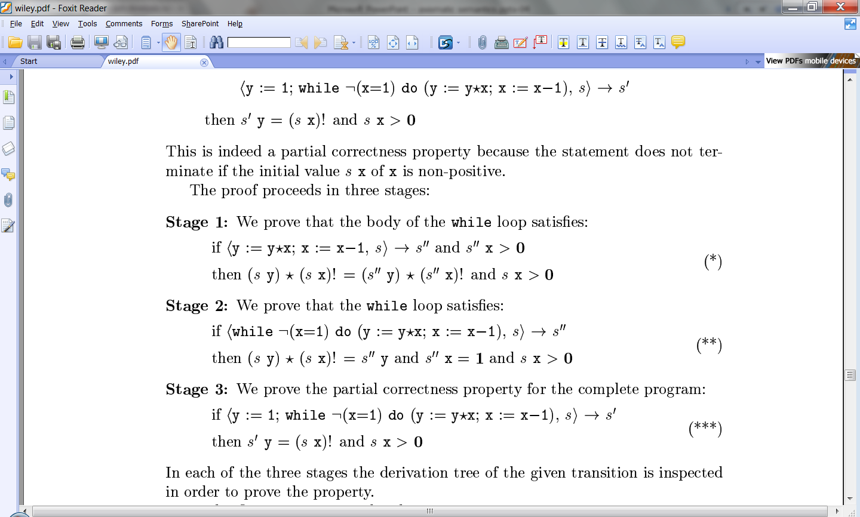
Staged proof

Slide 83
Staged proof

Slide 84
Stages
s y  (s x)! = s’’’ y  (s’’’ x)!  s x > 0
s
s’’’
y := y*x; x := x–1
s y  (s x)! = s’’ y  (s’’ x)!  s’’x = 1  s x > 0
s
s’’
while ¬(x=1) do (y := y*x; x := x–1)
s’ y = (s x)!  s x > 0
s
s’
y := 1; while ¬(x=1) do (y := y*x; x := x–1)

Slide 85
Inductive proof over iterations
s y  (s x)! = s’’’ y  (s’’’ x)!  s x > 0
s
S’’’
(y := y*x; x := x–1)
s’’’
s’’
while ¬(x=1) do (y := y*x; x := x–1)
s’’’ y  (s’’’ x)! = s’’ y  (s’’ x)!  s’’x = 1  s’’’ x > 0
s
while ¬(x=1) do (y := y*x; x := x–1)
s’’
s y  (s x)! = s’’ y  (s’’ x)!  s’’x = 1  s x > 0

Slide 86
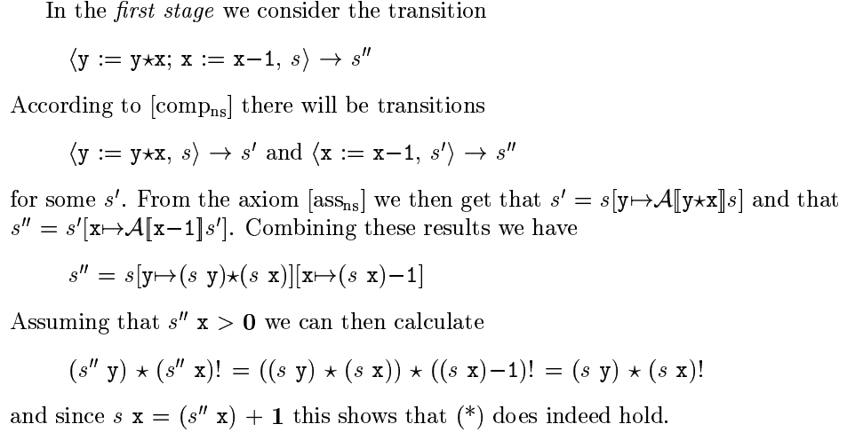
First stage

Slide 87
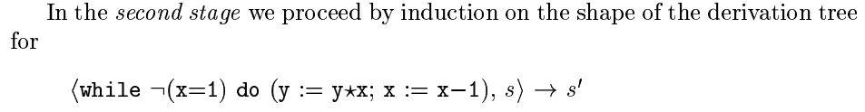
Second stage

Slide 88
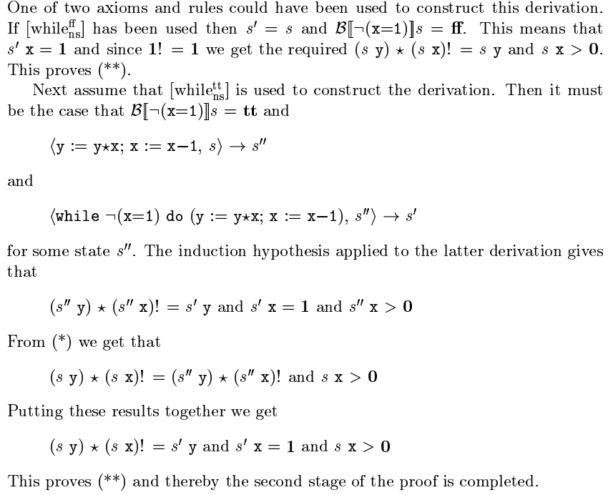
⟨while ¬(x=1) do (y := y*x; x := x–1), s⟩  s’

Slide 89
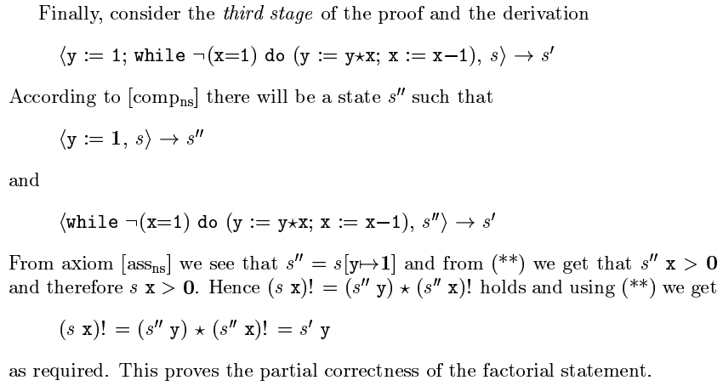
Third stage

Slide 90
How easy was that?
Proof is very laborious
  Need to connect all transitions and argues about relationships between their states
  Reason: too closely connected to semantics of programming language
Is the proof correct?
How did we know to find this proof?
  Is there a methodology?

Slide 91
The End

