Slide 1
Compilation
0368-3133
Lecture 2:
Lexical Analysis
Noam Rinetzky

Slide 2


Slide 3
Lexical Analysis
Modern Compiler Design: Chapter 2.1

Slide 4
Conceptual Structure of a Compiler
Compiler
Source
text
txt
Executable
code
exe
Frontend
Semantic
Representation
Backend
Lexical
Analysis
Syntax Analysis
Parsing
Semantic
Analysis
Intermediate
Representation
(IR)
Code
Generation

Slide 5
Conceptual Structure of a Compiler
Compiler
Source
text
txt
Executable
code
exe
Frontend
Semantic
Representation
Backend
Lexical
Analysis
Syntax Analysis
Parsing
Semantic
Analysis
Intermediate
Representation
(IR)
Code
Generation
words
sentences

Slide 6
What does Lexical Analysis do?
Language: fully parenthesized expressions
Expr → Num | LP Expr Op Expr RP
Num → Dig | Dig Num
Dig → ‘0’|‘1’|‘2’|‘3’|‘4’|‘5’|‘6’|‘7’|‘8’|‘9’
LP → ‘(’
RP → ‘)’
Op → ‘+’ | ‘*’
( ( 23 + 7 ) * 19 )

Slide 7
What does Lexical Analysis do?
Language: fully parenthesized expressions
Context free language
Expr → Num | LP Expr Op Expr RP
Num → Dig | Dig Num
Dig → ‘0’|‘1’|‘2’|‘3’|‘4’|‘5’|‘6’|‘7’|‘8’|‘9’
LP → ‘(’
RP → ‘)’
Op → ‘+’ | ‘*’
Regular
languages
( ( 23 + 7 ) * 19 )

Slide 8
What does Lexical Analysis do?
Language: fully parenthesized expressions
Context free language
Expr → Num | LP Expr Op Expr RP
Num → Dig | Dig Num
Dig → ‘0’|‘1’|‘2’|‘3’|‘4’|‘5’|‘6’|‘7’|‘8’|‘9’
LP → ‘(’
RP → ‘)’
Op → ‘+’ | ‘*’
Regular
languages
( ( 23 + 7 ) * 19 )

Slide 9
What does Lexical Analysis do?
Language: fully parenthesized expressions
Context free language
Expr → Num | LP Expr Op Expr RP
Num → Dig | Dig Num
Dig → ‘0’|‘1’|‘2’|‘3’|‘4’|‘5’|‘6’|‘7’|‘8’|‘9’
LP → ‘(’
RP → ‘)’
Op → ‘+’ | ‘*’
Regular
languages
( ( 23 + 7 ) * 19 )

Slide 10
What does Lexical Analysis do?
Language: fully parenthesized expressions
Context free language
Expr → Num | LP Expr Op Expr RP
Num → Dig | Dig Num
Dig → ‘0’|‘1’|‘2’|‘3’|‘4’|‘5’|‘6’|‘7’|‘8’|‘9’
LP → ‘(’
RP → ‘)’
Op → ‘+’ | ‘*’
Regular
languages
( ( 23 + 7 ) * 19 )
LP LP Num Op Num RP Op Num RP

Slide 11
What does Lexical Analysis do?
Language: fully parenthesized expressions
Context free language
Expr → Num | LP Expr Op Expr RP
Num → Dig | Dig Num
Dig → ‘0’|‘1’|‘2’|‘3’|‘4’|‘5’|‘6’|‘7’|‘8’|‘9’
LP → ‘(’
RP → ‘)’
Op → ‘+’ | ‘*’
Regular
languages
Value
( ( 23 + 7 ) * 19 )
Kind
LP LP Num Op Num RP Op Num RP

Slide 12
What does Lexical Analysis do?
Language: fully parenthesized expressions
Context free language
Expr → Num | LP Expr Op Expr RP
Num → Dig | Dig Num
Dig → ‘0’|‘1’|‘2’|‘3’|‘4’|‘5’|‘6’|‘7’|‘8’|‘9’
LP → ‘(’
RP → ‘)’
Op → ‘+’ | ‘*’
Regular
languages
Token
Token
…
Value
( ( 23 + 7 ) * 19 )
Kind
LP LP Num Op Num RP Op Num RP

Slide 13
What does Lexical Analysis do?
Partitions the input into stream of tokens
  Numbers
  Identifiers
  Keywords
  Punctuation
Usually represented as (kind, value) pairs
  (Num, 23)
  (Op, ‘*’)
  “word” in the source language
  “meaningful” to the syntactical analysis

Slide 14
From scanning to parsing
program text
((23 + 7) * x)
Lexical
Analyzer
token stream
) | ? | * | ) | 7 | + | 23 | ( | (
RP | Id | OP | RP | Num | OP | Num | LP | LP
Grammar:
Expr → ... | Id
Id → ‘a’ | ... | ‘z’
Parser
syntax
error
valid
Op(*)
Abstract Syntax Tree
Op(+)
Id(?)
Num(23)
Num(7)

Slide 15
Why Lexical Analysis?
Well, not strictly necessary, but …
  Regular languages ⊆ Context-Free languages
Simplifies the syntax analysis (parsing)
  And language definition
Modularity
Reusability
Efficiency

Slide 16
Lecture goals
Understand role & place of lexical analysis
Lexical analysis theory
Using program generating tools

Slide 17
Lecture Outline
Role & place of lexical analysis
What is a token?
Regular languages
Lexical analysis
Error handling
Automatic creation of lexical analyzers

Slide 18
What is a token? (Intuitively)
A “word” in the source language
  Anything that should appear in the input to syntax analysis
    Identifiers
    Values
    Language keywords
Usually, represented as a pair of (kind, value)

Slide 19
Example Tokens
Type | Examples
ID | foo, n_14, last
NUM | 73, 00, 517, 082
REAL | 66.1, .5, 5.5e-10
IF | if
COMMA | ,
NOTEQ | !=
LPAREN | (
RPAREN | )

Slide 20
Example Non Tokens
Type | Examples
comment | /* ignored */
preprocessor directive | #include <foo.h>
 | #define NUMS 5.6
macro | NUMS
whitespace | \t, \n, \b, ‘ ‘

Slide 21
Some basic terminology
Lexeme (aka symbol) - a series of letters separated from the rest of the program according to a convention (space, semi-column, comma, etc.)
Pattern - a rule specifying a set of strings.
Example: “an identifier is a string that starts with a letter and continues with letters and digits”
  (Usually) a regular expression
Token - a pair of (pattern, attributes)

Slide 22
Example
void match0(char *s) /* find a zero */
{
if (!strncmp(s, “0.0”, 3))
return 0.0 ;
}
VOID ID(match0) LPAREN CHAR DEREF ID(s) RPAREN
LBRACE
IF LPAREN NOT ID(strncmp) LPAREN ID(s) COMMA STRING(0.0) COMMA NUM(3) RPAREN RPAREN
RETURN REAL(0.0) SEMI
RBRACE
EOF

Slide 23
Example Non Tokens
Type | Examples
comment | /* ignored */
preprocessor directive | #include <foo.h>
 | #define NUMS 5.6
macro | NUMS
whitespace | \t, \n, \b, ‘ ‘
Lexemes that are recognized but get consumed rather than transmitted to parser
  if
  i/*comment*/f

Slide 24
Lecture Outline
Role & place of lexical analysis
What is a token?
Regular languages
Lexical analysis
Error handling
Automatic creation of lexical analyzers

Slide 25
How can we define tokens?
Keywords – easy!
  if, then, else, for, while, …
Identifiers?
Numerical Values?
Strings?
Characterize unbounded sets of values using a bounded description?

Slide 26
Regular languages
Formal languages
  Σ = finite set of letters
  Word = sequence of letter
  Language = set of words
Regular languages defined equivalently by
  Regular expressions
  Finite-state automata

Slide 27
Common format for reg-exps
Basic Patterns | Matching
x | The character x
. | Any character, usually except a new line
[xyz] | Any of the characters x,y,z
^x | Any character except x
Repetition Operators
R? | An R or nothing (=optionally an R)
R* | Zero or more occurrences of R
R+ | One or more occurrences of R
Composition Operators
R1R2 | An R1 followed by R2
R1|R2 | Either an R1 or R2
Grouping
(R) | R itself

Slide 28
Examples
ab*|cd? =
(a|b)* =
(0 | 1 | 2 | 3 | 4 | 5 | 6 | 7 | 8 | 9)* =

Slide 29
Escape characters
What is the expression for one or more + symbols?
  (+)+ won’t work
  (\+)+ will
backslash \ before an operator turns it to standard character
  \*, \?, \+, a\(b\+\*, (a\(b\+\*)+, …
backslash double quotes surrounds text
  “a(b+*”, “a(b+*”+

Slide 30
Shorthands
Use names for expressions
  letter = a | b | … | z | A | B | … | Z
  letter_ = letter | _
  digit = 0 | 1 | 2 | … | 9
  id = letter_ (letter_ | digit)*
Use hyphen to denote a range
  letter = a-z | A-Z
  digit = 0-9

Slide 31
Examples
if = if
then = then
relop = < | > | <= | >= | = | <>
digit = 0-9
digits = digit+

Slide 32
Example
A number is
number = ( 0 | 1 | 2 | 3 | 4 | 5 | 6 | 7 | 8 | 9 )⁺
( ε | \. ( 0 | 1 | 2 | 3 | 4 | 5 | 6 | 7 | 8 | 9 )⁺
( ε | E ( 0 | 1 | 2 | 3 | 4 | 5 | 6 | 7 | 8 | 9 )⁺
)
)
Using shorthands it can be written as
number = digits (ε | \.digits (ε | E (ε|+|-) digits ) )

Slide 33
Exercise 1 - Question
Language of rational numbers in decimal representation (no leading, ending zeros)
  0
  123.757
  .933333
  Not 007
  Not 0.30

Slide 34
Exercise 1 - Answer
Language of rational numbers in decimal representation (no leading, ending zeros)
  Digit = 1|2|…|9
  Digit0 = 0|Digit
  Num = Digit Digit0*
  Frac = Digit0* Digit
  Pos = Num | \.Frac | 0\.Frac| Num\.Frac
  PosOrNeg = (Є|-)Pos
  R = 0 | PosOrNeg

Slide 35
Exercise 2 - Question
Equal number of opening and closing parenthesis: [^{n}]^{n} = [], [[]], [[[]]], …

Slide 36
Exercise 2 - Answer
Equal number of opening and closing parenthesis: [^{n}]^{n} = [], [[]], [[[]]], …
Not regular
Context-free
Grammar: S ::= [] | [S]

Slide 37
Challenge: Ambiguity
If = if
Id = Letter (Letter | Digit)*
“if” is a valid identifiers… what should it be?
‘’iffy” is also a valid identifier
Solution
  Longest matching token
  Break ties using order of definitions…
    Keywords should appear before identifiers

Slide 38
Creating a lexical analyzer
  Given a list of token definitions (pattern name, regex), write a program such that
  Input: String to be analyzed
  Output: List of tokens
How do we build an analyzer?

Slide 39
Building a Scanner – Take I
Input: String
Output: Sequence of tokens

Slide 40
Building a Scanner – Take I
Token nextToken()
{
char c ;
loop: c = getchar();
switch (c){
case ` `: goto loop ;
case `;`: return SemiColumn;
case `+`:
c = getchar() ;
switch (c) {
case `+': return PlusPlus ;
case '=’ return PlusEqual;
default: ungetc(c); return Plus;
};
case `<`: …
case `w`: …
}

Slide 41
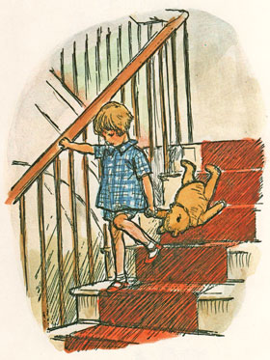
There must be a better way!

Slide 42
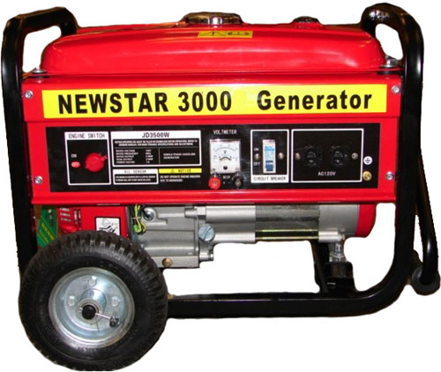
A better way
Automatically generate a scanner
Define tokens using regular expressions
Use finite-state automata for detection

Slide 43
Reg-exp vs. automata
Regular expressions are declarative
  Good for humans
  Not “executable”
Automata are operative
  Define an algorithm for deciding whether a given word is in a regular language
  Not a natural notation for humans

Slide 44


Overview
Define tokens using regular expressions
Construct a nondeterministic finite-state automaton (NFA) from regular expression
Determinize the NFA into a deterministic finite-state automaton (DFA)
DFA can be directly used to identify tokens

Slide 45
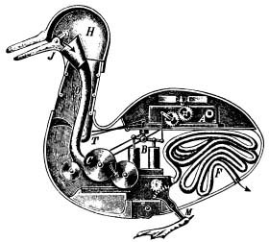
Automata theory: a bird’s-eye view

Slide 46
Deterministic Automata (DFA)
M = (Σ, Q, δ, q₀, F)
  Σ - alphabet
  Q – finite set of state
  q₀ ∈ Q – initial state
  F ⊆ Q – final states
  δ : Q × Σ → Q - transition function
For a word w, M reach some state x
  M accepts w if x ∈ F

Slide 47
DFA in pictures
An automaton is defined by states and transitions
transition
accepting
state
a,b
c
a
start
a,b,c
a,b,c
b,c
start
state

Slide 48
Accepting Words
Words are read left-to-right
c | b | a
b
c
a
start
Missing transition = non-acceptance
  “Stuck state”

Slide 49
Accepting Words
Words are read left-to-right
c | b | a
b
c
a
start

Slide 50
Accepting Words
Words are read left-to-right
c | b | a
b
c
a
start

Slide 51
Accepting Words
Words are read left-to-right
word
accepted
c | b | a
b
c
a
start

Slide 52
Rejecting Words
Words are read left-to-right
c | b | b
b
c
a
start

Slide 53
Rejecting Words
Missing transition means non-acceptance
c | b | b
b
c
a
start

Slide 54
Non-deterministic Automata (NFA)
M = (Σ, Q, δ, q₀, F)
  Σ - alphabet
  Q – finite set of state
  q₀ ∈ Q – initial state
  F ⊆ Q – final states
  δ : Q × (Σ ∪ {ε}) → 2^{Q} - transition function
    DFA: δ : Q × Σ → Q
For a word w, M can reach a number of states X
  M accepts w if X ∩ M ≠ {}
    Possible: X = {}
Possible ε-transitions

Slide 55
NFA
Allow multiple transitions from given state labeled by same letter
b
c
a
start
c
a
b

Slide 56
Accepting words
c | b | a
b
c
a
start
c
a
b

Slide 57
Accepting words
Maintain set of states
c | b | a
b
c
a
start
c
a
b

Slide 58
Accepting words
c | b | a
b
c
a
start
c
a
b

Slide 59
Accepting words
Accept word if reached an accepting state
word
accepted
c | b | a
b
c
a
start
c
a
b

Slide 60
NFA+Є automata
Є transitions can “fire” without reading the input
b
a
c
start
Є

Slide 61
NFA+Є run example
c | b | a
b
a
c
start
Є

Slide 62
NFA+Є run example
Now Є transition can non-deterministically take place
c | b | a
b
a
c
start
Є

Slide 63
NFA+Є run example
c | b | a
b
a
c
start
Є

Slide 64
NFA+Є run example
c | b | a
b
a
c
start
Є

Slide 65
NFA+Є run example
Є transitions can “fire” without reading the input
c | b | a
b
a
c
start
Є

Slide 66
NFA+Є run example
Word accepted
c | b | a
b
a
c
start
Є

Slide 67
From regular expressions to NFA
Step 1: assign expression names and obtain pure regular expressions R₁…R_{m}
Step 2: construct an NFA M_{i} for each regular expression R_{i}
Step 3: combine all M_{i} into a single NFA
Ambiguity resolution: prefer longest accepting word

Slide 68
From reg. exp. to automata
Theorem: there is an algorithm to build an NFA+Є automaton for any regular expression
Proof: by induction on the structure of the regular expression
start

Slide 69
Basic constructs
R = ε
a
R = a
R = φ

Slide 70
Composition
R = R1 | R2
M1
ε
ε
ε
M2
ε
R = R1R2
ε
M1
ε
M2
ε

Slide 71
Repetition
R = R1*
ε
ε
M1
ε
ε

Slide 72


Slide 73
Naïve approach
Try each automaton separately
Given a word w:
  Try M₁(w)
  Try M₂(w)
  …
  Try M_{n}(w)
Requires resetting after every attempt

Slide 74
Actually, we combine automata
combines
a
abb
a*b+
abab
a
1
a
2
ε
abb
3
a
4
b
5
b
6
ε
0
a
b
a*b+
ε
7
b
8
ε
abab
9
a
10
b
11
a
12
b
13

Slide 75
Corresponding DFA
abb
a*b+
b
a*b+
8
b
6 8
b
b
a
b
0 1 3 7 9
7
a
abab
a
2 4 7 10
b
5 8 11
a
12
b
13
a
a*b+

Slide 76
Scanning with DFA
Run until stuck
  Remember last accepting state
Go back to accepting state
Return token

Slide 77
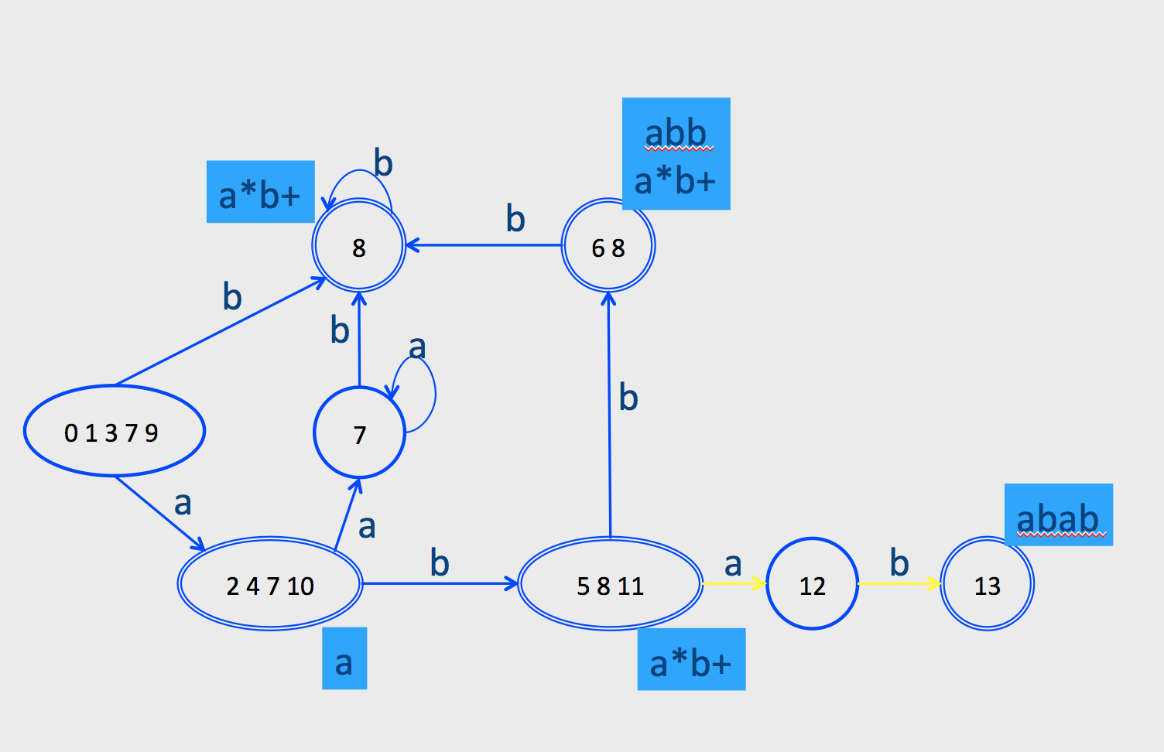
Ambiguity resolution
Longest word
Tie-breaker based on order of rules when words have same length

Slide 78
Examples
abb
a*b+
b
a*b+
8
b
6 8
b
b
a
b
0 1 3 7 9
7
a
abab
a
2 4 7 10
b
5 8 11
a
12
b
13
a
a*b+
abaa: gets stuck after aba in state 12, backs up to state (5 8 11) pattern is a*b+, token is ab
Tokens: <a*b+, ab> <a,a><a,a>

Slide 79
Examples
abb
a*b+
b
a*b+
8
b
6 8
b
b
a
b
0 1 3 7 9
7
a
abab
a
2 4 7 10
b
5 8 11
a
12
b
13
a
a*b+
abba: stops after second b in (6 8), token is abb because it comes first in spec
Tokens: <abb, abb> <a,a>

Slide 80
Summary of Construction
Describe tokens as regular expressions
  Decide attributes (values) to save for each token
Regular expressions turned into a DFA
  Also, records which attributes (values) to keep
Lexical analyzer simulates the run of an automata with the given transition table on any input string

Slide 81
A Few Remarks
Turning an NFA to a DFA is expensive, but
  Exponential in the worst case
  In practice, works fine
The construction is done once per-language
  At Compiler construction time
  Not at compilation time

Slide 82

Implementation

Slide 83
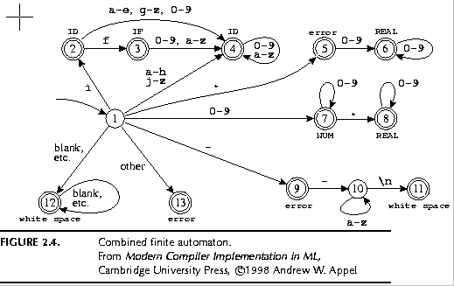
Implementation by Example
if
if { return IF; }
[a-z][a-z0-9]* { return ID; }
[0-9]+ { return NUM; }
[0-9]”.”[0-9]+|[0-9]*”.”[0-9]+ { return REAL; }
(\-\-[a-z]*\n)|(“ “|\n|\t) { ; }
. { error(); }
xy, i, zs98
3,32, 032
0.55, 33.1
--comm\n
\n, \t, “ “
ID
ID
error
REAL
2
3
IF
0
1
NUM
REAL
9
10
11
12
w.s.
w.s.
error
error

Slide 84
ID
ID
error
REAL
2
3
IF
0
1
NUM
REAL
9
10
11
12
w.s.
w.s.
error
error
int edges[][256]= {
/* …, 0, 1, 2, 3, ..., -, e, f, g, h, i, j, ... */
/* state 0 */ {0, …, 0, 0, …, 0, 0, 0, 0, 0, ..., 0, 0, 0, 0, 0, 0},
/* state 1 */ {13, … , 7, 7, 7, 7, …, 9, 4, 4, 4, 4, 2, 4, …, 13, 13},
/* state 2 */ {0, …, 4, 4, 4, 4, ..., 0, 4, 3, 4, 4, 4, 4, …, 0, 0},
/* state 3 */ {0, …, 4, 4, 4, 4, …, 0, 4, 4, 4, 4, 4, 4, , 0, 0},
/* state 4 */ {0, …, 4, 4, 4, 4, …, 0, 4, 4, 4, 4, 4, 4, …, 0, 0},
/* state 5 */ {0, …, 6, 6, 6, 6, …, 0, 0, 0, 0, 0, 0, 0, …, 0, 0},
/* state 6 */ {0, …, 6, 6, 6, 6, …, 0, 0, 0, 0, 0, 0, 0, ..., 0, 0},
/* state 7 */
/* state … */ ...
/* state 13 */ {0, …, 0, 0, 0, 0, …, 0, 0, 0, 0, 0, 0, 0, …, 0, 0}
};

Slide 85
Pseudo Code for Scanner
char* input = … ;
Token nextToken() {
lastFinal = 0;
currentState = 1 ;
inputPositionAtLastFinal = input;
currentPosition = input;
while (not(isDead(currentState))) {
nextState = edges[currentState][*currentPosition];
if (isFinal(nextState)) {
lastFinal = nextState ;
inputPositionAtLastFinal = currentPosition;
}
currentState = nextState;
advance currentPosition;
}
input = inputPositionAtLastFinal + 1;
return action[lastFinal];
}

Slide 86
Example
ID
ID
error
REAL
2
3
IF
0
1
NUM
REAL
9
10
11
12
w.s.
w.s.
error
error
Input: “if --not-a-com”
2 blanks

Slide 87
ID
ID
error
REAL
final | state | input
0 | 1 | if --not-a-com
2 | 2 | if --not-a-com
3 | 3 | if --not-a-com
3 | 0 | if --not-a-com
2
3
IF
0
1
NUM
REAL
9
10
11
12
w.s.
w.s.
error
error
return IF

Slide 88
final | state | input
0 | 1 | --not-a-com
12 | 12 | --not-a-com
12 | 12 | --not-a-com
12 | 0 | --not-a-com
found whitespace

Slide 89
ID
ID
error
REAL
final | state | input
0 | 1 | --not-a-com
9 | 9 | --not-a-com
9 | 10 | --not-a-com
10 | 10 | --not-a-com
10 | 10 | --not-a-com
10 | 0 | --not-a-com
2
3
IF
0
1
NUM
REAL
9
10
11
12
w.s.
w.s.
error
error
error

Slide 90
ID
ID
error
REAL
final | state | input
0 | 1 | -not-a-com
9 | 9 | -not-a-com
9 | 0 | -not-a-com
9 | 0 | -not-a-com
9 | 0 | -not-a-com
2
3
IF
0
1
NUM
REAL
9
10
11
12
w.s.
w.s.
error
error
error

Slide 91
Concluding remarks
Efficient scanner
Minimization
Error handling
Automatic creation of lexical analyzers

Slide 92
Efficient Scanners
Efficient state representation
Input buffering
Using switch and gotos instead of tables

Slide 93
Minimization
Create a non-deterministic automaton (NDFA) from every regular expression
Merge all the automata using epsilon moves
(like the | construction)
Construct a deterministic finite automaton (DFA)
  State priority
Minimize the automaton
  separate accepting states by token kinds

Slide 94
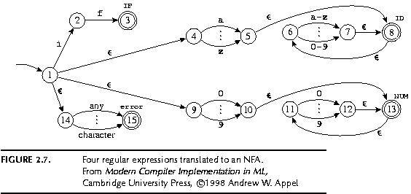
Example
if { return IF; }
[a-z][a-z0-9]* { return ID; }
[0-9]+ { return NUM; }
IF
ID
error
NUM
Modern compiler implementation in ML, Andrew Appel, (c)1998, Figures 2.7,2.8

Slide 95
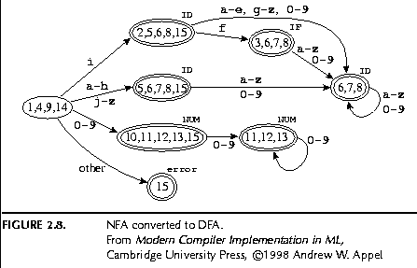
Example
if { return IF; }
[a-z][a-z0-9]* { return ID; }
[0-9]+ { return NUM; }
ID
IF
ID
IF
ID
ID
error
NUM
NUM
NUM
error
Modern compiler implementation in ML, Andrew Appel, (c)1998, Figures 2.7,2.8

Slide 96
Example
ID
IF
if { return IF; }
[a-z][a-z0-9]* { return ID; }
[0-9]+ { return NUM; }
ID
ID
IF
IF
ID
ID
ID
ID
NUM
NUM
NUM
error
IF
ID
NUM
NUM
error
error
NUM
error
Modern compiler implementation in ML, Andrew Appel, (c)1998, Figures 2.7,2.8

Slide 97
Example
ID
IF
if { return IF; }
[a-z][a-z0-9]* { return ID; }
[0-9]+ { return NUM; }
ID
ID
IF
ID
NUM
NUM
error
NUM
error
Modern compiler implementation in ML, Andrew Appel, (c)1998, Figures 2.7,2.8

Slide 98
Error Handling
Many errors cannot be identified at this stage
Example: “fi (a==f(x))”. Should “fi” be “if”? Or is it a routine name?
  We will discover this later in the analysis
  At this point, we just create an identifier token
Sometimes the lexeme does not match any pattern
  Easiest: eliminate letters until the beginning of a legitimate lexeme
  Alternatives: eliminate/add/replace one letter, replace order of two adjacent letters, etc.
Goal: allow the compilation to continue
Problem: errors that spread all over

Slide 99
Automatically generated scanners
Use of Program-Generating Tools
  Specification ➔ Part of compiler
  Compiler-Compiler
regular expressions
JFlex
input program
scanner
Stream of tokens

Slide 100
Use of Program-Generating Tools
  Input: regular expressions and actions
    Action = Java code
  Output: a scanner program that
    Produces a stream of tokens
    Invoke actions when pattern is matched
regular expressions
JFlex
input program
scanner
Stream of tokens

Slide 101
Line Counting Example
Create a program that counts the number of lines in a given input text file

Slide 102
Creating a Scanner using Flex
int num_lines = 0;
%%
\n ++num_lines;
. ;
%%
main() {
yylex();
printf( "# of lines = %d\n", num_lines);
}

Slide 103
Creating a Scanner using Flex
int num_lines = 0;
%%
\n ++num_lines;
. ;
%%
main() {
yylex();
printf( "# of lines = %d\n", num_lines);
}
\n
newline
initial
^\n
other

Slide 104
JFLex Spec File
Possible source of javac errors down the road
User code: Copied directly to Java file
%%
JFlex directives: macros, state names
%%
Lexical analysis rules:
  Optional state, regular expression, action
  How to break input to tokens
  Action when token matched
DIGIT= [0-9]
LETTER= [a-zA-Z]
YYINITIAL
{LETTER}
({LETTER}|{DIGIT})*

Slide 105
Creating a Scanner using JFlex
import java_cup.runtime.*;
%%
%cup
%{
private int lineCounter = 0;
%}
%eofval{
System.out.println("line number=" + lineCounter);
return new Symbol(sym.EOF);
%eofval}
NEWLINE=\n
%%
{NEWLINE} { lineCounter++; }
[^{NEWLINE}] { }

Slide 106
Catching errors
What if input doesn’t match any token definition?
Trick: Add a “catch-all” rule that matches
any character and reports an error
  Add after all other rules

Slide 107
A JFlex specification of C Scanner
import java_cup.runtime.*;
%%
%cup
%{
private int lineCounter = 0;
%}
Letter= [a-zA-Z_]
Digit= [0-9]
%%
”\t” { }
”\n” { lineCounter++; }
“;” { return new Symbol(sym.SemiColumn);}
“++” { return new Symbol(sym.PlusPlus); }
“+=” { return new Symbol(sym.PlusEq); }
“+” { return new Symbol(sym.Plus); }
“while” { return new Symbol(sym.While); }
{Letter}({Letter}|{Digit})*
{ return new Symbol(sym.Id, yytext() ); }
“<=” { return new Symbol(sym.LessOrEqual); }
“<” { return new Symbol(sym.LessThan); }

Slide 108
Missing
Creating a lexical analysis by hand
Table compression
Symbol Tables
Nested Comments
Handling Macros

Slide 109
Lexical Analysis: What
Input: program text (file)
Output: sequence of tokens

Slide 110
Lexical Analysis: How
Define tokens using regular expressions
Construct a nondeterministic finite-state automaton (NFA) from regular expression
Determinize the NFA into a deterministic finite-state automaton (DFA)
DFA can be directly used to identify tokens

Slide 111
Lexical Analysis: Why
Read input file
Identify language keywords and standard identifiers
Handle include files and macros
Count line numbers
Remove whitespaces
Report illegal symbols
[Produce symbol table]

Slide 112
The Real Anatomy of a Compiler
Source
text
txt
Process text input
Lexical
Analysis
Syntax
Analysis
Sem.
Analysis
characters
Lexical
Analysis
tokens
Syntax
Analysis
AST
Annotated AST
Intermediate code generation
IR
Intermediate code optimization
IR
Code
generation
Symbolic Instructions
Executable
code
Target code optimization
SI
Machine code generation
MI
Write executable output
exe

