Slide 1
Compilation 0368-3133 2016/17a Lecture 10
Register Allocation
Noam Rinetzky

Slide 2
What is a Compiler?

Slide 3
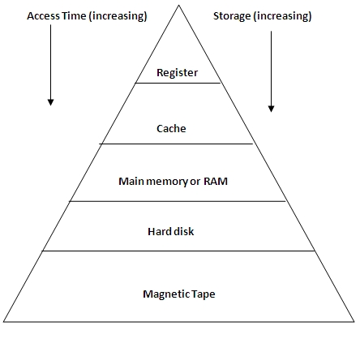
Registers
Dedicated memory locations that
can be accessed quickly,
can have computations performed on them, and

Slide 4
Registers
Dedicated memory locations that
can be accessed quickly,
can have computations performed on them, and
Usages
Operands of instructions
Store temporary results
Can (should) be used as loop indexes due to frequent arithmetic operation
Used to manage administrative info
e.g., runtime stack

Slide 5
Register allocation
Number of registers is limited
Need to allocate them in a clever way
Using registers intelligently is a critical step in any compiler
A good register allocator can generate code orders of magnitude better than a bad register allocator

Slide 6
Register Allocation: IR
Source code
(program)
Lexical Analysis
Syntax Analysis
Parsing
AST
Symbol Table etc.
Inter. Rep. (IR)
Code Generation
Target code
(executable)

Slide 7
Simple approach
Straightforward solution:
Allocate each variable in activation record
At each instruction, bring values needed into registers, perform operation, then store result to memory
mov 16(%ebp), %eax mov 20(%ebp), %ebx add %ebx, %eax mov %eax, 24(%ebp)
x = y + z
Problem: program execution very inefficient–moving data back and forth between memory and registers

Slide 8
Simple code generation
assume machine instructions of the form
LD reg, mem
ST mem, reg
OP reg,reg,reg (*)
assume that we have all registers available for our use
Ignore registers allocated for stack management
Treat all registers as general-purpose

Slide 9
simple code generation
assume machine instructions of the form
LD reg, mem
ST mem, reg
OP reg,reg,reg (*)
Fixed number of Registers!

Slide 10
Register allocation
In TAC, there is an unlimited number of variables (temporaries)
On a physical machine there is a small number of registers:
x86 has 4 general-purpose registers and a number of specialized registers
MIPS has 24 general-purpose registers and 8 special-purpose registers
Register allocation is the process of assigning variables to registers and managing data transfer in and out of registers

Slide 11
simple code generation
assume machine instructions of the form
LD reg, mem
ST mem, reg
OP reg,reg,reg (*)
We will assume that we have all registers available for any usage
Ignore registers allocated for stack management
Treat all registers as general-purpose
Fixed number of Registers!

Slide 12
Plan
Goal: Reduce number of temporaries (registers)
Machine-agnostic optimizations
Assume unbounded number of registers
Machine-dependent optimization
Use at most K registers
K is machine dependent

Slide 13
Sethi-Ullman translation
Algorithm by Ravi Sethi and Jeffrey D. Ullman to emit optimal TAC
Minimizes number of temporaries for a single expression

Slide 14
Generating Compound Expressions
Use registers to store temporaries
Why can we do it?
Maintain a counter for temporaries in c
Initially: c = 0
cgen(e₁ op e₂) = { Let A = cgen(e₁) c = c + 1 Let B = cgen(e₂) c = c + 1 Emit( _tc = A op B; ) // _tc is a register Return _tc }
Why Naïve?

Slide 15
Improving cgen for expressions
Observation – naïve translation needlessly generates temporaries for leaf expressions
Observation – temporaries used exactly once
Once a temporary has been read it can be reused for another sub-expression
cgen(e₁ op e₂) = { Let _t1 = cgen(e₁) Let _t2 = cgen(e₂) Emit( _t1 =_t1 op _t2; ) Return _t1 }
Temporaries cgen(e₁) can be reused in cgen(e₂)

Slide 16
Register Allocation
Machine-agnostic optimizations
Assume unbounded number of registers
Expression trees
Basic blocks
Machine-dependent optimization
K registers
Some have special purposes
Control flow graphs (whole program)

Slide 17
Sethi-Ullman translation
Algorithm by Ravi Sethi and Jeffrey D. Ullman to emit optimal TAC
Minimizes number of temporaries for a single expression

Slide 18
Example (optimized): b*b-4*a*c
3
-
2
2
*
*
1
1
1
2
b
b
4
*
1
1
a
c

Slide 19
Generalizations
More than two arguments for operators
Function calls
Multiple effected registers
Multiplication
Spilling
Need more registers than available
Register/memory operations

Slide 20
Simple Spilling Method
Heavy tree – Needs more registers than available
A “heavy” tree contains a “heavy” subtree whose dependents are “light”
Simple spilling
Generate code for the light tree
Spill the content into memory and replace subtree by temporary
Generate code for the resultant tree

Slide 21
Example (optimized): b*b-4*a*c
3
-
2
2
*
*
1
1
1
2
b
b
4
*
1
1
a
c

Slide 22
Example (spilled): x := b*b-4*a*c
2
2
*
-
1
1
1
t₇
2
b
b
*
1
2
4
*
1
1
a
c
t7 := b * b
x := t7 – 4 * a * c

Slide 23
Example: b*b-4*a*c
-
*
*
b
b
4
*
a
c

Slide 24
Example (simple): b*b-4*a*c
9
-
3
8
*
*
1
2
4
7
b
b
4
*
5
6
a
c

Slide 25
Example (optimized): b*b-4*a*c
3
-
2
2
*
*
1
1
1
2
b
b
4
*
1
1
a
c

Slide 26
Spilling
Even an optimal register allocator can require more registers than available
Need to generate code for every correct program
The compiler can save temporary results
Spill registers into temporaries
Load when needed
Many heuristics exist

Slide 27
Simple Spilling Method
Heavy tree – Needs more registers than available
A `heavy’ tree contains a `heavy’ subtree whose dependents are ‘light’
Generate code for the light tree
Spill the content into memory and replace subtree by temporary
Generate code for the resultant tree

Slide 28
Spilling
Even an optimal register allocator can require more registers than available
Need to generate code for every correct program
The compiler can save temporary results
Spill registers into temporaries
Load when needed
Many heuristics exist

Slide 29
Simple approach
Straightforward solution:
Allocate each variable in activation record
At each instruction, bring values needed into registers, perform operation, then store result to memory
mov 16(%ebp), %eax mov 20(%ebp), %ebx add %ebx, %eax mov %eax, 24(%ebx)
x = y + z
Problem: program execution very inefficient–moving data back and forth between memory and registers

Slide 30
Register Allocation
Machine-agnostic optimizations
Assume unbounded number of registers
Expression trees (tree-local)
Basic blocks (block-local)
Machine-dependent optimization
K registers
Some have special purposes
Control flow graphs (global register allocation)

Slide 31
Example (optimized): b*b-4*a*c
3
-
2
2
*
*
1
1
1
2
b
b
4
*
1
1
a
c

Slide 32
Example (spilled): x := b*b-4*a*c
2
2
*
-
1
1
1
t₇
2
b
b
*
1
2
4
*
1
1
a
c
t7 := b * b
x := t7 – 4 * a * c

Slide 33
Simple Spilling Method

Slide 34
Register Memory Operations
Add_Mem X, R1
Mult_Mem X, R1
No need for registers to store right operands
Hidden Registers

Slide 35
Example: b*b-4*a*c
2
-
1
1
Mult_Mem
Mult_Mem
0
1
0
1
b
b
4
Mult_Mem
0
1
a
c

Slide 36
Can We do Better?
Yes: Increase view of code
Simultaneously allocate registers for multiple expressions
But: Lose per expression optimality
Works well in practice

Slide 37
Register Allocation
Machine-agnostic optimizations
Assume unbounded number of registers
Expression trees
Basic blocks
Machine-dependent optimization
K registers
Some have special purposes
Control flow graphs (whole program)

Slide 38
Basic Blocks
basic block is a sequence of instructions with
single entry (to first instruction), no jumps to the middle of the block
single exit (last instruction)
code execute as a sequence from first instruction to last instruction without any jumps
edge from one basic block B1 to another block B2 when the last statement of B1 may jump to B2

Slide 39
control flow graph
A directed graph G=(V,E)
nodes V = basic blocks
edges E = control flow
(B1,B2) ∈ E when control from B1 flows to B2
Leaders-based construction
Target of jump instructions
Instructions following jumps
…
prod := 0
i := 1
B₁
B1
B2
t₁ := 4 * i
t₂ := a [ t₁ ]
t₃ := 4 * i
t₄ := b [ t₃ ]
t₅ := t₂ * t₄
t₆ := prod + t₅
prod := t₆
t₇ := i + 1
i := t₇
if i <= 20 goto B₂
B₂
…
True
False

Slide 40
control flow graph
A directed graph G=(V,E)
nodes V = basic blocks
edges E = control flow
(B1,B2) ∈ E when control from B1 flows to B2
…
prod := 0
i := 1
B₁
B1
B2
t₁ := 4 * i
t₂ := a [ t₁ ]
t₃ := 4 * i
t₄ := b [ t₃ ]
t₅ := t₂ * t₄
t₆ := prod + t₅
prod := t₆
t₇ := i + 1
i := t₇
if i <= 20 goto B₂
B₂
…

Slide 41
AST for a Basic Block
{
int n;
n := a + 1;
x := b + n * n + c;
n := n + 1;
y := d * n;
}

Slide 42
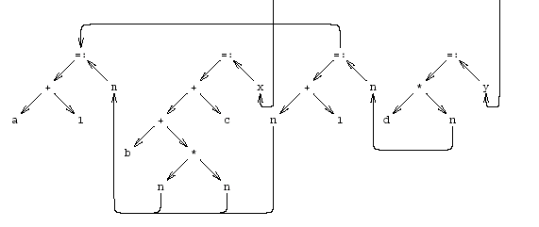
Dependency graph
{
int n;
n := a + 1;
x := b + n * n + c;
n := n + 1;
y := d * n;
}

Slide 43
Simplified Data Dependency Graph
{
int n;
n := a + 1;
x := b + n * n + c;
n := n + 1;
y := d * n;
}

Slide 44
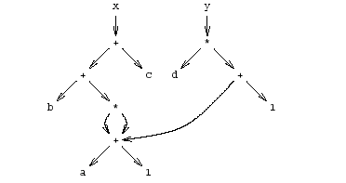
Pseudo Register Target Code

Slide 45
Question: Why “y”?
{
int n;
n := a + 1;
x := b + n * n + c;
n := n + 1;
y := d * n;
}

Slide 46
Question: Why “y”?
…
False
True
int n;
n := a + 1;
x := b + n * n + c;
n := n + 1;
y := d * n;
z := y + x;
y := 0;

Slide 47
Question: Why “y”?
…
False
True
int n;
n := a + 1;
x := b + n * n + c;
n := n + 1;
y := d * n;
y := 0;
z := y + x;

Slide 48
Question: Why “y”?
…
False
True
int n;
n := a + 1;
x := b + n * n + c;
n := n + 1;
y := d * n;
y := 0;
z := y + x;

Slide 49
y, dead or alive?
…
…
False
True
False
True
int n;
n := a + 1;
x := b + n * n + c;
n := n + 1;
y := d * n;
int n;
n := a + 1;
x := b + n * n + c;
n := n + 1;
y := d * n;
y := 0;
z := y + x;
z := y + x;
y := 0;

Slide 50
x, dead or alive?
…
…
False
True
False
True
int n;
n := a + 1;
x := b + n * n + c;
n := n + 1;
y := d * n;
int n;
n := a + 1;
x := b + n * n + c;
n := n + 1;
y := d * n;
y := 0;
z := y + x;
z := y + x;
y := 0;

Slide 51
Another Example
B1
t₁ := 4 * i
t₂ := a [ t₁ ]
if t₂ <= 20 goto B₃
…
B1
B2
False
True
B3
B2
t₃ := 4 * i
t₄ := b [ t₃ ]
goto B4
B3
B4
t₅ := t₂ * t₄
t₆ := prod + t₅
prod := t₆
goto B₄
…
B4
t₇ := i + 1
i := t₂
Goto B₅

Slide 52
Creating Basic Blocks
Input: A sequence of three-address statements
Output: A list of basic blocks with each three-address statement in exactly one block
Method
Determine the set of leaders (first statement of a block)
The first statement is a leader
Any statement that is the target of a jump is a leader
Any statement that immediately follows a jump is a leader
For each leader, its basic block consists of the leader and all statements up to but not including the next leader or the end of the program

Slide 53
example
IR
CFG
for i from 1 to 10 do
for j from 1 to 10
do
a[i, j] = 0.0;
for i from 1 to 10
do
a[i, i] = 1.0;
source
i = 1
j =1
t1 = 10*I
t2 = t1 + j
t3 = 8*t2
t4 = t3-88
a[t4] = 0.0
j = j + 1
if j <= 10 goto (3)
i=i+1
if i <= 10 goto (2)
i=1
t5=i-1
t6=88*t5
a[t6]=1.0
i=i+1
if I <=10 goto (13)
B₁
i = 1
B₂
j = 1
B₃
t1 = 10*I
t2 = t1 + j
t3 = 8*t2
t4 = t3-88
a[t4] = 0.0
j = j + 1
if j <= 10 goto B3
B₄
i=i+1
if i <= 10 goto B2
B₅
i = 1
B₆
t5=i-1
t6=88*t5
a[t6]=1.0
i=i+1
if I <=10 goto B6

Slide 54
Example: Code Block
{
int n;
n := a + 1;
x := b + n * n + c;
n := n + 1;
y := d * n;
}

Slide 55
Example: Basic Block
{
int n;
n := a + 1;
x := b + n * n + c;
n := n + 1;
y := d * n;
}

Slide 56
AST of the Example
{
int n;
n := a + 1;
x := b + n * n + c;
n := n + 1;
y := d * n;
}

Slide 57
Optimized Code (gcc)
{
int n;
n := a + 1;
x := b + n * n + c;
n := n + 1;
y := d * n;
}

Slide 58
Register Allocation for B.B.
Dependency graphs for basic blocks
Transformations on dependency graphs
From dependency graphs into code
Instruction selection
linearizations of dependency graphs
Register allocation
At the basic block level

Slide 59
Dependency graphs
TAC imposes an order of execution
But the compiler can reorder assignments as long as the program results are not changed
Define a partial order on assignments
a < b ⇔ a must be executed before b
Represented as a directed graph
Nodes are assignments
Edges represent dependency
Acyclic for basic blocks

Slide 60
Running Example
{
int n;
n := a + 1;
x := b + n * n + c;
n := n + 1;
y := d * n;
}

Slide 61
Sources of dependency
Data flow inside expressions
Operator depends on operands
Assignment depends on assigned expressions
Data flow between statements
From assignments to their use
Pointers complicate dependencies

Slide 62
Sources of dependency
Order of subexpresion evaluation is immaterial
As long as inside dependencies are respected
The order of uses of a variable X are immaterial as long as:
X is used between dependent assignments
Before next assignment to X

Slide 63
Creating Dependency Graph from AST
Nodes AST becomes nodes of the graph
Replaces arcs of AST by dependency arrows
Operator → Operand
Create arcs from assignments to uses
Create arcs between assignments of the same variable
Select output variables (roots)
Remove ; nodes and their arrows

Slide 64
Running Example

Slide 65
Dependency Graph Simplifications
Short-circuit assignments
Connect variables to assigned expressions
Connect expression to uses
Eliminate nodes not reachable from roots

Slide 66
Running Example

Slide 67
Cleaned-Up Data Dependency Graph

Slide 68
Common Subexpressions
Repeated subexpressions
Examples x = a * a + 2 * a * b + b * b; y = a * a – 2 * a * b + b * b; n[i] := n[i] +m[i]
Can be eliminated by the compiler
In the case of basic blocks rewrite the DAG

Slide 69
From Dependency Graph into Code
Linearize the dependency graph
Instructions must follow dependency
Many solutions exist
Select the one with small runtime cost
Assume infinite number of registers
Symbolic registers
Assign registers later
May need additional spill
Possible Heuristics
Late evaluation
Ladders

Slide 70
Pseudo Register Target Code

Slide 71
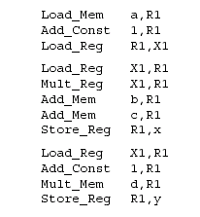
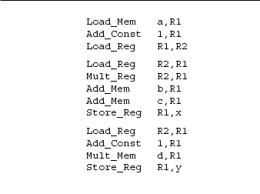
Non optimized vs Optimized Code
{
int n;
n := a + 1;
x := b + n * n + c;
n := n + 1;
y := d * n;
}

Slide 72
Register Allocation
Maps symbolic registers into physical registers
Reuse registers as much as possible
Graph coloring (next)
Undirected graph
Nodes = Registers (Symbolic and real)
Edges = Interference
May require spilling

Slide 73
Register Allocation for Basic Blocks
Heuristics for code generation of basic blocks
Works well in practice
Fits modern machine architecture
Can be extended to perform other tasks
Common subexpression elimination
But basic blocks are small
Can be generalized to a procedure

Slide 74
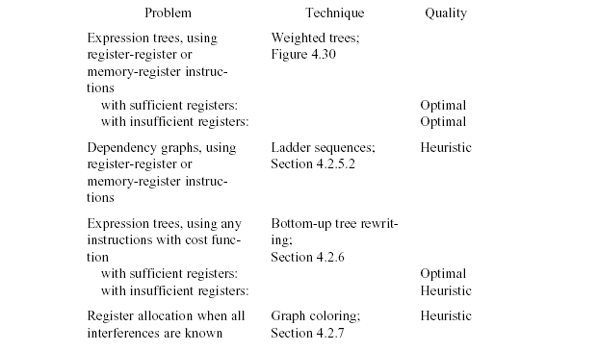

Slide 75
Register Allocation
Machine-agnostic optimizations
Assume unbounded number of registers
Expression trees
Basic blocks
Machine-dependent optimization
K registers
Some have special purposes
Control flow graphs (global register allocation)

Slide 76
Register Allocation: Assembly
Source code
(program)
Lexical Analysis
Syntax Analysis
Parsing
AST
Symbol Table etc.
Inter. Rep. (IR)
Code Generation
Target code
(executable)

Slide 77
Register Allocation: Assembly
Source code
(program)
Lexical Analysis
Syntax Analysis
Parsing
AST
Symbol Table etc.
Inter. Rep. (IR)
Code Generation
Target code
(executable)
IR (TAC) generation
Global register allocation
Instruction selection
IR Optimization
AST + Sym. Tab.
“Optimized” IR
IR
“Assembly”
Assembly

Slide 78
Register Allocation: Assembly
Source code
(program)
Lexical Analysis
Syntax Analysis
Parsing
AST
Symbol Table etc.
Inter. Rep. (IR)
Code Generation
Target code
(executable)
IR (TAC) generation
Global register allocation
Instruction selection
IR Optimization
AST + Sym. Tab.
“Optimized” IR
IR
“Assembly”
Assembly
Modern compiler implementation in C
Andrew A. Appel

Slide 79
“Global” Register Allocation
Input:
Sequence of machine instructions (“assembly”)
Unbounded number of temporary variables
aka symbolic registers
“machine description”
# of registers, restrictions
Output
Sequence of machine instructions using machine registers (assembly)
Some MOV instructions removed

Slide 80
Variable Liveness
A statement x = y + z
defines x
uses y and z
A variable x is live at a program point if its value (at this point) is used at a later point
y = 42
z = 73
x = y + z
print(x);
x undef, y live, z undef
x undef, y live, z live
x is live, y dead, z dead
x is dead, y dead, z dead
(showing state after the statement)

Slide 81
Computing Liveness Information
between basic blocks – dataflow analysis (previous lecture)
within a single basic block?
idea
use symbol table to record next-use information
scan basic block backwards
update next-use for each variable

Slide 82
Computing Liveness Information
INPUT: A basic block B of three-address statements. symbol table initially shows all non-temporary variables in B as being live on exit.
OUTPUT: At each statement i: x = y + z in B, liveness and next-use information of x, y, and z at i.
Start at the last statement in B and scan backwards
At each statement i: x = y + z in B, we do the following:
Attach to i the information currently found in the symbol table regarding the next use and liveness of x, y, and z.
In the symbol table, set x to "not live" and "no next use.“
In the symbol table, set y and z to "live" and the next uses of y and z to i

Slide 83
Computing Liveness Information
Start at the last statement in B and scan backwards
At each statement i: x = y + z in B, we do the following:
Attach to i the information currently found in the symbol table regarding the next use and liveness of x, y, and z.
In the symbol table, set x to "not live" and "no next use.“
In the symbol table, set y and z to "live" and the next uses of y and z to i
x = 1
y = x + 3
z = x * 3
x = x * z
can we change the order between 2 and 3?

Slide 84
simple code generation
translate each TAC instruction separately
For each register, a register descriptor records the variable names whose current value is in that register
we use only those registers that are available for local use within a basic block, we assume that initially, all register descriptors are empty
As code generation progresses, each register will hold the value of zero or more names
For each program variable, an address descriptor records the location(s) where the current value of the variable can be found
The location may be a register, a memory address, a stack location, or some set of more than one of these
Information can be stored in the symbol-table entry for that variable

Slide 85
simple code generation
For each three-address statement x := y op z,
Invoke getreg (x := y op z) to select registers R_{x}, R_{y}, and R_{z}
If Ry does not contain y, issue: LD R_{y},y’ for a location y’ of y
If Rz does not contain z, issue: LD R_{z},z’ for a location z’ of z
Issue the instruction OP R_{x},R_{y},R_{z}
Update the address descriptors of x, y, z, if necessary
R_{x} is the only location of x now, and R_{x} contains only x (remove R_{x} from other address descriptors)
The function getreg is not defined yet, for now think of it as an oracle that gives us 3 registers for an instruction

Slide 86
Find a register allocation
register | variable
? | a
? | b
? | c
register
eax
ebx
b = a + 2
c = b * b
b = c + 1
return b * a

Slide 87
Is this a valid allocation?
register | variable
eax | a
ebx | b
eax | c
register
eax
ebx
Overwrites previous value of ‘a’ also stored in eax
b = a + 2
c = b * b
b = c + 1
return b * a
ebx = eax + 2
eax = ebx * ebx
ebx = eax + 1
return ebx * eax

Slide 88
Is this a valid allocation?
register | variable
eax | a
ebx | b
eax | c
register
eax
ebx
b = a + 2
c = b * b
b = c + 1
return b * a
ebx = eax + 2
eax = ebx * ebx
ebx = eax + 1
return ebx * eax
Value of ‘c’ stored in eax is not needed anymore so reuse it for ‘b’

Slide 89
Main idea
For every node n in CFG, we have out[n]
Set of temporaries live out of n
Two variables interfere if they appear in the same out[n] of any node n
Cannot be allocated to the same register
Conversely, if two variables do not interfere with each other, they can be assigned the same register
We say they have disjoint live ranges
How to assign registers to variables?

Slide 90
Interference graph
Nodes of the graph = variables
Edges connect variables that interfere with one another
Nodes will be assigned a color corresponding to the register assigned to the variable
Two colors can’t be next to one another in the graph

Slide 91
Interference graph construction
b = a + 2
c = b * b
b = c + 1
return b * a

Slide 92
Interference graph construction
b = a + 2
c = b * b
b = c + 1
{b, a}
return b * a

Slide 93
Interference graph construction
b = a + 2
c = b * b
{a, c}
b = c + 1
{b, a}
return b * a

Slide 94
Interference graph construction
b = a + 2
{b, a}
c = b * b
{a, c}
b = c + 1
{b, a}
return b * a

Slide 95
Interference graph construction
{a} b = a + 2
{b, a}
c = b * b
{a, c}
b = c + 1
{b, a}
return b * a

Slide 96
Interference graph
color register
{a} b = a + 2
{b, a}
c = b * b
{a, c}
b = c + 1
{b, a}
return b * a
eax
ebx
a
b
c

Slide 97
Colored graph
color register
{a} b = a + 2
{b, a}
c = b * b
{a, c}
b = c + 1
{b, a}
return b * a
eax
ebx
a
b
c

Slide 98
Graph coloring
This problem is equivalent to graph-coloring, which is NP-hard if there are at least three registers
No good polynomial-time algorithms (or even good approximations!) are known for this problem
We have to be content with a heuristic that is good enough for RIGs that arise in practice

Slide 99
Coloring by simplification [Kempe 1879]
How to find a k-coloring of a graph
Intuition:
Suppose we are trying to k-color a graph and find a node with fewer than k edges
If we delete this node from the graph and color what remains, we can find a color for this node if we add it back in
Reason: fewer than k neighbors  some color must be left over

Slide 100
Coloring by simplification [Kempe 1879]
How to find a k-coloring of a graph
Phase 1: Simplification
Repeatedly simplify graph
When a variable (i.e., graph node) is removed, push it on a stack
Phase 2: Coloring
Unwind stack and reconstruct the graph as follows:
Pop variable from the stack
Add it back to the graph
Color the node for that variable with a color that it doesn’t interfere with
simplify
color

Slide 101
Coloring k=2
color register
eax
ebx
a
stack:
b
c
d
e

Slide 102
Coloring k=2
color register
eax
ebx
a
stack:
c
b
c
d
e

Slide 103
Coloring k=2
color register
eax
ebx
a
stack:
e
c
b
c
d
e

Slide 104
Coloring k=2
color register
eax
ebx
a
stack:
a
e
c
b
c
d
e

Slide 105
Coloring k=2
color register
eax
ebx
a
stack:
b
a
e
c
b
c
d
e

Slide 106
Coloring k=2
color register
eax
ebx
a
stack:
d
b
a
e
c
b
c
d
e

Slide 107
Coloring k=2
color register
eax
ebx
a
stack:
b
a
e
c
b
c
d
e

Slide 108
Coloring k=2
color register
eax
ebx
a
stack:
a
e
c
b
c
d
e

Slide 109
Coloring k=2
color register
eax
ebx
a
stack:
e
c
b
c
d
e

Slide 110
Coloring k=2
color register
eax
ebx
a
stack:
c
b
c
d
e

Slide 111
Coloring k=2
color register
eax
ebx
a
stack:
b
c
d
e

Slide 112
Failure of heuristic
If the graph cannot be colored, it will eventually be simplified to graph in which every node has at least K neighbors
Sometimes, the graph is still K-colorable!
Finding a K-coloring in all situations is an NP-complete problem
We will have to approximate to make register allocators fast enough

Slide 113
Coloring k=2
color register
eax
ebx
a
stack:
b
c
d
e

Slide 114
Coloring k=2
color register
eax
Some graphs can’t be colored
in K colors:
ebx
a
stack: c b e a d
b
c
d
e

Slide 115
Coloring k=2
color register
eax
Some graphs can’t be colored
in K colors:
ebx
a
stack: b e a d
b
c
d
e

Slide 116
Coloring k=2
color register
eax
Some graphs can’t be colored
in K colors:
ebx
a
stack: e a d
b
c
d
e

Slide 117
Coloring k=2
color register
eax
Some graphs can’t be colored
in K colors:
ebx
a
stack: e a d
b
c
d
e
no colors left for e!

Slide 118
Chaitin’s algorithm
Choose and remove an arbitrary node, marking it “troublesome”
Use heuristics to choose which one
When adding node back in, it may be possible to find a valid color
Otherwise, we have to spill that node

Slide 119
Spilling
Phase 3: spilling
once all nodes have K or more neighbors, pick a node for spilling
There are many heuristics that can be used to pick a node
Try to pick node not used much, not in inner loop
Storage in activation record
Remove it from graph
We can now repeat phases 1-2 without this node
Better approach – rewrite code to spill variable, recompute liveness information and try to color again

Slide 120
Coloring k=2
color register
eax
Some graphs can’t be colored
in K colors:
ebx
a
stack: e a d
b
c
d
e
no colors left for e!

Slide 121
Coloring k=2
color register
eax
Some graphs can’t be colored
in K colors:
ebx
a
stack: b e a d
b
c
d
e

Slide 122
Coloring k=2
color register
eax
Some graphs can’t be colored
in K colors:
ebx
a
stack: e a d
b
c
d
e

Slide 123
Coloring k=2
color register
eax
Some graphs can’t be colored
in K colors:
ebx
a
stack: a d
b
c
d
e

Slide 124
Coloring k=2
color register
eax
Some graphs can’t be colored
in K colors:
ebx
a
stack: d
b
c
d
e

Slide 125
Coloring k=2
color register
eax
Some graphs can’t be colored
in K colors:
ebx
a
stack:
b
c
d
e

Slide 126
Handling precolored nodes
Some variables are pre-assigned to registers
Eg: mul on x86/pentium
uses eax; defines eax, edx
Eg: call on x86/pentium
Defines (trashes) caller-save registers eax, ecx, edx
To properly allocate registers, treat these register uses as special temporary variables and enter into interference graph as precolored nodes

Slide 127
Handling precolored nodes
Simplify. Never remove a pre-colored node – it already has a color, i.e., it is a given register
Coloring. Once simplified graph is all colored nodes, add other nodes back in and color them using precolored nodes as starting point

Slide 128
Optimizing move instructions
Code generation produces a lot of extra mov instructions mov t5, t9
If we can assign t5 and t9 to same register, we can get rid of the mov
effectively, copy elimination at the register allocation level
Idea: if t5 and t9 are not connected in inference graph, coalesce them into a single variable; the move will be redundant
Problem: coalescing nodes can make a graph un-colorable
Conservative coalescing heuristic

Slide 129
“Global” Register Allocation
Input:
Sequence of machine code instructions (assembly)
Unbounded number of temporary registers
Output
Sequence of machine code instructions (assembly)
Machine registers
Some MOVE instructions removed
Missing prologue and epilogue

Slide 130
Basic Compiler Phases
Source program (string)
lexical analysis
Tokens
syntax analysis
Abstract syntax tree
semantic analysis
Translate
Frame
Intermediate representation
Instruction selection
Assembly
Global Register Allocation
Fin. Assembly

Slide 131
Graph Coloring by Simplification
Build: Construct the interference graph
Simplify: Recursively remove nodes with less than K neighbors ; Push removed nodes into stack
Potential-Spill: Spill some nodes and remove nodes
Push removed nodes into stack
Select: Assign actual registers (from simplify/spill stack)
Actual-Spill: Spill some potential spills and repeat the process

Slide 132
Artificial Example K=2
t2
t6
t1
t5
t7
t3
t8
t4

Slide 133
Coalescing
MOVs can be removed if the source and the target share the same register
The source and the target of the move can be merged into a single node (unifying the sets of neighbors)
May require more registers
Conservative Coalescing
Merge nodes only if the resulting node has fewer than K neighbors with degree  K (in the resulting graph)

Slide 134
Constrained Moves
A instruction T ← S is constrained
if S and T interfere
May happen after coalescing
Constrained MOVs are not coalesced
X ←Y /* X, Y, Z */
X
Y
Y←Z
Z

Slide 135
Graph Coloring with Coalescing
Build: Construct the interference graph
Simplify: Recursively remove non MOVE nodes
with less than K neighbors; Push removed nodes into stack
Coalesce: Conservatively merge unconstrained MOV related nodes with fewer than K “heavy” neighbors
Freeze: Give-Up Coalescing on some low-degree MOV related nodes
Potential-Spill: Spill some nodes and remove nodes
Push removed nodes into stack
Select: Assign actual registers (from simplify/spill stack)
Actual-Spill: Spill some potential spills and repeat the process

Slide 136
Pre-Colored Nodes
Some registers in the intermediate language are pre-colored:
correspond to real registers (stack-pointer, frame-pointer, parameters, )
Cannot be Simplified, Coalesced, or Spilled (infinite degree)
Interfered with each other
But normal temporaries can be coalesced into pre-colored registers
Register allocation is completed when all the nodes are pre-colored

Slide 137
Graph Coloring with Coalescing
Build: Construct the interference graph
Simplify: Recursively remove non MOVE nodes
with less than K neighbors; Push removed nodes into stack
Coalesce: Conservatively merge unconstrained MOV related nodes with fewer that K “heavy” neighbors
Freeze: Give-Up Coalescing on some low-degree MOV related nodes
Potential-Spill: Spill some nodes and remove nodes
Push removed nodes into stack
Select: Assign actual registers (from simplify/spill stack)
Actual-Spill: Spill some potential spills and repeat the process

Slide 138
Optimizing MOV instructions
Code generation produces a lot of extra mov instructions mov t5, t9
If we can assign t5 and t9 to same register, we can get rid of the mov
effectively, copy elimination at the register allocation level
Idea: if t5 and t9 are not connected in inference graph, coalesce them into a single variable; the move will be redundant
Problem: coalescing nodes can make a graph un-colorable
Conservative coalescing heuristic

Slide 139
Coalescing
MOVs can be removed if the source and the target share the same register
The source and the target of the move can be merged into a single node (unifying the sets of neighbors)
May require more registers
Conservative Coalescing
Merge nodes only if the resulting node has fewer than K neighbors with degree  K (in the resulting graph)

Slide 140
Constrained Moves
A instruction T ← S is constrained
if S and T interfere
May happen after coalescing
Constrained MOVs are not coalesced
X
Y
X ← Y
Y ← Z
Z

Slide 141
Constrained Moves
A instruction T ← S is constrained
if S and T interfere
May happen after coalescing
Constrained MOVs are not coalesced
X,Y
X ← Y
Y ← Z
Z

Slide 142
Constrained Moves
A instruction T ← S is constrained
if S and T interfere
May happen after coalescing
Constrained MOVs are not coalesced
X,Y
X ← Y
Y ← Z
Z

Slide 143
Graph Coloring with Coalescing
Build: Construct the interference graph
Special case: merged node has less than k neighbors
Simplify: Recursively remove non-MOV nodes with less than K neighbors; Push removed nodes into stack
Coalesce: Conservatively merge unconstrained MOV related nodes with fewer than K “heavy” neighbors
All non-MOV related nodes are “heavy”
Freeze: Give-Up Coalescing on some MOV related nodes with low degree of interference edges
Potential-Spill: Spill some nodes and remove nodes
Push removed nodes into stack
Select: Assign actual registers (from simplify/spill stack)
Actual-Spill: Spill some potential spills and repeat the process

Slide 144
Pre-Colored Nodes
Some registers in the intermediate language are pre-colored:
correspond to real registers (stack-pointer, frame-pointer, parameters, )
Cannot be Simplified, Coalesced, or Spilled
infinite degree
Interfered with each other
But normal temporaries can be coalesced into pre-colored registers
Register allocation is completed when all the nodes are pre-colored

Slide 145
Caller-Save and Callee-Save Registers
callee-save-registers (MIPS 16-23)
Saved by the callee when modified
Values are automatically preserved across calls
caller-save-registers
Saved by the caller when needed
Values are not automatically preserved
Usually the architecture defines caller-save and callee-save registers
Separate compilation
Interoperability between code produced by different compilers/languages
But compilers can decide when to use caller/callee registers

Slide 146
Caller-Save vs. Callee-Save Registers
int foo(int a) {
int b=a+1;
f1();
g1(b);
return(b+2);
}
void bar (int y) {
int x=y+1;
f2(y);
g2(2);
}

Slide 147
Saving Callee-Save Registers
enter: def(r₇)
…
exit: use(r₇)
enter: def(r₇)
t₂₃₁ ← r₇
…
r₇ ← t₂₃₁
exit: use(r₇)

Slide 148
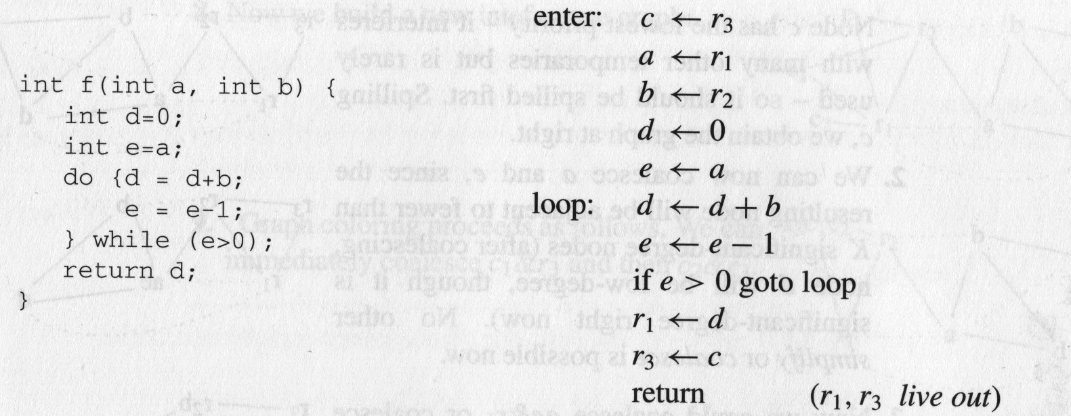
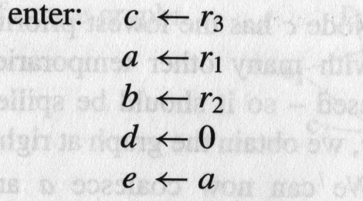
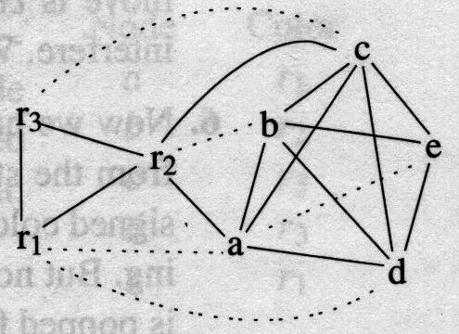
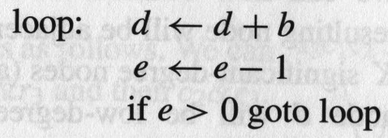
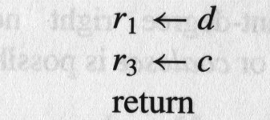
A Complete Example
Callee-saved registers
Caller-saved registers

Slide 149
A Complete Example

Slide 150
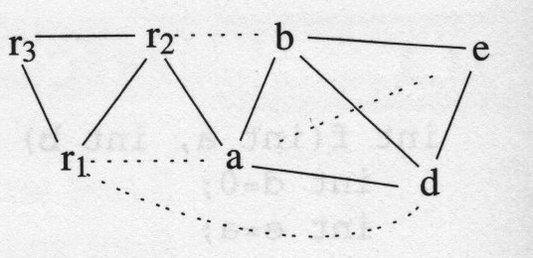
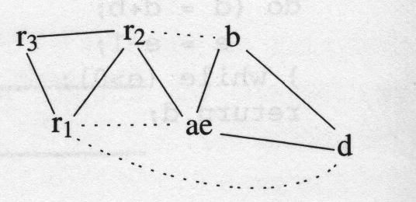
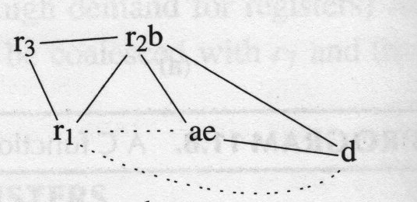
A Complete Example
Spill c
c
Deg. of r1,ae,d < K
a & e
c
r2 & b
(Alt: ae+r1)
c

Slide 151
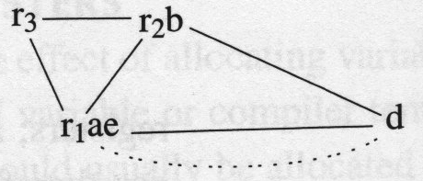
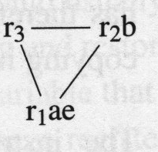
A Complete Example
ae & r1
(Alt: …)
c
freeze r₁ae-d
Simplify d
pop c …
dc
d
pop d
(Alt: ae+r1)
c

Slide 152
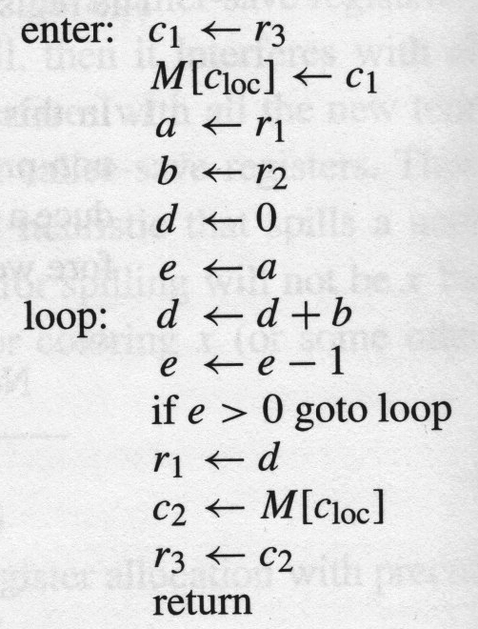
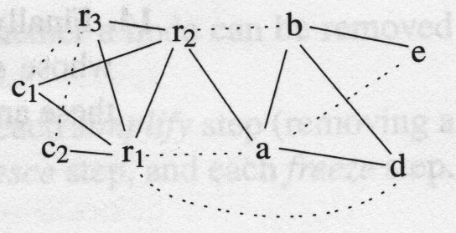
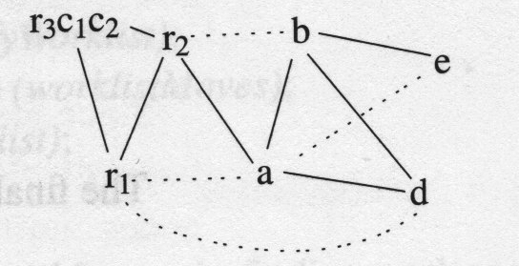
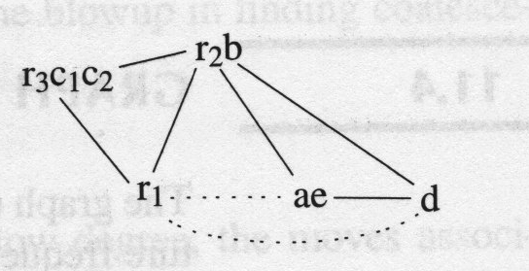
A Complete Example
c1&r3, c2 &r3
a&e, b&r2

Slide 153
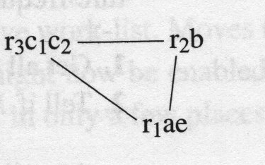
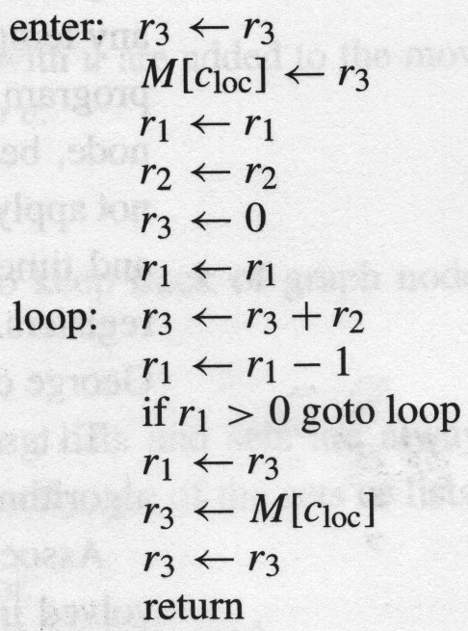
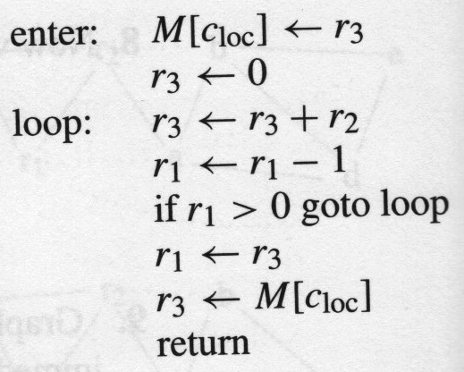
A Complete Example
ae & r1
Simplify d
Pop d
d
“opt”
gen code

Slide 154
Interprocedural Allocation
Allocate registers to multiple procedures
Potential saving
caller/callee save registers
Parameter passing
Return values
But may increase compilation cost
Function inline can help

Slide 155
Summary
Two Register Allocation Methods
Local of every IR tree
Simultaneous instruction selection and register allocation
Optimal (under certain conditions)
Global of every function
Applied after instruction selection
Performs well for machines with many registers
Can handle instruction level parallelism
Missing
Interprocedural allocation

Slide 156
The End

Slide 157
global register allocation
idea: compute “weight” for each variable
for each use of v in B prior to any definition of v add 1 point
for each occurrence of v in a following block using v add 2 points, as we save the store/load between blocks
cost(v) = Σ_{B}use(v,B) + 2*live(v,B)
use(v,B) is is the number of times v is used in B prior to any definition of v
live(v, B) is 1 if v is live on exit from B and is assigned a value in B
after computing weights, allocate registers to the “heaviest” values

Slide 158
Two Phase Solution Dynamic Programming Sethi & Ullman
Bottom-up (labeling)
Compute for every subtree
The minimal number of registers needed (weight)
Top-Down
Generate the code using labeling by preferring “heavier” subtrees (larger labeling)

Slide 159
“Global” Register Allocation
Input:
Sequence of machine code instructions (assembly)
Unbounded number of temporary registers
Output
Sequence of machine code instructions (assembly)
Machine registers
Some MOVE instructions removed
Missing prologue and epilogue

Slide 160
Basic Compiler Phases
Source program (string)
lexical analysis
Tokens
syntax analysis
Abstract syntax tree
semantic analysis
Translate
Frame
Intermediate representation
Instruction selection
Assembly
Global Register Allocation
Fin. Assembly

Slide 161
{$0, t128}
use {t128, $0} def {t131}
l3: beq t128, $0, l0
l1: or t131, $0, t128
addi t132, t128, -1
or $4, $0, t132
jal nfactor
or t130, $0, $2
or t133, $0, t131
mult t133, t130
mflo t133
or t129, $0, t133
l2: or t103, $0, t129
b lend
l0: addi t129, $0, 1
b l2
use {t128, $0} def {}
{$0, t131, t128}
{$0, t128}
use {t128} def {t132}
{$0, t131, t132}
use {$0, t132} def {$4}
use {$0} def {t129}
{$0, t131, $4}
{$0, t129}
use {$4} def {$2}
{$0, t131, $2}
use {$0, $2} def {t130}
{$0, t130, t131}
use {$0, t131} def {t133}
{$0, t133, t130}
use {t133, t130} def {t133}
{$0, t133}
use {t133} def {t133}
{$0, t133}
use {$0, t133} def {t129}
{$0, t129}
use {} def {}
use {$0, t129} def {t103}
{$0, t129}
{$0, t103}
{$0, $2}
use {t103} def {$2}
use {} def {}
{$0, t103}

Slide 162
l3: beq t128, $0, l0 /* $0, t128 */
l1: or t131, $0, t128 /* $0, t128, t131 */
addi t132, t128, -1 /* $0, t131, t132 */
or $4, $0, t132 /* $0, $4, t131 */
jal nfactor /* $0, $2, t131 */
or t130, $0, $2 /* $0, t130, t131 */
or t133, $0, t131 /* $0, t130, t133 */
mult t133, t130 /* $0, t133 */
mflo t133 /* $0, t133 */
or t129, $0, t133 /* $0, t129 */
l2: or t103, $0, t129 /* $0, t103 */
b lend /* $0, t103 */
l0: addi t129, $0, 1 /* $0, t129 */
b l2 /* $0, t129 */
t132
t132
t130
t130
t131
t131
t133
t133
t128
t128
t129
t129
$0
$2
$4
t103
t103

Slide 163
l3: beq t128, $0, l0
l1: or t131, $0, t128
addi t132, t128, -1
or $4, $0, t132
jal nfactor
or t130, $0, $2
or t133, $0, t131
mult t133, t130
mflo t133
or t129, $0, t133
l2: or t103, $0, t129
b lend
l0: addi t129, $0, 1
b l2
t132
t132
t130
t130
t131
t131
t133
t133
t128
t128
t129
t129
$0
$2
$4
t103
t103

Slide 164
Global Register Allocation Process
Repeat
Construct the interference graph
Color graph nodes with machine registers
Adjacent nodes are not colored by the same register
Spill a temporary into memory
Until no more spill

Slide 165
Constructing interference graphs (take 1)
Compute liveness information at every statement
Variables ‘a’ and ‘b’ interfere when there exists a control flow node n such that ‘a’, ‘b’ ∈ Lv[n]

Slide 166
A Simple Example
/* c */
L0: a := 0
/* ac */
L1: b := a + 1
/* bc */
c := c + b
/* bc */
a := b * 2
/* ac */
if c < N goto L1
/* c */
return c
c
a :=0
a
b
ac
b := a +1
bc
c := c +b
c
bc
a := b * 2
c < N
ac
c ≥ N
c

Slide 167
Constructing interference graphs (take 2)
Compute liveness information at every statement
Variables ‘a’ and ‘b’ interfere when there exists a control flow edge (m, n) with an assignment a := exp and ‘b’ ∈ Lv[n]

Slide 168
Constructing interference graphs (take 3)
Compute liveness information at every statement
Variables ‘a’ and ‘b’ interfere when there exists a control flow edge (m, n) with an assignment a := exp and ‘b’ ∈ Lv[n] and ‘b’ ≠ exp

Slide 169
l3: beq t128, $0, l0 /* $0, t128 */
l1: or t131, $0, t128 /* $0, t128, t131 */
addi t132, t128, -1 /* $0, t131, t132 */
or $4, $0, t132 /* $0, $4, t131 */
jal nfactor /* $0, $2, t131 */
or t130, $0, $2 /* $0, t130, t131 */
or t133, $0, t131 /* $0, t130, t133 */
mult t133, t130 /* $0, t133 */
mflo t133 /* $0, t133 */
or t129, $0, t133 /* $0, t129 */
l2: or t103, $0, t129 /* $0, t103 */
b lend /* $0, t103 */
l0: addi t129, $0, 1 /* $0, t129 */
b l2 /* $0, t129 */
t132
t132
t130
t130
t131
t131
t133
t133
t128
t128
t129
t129
$0
$2
$4
t103
t103

Slide 170
Challenges
The Coloring problem is computationally hard
The number of machine registers may be small
Avoid too many MOVEs
Handle “pre-colored” nodes

Slide 171
Theorem [Kempe 1879]
Assume:
An undirected graph G(V, E)
A node v ∈V with less than K neighbors
G – {v} is K colorable
Then, G is K colorable

Slide 172
Coloring by Simplification [Kempe 1879]
K
the number of machine registers
G(V, E)
the interference graph
Consider a node v ∈V with less than K neighbors:
Color G – v in K colors
Color v in a color different than its (colored) neighbors

Slide 173
Graph Coloring by Simplification
Build: Construct the interference graph
Simplify: Recursively remove nodes with less than K neighbors ; Push removed nodes into stack
Potential-Spill: Spill some nodes and remove nodes
Push removed nodes into stack
Select: Assign actual registers (from simplify/spill stack)
Actual-Spill: Spill some potential spills and repeat the process

Slide 174
Artificial Example K=2
t2
t6
t1
t5
t7
t3
t8
t4

Slide 175
Coalescing
MOVs can be removed if the source and the target share the same register
The source and the target of the move can be merged into a single node (unifying the sets of neighbors)
May require more registers
Conservative Coalescing
Merge nodes only if the resulting node has fewer than K neighbors with degree  K (in the resulting graph)

Slide 176
Constrained Moves
A instruction T ← S is constrained
if S and T interfere
May happen after coalescing
Constrained MOVs are not coalesced
X ←Y /* X, Y, Z */
X
Y
Y←Z
Z

Slide 177
Graph Coloring with Coalescing
Build: Construct the interference graph
Simplify: Recursively remove non MOVE nodes
with less than K neighbors; Push removed nodes into stack
Coalesce: Conservatively merge unconstrained MOV related nodes with fewer than K “heavy” neighbors
Freeze: Give-Up Coalescing on some low-degree MOV related nodes
Potential-Spill: Spill some nodes and remove nodes
Push removed nodes into stack
Select: Assign actual registers (from simplify/spill stack)
Actual-Spill: Spill some potential spills and repeat the process

Slide 178
Spilling
Many heuristics exist
Maximal degree
Live-ranges
Number of uses in loops
The whole process need to be repeated after an actual spill

Slide 179
Pre-Colored Nodes
Some registers in the intermediate language are pre-colored:
correspond to real registers (stack-pointer, frame-pointer, parameters, )
Cannot be Simplified, Coalesced, or Spilled (infinite degree)
Interfered with each other
But normal temporaries can be coalesced into pre-colored registers
Register allocation is completed when all the nodes are pre-colored

Slide 180
Caller-Save and Callee-Save Registers
callee-save-registers (MIPS 16-23)
Saved by the callee when modified
Values are automatically preserved across calls
caller-save-registers
Saved by the caller when needed
Values are not automatically preserved
Usually the architecture defines caller-save and callee-save registers
Separate compilation
Interoperability between code produced by different compilers/languages
But compilers can decide when to use calller/callee registers

Slide 181
Caller-Save vs. Callee-Save Registers
int foo(int a) {
int b=a+1;
f1();
g1(b);
return(b+2);
}
void bar (int y) {
int x=y+1;
f2(y);
g2(2);
}

Slide 182
Saving Callee-Save Registers
enter: def(r₇)
…
exit: use(r₇)
enter: def(r₇)
t₂₃₁ ← r₇
…
r₇ ← t₂₃₁
exit: use(r₇)

Slide 183
A Complete Example
enter:
c := r3
a := r1
b := r2
d := 0
e := a
loop:
d := d+b
e := e-1
if e>0 goto loop
r1 := d
r3 := c
return /* r1,r3 */
r1, r2 caller save
r3 callee-save

Slide 184
Graph Coloring with Coalescing
Build: Construct the interference graph
Simplify: Recursively remove non MOVE nodes
with less than K neighbors; Push removed nodes into stack
Coalesce: Conservatively merge unconstrained MOV related nodes with fewer that K “heavy” neighbors
Freeze: Give-Up Coalescing on some low-degree MOV related nodes
Potential-Spill: Spill some nodes and remove nodes
Push removed nodes into stack
Select: Assign actual registers (from simplify/spill stack)
Actual-Spill: Spill some potential spills and repeat the process

Slide 185
A Complete Example
use{r3} def{c}
enter:
c := r3
a := r1
b := r2
d := 0
e := a
loop:
d := d+b
e := e-1
if e>0 goto loop
r1 := d
r3 := c
return /* r1,r3 */
r1, r2 caller save
r3 callee-save
use{r1} def{a}
use{r2} def{b}
use{} def{d}
use{a} def{e}
use{d, b} def{d}
{c, d, e}
use{e} def{e}
{c, d, e}
use{e} def{}
{c, d}
use{d} def{r1}
{r1, c}
{r1, r3}
use{c} def{r3}

Slide 186
A Complete Example
use{r3} def{c}
enter:
c := r3
a := r1
b := r2
d := 0
e := a
loop:
d := d+b
e := e-1
if e>0 goto loop
r1 := d
r3 := c
return /* r1,r3 */
use{r1} def{a}
use{r2} def{b}
use{} def{d}
use{a} def{e}
{c, d, e, b}
use{d, b} def{d}
{c, d, e}
use{e} def{e}
{c, d, e}
use{e} def{}
{c, d, e, b}
use{d} def{r1}
{r1, c}
{r1, r3}
use{c} def{r3}

Slide 187
A Complete Example
use{r3} def{c}
enter:
c := r3
a := r1
b := r2
d := 0
e := a
loop:
d := d+b
e := e-1
if e>0 goto loop
r1 := d
r3 := c
return /* r1,r3 */
use{r1} def{a}
use{r2} def{b}
use{} def{d}
use{a} def{e}
{c, d, e, b}
use{d, b} def{d}
{c, d, e}
use{e} def{e}
{c, d, e, b}
use{e} def{}
{c, d, e, b}
use{d} def{r1}
{r1, c}
{r1, r3}
use{c} def{r3}

Slide 188
A Complete Example
{ r2, r1, r3}
use{r3} def{c}
enter:
c := r3
a := r1
b := r2
d := 0
e := a
loop:
d := d+b
e := e-1
if e>0 goto loop
r1 := d
r3 := c
return /* r1,r3 */
{c, r2, r1}
use{r1} def{a}
{c, a, r2}
use{r2} def{b}
{c, b, a}
use{} def{d}
{c, d, b, a}
use{a} def{e}
{c, d, e, b}
use{d, b} def{d}
{c, d, e, b}
use{e} def{e}
{c, d, e, b}
use{e} def{}
{c, d, e, b}
use{d} def{r1}
{r1, c}
{r1, r3}
use{c} def{r3}

Slide 189
Live Variables Results
enter:
c := r3
a := r1
b := r2
d := 0
e := a
loop:
d := d+b
e := e-1
if e>0 goto loop
r1 := d
r3 := c
return /* r1,r3 */
enter: /* r2, r1, r3 */
c := r3 /* c, r2, r1 */
a := r1 /* a, c, r2 */
b := r2 /* a, c, b */
d := 0 /* a, c, b, d */
e := a /* e, c, b, d */
loop:
d := d+b /* e, c, b, d */
e := e-1 /* e, c, b, d */
if e>0 goto loop /* c, d */
r1 := d /* r1, c */
r3 := c /* r1, r3 */
return /* r1, r3 */

Slide 190
enter: /* r2, r1, r3 */
c := r3 /* c, r2, r1 */
a := r1 /* a, c, r2 */
b := r2 /* a, c, b */
d := 0 /* a, c, b, d */
e := a /* e, c, b, d */
loop:
d := d+b /* e, c, b, d */
e := e-1 /* e, c, b, d */
if e>0 goto loop /* c, d */
r1 := d /* r1, c */
r3 := c /* r1, r3 */
return /* r1,r3 */

Slide 191
spill priority = (uo + 10 ui)/deg
enter: /* r2, r1, r3 */
c := r3 /* c, r2, r1 */
a := r1 /* a, c, r2 */
b := r2 /* a, c, b */
d := 0 /* a, c, b, d */
e := a / * e, c, b, d */
loop:
d := d+b /* e, c, b, d */
e := e-1 /* e, c, b, d */
if e>0 goto loop /* c, d */
r1 := d /* r1, c */
r3 := c /* r1, r3 */
return /* r1,r3 */
 | use+ def outside loop | use+ def within loop | deg | spill priority
a | 2 | 0 | 4 | 0.5
b | 1 | 1 | 4 | 2.75
c | 2 | 0 | 6 | 0.33
d | 2 | 2 | 4 | 5.5
e | 1 | 3 | 3 | 10.3

Slide 192
Optimizing MOV instructions
Code generation produces a lot of extra mov instructions mov t5, t9
If we can assign t5 and t9 to same register, we can get rid of the mov
effectively, copy elimination at the register allocation level
Idea: if t5 and t9 are not connected in inference graph, coalesce them into a single variable; the move will be redundant
Problem: coalescing nodes can make a graph un-colorable
Conservative coalescing heuristic

Slide 193
Coalescing
MOVs can be removed if the source and the target share the same register
The source and the target of the move can be merged into a single node (unifying the sets of neighbors)
May require more registers
Conservative Coalescing
Merge nodes only if the resulting node has fewer than K neighbors with degree  K (in the resulting graph)

Slide 194
Constrained Moves
A instruction T ← S is constrained
if S and T interfere
May happen after coalescing
Constrained MOVs are not coalesced
X
Y
X ← Y
Y ← Z
Z

Slide 195
Constrained Moves
A instruction T ← S is constrained
if S and T interfere
May happen after coalescing
Constrained MOVs are not coalesced
X,Y
X ← Y
Y ← Z
Z

Slide 196
Constrained Moves
A instruction T ← S is constrained
if S and T interfere
May happen after coalescing
Constrained MOVs are not coalesced
X,Y
X ← Y
Y ← Z
Z

Slide 197
Graph Coloring with Coalescing
Build: Construct the interference graph
Special case: merged node has less than k neighbors
Simplify: Recursively remove non-MOV nodes with less than K neighbors; Push removed nodes into stack
Coalesce: Conservatively merge unconstrained MOV related nodes with fewer than K “heavy” neighbors
All non-MOV related nodes are “heavy”
Freeze: Give-Up Coalescing on some MOV related nodes with low degree of interference edges
Potential-Spill: Spill some nodes and remove nodes
Push removed nodes into stack
Select: Assign actual registers (from simplify/spill stack)
Actual-Spill: Spill some potential spills and repeat the process

Slide 198
Spilling
Many heuristics exist
Maximal degree
Live-ranges
Number of uses in loops
The whole process need to be repeated after an actual spill

Slide 199
Pre-Colored Nodes
Some registers in the intermediate language are pre-colored:
correspond to real registers (stack-pointer, frame-pointer, parameters, )
Cannot be Simplified, Coalesced, or Spilled
infinite degree
Interfered with each other
But normal temporaries can be coalesced into pre-colored registers
Register allocation is completed when all the nodes are pre-colored

Slide 200
Caller-Save and Callee-Save Registers
callee-save-registers (MIPS 16-23)
Saved by the callee when modified
Values are automatically preserved across calls
caller-save-registers
Saved by the caller when needed
Values are not automatically preserved
Usually the architecture defines caller-save and callee-save registers
Separate compilation
Interoperability between code produced by different compilers/languages
But compilers can decide when to use caller/callee registers

Slide 201
Caller-Save vs. Callee-Save Registers
int foo(int a) {
int b=a+1;
f1();
g1(b);
return(b+2);
}
void bar (int y) {
int x=y+1;
f2(y);
g2(2);
}

Slide 202
Saving Callee-Save Registers
enter: def(r₇)
…
exit: use(r₇)
enter: def(r₇)
t₂₃₁ ← r₇
…
r₇ ← t₂₃₁
exit: use(r₇)

Slide 203
A Complete Example
Callee-saved registers
Caller-saved registers

Slide 204
A Complete Example

Slide 205
A Complete Example
Spill c
c
Deg. of r1,ae,d < K
a & e
c
r2 & b
(Alt: ae+r1)
c

Slide 206
A Complete Example
ae & r1
(Alt: …)
c
freeze r₁ae-d
Simplify d
pop c …
dc
d
pop d
(Alt: ae+r1)
c

Slide 207
A Complete Example
c1&r3, c2 &r3
a&e, b&r2

Slide 208
A Complete Example
ae & r1
Simplify d
Pop d
d
“opt”
gen code

Slide 209
Interprocedural Allocation
Allocate registers to multiple procedures
Potential saving
caller/callee save registers
Parameter passing
Return values
But may increase compilation cost
Function inline can help

Slide 210
Summary
Two Register Allocation Methods
Local of every IR tree
Simultaneous instruction selection and register allocation
Optimal (under certain conditions)
Global of every function
Applied after instruction selection
Performs well for machines with many registers
Can handle instruction level parallelism
Missing
Interprocedural allocation

Slide 211
The End

Slide 212
Spill C
stack
stack
c

Slide 213
Coalescing a+e
stack
stack
c
c

Slide 214
Coalescing b+r2
stack
stack
c
c

Slide 215
Coalescing ae+r1
stack
stack
c
c
r1ae and d are constrained

Slide 216
Simplifying d
stack
stack
d
c
c

Slide 217
Pop d
stack
stack
d
c
c
d is assigned to r3

Slide 218
Pop c
stack
stack
c
c
actual spill!

Slide 219
enter: /* r2, r1, r3 */
c := r3 /* c, r2, r1 */
a := r1 /* a, c, r2 */
b := r2 /* a, c, b */
d := 0 /* a, c, b, d */
e := a / * e, c, b, d */
loop:
d := d+b /* e, c, b, d */
e := e-1 /* e, c, b, d */
if e>0 goto loop /* c, d */
r1 := d /* r1, c */
r3 := c /* r1, r3 */
return /* r1,r3 */
enter: /* r2, r1, r3 */
c1 := r3 /* c1, r2, r1 */
M[c_loc] := c1 /* r2 */
a := r1 /* a, r2 */
b := r2 /* a, b */
d := 0 /* a, b, d */
e := a / * e, b, d */
loop:
d := d+b /* e, b, d */
e := e-1 /* e, b, d */
if e>0 goto loop /* d */
r1 := d /* r1 */
c2 := M[c_loc] /* r1, c2 */
r3 := c2 /* r1, r3 */
return /* r1,r3 */

Slide 220
enter: /* r2, r1, r3 */
c1 := r3 /* c1, r2, r1 */
M[c_loc] := c1 /* r2 */
a := r1 /* a, r2 */
b := r2 /* a, b */
d := 0 /* a, b, d */
e := a / * e, b, d */
loop:
d := d+b /* e, b, d */
e := e-1 /* e, b, d */
if e>0 goto loop /* d */
r1 := d /* r1 */
c2 := M[c_loc] /* r1, c2 */
r3 := c2 /* r1, r3 */
return /* r1,r3 */

Slide 221
Coalescing c1+r3; c2+c1r3
stack
stack

Slide 222
Coalescing a+e; b+r2
stack
stack

Slide 223
Coalescing ae+r1
stack
stack
d
r1ae and d are constrained

Slide 224
Simplify d
stack
stack
d
d

Slide 225
Pop d
stack
stack
d
a r1
b r2
c1 r3
c2 r3
d r3
e r1
d

Slide 226
enter:
c1 := r3
M[c_loc] := c1
a := r1
b := r2
d := 0
e := a
loop:
d := d+b
e := e-1
if e>0 goto loop
r1 := d
c2 := M[c_loc]
r3 := c2
return /* r1,r3 */
enter:
r3 := r3
M[c_loc] := r3
r1 := r1
r2 := r2
r3 := 0
r1 := r1
loop:
r3 := r3+r2
r1 := r1-1
if r1>0 goto loop
r1 := r3
r3 := M[c_loc]
r3 := r3
return /* r1,r3 */
a r1
b r2
c1 r3
c2 r3
d r3
e r1

Slide 227
enter:
r3 := r3
M[c_loc] := r3
r1 := r1
r2 := r2
r3 := 0
r1 := r1
loop:
r3 := r3+r2
r1 := r1-1
if r1>0 goto loop
r1 := r3
r3 := M[c_loc]
r3 := r3
return /* r1,r3 */
enter:
M[c_loc] := r3
r3 := 0
loop:
r3 := r3+r2
r1 := r1-1
if r1>0 goto loop
r1 := r3
r3 := M[c_loc]
return /* r1,r3 */

Slide 228
main: addiu $sp,$sp, -K1
L4: sw $2,0+K1($sp)
or $25,$0,$31
sw $25,-4+K1($sp)
addiu $25,$sp,0+K1
or $2,$0,$25
addi $25,$0,10
or $4,$0,$25
jal nfactor
lw $25,-4+K1
or $31,$0,$25
b L3
L3: addiu $sp,$sp,K1
j $31
nfactor: addiu $sp,$sp,-K2
L6: sw $2,0+K2($sp)
or $25,$0,$4
or $24,$0,$31
sw $24,-4+K2($sp)
sw $30,-8+K2($sp)
beq $25,$0,L0
L1: or $30,$0,$25
lw $24,0+K2
or $2,$0,$24
addi $25,$25,-1
or $4,$0,$25
jal nfactor
or $25,$0,$2
mult $30,$25
mflo $30
L2: or $2,$0,$30
lw $30,-4+K2($sp)
or $31,$0,$30
lw $30,-8+K2($sp)
b L5
L0: addi $30,$0,1
b L2
L5: addiu $sp,$sp,K2
j $31

Slide 229
Interprocedural Allocation
Allocate registers to multiple procedures
Potential saving
caller/callee save registers
Parameter passing
Return values
But may increase compilation cost
Function inline can help

Slide 230
Summary
Two Register Allocation Methods
Local of every IR tree
Simultaneous instruction selection and register allocation
Optimal (under certain conditions)
Global of every function
Applied after instruction selection
Performs well for machines with many registers
Can handle instruction level parallelism
Missing
Interprocedural allocation

Slide 232
Challenges in register allocation
Registers are scarce
Often substantially more IR variables than registers
Need to find a way to reuse registers whenever possible
Registers are complicated
x86: Each register made of several smaller registers; can't use a register and its constituent registers at the same time
x86: Certain instructions must store their results in specific registers; can't store values there if you want to use those instructions
MIPS: Some registers reserved for the assembler or operating system
Most architectures: Some registers must be preserved across function calls

Slide 233
The End

Slide 234
The End

