Slide 1
Compilation 0368-3133
Lecture 1:
Introduction
Noam Rinetzky

Slide 3
Admin
Lecturer: Noam Rinetzky
maon@tau.ac.il
http://www.cs.tau.ac.il/~maon
T.A.: Oren Ish Shalom
Textbooks:
Modern Compiler Design
Compilers: principles, techniques and tools

Slide 4
Admin
Compiler Project 50%
4-4.5 practical exercises
Groups of 3
Final exam 50%
must pass

Slide 5
Course Goals
What is a compiler
How does it work
(Reusable) techniques & tools

Slide 6
Course Goals
What is a compiler
How does it work
(Reusable) techniques & tools
Programming language implementation
runtime systems
Execution environments
Assembly, linkers, loaders, OS

Slide 7
Introduction
Compilers: principles, techniques and tools

Slide 8
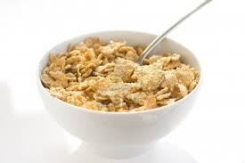
What is a Compiler?

Slide 9
What is a Compiler?
“A compiler is a computer program that transforms source code written in a programming language (source language) into another language (target language).
The most common reason for wanting to transform source code is to create an executable program.” --Wikipedia

Slide 10
What is a Compiler?
source language
target language
Source
text
txt
Executable
code
exe
Compiler

Slide 11
What is a Compiler?
Compiler
Source
text
txt
Executable
code
exe
int a, b;
a = 2;
b = a*2 + 1;
MOV R1,2
SAL R1
INC R1
MOV R2,R1

Slide 12
What is a Compiler?
source language
target language
Compiler
C
C++
Pascal
Java
Postscript
TeX
Perl
JavaScript
Python
Ruby
Prolog
Lisp
Scheme
ML
OCaml
IA32
IA64
SPARC
C
C++
Pascal
Java
Java Bytecode
…

Slide 13
High Level Programming Languages
Imperative Algol, PL1, Fortran, Pascal, Ada, Modula, C
Closely related to “von Neumann” Computers
Object-oriented Simula, Smalltalk, Modula3, C++, Java, C#, Python
Data abstraction and ‘evolutionary’ form of program development
Class an implementation of an abstract data type (data+code)
Objects Instances of a class
Inheritance + generics
Functional Lisp, Scheme, ML, Miranda, Hope, Haskel, OCaml, F#
Logic Programming Prolog

Slide 14
More Languages
Hardware description languages VHDL
The program describes Hardware components
The compiler generates hardware layouts
Graphics and Text processing TeX, LaTeX, postscript
The compiler generates page layouts
Scripting languages Shell, C-shell, Perl
Include primitives constructs from the current software environment
Web/Internet HTML, Telescript, JAVA, Javascript
Intermediate-languages Java bytecode, IDL

Slide 15
High Level Prog. Lang., Why?

Slide 16
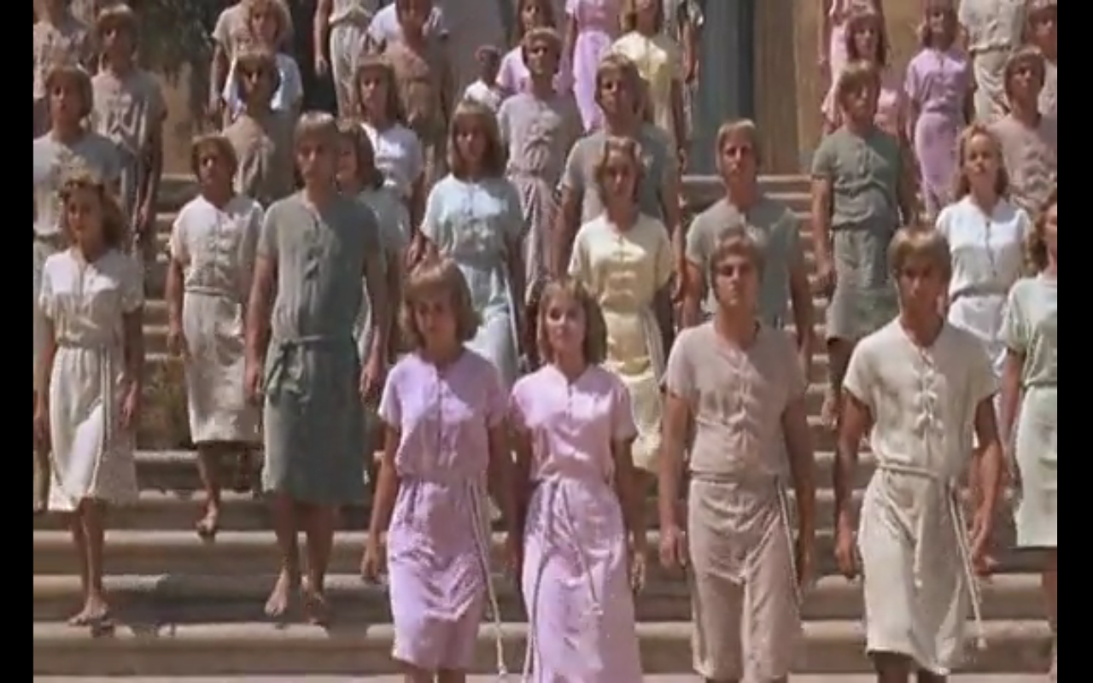
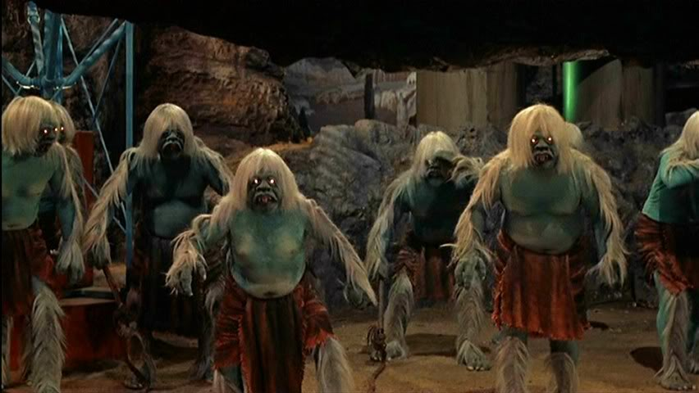
High Level Prog. Lang., Why?

Slide 17
Compiler vs. Interpreter

Slide 18
Compiler
A program which transforms programs
Input a program (P)
Output an object program (O)
For any x, “O(x)” “=“ “P(x)”
Compiler
Source
text
txt
Executable
code
exe
P
O

Slide 19
Compiling C to Assembly
5
Compiler
add %fp,-8, %l1
mov %l1, %o1
call scanf
ld [%fp-8],%l0
add %l0,1,%l0
st %l0,[%fp-8]
ld [%fp-8], %l1
mov %l1, %o1
call printf
int x;
scanf(“%d”, &x);
x = x + 1 ;
printf(“%d”, x);
6

Slide 20
Interpreter
A program which executes a program
Input a program (P) + its input (x)
Output the computed output (P(x))
Interpreter
Source
text
txt
Output
Input

Slide 21
Interpreting (running) .py programs
A program which executes a program
Input a program (P) + its input (x)
Output the computed output (“P(x)”)
Interpreter
int x;
scanf(“%d”, &x);
x = x + 1 ;
printf(“%d”, x);
6
5

Slide 22
Compiler vs. Interpreter
Source
Code
Executable
Code
Machine
preprocessing
processing
Source
Code
Intermediate
Code
Interpreter
processing
preprocessing

Slide 23
Compiled programs are usually more efficient than interpreted
add %fp,-8, %l1
mov %l1, %o1
call scanf
mov 5, %l0 st %l0,[%fp-12]
mov 7,%l0
st %l0,[%fp-16]
ld [%fp-8], %l0
ld [%fp-8],%l0
add %l0, 35 ,%l0
st %l0,[%fp-8]
ld [%fp-8], %l1
mov %l1, %o1
call printf
Compiler
scanf(“%d”,&x);
y = 5 ;
z = 7 ;
x = x + y * z;
printf(“%d”,x);

Slide 24
Compilers report input-independent possible errors
Input-program
Compiler-Output
“line 88: x may be used before set''
scanf(“%d”, &y);
if (y < 0) x = 5;
...
if (y <= 0)
z = x + 1;

Slide 25
Interpreters report input-specific definite errors
Input-program
Input data
y = -1
y = 0
scanf(“%d”, &y);
if (y < 0) x = 5;
...
if (y <= 0)
z = x + 1;

Slide 26
Interpreter vs. Compiler
Conceptually simpler
“define” the prog. lang.
Can provide more specific error report
Easier to port
Faster response time
[More secure]
How do we know the translation is correct?
Can report errors before input is given
More efficient code
Compilation can be expensive
move computations to compile-time
compile-time + execution-time < interpretation-time is possible
Notes:
More secure

Slide 27
Concluding Remarks
Both compilers and interpreters are programs written in high level language
Compilers and interpreters share functionality
In this course we focus on compilers

Slide 28
Everything should be built top-down, except the first time
-- Alan J. Perlis
Alan Jay Perlis (1922 – 1990) a pioneer in the field of programming language and compilers, first recipient of the Turing Award

Slide 29
Ex 0: A Simple Interpreter

Slide 30
Toy compiler/interpreter
Trivial programming language
Stack machine
Compiler/interpreter written in C
Demonstrate the basic steps
Textbook: Modern Compiler Design 1.2

Slide 31
Conceptual Structure of a Compiler
Compiler
Source
text
txt
Executable
code
exe
Frontend
(analysis)
Semantic
Representation
Backend
(synthesis)
Lexical Analysis
Syntax Analysis
Parsing
Semantic Analysis
Intermediate Representation
(IR)
Code
Generation

Slide 32
Structure of toy Compiler / interpreter
Executable code
exe
Source
text
Backend (synthesis)
txt
Frontend
(analysis)
Semantic
Representation
Execution Engine
Output*
Lexical Analysis
Syntax Analysis
Parsing
Semantic Analysis
(NOP)
Intermediate Representation
(AST)
Code
Generation
Execution
Engine
* Programs in our PL do not take input

Slide 33
Source Language
Fully parameterized expressions
Arguments can be a single digit
(4 + (3 * 9))
3 + 4 + 5
(12 + 3)
expression → digit | ‘(‘ expression operator expression ‘)’
operator → ‘+’ | ‘*’
digit → ‘0’ | ‘1’ | ‘2’ | ‘3’ | ‘4’ | ‘5’ | ‘6’ | ‘7’ | ‘8’ | ‘9’

Slide 34
The abstract syntax tree (AST)
Intermediate program representation
Defines a tree
Preserves program hierarchy
Generated by the parser
Keywords and punctuation symbols are not stored
Not relevant once the tree exists

Slide 35
Concrete syntax tree# for 5*(a+b)
expression
number
‘*’
expression
‘5’
‘(’
expression
‘)’
identifier
‘+’
identifier
‘a’
‘b’
#Parse tree

Slide 36
Abstract Syntax tree for 5*(a+b)
‘*’
‘5’
‘+’
‘a’
‘b’

Slide 37
Annotated Abstract Syntax tree
type:real
loc: reg1
‘*’
type:real
loc: reg2
‘5’
type:integer
‘+’
‘a’
‘b’
type:real
loc: sp+8
type:real
loc: sp+24

Slide 38
Driver for the toy compiler/interpreter
#include "parser.h" /* for type AST_node */
#include "backend.h" /* for Process() */
#include "error.h" /* for Error() */
int main(void) {
AST_node *icode;
if (!Parse_program(&icode)) Error("No top-level expression");
Process(icode);
return 0;
}

Slide 39
Structure of toy Compiler / interpreter
Executable code
exe
Source
text
Backend (synthesis)
txt
Frontend
(analysis)
Semantic
Representation
Execution Engine
Output*
Lexical Analysis
Syntax Analysis
Parsing
Semantic Analysis
(NOP)
Intermediate Representation
(AST)
Code
Generation
Execution
Engine
* Programs in our PL do not take input

Slide 40
Lexical Analysis
Partitions the inputs into tokens
DIGIT
EOF
‘*’
‘+’
‘(‘
‘)’
Each token has its representation
Ignores whitespaces

Slide 41
lex.h: Header File for Lexical Analysis
/* Define class constants */
/* Values 0-255 are reserved for ASCII characters */
#define EoF 256
#define DIGIT 257
typedef struct {
int class;
char repr;} Token_type;
extern Token_type Token;
extern void get_next_token(void);

Slide 42
Lexical Analyzer
#include "lex.h"
token_type Token; // Global variable
void get_next_token(void) {
int ch;
do {
ch = getchar();
if (ch < 0) {
Token.class = EoF; Token.repr = '#';
return;
}
} while (Layout_char(ch));
if ('0' <= ch && ch <= '9') {Token.class = DIGIT;}
else {Token.class = ch;}
Token.repr = ch;
}
static int Layout_char(int ch) {
switch (ch) {
case ' ': case '\t': case '\n': return 1;
default: return 0;
}
}

Slide 43
Structure of toy Compiler / interpreter
Executable code
exe
Source
text
Backend (synthesis)
txt
Frontend
(analysis)
Semantic
Representation
Execution Engine
Output*
Lexical Analysis
Syntax Analysis
Parsing
Semantic Analysis
(NOP)
Intermediate Representation
(AST)
Code
Generation
Execution
Engine
* Programs in our PL do not take input

Slide 44
Parser
Invokes lexical analyzer
Reports syntax errors
Constructs AST

Slide 45
Parser Header File
typedef int Operator;
typedef struct _expression {
char type; /* 'D' or 'P' */
int value; /* for 'D' type expression */
struct _expression *left, *right; /* for 'P' type expression */
Operator oper; /* for 'P' type expression */
} Expression;
typedef Expression AST_node; /* the top node is an Expression */
extern int Parse_program(AST_node **);

Slide 46
AST for (2 * ((3*4)+9))
type
P
left
*
right
oper
D
P
2
+
P
D
*
9
D
D
3
4

Slide 47
AST for (2 * ((3*4)+9))
type
P
left
*
right
oper
D
P
2
+
P
D
*
9
D
D
3
4

Slide 48
Driver for the Toy Compiler
#include "parser.h" /* for type AST_node */
#include "backend.h" /* for Process() */
#include "error.h" /* for Error() */
int main(void) {
AST_node *icode;
if (!Parse_program(&icode)) Error("No top-level expression");
Process(icode);
return 0;
}

Slide 49
Source Language
Fully parenthesized expressions
Arguments can be a single digit
(4 + (3 * 9))
3 + 4 + 5
(12 + 3)
expression → digit | ‘(‘ expression operator expression ‘)’
operator → ‘+’ | ‘*’
digit → ‘0’ | ‘1’ | ‘2’ | ‘3’ | ‘4’ | ‘5’ | ‘6’ | ‘7’ | ‘8’ | ‘9’

Slide 50
lex.h: Header File for Lexical Analysis
/* Define class constants */
/* Integers are used to encode characters + special codes */
/* Values 0-255 are reserved for ASCII characters */
#define EoF 256
#define DIGIT 257
typedef struct {
int class;
char repr;} Token_type;
extern Token_type Token;
extern void get_next_token(void);

Slide 51
Lexical Analyzer
#include "lex.h"
token_type Token; // Global variable
void get_next_token(void) {
int ch;
do {
ch = getchar();
if (ch < 0) {
Token.class = EoF; Token.repr = '#’; return;}
} while (Layout_char(ch));
if ('0' <= ch && ch <= '9')
Token.class = DIGIT;
else
Token.class = ch;
Token.repr = ch;
}
static int Layout_char(int ch) {
switch (ch) {
case ' ': case '\t': case '\n': return 1;
default: return 0;
}
}

Slide 52
AST for (2 * ((3*4)+9))
type
P
left
*
right
oper
D
P
2
+
P
D
*
9
D
D
3
4

Slide 53
Driver for the Toy Compiler
#include "parser.h" /* for type AST_node */
#include "backend.h" /* for Process() */
#include "error.h" /* for Error() */
int main(void) {
AST_node *icode;
if (!Parse_program(&icode)) Error("No top-level expression");
Process(icode);
return 0;
}

Slide 54
Parser Environment
#include "lex.h”, "error.h”, "parser.h"
static Expression *new_expression(void) {
return (Expression *)malloc(sizeof (Expression));
}
static int Parse_operator(Operator *oper_p);
static int Parse_expression(Expression **expr_p);
int Parse_program(AST_node **icode_p) {
Expression *expr;
get_next_token(); /* start the lexical analyzer */
if (Parse_expression(&expr)) {
if (Token.class != EoF) {
Error("Garbage after end of program");
}
*icode_p = expr;
return 1;
}
return 0;
}

Slide 55
Top-Down Parsing
Optimistically build the tree from the root to leaves
For every P → A1 A2 … An | B1 B2 … Bm
If A1 succeeds
If A2 succeeds & A3 succeeds & …
Else fail
Else if B1 succeeds
If B2 succeeds & B3 succeeds & ..
Else fail
Else fail
Recursive descent parsing
Simplified: no backtracking
Can be applied for certain grammars

Slide 56
Parser
static int Parse_expression(Expression **expr_p) {
Expression *expr = *expr_p = new_expression();
if (Token.class == DIGIT) {
expr->type = 'D'; expr->value = Token.repr - '0';
get_next_token(); return 1;
}
if (Token.class == '(') {
expr->type = 'P'; get_next_token();
if (!Parse_expression(&expr->left)) { Error("Missing expression"); }
if (!Parse_operator(&expr->oper)) { Error("Missing operator"); }
if (!Parse_expression(&expr->right)) { Error("Missing expression"); }
if (Token.class != ')') { Error("Missing )"); }
get_next_token();
return 1;
}
/* failed on both attempts */
free_expression(expr); return 0;
}
static int Parse_operator(Operator *oper) {
if (Token.class == '+') {
*oper = '+'; get_next_token(); return 1;
}
if (Token.class == '*') {
*oper = '*'; get_next_token(); return 1;
}
return 0;
}

Slide 57
AST for (2 * ((3*4)+9))
type
P
left
*
right
oper
D
P
2
+
P
D
*
9
D
D
3
4

Slide 58
Structure of toy Compiler / interpreter
Executable code
exe
Source
text
Backend (synthesis)
txt
Frontend
(analysis)
Semantic
Representation
Execution Engine
Output*
Lexical Analysis
Syntax Analysis
Parsing
Semantic Analysis
(NOP)
Intermediate Representation
(AST)
Code
Generation
Execution
Engine
* Programs in our PL do not take input

Slide 59
Semantic Analysis
Trivial in our case
No identifiers
No procedure / functions
A single type for all expressions

Slide 60
Structure of toy Compiler / interpreter
Executable code
exe
Source
text
Backend (synthesis)
txt
Frontend
(analysis)
Semantic
Representation
Execution Engine
Output*
Lexical Analysis
Syntax Analysis
Parsing
Semantic Analysis
(NOP)
Intermediate Representation
(AST)
Code
Generation
Execution
Engine
* Programs in our PL do not take input

Slide 61
Intermediate Representation
type
P
left
*
right
oper
D
P
2
+
P
D
*
9
D
D
3
4

Slide 62
Alternative IR: 3-Address Code
L1: _t0=a _t1=b _t2=_t0*_t1 _t3=d _t4=_t2-_t3
GOTO L1
“Simple Basic-like programming language”

Slide 63
Structure of toy Compiler / interpreter
Executable code
exe
Source
text
Backend (synthesis)
txt
Frontend
(analysis)
Semantic
Representation
Execution Engine
Output*
Lexical Analysis
Syntax Analysis
Parsing
Semantic Analysis
(NOP)
Intermediate Representation
(AST)
Code
Generation
Execution
Engine
* Programs in our PL do not take input

Slide 64
Code generation
Stack based machine
Four instructions
PUSH n
ADD
MULT
PRINT

Slide 65
Code generation
#include "parser.h"
#include "backend.h"
static void Code_gen_expression(Expression *expr) {
switch (expr->type) {
case 'D':
printf("PUSH %d\n", expr->value);
break;
case 'P':
Code_gen_expression(expr->left);
Code_gen_expression(expr->right);
switch (expr->oper) {
case '+': printf("ADD\n"); break;
case '*': printf("MULT\n"); break;
}
break;
}
}
void Process(AST_node *icode) {
Code_gen_expression(icode); printf("PRINT\n");
}

Slide 66
Compiling (2*((3*4)+9))
type
P
left
*
right
PUSH 2
oper
PUSH 3
D
P
PUSH 4
2
+
MULT
P
D
PUSH 9
*
9
ADD
D
D
MULT
3
4
PRINT

Slide 67
Executing Compiled Program
Executable code
exe
Source
text
Backend (synthesis)
txt
Frontend
(analysis)
Semantic
Representation
Execution Engine
Output*
Lexical Analysis
Syntax Analysis
Parsing
Semantic Analysis
(NOP)
Intermediate Representation
(AST)
Code
Generation
Execution
Engine
* Programs in our PL do not take input

Slide 68
Generated Code Execution
Stack
Stack’
PUSH 2
PUSH 3
PUSH 4
MULT
PUSH 9
ADD
MULT
PRINT
2

Slide 69
Generated Code Execution
Stack
Stack’
PUSH 2
PUSH 3
PUSH 4
MULT
PUSH 9
ADD
MULT
PRINT
2
3
2

Slide 70
Generated Code Execution
Stack
Stack’
PUSH 2
PUSH 3
PUSH 4
MULT
PUSH 9
ADD
MULT
PRINT
3
2
4
3
2

Slide 71
Generated Code Execution
Stack
Stack’
PUSH 2
PUSH 3
PUSH 4
MULT
PUSH 9
ADD
MULT
PRINT
4
3
2
12
2

Slide 72
Generated Code Execution
Stack
Stack’
PUSH 2
PUSH 3
PUSH 4
MULT
PUSH 9
ADD
MULT
PRINT
12
2
9
12
2

Slide 73
Generated Code Execution
Stack
Stack’
PUSH 2
PUSH 3
PUSH 4
MULT
PUSH 9
ADD
MULT
PRINT
9
12
2
21
2

Slide 74
Generated Code Execution
Stack
Stack’
PUSH 2
PUSH 3
PUSH 4
MULT
PUSH 9
ADD
MULT
PRINT
21
2
42

Slide 75
Generated Code Execution
Stack
Stack’
PUSH 2
PUSH 3
PUSH 4
MULT
PUSH 9
ADD
MULT
PRINT
42

Slide 76
Shortcuts
Avoid generating machine code
Use assembler
Generate C code

Slide 77
Structure of toy Compiler / interpreter
Executable code
exe
Source
text
Backend (synthesis)
txt
Frontend
(analysis)
Semantic
Representation
Execution Engine
Output*
Lexical Analysis
Syntax Analysis
Parsing
Semantic Analysis
(NOP)
Intermediate Representation
(AST)
Code
Generation
Execution
Engine
* Programs in our PL do not take input

Slide 78
Interpretation
Bottom-up evaluation of expressions
The same interface of the compiler

Slide 79
#include "parser.h"
#include "backend.h”
static int Interpret_expression(Expression *expr) {
switch (expr->type) {
case 'D':
return expr->value;
break;
case 'P':
int e_left = Interpret_expression(expr->left);
int e_right = Interpret_expression(expr->right);
switch (expr->oper) {
case '+': return e_left + e_right;
case '*': return e_left * e_right;
break;
}
}
void Process(AST_node *icode) {
printf("%d\n", Interpret_expression(icode));
}

Slide 80
Interpreting (2*((3*4)+9))
type
P
left
*
right
oper
D
P
2
+
P
D
*
9
D
D
3
4

Slide 81
Summary: Journey inside a compiler
Token Stream
x = b*b – 4*a*c
txt
<ID,”x”> <EQ> <ID,”b”> <MULT> <ID,”b”> <MINUS> <INT,4> <MULT> <ID,”a”> <MULT> <ID,”c”>
Lexical Analysis
Syntax Analysis
Sem. Analysis
Inter. Rep.
Code Gen.

Slide 82
Summary: Journey inside a compiler
<ID,”x”> <EQ> <ID,”b”> <MULT> <ID,”b”> <MINUS> <INT,4> <MULT> <ID,”a”> <MULT> <ID,”c”>
Statement
ID
EQ
expression
Syntax Tree
‘x’
expression
MINUS
term
expression
MULT
factor
term
term
ID
term
MULT
factor
term
MULT
factor
‘c’
factor
ID
factor
ID
ID
‘b’
ID
‘a’
‘b’
‘4’
Lexical Analysis
Syntax Analysis
Sem. Analysis
Inter. Rep.
Code Gen.

Slide 83
Summary: Journey inside a compiler
<ID,”x”> <EQ> <ID,”b”> <MULT> <ID,”b”> <MINUS> <INT,4> <MULT> <ID,”a”> <MULT> <ID,”c”>
expression
Syntax Tree
expression
MINUS
term
expression
MULT
factor
term
term
ID
term
MULT
factor
term
MULT
factor
‘c’
factor
ID
factor
ID
ID
‘b’
ID
‘a’
‘b’
‘4’
Lexical Analysis
Syntax Analysis
Sem. Analysis
Inter. Rep.
Code Gen.

Slide 84
Summary: Journey inside a compiler
MINUS
Abstract Syntax Tree
MULT
MULT
‘b’
‘b’
MULT
‘c’
‘4’
‘a’
Lexical Analysis
Syntax Analysis
Sem. Analysis
Inter. Rep.
Code Gen.

Slide 85
Summary: Journey inside a compiler
type: int loc: R1
Annotated Abstract Syntax Tree
MINUS
type: int loc: R1
type: int loc: R2
MULT
MULT
type: int loc: sp+16
type: int loc: sp+16
type: int loc: R2
type: int loc: sp+24
‘b’
‘b’
MULT
‘c’
type: int loc: const
type: int loc: sp+8
‘4’
‘a’
Lexical Analysis
Syntax Analysis
Sem. Analysis
Inter. Rep.
Code Gen.

Slide 86
Journey inside a compiler
type: int loc: R1
Intermediate Representation
MINUS
R2 = 4*a
R1=b*b
R2= R2*c
R1=R1-R2
type: int loc: R1
type: int loc: R2
MULT
MULT
type: int loc: sp+16
type: int loc: sp+16
type: int loc: R2
type: int loc: sp+24
‘b’
‘b’
MULT
‘c’
type: int loc: const
type: int loc: sp+8
‘4’
‘a’
Lexical Analysis
Syntax Analysis
Sem. Analysis
Inter. Rep.
Code Gen.

Slide 87
Journey inside a compiler
type: int loc: R1
Intermediate Representation
MINUS
R2 = 4*a
R1=b*b
R2= R2*c
R1=R1-R2
type: int loc: R1
type: int loc: R2
MULT
MULT
Assembly Code
type: int loc: sp+16
type: int loc: sp+16
type: int loc: R2
type: int loc: sp+24
MOV R2,(sp+8)
SAL R2,2
MOV R1,(sp+16)
MUL R1,(sp+16)
MUL R2,(sp+24)
SUB R1,R2
‘b’
‘b’
MULT
‘c’
type: int loc: const
type: int loc: sp+8
‘4’
‘a’
Lexical Analysis
Syntax Analysis
Sem. Analysis
Inter. Rep.
Code Gen.

Slide 88
Error Checking
In every stage…
Lexical analysis: illegal tokens
Syntax analysis: illegal syntax
Semantic analysis: incompatible types, undefined variables, …
Every phase tries to recover and proceed with compilation (why?)
Divergence is a challenge

Slide 89
The Real Anatomy of a Compiler
Source
text
txt
Process text input
characters
Lexical Analysis
tokens
Syntax Analysis
AST
Sem. Analysis
Annotated AST
Intermediate code generation
IR
Intermediate code optimization
IR
Code generation
Symbolic Instructions
Executable
code
Target code optimization
SI
Machine code generation
MI
Write executable output
exe

Slide 90
Optimizations
“Optimal code” is out of reach
many problems are undecidable or too expensive (NP-complete)
Use approximation and/or heuristics
Loop optimizations: hoisting, unrolling, …
Peephole optimizations
Constant propagation
Leverage compile-time information to save work at runtime (pre-computation)
Dead code elimination
space
…

Slide 91
Machine code generation
Register allocation
Optimal register assignment is NP-Complete
In practice, known heuristics perform well
assign variables to memory locations
Instruction selection
Convert IR to actual machine instructions
Modern architectures
Multicores
Challenging memory hierarchies

Slide 92
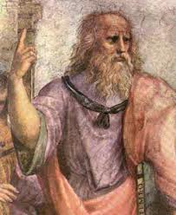
And on a More General Note

Slide 93
Course Goals
What is a compiler
How does it work
(Reusable) techniques & tools
Programming language implementation
runtime systems
Execution environments
Assembly, linkers, loaders, OS

Slide 94
To Compilers, and Beyond …
Compiler construction is successful
Clear problem
Proper structure of the solution
Judicious use of formalisms
Wider application
Many conversions can be viewed as compilation
Useful algorithms

Slide 95
Conceptual Structure of a Compiler
Compiler
Source
text
txt
Executable
code
exe
Frontend
(analysis)
Semantic
Representation
Backend
(synthesis)

Slide 96
Conceptual Structure of a Compiler
Compiler
Source
text
txt
Executable
code
exe
Frontend
(analysis)
Semantic
Representation
Backend
(synthesis)
Lexical Analysis
Syntax Analysis
Parsing
Semantic Analysis
Intermediate Representation
(IR)
Code
Generation

Slide 97
Judicious use of formalisms
Regular expressions (lexical analysis)
Context-free grammars (syntactic analysis)
Attribute grammars (context analysis)
Code generator generators (dynamic programming)
But also some nitty-gritty programming
Lexical Analysis
Syntax Analysis
Parsing
Semantic Analysis
Intermediate Representation
(IR)
Code
Generation

Slide 98
Use of program-generating tools
Parts of the compiler are automatically generated from specification
regular expressions
Jlex
input program
scanner
Stream of tokens

Slide 99
Use of program-generating tools
Parts of the compiler are automatically generated from specification
Context free grammar
Jcup
Stream of tokens
parser
Syntax tree

Slide 100
Use of program-generating tools
Simpler compiler construction
Less error prone
More flexible
Use of pre-canned tailored code
Use of dirty program tricks
Reuse of specification
specification
tool
input
(generated) code
output

Slide 101
Compiler Construction Toolset
Lexical analysis generators
Lex, JLex
Parser generators
Yacc, Jcup
Syntax-directed translators
Dataflow analysis engines

Slide 102
Wide applicability
Structured data can be expressed using context free grammars
HTML files
Postscript
Tex/dvi files
…

Slide 103
Generally useful algorithms
Parser generators
Garbage collection
Dynamic programming
Graph coloring

Slide 104
How to write a compiler?

Slide 105
How to write a compiler?
L1
L2 Compiler source
Executable compiler
txt
exe
L1 Compiler

Slide 106
How to write a compiler?
L1
L2 Compiler source
Executable compiler
txt
exe
L1 Compiler
=
L2
Program source
Executable program
txt
exe
L2 Compiler

Slide 107
How to write a compiler?
L1
L2 Compiler source
Executable compiler
txt
exe
L1 Compiler
=
L2
Program source
Executable program
txt
exe
L2 Compiler
=
Output
Input
Y
X
Program
107

Slide 108
Bootstrapping a compiler

Slide 109
Bootstrapping a compiler
L1
Simple
L2 compiler source
simple
L2 executable compiler
txt
exe
L1 Compiler
=
Inefficient adv.
L2 executable compiler
L2
exe
advanced
L2 compiler source
txt
L2^{s} Compiler
=
Efficient adv.
L2 executable compiler
advanced
L2 compiler source
Y
X
L2 Compiler

Slide 110
Proper Design
Simplify the compilation phase
Portability of the compiler frontend
Reusability of the compiler backend
Professional compilers are integrated
C++
Pentium
C++
Pentium
Java
Java
MIPS
MIPS
C
IR
C
Pascal
Sparc
Sparc
Pascal
ML
ML

Slide 111
Modularity
SET R1,2
STORE #0,R1
SHIFT R1,1
STORE #1,R1
ADD R1,1
STORE #2,R1
Source Language 1
txt
Executable target 1
Frontend
SL1
Backend
TL1
exe
Source Language 1
txt
Executable target 1
Frontend
SL2
Semantic Representation
Backend
TL2
exe
Source Language 1
txt
Executable target 1
Frontend
SL3
Backend
TL3
exe
MOV R1,2
SAL R1
INC R1
MOV R2,R1
int a, b;
a = 2;
b = a*2 + 1;

