Slide 1
Mark-Sweep and Mark-Compact GC
Richard Jones
Anthony Hoskins
Eliot Moss
Presented by Pavel Brodsky
04/11/14

Slide 2
Our topics today
Two basic garbage collection paradigms:
Mark-Sweep GC
Mark-Compact GC

Slide 3
Definitions
Heap - a contiguous* array of memory words.
Granule - the smallest unit of allocation (usually a word or a double word) in the heap.
Roots - objects in the heap, directly accessible by the application code.

Slide 4
Definitions (cont.)
A collector is the thread(s) responsible for garbage collection.
Mutators are threads that alter the heap (application code).

Slide 5
Notation
← is the assignment operator.
= is the equality operator.
Pointers(obj) - all of obj’s fields (which might be data, objects, or pointers to objects).

Slide 6
Assumptions
In our code, possibly multiple mutator threads, only one collector thread.
Stop-the-world assumption - all mutator threads are stopped when the collector thread runs:
Simulates atomicity.

Slide 7
Liveness
An object is live if it will be accessed by a mutator at some point in the future.
It’s dead otherwise.
True liveness is undecidable, so we turn to an approximation - pointer reachability.

Slide 8
Pointer reachability
In our context:
An object is live iff it can be reached by following a chain of references from the roots.
An object is dead iff it cannot be reached by any such chain.
A safe estimate - all dead objects are certainly dead (cannot be brought back to life by mutator threads).

Slide 9
The tricolor abstraction
A convenient way to describe object states:
Initially, every node is white.
When a node is first encountered (during tracing), it is colored grey.
When it has been scanned, and its children identified, it is colored black.
At the end of each sweep, no references from black to white objects.
All the white objects are unreachable = garbage.

Slide 10
Mark-Sweep (McCarthy, 1960)
Two main phases:
Tracing/Marking:
Traverse the graph of objects from the roots
Follow pointers
Mark each encountered object.
Sweeping:
Examine every object in the heap
Reclaim the space of any unmarked object (garbage).

Slide 11
Bitmap marking
Use a mark-bit to determine the liveness of an object (1 = live, 0 = dead).
Two ways to keep track of mark-bits:
A bit in the header of an object.
A bitmap.

Slide 12
Mark-Sweep (cont.)
An indirect collection algorithm:
Doesn’t identify garbage.
Identifies all the live objects.
Concludes that all the rest is garbage.
Recalculates the live set (a set of all the marked/live objects) with each invocation.
Whiteboard example.

Slide 13
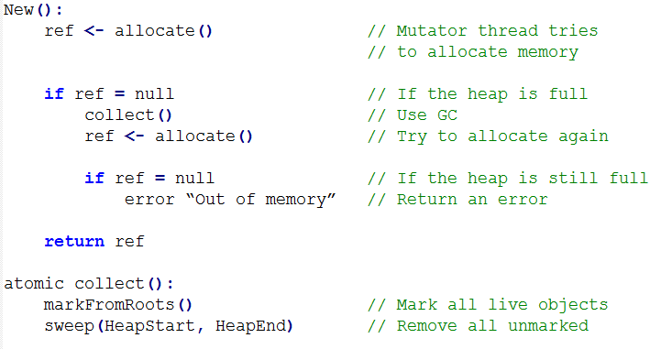
New
GC’s interaction with the mutator:

Slide 14
markFromRoots
Note: mark() doesn't have to be called after adding every root object. Its call can be moved outside the loop.

Slide 15
mark
Worklist implementation:
A single-thread collector can be implemented with a stack.
Meaning - the traversal is done using DFS.

Slide 16
Correctness of mark
Termination is enforced by not adding already marked objects to the worklist.
Eventually, the list becomes empty.
At that point, every object reachable from the roots has been visited and was marked.

Slide 17
sweep
Reminder: we call sweep from collect with HeapStart and HeapEnd as the parameters.
We then traverse the whole heap, and reclaim the space of any unmarked object.

Slide 18
Possible issues with mark-sweep
Severe fragmentation (caused by not moving objects).
Heap traversal in the presence of padding.

Slide 19
Improving Mark-Sweep
Linear bitmaps [Printezis and Detlefs, 2000]
Lazy sweeping [Hughes, 1982]
If there’s time:
FIFO prefetch buffer [Cher et al, 2004]
Edge marking [Garner et al, 2007]

Slide 20
Bitmaps
A bitmap is a table of mark-bits.
Each bit corresponds to an object on the heap.
Fast access (may be held in the RAM).
Can find the corresponding bit in O(1) time.

Slide 21
MS Improvement: Linear bitmaps
Use bitmaps to reduce the amount of space used for the mark stacks (the worklist):
Mark all the root objects in the bitmap.
Next, linearly traverse the bitmap, top down, and only add new children to the worklist if they are below a “finger”.
Maintain the invariant that marked object below the “finger” are black, and those above it are grey.

Slide 22
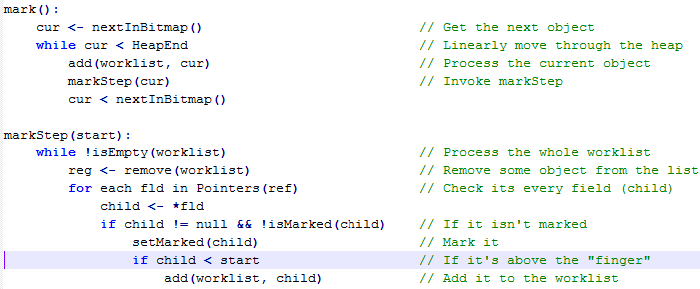
Bitmap mark
Main change is in the highlighted row: new objects are only added to the worklist if they are above the current “finger”.
Possibly a constant improvement in running time (not asymptotic).

Slide 23
MS Improvement: Lazy sweeping
Motivation: reduce (or even eliminate) mutators stop time during the sweep phase.
Two observations:
Once an object is garbage, it remains garbage: it can neither be seen nor resurrected by a mutator.
Mutators cannot access mark-bits.
Conclusion: the sweeper can be executed in parallel with mutator threads.

Slide 24
Lazy sweeping
Amortise the cost of sweeping by having the allocator perform the sweep.
allocate advances the sweep pointer until it finds sufficient space.
Usually more practical to sweep a block at a time.

Slide 25
collect and allocate
Note: blocks are grouped by their size class (sz).

Slide 26
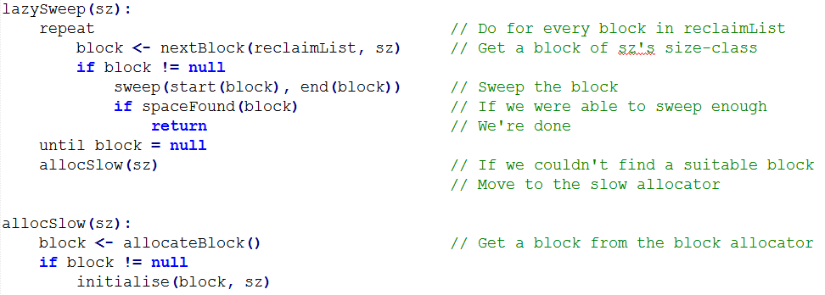
lazySweep

Slide 27
Lazy sweep benefits
Good locality:
Object slots tend to be used soon after they are swept.
Complexity is now proportional to the size of the live data in the heap (as opposed to the whole heap).
Performs best when most of the heap is empty.

Slide 28
Bonus: Snapshot mark-sweep
The basic mark and sweep algorithm stops all mutator threads during both mark and sweep phases.
Use the observation that the set of unreachable objects does not shrink
So the only time mutator threads must be stopped is during the mark phase.

Slide 29
Snapshot mark-sweep (cont.)
Basic algorithm:
Stop all mutators
Take a snapshot (replica) of the heap and roots
Resume mutators
Trace the replica
Sweep all objects in the original heap whose replicated counterparts are unmarked.
These objects must have been unreachable at the time the snapshot was taken.
They will remain unreachable until the collector frees them.

Slide 30
Snapshot mark-sweep (limitations)
The problem with this approach is that making a snapshot of the heap is not realistic.
Requires too much space and time.
Usually, only a small part of the heap it is modified at a time.
A full solution to this problem exists, but is outside the scope of this discussion.

Slide 31
Mark-sweep GC advantages
Low overhead:
Basic mark-sweep imposes no overhead on mutator read and write operations.
Good throughput:
Setting a bit or byte is cheap
The mark phase is very inexpensive.
Good space usage:
A single bit/byte for an object is an inexpensive way to store that object’s state.

Slide 32
Moving objects
The benefit in not moving objects is that mark-sweep is suitable for use in environments with no type-safety.
Moving an object forces us to update the roots.
The disadvantage is severe fragmentation, especially for long-running programs.

Slide 33
Possible solution to not moving
Some collectors that use mark-sweep, also periodically employ another algorithm, such as mark-compact, to defragment the heap.
Especially useful in cases where the program doesn’t use consistent object sizes.

Slide 34
Mark-compact GC
Two main phases:
Tracing/marking:
Mark all the live objects.
Compacting:
Relocate live objects
Update the pointer values of all the live references to objects that were moved.
The number/order of passes and the way in which objects are relocated varies.

Slide 35
Compaction order
Three ways to rearrange objects in the heap:
Arbitrary: objects are relocated without regard for their original order.
Fast, but leads to poor spatial locality.
Linearising: objects are relocated to be adjacent to related objects (siblings, pointer and reference, etc.)
Sliding: objects are slid to one end of the heap, “squeezing out” garbage, and maintaining the original allocation order in the heap.
Used by most modern mark-compact collectors.

Slide 36
Mark-compact GC
The compacting technique minimizes (or even eliminates) fragmentation.
Very fast, sequential allocation:
Test against a heap limit.
‘Bump’ a free pointer by the size of the allocation request.
We only discuss in-place compaction (as opposed to copying collection).

Slide 37
The algorithms we will discuss
Edward’s Two-finger compactions [Saunders, 1974]
Lisp 2 collector
If there’s time:
Threaded compaction [Jonkers, 1979]
One pass algorithms [Abuaiadh et al, 2004, Kermany and Petrank, 2006]

Slide 38
Invocation
All compaction algorithms are invoked as follows:

Slide 39
Two-finger compaction
A two-pass, arbitrary order algorithm
Works best if objects are of a fixed size.
Basic idea:
Given the number of live objects,
Set a high-water mark:
Move all the live objects into gaps below it.
Reclaim all the space above it.

Slide 40
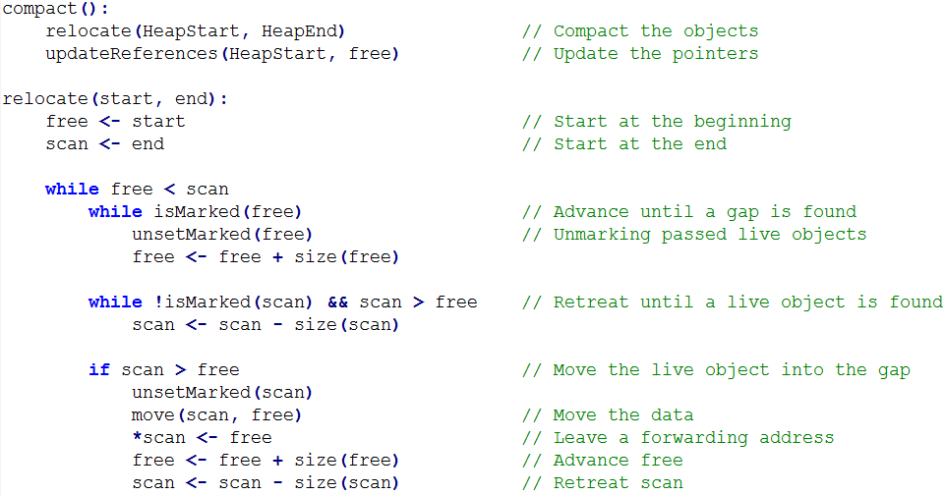
TF compaction: relocate
The forwarding address will allow us to update old values of pointers to objects above the high-water mark (that free is pointing to, at the end of the first pass).

Slide 41
TF compaction: updateReferences

Slide 42
TF compaction: pros and cons
Pros:
Simplicity and speed: minimal work is done at each iteration.
No memory overhead: forwarding addresses are written into slots above the high-water mark, after the information has been moved, so no information is ever destroyed.
Cons:
The movement of scan requires the ability to traverse the heap backwards.
Arbitrary move order.

Slide 43
TF compaction: an improvement
A possible improvement to the mutator locality is to move groups of consecutive live objects into large gaps, using the fact that objects tend to live and die together in clumps.

Slide 44
Lisp 2
A sliding collector algorithm.
Adds a field to the header of every object for the forwarding address.
Can also be used for the mark-bit.
That memory overhead is the chief drawback of the algorithm.
Can be used with objects of varying sizes.
Arguably the fastest compaction algorithm.

Slide 45
Three passes over the heap
The first pass (after marking):
Compute the future location of each live object.
Store it in the object’s forwardingAddress field.
The second pass:
Updates all pointers to the new forwarding address.
The third pass:
Moves the actual objects to the forwarding address.

Slide 46
Pass direction
The direction of the passes (upward in the heap) is opposite to the object’s moving direction (downward).
This guarantees that when the object is copied (in the third pass), the location is already vacant.

Slide 47
computeLocations
Ignore any dead objects - no need to relocate them.

Slide 48
updateReferences
Use the forwarding addresses to update the references of the live objects.

Slide 49
relocate
Move every object to the forwarding address.

Slide 50
Mark-compact collection: pros
Compaction is very effective way to deal with heap fragmentation.
Allows for very fast sequential allocation, after compaction.
Effective in the case of long lived (or immortal) objects, that remain unmoved at the bottom of the heap.

Slide 51
Mark-compact collection: cons
Has some space overheads incurred by storing forwarding addresses.
Usually has a slower throughput than mark-sweep or copying GC, as it requires more passes over the heap.

Slide 52
Discussion
In MS, think of a way to prefetch objects ahead of time.
In MS, think of a way to reduce the size of the worklist.
In MC, think of a way to not use any extra space.
In MC, think of a way to sweep in one pass.

Slide 53
Fin
＼(^o^)／
Questions?

Slide 54
Appendix
Additional algorithms

Slide 55
MS Improvement: FIFO prefetch buffer
Use a FIFO buffer alongside the mark stack:
To add an object to the worklist:
Push it onto the mark stack.
To remove an object from the worklist
Remove the oldest item from the buffer.
Insert the entry at the top of the stack to the buffer.
Prefetch the object to which the entry points.
It will be in the cache when the entry leaves the buffer.

Slide 56
FIFO prefetch buffer
mark stack
roots
add()
children
children
...
...
...
child
FIFO
remove()
obj
addr
prefetch()

Slide 57
Marking with a FIFO prefetch buffer

Slide 58
MS Improvement: Edge marking
Motivation: reduce the number of cache misses when checking isMarked(child) during mark.
Add to the worklist every child of an unmarked object, without checking.
Works in conjunction with the FIFO buffer.

Slide 59
mark with edge marking
We aren’t checking whether isMarked(child), but instead adding every child, regardless.
isMarked and Pointers now operate only on obj, which has been (hopefully) prefetched using the FIFO queue, thus, much fewer misses should occur.

Slide 60
MC improvement: Threaded compaction
We allow all references to a node N to be found from N.
Achieved by temporarily reversing the direction of pointers.
The algorithm we discuss is by Jonkers [1979]
Two passes over the heap:
The first to thread references that point forward in the heap.
The second to thread backward pointers.

Slide 61
Threaded compaction (cont.)
Threading requires no extra storage yet supports sliding compaction.
Requires enough room in the header to store an address (a weak requirement).
Also requires the ability to differentiate pointers from other values (may be harder).

Slide 62
Threading: visualisation
A
B
C
N
info
Before threading: three objects refer to N.
A
info
B
C
N
After threading: all pointers to N have been ‘threaded’ so that the objects that previously referred to N can now be found from N. The value previously stored in the header word of N, which is now used to store the threading pointer, has been (temporarily) moved to the first field (in A) that referred to N.

Slide 63
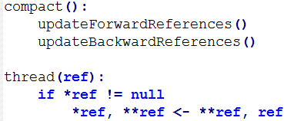
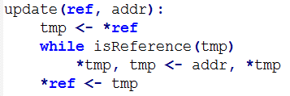
compact, thread and update
Illustration on the board.

Slide 64
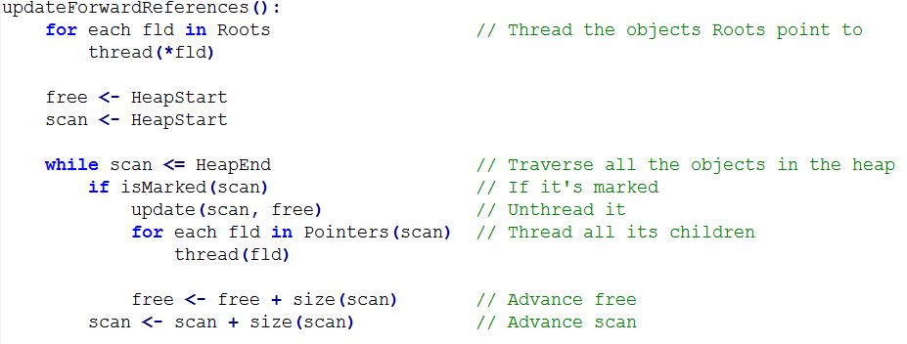
updateForwardReferences
Unthreading means pointing all the threaded objects that used to point to scan to the address occupied by free, where the object that resides in scan will eventually move to.

Slide 65
updateBackwardReferences
Threading of all the children and forward references unthreading were done in the first pass.
All the backward references were threaded during the first pass, and these are the only ones we’re updating now.

Slide 66
Threaded compaction: pros and cons
Pros:
Doesn’t require any additional space
Cons:
Each pointer is modified twice (thread/unthread).
Cache unfriendly - requires chasing pointers (3 times in Jonkers’ algorithm: mark/thread/unthread).
Object fields must be large enough to hold a pointer.
Pointers must be distinguishable from a normal value.

Slide 67
MC improvement: One-pass algorithms
Motivation: perform sliding compaction in one pass.
Achieved by using a bitmap, and another table, to store forwarding addresses.

Slide 68
The two tables
A bitmap:
One bit for each granule of the heap.
Marking sets bits corresponding to the first and last granules of each live object.
An offset table for the forwarding addresses:
Divide the heap into small, equal-sized blocks (256 or 512 bytes).
Store the forwarding address of the first live object in each block in the table.

Slide 69
Address derivations
The new location of the other live objects in a block (other than the first one) can be computed on-the-fly from the offset and mark-bit vectors.
Similarly, given a reference to any object, we can compute its block number, and thus derive its forwarding address from the entry in the offset table and the mark-bits.

Slide 70
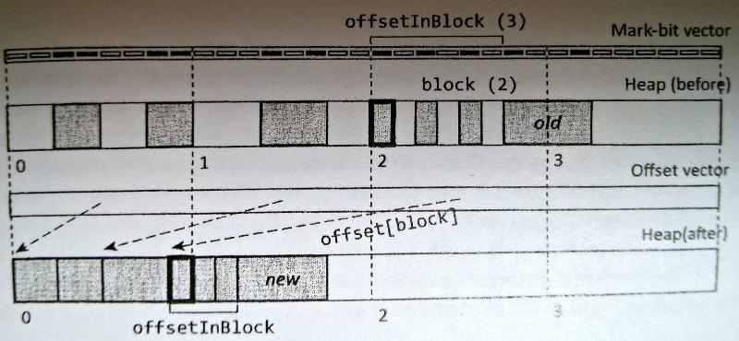
Visualization
Consider the object in bold. Bits 2-3, 6-7 in the first block and 4-6 in the second are set. Thus, 7 granules are already taken by objects that come before. So the first live object in block 2 will be relocated to the 8th slot in the heap (as seen in the offset vector - see the arrow).

Slide 71
Visualization (cont.)
Consider the object old. We obtain its block number and use it as an index into the offset vector. This is the address of the first object in the block. Then look at the bitmap, to find the offset in this block (3), and calculate the final address: offset[block]=7 plus offsetInBlock(old)=3 equals 10.

Slide 72
computeLocations

Slide 73
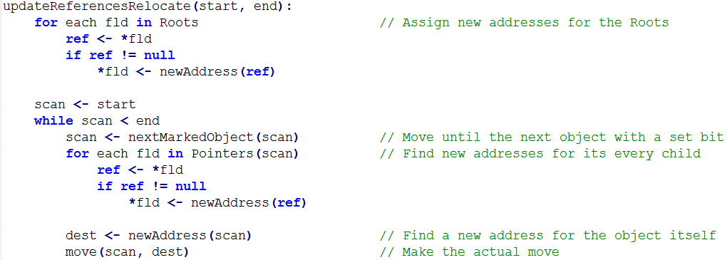
updateReferencesRelocate

