Slide 1
Concurrent copying & compaction
Hanan Rofe Haim
6/1/15

Slide 2
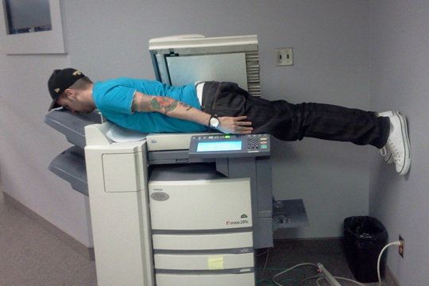
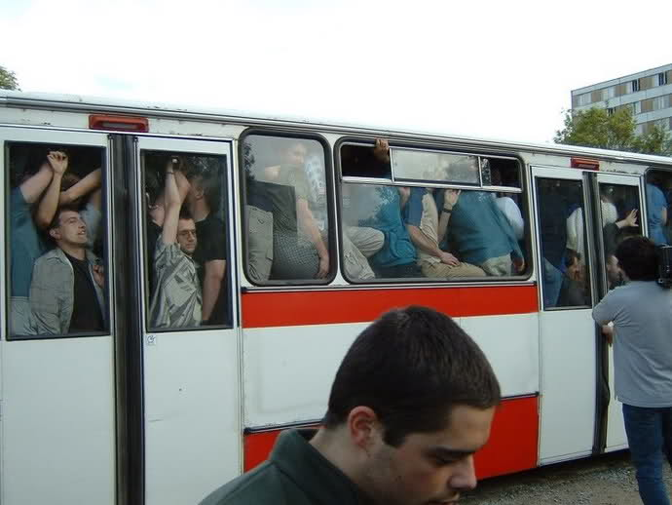
Outline
Concurrent Copying
- Reminder
- Baker’s algorithm
- Brook’s indirection barrier
- Replication copying
- Multi-version copying
- Sapphire algorithm- basics
Concurrent Compaction
- Reminder
- Compressor
- Pauseless collector
- Discussion
- Summery

Slide 3
Copying- recap
Courtesy of Jonathan Kalechstain
- Heap divided into 2 equally sized semi spaces:
The From-space and the To-space.
- The To-space acts as the heap de facto.
- From-space is empty between collection cycles.
- During a collection cycle:
1. The To-space becomes the From-space (flip).
2. Live objects are copied to the new empty To-space.
3. References are updated
4. From-space is cleared, collecting all dead objects in the process.

Slide 4
Copying- recap
Definitions
White node- not yet processed/garbage.
Grey node- a node copied to the To-space.
Black node- a node whose pointers were updated (meaning all of its children were processed)

Slide 5
Copying- recap
Test run
roots
fld
free = 1040
process(fld):
fromRef $←$ *fld
if fromRef != null
*fld $←$ forward(fromRef)
forward(fromRef):
toRef $←$ forwardingAddress(fromRef)
if toRef = null
toRef $←$ copy(fromRef)
return toRef
Copy(fromRef):
toRef $←$ free
free $←$ free+size(fromRef)
move(fromRef,toRef)
forwardingAddress(fromRef) $←$ toRef
add(worklist,toRef)
return toRef
fromRef
free = 1000
FA
A`
A
B
C
fromRef = &A
toRef = null
toRef = 1000
free = free + 40 = 1040
FA(fromRef)=1000
Return 1000

Slide 6
Copying- recap
Test run
free = 1080
free = 1040
process(fld):
fromRef $←$ *fld
if fromRef != null
*fld $←$ forward(fromRef)
forward(fromRef):
toRef $←$ forwardingAddress(fromRef)
if toRef = null
toRef $←$ copy(fromRef)
return toRef
Copy(fromRef):
toRef $←$ free
free $←$ free+size(fromRef)
move(fromRef,toRef)
forwardingAddress(fromRef) $←$ toRef
add(worklist,toRef)
return toRef
FA
A`
B`
A
ptr1
FA
C
B
fromRef = A.ptr1
toRef = null
toRef = 1040
free = free + 40 = 1080
FA(fromRef)=1040
Return 1040

Slide 7
And now, here's something we hope you'll really like!
Concurrent copying!

Slide 8
Concurrent GC
Recap - definitions
A mutator, just like objects, has a color:
Grey mutator- either has not yet been scanned by the collector so its roots
are still to be traced or its root has been scanned and need to be rescanned.
Black mutator- has been scanned by the collector so its roots have been traced.
We defined the “grey wavefront”- The boundary between black and white objects.
Objects ahead of the wavefront = grey/white objects.
Objects behind of the wavefront = black objects.
Black objects
White/grey objects

Slide 9
Concurrent copying
- Until now – The collector ran while the mutator was halted.
- Now, the collector must, while the mutator is running , be able to:
1. Copy objects from From-space to To-space.
2. Update pointers to new location of objects.
Things to notice:
1. Concurrent copying GC must protect mutator and collector from each other!
2. Concurrent updates by the mutator must be propagated to the
copies being constructed in To-space by the collector

Slide 10
Concurrent copying

Slide 11
Concurrent copying
What could go wrong?
A.ptr1=B.ptr1
Roots
FA
FA
A
B
A’
B’
C’
FA
FA
D’
C
D

Slide 12
Concurrent copying
What could go wrong? V2
A.ptr1=B.ptr1
Roots
FA
FA
A
B
A’
B’
C’
FA
C

Slide 13
Concurrent copying
Invariants
- The black mutator To-space invariant:
A black mutator must, by definition, hold only To-space pointers.
If it held From-space pointers then the collector would never revisit and
forward them, vi­olating correctness.
- The grey mutator From-space invariant:
A grey mutator must, by definition, hold only From-space pointers at the beginning
of the collector cycle.

Slide 14
Concurrent copying
Termination
For termination of a copying algorithm, all mutator threads must end the collection
cycle holding only To-space pointers!
* So, any copying collector that allows grey mutator threads to continue operating
in From-space must eventually switch them all over to To-space by forwarding
their roots.

Slide 15
Concurrent copying
Simple is better
Because it guarantees that the mutator threads never see objects that the collector
is yet to copy, or is in the middle of copying.
- Maintaining a To-space invariant for all mutator threads is perhaps the simplest
approach to concurrent copying.

Slide 16
Concurrent copying
Simple is better- but how?
- So, we want to maintain the black mutator invariant.
- But how?
1. Stop all the mutator threads (atomically).
2. Forward their roots (copying their targets) at the beginning of the collection cycle.
At this point, the now-black mutators contain only (grey) To-space pointers.
But wait, there’s a catch! The (unscanned) grey targets will still contain From-space pointers.

Slide 17
Concurrent copying
New collect, not completely atomic!
collect():
atomic
flip()
initialise(worklist)
for each fld in Roots
process(fld)
while true
atomic
if isEmpty(worklist)
break
ref $←$ remove(worklist)
for each child in Pointers(ref)
process(child)
atomic collect():
flip()
initialise(worklist)
for each fld in Roots
process(fld)
while not isEmpty(worklist)
ref $←$ remove(worklist)
for each child in Pointers(ref)
process(child)

Slide 18
Concurrent copying
Baker to the rescue!
Introducing: Baker’s black mutator read barrier
(1978)

Slide 19
Concurrent copying
Baker’s read barrier
Every object read by the mutator must be in the To-space!
When the mutator tries to read through a pointer!

Slide 20
Concurrent copying
Baker’s read barrier
the read barrier needs to trigger only when loading from a grey To-space object !
atomic Read(src, 1):
ref <— src[i]
if ref != null && isGrey(src)
ref <— forward(ref)
return ref
forward(fromRef):
toRef $←$ forwardingAddress(fromRef)
if toRef = null
toRef $←$ copy(fromRef)
return toRef
Copy(fromRef):
toRef $←$ free
free $←$ free+size(fromRef)
move(fromRef,toRef)
forwardingAddress(fromRef) $←$ toRef
add(worklist,toRef)
return toRef
* Objects allocated in the To-space are considered black!

Slide 21
Concurrent copying
Baker the illusionist
The read barrier has the effect of presenting the illusion to the mutator threads that the collection cycle has completed!

Slide 22
Concurrent copying
Baker’s read barrier-correctness
Recall we wanted to protect the mutator and the collector from each other.
Baker’s read barrier does just that!
The mutator is protected from the collector!
If the mutator tries to read a white object, it is forwarded and colored grey so
no matter what- the mutator always reads the To-space version of the object.
The collector is protected from the mutator!
Since the mutator can’t read a pointer to a white object, it can’t store such a
pointer in a black object and make the collector collect a live object.

Slide 23
Concurrent copying
What could go wrong? V2 – fixed!
A.ptr1=B.ptr1
Roots
Read barrier!
FA
FA
A
B
A’
B’
C’
FA
C

Slide 24
Concurrent copying
Baker’s read barrier- good, could be better
Baker’s barrier is conservative:
Objects allocated during the collection cycle are considered black
Which means they are not collected, even if they die during the cycle.
Similarly, objects which were already traversed and then died ,while the collection cycle is still running, will not be collected.

Slide 25
Concurrent copying
Baker’s read barrier- good, could be better
Baker’s barrier is expensive in time and space:
Zorn (1993) reported that pointer reads form about 15% of the total number of
instructions.
Inlining the barrier in each such read would create an unacceptably large
mutator code size.
Zorn also reported a 20% time overhead when using software read barriers.

Slide 26
Concurrent copying
Baker’s read barrier- good, could be better
So, according to Zorn, reads are too common in every program, making
the read barrier both time consuming and code size enlarging.
What’s the alternative?

Slide 27
Concurrent copying
Brooks to the rescue!
Introducing: Brooks's indirection barrier (1984)

Slide 28
Concurrent copying
Brooks's indirection barrier
Brook’s suggested a different approach :
Instead of requiring the To-space invariant allow the mutator to make progress
without concern for the wavefront.
Brooks observed that if every object (whether in From-space or To-space) has a non-null forwarding pointer (either to its from-space original or to its copy in To-space) then the test on the src object in the read barrier can be eliminated!
Basically, Brooks suggested:
Roots
FA
FA
A
A’

Slide 29
Concurrent copying
Brooks's indirection barrier
Follow forwarding address
no matter what!
atomic Read(src, i):
src <-- forwardingAddress(src)
return src[i]
atomic Write(src, i, ref):
src <-- forwardingAddress(src)
if isBlack(src)
ref <-- forward(ref)
src[i] <-- ref
Dijkstra-style Write barrier to prevent the insertion of From-space pointers behind the wavefront

Slide 30
Concurrent copying
Brooks's indirection barrier –is it correct?
atomic Read(src, i):
src <-- forwardingAddress(src)
return src[i]
Let’s recall that Baker’s barrier was introduced in order to prevent reading of From-space objects.
Does Brooks read barrier takes care of that?
No, it does not!
the read barrier can still read a field ahead of the wave-front that might refer to
an uncopied From-space object.
- Fortunately, Brooks forwarding pointer relaxes the need for the
To-space invariant imposed by Baker so the mutator is allowed to operate
grey and hold From-space references.

Slide 31
Concurrent copying
Brooks's indirection barrier –termination
- Let’s recall:
Termination requires all mutators to hold only To-space references.
- But Brooks allows mutators to operate grey!
Once copying is finished all mutators need a final scan of their stacks to replace any remaining unforwarded references

Slide 32
Concurrent copying
Brooks's indirection barrier –summery
It has the advantage of avoiding the need for Baker's To-space invariant which forces the mutator to perform copying work when loading a From-space reference from the heap.
Makes sure heap updates are never lost because they occur either to the From-space original before it is copied or to the To-space copy afterwards.
BUT
The Brooks indirection barrier imposes a time and space penalty.
Following an indirection pointer adds (bounded) overhead to every mutator heap access-
Wasting time !
The indirection pointer adds an additional pointer word to the header of every object-
Wasting space !

Slide 33
Concurrent copying
Brooks's indirection barrier – could be better
As we said, Brooks' solution is a bit wasteful both in time and in space.
Can we do better?

Slide 34
Concurrent copying
Nettles to the rescue!
Introducing: Replication copying collectors [Nettles et al, 1992; Nettles and O'Toole, 1993]

Slide 35
Concurrent copying
Replication copying collectors
Brook’s said: If you have a To-space copy, use it!
Nettles says: Let’s allow the mutator to use From-space originals, even while the collector is copying them to the To-space!
But how?

Slide 36
Concurrent copying
Replication copying collectors
General idea:
The mutator threads obey a From-space invariant, updating the From-space objects directly, while a write barrier logs all updates to From-space objects to record the differences that must still be applied to their To-space copies

Slide 37
Concurrent copying
Replication copying collectors
Replication copying collectors allow the state of the To-space copy to lag behind that of its From- space original.
Just as long as by the time the collector is fin­ished copying, but before it can clear the From-space, all mutator updates have been applied from the log to the To-pace copy and all mutator roots have been forwarded.
Termination condition:
The mutation log is empty, the mutator's roots have all been scanned, and all of the
objects in To-space have been scanned.

Slide 38
Concurrent copying
Replication copying collectors- correctness requirements
What are our demands regarding correctness?
Synchronization between the mutator and col­lector via the mutation log, and when updating the roots from the mutators.
The collector must use the muta­tion log to ensure that all replicas reach a consistent state before the collection terminates.
When the collector modifies a black object it must rescan the object to make sure that any object referenced as a result of the mutation is also replicated in To-space.

Slide 39
Concurrent copying
Replication copying collectors- termination requirements
What are our demands regarding termination?
Termination of the collector requires that each mutator thread be stopped to scan its roots.
When the collection cycle is fin­ished, all the mutator threads need to stop together briefly in order to switch them over to To-space by redirecting their roots.

Slide 40
Concurrent copying
What could go wrong? – fixed!
A.ptr1=B.ptr1
Roots
Stop the world
Write barrier!
FA
FA
A
B
A’
B’
C’
FA
FA
D’
C
D
Mutation log

Slide 41
Concurrent copying
Replication copying collectors- better, still not flawless
The Good- only short pauses to sample (and at the end redirect) the mutator roots.
The Bad - The mutation log can become a bottleneck:
the collector reads the mutation log, which is being written by the client.
The Ugly- every mutation of the heap, not just point­ers, needs to be logged by the mutator threads- Higher overhead than for traditional (pointer-only) write barriers.

Slide 42
Concurrent copying
Replication copying collectors- bad is relative
When is the bad not so bad?
Purely functional languages (e.g. Haskell) does not allow mutations of records/variables once created.
Nettles and O'Toole used ML.
ML, being a functional language (not pure, allows side-effects),
discourages mutations ,so their performance suffered less.

Slide 43
Concurrent copying
Replication copying collectors- not good enough
Nettles’ collector still requires global stop-the-world synchronization of the mu­tator threads to transition them to To-space.
- The algorithm is not lock-free- When world stop, no mutator can make progress!
Can we do better?

Slide 44
Concurrent copying
Herlihy and Moss to the rescue!
From-space
From-space
From-space
From-space
To-space
From-space
From-space
Introducing: Herlihy and Moss multi-version copying (1992)

Slide 45
Concurrent copying
Baker 1978- never forget
But first!

Slide 46
Concurrent copying
Baker 1978- never forget
BACK
baker
to
the
Halstead's multiprocessor refinement
of Baker's algorithm (1985)

Slide 47
Concurrent copying
Halstead's multiprocessor Baker-style algorithm
Heap is divided into multiple per-processor regions:
Each processor has its own From-space and To-space
Each processor is responsible for evacuating into its own To-space any From-space object it discovers while scanning.
Uses locking to handle races between processors that compete to copy the same object, and for updates to avoid writing to an object while it is being evacuated.
Uses global synchronization to have all the processors perform the flip into their To-space before discarding their From-space.

Slide 48
Concurrent copying
Herlihy and Moss multi-version copying – the basic idea
Each processor* region composed of one To-space and many (0-n) From-spaces.
While copying is performed, multiple From-space ver­sions of an object can accumulate in different spaces.
Only one of these versions is current while the rest are obsolete.
Today a “processor” is actually a thread, but we’ll still refer to it as
a processor in order to be consistent with Halstead's version.

Slide 49
Concurrent copying
Herlihy and Moss multi-version copying – basic idea
Each processor alternates between 2 tasks:
1. A mutator task.
2. A scanning task looking for From-space pointers.
When such a pointer is found, the scanner locates the object's current version.
Current version in a From-space -> copied to To-space.
(the old version is now obsolete)

Slide 50
Concurrent copying
Herlihy and Moss multi-version copying – definitions

Slide 51
Concurrent copying
Herlihy and Moss multi-version copying – definitions
Owner- A processor which owns From-spaces.
Scanner- A mutator currently in running a scanning task.
Clean scan- for some scanner, a scan which completes without finding any pointers to versions in any From-space.
Dirty scan- opposite of clean.
Round - an interval during which every processor starts and completes a scan.
Clean round- one in which every scan is clean and no processor executes a flip.
Handshake bits- atomic bits, initially match.

Slide 52
Concurrent copying
Herlihy and Moss multi-version copying – how does it work
The processors need to cooperate!
Each processor is responsible for scanning its own To-space and local variables on its stack for From-space pointers.
Each processor is responsible for copying any From- space object it finds.
Includ­ing objects in From-spaces of other processors!
Only if the object does not have a current To-space copy in some processor.
But how can it know?
Stay tuned…

Slide 53
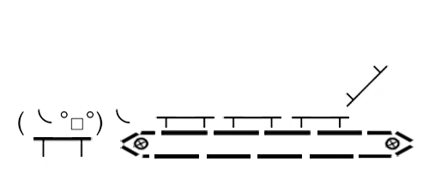
Concurrent copying
Herlihy and Moss multi-version copying – how does it work
One flip is for the weak
A processor can flip at any time during its mutator task and as many times as it needs **

Slide 54
Concurrent copying
Herlihy and Moss multi-version copying – how does it work
So, when does a process need to flip?
When its To-space is full (and not during a scan).
*Just as long as it has sufficient free space to allocate a new To-space.
After a processor executes a flip, a new From-space is generated.
This From-space can be reclaimed only after completion of a subsequent clean round.
A processor cannot free its From-spaces until it can be sure no other
processor holds references to any of its From-space objects.

Slide 55
Concurrent copying
Herlihy and Moss multi-version copying – managing versions
Need a way of managing and keeping track of versions
Maintain a forwarding pointer field next at all times in each object, referring to its next (newer version).
For the current version, next=null.
A
A1
A2
A3 Null

Slide 56
Concurrent copying
Herlihy and Moss multi-version copying – managing versions
When copying a From-space object into its own To-space, a scanning processor atomically installs the To-space copy at the end of the version chain using CompareAndSwap, making it current.
A1
A3
A3 null
A4 Null
A
A2
A3 null
To-space version
Every mutator heap access must traverse to the end of the chain of versions before per­forming the access!

Slide 57
Concurrent copying
Herlihy and Moss multi-version copying – the algorithm
Find-current(x)
while x.next!=null
x ← x.next
return x
Fetch (x,i)
x ← find-current (x)
return x[i]

Slide 58
Concurrent copying
Herlihy and Moss multi-version copying –managing versions
Need a way to stay lock-free and make sure heap updates aren’t lost.
Every store into an object creates a new version of the object in the mutat­ing processor's To-space.
Scanning and copying require no global synchronization, while preserving all mutator updates.

Slide 59
Concurrent copying
Herlihy and Moss multi-version copying – the algorithm
Store(x, i, value)
/* Allocate space (in my To-space) for a new version of x */
temp ← allocateSpaceForNewVersion()
while true
/* Find current version of x and to new version */
x ← find-current (x)
for i in [0,x.size)
temp[i] ← x[i]
/* Set new value to new version */
temp[i] ← value
/* Try setting the new version of x */
if compare&swap (x.next,null,temp)
return

Slide 60
Concurrent copying
Herlihy and Moss multi-version copying – how does it work
We want to make sure an owner discards its From-spaces only if no other scanner holds any of its From-space pointers.
An owner detects that another scanner has started and completed a scan using the handshake bits, each bit is written by one processor and read by the other.

Slide 61
Concurrent copying
Herlihy and Moss multi-version copying – how does it work
In order to start a flip the owner:
1. Creates a new To-space.
2. Marks the old To-space as a From-space.
3. Inverts its handshake bit.
At the start of a scan the scanner:
1. Reads the owner's handshake bit.
2. Performs the scan.
3. Sets its handshake bit to the value read from the owner's bit.

Slide 62
Concurrent copying
Herlihy and Moss multi-version copying – how does it work
Observation:
Handshake bits will agree once the scanner has started and completed a scan in the interval since the owner's bit was inverted
Owner inverts its bit
Scanner starts scan
Scanner ends scan
Time
Owner bit is 1
Scanner bit is 1

Slide 63
Concurrent copying
Herlihy and Moss multi-version copying – how does it work
So, we covered synchronization between an owners and a scanners
An owner must detect that all processes have started and completed a scan

Slide 64
Concurrent copying
Herlihy and Moss multi-version copying – how does it work
Need to remember: every processor is both an owner and a scanner!
To synchronize an owner with all scanners we do the following:
- The handshake bits are arranged into two arrays:
1. An owner array containing the owners handshake bits, indexed by owner
processor.
2. A 2-dimensional scanner array containing the scanners handshake bits,
with an element for each owner-scanner pair.

Slide 65
Concurrent copying
Herlihy and Moss multi-version copying – how does it work
So, how do we use those arrays?
Because a scan can complete with respect to multiple owners, the scanner must copy the entire owner array into a local array on each scan.
At the end of the scan, the scanner must set its corresponding scanner bits to these previously saved values.
How an can an owner detect a round is complete?
A round is complete as soon as its owner bit agrees with the bits from all scanners.
An owner cannot begin a new round until the current round is complete!

Slide 66
Concurrent copying
Herlihy and Moss multi-version copying – how does it work

Slide 67
Concurrent copying
Herlihy and Moss multi-version copying – test run
Let’s do a test run on those arrays:
We’ll use 3 processors
Owner array:
0 | 0 | 0
p3 | P2 | P1
As scanner
p3 | P2 | P1
P1
P2
P3
0 | 0 | 0
0 | 0 | 0
0 | 0 | 0
Scanner array:
As owner

Slide 68
Concurrent copying
Herlihy and Moss multi-version copying – test run
Owner array
P1 performs a flip
0 | 0 | 0
0 | 0 | 1
0 | 0 | 1
1 | 0 | 1
1 | 0 | 1
1 | 0 | 1
P2 starts a scan
p3 | P2 | P1
P3 performs a flip
Scanner array
P1 starts a scan
As scanner
P3 starts a scan
P2 ends the scan
p3 | P2 | P1
0 | 0 | 0
0 | 0 | 0
0 | 0 | 0
1 | 1 | 1
0 | 0 | 0
1 | 0 | 1
0 | 1 | 1
0 | 0 | 0
0 | 0 | 1
P1
P2
P3
0 | 1 | 0
0 | 0 | 0
0 | 0 | 0
P1 ends the scan
P3 ends the scan
As owner

Slide 69
Concurrent copying
Herlihy and Moss multi-version copying – how does it work
How can an owner detect a round is clean?
Processes share an array of dirty bits, indexed by processor
When do processors set values in the dirty array?
1. When an owner executes a flip,
it sets the dirty bit for all other processors.
2. When a scanner finds a pointer into another processor's From-space it sets that processor's dirty bit.

Slide 70
Concurrent copying
Herlihy and Moss multi-version copying – the algorithm
flip():
createNewToSpace()
markOldSpaceAsFromSpace()
/* Make sure everyone knows this round is dirty */
for i in [1,n) do
if i != me
dirty[i] ← true
/* Invert my handshake bit */
owner[me] ← ! owner[me]
Scan-start():
/* Copy owner array to my own local array */
for i in [1,n) do
local-owner[i] ← owner[i]

Slide 71
Concurrent copying
Herlihy and Moss multi-version copying – how does it work
How to use the dirty array to determine a round is clean?
If an owner's dirty bit is clear at the end of a round then the round was clean, and it can clear its From-spaces.
If not, then it simply clears its dirty bit.
Either way, the owner starts a new scan.

Slide 72
Concurrent copying
Herlihy and Moss multi-version copying – the algorithm
Scan-end():
/* Notify other processes I’m done scanning */
for i in [1,n) do
scanner[i][me] ← local-owner[i]
/* Did a round complete? */
if for every I scanner[me][i] = owner[me]
/* If round is clean, I can safely clear my From-spaces */
if !dirty[me]
discardFromSpaces()
/* Clear dirty bit for next scan*/
dirty[me] ← false
/* Start another scan*/
scan-start()

Slide 73
Concurrent copying
Herlihy and Moss multi-version copying – the algorithm
Scan-value(x):
/* If found From-space owner, set its owner as dirty*/
if old(x)
dirty[owner(x)] ← true
/* Move object if needed */
while true
/* Find current version of x and check if its in a To-space*/
x ← find-current(x)
if new(x)
return x
/* Create a copy of x*/
temp ← allocateSpaceForNewVersion()
for I in [1,x.size)
temp[j]← x[j]
/* Try setting the new version of x*/
if compare&swap (x.next,null,temp)
return temp
else
free(temp)

Slide 74
Concurrent copying
Herlihy and Moss multi-version copying – correctness
Multi-versioning looks good, is it correct?
Liveness- Each processor always eventually scans then some processor always eventually re­claims its From-spaces.
Termination- At worst, because each processor will eventually run out of free space, further flips will cease, and all processors will eventually focus on scanning until reaching a clean round.
Performance – No thank you.

Slide 75
Concurrent copying
Herlihy and Moss multi-version copying – optimizations
We just saw an entirely lock-free copying algorithm.
Its downside is the need to create a new version on every heap update.
For you brave souls, Herlihy and Moss offered alternatives to avoiding versioning on every update.

Slide 76
Concurrent copying
Herlihy and Moss multi-version copying – still not the best
Time to say something bad about the algorithm.
A bad scenario (bottleneck) :
One processor happens to hold a large portion of the heap.
Other processors have to wait for it to complete its scan (and end the round) before they can clear their From-spaces
They may end up stalling if they have no free space in which to allocate.
Can we do better?

Slide 77
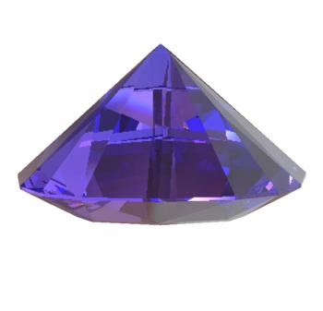
Concurrent copying
Hudson and Moss to the rescue!
Introducing: Sapphire algorithm [Hudson and Moss, 2001, 2003]

Slide 78
Concurrent copying
Hudson and Moss’s sapphire algorithm- basics
Extends previous concurrent copying algorithms.
Has much in common with replication schemes.
It permits only one thread at a time to flip from From-space to To-space rather than all at once.
Mutators simply update both the From-space and To-space copies of an object (when both exist) to keep them coherent.
Can we do better?

Slide 79
Concurrent compaction

Slide 80
Compaction-recap
Mark and compact (Pavel Brodsky)
Two main phases:
1. Tracing/marking: mark all the live objects.
2. Compacting: relocate live objects and update references to them.
Separation of marking and copying allows us compaction concurrently with mutators!
In a way, a compacting algorithm is better than a copying one
Gives us control over the order in which objects are relocated.

Slide 81
Compaction-recap
Mark and compact
Three ways to rearrange objects in the heap:
1. Arbitrary: objects are relocated without regard for their original order.
- Fast, but leads to poor spatial locality.
2. Linearising: objects are relocated close to related objects (siblings, pointer and
reference, etc.)
3. Sliding: objects are slid to one end of the heap, “squeezing out” garbage, and
maintaining the original allocation order in the heap.
Used by most modern mark-compact collectors

Slide 82
Compaction-recap
Compressor
At first, Pavel showed us compacting algorithms which need more than one pass on the full heap in order to relocate objects and update pointers (Lisp 2).
We also saw a one-pass sliding algorithm

Slide 83
Compaction-recap
One-pass compressor
[Kermany and Petrank, 2006]
Basic idea:
Heap is divided into equally sized blocks.
We maintain a mark-bitmap with one bit for each word (could be other size).
Marking phase sets the bits corresponding to the first and last words of each live object.
Additionally, we maintain an offset-vector – storing the forwarding address of the first live object in each block.

Slide 84
Compaction-recap
One-pass compressor
How does it work:
After marking is done, a routine passes over the mark-bitmap and constructs the offset-vector.
Once the offset-vector is initialized, the roots and live references are updated to point to the objects new locations.
Combined use of the offset-vector and the mark-bitmap gives us the ability to calculate an object’s new address easily and rapidly.
Too theoretical, let’s see some shiny pictures!

Slide 85
Compaction-recap
One-pass compressor
Offset in block( =3)
Mark phase
Construct offset-vector
Where to move OLD?
Mark-bitmap
Heap(after)
OLD
Offset-vector
Heap(after)
NEW

Slide 86
Compaction-recap
One-pass compressor- algorithm (Originally stolen from Pavel)

Slide 87
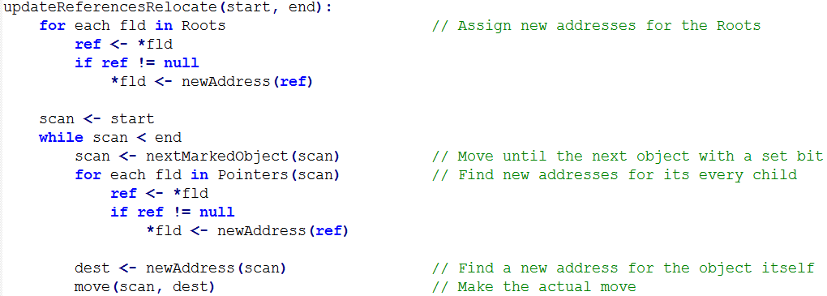
Compaction-recap
One-pass compressor- algorithm (Thanks again Pavel)

Slide 88
Concurrent compaction
One-pass compressor- concurrently
But how does the Compressor handles concurrent compaction?
Virtual memory page protec­tion primitives

Slide 89
Concurrent compaction
One-pass compressor- concurrently
Compressor uses page protection primitives:
PROT1: decrease the accessibility of a page.
UNPROT: increase the accessibility of a page.
But most importantly:
MAP2:
map the same physical page at two different virtual addresses, at different levels of protection.
Virtual 1
Virtual 2
Physical

Slide 90
Concurrent compaction
One-pass compressor- concurrently
So, how does it work?
Compressor protects the To-space pages from read/write access
(without yet mapping them to physical pages).
Offset-vector construction and To-space protection happens while mutators do their thing in the From-space.
Eventually, need to stop the world to switch mutators roots to To-space.

Slide 91
Compaction-recap
One-pass compressor- problem
Let’s recall the Compressor changes pointers before the actual copying.
Mutators can access uncopied To-space addresses!

Slide 92
Concurrent compaction
One-pass compressor- problem and solution
Solution: Trap any mutator trying to access a protected To-space copy!

Slide 93
Concurrent compaction
One-pass compressor- problem and solution
What do we want from our trap?
1. Map and populate the page with its copies.
2. Forward the references in those copies.
Two things to notice:
1. An object must start inside the page to be considered in it.
2. The trap de facto makes the mutator a compactor briefly.

Slide 94
Concurrent compaction
One-pass compressor- problem and solution
So we prevented mutator access to uncopied objects by trapping them.
But wait, won’t the compactor thread also be trapped?
- Remember, we have the primitive “Map2”
- Physical page is mapped twice:
1. A protected To-space virtual page (for mutators access).
2. An protected virtual page (private for compactor access).
Discarded when work on page done.
Virtual 1 (protected)
Virtual 2 (unprotected)
Physical

Slide 95
Concurrent compaction
One-pass compressor- colors
Colors are assigned to pages now.
Need to define what each page color means:
1. White page- From-space page.
2. Grey page- protected To-space page.
3. Black page- unprotected To-space page.
- When does a grey page turns black?
- Once the compaction work for that page has been done.

Slide 96
Concurrent compaction
One-pass compressor- more problems
Problem 1:
While the offset-vector is being computed, mutators can allocate objects
in “holes” in the To-space.
Solution:
Before the offset-vector is being computed, mutators allocates object only in
the To-space.

Slide 97
Concurrent compaction
One-pass compressor- more problems
Problem 2:
Newly allocated To-space objects can point to stale From-space objects.
Same problem for roots!
Solution:
Scan pointer fields after mutators flip to To-space and redirect pointers if
needed.
Requires adding another trap to new pages and to the roots which will
perform the pointers scanning.

Slide 98
Concurrent compaction
One-pass compressor- illustrated
Roots
Live
Live
Live
Compute forwarding information

Slide 99
Concurrent compaction
One-pass compressor- illustrated
Roots
Live
Live
Live
Protect To-space pages

Slide 100
Concurrent compaction
One-pass compressor- illustrated
Roots
Live
Live
Live
Flip mutator roots

Slide 101
Concurrent compaction
One-pass compressor- illustrated
Roots
Live1
Live2
Live2
A mutator is trying to access Live1
Trap it!

Slide 102
Concurrent compaction
One-pass compressor- illustrated
Roots
Live1
Live2
Live2
Free
A mutator is trying to access rightmost To-space page
Trap it!

Slide 103
Concurrent compaction
One-pass compressor- illustrated
Roots
Live1
Live2
Live2
Free
Free
Free
Free
Free
Free
Mutator is done interfering, finish compaction

Slide 104
Concurrent compaction
One-pass compressor- not perfect
The Compressor we just saw has a downside.
Trapping a mutator means copying all of the accessed page objects and forward all the pointers in those objects to refer to To-space locations.
Significant pauses on the mutator!

Slide 105
Concurrent compaction
Click and Azul to the rescue!
Introducing: The Pauseless collector [Click et al, 2005; Azul, 2008]

Slide 106
Concurrent compaction
Pauseless collector- basic idea
The Compressor we just saw protected To-space pages.
Pauseless algorithm basic idea:
- Protect From-space pages that contain objects being moved.
* A much smaller set of pages to protect.
- Pages can be protected incrementally.
- Use a read barrier whenever a mutator tries to read a stale From-space reference.

Slide 107
Concurrent compaction
Pauseless collector- basic idea
Pauseless can be implemented in 2 ways:
1. Use special hardware to implement the read barrier as an instruction.
*Original implementation!
2. On stock hardware, lnline barrier logic wherever a reference is being loaded.

Slide 108
Concurrent compaction
Pauseless collector- implementation
Pauseless can be implemented in 2 ways:
1. Use special hardware to implement the read barrier as an instruction.
*Original implementation!
2. On stock hardware, lnline barrier logic wherever a reference is being loaded.
We’ll focus on the hardware implementation

Slide 109
Concurrent compaction
Pauseless collector- hardware support
Azul’s hardware differs from a stock hardware:
1. Supports several fast user-mode trap handlers (for barriers).
2. Adds another privilege level: GC-mode.
*Several of the user-mode traps switch to GC-mode.
3. Supports large (up to 2MB) pages.
These pages are the standard pages for the Pauseless collector.

Slide 110
Concurrent compaction
Pauseless collector- don’t stop me now
Until now we used a Stop-the-world technique, Pauseless uses a checkpoint:
When a mutator reaches the checkpoint, it can be asked to do some GC work before it could proceed.
The collector helps blocked threads by performing the GC work for them.
As opposed to Stop-the-world, checkpoint never stops a running thread!

Slide 111
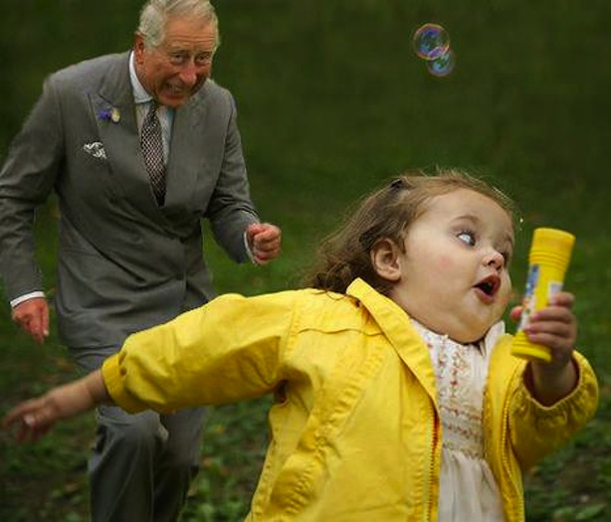
Concurrent compaction
Pauseless collector- NMT
Need a way to track scanned references.
Pauseless steals one bit from every address.
This bit is called Not-Marked-Through (NMT) .
The hardware maintains a desired-value for the bit.
Any use of a reference which has an un-desired NMT value will set off a trap.

Slide 112
Concurrent compaction
Pauseless collector- phases
So, how does it work?
The Pauseless collector is divided into 3 phases:
All phases are fully parallel and concurrent!
1. Mark phase- responsible for periodically refreshing the mark bits.
2. Relocate phase- uses the most recently available mark bits to find pages with little amount of live data, relocate their objects and free their physical memory.
3. Remap phase- updates every pointer in the heap whose target has been relocated.

Slide 113
Concurrent compaction
Pauseless collector- got to love it
Time to see how each phase works
BUT FIRST
Let’s see what’s so great about the Pauseless collector!

Slide 114
Concurrent compaction
Pauseless collector- got to love it
The Pauseless collector is more “relaxed”:
We’re never in a hurry to finish any given phase due to the fact that no phase bothers the mutators too much.
There’s no race to finish some phase before starting another collection:
The relocate phase runs non-stop and can immediately free
memory at any point.
What if we have to keep up with a substantially large amount of mutators?
Since all phases are parallel, the collector can keep up simply by adding
more collector threads.

Slide 115
Concurrent compaction
Pauseless collector- got to love it
The phases incorporate a “self-healing” effect:
If a mutator is trapped in a read barrier,
it replaces the old reference with updated one, thus preventing triggering the trap again.

Slide 116
Concurrent compaction
Pauseless collector- mark phase
The Pauseless first phase is mark:
Each object has two mark bits, one for the current cycle and one for the previous cycle.
At each scan, mark is responsible for:
1. At the start, clearing the current cycle's mark bits.
2. Periodically refreshing the mark bits.
3. Set the NMT bit for all references it encounters to the desired value.
4. Gather liveness information for each page.
5. After scan is done, flip the per-thread desired NMT value.

Slide 117
Concurrent compaction
Pauseless collector- mark phase, NMT
Let’s recall we have a NMT bit:
If a mutator tries to load a reference which has the wrong NMT value:
A trap will set off:
Communicate the reference to the marker threads.
Store the corrected (marked) reference back to memory, so the trap won’t set off again.
Mutators does not have to wait for the marker threads to flip the NMT bit for objects.
Instead, each mutator flips each reference it encounters as it runs.

Slide 118
Concurrent compaction
Pauseless collector- mark phase
Let’s recall the Pauseless collector uses a checkpoint!
We can give the mutator some of the collector’s dirty work:
When a running thread reaches the checkpoint, it marks it’s own root set.
What about blocked threads?
Collectors in the mark phase take care of it!
Each mutator can proceed safely once its roots has been marked.
BUT
- The mark phase cannot proceed until all threads have passed the checkpoint.

Slide 119
Concurrent compaction
Pauseless collector- relocate phase
The relocate phase is responsible for (in that order):
1. Finding sparsely occupied pages (good candidates for compaction).
2. Building side arrays to hold forwarding addresses for the objects to be relocated.
Why not just keep the FA in the From-space originals like we’re used to?
Because physical memory is reclaimed right after copying is done and before the pointers are forwarded.
3. Protecting the candidates pages from access by the mutators.
If a mutator tries accessing a protected page, it will set off a trap!

Slide 120
Concurrent compaction
Pauseless collector- remap phase
The remap phase is responsible for:
1. Forwarding the re­maining stale references in the live pages.
2. Reclaiming virtual memory.
* Since there are no more stale references to the From-space pages,
their virtual memory can now be recycled.

Slide 121
Summery
All algorithms had a common goal: Collect garbage while protecting the mutator and the collector from each other.
Some algorithms accomplish this with the To-space invariant
Baker’s algorithm
Others let the mutator use the To-space copy, if one exists, or otherwise use From-space objects
Brook’s indirection barrier
Others let the mutator operate in the From-space, as long as all the changes it makes eventually propagate to the To-space
Nettles and O’Toole mutator log

Slide 122
Summery
Algorithms which wanted to prevent stopping the world to redirect root pointers
Ended up creating multiple versions for each object
Herlihy and Moss multi-version collector
We also saw compaction can be done in similar ways, but without the need to copy all objects at every collection
Compressor and Pauseless

Slide 123
Discussion
There one common bad thing all copying algorithms we just saw share in common
They copy!
Any ideas?

Slide 124
Discussion
Compressor heavily depends on virtual memory and primitives (map2) which can be costly
Any ideas?

Slide 125
FIN

Slide 126
Thank you!

