Slide 1
SADNA – Ad Auction
Yishay Mansour
Mariano Schain

Slide 2
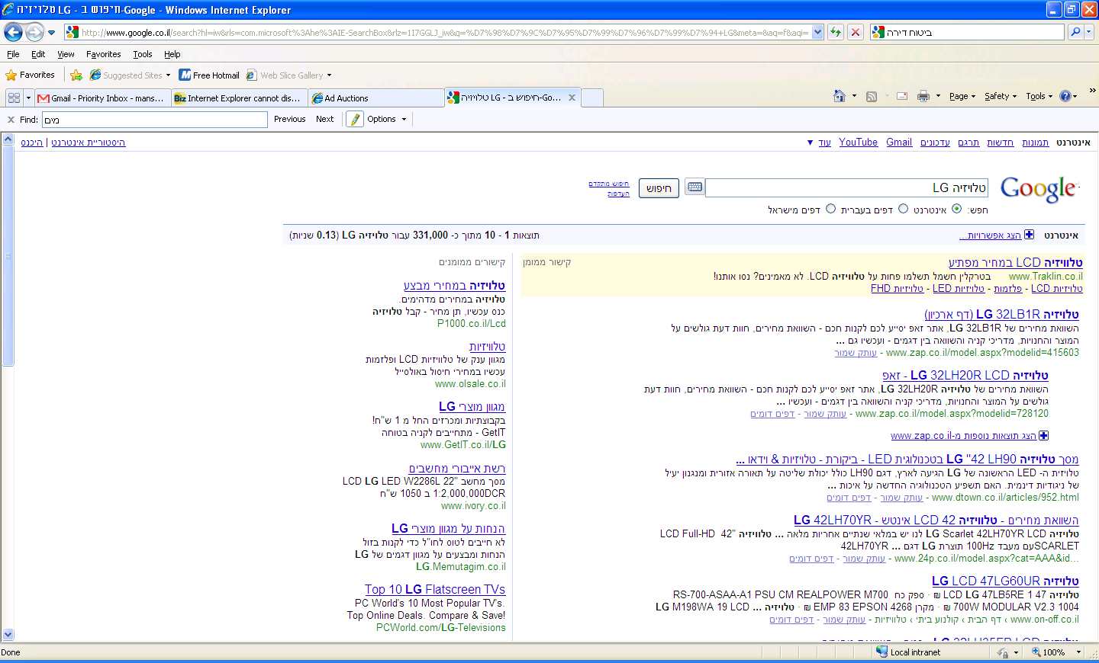

Slide 3
Participants
Users
Searching
Submit queries
Buy items
Sellers (advertisers)
Sell items
Have inventory
Advertise their items to sell
Publisher
Search engine / web site
Paid for advertisements

Slide 4
Users
Each one of you
Looking for information/items
Use queries for search
Reveal partial information about preferences
From user perspective:
Submit query
Obverse Ads
Maybe click on some Ad (clicks)
Maybe buy from the seller (conversion)

Slide 5
Sellers
Have items to sell
Limited inventory
Submit Advertisements
Attract users
Pay for users that click on Ads
No click → No pay
Sell to “Clickers”
Get users to buy

Slide 6
Seller - Advertisement
Builds campaigns
Define the keywords it like to bid on
“television”, “dvd” , …
Define a bid
Maximum amount of money willing to pay per click
Define a budget
Bounds the maximum pay on Ads during a period.
Day or month

Slide 7
Seller - profit
Outcome
Clicking users perform conversions
Profit:
Revenue = number of conversions x profit per unit
Ad Cost = number of click x CPC
CPC = cost per click
Goal: Maximize conversions and minimize CPC

Slide 8
Publisher
Gets Ads proposal from Sellers
Sets a bidding platform
Clear rules
Maximize its revenue
Clicks x CPC
Today: we will learn about the popular platforms
Also used in the simulations

Slide 9
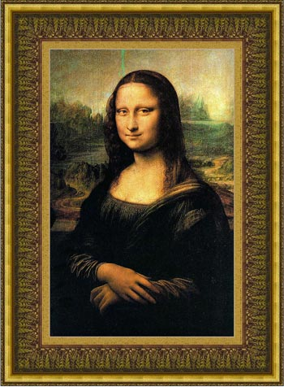
How to set an auction
Suppose you want to sell a single item
Users / bidders
Have a private value for the item
Goals:
Sell the item
Sell to the person with highest value
Maximize revenue
Challenge
User have strategic behavior

Slide 10
First Price Auction
Each bidder submit a bid
Winner = highest bid
Price = his bid
Challenge 1:
How should you bid?
Challenge 2:
What are plausible outcomes?
Plausible outcome = equilibrium

Slide 11
Second price auction
Each bidder submit a bid
Winner = highest bid
Price = the second highest bid
Minimal bid to stay in first place
CLAIM: each bidder can simply bid his value
Case analysis
Equivalent to English auction

Slide 12
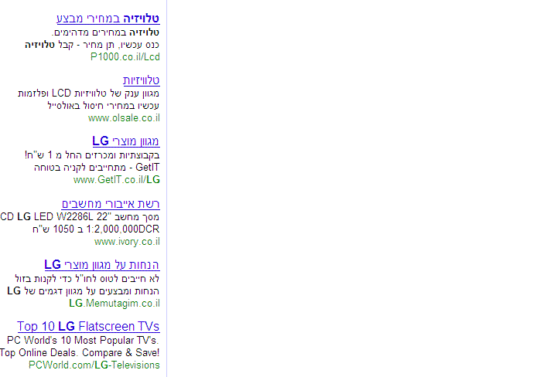
Back to Ad Auction
Multiple Slots
Advertiser can appear only once
Higher slots have higher CTR
CTR= Click Through Rate
Probability of a click
CTR[Ad]*CTR[slot]
Simple model
Widely used
To a large extent, ignore CTR[Ad]
Assume its integrated in the bid

Slide 13
Generalized Second Price (GSP)
Multiple Slots
Rank the Ads by:
Bid
Rank by bid
Bid*CTR[Ad]
Rank by revenue
Cost for slot i:
Bid[i+1]
Bid[i+1]*CTR[Ad_{i+1}]/CTR[Ad_{i}]

Slide 14
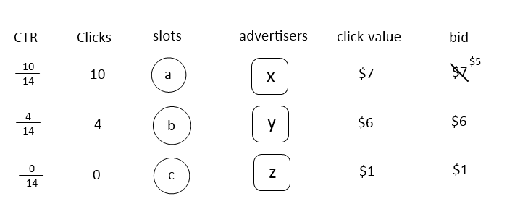
GSP: properties
Claim: bidding your value is not always best.
Example:

Slide 15
Budgets
Budget :
Advertiser specifies a bid and budget.
If the total spent + bid < budget
Ignore budget
Otherwise: bidder can not participate
Advertiser do use budget
Limit the total spent
Limit the risk
Complex strategic behavior

Slide 16
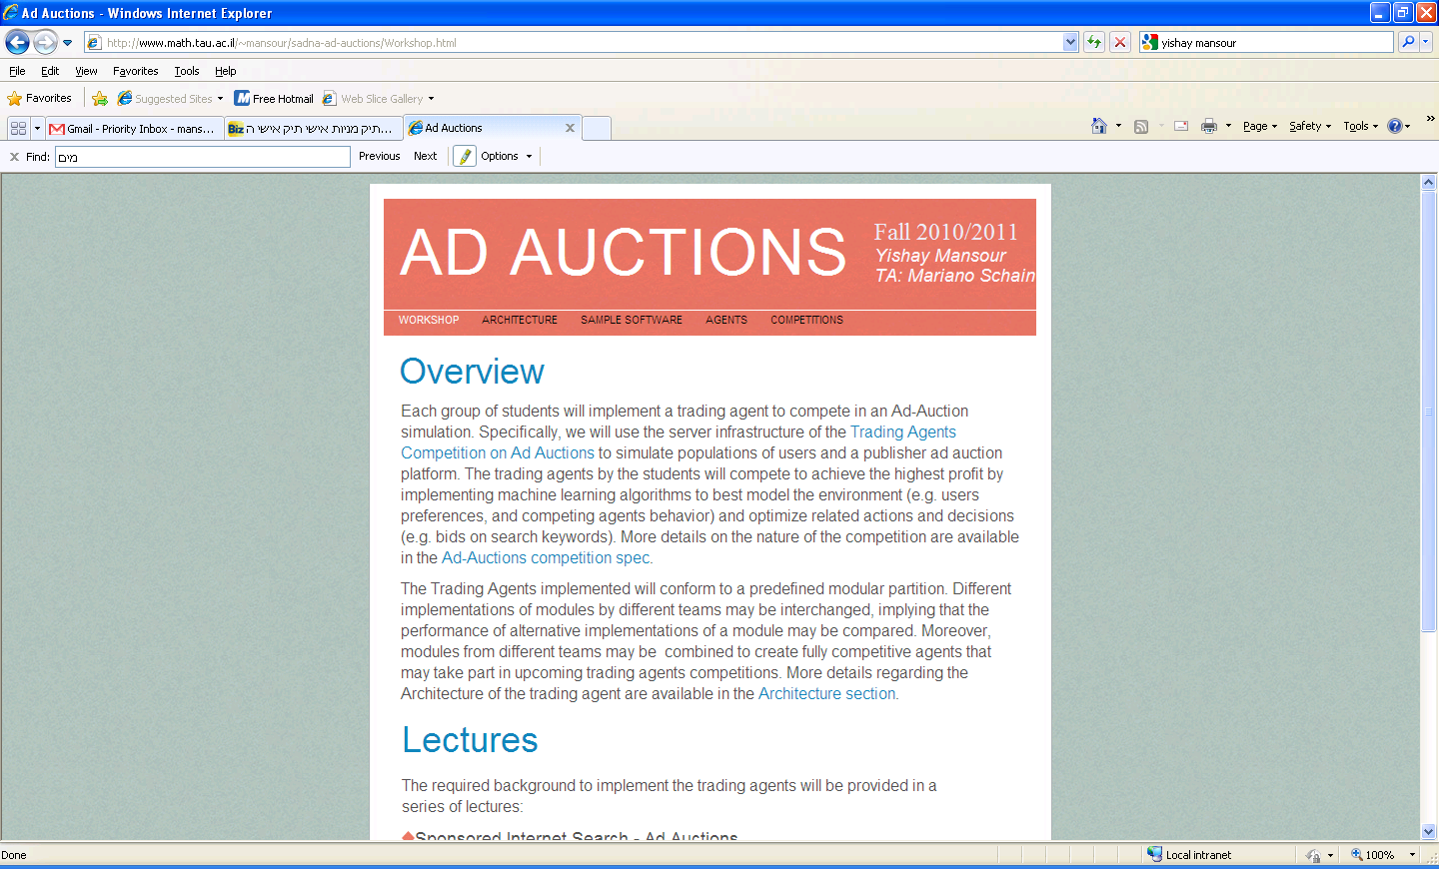

Slide 17
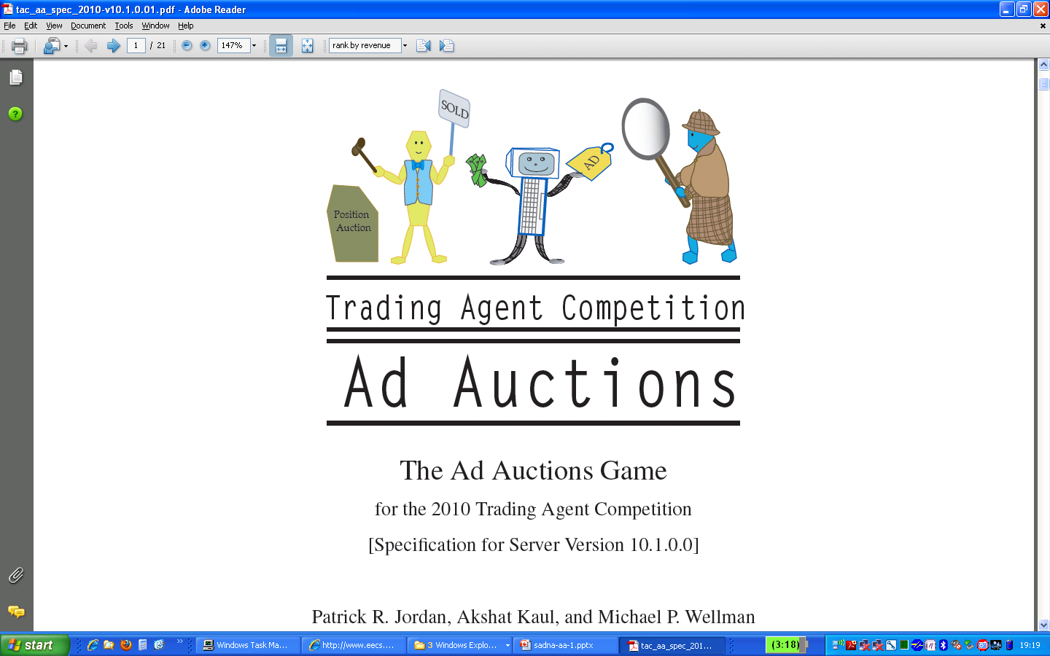

Slide 18
The Project
Write code for an advertiser
Participate in a simulation of an Ad Auction

Slide 19
ee

Slide 20
Overview of the system
Products:
Three products:
TV audio, dvd
Three manufacturers:
Lioneer, PG, Flat
Agent - input:
preferred product and manufacturer
Slightly higher profits
Limited inventory
Lower conversions when “over-selling”

Slide 21
Overview of the system
Queries and users:
Users can be in a few modes
Submit one of three type queries:
Product and manufacturer
9 combinations
One of Product or manufacturer
6 combinations
Neither
1 combination

Slide 22
Overview of the system
Competition:
Duration: 60 days
Each day, each agent:
Submit bids and budgets
Bids using ad type
Each day, publisher:
Simulates the auction
End of a day:
Agent receive statistics of previous day

Slide 23
General comments
Read the spec definition for next class
Not important to follow all the details
What will you receive:
Server – running to do the simulations
Test agents – to pay with
Basic Agent – to understand the architecture
Implementation:
Need to follow the given API
More: next class
What can you use:
Any software
Need to document: WHICH software and WHERE is it used

