Slide 1
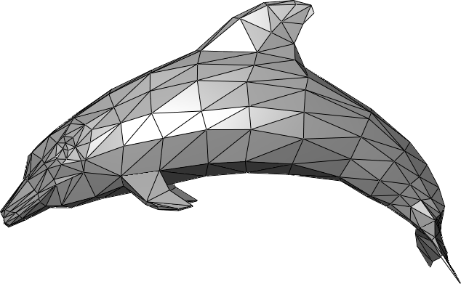
Good Triangulations and Meshing
Lecturer: Ofer Rothschild
Notes:
\sharp \Delta (P, D) = \int_{p \in D}\frac{1}{(lfs_{_P}(p))^2} = \sum_{\Box_v \in D}\int_{p \in \Box_v}\frac{1}{(lfs_{_P}(p))^2} \geq \sum_{\Box_v \in D}\frac{1}{c^2} = \frac{m}{c^2}
1/sin(\phi) \leq A_{ratio}( \triangle ) \leq 2/sin(\phi)
\phi \geq 1/A_{ratio}(\triangle)
||e_{_{long}}||/||e_{_{short}}|| \leq c_2
E_{ratio}(\triangle) \geq A_{ratio}(\triangle)

Slide 2
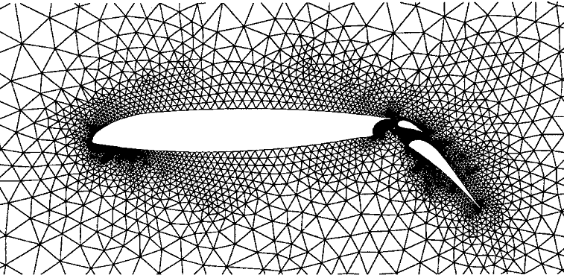
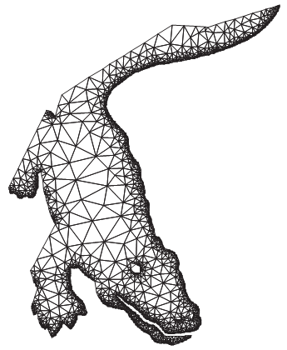
Problem with the borders

Slide 3
Meshes without borders
Given a set of points in [1/4, 3/4]X[1/4, 3/4]
With diameter > ½
The points are vertices in the triangulation

Slide 4
Fat triangulation
Aspect ratio of a triangle: the longest side divided by its height
We want to minimize the maximal aspect ration in the triangulation
Alpha-fat triangulation
The longest dimension to the shortest

Slide 5
Balanced quadtrees
Corner
Split
Balanced: No more than one split in each side
And no compressed nodes

Slide 6
Extended cluster
Extended cluster of a cell: 9X9 cells around it with the same size

Slide 7
Well-balanced quadtree
Balanced
Every none-empty cell has all its extended cluster,
And doesn’t have any other point in it

Slide 8
Points -> Well balanced quadtree
Given a set of points
Time: O(n log n + m)
Build a compressed quadtree
Uncompress it
Make it balanced
Make it well balanced

Slide 9
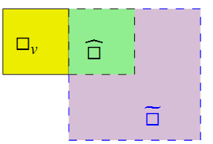
Make it balanced
Queue of all nodes
Hash table of id -> node
For each node side:
Does or exist?
Create and all its parents
O(m) time

Slide 10
Make it well balanced
For every point p and its leaf cell :
If the (theoretical) extended cluster contains other points:
Split enough times and insert its extended cluster
Rebalance the new nodes
Time: testing time + new nodes

Slide 11
Emptiness of EC
During the algorithm:
We remember for every node if it contains points in its sub tree
For every cell in the EC:
If it exists, check the flag.
Otherwise, its parent exists as a leaf.
If the parent isn’t empty, test the point.
Add illustration

Slide 12
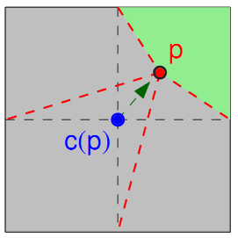
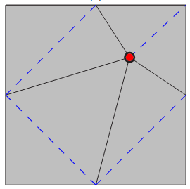
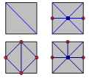
Well balanced -> Triangulation
For every point: warp the cells and triangulate:
For other cells:

Slide 13
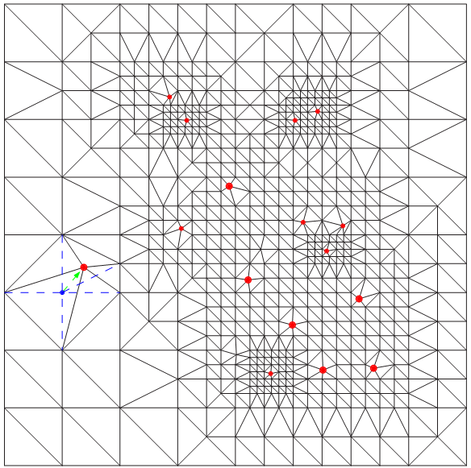

Slide 14
The aspect ratio is at most 4
For cells without points: 2

Slide 15
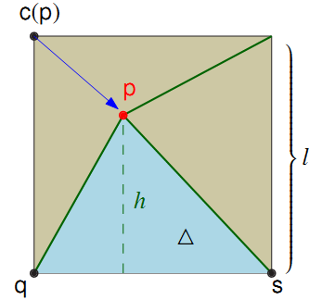
Warped cells: point inside cell

Slide 16
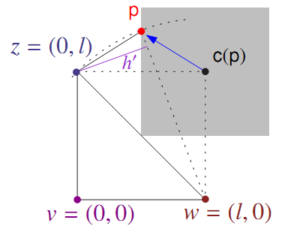
Warped cells: point outside of cell

Slide 17
Local feature size
For any point p in the domain, lfs_{P}(p): the distance from the second closest point in P.
The size of the triangulation:

Slide 18
Upper bound
The leaves are not much smaller than lfs:

Slide 19
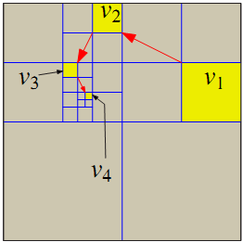
J’accuse: why the cell exists
EC of a point
Original quadtree cell
Cell with a point
Empty cell
Balance condition
Blame another cell
 | *
*

Slide 20
m = O(#Δ(P, D))

Slide 21
Lower bound
Assume a triangulation with aspect ratio α.

Slide 22
Aspect ratio
Let phi be the smallest angle in a triangle.
In particular,

Slide 23
Edge ratio

Slide 24
p

Slide 25
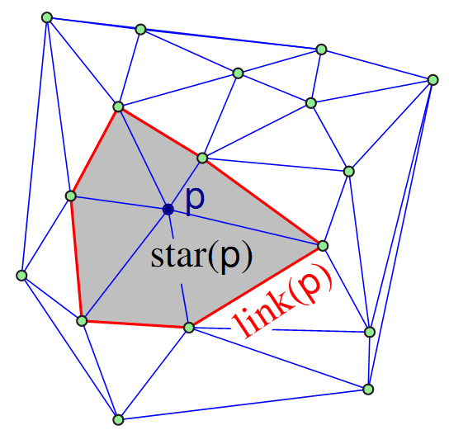
Star and link

Slide 26
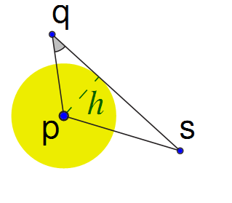
Disk in star
Let e be the longest edge of p.
The disk with radius:
centered at p, is contained in star(p).
p

Slide 27
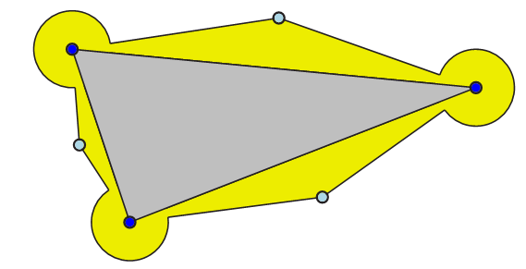
Empty buffer around the triangle

Slide 28
We prove that every triangle contributes a constant to the integral of #.
So the whole integral is proportional to the number of triangles.

Slide 30
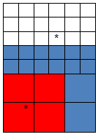
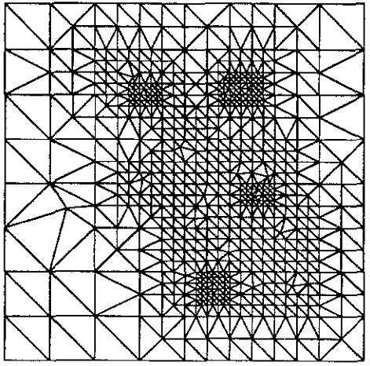
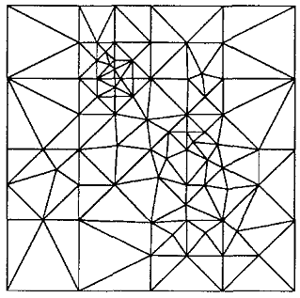
Supplementaries
5 X 5
9 X 9
Size of the triangulation

Slide 31
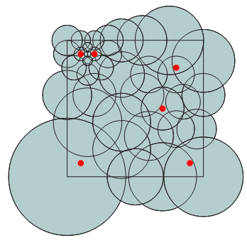
Covering by disks
Given a set of points P in a domain D:
Cover the domain with a small number of disks, s.t.:
Every disk contains up to one point of P
Every two intersecting disks
have roughly the same radius

Slide 32
A greedy algorithm
For every uncovered point p in D, add the disk with size
Clearly, the algorithm stops

Slide 33
Lemma: lfs is 1-Lipschitz

Slide 34
Intersecting disks are about the same size
q
p
r'
r

Slide 35
No point in the plane is covered by more than O(1) disks

Slide 36
How many disks do we expect?
If lfs(p) is α, the radius is α /2 and the area is Θ(α ²).
If the lfs is the same everywhere:
Number of disks will be Θ(area(D)/ α² )

Slide 37
But the lfs changes

