Slide 1
Lower Envelopes
Yuval Suede

Slide 2
What’s on the menu?
Lower Envelopes
Davenport-Schinzel Sequences
Trivial upper bound
Super linear complexity*
Tight upper bound

Slide 3
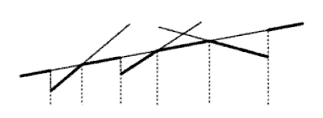
Lower Envelope
Informal definition:
The part that can be seen by observer sitting at and looking upward.
Lower Envelope is the graph of the pointwise minimum of the (partially defined) functions.

Slide 4
Davenport-Schinzel Sequences
Let be the maximum number of pieces in the lower envelope.
We are interested in finding upper bound to
Davenport-Schinzel Seq. is a combinatorial abstraction of lower envelopes that is used to obtain a tight upper bound.

Slide 5
Davenport-Schinzel Sequences
Let us consider a finite set of curves in the plain:
Suppose that each curve is a graph of continuous function
Assume that every two curves intersect at most s points for some constant s.

Slide 6
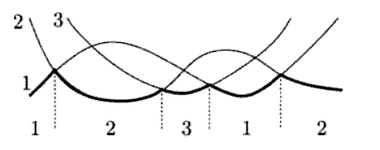
Davenport-Schinzel Sequences
Let us number the curves 1 through n, and write down the sequence of the numbers along the lower envelope:
We obtain a sequence a1a2 ... am with the properties:
(1)
(2) No two adjacent terms coincide; i.e. ,

Slide 7
Davenport-Schinzel Sequences
(3) There is no subsequence of the form:
note: between an occurrence a curve a and occurrence of a curve b, a and b have to intersect.

Slide 8
Davenport-Schinzel Sequences
Theorem: Each D-S sequence of order s over n symbols corresponds to the lower envelope of a suitable set of n curves with at most s intersections between each pair.

Slide 9
Davenport-Schinzel Sequences
Given DS sequence U=(a1a2 ... am) of order s over n symbols:
Suppose that the leftmost appearance of symbol i precedes the leftmost appearance of j iff I < j
Choose m-1 transition points on the x-axis, and n+m-1 distinct horizontal levels, at y=1,2,..,n,-1, -2,…,-(m-1).
For each symbol the graph fa is horizontal at one of this levels except for short intervals near of the transition points.

Slide 10
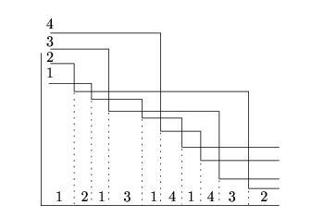
Davenport-Schinzel Sequences
Each pair of functions intersect in at most s points.

Slide 11
Davenport-Schinzel Sequences
Each pair of segments intersect once – is it DS(n,1)?
We can convert each segment into a graph of an everywhere-defined function:
Each pairs of these curves have at most 3 intersections, and so we have DS sequence of order 3 (no ababa).

Slide 12
Trivial upper bound
Let be the maximum possible length of Davenport-Schinzel sequence of order s over n symbols.
Theorem: = n
Proof:
Let U be a DS(n,1)-sequence.
U cannot contain any subsequence a .. b .. a
therefore all elements of U are distinct

Slide 13
Trivial upper bound
Theorem:
Proof (by induction):
Case n=1: …
Suppose the claim holds for n-1, and let U be DS(n,2)-sequence. Again assume leftmost occurrence of i before j for i<j in U.
Then n has only 1 occurrence in U or else the forbidden pattern (.. x .. n .. x .. n) appears
Remove the appearance of n and at most one of its neighbors if they are equal.

Slide 14
Trivial upper bound
The resulting sequence is DS(n-1,2) and has one or two elements less.
Therefore D(n,2) has 2*(n-1) -1 + 2 =
= 2n -3 + 2 = 2n – 1 length at most.

Slide 15
Trivial upper bound
Determining asymptotic of is hard
Was first posed on 1965.
Solved in the mid-1980s.
Proposition:
Proof:
Let w be DS(n,3).
if the length of w is m, there is a symbol a occurring at most times in w.

Slide 16
Trivial upper bound – proof(cont.)
Let us remove all occurrences of a from w.
The resulting sequence can contain pairs of identical adjacent symbols
But there are only 2 pairs at most – the ones of the first and last occurrence of a in w.
Else, we would get the sequence (.. a .. bab .. a ..)
By deleting all the a and at most 2 symbols we get DS(n-1,3)

Slide 17
Trivial upper bound – proof(cont.)
We get the recurrence:
Which can be written as:
We know that and so we get:
And so :

Slide 18
Super linear complexity
Maybe the upper bound is O(n)?
Theorem(7.2.1):
The function is superlinear – for every C there exists an n0 such that σ(n0) Cn0

