Slide 1
Cutting trees and the cutting lemma
Presented by Amir Mograbi

Slide 2
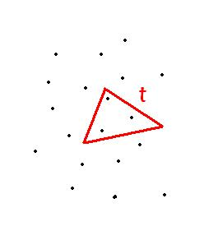
Goal:
Solve the Triangular range counting problem.
The problem:
Given a set S of n points in the plane and a triangle t, count the points in t.
t contains 3 points
For now lets forget it altogether,
We must perform some steps before.

Slide 3
Cutting Trees
Definition: given a set L of n lines in the plane
A (1/r)-cutting is the partitioning of the plane into triangles (possibly unbounded) so that each triangle is intersected by at most n/r line.
The size of the cutting is defined as the number these triangles.

Slide 4
An example:
A (1/2)-cutting of size 10 in a plane with a set of 6 lines
n/r = 6/2 = 3 the maximum of lines to intersect a triangle.

Slide 5
The cutting lemma
For any set L of n lines in the plane, and any parameter r with 1≤r≤n, a (1/r)-cutting of size O(r^2) exists.

Slide 6
A new problem:
Given a set L of n lines in the plane.
Query: given a point p, count how many lines are below p.

Slide 7
Solution:
We solve this by building a cutting tree over the set of lines, and performing the query using it.

Slide 8
Structure of Cutting trees
The tree structure is recursively defined as follows:
Given a (1/r)-cutting of size O(r^2) of the plane, and a set L of lines.
If there is only one line in L, the tree consists of a single leaf where L is explicitly stored.
l

Slide 9
Structure of Cutting trees – cont.
If L consists of more than 1 line the tree will consist of a root with r^2 children.
each child corresponds to a single triangle of the cutting.
each child v, contains:
L-(v) number of all lines under it.
L+(v) number of lines above it.
τ(v) a cutting tree over lines intersecting v.
…
r^2 direct children of the root each refers to a triangle of the cut
Note: using a new (1/r)-cutting of the triangle which corresponds to v.

Slide 10
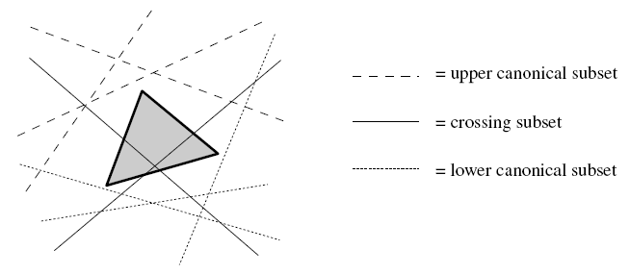
Structure of Cutting trees – cont.
A visual example of L-(v) L+(v)
Yes, they are called “canonical subsets” but I spared you the jargon earlier.

Slide 11
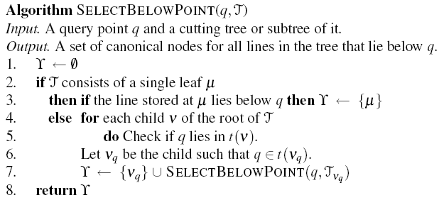
Using cutting trees
Given a point p and a set L of n lines in the plane we want to count the number of lines under p.
Algorithm:

Slide 12
Space and Time requirements
We now prove that using the “select Below Point” algorithm takes time, and the cutting tree used by the algorithm takes
Proof: Let Q(n) denote the runtime, it satisfies:
Which solves to:

Slide 13
Finding time complexity

Slide 14
Space and Time requirements – cont.
According to the cutting lemma:
Given r ,we can construct a (1/r)-cutting for L of size ,c is a constant.
Let ε>0 we will prove that by wisely choosing r we could make the space complexity:
Resolve to:

Slide 15
Since we have cr^2 children, each a cutting tree over at most 1/r lines.

Slide 16
Let p=cr^2
Now it boils down to this!
This is a geometrical series and p<1, thus its bounded by the constant 1/(1-p)
so its O(1)

Slide 17
We promised that complexity would be proved to be:
For any ε>0
c is a constant we cant change (given by the cutting lemma)
On the other hand, r we can choose!
So for a required ε let
Now we look at this
Combining the above we get:

Slide 18
Space Time complexity recap
We saw that we can query (count and select) the number of lines under a point in:
Time:
Space:
Where n is the number of lines, and ε>0 is as small as we want.

Slide 19
Cutting Trees – two level tree
Earlier we solved the query: “find the number of lines below a point”
Now we see how we solve this new query:
Input: two points q1 q2, a set L of n lines
Query: count the lines from L below both q1 & q2.

Slide 20
At first glance…
Hold your horses! Can’t we just determine which point is lower and query for lines below that point like we did before?
Absolutely Not!

Slide 21
Cutting Trees – two level tree cont.
Structure of a two level cutting tree:
first we construct a cutting tree as before, T
for each direct child of the root of T:
In addition to L-(v) the number of lines below v we store T-(v), which is a cutting tree over the lines below v.
T-(v)
…
v
T(v)

Slide 22
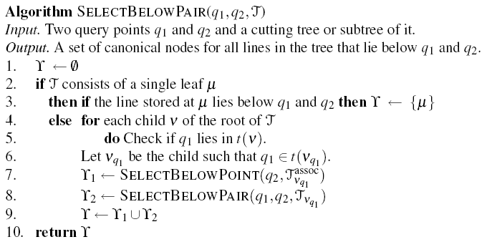
Cutting Trees – two level tree cont.
Algorithm:

Slide 23
Two level cutting tree - Analysis
We will prove that adding the extra level will:
Keep space complexity as before:
Worsen time complexity to:
Which solves to:
Which solves to

Slide 24
The only difference here is that we replace r^2 with r^2 + O(logn)
After replacing:

Slide 25
Since we have cr^2 children, each a cutting tree over at most 1/r lines.

Slide 27
Three level cutting tree
A three point query
Given:
a set L of n lines in the plane
Query:
For a triple of points, each of which has a direction attached (below/above):
Find out how many lines answer the criteria of the points.

Slide 28
Three level cutting tree - structure
Root
Direct child
2-level tree over lines below
3-level tree over intersecting lines
2-level tree over lines above

Slide 29
Three level cutting tree
Input: three query points p1,p2,p3, with ↑↓, a 3-level cutting tree T
Output: a set of all canonical subsets that fulfill criteria
SelectTriple(p1,p2,p3,T) (we assume p1↓,p2↓,p3↑)
γ←Ø
If T is a single leaf
Then – check explicitly if the line fulfills criteria
Else - find the child which p3 belongs to – Vp3
γ1 ← SelectTriple(p1,p2,p3,T(Vp3))
γ2 ← SelectBelowPair(p1,p2,T+(Vp3))
γ ← γ1 U γ2
Return γ

Slide 30
Three level cutting tree - Analysis
Similarly to its two level variant:
Lets look at the recurrence
Time:
Space:
Which solves to:
Which solves to

Slide 31
Applying to our first problem:
Using the duality transform
we convert the set of points P to a set of lines L.
convert the three lines of the query triangle into a triple with above/below tag.
perform the query, and then we can convert the lines found back to the original points.

