Slide 1
Seminar on differential privacy, fall 19/20
Haim Kaplan

Slide 2
Data Privacy – The Problem
Given:
  a dataset with sensitive information
    Health records, census data, financial data, …
How to:
  Compute and release functions of the dataset,
  Without compromising individual privacy.

Slide 3



Data Privacy – The Problem
Individuals
Server/agency (trusted)
Users
(
)
Government,
researchers,
businesses
(or)
Malicious
adversary
queries
A
answers
Notes:
Say:
-- “background knowledge”
-- more of an issue now than it was twenty years ago
Add UT logo

Slide 4
A Real Problem
Typical examples:
Census
Civic archives
Medical records
Search information
Communication logs
Social networks
Genetic databases
…
Benefits:
New discoveries
Improved medical care
National security
discoveries
med care
privacy
security

Slide 5
The Anonymization Dream
Database
Anonymized Database
Trusted server:
  Removes identifying information (name, address, ssn, …).
  Replaces identities with random identifiers.
Idea hard wired into practices, regulations, …, thought.
  Many uses.
Reality: it fails.
  Pronounced both in academic and public literature.

Slide 6
Reidentification Linkage Attacks [Sweeney 2000]
GIC
Group Insurance
Commission
patient specific data
(≈ 135,000 patients)
  ≈100 attributes
  per encounter
    Anonymized
Voter registration
of Cambridge MA
  “Public records”
  open for inspection by anyone
Name
Address
Date registered
Party affiliation
Date last voted
Ethnicity
visit date
Diagnosis
Procedure
Medication
Total Charge
ZIP
Birth date
Sex
ZIP
Birth date
Sex
Anonymized GIC data
Voter registration

Slide 7
Reidentification Linkage Attacks via Quasi identifiers
William Weld (governor of Massachusetts at the time)
  According to the Cambridge Voter list:
    Six people had his particular birth date
    Of which three were men
    He was the only one in his 5-digit ZIP code!
Notes:
Idea is recurring, probably rediscovered every few years (there;s a paper by Dalenius from 86). What’s interesting here is that this really works and in masses.

Slide 8
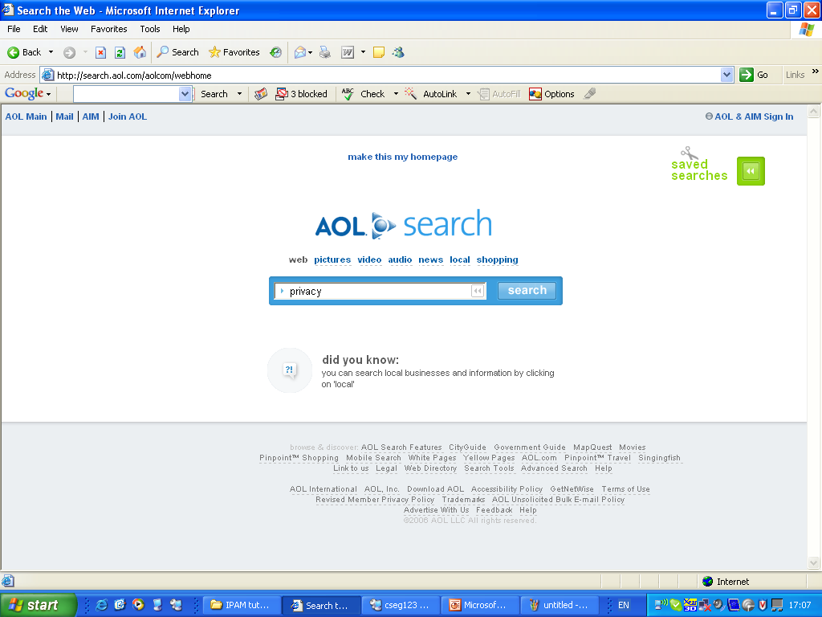

Slide 9
AOL Data release (2006)
AOL released search data
  A sample of ~20M web queries collected from ~650k users over three months
Goal: provide real query log data that is based on real users
  “It could be used for personalization, query reformulation or other types of search research”
The data set:
AnonID
Query
QueryTime
ItemRank
ClickURL

Slide 10
4417749 best dog for older owner 3/6/2006 11:48:24 1 http://www.canismajor.com
4417749 best dog for older owner 3/6/2006 11:48:24 5 http://dogs.about.com
4417749 landscapers in lilburn ga. 3/6/2006 18:37:26
4417749 effects of nicotine 3/7/2006 19:17:19 6 http://www.nida.nih.gov
4417749 best retirement in the world 3/9/2006 21:47:26 4 http://www.escapeartist.com
4417749 best retirement place in usa 3/9/2006 21:49:37 10 http://www.clubmarena.com
4417749 best retirement place in usa 3/9/2006 21:49:37 9 http://www.committment.com
4417749 bi polar and heredity 3/13/2006 20:57:11
4417749 adventure for the older american 3/17/2006 21:35:48
4417749 nicotine effects on the body 3/26/2006 10:31:15 3 http://www.geocities.com
4417749 nicotine effects on the body 3/26/2006 10:31:15 2 http://health.howstuffworks.com
4417749 wrinkling of the skin 3/26/2006 10:38:23
4417749 mini strokes 3/26/2006 14:56:56 1 http://www.ninds.nih.gov
4417749 panic disorders 3/26/2006 14:58:25
4417749 jarrett t. arnold eugene oregon 3/23/2006 21:48:01 2 http://www2.eugeneweekly.com
4417749 jarrett t. arnold eugene oregon 3/23/2006 21:48:01 3 http://www2.eugeneweekly.com
4417749 plastic surgeons in gwinnett county 3/28/2006 15:04:23 1 http://www.wedalert.com
4417749 plastic surgeons in gwinnett county 3/28/2006 15:04:23 4 http://www.implantinfo.com
4417749 plastic surgeons in gwinnett county 3/28/2006 15:31:00
4417749 60 single men 3/29/2006 20:11:52 6 http://www.adultlovecompass.com
4417749 60 single men 3/29/2006 20:14:14
4417749 clothes for 60 plus age 4/19/2006 12:44:03
4417749 clothes for age 60 4/19/2006 12:44:41 10 http://www.news.cornell.edu
4417749 clothes for age 60 4/19/2006 12:45:41
4417749 lactose intolerant 4/21/2006 20:53:51 2 http://digestive.niddk.nih.gov
4417749 lactose intolerant 4/21/2006 20:53:51 10 http://www.netdoctor.co.uk
4417749 dog who urinate on everything 4/28/2006 13:24:07 6 http://www.dogdaysusa.com
4417749 fingers going numb 5/2/2006 17:35:47

Slide 11
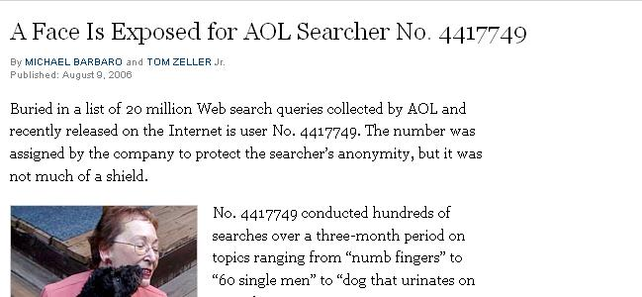
Name: Thelma Arnold
Age: 62
Widow
Residence: Lilburn, GA

Slide 12
Other Re-Identification Examples
[partial and unordered list]
Netflix award [Narayanan, Shmatikov 08].
Social networks [Backstrom, Dwork, Kleinberg 07, NS 09].
Computer networks [Coull, Wright, Monrose, Collins, Reiter ’07, Ribeiro, Chen, Miklau, Townsley 08].
Genetic data (GWAS) [Homer, Szelinger, Redman, Duggan, Tembe, Muehling, Pearson, Stephan, Nelson, Craig 08, ...].
Microtargeted advertising [Korolova 11].
Recommendation Systems [Calandrino, Kiltzer, Naryanan, Felten, Shmatikov 11].
Israeli CBS [Mukatren, N, Salman, Tromer].
…
Notes:
Add references

Slide 13
k-Anonymity [SS98,S02]
Def: A data base is said be k-anonymized if every combination of values of protected columns appears at least k times.
Example: A 2-anonymized data set:
Zip | Age
4217 | 34
4217 | 34
1742 | 77
1742 | 77
4217 | 34

Slide 14
k-Anonymity [SS98,S02]
Def: A data base is said be k-anonymized if every combination of values of protected columns appears at least k times.
Example: Are the following databases 2-anonymized ?
Zip | Age
4217 | 34
4217 | 34
1742 | 77
1743 | 77
4217 | 34
Zip | Age
4217 | 34
4217 | 34
1742 | 34
1742 | 77
4217 | 34
Intuitively prevents re-identification linkage attacks

Slide 15
k-Anonymity (difficulties)
Not clear how to choose the protected columns (quasi identifiers)
Not clear how to choose k

Slide 16
k-Anonymizing
Generalization:
Zip | Age
4217 | 34
4217 | 39
1742 | 79
1691 | 75
4217 | 34
Zip | Age
4217 | 34-29
4217 | 34-29
1*** | 75-79
1*** | 75-79
4217 | 34-29
Suppression:
Zip | Age
4217 | 34
4217 | 39
1742 | 79
1691 | 75
9755 | 13
Zip | Age
4217 | 34-29
4217 | 34-29
1*** | 75-79
1*** | 75-79

Slide 17
k-Anonymity -- algorithms
It is NP-hard to find the optimal k-anonymization (for many notions of optimality)
Approximation algorithms have been developed, and there are some publicly available tools.
For references and more information see this Blog post by Desfontaines

Slide 18
Respond to queries
Do not publish an anonymized data set
Only answer queries
Do not answer queries on small subsets only on large aggregates

Slide 19
Differencing attack
I know you have done an HIV test during the second week of October 2019
Consider the queries:
How many HIV postives are in the database that were registered by the end of September 2019 ?
How many HIV positives are in the database today ?

Slide 20
Auditing
Here’s the answer
OR
Query denied (as the answer would cause privacy loss)
Here’s a new query: q_{i+1}
Statistical
database
Auditor
Query log
q₁,…,q_{i}

Slide 21
Example : Sum/Max auditing
  d_{i} real, sum/max queries, privacy breached if some d_{i} learned
q1 = sum(d1,d2,d3)
sum(d1,d2,d3) = 15
q2 = max(d1,d2,d3)
Denied (the answer would cause privacy loss)
Oh well…
Auditor

Slide 22
… After Two Minutes …
  d_{i} real, sum/max queries, privacy breached if some d_{i} learned
q1 = sum(d1,d2,d3)
sum(d1,d2,d3) = 15
q2 = max(d1,d2,d3)
Denied (the answer would cause privacy loss)
There must be a reason for the denial…
q2 is denied iff d1=d2=d3 = 5
I win!
Oh well…
Auditor

Slide 23
Randomization
Add some random noise to your aggregated answers..
Example: Return sum(rows that satisfy some criteria) + noise

Slide 24
Note
We still do not have a definition of what notion of privacy we want
But we certainly do not want the attacker to reconstruct the data…

Slide 25
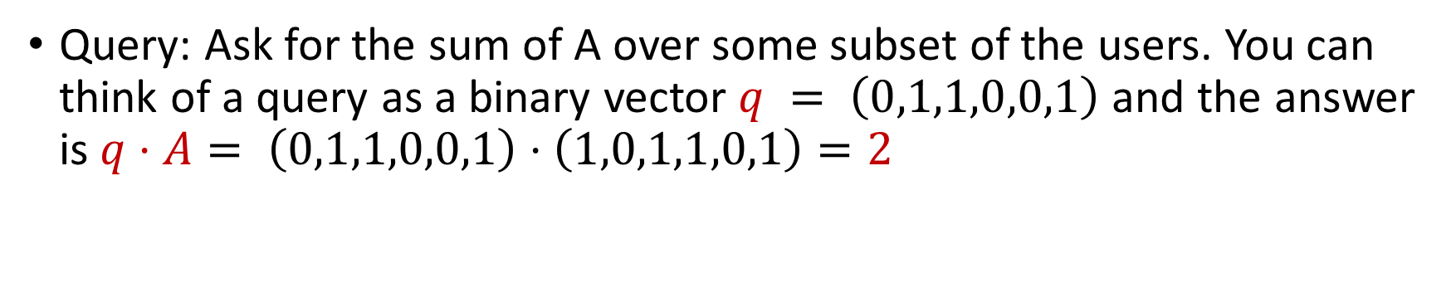
Reconstruction attacks (You cannot allow too many queries…)
Consider a single binary attribute
user | A
1 | 1
2 | 0
3 | 1
4 | 1
5 | 0
6 | 1
Query: Ask for the sum of A over some subset of the users. You can think of a query as a binary vector $q = \left(0,1,1,0,0,1\right)$ and the answer is $q⋅A= \left(0,1,1,0,0,1\right)⋅\left(1,0,1,1,0,1\right)=2$

Slide 26
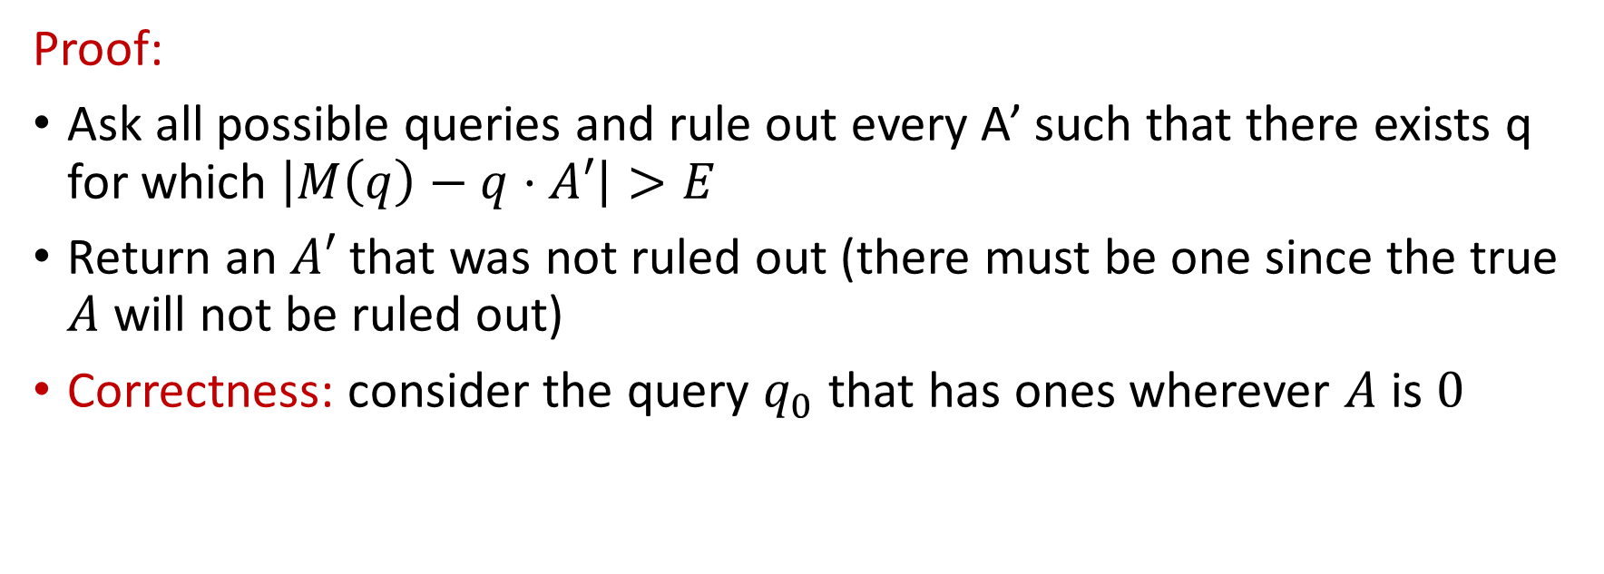
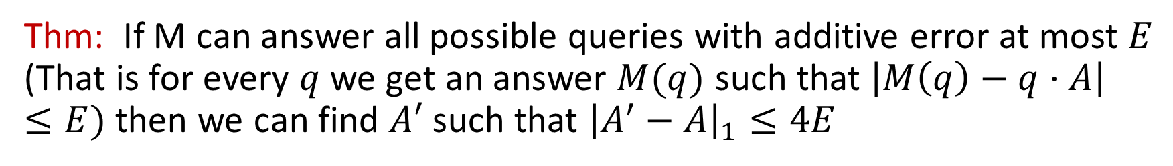
Reconstruction attacks
Thm: If M can answer all possible queries with additive error at most $E$ (That is for every $q$ we get an answer $M(q)$ such that $\left|M\left(q\right)−q⋅A\right|≤E)$ then we can find $A′$ such that ${\left|A^{′}−A\right|}_{1}≤4E$
Proof:
Ask all possible queries and rule out every A’ such that there exists q for which $\left|M\left(q\right)−q⋅A′\right|>E$
Return an $A′$ that was not ruled out (there must be one since the true $A$ will not be ruled out)
Correctness: consider the query $q_{0}$ that has ones wherever $A$ is $0$

Slide 27
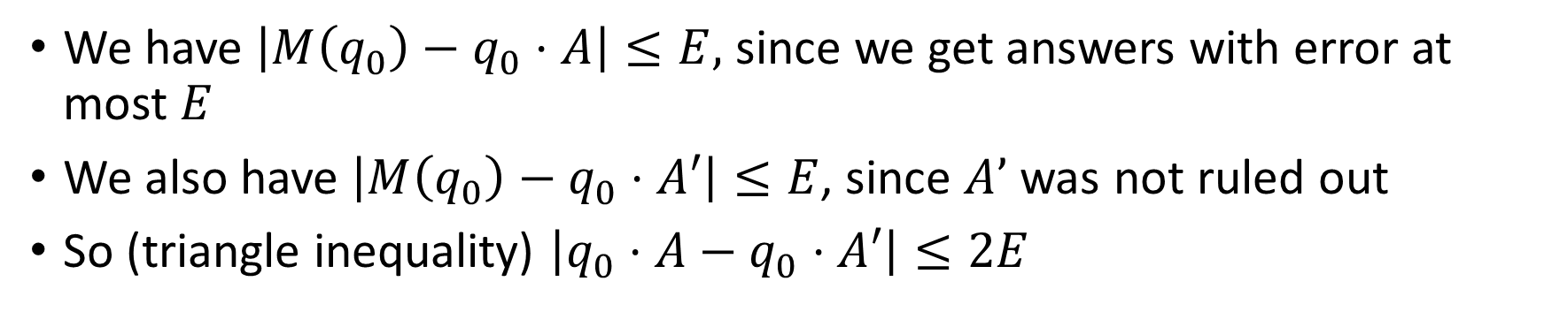
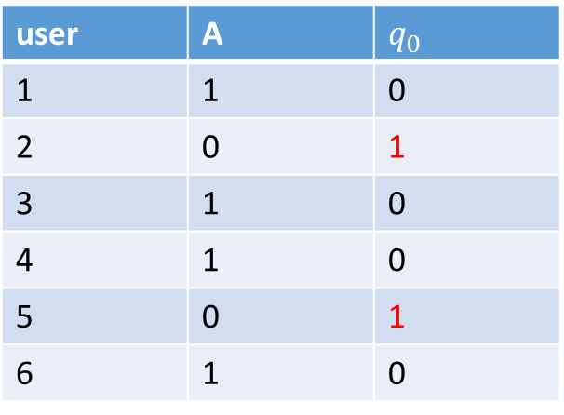
Reconstruction attacks
user | A | $$q_{0}$$
1 | 1 | 0
2 | 0 | 1
3 | 1 | 0
4 | 1 | 0
5 | 0 | 1
6 | 1 | 0
We have $\left|M\left(q_{0}\right)−q_{0}⋅A\right|≤E,$ since we get answers with error at most $E$
We also have $\left|M\left(q_{0}\right)−q_{0}⋅A′\right|≤E$, since $A’$ was not ruled out
So (triangle inequality) $\left|q_{0}⋅A−q_{0}⋅A′\right|≤2E$

Slide 28
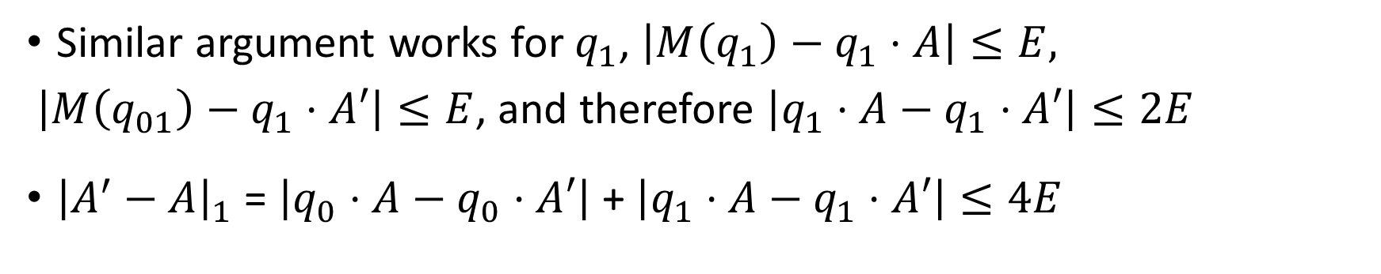
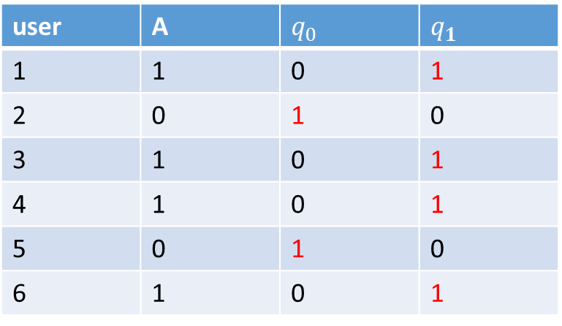
Reconstruction attacks
user | A | $$q_{0}$$ | $$q_{1}$$
1 | 1 | 0 | 1
2 | 0 | 1 | 0
3 | 1 | 0 | 1
4 | 1 | 0 | 1
5 | 0 | 1 | 0
6 | 1 | 0 | 1
Similar argument works for $q_{1}$, $\left|M\left(q_{1}\right)−q_{1}⋅A\right|≤E,$
$\left|M\left(q_{01}\right)−q_{1}⋅A′\right|≤E$, and therefore $\left|q_{1}⋅A−q_{1}⋅A′\right|≤2E$
${\left|A^{′}−A\right|}_{1}$ = $\left|q_{0}⋅A−q_{0}⋅A′\right|$ + $\left|q_{1}⋅A−q_{1}⋅A′\right|≤4E$

Slide 29
Summary so far
We will add noise… and
we will restrict the # of queries…
BUT, we still do not have a definition of privacy…

Slide 30

Differential Privacy [Dwork McSherry Nissim Smith 06]
Real world:
☺’s ideal world:
Data
Analysis
(Computation)
Outcome
$(ε,δ)$-”similar”
Data
w/☺’s info removed
Analysis
(Computation)
Outcome

Slide 31
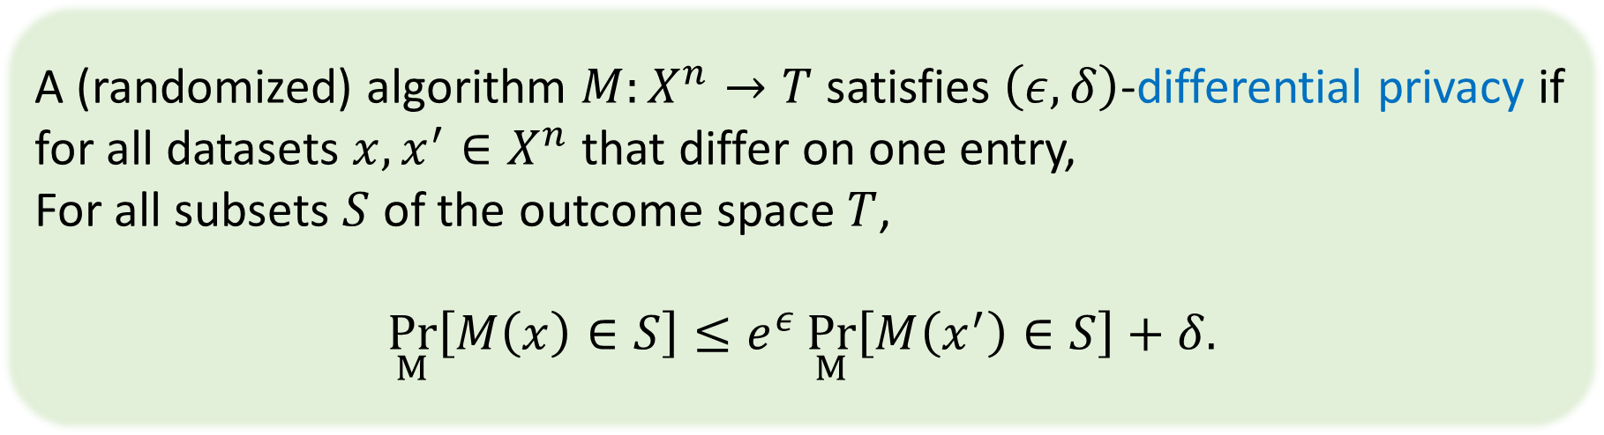
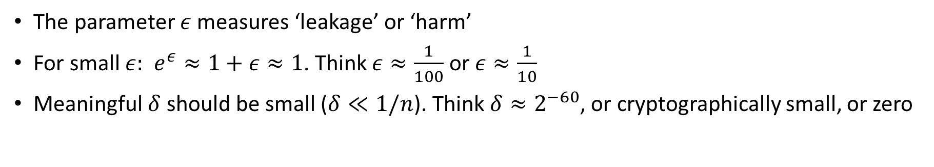
Differential Privacy [Dwork McSherry Nissim Smith 06/J2016]6]
A (randomized) algorithm $M:X^{n}→T$ satisfies $\left(ε,δ\right)$-differential privacy if
for all datasets $x,x^{′}∈X^{n}$ that differ on one entry,
For all subsets $S$ of the outcome space $T$,
$$\underset{M}{Pr}\left[M\left(x\right)∈S\right]≤e^{ε}\underset{M}{Pr}\left[M\left(x^{′}\right)∈S\right]+δ.$$
The parameter $ε$ measures ‘leakage’ or ‘harm’
For small $ε:$ $e^{ε}≈1+ε≈1$. Think $ε≈\frac{1}{100}$ or $ε≈\frac{1}{10}$
Meaningful $δ$ should be small ($δ≪1/n$). Think $δ≈2^{−60}$, or cryptographically small, or zero
$δ≪1/n$ (usually cryptographically small; “pure” differential privacy: $δ=0$)

Slide 32
Why Differential Privacy?
DP: quantifiable, composable mathematical privacy guarantee
Provably resilient to known and unknown attack modes!
Opens door to algorithmic development
  Theoretically, DP enables many computations with personal data while preserving personal privacy
  Practicality in first stages of validation
Has a natural interpretation

Slide 33
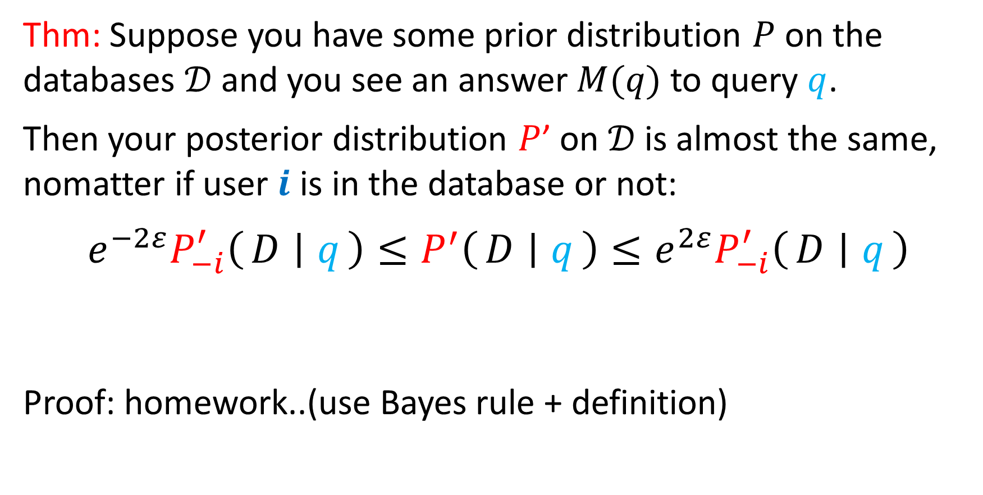
Interpreting Differential Privacy [Kasiviswanathan and Smith J2014]
Thm: Suppose you have some prior distribution $P$ on the databases $𝒟$ and you see an answer $M(q)$ to query $q$.
Then your posterior distribution $P$’ on $𝒟$ is almost the same, nomatter if user $i$ is in the database or not:
$$e^{−2ε}P_{−i}^{′}\left(D ∣ q\right)≤P^{′}\left(D ∣ q\right)≤e^{2ε}P_{−i}^{′}\left(D ∣ q\right)$$
Proof: homework..(use Bayes rule + definition)

Slide 34
Are you HIV positive?
Toss Coin
  If heads tell the truth
  If tails, toss another coin:
    If heads say yes
    If tails say no

Slide 35
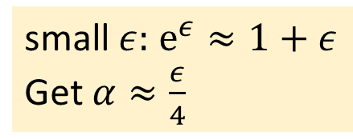
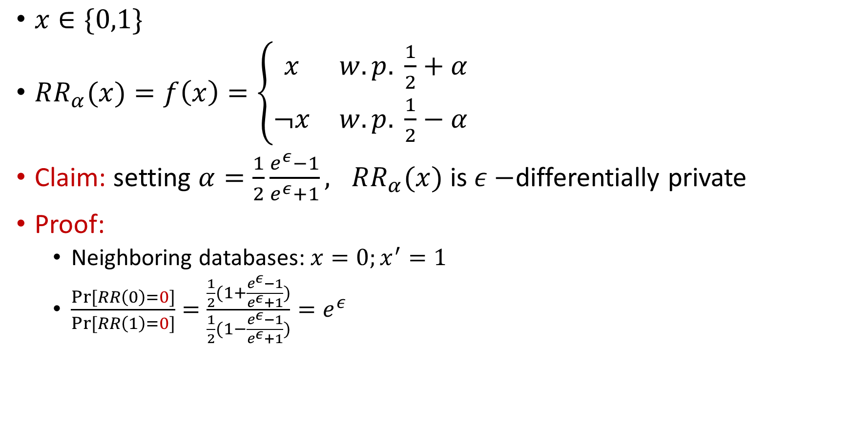
Randomized response [Warner 65]
$x∈\{0,1\}$
$RR_{α}(x)=f\left(x\right)=\left\{\begin{matrix}x & w.p. \frac{1}{2}+α \\ ¬x & w.p. \frac{1}{2}−α\end{matrix}\right.$
Claim: setting $α=\frac{1}{2}\frac{e^{ε}−1}{e^{ε}+1}, RR_{α}(x)$ is $ε−$differentially private
Proof:
  Neighboring databases: $x=0;x^{′}=1$
  $\frac{Pr⁡[RR\left(0\right)=0]}{Pr⁡[RR\left(1\right)=0]}=\frac{\frac{1}{2}(1+\frac{e^{ε}−1}{e^{ε}+1})}{\frac{1}{2}(1−\frac{e^{ε}−1}{e^{ε}+1})}=e^{ε}$
small $ε:$ $e^{ε}≈1+ε$
Get $α≈\frac{ε}{4}$

Slide 36
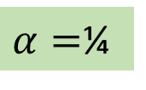

Randomized response [Warner 65]
$α=$¼
$x∈\{0,1\}$
$RR_{α}(x)=f\left(x\right)=\left\{\begin{matrix}x & w.p. \frac{1}{2}+α \\ ¬x & w.p. \frac{1}{2}−α\end{matrix}\right.$
Claim: setting $α=\frac{1}{2}\frac{e^{ε}−1}{e^{ε}+1}, RR_{α}(x)$ is $ε−$differentially private
Proof:
  Neighboring databases: $x=0;x^{′}=1$
  $\frac{Pr⁡[RR\left(0\right)=0]}{Pr⁡[RR\left(1\right)=0]}=\frac{\frac{1}{2}(1+\frac{e^{ε}−1}{e^{ε}+1})}{\frac{1}{2}(1−\frac{e^{ε}−1}{e^{ε}+1})}=e^{ε}$
w.p. ¾
w.p. ¼
small $ε:$ $e^{ε}≈1+ε$
Get $α≈\frac{ε}{4}$
$$ε=\ln{3}$$

Slide 37



Can we make use of randomized response?
Individuals
$$x_{1}$$
Analyzer (untrusted)
A
$$x_{2}$$
$$x_{n}$$
Notes:
Say:
-- “background knowledge”
-- more of an issue now than it was twenty years ago
Add UT logo

Slide 38



The local model
Individuals
$$x_{1}$$
$$Y_{1}=RR_{α}\left(x_{1}\right)$$
Analyzer (untrusted)
$$Y_{2}=RR_{α}\left(x_{2}\right)$$
A
$$x_{2}$$
$$x_{n}$$
$$Y_{n}=RR_{α}\left(x_{n}\right)$$
Notes:
Say:
-- “background knowledge”
-- more of an issue now than it was twenty years ago
Add UT logo

Slide 39
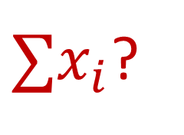
The local model
Individuals
$$x_{1}$$
$$Y_{1}=RR_{α}\left(x_{1}\right)$$
Analyzer (untrusted)
$$Y_{2}=RR_{α}\left(x_{2}\right)$$
A
$$x_{2}$$
$∑x_{i}$?
$$x_{n}$$
$$Y_{n}=RR_{α}\left(x_{n}\right)$$
Notes:
Say:
-- “background knowledge”
-- more of an issue now than it was twenty years ago
Add UT logo

Slide 40
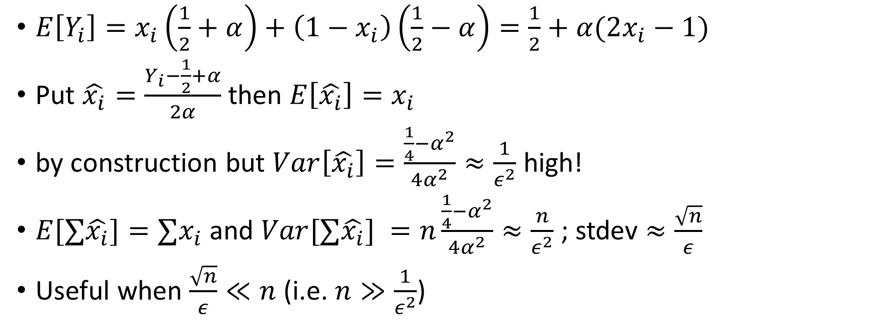
The local model
$E\left[Y_{i}\right]=x_{i}\left(\frac{1}{2}+α\right)+\left(1−x_{i}\right)\left(\frac{1}{2}−α\right)=\frac{1}{2}+α(2x_{i}−1)$
Put $\hat{x_{i}}=\frac{Y_{i}−\frac{1}{2}+α}{2α}$ then $E\left[\hat{x_{i}}\right]=x_{i}$
by construction but $Var\left[\hat{x_{i}}\right]=\frac{\frac{1}{4}−α^{2}}{4α^{2}}≈\frac{1}{ε^{2}}$ high!
$E[∑\hat{x_{i}}]={∑x}_{i}$ and $Var[∑\hat{x_{i}}] =n\frac{\frac{1}{4}−α^{2}}{4α^{2}}≈\frac{n}{ε^{2}}$ ; stdev $≈\frac{\sqrt{n}}{ε}$
Useful when $\frac{\sqrt{n}}{ε}≪n$ (i.e. $n≫\frac{1}{ε^{2}}$)

Slide 41
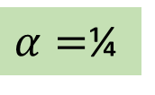
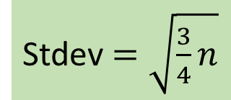
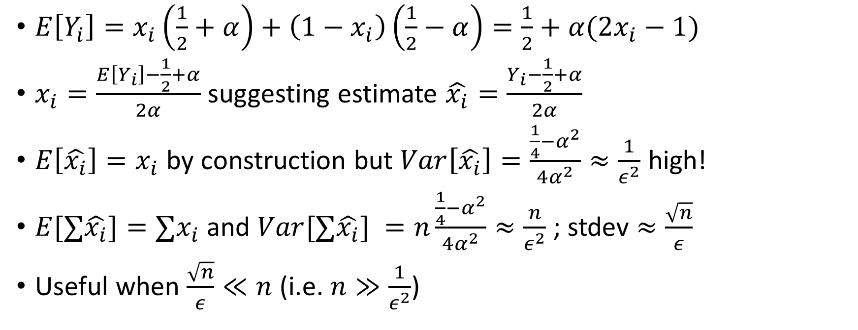


The local model
$α=$¼
$$E\left[Y_{i}\right]=\frac{1}{4}+\frac{x_{i}}{2}$$
$E\left[Y_{i}\right]=x_{i}\left(\frac{1}{2}+α\right)+\left(1−x_{i}\right)\left(\frac{1}{2}−α\right)=\frac{1}{2}+α(2x_{i}−1)$
$x_{i}=\frac{E\left[Y_{i}\right]−\frac{1}{2}+α}{2α}$ suggesting estimate $\hat{x_{i}}=\frac{Y_{i}−\frac{1}{2}+α}{2α}$
$E\left[\hat{x_{i}}\right]=x_{i}$ by construction but $Var\left[\hat{x_{i}}\right]=\frac{\frac{1}{4}−α^{2}}{4α^{2}}≈\frac{1}{ε^{2}}$ high!
$E[∑\hat{x_{i}}]={∑x}_{i}$ and $Var[∑\hat{x_{i}}] =n\frac{\frac{1}{4}−α^{2}}{4α^{2}}≈\frac{n}{ε^{2}}$ ; stdev $≈\frac{\sqrt{n}}{ε}$
Useful when $\frac{\sqrt{n}}{ε}≪n$ (i.e. $n≫\frac{1}{ε^{2}}$)
$$\hat{x_{i}}=2y_{i}−\frac{1}{2}$$
Stdev $=\sqrt{\frac{3}{4}n}$

Slide 42

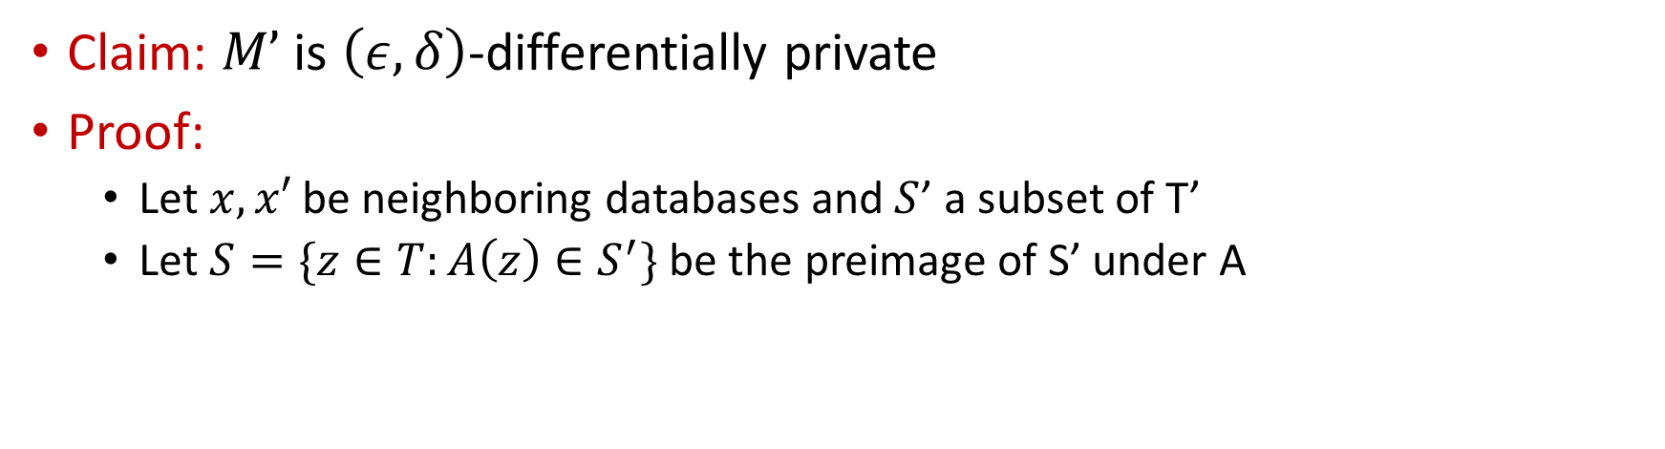

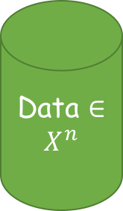






Basic properties of differential privacy: post processing
Data $∈X^{n}$
$$M:X^{n}→T$$
$$A:T→T′$$
M
$$\left(ε,δ\right)−DP$$
A
$$M’$$
Claim: $M’$ is $\left(ε,δ\right)$-differentially private
Proof:
  Let $x,x′$ be neighboring databases and $S$’ a subset of T’
  Let $S=\{z∈T:A\left(z\right)∈S^{′}\}$ be the preimage of S’ under A
$$\operatorname{Pr}\left[M^{′}\left(x\right)∈S^{′}\right]$$
$$=Pr\left[M\left(x\right)∈S\right]$$
$$≤e^{ε}\operatorname{Pr}\left[M\left(x^{′}\right)∈S\right]+δ$$
$$=e^{ε}\operatorname{Pr}\left[M^{′}\left(x^{′}\right)∈S′\right]+δ$$

Slide 43
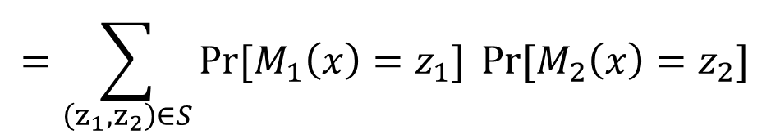
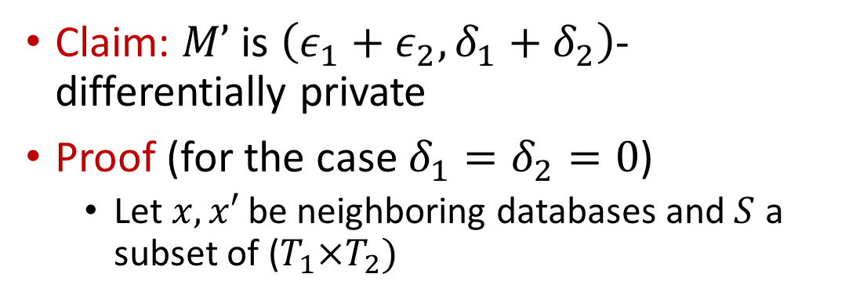
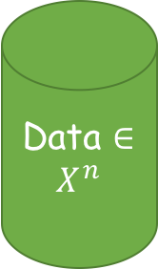


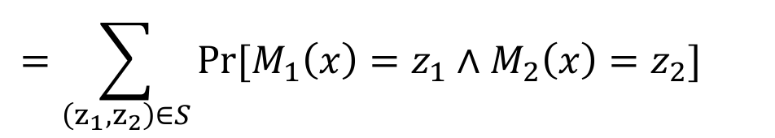




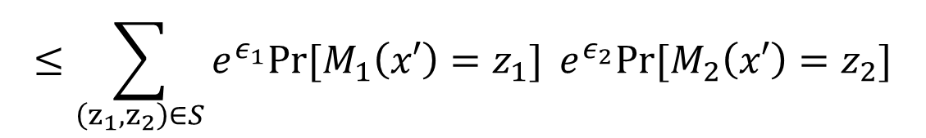
Basic properties of differential privacy: Basic composition [DMNS06, DKMMN06, DL09]
Data $∈X^{n}$
Claim: $M’$ is $\left(ε_{1}+ε_{2},δ_{1}+δ_{2}\right)$-differentially private
Proof (for the case $δ_{1}=δ_{2}=0$)
  Let $x,x′$ be neighboring databases and $S$ a subset of ($T_{1}×T_{2})$
M1
$$\left(ε_{1},δ_{1}\right)−DP$$
M2
$$\left(ε_{2},δ_{2}\right)−DP$$
$$=\sum_{\left(z_{1},z_{2}\right)∈S}{Pr⁡[M_{1}\left(x\right)=z_{1}∧M_{2}\left(x\right)=z_{2}]}{}$$
$$\operatorname{Pr}\left[M^{′}\left(x\right)∈S\right]$$
$$M’$$
$$M_{i}:X^{n}→T_{i}$$
$$=\sum_{\left(z_{1},z_{2}\right)∈S}{Pr⁡[M_{1}\left(x\right)=z_{1}]}{Pr⁡[M_{2}\left(x\right)=z_{2}]}$$
$$≤\sum_{\left(z_{1},z_{2}\right)∈S}{e^{ε_{1}}Pr⁡[M_{1}\left(x′\right)=z_{1}]}{e^{ε_{2}}Pr⁡[M_{2}\left(x′\right)=z_{2}]}$$
$$=e^{ε_{1}+ε_{2}}Pr\left[M^{′}\left(x′\right)∈S\right]$$

Slide 44
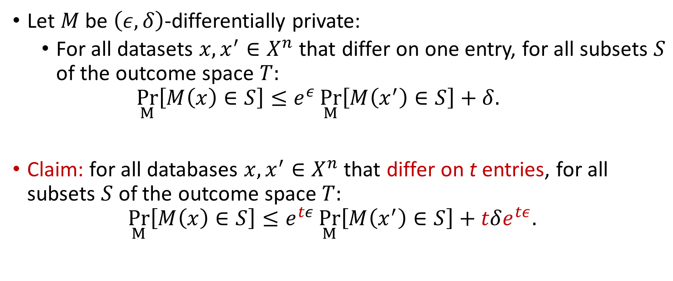
Basic properties of DP: Group privacy
Let $M$ be $\left(ε,δ\right)$-differentially private:
  For all datasets $x,x^{′}∈X^{n}$ that differ on one entry, for all subsets $S$ of the outcome space $T:$
  $\underset{M}{Pr}\left[M\left(x\right)∈S\right]≤e^{ε}\underset{M}{Pr}\left[M\left(x^{′}\right)∈S\right]+δ.$
Claim: for all databases $x,x^{′}∈X^{n}$ that differ on t entries, for all subsets $S$ of the outcome space $T:$
$\underset{M}{Pr}\left[M\left(x\right)∈S\right]≤e^{tε}\underset{M}{Pr}\left[M\left(x^{′}\right)∈S\right]+tδe^{tε}.$

