Slide 1
What Can We Learn Privately?
Shiva Prasad Kasiviswanathan, Homin K. Lee, Kobbi Nissim, Sofya Raskhodnikova Adam Smith
First published 2008
Presentation by Or Shahaf
Notes:
Goal:
What ML classification problems can we learn privately?
What’s the “cost” of privacy?

Slide 2
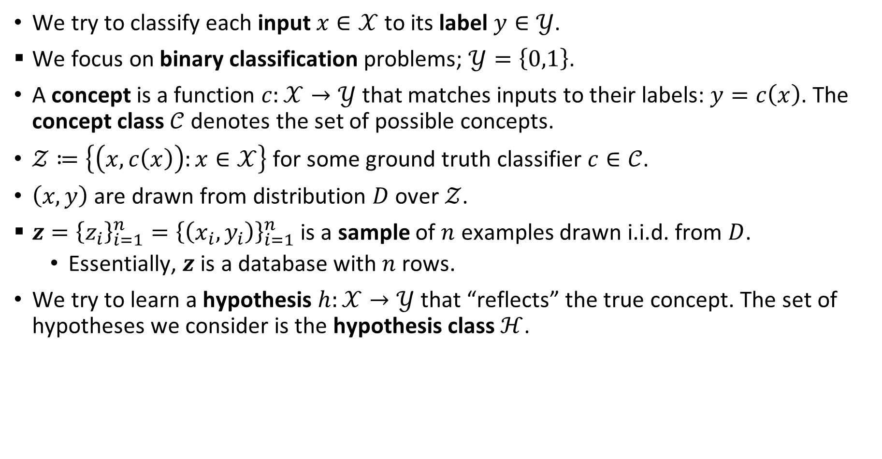
ML reminder: basics and notations
We try to classify each input $x∈𝒳$ to its label $y∈𝒴$.
We focus on binary classification problems; $𝒴=\left\{0,1\right\}$.
A concept is a function $c:𝒳→𝒴$ that matches inputs to their labels: $y=c\left(x\right)$. The concept class $𝒞$ denotes the set of possible concepts.
$𝒵≔\left\{\left(x,c\left(x\right)\right):x∈𝒳\right\}$ for some ground truth classifier $c∈𝒞$.
$\left(x,y\right)$ are drawn from distribution $D$ over $𝒵$.
$z={\left\{z_{i}\right\}}_{i=1}^{n}={\left\{\left(x_{i},y_{i}\right)\right\}}_{i=1}^{n}$ is a sample of $n$ examples drawn i.i.d. from $D$.
  Essentially, $z$ is a database with $n$ rows.
We try to learn a hypothesis $h:𝒳→𝒴$ that “reflects” the true concept. The set of hypotheses we consider is the hypothesis class $ℋ$.
Notes:
The notations are what matters.
Example: $x$ can be the features of a house, its price and time offered on sale. $y$ is whether it was already sold.

Slide 3



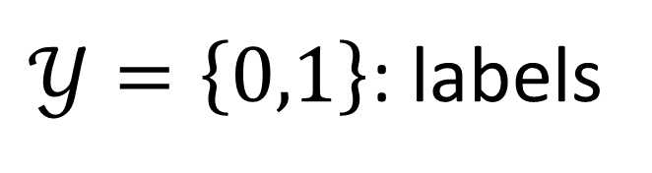



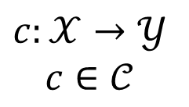




ML reminder: problem
$𝒳$: inputs
$𝒴$: labels
$𝒴=\left\{0,1\right\}$: labels
$$c:𝒳→𝒴$$
$$c∈𝒞$$
$$y_{1}$$
$$1$$
$$x_{1}=\left(age:27,gender:male,…\right)$$
$$y_{3}$$
$$x_{2}$$
$$y_{2}$$
$$0$$
$$x_{3}$$
$size\left(x\right)=d$ bits
Denote $𝒵=\left\{\left(x,c\left(x\right)\right):x∈𝒳\right\}⊂𝒳×𝒴$

Slide 4
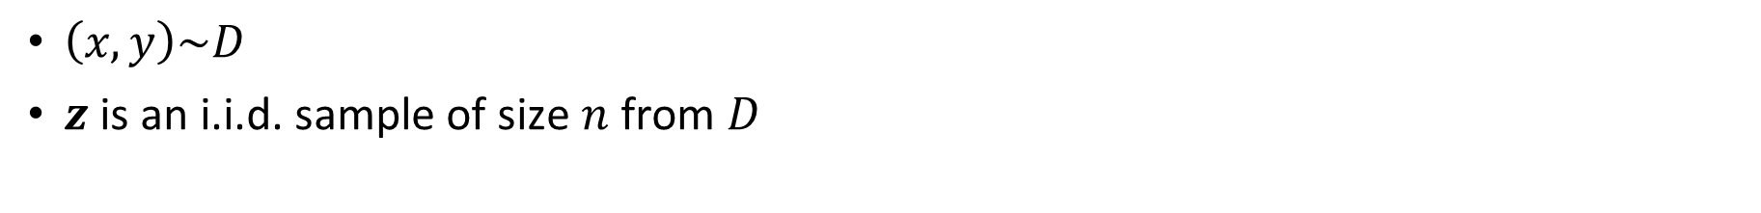



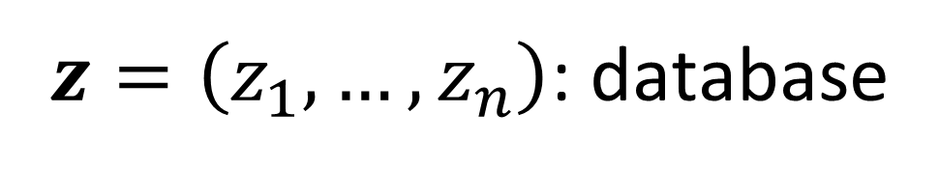
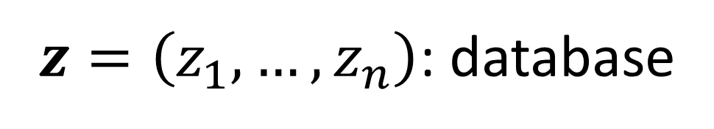
ML reminder: sample
$z=\left(z_{1},…,z_{n}\right)$: database
$z=\left(z_{1},…,z_{n}\right)$: database
$$z_{1}=\left(x_{1},y_{1}\right)$$
$$=\left(age:27,gender:male,…,hiv:0\right)$$
$${f(z}_{1}) =\left(x_{1},y_{1}\right)$$
$$=\left(age:27,gender:male,…,hiv:0\right)$$
$$z_{2}=\left(x_{2},y_{2}\right)$$
$$f\left(z_{2}\right)=\left(x_{2},y_{2}\right)$$
$$⋮$$
$$⋮$$
$$z_{n}=\left(x_{n},y_{n}\right)$$
$$f\left(z_{n}\right)=\left(x_{n},y_{n}\right)$$
$\left(x,y\right)\sim D$
$z$ is an i.i.d. sample of size $n$ from $D$
Notes:
🖱️
$D$ is a distribution over $𝒵$
🖱️

Slide 5

ML reminder: goal
Hypothesis class: $ℋ⊆𝒞$
The true error of hypothesis $h∈ℋ$ on distribution $D$:
$e_{D}\left(h\right)≔\underset{\left(x,y\right)\sim D}{Pr}\left[h\left(x\right)≠y\right]$
Goal:
find algorithm $A:ℕ^{𝒵}↦ℋ$ that minimizes $e_{D}\left(A\left(z\right)\right)$

Slide 6

Adding Privacy
$z$ is private.
$A\left(z\right)$ is public.
We want $A$ to also be $ε$-differentially private:
$∀h∈ℋ: ∀_{z,z^{′}}{\left\|z−z^{′}\right\|}_{1}=1:$
$\operatorname{Pr}\left[A\left(z\right)=h\right]≤e^{ε}\operatorname{Pr}\left[A\left(z^{′}\right)=h\right]$
Notes:
e.g. We want to learn to detect HIV and publish the classifier

Slide 7
Hierarchy of Private Learning Algorithm Classes
Each class is a certain set of classification problems.
We’ll prove part of this hierarchy.
PAC* = PPAC*
LI* = SQ*
LNI* = NASQ*

Slide 8
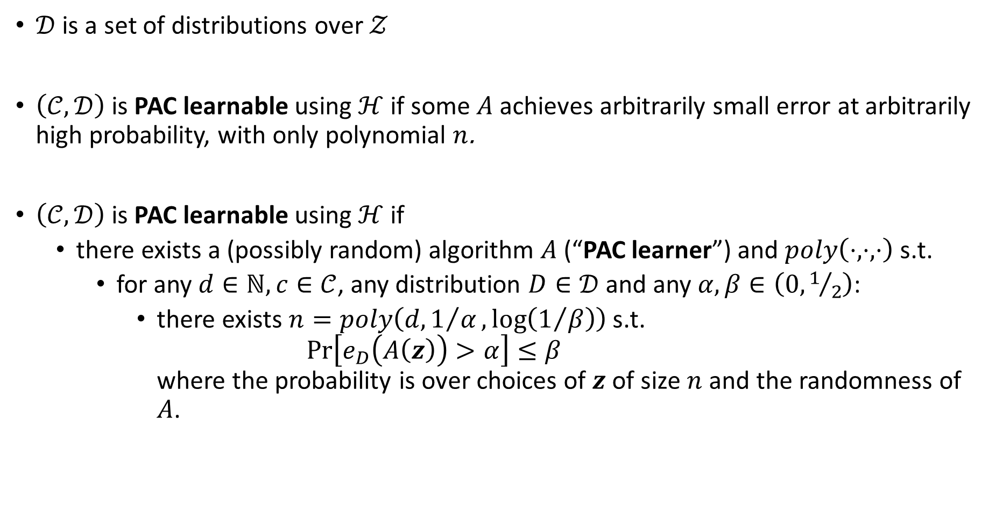
ML Reminder: PAC learnable
$𝒟$ is a set of distributions over $𝒵$
$\left(𝒞,𝒟\right)$ is PAC learnable using $ℋ$ if some $A$ achieves arbitrarily small error at arbitrarily high probability, with only polynomial $n$.
$\left(𝒞,𝒟\right)$ is PAC learnable using $ℋ$ if
  there exists a (possibly random) algorithm $A$ (“PAC learner”) and $poly\left(⋅,⋅,⋅\right)$ s.t.
    for any $d∈ℕ,c∈𝒞$, any distribution $D∈𝒟$ and any $α,β∈\left(0,1/2\right)$:
      there exists $n=poly\left(d,1/α,\log\left(1/β\right)\right)$ s.t.
      $\operatorname{Pr}\left[e_{D}\left(A\left(z\right)\right)>α\right]≤β$
      where the probability is over choices of $z$ of size $n$ and the randomness of $A$.
Notes:
Before going over this, ask who remembers what PAC learnable means.
Intuition for PAC learnable:
approximately correct = the error is not over $α$ from the best error
Probably approximately correct = the probability that it’s not approximately correct is at most $β$.
The number of samples required by the algorithm must be polynomial in $d,1/α,\log\left(1/β\right)$.

Slide 9
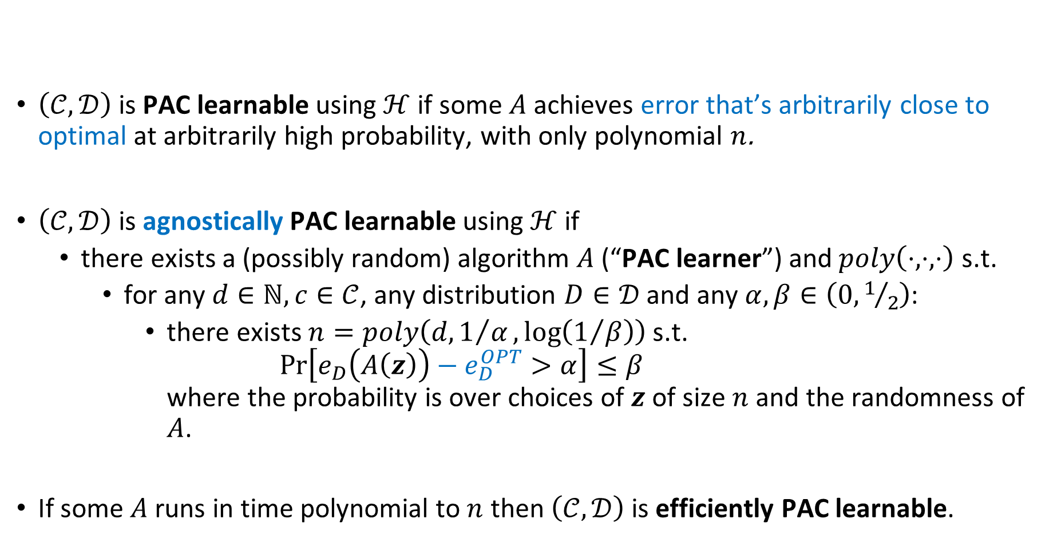
ML Reminder: agnostically PAC learnable
$\left(𝒞,𝒟\right)$ is PAC learnable using $ℋ$ if some $A$ achieves error that’s arbitrarily close to optimal at arbitrarily high probability, with only polynomial $n$.
$\left(𝒞,𝒟\right)$ is agnostically PAC learnable using $ℋ$ if
  there exists a (possibly random) algorithm $A$ (“PAC learner”) and $poly\left(⋅,⋅,⋅\right)$ s.t.
    for any $d∈ℕ,c∈𝒞$, any distribution $D∈𝒟$ and any $α,β∈\left(0,1/2\right)$:
      there exists $n=poly\left(d,1/α,\log\left(1/β\right)\right)$ s.t.
      $\operatorname{Pr}\left[e_{D}\left(A\left(z\right)\right)−e_{D}^{OPT}>α\right]≤β$
      where the probability is over choices of $z$ of size $n$ and the randomness of $A$.
If some $A$ runs in time polynomial to $n$ then $\left(𝒞,𝒟\right)$ is efficiently PAC learnable.
Notes:
Before going over this, ask who remembers what PAC learnable means.
Intuition for PAC learnable:
approximately correct = the error is not over $α$ from the best error
Probably approximately correct = the probability that it’s not approximately correct is at most $β$.
The number of samples required by the algorithm must be polynomial in $d,1/α,\log\left(1/β\right)$.

Slide 10
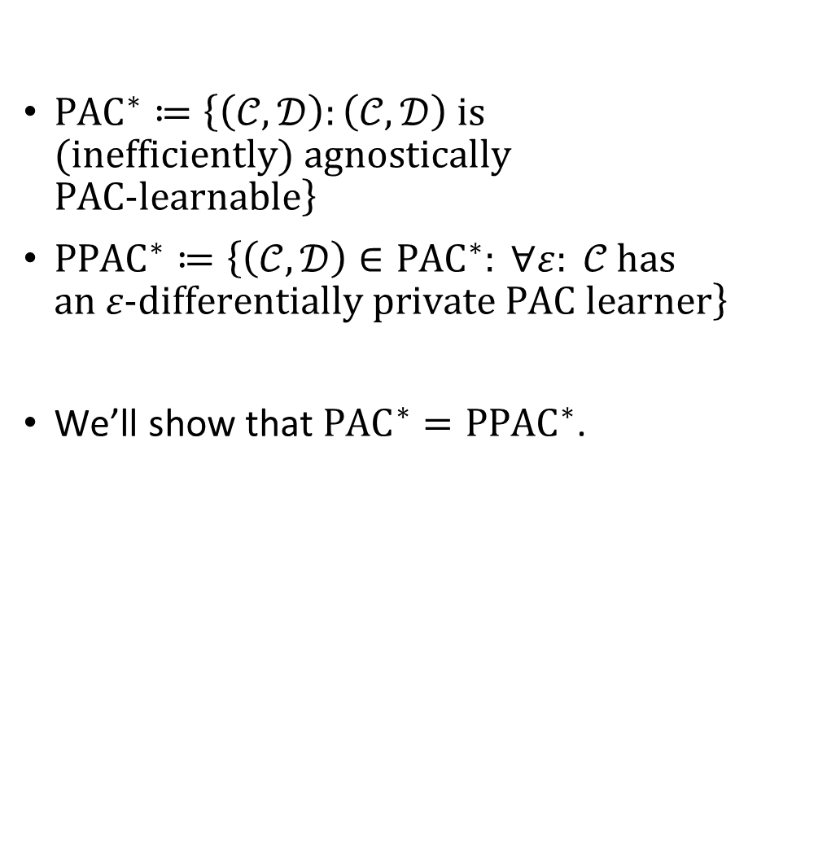
PAC* = PPAC*
${PAC}^{∗}≔\left\{\left(𝒞,𝒟\right):\left(𝒞,𝒟\right) \text{is}\text{ (}\text{inefficiently}\text{) }\text{agnostically} \text{PAC}\text{-}\text{learnable}\right\}$
${PPAC}^{∗}≔\left\{\left(𝒞,𝒟\right)∈{PAC}^{∗}: ∀ε: 𝒞 \text{has} \text{an} ε\text{-}\text{differentially} \text{private} \text{PAC} \text{learner}\right\}$
We’ll show that ${{PAC}^{∗}=PPAC}^{∗}$.
PAC* = PPAC*
LI* = SQ*
LNI* = NASQ*

Slide 11
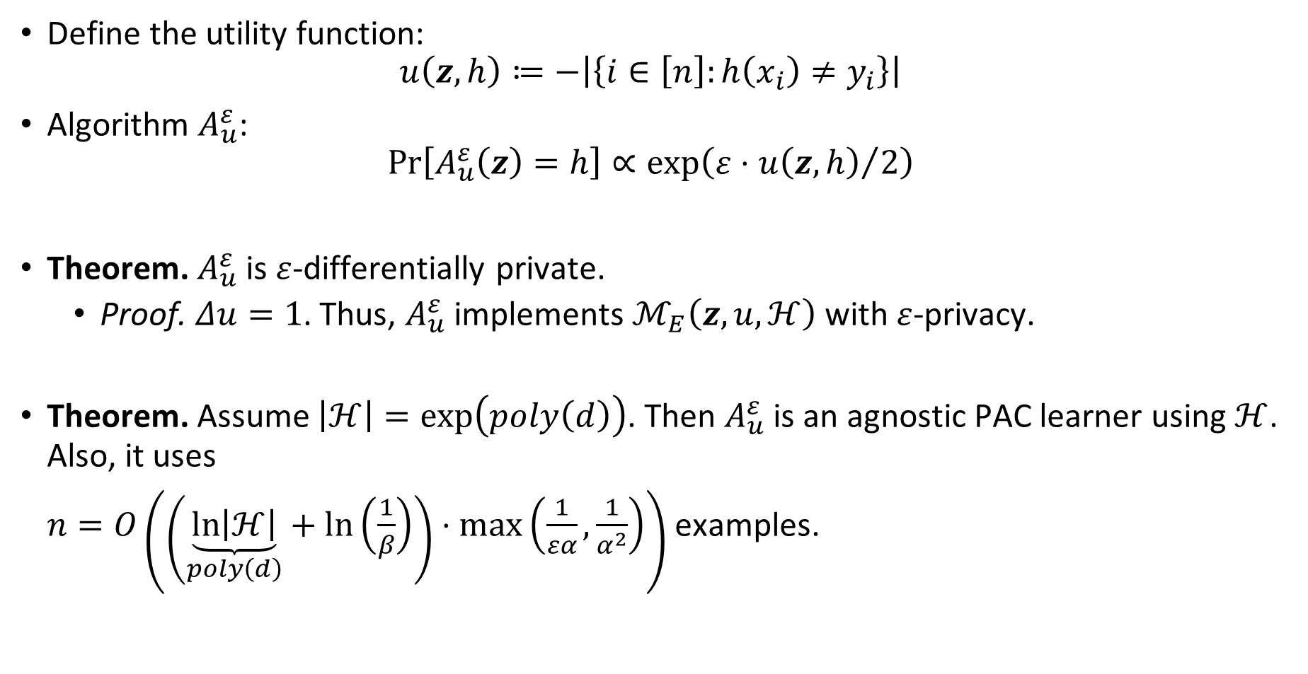
Generic Private Agnostic Learner
Define the utility function:
$u\left(z, h\right)≔−\left|\left\{i∈\left[n\right]:h\left(x_{i}\right)≠y_{i}\right\}\right|$
Algorithm $A_{u}^{ε}$:
$\operatorname{Pr}\left[A_{u}^{ε}\left(z\right)=h\right]∝\exp\left(ε⋅{u\left(z,h\right)}/2\right)$
Theorem. $A_{u}^{ε}$ is $ε$-differentially private.
  Proof. $Δu=1$. Thus, $A_{u}^{ε}$ implements $ℳ_{E}\left(z,u,ℋ\right)$ with $ε$-privacy.
Theorem. Assume $\left|ℋ\right|=\exp\left(poly\left(d\right)\right)$. Then $A_{u}^{ε}$ is an agnostic PAC learner using $ℋ$. Also, it uses
$n=O\left(\left(\underset{poly\left(d\right)}{\underbrace{\ln\left|ℋ\right|}}+\ln\left(\frac{1}{β}\right)\right)⋅\max\left(\frac{1}{εα},\frac{1}{α^{2}}\right)\right)$ examples.
Notes:
We now define a private PAC learner.
It’s based on exp mech, so first define utility.
🖱️
Under 2nd theorem, note that $\ln\left|H_{d}\right|=poly\left(d\right)$ for the aforementioned $poly$.

Slide 12

ML reminder: errors
The empirical error of $h$ on $z$:
$e_{z}\left(h\right)≔\underset{i←\left[n\right]}{Pr}\left[h\left(x_{i}\right)≠y_{i}\right]=\frac{1}{n}\left|\left\{i∈\left[n\right]:h\left(x_{i}\right)≠y_{i}\right\}\right|$
The minimal true/empirical errors: $e_{D}^{OPT}, e_{z}^{OPT}$

Slide 13
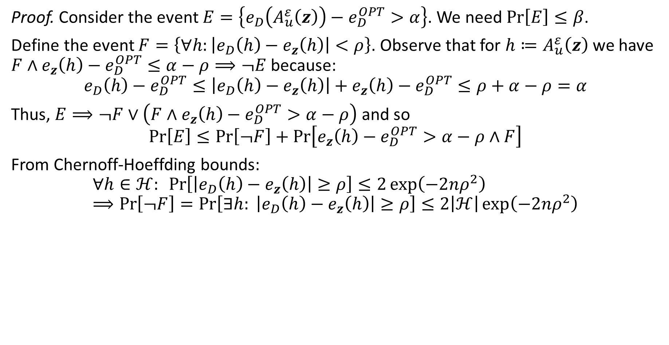
Generic Private Agnostic Learner: Utility Proof 1
Proof. Consider the event $E=\left\{e_{D}\left(A_{u}^{ε}\left(z\right)\right)−e_{D}^{OPT}>α\right\}$. We need $\operatorname{Pr}\left[E\right]≤β$.
Define the event $F=\left\{∀h:\left|e_{D}\left(h\right)−e_{z}\left(h\right)\right|<ρ\right\}$. Observe that for $h≔A_{u}^{ε}\left(z\right)$ we have $F∧e_{z}\left(h\right)−e_{D}^{OPT}≤α−ρ⟹¬E$ because:
$$e_{D}\left(h\right)−e_{D}^{OPT}≤\left|e_{D}\left(h\right)−e_{z}\left(h\right)\right|+e_{z}\left(h\right)−e_{D}^{OPT}≤ρ+α−ρ=α$$
Thus, $E⟹¬F∨\left(F∧e_{z}\left(h\right)−e_{D}^{OPT}>α−ρ\right)$ and so
$$\operatorname{Pr}\left[E\right]≤\operatorname{Pr}\left[¬F\right]+\operatorname{Pr}\left[e_{z}\left(h\right)−e_{D}^{OPT}>α−ρ∧F\right]$$
From Chernoff-Hoeffding bounds:
$$∀h∈ℋ: \operatorname{Pr}\left[\left|e_{D}\left(h\right)−e_{z}\left(h\right)\right|≥ρ\right]≤2\exp\left(−2nρ^{2}\right) \\ ⟹\operatorname{Pr}\left[¬F\right]=\operatorname{Pr}\left[∃h: \left|e_{D}\left(h\right)−e_{z}\left(h\right)\right|≥ρ\right]≤2\left|ℋ\right|\exp\left(−2nρ^{2}\right)$$
Notes:
Eventually decided to just skip this proof altogether. Maybe a short proof sketch if there’s time.
If so, consider writing Chernoff-Hoeffding bounds here in the notes.

Slide 14
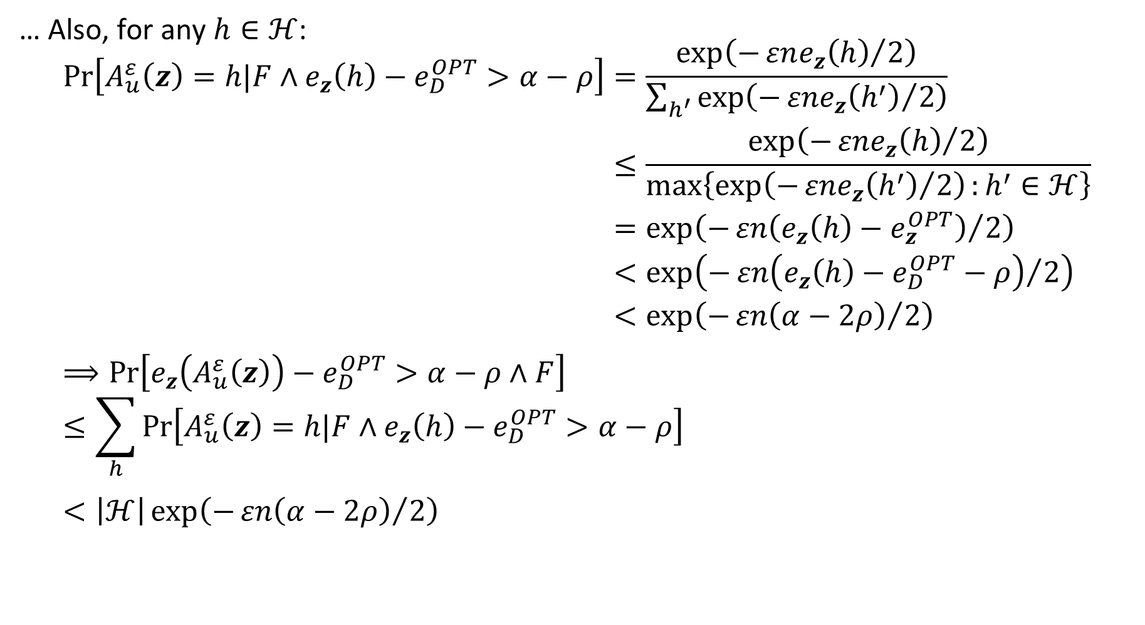
Generic Private Agnostic Learner: Utility Proof 2
… Also, for any $h∈ℋ$:
$$\begin{aligned}\operatorname{Pr}\left[A_{u}^{ε}\left(z\right)=h|F∧e_{z}\left(h\right)−e_{D}^{OPT}>α−ρ\right]&=\frac{\exp\left(−{εne_{z}\left(h\right)}/2\right)}{\sum_{h^{′}}{\exp\left(−{εne_{z}\left(h^{′}\right)}/2\right)}} \\ &≤\frac{\exp\left(−{εne_{z}\left(h\right)}/2\right)}{\max\left\{\exp\left(−{εne_{z}\left(h^{′}\right)}/2\right):h^{′}∈ℋ\right\}} \\ &=\exp\left(−{εn\left(e_{z}\left(h\right)−e_{z}^{OPT}\right)}/2\right) \\ &<\exp\left(−{εn\left(e_{z}\left(h\right)−e_{D}^{OPT}−ρ\right)}/2\right) \\ &<\exp\left(−{εn\left(α−2ρ\right)}/2\right) \\ &\end{aligned} \\ ⟹\operatorname{Pr}\left[e_{z}\left(A_{u}^{ε}\left(z\right)\right)−e_{D}^{OPT}>α−ρ∧F\right] \\ ≤\sum_{h}{\operatorname{Pr}\left[A_{u}^{ε}\left(z\right)=h|F∧e_{z}\left(h\right)−e_{D}^{OPT}>α−ρ\right]} \\ <\left|ℋ\right|\exp\left(−{εn\left(α−2ρ\right)}/2\right)$$

Slide 15

Generic Private Agnostic Learner: Utility Proof 3
… Set $ρ≔α/3$ and finally:
$$\begin{aligned}\operatorname{Pr}\left[E\right]&≤\operatorname{Pr}\left[¬F\right]+\operatorname{Pr}\left[e_{z}\left(h\right)−e_{D}^{OPT}>{2α}/3∧F\right] \\ &<\left|ℋ\right|\left(2\exp\left(−{2nα^{2}}/9\right)+\exp\left(−{εnα}/6\right)\right) \\ &≤β\end{aligned}$$
This is satisfied with
$$n≥6\left(\ln\left|ℋ\right|+\ln\left(\frac{1}{β}\right)\right)⋅\max\left(\frac{1}{εα},\frac{1}{α^{2}}\right)$$

Slide 16
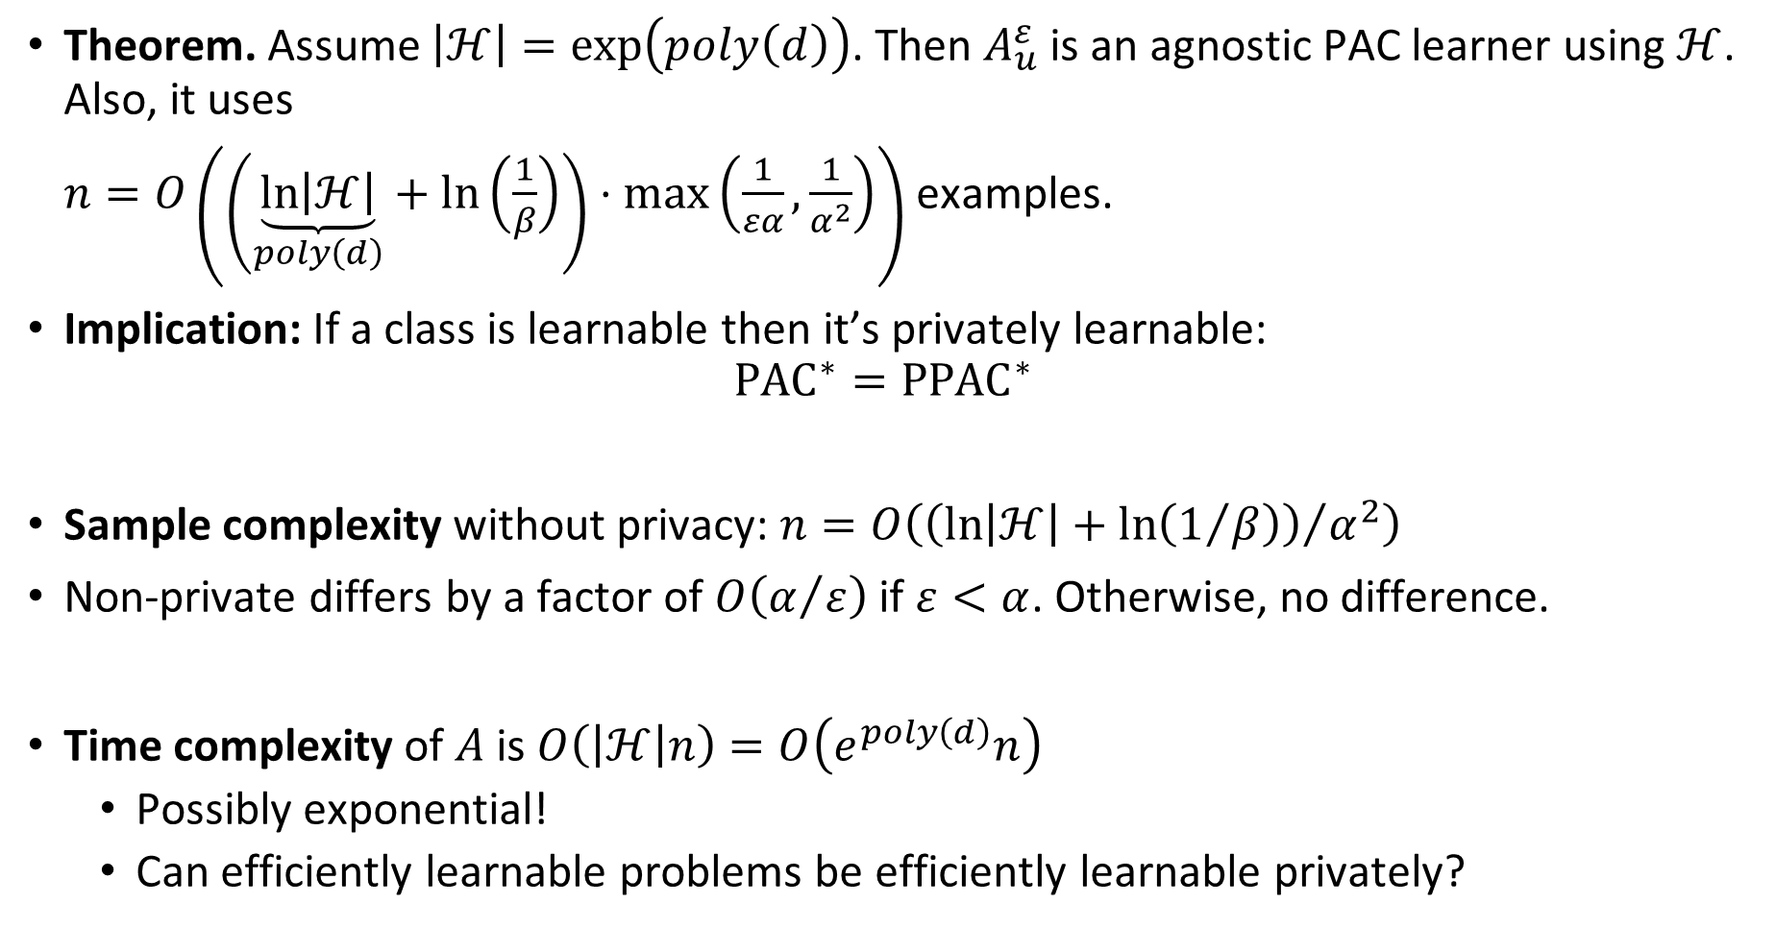
Generic Private Learner vs. Non-private
Theorem. Assume $\left|ℋ\right|=\exp\left(poly\left(d\right)\right)$. Then $A_{u}^{ε}$ is an agnostic PAC learner using $ℋ$. Also, it uses
$n=O\left(\left(\underset{poly\left(d\right)}{\underbrace{\ln\left|ℋ\right|}}+\ln\left(\frac{1}{β}\right)\right)⋅\max\left(\frac{1}{εα},\frac{1}{α^{2}}\right)\right)$ examples.
Implication: If a class is learnable then it’s privately learnable:
${{PAC}^{∗}=PPAC}^{∗}$
Sample complexity without privacy: $n=O\left({\left(\ln\left|ℋ\right|+\ln\left(1/β\right)\right)}/{α^{2}}\right)$
Non-private differs by a factor of $O\left(α/ε\right)$ if $ε<α$. Otherwise, no difference.
Time complexity of $A$ is $O\left(\left|ℋ\right|n\right)=O\left(e^{poly\left(d\right)}n\right)$
  Possibly exponential!
  Can efficiently learnable problems be efficiently learnable privately?
Notes:
The article says the last question is an open question.

Slide 17





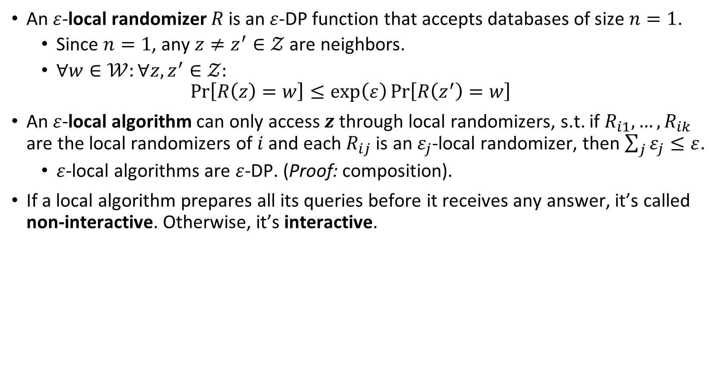






The Local Model
$$z_{1}$$
$$⋮$$
$$z_{i}$$
An $ε$-local randomizer $R$ is an $ε$-DP function that accepts databases of size $n=1$.
  Since $n=1$, any $z≠z^{′}∈𝒵$ are neighbors.
  $∀w∈𝒲:∀z,z^{′}∈𝒵:$
  $\operatorname{Pr}\left[R\left(z\right)=w\right]≤\exp\left(ε\right)\operatorname{Pr}\left[R\left(z^{′}\right)=w\right]$
An $ε$-local algorithm can only access $z$ through local randomizers, s.t. if $R_{i1},…,R_{ik}$ are the local randomizers of $i$ and each $R_{ij}$ is an $ε_{j}$-local randomizer, then $\sum_{j}{ε_{j}}≤ε$.
  $ε$-local algorithms are $ε$-DP. (Proof: composition).
If a local algorithm prepares all its queries before it receives any answer, it’s called non-interactive. Otherwise, it’s interactive.
$$⋮$$
$$z_{n}$$
$$z_{i}$$
$$R_{i1}$$
$$R_{i1}\left(z_{i}\right)$$
Local Algorithm
$$z_{j}$$
$$R_{j1}$$
$$R_{j1}\left(z_{j}\right)$$

Slide 18






The Statistical Query Model
Let $D$ distribution over $𝒵$. An SQ oracle $SQ_{D}\left(⋅,⋅\right)$ takes $g:𝒵→\left[−b,b\right]$ and a tolerance $τ∈\left(0,1\right)$ and outputs $v∈ℝ$ such that
$\left|v−E_{z^{′}\sim D}\left[g\left(z^{′}\right)\right]\right|≤τ$
  Note: $g$ doesn’t have to be efficiently computable.
An SQ algorithm accesses the distribution $D$ only via the $SQ_{D}$.
If an SQ algorithm prepares all its queries to $SQ_{D}$ before it receives any answer, it’s called non-adaptive. Otherwise, it’s adaptive.
$$g_{1},τ_{1}$$
$SQ_{D}$ Oracle
SQ Algorithm
$$≈E_{z^{′}\sim D}\left[g_{1}\left(z^{′}\right)\right]$$
$$g_{2},τ_{2}$$
$$≈E_{z^{′}\sim D}\left[g_{2}\left(z^{′}\right)\right]$$
Notes:
🖱️
e.g. g(z) = age of z
🖱️🖱️🖱️🖱️🖱️…
Intuition: learning in SQ models is like learning with noise.

Slide 19

Local model vs. SQ model
We show that if $z_{1},…,z_{n}$ are drawn i.i.d. from $D$ then the models are “equivalent”.
Moreover, the expected query complexity is preserved up to a polynomial factor.
Notes:
Both local and SQ models restrict access.
Diff: local uses a databases, SQ uses a distribution

Slide 20











Simulate SQ Algorithm by Local Algorithm
Local Algorithm
$$z_{1}$$
$$R_{g}$$
$$R_{g}\left(z_{1}\right)$$
$SQ_{D}$ Oracle
SQ Algorithm
$SQ_{D}$ Oracle
Simulator
$$g,τ$$
$$z_{2}$$
$$R_{g}$$
$$≈E_{z^{′}\sim D}\left[g\left(z^{′}\right)\right]$$
$$R_{g}\left(z_{2}\right)$$
$$⋮$$

Slide 21
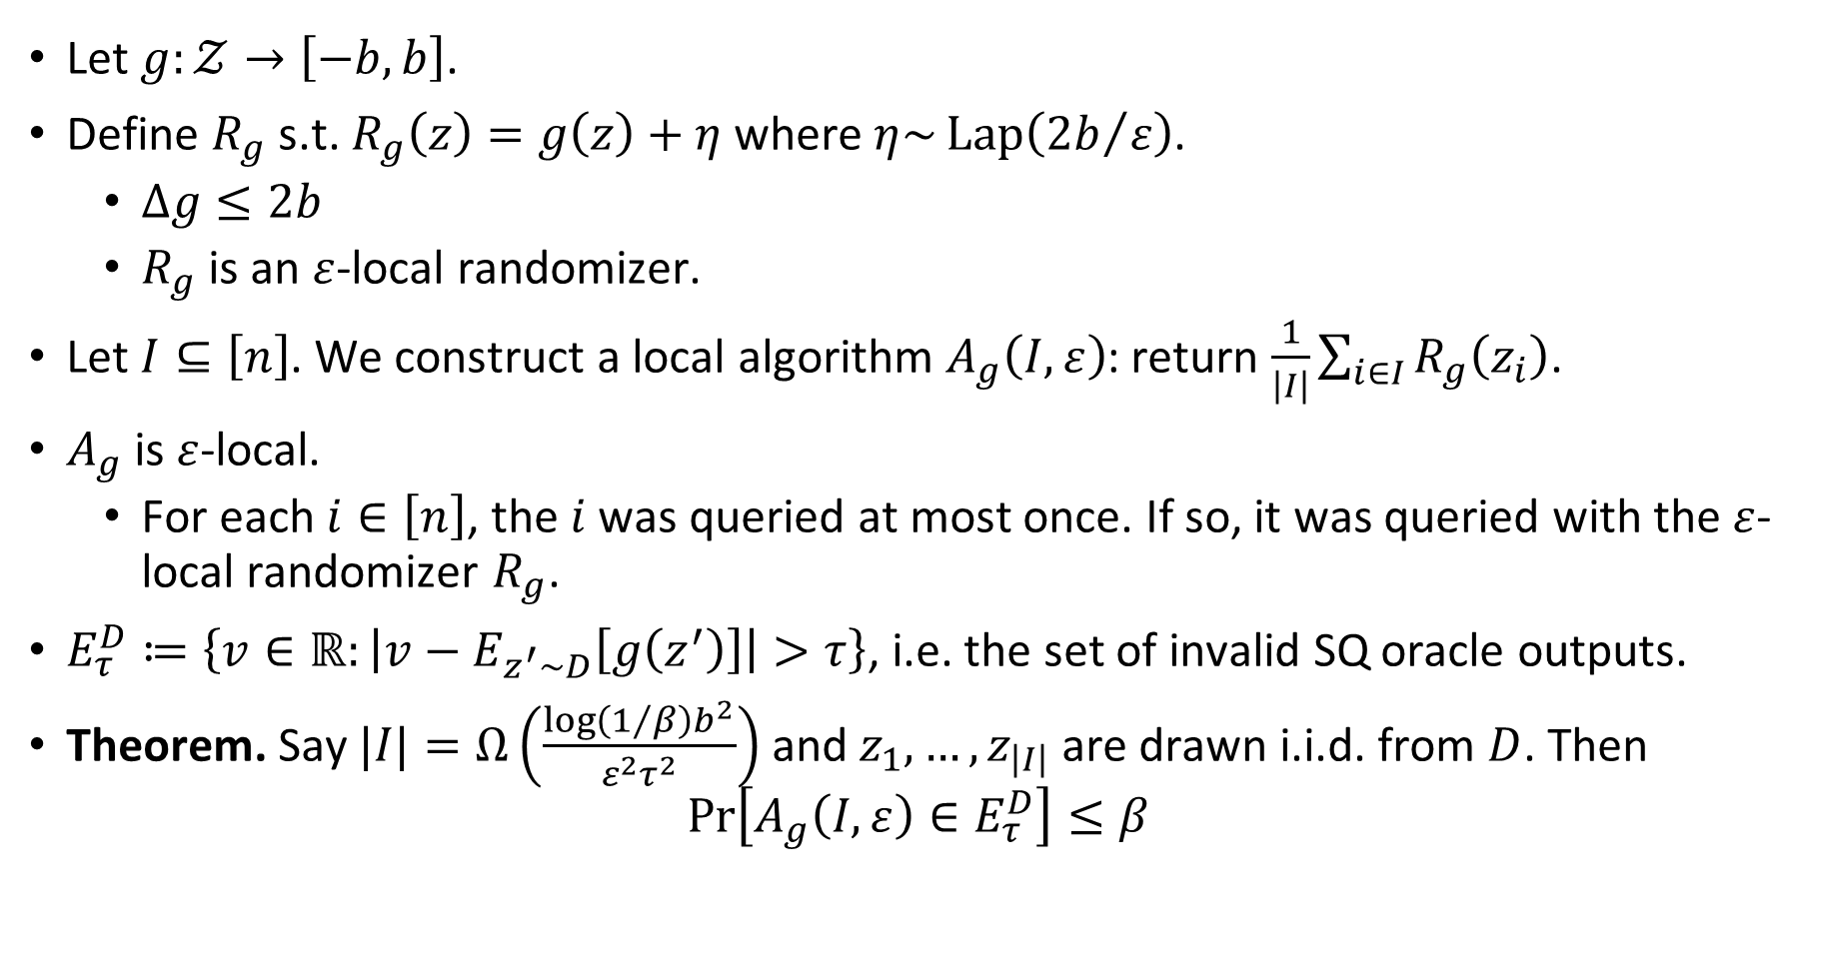
Simulate SQ Oracle by Local Randomizers
Let $g:𝒵→\left[−b,b\right]$.
Define $R_{g}$ s.t. $R_{g}\left(z\right)=g\left(z\right)+η$ where $η\sim \operatorname{Lap}\left({2b}/ε\right)$.
  $Δg≤2b$
  $R_{g}$ is an $ε$-local randomizer.
Let $I⊆\left[n\right]$. We construct a local algorithm $A_{g}\left(I,ε\right)$: return $\frac{1}{\left|I\right|}\sum_{i∈I}{R_{g}\left(z_{i}\right)}$.
$A_{g}$ is $ε$-local.
  For each $i∈\left[n\right]$, the $i$ was queried at most once. If so, it was queried with the $ε$-local randomizer $R_{g}$.
$E_{τ}^{D}≔\left\{v∈ℝ:\left|v−E_{z^{′}\sim D}\left[g\left(z^{′}\right)\right]\right|>τ\right\}$, i.e. the set of invalid SQ oracle outputs.
Theorem. Say $|I|=Ω\left(\frac{\log\left(1/β\right)b^{2}}{ε^{2}τ^{2}}\right)$ and $z_{1},…,z_{\left|I\right|}$ are drawn i.i.d. from $D$. Then
$\operatorname{Pr}\left[A_{g}\left(I,ε\right)∈E_{τ}^{D}\right]≤β$

Slide 22
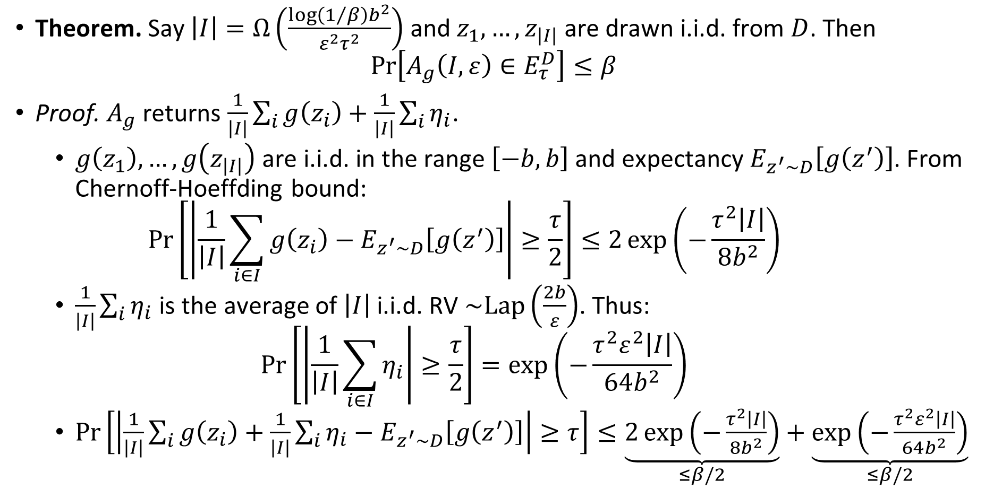
$A_{g}$ is $ε$-local with probability $1−β$: proof
Theorem. Say $\left|I\right|=Ω\left(\frac{\log\left(1/β\right)b^{2}}{ε^{2}τ^{2}}\right)$ and $z_{1},…,z_{\left|I\right|}$ are drawn i.i.d. from $D$. Then
$\operatorname{Pr}\left[A_{g}\left(I,ε\right)∈E_{τ}^{D}\right]≤β$
Proof. $A_{g}$ returns $\frac{1}{\left|I\right|}\sum_{i}{g\left(z_{i}\right)}+\frac{1}{\left|I\right|}\sum_{i}{η_{i}}$.
  $g\left(z_{1}\right),…,g\left(z_{\left|I\right|}\right)$ are i.i.d. in the range $\left[−b,b\right]$ and expectancy $E_{z^{′}\sim D}\left[g\left(z^{′}\right)\right]$. From Chernoff-Hoeffding bound:
  $\operatorname{Pr}\left[\left|\frac{1}{\left|I\right|}\sum_{i∈I}{g\left(z_{i}\right)}−E_{z^{′}\sim D}\left[g\left(z^{′}\right)\right]\right|≥\frac{τ}{2}\right]≤2\exp\left(−\frac{τ^{2}\left|I\right|}{8b^{2}}\right)$
  $\frac{1}{\left|I\right|}\sum_{i}{η_{i}}$ is the average of $\left|I\right|$ i.i.d. RV $\sim Lap\left(\frac{2b}{ε}\right)$. Thus:
  $\operatorname{Pr}\left[\left|\frac{1}{\left|I\right|}\sum_{i∈I}{η_{i}}\right|≥\frac{τ}{2}\right]=\exp\left(−\frac{τ^{2}ε^{2}\left|I\right|}{64b^{2}}\right)$
  $\operatorname{Pr}\left[\left|\frac{1}{\left|I\right|}\sum_{i}{g\left(z_{i}\right)}+\frac{1}{\left|I\right|}\sum_{i}{η_{i}}−E_{z^{′}\sim D}\left[g\left(z^{′}\right)\right]\right|≥τ\right]≤\underset{≤β/2}{\underbrace{2\exp\left(−\frac{τ^{2}\left|I\right|}{8b^{2}}\right)}}+\underset{≤β/2}{\underbrace{\exp\left(−\frac{τ^{2}ε^{2}\left|I\right|}{64b^{2}}\right)}}$
Notes:
Last line:
$\left|I\right|=Ω\left(\frac{\log\left(1/β\right)b^{2}}{τ^{2}}\right)$ is enough for $2\exp\left(−\frac{τ^{2}\left|I\right|}{8b^{2}}\right)≤\frac{β}{2}$
$\left|I\right|=Ω\left(\frac{\log\left(1/β\right)b^{2}}{ε^{2}τ^{2}}\right)$ is enough for $\exp\left(−\frac{τ^{2}ε^{2}\left|I\right|}{64b^{2}}\right)≤\frac{β}{2}$

Slide 23






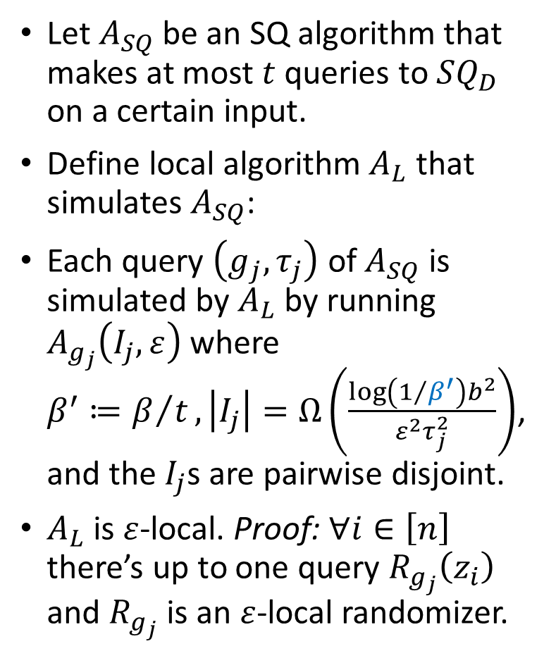









Simulate SQ Algorithm by Local Algorithm
Let $A_{SQ}$ be an SQ algorithm that makes at most $t$ queries to $SQ_{D}$ on a certain input.
Define local algorithm $A_{L}$ that simulates $A_{SQ}$:
Each query $\left(g_{j},τ_{j}\right)$ of $A_{SQ}$ is simulated by $A_{L}$ by running $A_{g_{j}}\left(I_{j},ε\right)$ where
$β^{′}≔β/t,\left|I_{j}\right|=Ω\left(\frac{\log\left(1/{β^{′}}\right)b^{2}}{ε^{2}τ_{j}^{2}}\right)$, and the $I_{j}$s are pairwise disjoint.
$A_{L}$ is $ε$-local. Proof: $∀i∈\left[n\right]$ there’s up to one query $R_{g_{j}}\left(z_{i}\right)$ and $R_{g_{j}}$ is an $ε$-local randomizer.
Local Algorithm
$$I_{1}$$
SQ Algorithm
$$\left(g_{1},ε\right)$$
$SQ_{D}$ Oracle
Simulator
$$g_{1},τ_{1}$$
$$A_{g_{1}}\left(I_{1},ε\right)$$
$$≈E_{z^{′}\sim D}\left[g_{1}\left(z^{′}\right)\right]$$
$$⋮$$
$$I_{2}$$
$$\left(g_{2},ε\right)$$
$SQ_{D}$ Oracle
Simulator
$$g_{2},τ_{2}$$
$$A_{g_{2}}\left(I_{2},ε\right)$$
$$≈E_{z^{′}\sim D}\left[g_{2}\left(z^{′}\right)\right]$$
$$⋮$$
$$⋮$$

Slide 24
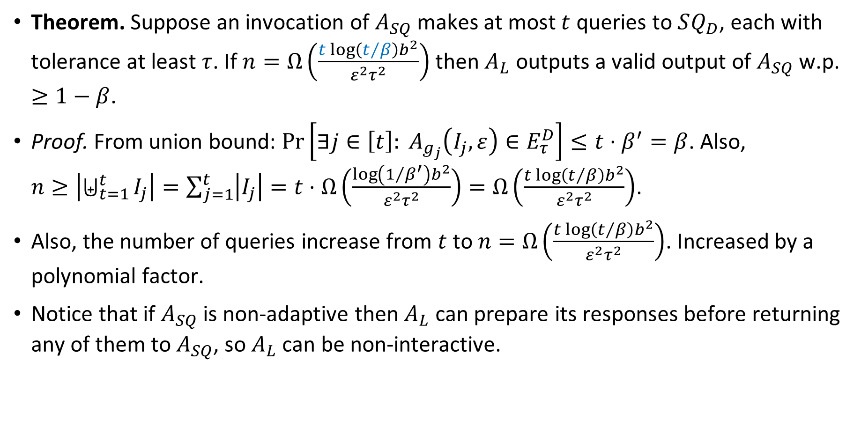
Simulate SQ Algorithm by Local Algorithm
Theorem. Suppose an invocation of $A_{SQ}$ makes at most $t$ queries to $SQ_{D}$, each with tolerance at least $τ$. If $n=Ω\left(\frac{t\log\left(t/β\right)b^{2}}{ε^{2}τ^{2}}\right)$ then $A_{L}$ outputs a valid output of $A_{SQ}$ w.p. $≥1−β$.
Proof. From union bound: $\operatorname{Pr}\left[∃j∈\left[t\right]: A_{g_{j}}\left(I_{j},ε\right)∈E_{τ}^{D}\right]≤t⋅β^{′}=β$. Also,
$n≥\left|⨄_{t=1}^{t}{I_{j}}\right|=\sum_{j=1}^{t}{\left|I_{j}\right|}=t⋅Ω\left(\frac{\log\left(1/{β^{′}}\right)b^{2}}{ε^{2}τ^{2}}\right)=Ω\left(\frac{t\log\left(t/β\right)b^{2}}{ε^{2}τ^{2}}\right)$.
Also, the number of queries increase from $t$ to $n=Ω\left(\frac{t\log\left(t/β\right)b^{2}}{ε^{2}τ^{2}}\right)$. Increased by a polynomial factor.
Notice that if $A_{SQ}$ is non-adaptive then $A_{L}$ can prepare its responses before returning any of them to $A_{SQ}$, so $A_{L}$ can be non-interactive.

Slide 25
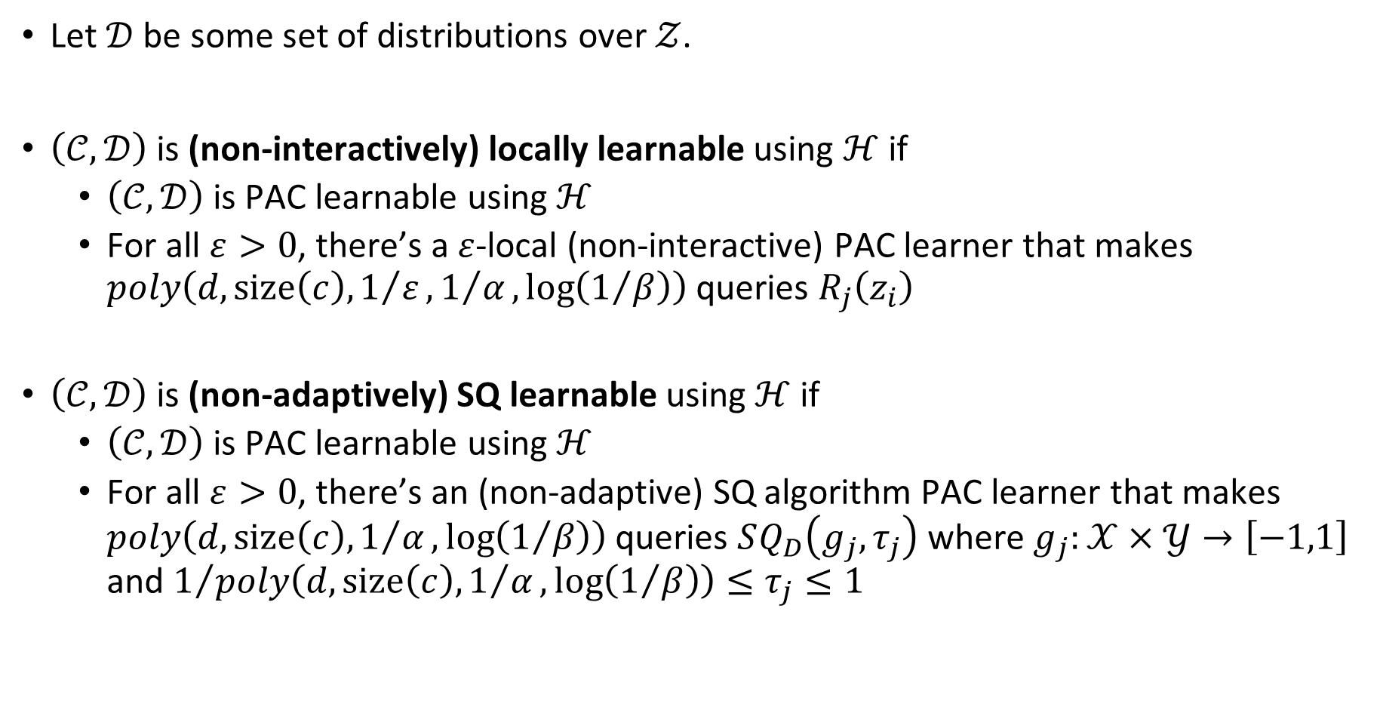
Local and SQ Learnability
Let $𝒟$ be some set of distributions over $𝒵$.
$\left(𝒞,𝒟\right)$ is (non-interactively) locally learnable using $ℋ$ if
  $\left(𝒞,𝒟\right)$ is PAC learnable using $ℋ$
  For all $ε>0$, there’s a $ε$-local (non-interactive) PAC learner that makes $poly\left(d,size\left(c\right),1/ε,1/α,\log\left(1/β\right)\right)$ queries $R_{j}\left(z_{i}\right)$
$\left(𝒞,𝒟\right)$ is (non-adaptively) SQ learnable using $ℋ$ if
  $\left(𝒞,𝒟\right)$ is PAC learnable using $ℋ$
  For all $ε>0$, there’s an (non-adaptive) SQ algorithm PAC learner that makes $poly\left(d,size\left(c\right),1/α,\log\left(1/β\right)\right)$ queries $SQ_{D}\left(g_{j},τ_{j}\right)$ where $g_{j}:𝒳×𝒴→\left[−1,1\right]$ and $1/{poly\left(d,size\left(c\right),1/α,\log\left(1/β\right)\right)}≤τ_{j}≤1$
Notes:
As for SQ learnable, the standard definition doesn’t allow $β>0$, but then there’s no equivalence. Private algorithms must allow some probability of error.

Slide 26
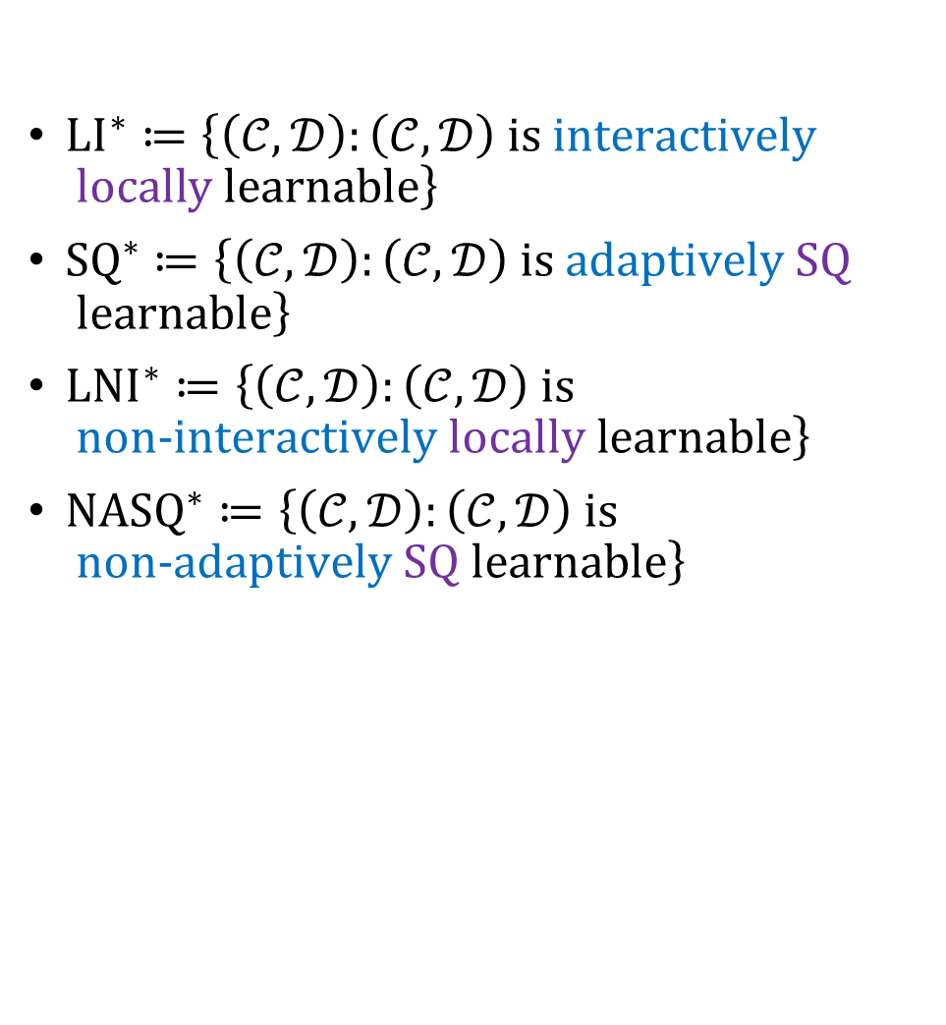
LI*, SQ*
${LI}^{∗}≔\left\{\left(𝒞,𝒟\right):\left(𝒞,𝒟\right) \text{is} \text{interactively} \text{locally} \text{learnable}\right\}$
${SQ}^{∗}≔\left\{\left(𝒞,𝒟\right):\left(𝒞,𝒟\right) \text{is} \text{adaptively} \text{SQ} \text{learnable}\right\}$
${LNI}^{∗}≔\left\{\left(𝒞,𝒟\right):\left(𝒞,𝒟\right) \text{is} \text{non}\text{-}\text{interactively} \text{locally} \text{learnable}\right\}$
${NASQ}^{∗}≔\left\{\left(𝒞,𝒟\right):\left(𝒞,𝒟\right) \text{is} \text{non}\text{-}\text{adaptively} \text{SQ} \text{learnable}\right\}$
PAC* = PPAC*
LI* = SQ*
LNI* = NASQ*
Notes:
Nice to know: runtime efficiency is also preserved

Slide 27
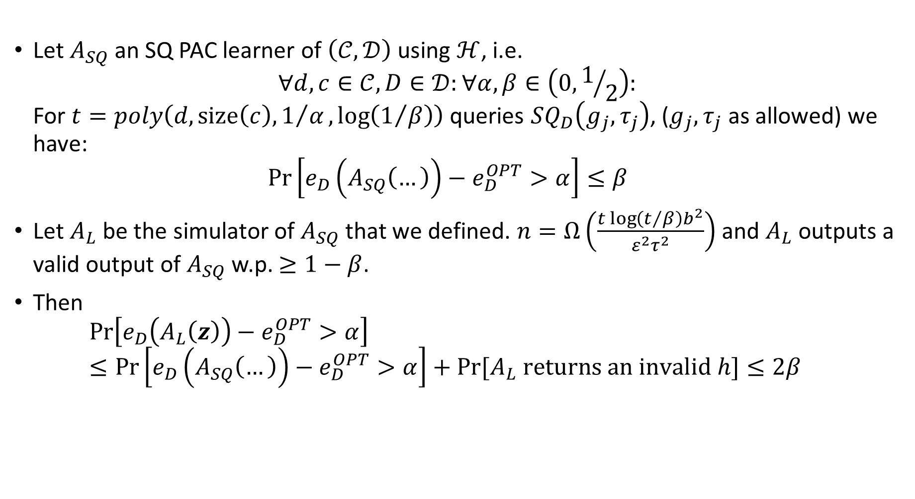

Proving ${SQ}^{∗}⊆{LI}^{∗}$
Let $A_{SQ}$ an SQ PAC learner of $\left(𝒞,𝒟\right)$ using $ℋ$, i.e.
$∀d,c∈𝒞,D∈𝒟:∀α,β∈\left(0,1/2\right):$
For $t=poly\left(d,size\left(c\right),1/α,\log\left(1/β\right)\right)$ queries $SQ_{D}\left(g_{j},τ_{j}\right)$, ($g_{j},τ_{j}$ as allowed) we have:
$\operatorname{Pr}\left[e_{D}\left(A_{SQ}\left(…\right)\right)−e_{D}^{OPT}>α\right]≤β$
Let $A_{L}$ be the simulator of $A_{SQ}$ that we defined. $n=Ω\left(\frac{t\log\left(t/β\right)b^{2}}{ε^{2}τ^{2}}\right)$ and $A_{L}$ outputs a valid output of $A_{SQ}$ w.p. $≥1−β$.
Then
$\operatorname{Pr}\left[e_{D}\left(A_{L}\left(z\right)\right)−e_{D}^{OPT}>α\right]≤\operatorname{Pr}\left[e_{D}\left(A_{SQ}\left(…\right)\right)−e_{D}^{OPT}>α\right]+Pr⁡[A_{L} \text{returns} \text{an} \text{invalid} h\text{]}≤2β$

Slide 28
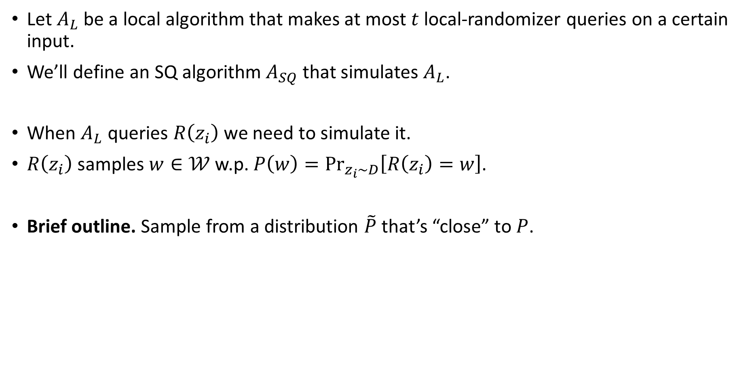
Simulate Local Algorithm by SQ Algorithm
Let $A_{L}$ be a local algorithm that makes at most $t$ local-randomizer queries on a certain input.
We’ll define an SQ algorithm $A_{SQ}$ that simulates $A_{L}$.
When $A_{L}$ queries $R\left(z_{i}\right)$ we need to simulate it.
$R\left(z_{i}\right)$ samples $w∈𝒲$ w.p. $P\left(w\right)=\underset{z_{i}\sim D}{Pr}\left[R\left(z_{i}\right)=w\right]$.
Brief outline. Sample from a distribution $\tilde{P}$ that’s “close” to $P$.

Slide 29

Implications
Learning with noise (SQ*) is worse than learning with privacy (PPAC*).
Much of the attention that local models received were for the benefits of non-interactive models. Sadly, the article proves that ${LI}^{∗}⊋{LNI}^{∗}$.

