Slide 1
Online Query Release via Private Multiplicative Weights
Omri Keren
Dec 4, 2019

Slide 2
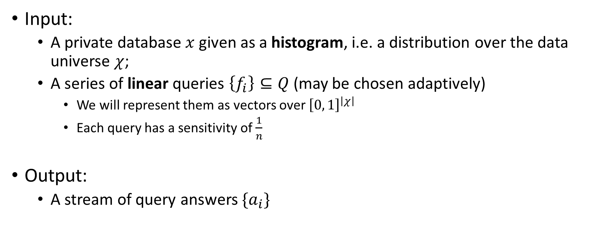
The Settings
Input:
  A private database $x$ given as a histogram, i.e. a distribution over the data universe $χ$;
  A series of linear queries $\left\{f_{i}\right\}⊆Q$(may be chosen adaptively)
    We will represent them as vectors over ${\left[0, 1\right]}^{\left|χ\right|}$
    Each query has a sensitivity of $\frac{1}{n}$
Output:
  A stream of query answers $\{a_{i}\}$
Notes:
Explain what are adaptive queries.

Slide 3
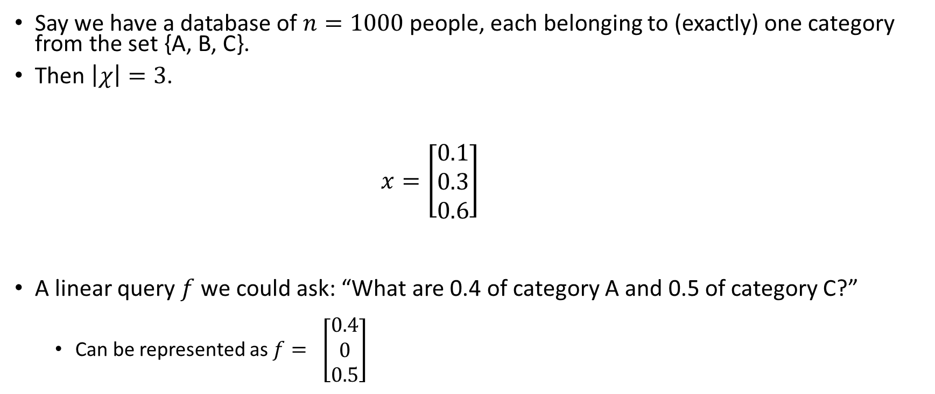
Example
Say we have a database of $n=1000$people, each belonging to (exactly) one category from the set {A, B, C}.
Then $\left|χ\right|=3$.
    $$x=\left[\begin{matrix}0.1 \\ 0.3 \\ 0.6\end{matrix}\right]$$
A linear query $f$ we could ask: “What are 0.4 of category A and 0.5 of category C?”
  Can be represented as $f=$ $\left[\begin{matrix}0.4 \\ 0 \\ 0.5\end{matrix}\right]$
A | B | C
100 | 300 | 600

Slide 4
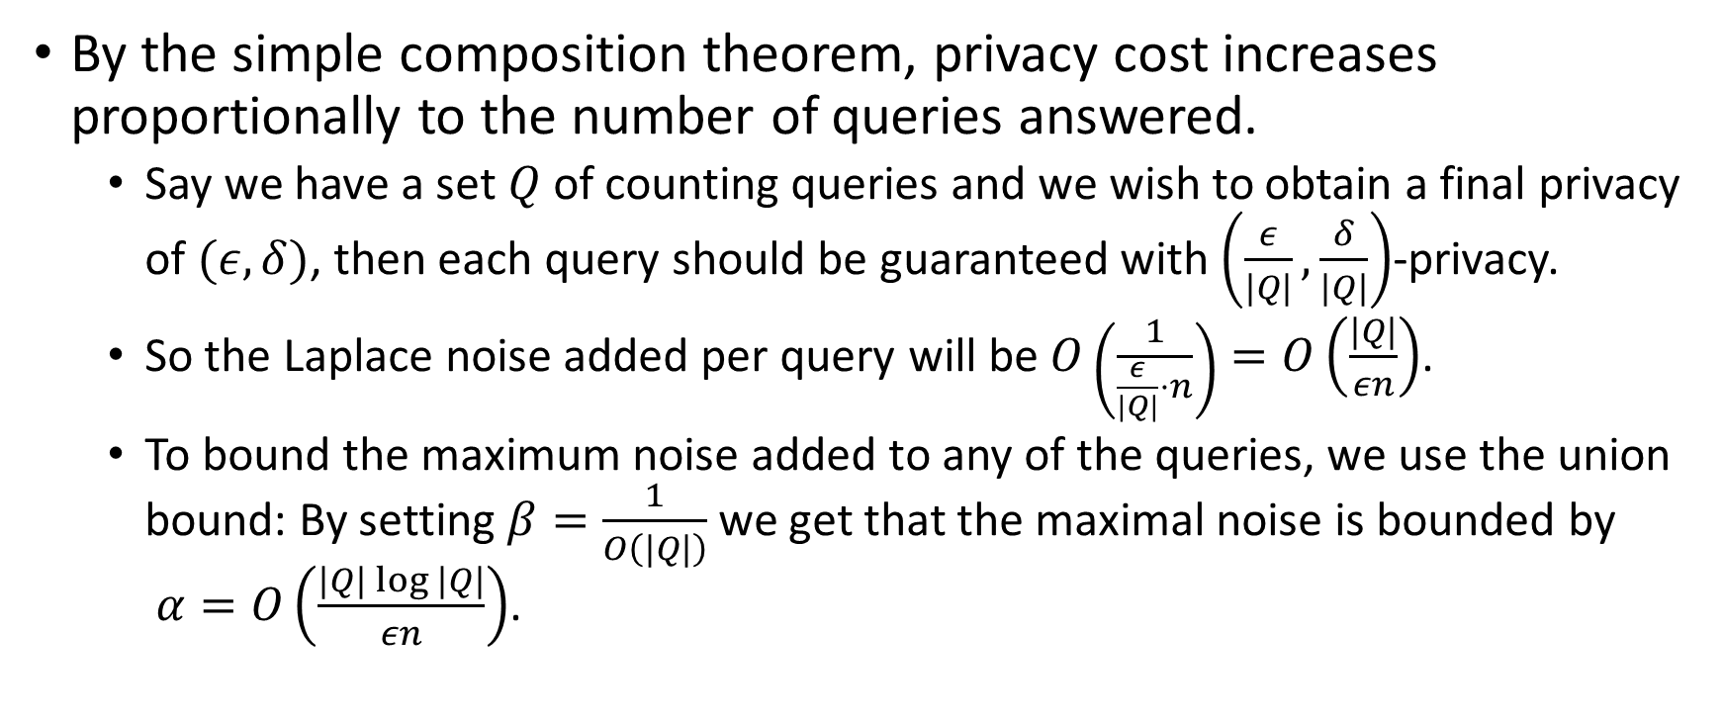
Reminder: Composition
By the simple composition theorem, privacy cost increases proportionally to the number of queries answered.
  Say we have a set$Q$of counting queries and we wish to obtain a final privacy of $(ε,δ)$, then each query should be guaranteed with $\left(\frac{ε}{|Q|},\frac{δ}{|Q|}\right)$-privacy.
  So the Laplace noise added per query will be $O\left(\frac{1}{\frac{ε}{|Q|}⋅n}\right)=O\left(\frac{|Q|}{εn}\right)$.
  To bound the maximum noise added to any of the queries, we use the union bound: By setting $β=\frac{1}{O\left(|Q|\right)}$we get that the maximal noise is bounded by $α=O\left(\frac{|Q|\log{|Q|}}{εn}\right)$.
Notes:
$$Pr\left[{\left|f\left(x\right)−y\right|}_{∞}≥\frac{\log\left(\frac{1}{β}\right)Δf}{ε}\right]≤β⇒Pr\left[\left|f\left(x\right)−y\right|≥\frac{|Q|\log{|Q|⋅\frac{1}{n}}}{ε}\right]≤β$$
Explain in details, as found on page 18 of Vadhan.
Remind the Laplace mechanism and its privacy theorem;
Explain what is beta + union bound over k queries…
Mention that this is bad.

Slide 5
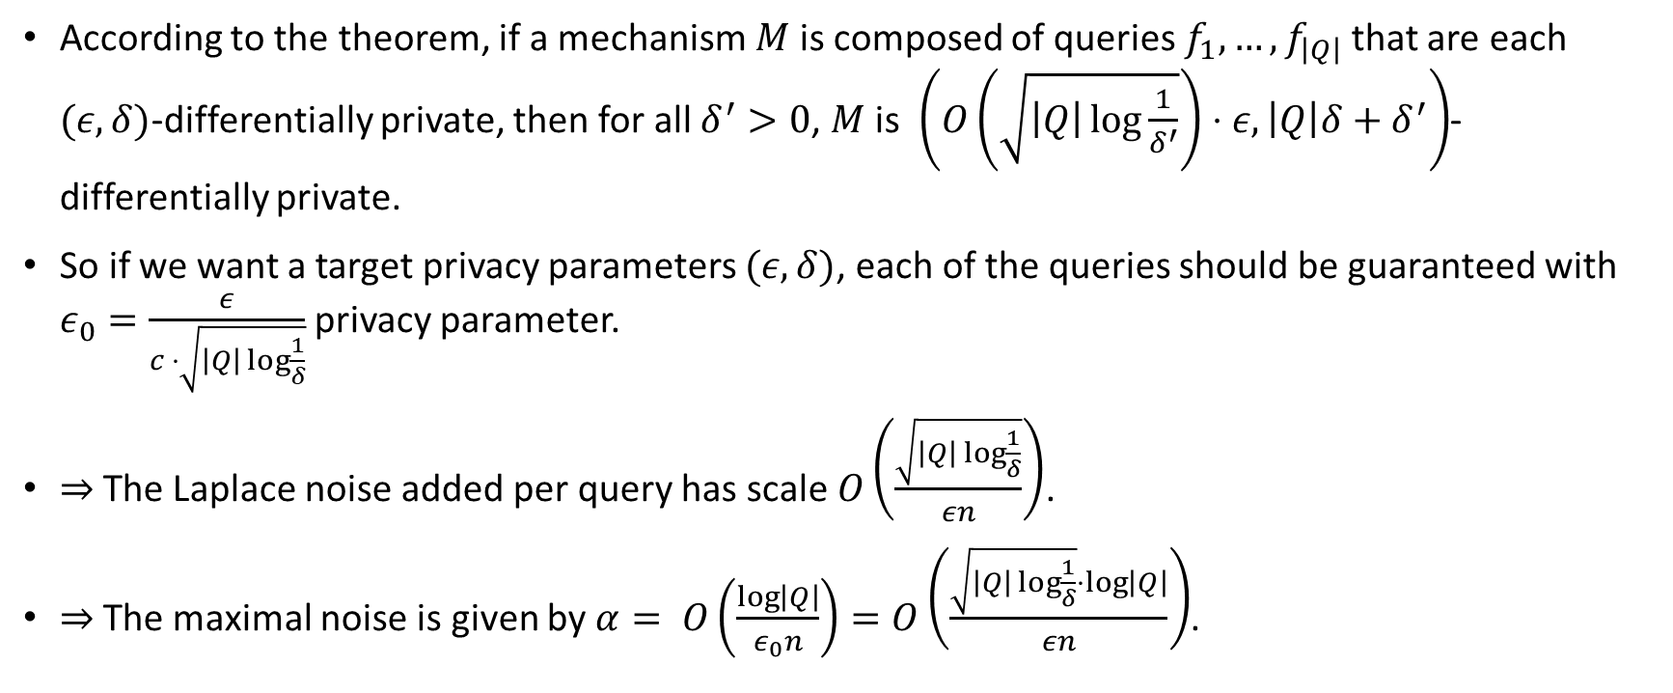
Advanced Composition
According to the theorem, if a mechanism $M$ is composed of queries $f_{1},…,f_{\left|Q\right|}$ that are each $(ε, δ)$-differentially private, then for all $δ^{′}>0$, $M$is $\left(O\left(\sqrt{\left|Q\right|\log{\frac{1}{δ^{′}}}}\right)⋅ε,\left|Q\right|δ+δ^{′}\right)$-differentially private.
So if we want a target privacy parameters $(ε,δ)$, each of the queries should be guaranteed with $ε_{0}=\frac{ε}{c ⋅\sqrt{\left|Q\right|\log{\frac{1}{δ}}}}$ privacy parameter.
$⇒$The Laplace noise added per query has scale $O\left(\frac{\sqrt{\left|Q\right|\log{\frac{1}{δ}}}}{εn}\right)$.
$⇒$The maximal noise is given by $α= O\left(\frac{\log\left|Q\right|}{ε_{0}n}\right)=O\left(\frac{\sqrt{\left|Q\right|\log{\frac{1}{δ}}}⋅\log\left|Q\right|}{εn}\right)$.

Slide 6
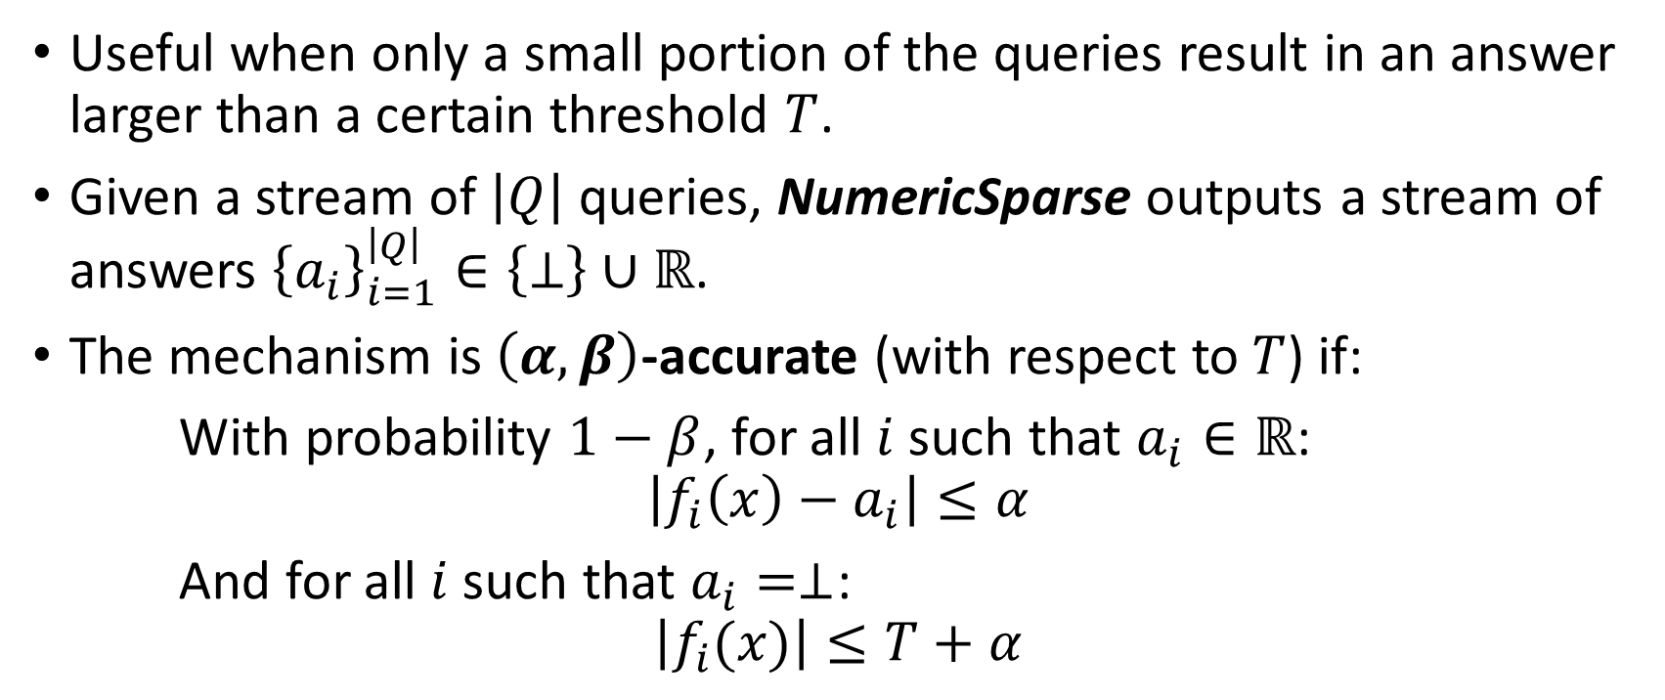
Reminder: Sparse Vector Technique
Useful when only a small portion of the queries result in an answer larger than a certain threshold $T$.
Given a stream of $\left|Q\right|$queries, NumericSparse outputs a stream of answers ${\left\{a_{i}\right\}}_{i=1}^{\left|Q\right|}∈\left\{⊥\right\}∪ℝ$.
The mechanism is $\left(α,β\right)$-accurate (with respect to $T$) if:
With probability $1−β$, for all $i$ such that $a_{i}∈ℝ$:
$$\left|f_{i}\left(x\right)−a_{i}\right|≤α$$
And for all $i$ such that $a_{i}=⊥$:
$$\left|f_{i}(x)\right|≤T+α$$

Slide 7
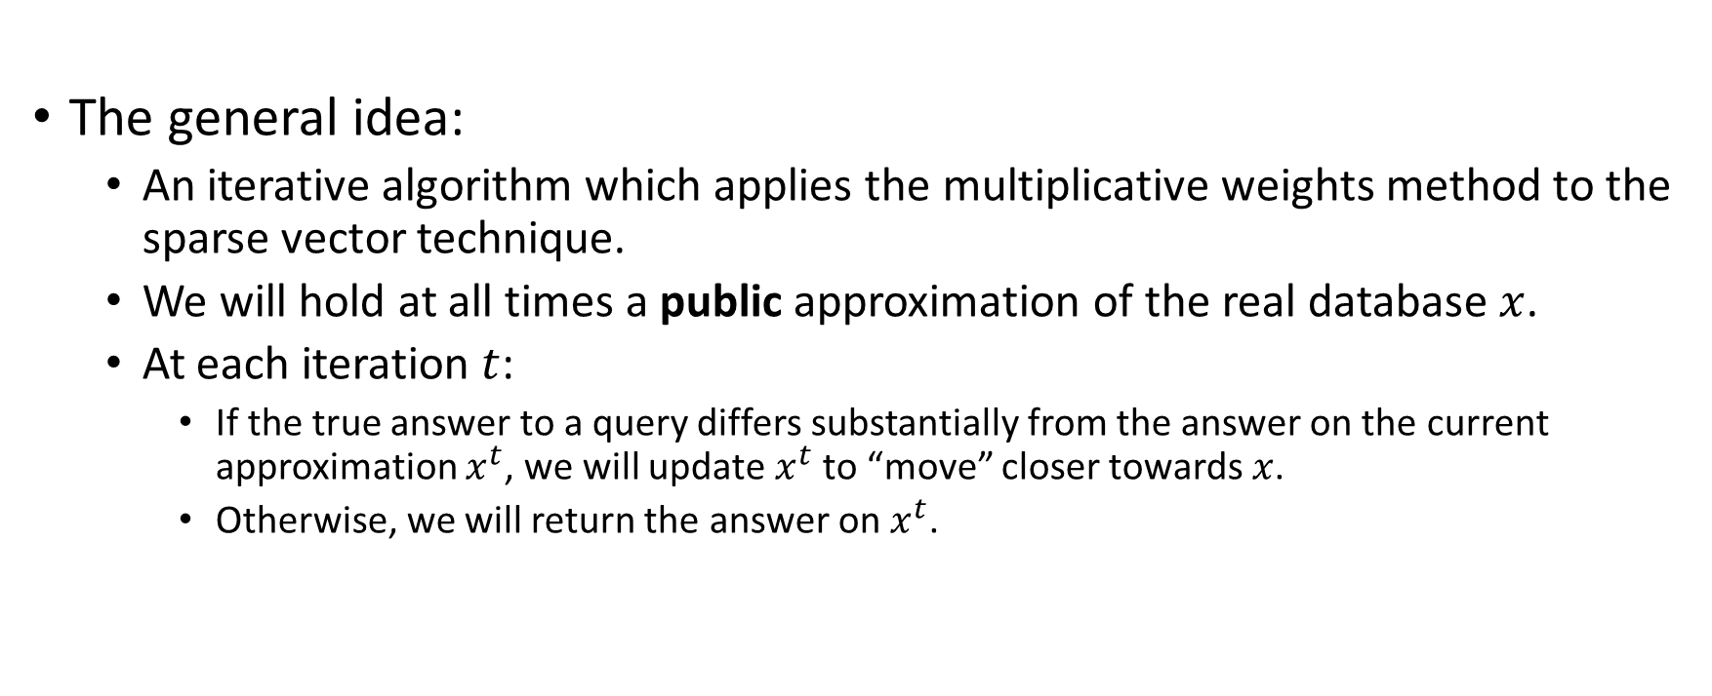
The Mechanism
The general idea:
  An iterative algorithm which applies the multiplicative weights method to the sparse vector technique.
  We will hold at all times a public approximation of the real database $x$.
  At each iteration $t$:
    If the true answer to a query differs substantially from the answer on the current approximation $x^{t}$, we will update $x^{t}$to “move” closer towards $x$.
    Otherwise, we will return the answer on $x^{t}$.

Slide 8
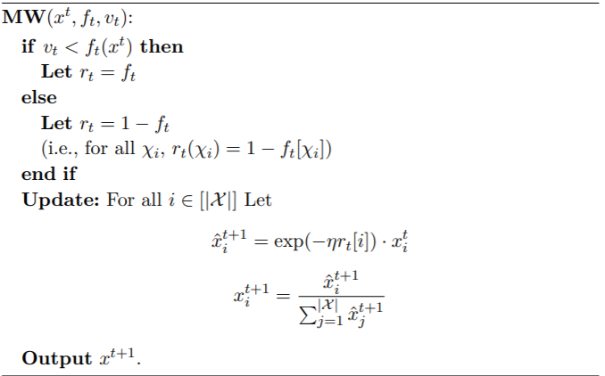
The Multiplicative Weights (MW) Update Rule
Notes:
Give an example on the blackboard.

Slide 9
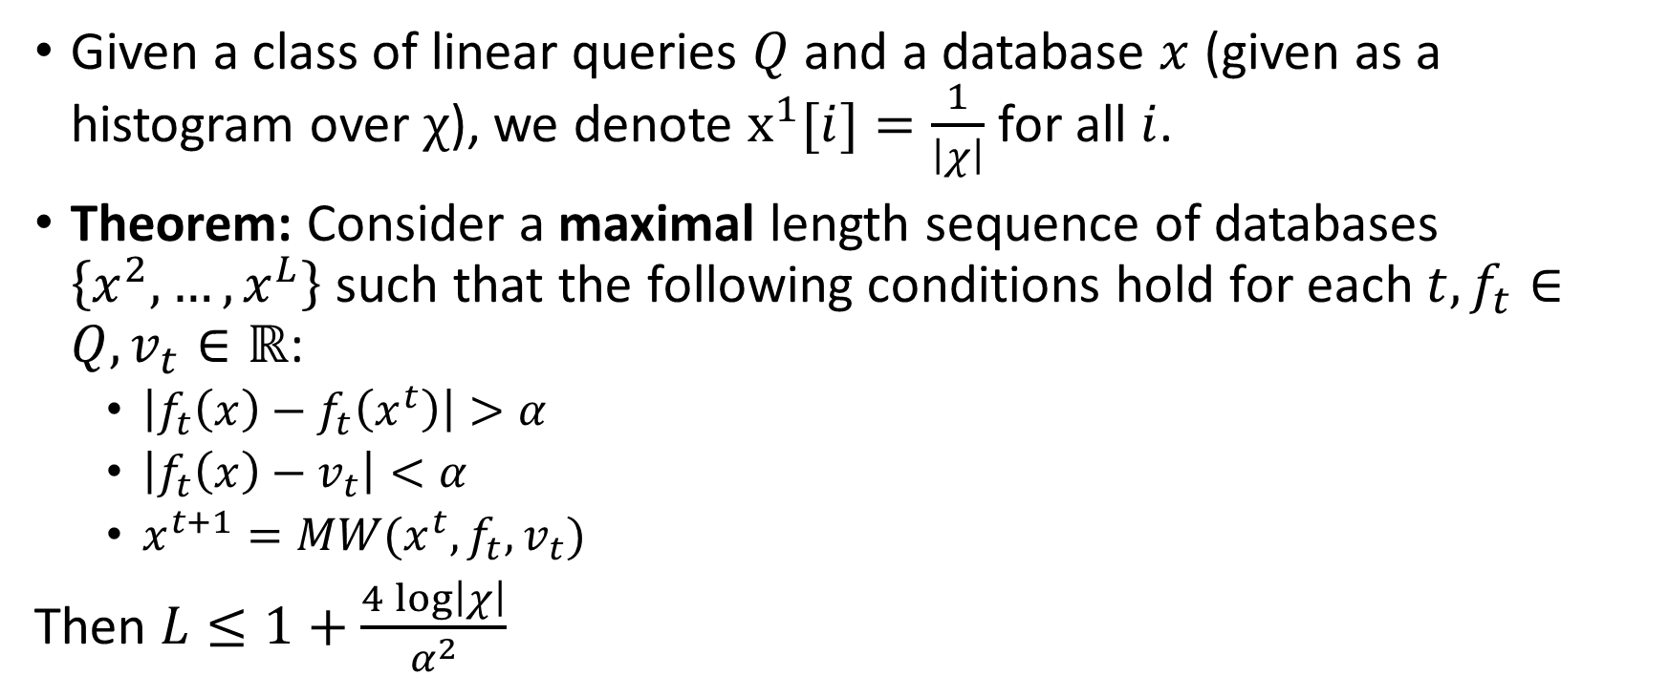
How many updates are needed?
Given a class of linear queries $Q$and a database $x$ (given as a histogram over $χ$), we denote $x^{1}[i]=\frac{1}{\left|χ\right|}$ for all $i$.
Theorem: Consider a maximal length sequence of databases $\left\{x^{2}, …, x^{L}\right\}$ such that the following conditions hold for each $t, f_{t}∈Q, v_{t}∈ℝ$:
  $\left|f_{t}\left(x\right)−f_{t}\left(x^{t}\right)\right|>α$
  $\left|f_{t}\left(x\right)−v_{t}\right|<α$
  $x^{t+1}=MW(x^{t},f_{t},v_{t})$
Then $L≤1+\frac{4\log\left|χ\right|}{α^{2}}$
Notes:
We need to show that the update rounds are not so numerous, and then show the entire mechanism that combines sparse vector and MW.

Slide 10
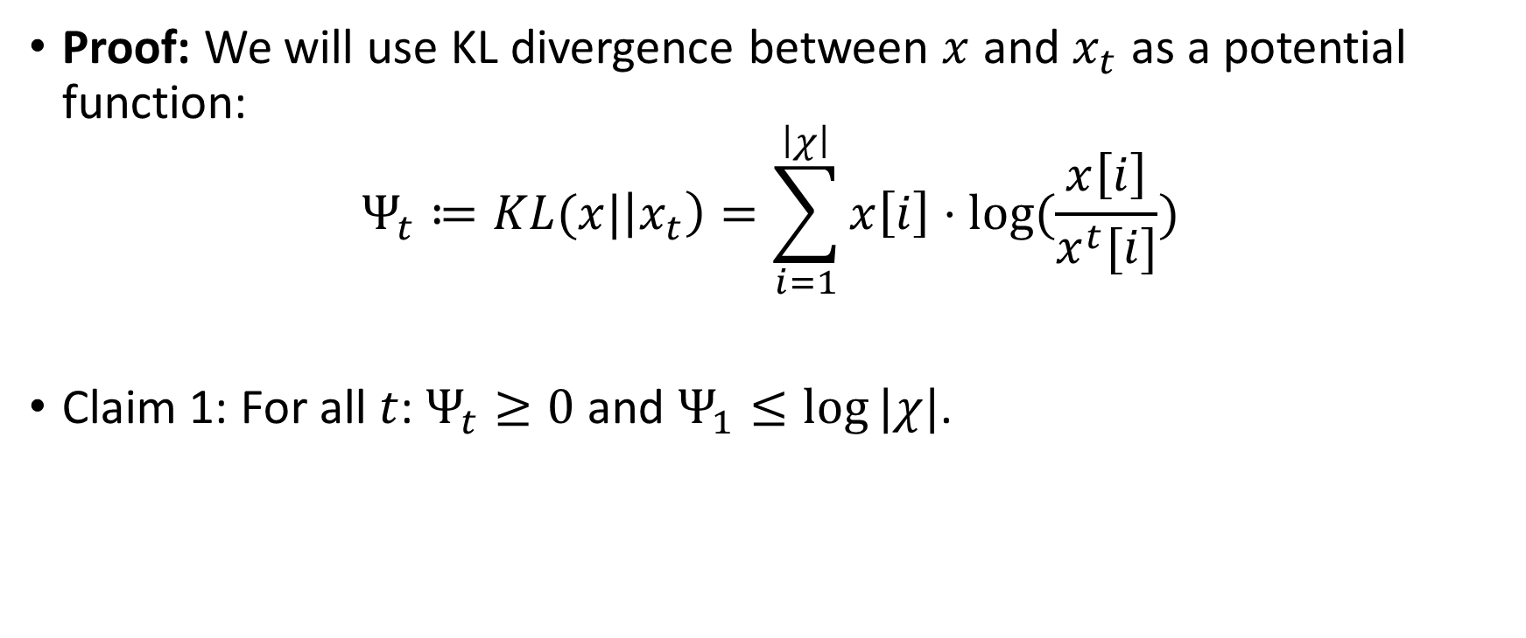
How many updates are needed?
Proof: We will use KL divergence between $x$ and $x_{t}$ as a potential function:
$$Ψ_{t}≔KL(x|\left|x_{t}\right)=\sum_{i=1}^{\left|χ\right|}{x\left[i\right]⋅log⁡(\frac{x\left[i\right]}{x^{t}[i]})}$$
Claim 1: For all $t$: $Ψ_{t}≥0$ and $Ψ_{1}≤log⁡|χ|$.

Slide 11
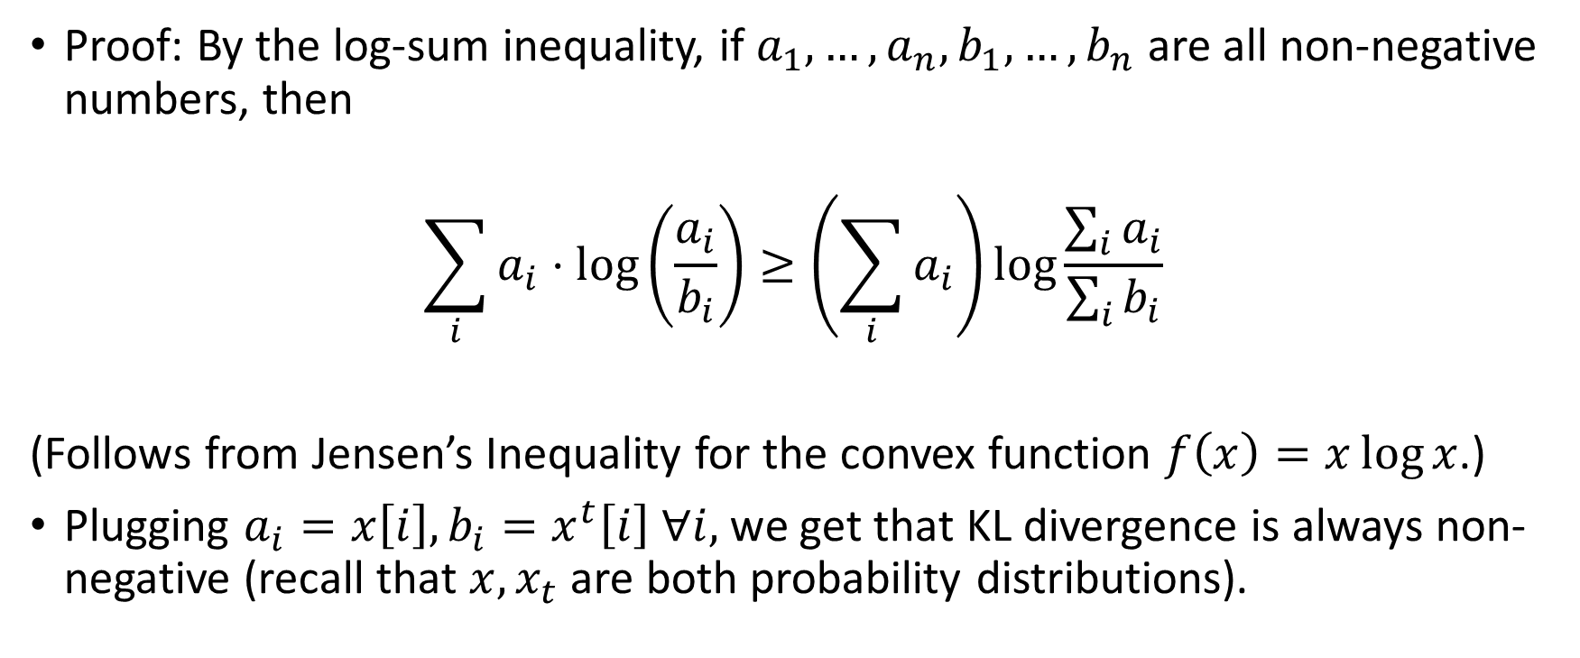
How many updates are needed? – Cont.
Proof: By the log-sum inequality, if $a_{1},…,a_{n}, b_{1},…,b_{n}$ are all non-negative numbers, then
$$\sum_{i}{a_{i}⋅\log\left(\frac{a_{i}}{b_{i}}\right)≥\left(\sum_{i}{a_{i}}\right)\log{\frac{\sum_{i}{a_{i}}}{\sum_{i}{b_{i}}}}}$$
(Follows from Jensen’s Inequality for the convex function $f\left(x\right)=x\log{x}$.)
Plugging $a_{i}=x\left[i\right], b_{i}=x^{t}\left[i\right] ∀i,$we get that KL divergence is always non-negative (recall that $x, x_{t}$ are both probability distributions).
Notes:
Explain how this follows from Jensen.

Slide 12
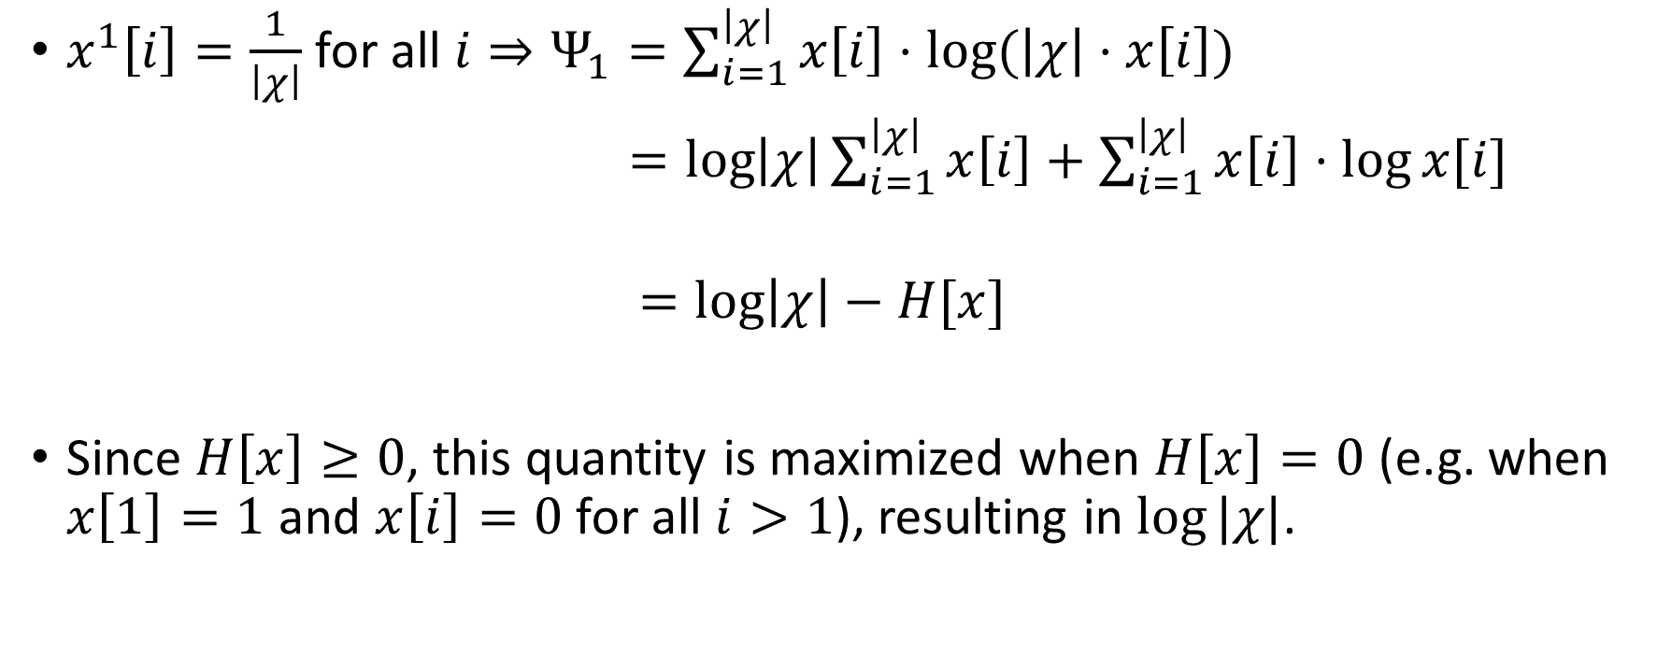
How many updates are needed? – Cont.
$x^{1}\left[i\right]=\frac{1}{\left|χ\right|}$ for all $i⇒Ψ_{1}=\sum_{i=1}^{\left|χ\right|}{x\left[i\right]⋅log⁡(\left|χ\right|⋅x\left[i\right])}$
$=\log\left|χ\right|\sum_{i=1}^{\left|χ\right|}{x\left[i\right]+\sum_{i=1}^{\left|χ\right|}{x\left[i\right]⋅\log{x[i]}}}$
$$=\log\left|χ\right|−H[x]$$
Since $H\left[x\right]≥0$, this quantity is maximized when $H\left[x\right]=0$ (e.g. when $x\left[1\right]=1$ and $x\left[i\right]=0$ for all $i>1$), resulting in $log⁡|χ|$.

Slide 13

How many updates are needed? – Cont.
Claim 2: For all $t$, it holds that:
$$Ψ_{t}−Ψ_{t+1}≥η⋅\left(\left\langle r_{t},x^{t}\right\rangle −\left\langle r_{t},x\right\rangle \right)−η^{2}$$
Proof: on the blackboard.

Slide 14
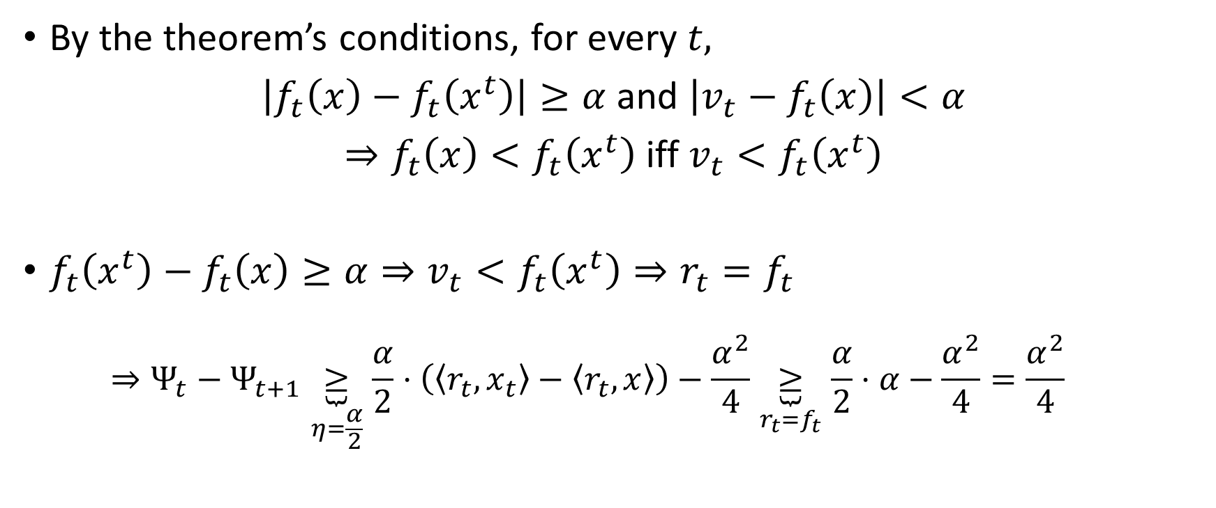
By the theorem’s conditions, for every $t,$
$\left|f_{t}\left(x\right)−f_{t}\left(x^{t}\right)\right|≥α$ and $\left|v_{t}−f_{t}\left(x\right)\right|<α$
$⇒f_{t}\left(x\right)<f_{t}\left(x^{t}\right)$iff $v_{t}<f_{t}\left(x^{t}\right)$
${f_{t}\left(x^{t}\right)−f_{t}\left(x\right)≥α⇒v}_{t}<f_{t}\left(x^{t}\right)⇒r_{t}=f_{t}$
  $$⇒Ψ_{t}−Ψ_{t+1}\underset{η=\frac{α}{2}}{\underbrace{≥}}\frac{α}{2}⋅\left(\left\langle r_{t}, x_{t}\right\rangle −\left\langle r_{t},x\right\rangle \right)−\frac{α^{2}}{4}\underset{r_{t}=f_{t}}{\underbrace{≥}}\frac{α}{2}⋅α−\frac{α^{2}}{4}=\frac{α^{2}}{4}$$

Slide 15

$f_{t}\left(x\right)−f_{t}\left(x_{t}\right)≥α⇒v_{t}≥f_{t}\left(x^{t}\right)⇒r_{t}=\vec{1}−f_{t}$
$$⇒Ψ_{t}−Ψ_{t+1}\underset{η=\frac{α}{2}}{\underbrace{≥}}\frac{α}{2}⋅\left(\left\langle r_{t}, x_{t}\right\rangle −\left\langle r_{t},x\right\rangle \right)−\frac{α^{2}}{4}\underset{r_{t}=1−f_{t}}{\underbrace{=}}\frac{α}{2}⋅\left(1−f_{t}\left(x^{t}\right)−1+f_{t}\left(x\right)\right)−\frac{α^{2}}{4}≥\frac{α}{2}⋅α−\frac{α^{2}}{4}=\frac{α^{2}}{4}$$
Finally, we have
$${log \left|χ\right|≥Ψ}_{1}−Ψ_{L}=\sum_{t=1}^{L−1}{\left(Ψ_{t}−Ψ_{t+1}\right)}≥\left(L−1\right)⋅\frac{α^{2}}{4}$$
$$⇒L≤1+\frac{4\log\left|χ\right|}{α^{2}}$$

Slide 16
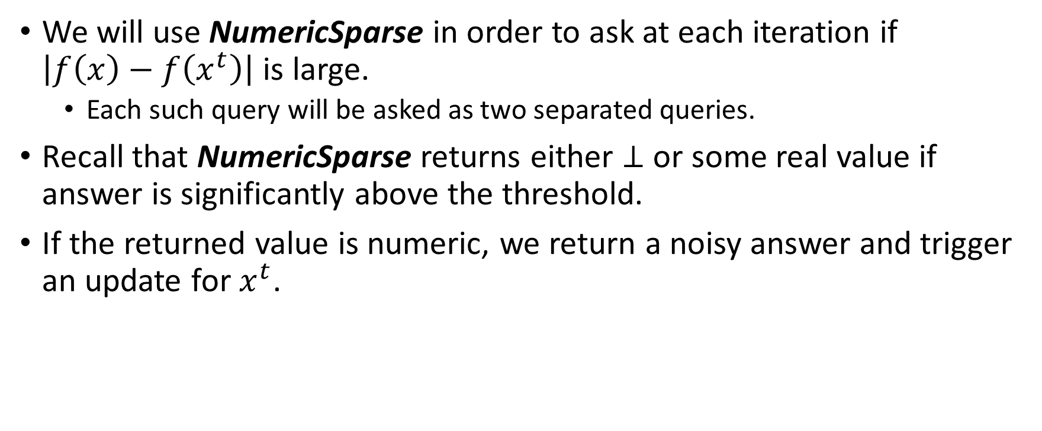
The mechanism
We will use NumericSparse in order to ask at each iteration if $\left|f\left(x\right)−f\left(x^{t}\right)\right|$ is large.
  Each such query will be asked as two separated queries.
Recall that NumericSparse returns either $⊥$ or some real value if answer is significantly above the threshold.
If the returned value is numeric, we return a noisy answer and trigger an update for $x^{t}$.

Slide 17

$\text{OnlineMultiplicativeWeights}\left(x,ε,δ=0,α,β,\left\{f_{i}\right\}\right)$
$c←\frac{4\log\left|χ\right|}{α^{2}}$
$T←\frac{18c\left(\log\left(2\left|Q\right|\right)+\log\left(\frac{4c}{β}\right)\right)}{εn}$
Initialize NumericSparse($x, \left\{f_{i}^{′}\right\},T,c,ε,δ=0)$with a stream of queries $\left\{f_{i}^{′}\right\}$, outputting a stream of answers $\left\{E_{i}\right\}$.
$t←1$
$x_{i}^{1}=\frac{1}{\left|χ\right|} ∀i∈\left[\left|χ\right|\right]$
For each query $f_{i}$:
  $f_{2i−1}^{′}\left(⋅\right)←f_{i}\left(⋅\right)−f_{i}\left(x^{t}\right)$
  $f_{2i}^{′}\left(⋅\right)←f_{i}\left(x^{t}\right)−f_{i}\left(⋅\right)$
  If $E_{2i−1}=⊥and E_{2i}=⊥$ then
    $a_{i}←f_{i}\left(x^{t}\right)$
  Else
    If $E_{2i−1}∈ℝ$then
      $a_{i}←f_{i}\left(x^{t}\right)+E_{2i−1}$
    Else
      $a_{i}←f_{i}\left(x^{t}\right)−E_{2i}$
    ${ x}^{t+1}←MW\left(x^{t},f_{i},a_{i}\right)$
    $t ←t + 1$

Slide 18

Privacy Analysis
Note that the mechanism is $(ε,δ)$-differentially private.
Since the online mechanism accesses the database only through NumericSparse, this follows directly from the privacy analysis of NumericSparse.

Slide 19
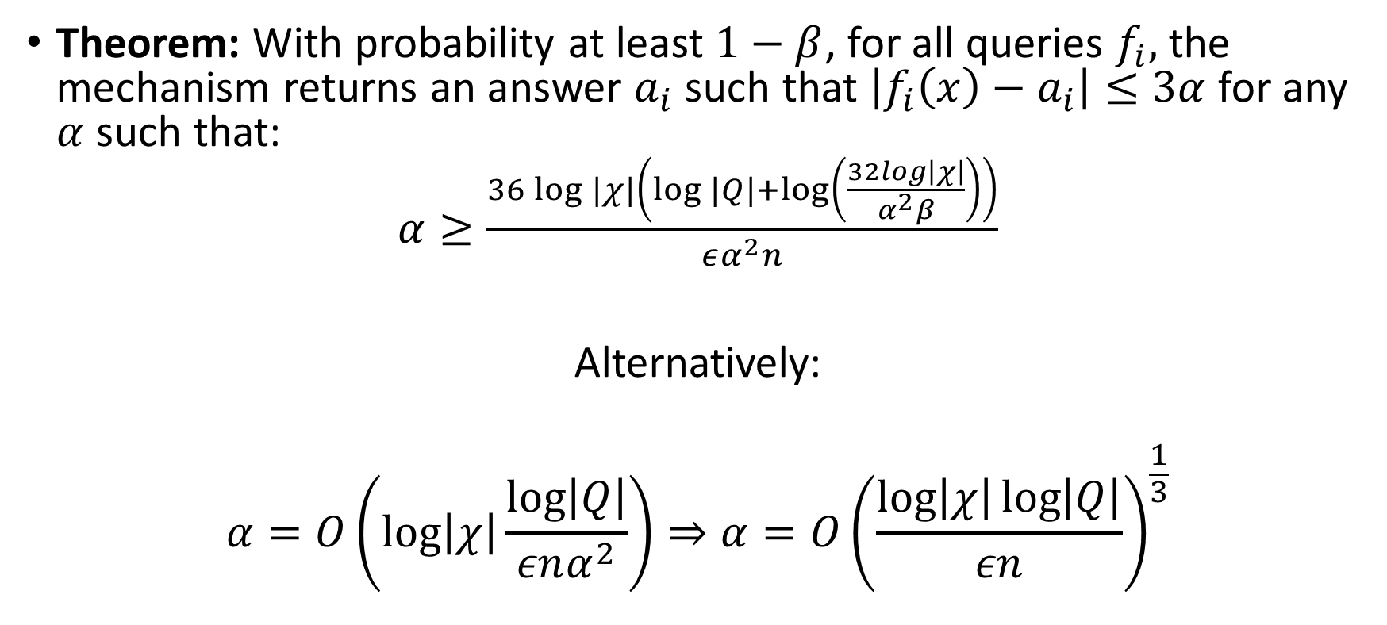

Accuracy Analysis ($δ=0$)
Theorem: With probability at least $1−β$, for all queries $f_{i},$ the mechanism returns an answer $a_{i}$ such that $\left|f_{i}\left(x\right)−a_{i}\right|≤3α$ for any $α$ such that:
$α≥\frac{36\log{|χ|}\left(\log{|Q|}+\log\left(\frac{32log\left|χ\right|}{α^{2}β}\right)\right)}{εα^{2}n}$
Alternatively:
$$α=O\left(\log\left|χ\right|\frac{\log\left|Q\right|}{εnα^{2}}\right)⇒α=O{\left(\frac{\log\left|χ\right|\log\left|Q\right|}{εn}\right)}^{\frac{1}{3}}$$

Slide 20

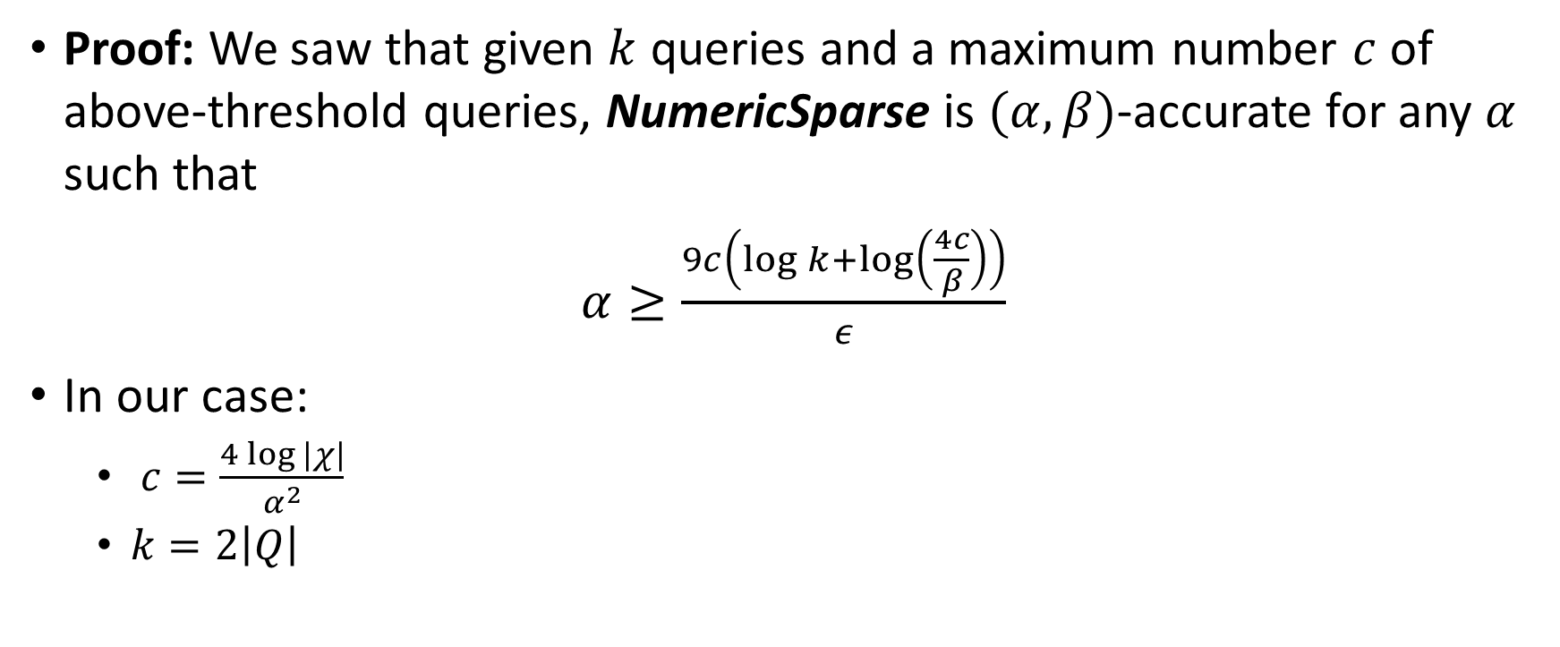
Accuracy Analysis ($δ=0$) – Cont.
Proof: We saw that given $k$ queries and a maximum number $c$ of above-threshold queries, NumericSparse is $(α,β)$-accurate for any $α$ such that
$α≥\frac{9c\left(\log{k+\log\left(\frac{4c}{β}\right)}\right)}{ε}$
In our case:
  $c=\frac{4\log{|χ|}}{α^{2}}$
  $k=2\left|Q\right|$

Slide 21
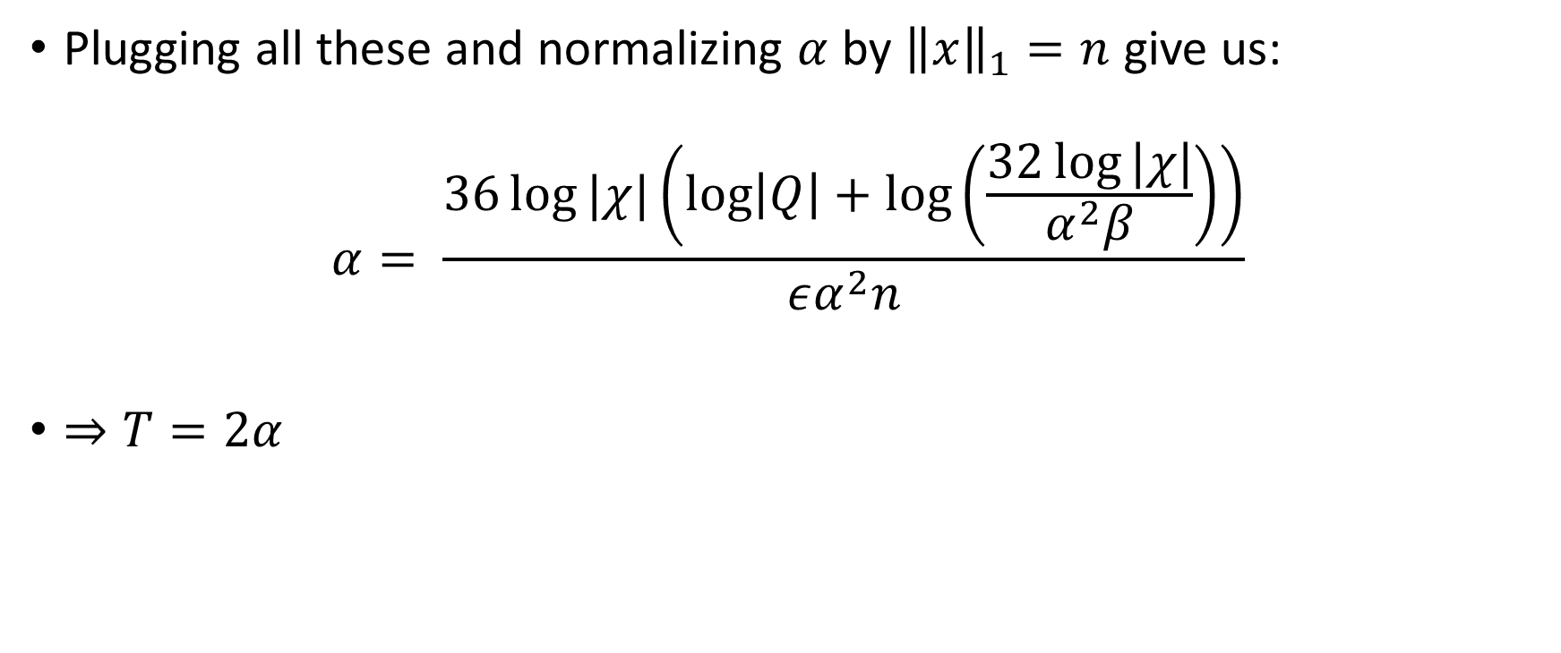
Accuracy Analysis ($δ=0$) – Cont.
Plugging all these and normalizing $α$ by ${\left\|x\right\|}_{1}=n$ give us:
$$α= \frac{36\log{|χ|\left(\log\left|Q\right|+\log\left(\frac{32\log{|χ|}}{α^{2}β}\right)\right)}}{εα^{2}n}$$
$⇒T=2α$

Slide 22
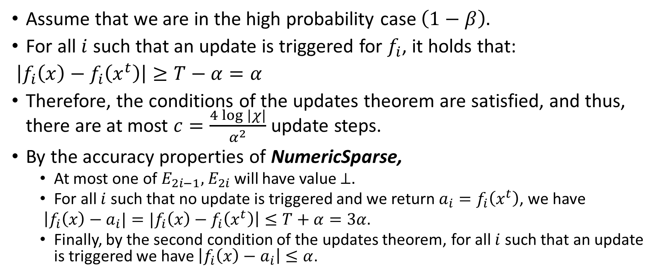
Accuracy Analysis ($δ=0$) – Cont.
Assume that we are in the high probability case $\left(1−β\right).$
For all $i$ such that an update is triggered for $f_{i}$, it holds that:
$\left|f_{i}\left(x\right)−f_{i}\left(x^{t}\right)\right|≥T−α=α$
Therefore, the conditions of the updates theorem are satisfied, and thus, there are at most $c=\frac{4\log{|χ|}}{α^{2}}$ update steps.
By the accuracy properties of NumericSparse,
  At most one of $E_{2i−1},{ E}_{2i}$will have value $⊥.$
  For all $i$ such that no update is triggered and we return $a_{i}=f_{i}\left(x^{t}\right)$, we have
  $\left|f_{i}\left(x\right)−a_{i}|=|f_{i}\left(x\right)−f_{i}\left(x^{t}\right)\right|≤T+α=3α.$
  Finally, by the second condition of the updates theorem, for all $i$ such that an update is triggered we have $\left|f_{i}\left(x\right)−a_{i}\right|≤α$.

Slide 23

$\text{OnlineMultiplicativeWeights}\left(x,ε,δ,α,β,\left\{f_{i}\right\}\right)$
$c←\frac{4\log\left|χ\right|}{α^{2}}$
$T←\frac{\left(2+32\sqrt{2}\right)\left(\sqrt{c\log{\frac{2}{δ}}}{ }\left(\log{k+\log{\frac{4c}{β}}}\right)\right)}{εn}$
Initialize NumericSparse($x, \left\{f_{i}^{′}\right\},T,c,ε,δ)$with a stream of queries $\left\{f_{i}^{′}\right\}$, outputting a stream of answers $\left\{E_{i}\right\}$.
$t←1$
$x_{i}^{1}=\frac{1}{\left|χ\right|} ∀i∈\left[\left|χ\right|\right]$
For each query $f_{i}$:
  $f_{2i−1}^{′}\left(⋅\right)←f_{i}\left(⋅\right)−f_{i}\left(x^{t}\right)$
  $f_{2i}^{′}\left(⋅\right)←f_{i}\left(x^{t}\right)−f_{i}\left(⋅\right)$
  If $E_{2i−1}=⊥and E_{2i}=⊥$ then
    $a_{i}←f_{i}\left(x^{t}\right)$
  Else
    If $E_{2i−1}∈ℝ$then
      $a_{i}←f_{i}\left(x^{t}\right)+E_{2i−1}$
    Else
      $a_{i}←f_{i}\left(x^{t}\right)−E_{2i}$
    ${ x}^{t+1}←MW\left(x^{t},f_{i},a_{i}\right)$
    $t ←t + 1$

Slide 24


Accuracy Analysis ($δ>0$)
Theorem: With probability at least $1−β$, for all queries $f_{i},$ the mechanism returns an answer $a_{i}$ such that $\left|f_{i}\left(x\right)−a_{i}\right|≤3α$ for any $α$ such that:
$α≥\frac{\left(2+32\sqrt{2}\right)\sqrt{\log\left|χ\right|\log{\frac{2}{δ}}}\left(\log{|Q|}+\log\left(\frac{32\log\left|χ\right|}{α^{2}β}\right)\right)}{εαn}$

Slide 25

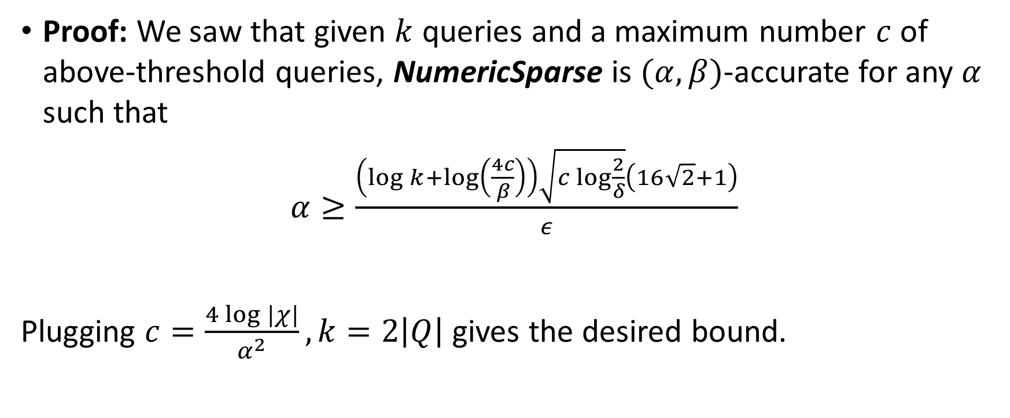
Accuracy Analysis ($δ>0$) – Cont.
Proof: We saw that given $k$ queries and a maximum number $c$ of above-threshold queries, NumericSparse is $(α,β)$-accurate for any $α$ such that
$α≥\frac{\left(\log{k+\log\left(\frac{4c}{β}\right)}\right)\sqrt{c\log{\frac{2}{δ}}}\left(16\sqrt{2}+1\right)}{ε}$
Plugging $c=\frac{4\log{|χ|}}{α^{2}}, k=2\left|Q\right|$ gives the desired bound.

