Slide 1
Streaming
& sampling

Slide 2
Today’s Topics
Intro – The problem
The streaming model:
Definition
Algorithm example
Frequency moments of data streams
#Distinct Elements in a Data Stream
2-Universal (Pairwise Independent) Hash Functions
Second moment estimation
Matrix Multiplication Using Sampling
Implementing Length Squared Sampling in Two Passes
Connection to SVD

Slide 3
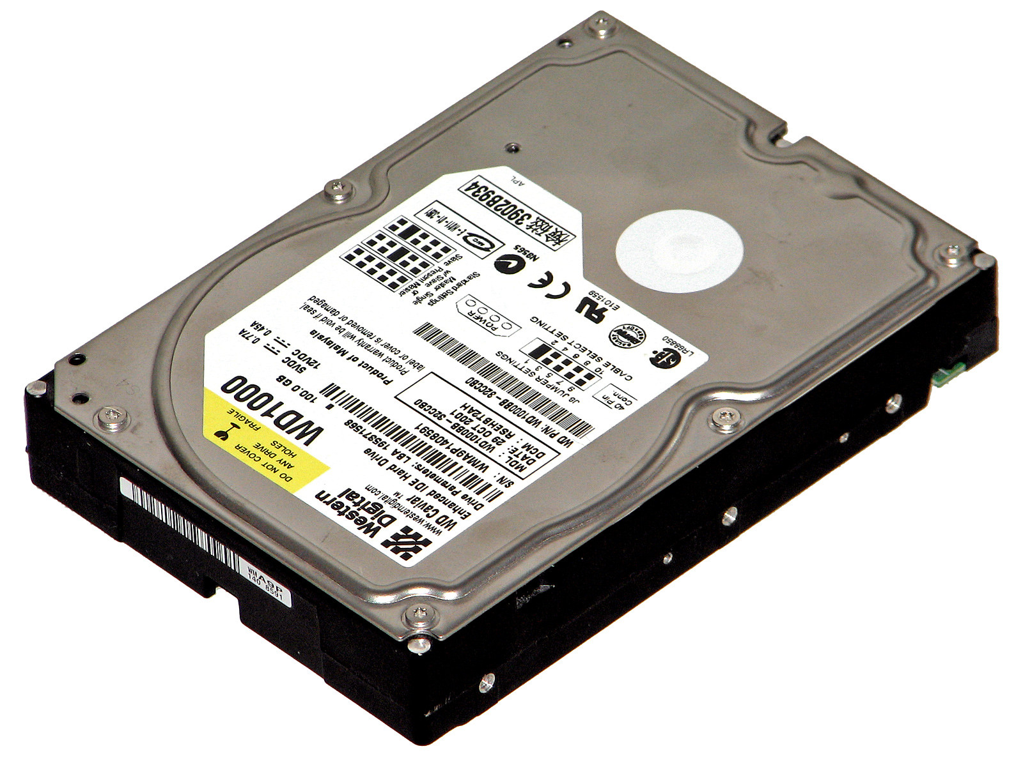
Intro – The Problem
Massive data problems where the input data is too large to be stored in RAM
500 MB RAM
5 GB

Slide 4
The Streaming Model - Definition
$n$ data items arrive one at a time - $a_{1},a_{2},…,a_{n}$
$a_{i}$ is from an alphabet of $m$ possible symbols. For convenience: $\left\{1,2,…,m\right\}$
$a_{i}$ is a $b$-bit quantity, $b$ is not too large
$s$ – a generic element of $\left\{1,2,…,m\right\}$
The goal: compute some statistics, property, or summary of these data items without using too much memory (much less than $n$)
Notes:
The switch example. I can’t save a dictionary of all the macs and their results.

Slide 5
The Streaming Model - Example
Input: Stream $a_{1},a_{2},…,a_{n}$
Output: Select an index $i$ with probability proportional to the value of $a_{i}$ ($Prob\left(i\right)=\frac{a_{i}}{\sum_{j}{a_{j}}}$)
Challenge: When we see an element, we do not know the probability with which to select it since the normalizing constant depends on all of the elements including those we have not yet seen
Solution: maintain the following variables
$S$ – the sum of the $a_{i}$’s seen so far $i$– index selected with probability $\frac{a_{i}}{S}$
At start $S=a_{1},i=1$
Input stream - $a_{1},a_{2},…,a_{n}$
$a_{i}∈\left\{1,2,…,m\right\}$
$s\text{ – }\text{a} \text{generic} \text{symbol} \text{of} \left\{1,2,…,m\right\}$
Notes:
The challenge: on seeing $a_{j}$ I don’t know the total sum of numbers. On the other hand I can calculate the sum but I forget the numbers.

Slide 6
Example – “on the fly” concept
Algorithm: after $j$ items $S=a_{1}+a_{2}+…+a_{j}$ and for each $i$ in $\left\{1,2,..,j\right\}$ the selected index will be $i$ with probability $\frac{a_{i}}{S}$
On seeing $a_{j+1}$:
Change $i$ to $j+1$ with probability $\frac{a_{j+1}}{S+a_{j+1}}$, or save the same index with probability of $1−\frac{a_{j+1}}{S+a_{j+1}}$
$S=S+a_{j+1}$
Input stream - $a_{1},a_{2},…,a_{n}$
$a_{i}∈\left\{1,2,…,m\right\}$
$s\text{ – }\text{a} \text{generic} \text{symbol} \text{of} \left\{1,2,…,m\right\}$
Notes:
If the index was change to $j+1$ so clearly the index was chosen with the right probability. Otherwise ($i$ not changed), the index is selected with probability of:
$\left(1−\frac{a_{j+1}}{S+a_{j+1}}\right)⋅\frac{a_{i}}{S}=\frac{S}{S+a_{j+1}}⋅\frac{a_{i}}{S}=\frac{a_{i}}{S+a_{j+1}}$ which is also correct
Calculating sum is ok – $Ο\left(b+\log\left(n\right)\right)$

Slide 7
Frequency Moments Of Data Streams
The frequency of a symbol $s$, $f_{s}$, is the number of occurrences of $s$ in the stream
For a non negative integer $p$ , the $p^{th}$ frequency moment of the stream is $\sum_{s=1}^{m}{f_{s}^{p}}$
When $p→ ∞$ we get that ${\left(\sum_{s=1}^{m}{f_{s}^{p}}\right)}^{\frac{1}{p}}$ is the frequency of the most frequent element(s)
Input stream - $a_{1},a_{2},…,a_{n}$
$a_{i}∈\left\{1,2,…,m\right\}$
$s\text{ – }\text{a} \text{generic} \text{symbol} \text{of} \left\{1,2,…,m\right\}$

Slide 8
Frequency Moments Of Data Streams
What is the frequency moment for $p=0$? Assume $0^{0}=0$
Number of distinct symbols in the stream
What is the first frequency moment?
$n$ – the length of the stream
What is the second moment good for? In computing the stream’s variance (the average squared difference from the average frequency). The variance is a skew indicator
Input stream - $a_{1},a_{2},…,a_{n}$
$a_{i}∈\left\{1,2,…,m\right\}$
$s\text{ – }\text{a} \text{generic} \text{symbol} \text{of} \left\{1,2,…,m\right\}$
$\sum_{s=1}^{m}{f_{s}^{p}}$ - the $p^{th}$ moment
Notes:
Variance calculation:
$$\frac{1}{m}\sum_{s=1}^{m}{{\left(f_{s}−\frac{n}{m}\right)}^{2}}=\frac{1}{m}\sum_{s=1}^{m}{\left(f_{s}^{2}−2\frac{n}{m}f_{s}+{\left(\frac{n}{m}\right)}^{2}\right)}=\left(\frac{1}{m}\sum_{s=1}^{m}{f_{s}^{2}}\right)−\frac{n^{2}}{m^{2}}$$

Slide 9
Frequency Moments - Motivation
The identity and frequency of the most frequent item, or more generally, items whose frequency exceeds a given fraction of $n$, is clearly important in many applications
“Real life” example - let’s look on a routers example:
The data items are network packets with source/dest IP addresses
Even if router could have log the massive amount of data passing through it (source+dest+#packets) it cannot be easily sorted or process
The high frequency items identify the heavy bandwidth users
It is important to know if some popular source-destination pairs have a lot of traffic
We can use the stream variance for this
Input stream - $a_{1},a_{2},…,a_{n}$
$a_{i}∈\left\{1,2,…,m\right\}$
$s\text{ – }\text{a} \text{generic} \text{symbol} \text{of} \left\{1,2,…,m\right\}$
$\sum_{s=1}^{m}{f_{s}^{p}}$ - the $p^{th}$ moment

Slide 10
#Distinct Elements in a Data Stream
Assume $n,m$ are very large. Each $a_{i}$ is an integer in the range $[1,m]$
Goal: Determine the number of distinct $a_{i}$ in the sequence
Easy to do in $Ο\left(m\right)$ space
Also easy to do in $Ο\left(n\log{m}\right)$ space
Our goal is to use space logarithmic in $m$ and $n$
Lemma: Any deterministic algorithm that determines the number of distinct elements exactly must use at least $m$ bits of memory on some input sequence of length $Ο\left(m\right)$
Input stream - $a_{1},a_{2},…,a_{n}$
$a_{i}∈\left\{1,2,…,m\right\}$
$s\text{ – }\text{a} \text{generic} \text{symbol} \text{of} \left\{1,2,…,m\right\}$
$\sum_{s=1}^{m}{f_{s}^{p}}$ - the $p^{th}$ moment
Notes:
Example: Each $a_{i}$ might represent a credit card number extracted from a sequence of
credit card transactions and we wish to determine how many distinct credit card accounts
there are.
Lemma: If $S_{1},S_{2}$ are of different sizes, then clearly this implies an error for one of the input sequences. On the
other hand, if they are the same size, then if the next symbol is in $S_{1}$ but not$S_{2}$, the
algorithm will give the same answer in both cases and therefore must give an incorrect
answer on at least one of them.

Slide 11
#Distinct Elements in a Data Stream
Approximate the answer up to a constant factor using randomization with a small probability of failure
Intuition:
Suppose the set $S$ of distinct elements was chosen uniformly at random from $\left\{1,…,m\right\}$
Let $min$ denote the minimum element in $S$
What is the expected value of $min$?
If $\left|S\right|=1$?
If there are two distinct elements?
Generally – the expected value of $min$ is $\frac{m}{\left|S\right|+1}$
So… $min=\frac{m}{\left|S\right|+1} ⇒ \left|S\right|=\frac{m}{min}−1$
Solved with $Ο\left(\log{m}\right)$ space!
$$\frac{m}{2}$$
$$\frac{m}{3}$$
Input stream - $a_{1},a_{2},…,a_{n}$
$a_{i}∈\left\{1,2,…,m\right\}$
$s\text{ – }\text{a} \text{generic} \text{symbol} \text{of} \left\{1,2,…,m\right\}$
$\sum_{s=1}^{m}{f_{s}^{p}}$ - the $p^{th}$ moment

Slide 12
#Distinct Elements in a Data Stream
Generally, the set $S$ might not have been chosen uniformly at random
We can convert our intuition into an algorithm that works well with high probability on every sequence via hashing
$$h:\left\{1,2,…,m\right\}→\left\{0,1,2,…,M−1\right\}$$
Now we keep track of the minimum hash value - $h\left(a_{1}\right),h\left(a_{2}\right),…,h\left(a_{n}\right)$
So what it left for us to see?
We need to find an appropriate $h$ and to store it compactly
Prove that the algorithm works
Input stream - $a_{1},a_{2},…,a_{n}$
$a_{i}∈\left\{1,2,…,m\right\}$
$s\text{ – }\text{a} \text{generic} \text{symbol} \text{of} \left\{1,2,…,m\right\}$
$\sum_{s=1}^{m}{f_{s}^{p}}$ - the $p^{th}$ moment

Slide 13
2-Universal (Pairwise Independent) Hash Functions
A set of hash functions $H=\left\{h| h:\left\{1,2,…,m\right\}→\left\{0,1,2,…,M−1\right\}\right\}$is 2-universal if and only if for all $x,y∈\left\{1,2,…,m\right\}, x≠y$ and for all $w,z∈\left\{0,1,2,…,M−1\right\}$:
$$Prob_{h\sim H}\left(h\left(x\right)=w and h\left(y\right)=z \right)=\frac{1}{M^{2}}$$
Example to $H$:
Let M be a prime greater than m
For each $a,b∈\left[0, M−1\right]$ define a hash function: $h_{a,b}\left(x\right)=ax+b \left(mod M\right)$
Storage needed: $Ο\left(\log{M}\right)$
Why is this 2-universal?
Input stream - $a_{1},a_{2},…,a_{n}$
$a_{i}∈\left\{1,2,…,m\right\}$
$s\text{ – }\text{a} \text{generic} \text{symbol} \text{of} \left\{1,2,…,m\right\}$
$\sum_{s=1}^{m}{f_{s}^{p}}$ - the $p^{th}$ moment
Notes:
It follows that a set of hash functions H is 2-universal if and
only if for all x and y in {1,2,…,m} ,x!=y, h(x) and h(y) are each equally likely to be
any element of {0,1,2,…,M-1} independently
Proof of the example: first half of page 176

Slide 14
#Distinct Elements in a Data Stream
So all we have to do now is to prove the algorithm is estimates the result in good probability:
Let $b_{1},b_{2},…,b_{d}$ be the distinct values that appear in the input
So $S=\left\{h\left(b_{1}\right),h\left(b_{2}\right),…,h\left(b_{d}\right)\right\}$ is a set of $d$ random and pairwise independent values from $\left[0,M−1\right]$
Lemma: With probability at least $\frac{2}{3}−\frac{d}{M}$, we have $\frac{d}{6}≤\frac{M}{min}≤6d$
$Prob\left(\frac{M}{min}>6d\right)<\frac{1}{6}+\frac{d}{M}$
$Prob\left(\frac{M}{min}<\frac{d}{6}\right)<\frac{1}{6}$
Input stream - $a_{1},a_{2},…,a_{n}$
$a_{i}∈\left\{1,2,…,m\right\}$
$s\text{ – }\text{a} \text{generic} \text{symbol} \text{of} \left\{1,2,…,m\right\}$
$\sum_{s=1}^{m}{f_{s}^{p}}$ - the $p^{th}$ moment

Slide 15
Second Moment Estimation
Reminder:
The second moment of a stream is given by $\sum_{s=1}^{m}{f_{s}^{2}}$
We can’t calculate it straight forward because of memory limitations
For each symbol $s$, $1≤s≤m$, independently set a random variable $x_{s}$ to $±1$ with probability $\frac{1}{2}$
Assume we can build these random variables with $Ο\left(\log{m}\right)$ space
Think of $x_{s}$ as the output of a random hash function $h\left(s\right)$ whose range is just the two buckets {−1, 1}
Assume $h$ is a 4-independent hash function (every 4 $x_{s}$-s are independent)
Input stream - $a_{1},a_{2},…,a_{n}$
$a_{i}∈\left\{1,2,…,m\right\}$
$s\text{ – }\text{a} \text{generic} \text{symbol} \text{of} \left\{1,2,…,m\right\}$
$\sum_{s=1}^{m}{f_{s}^{p}}$ - the $p^{th}$ moment

Slide 16
Second Moment Estimation
Maintain a sum by adding $x_{s}$ to the sum each time the symbol $s$ occurs in the stream
At the end – the sum will equal $\sum_{s=1}^{m}{x_{s}f_{s}}$
$E\left(\sum_{s=1}^{m}{x_{s}f_{s}}\right)=0$
Mark $a={\left(\sum_{s=1}^{m}{x_{s}f_{s}}\right)}^{2}$
$E\left(a\right)=\sum_{s=1}^{m}{f_{s}^{2}}$ => $a$ is an unbiased estimator of the second moment
Using Markov’s inequality we can determine that $Prob\left(a≥3\sum_{s=1}^{m}{f_{s}^{2}}\right)≤\frac{1}{3}$. But we can do better!
Input stream - $a_{1},a_{2},…,a_{n}$
$a_{i}∈\left\{1,2,…,m\right\}$
$s\text{ – }\text{a} \text{generic} \text{symbol} \text{of} \left\{1,2,…,m\right\}$
$\sum_{s=1}^{m}{f_{s}^{p}}$ - the $p^{th}$ moment

Slide 17
Second Moment Estimation
Mark $a={\left(\sum_{s=1}^{m}{x_{s}f_{s}}\right)}^{2}$, $E\left(a\right)=\sum_{s=1}^{m}{f_{s}^{2}}$
$E\left(a^{2}\right)≤3E^{2}\left(a\right)$ => $Var\left(a\right)≤2E^{2}\left(a\right)$
Therefore repeating the process several times and taking the average gives us high accuracy with high probability
Input stream - $a_{1},a_{2},…,a_{n}$
$a_{i}∈\left\{1,2,…,m\right\}$
$s\text{ – }\text{a} \text{generic} \text{symbol} \text{of} \left\{1,2,…,m\right\}$
$\sum_{s=1}^{m}{f_{s}^{p}}$ - the $p^{th}$ moment

Slide 18
Second Moment Estimation
Theorem
If we use $r=\frac{2}{ε^{2}δ}$ independently chosen 4-way independent sets of random variables, and let $x=Average\left(a_{1},a_{2},…,a_{r}\right)$, then
$$Prob\left(\left|x−E\left(x\right)\right|≥εE\left(x\right)\right)≤δ$$
$∎$
Input stream - $a_{1},a_{2},…,a_{n}$
$a_{i}∈\left\{1,2,…,m\right\}$
$s\text{ – }\text{a} \text{generic} \text{symbol} \text{of} \left\{1,2,…,m\right\}$
$\sum_{s=1}^{m}{f_{s}^{p}}$ - the $p^{th}$ moment
Notes:
Previously: $Var\left(a\right)≤2E^{2}\left(a\right)$
$var\left(x\right)=\frac{var\left(a\right)}{r}≤δε^{2}E^{2}\left(x\right)$, => $\sqrt{var\left(x\right)}≤εE\left(x\right)\sqrt{δ}$
And then using Chebyshev’s inequality.
Chebyshev’s inequality: $\operatorname{Pr}\left(\left|X−E\left(X\right)\right|>k\sqrt{var\left(X\right)}\right)≤\frac{1}{k^{2}}$ => $\operatorname{Pr}\left(\left|X−E\left(X\right)\right|≥kσ\right)≤\frac{1}{k^{2}}$
$εE\left(x\right)=\frac{1}{\sqrt{δ}}\left(εE\left(x\right)\sqrt{δ}\right)≥\frac{1}{\sqrt{δ}}\sqrt{var\left(x\right)}=\frac{1}{\sqrt{δ}}σ$

Slide 19
Matrix Algorithms Using Sampling
Different model: The input is saved in (a slow) memory, but because it is so large we would like to produce a much smaller approximation to it, or perform an approximate computation on it in low space.
In general- We look for matrix algorithms that have errors that are small compared to the Frobenius norm of the matrix.
For example: We want to multiply two large matrices. They are stored in a large slow memory and we would like a small “sketch” of them that can be stored in smaller fast memory and yet retains the important properties of the original input.

Slide 20
Matrix Algorithms Using Sampling
How to create the sketch?
A natural solution is to pick a random sub-matrix and compute with that.
If the sample size s is the number of columns we are willing to work with, we will do s independent identical trials. In each trial, we select a column of the matrix. All that we have to decide is what the probability of picking each column is.
Uniform probability? Nah..
Length squared sampling! The “optimal” probabilities are proportional to the squared length of columns.

Slide 21
Matrix Multiplication Using Sampling
Motivation:
Notes:
Page 184-186

Slide 22
Matrix Multiplication Using Sampling
The problem:
$A$ is $m×n$ matrix, $B$ is $n×p$ matrix.
We want to calculate $AB$.
Notions:
$A\left(:,k\right)$ - the $k^{th}$ column of $A$. A $m×1$ matrix.
$B(k,:)$ - the $k^{th}$ row of $B$. A $1×n$ matrix
Easy to see: $AB= \sum_{k=1}^{n}{A\left(:,k\right)B\left(k,:\right)}$
Using nonuniform probability:
Define a random variable $z$ that takes on values in $\left\{1,2,…,n\right\}$. $p_{k}=Prob\left(z=k\right)$
Choose $X=\frac{1}{p_{k}}A\left(:,k\right)B\left(k,:\right)$ with probability $p_{k}$
$E\left(X\right)=\sum_{k=1}^{n}{Prob\left(z=k\right)\frac{1}{p_{k}}A\left(:,k\right)B\left(k,:\right)=\sum_{k=1}^{n}{A\left(:,k\right)B\left(k,:\right)}=AB}$
Notes:
Page 184-186

Slide 23
Matrix Multiplication Using Sampling
It’s nice that $E\left(X\right)=AB$, but what about its variance?
$Var\left(X\right)=E\left({\left\|AB−X\right\|}_{F}^{2}\right)=\sum_{i=1}^{m}{\sum_{j=1}^{p}{Var(x_{ij})}}=\sum_{ij}{\left(E\left(x_{ij}^{2}\right)−E{\left(x_{ij}\right)}^{2}\right)}=$ $\sum_{k}{\frac{1}{p_{k}}{\left|A\left(:,k\right)\right|}^{2}{\left|B\left(k,:\right)\right|}^{2}}−{\left\|AB\right\|}_{F}^{2}$
We want to minimize it
Length squared sampling: $p_{k}=\frac{{\left|A\left(:,k\right)\right|}^{2}}{{\left\|A\right\|}_{F}^{2}}$
$Var\left(X\right)=E\left({\left\|AB−X\right\|}_{F}^{2}\right)≤{\left\|A\right\|}_{F}^{2}\sum_{k}{{\left|B\left(k,:\right)\right|}^{2}}={\left\|A\right\|}_{F}^{2}{\left\|B\right\|}_{F}^{2}$
Notes:
Page 184-186
Prove the variance on board.
Minimization- In the important special case when $B=A^{T}$, pick columns of A with probabilities proportional to the squared length of the
columns. Even in the general case when B is not $A^{T}$, doing so simplifies the bounds, so we will use it

Slide 24
Matrix Multiplication Using Sampling
Let’s try to reduce the variance:
Again, we can perform $s$ independent trials and take their “average”
Each trial $i=1, 2,…,s$yields a matrix $X_{i}=\frac{1}{p_{k}}A\left(:,k\right)B\left(k,:\right)$
Take $\frac{1}{s}\sum_{i=1}^{s}{X_{i}}$ as our estimation to $AB$
We get $Var\left(\frac{1}{s}\sum_{i=1}^{s}{X_{i}}\right)=\frac{1}{s}Var\left(X\right)≤\frac{1}{s}{\left\|A\right\|}_{F}^{2}{\left\|B\right\|}_{F}^{2}$
We now represent it differently;
$\frac{1}{s}\sum_{i=1}^{s}{X_{i}}=\frac{1}{s}\left(\frac{A\left(:,k_{1}\right)B\left(k_{1},:\right)}{p_{k_{1}}}+\frac{A\left(:,k_{2}\right)B\left(k_{2},:\right)}{p_{k_{2}}}+…+\frac{A\left(:,k_{s}\right)B\left(k_{s},:\right)}{p_{k_{s}}}\right)$
It is more convenient to write this as a product of an $m×s$ matrix with a $s×p$ matrix:
C = $m×s$ matrix = $\left[\frac{A\left(:,k_{1}\right)}{\sqrt{sp_{k_{1}}}},\frac{A\left(:,k_{2}\right)}{\sqrt{sp_{k_{2}}}},…,\frac{A\left(:,k_{s}\right)}{\sqrt{sp_{k_{s}}}}\right]$. $E\left(CC^{T}\right)=AA^{T}$
R = $s×p$ matrix = $\left[\frac{B\left(k_{1},:\right)}{\sqrt{sp_{k_{1}}}},\frac{B\left(k_{2},:\right)}{\sqrt{sp_{k_{2}}}},…,\frac{B\left(k_{s},:\right)}{\sqrt{sp_{k_{s}}}}\right]$. $E\left(R^{T}R\right)=B^{T}B$
We can see that $\frac{1}{s}\sum_{i=1}^{s}{X_{i}}=CR$

Slide 25
Matrix Multiplication Using Sampling
$$R$$
$$C$$
$AB$ can be estimated By $CR$, where $C$is an $m×s$ matrix consisting of $s$ scaled columns of $A$ picked according to length-squared distribution and $R$ is the $s×p$matrix consisting of the corresponding scaled rows of $B$. The error is bounded by:
$$E\left({\left\|AB−CR\right\|}_{F}^{2}\right)≤\frac{{\left\|A\right\|}_{F}^{2}{\left\|B\right\|}_{F}^{2}}{s}$$

Slide 26
Matrix Multiplication Using Sampling
So when does $E\left({\left\|AB−CR\right\|}_{F}^{2}\right)≤\frac{{\left\|A\right\|}_{F}^{2}{\left\|B\right\|}_{F}^{2}}{s}$ help us? Let’s focus on $B=A^{T}$.
If A is the identity matrix:
${\left\|AA^{T}\right\|}_{F}^{2}=n$, but $\frac{{\left\|A\right\|}_{F}^{2}{\left\|B\right\|}_{F}^{2}}{s}=\frac{n^{2}}{s}$
So we need $s>n$ for the bound to be better that approximating with the zero matrix. Not so helpful
Generally the trivial estimate of the zero matrix for $AA^{T}$ provides error of ${\left\|AA^{T}\right\|}_{F}^{2}$
What $s$ do we need to ensure the error is at most this?

Slide 27
Matrix Multiplication Using Sampling
Let $σ_{1},σ_{2},…$ be the singular values of $A$, then:
The singular values of $AA^{T}$ are $σ_{1}^{2}, σ_{2}^{2},…$
${\left\|A\right\|}_{F}^{2}=\sum_{t}{σ_{t}^{2}}$
${\left\|AA^{T}\right\|}_{F}^{2}=\sum_{t}{σ_{t}^{4}}$
We want our error to be better than the zero matrix error - ${\left\|AA^{T}\right\|}_{F}^{2}$
$E\left({\left\|AA^{T}−CR\right\|}_{F}^{2}\right)≤\frac{{\left\|A\right\|}_{F}^{2}{\left\|A^{T}\right\|}_{F}^{2}}{s}$ - therefore we want that ${\frac{{\left\|A\right\|}_{F}^{2}{\left\|A^{T}\right\|}_{F}^{2}}{s}≤\left\|AA^{T}\right\|}_{F}^{2}$
$\frac{{\left(σ_{1}^{2}+σ_{2}^{2}+…\right)}^{2}}{s}≤σ_{1}^{4}+σ_{2}^{4}+…$
$\frac{{\left(σ_{1}^{2}+σ_{2}^{2}+…\right)}^{2}}{σ_{1}^{4}+σ_{2}^{4}+…}≤s$
If $rank\left(A\right)=r$ there are $r$ non zero $σ_{t}$-s . So $\frac{{\left(σ_{1}^{2}+σ_{2}^{2}+…\right)}^{2}}{σ_{1}^{4}+σ_{2}^{4}+…}≤r$.

Slide 28
Matrix Multiplication Using Sampling
Therefore $s≥rank\left(A\right)$!
If $A$ is full rank sampling will not gain us anything over taking the whole matrix!
But if we there is a constant $c$ and a small $p$ such that: $c\left(σ_{1}^{2}+σ_{2}^{2}+…+σ_{p}^{2}\right)≥$ $σ_{1}^{2}+σ_{2}^{2}+…$:
$\frac{{\left(σ_{1}^{2}+σ_{2}^{2}+…\right)}^{2}}{σ_{1}^{4}+σ_{2}^{4}+…}≤\frac{c^{2}{\left(σ_{1}^{2}+σ_{2}^{2}+…σ_{p}^{2}\right)}^{2}}{σ_{1}^{4}+σ_{2}^{4}+…+σ_{p}^{4}}≤c^{2}p$
So $s≥c^{2}p$gives us a better estimation than the zero matrix.
Increasing $s$ by a factor decreases the error by the same factor

Slide 29
Implementing Length Squared Sampling In Two Passes
We want to draw a sample of columns of $A$ according to length squared probabilities, even if the matrix is not in row-order or column-order:
First pass: compute the length squared of each column and store this information in RAM- $Ο\left(n\log{m}\right)=Ο\left(nb\right)$ space
Second: calculate the probabilities and pick the columns to be sampled
What if the matrix is already presented in external memory in column-order? Then one pass is enough, using the first example in the lesson: Selecting an index $i$ with probability proportional to the value of $a_{i}$ ($Prob\left(i\right)=\frac{a_{i}}{\sum_{j}{a_{j}}}$)

Slide 30
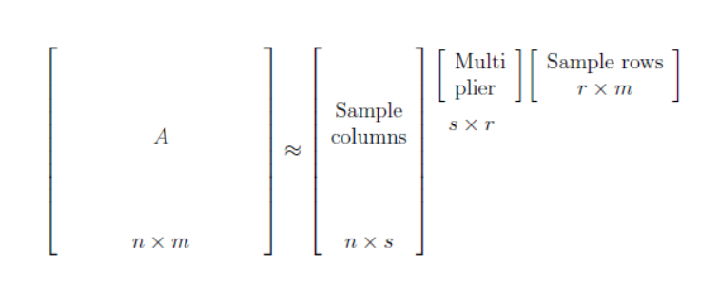
Connection to SVD
Result: Given matrix $A(n×m)$, we can create a good sketch of it by sampling
$C(n×s)$ = $s$ scaled columns of $A$
$R(r×m)$ = $r$ scaled columns of $A$
We can find $U$ such that $A≈CUR$
Compared to SVD:
Pros:
SVD takes more time to compute
SVD requires all of A to be stored in RAM
SVD does not have the property that the rows and columns are directly from A
CUR saves properties of the origin matrix, like sparsity
Logically more easy to interpret
Cons:
SVD has the best 2-norm approximation
Error bounds on for the CUR approximation are weaker
$$U$$
$$R$$
$$C$$

