Slide 1
High Density Clusters
June 2017

Slide 2
Idea Shift
Density-Based Clustering VS Center-Based.

Slide 3
Main Objective
Objective: find a clustering of tight knit groups in G.
Notes:
Connected= adjecent
First we will introduce a recursive algorithm based on sparse cuts.

Slide 4
Outline
Clustering Algorithm: Recursive Algorithm based on Sparse Cuts
Finding “Dense Submatrices”
Community Finding: Network Flow

Slide 5
Part $Ι$: Recursive Clustering

Slide 6
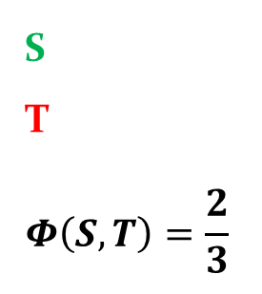
Recursive Clustering-Sparse Cuts
For two disjoint sets of nodes S,T, we will define:
$$Φ\left(S,T\right)= \frac{|edges from S to T|}{|edges incident to S in G|}$$
S
T
$$Φ\left(S,T\right)=\frac{2}{3}$$

Slide 7
Recursive Clustering-Sparse Cuts
For a set S, we will define:
$d\left(S\right)= \sum_{kεS}{d(k)}$
S
$d\left(S\right)$ = 3

Slide 8
Recursive Clustering-Sparse Cuts
2
3
S
$$Φ\left(S,W\backslash S\right)=\frac{5}{42}$$
4
1
6
11
7
8
5
12
10
9

Slide 9
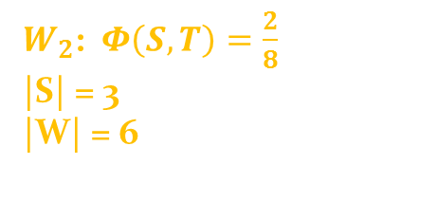
Let $ε$ be $\frac{1}{3}$
$W_{2}$: $Φ\left(S,T\right)=\frac{2}{8}$
|S| = 3
|W| = 6
$$T_{1}$$
4
2
$$S_{2}$$
$$T_{2}$$
6
1
3
5
7
$$S_{1}$$
$W_{1 }$: $Φ\left(S,T\right)=\frac{2}{8}$
|S| = 3
|W| = 9
8
9

Slide 10
Recursive Clustering-Sparse Cuts
Clusters(G)- List of current clusters
Initiailization:
Clusters(G) = {V} (One cluster- the graph)
Let $ε$ > 0
Rec_Clustering(G, $ε$, $Clusters(G)$)
for each cluster W in Clusters(G) do
if $(S⊆W s.t Φ\left(S,W\backslash S\right)≤ε∧|V\left(S\right)|≤\frac{1}{2}|V\left(W\right)|)$ do
$Clusters\left(G\right)=\left(Clusters\left(G\right)\backslash \{W\}\right)∪\left\{W\backslash S, S\right\}$
Rec_Clustering(G, $ε$, $Clusters(G)$)
Notes:
We will choose an appropriate $ε>0$, and initiate $Clusters\left(G\right)=V$.
In other words, at each stage we will cut a cluster into two, when the connectivity isn’t strong enough
Notice that Phi here talks about edges in W in the denominator
Change order of condition

Slide 11
Recursive Clustering-Sparse Cuts
Theorem 7.9 At the termination of Recursive Clustering, the total number of edges between vertices in different clusters is at most $Ο\left(εm\log{n}\right)$
Notes:
We can approximate the answer using eigenvalues and Cheeger’s Inequality, we will not discuss this here.
Conclusion
At each stage, we are required to compute $\min_{S⊆W}{Φ\left(S,W\backslash S\right)}$, which is NP-Hard.

Slide 12
Part $ΙΙ$: Dense Submatrices

Slide 13
Dense Submatrices - Different Approach
Let n data points in d-space be represented as a $n×d$ Matrix (We will assume that A is non negative).
Example: The Document-Term matrix.
Let D1 be the statement “I really really like Clustering”
and Let D2 be the statement “I love Clustering”
Clustering | really | love | like | I
1 | 2 | 0 | 1 | 1 | D1
1 | 0 | 1 | 0 | 1 | D2

Slide 14
$$Rows(Documents)$$
I
$$Columns(Words)$$
$$a_{i, j}−Can be weighted$$
Like
1
$$S=\{1, 2\}$$
Love
T$=\{2, 4\}$
Really
2
Clustering

Slide 15
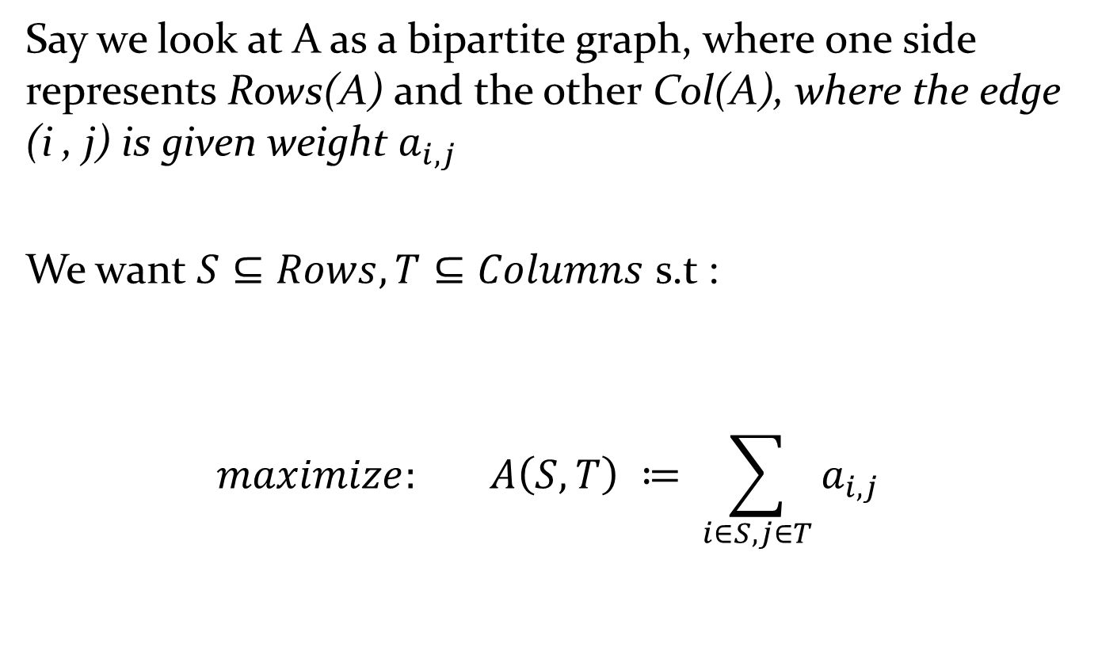
Dense Submatrices
Say we look at A as a bipartite graph, where one side represents Rows(A) and the other Col(A), where the edge (i , j) is given weight $a_{i,j}$
We want $S⊆Rows, T⊆Columns$ s.t :
$$maximize: A\left(S,T\right) ≔ \sum_{i∈S, j∈T}{a_{i,j}}$$
Notes:
Of Course, without limitations on the size of S,T, we will take S=Rows, T= Columns. We want a maximization criterion that takes into account the size of S,T.

Slide 16
Dense Submatrices
First Try: $maximize \frac{A(S,T)}{\left|S\right||T|}$
(The average size in the submatrix)
Second Try: $maximize \frac{A(S,T)}{\sqrt{\left|S\right||T|}}$
D$efine:d\left(S,T\right)= \frac{A(S,T)}{\sqrt{\left|S\right||T|}}$, and let
$$d\left(A\right)= \max_{S,T}{d(S,T)}$$
the density of A.

Slide 17
Dense Submatrices
Clustering | Love | Like | I
1 | 0 | 1 | 1 | D1
1 | 1 | 0 | 1 | D2
$$D\left(Purple\right)= \frac{3}{\sqrt{2×2}} = \frac{3}{2}$$
$$D\left(Yellow\right)= \frac{3}{\sqrt{1×4}} = \frac{3}{2}$$

Slide 18
Dense Submatrices
Theorem 7.10 Let A be a $n×d$ Matrix with entries in $(0,1)$ then
$$σ_{1}(A)≥d(A)≥\frac{σ_{1}(A)}{4\log{d}\log{n}}$$
Furthermore, we can find S,T such that $d\left(S,T\right)≥\frac{σ_{1}\left(A\right)}{4\log{d}\log{n}}$ using the top singular vector

Slide 19
Part $ΙΙΙ$: Community Finding

Slide 20
Dense Submatrices
Special Case: Similarity of the Set $A^{′}s Rows and Columns both represent the same set V,a_{i, j}ε\{0,1\}$
For S subgroup of V, What does D(S,S) represent?
1 2 3 4 5
1
2
3
4
5
0 | 0 | 1 | 1 | 0
0 | 0 | 1 | 0 | 1
1 | 1 | 0 | 1 | 1
1 | 0 | 1 | 0 | 0
0 | 1 | 1 | 0 | 0
Let S= {3,4,5}
Notes:
In this case, D(S,S) is the average degree of S!
We will solve this case with Network-Flow.
The general case of finding d(A) is hard. We will however bound d(A).

Slide 21
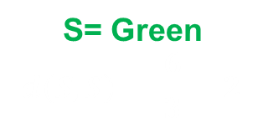
Dense Submatrices
1 2 3 4 5
1
2
3
4
5
0 | 0 | 1 | 1 | 0
0 | 0 | 1 | 0 | 1
1 | 1 | 0 | 1 | 1
1 | 0 | 1 | 0 | 0
0 | 1 | 1 | 0 | 0
2
1
3
4
5
S= Green
$$d\left(S, S\right)= \frac{6}{3}=2$$

Slide 22
Community Finding- Similarity of the Set
Goal: Find the subgraph with maximum average degree in graph G.
Notes:
Why is the goal what we want?

Slide 23
Community Finding
Let G=(V,E) a weighted graph. We define:
$$E\left(S,T\right)= \sum_{iεS, jεT}{e_{i,j}}$$
Where S,T are two sets of nodes.
The density of S will be:
$$d\left(S,S\right)= \frac{E(S,S)}{|S|}$$
What are we looking for in terms of density?
Notes:
Equivalent ton finding a tight knit community inside G(the most tight knit~ highest average degree).

Slide 24
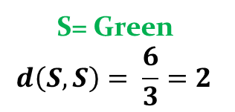
Flow technique
Sub-Problem
Let $λ>0, Find a subgraph with average degree of at least λ$.
(Or claim it does not exist!)
S= Green
$$d\left(S, S\right)= \frac{6}{3}=2$$

Slide 25
Flow technique
$$∞$$
u
(u,v)
$$λ$$
$$∞$$
1
v
s
1
$$∞$$
$$λ$$
t
(v,w)
$$λ$$
$$∞$$
w
1
$$∞$$
$$λ$$
(w,x)
$$∞$$
x
edges
vertices
What kinds of Cuts exist in H?

Slide 26
Type 1 Cut
$$∞$$
u
(u,v)
$$λ$$
$$∞$$
1
v
s
1
$$∞$$
$$λ$$
t
(v,w)
$$λ$$
$$∞$$
w
1
$$∞$$
$$λ$$
(w,x)
$$∞$$
x
edges
vertices
C(S,T) = |E|

Slide 27
Type 2 Cut
$$∞$$
u
(u,v)
$$λ$$
$$∞$$
1
v
s
1
$$∞$$
$$λ$$
t
(v,w)
$$λ$$
$$∞$$
w
1
$$∞$$
$$λ$$
(w,x)
$$∞$$
x
edges
vertices
C(S,T) = $λ$|V|

Slide 28
Type 3 Cut
$$∞$$
u
(u,v)
$$λ$$
$$∞$$
1
v
s
1
$$∞$$
$$λ$$
t
(v,w)
$$λ$$
$$∞$$
w
1
$$∞$$
$$λ$$
(w,x)
$$∞$$
x
edges
vertices
C(S,T) = $E − e_{S}+ λv_{S}$
Notes:
Notice that if an edge is in S, both vertices must be in S, otherwise the cut would include an edge of value infinity.

Slide 29
Flow technique
Theorem:
$$∃S⊆G with density ≥λ$$
$$⟺$$
$$Minimal Cut is of type 3$$

Slide 30
Flow technique
Algorithm:
Start with $λ= \frac{\frac{e}{v}+(v−1)}{2}$
Build Network, and run MaxFlow
If we get Type 3 Cut: Look for bigger $λ$
Else: Look for a smaller $λ$
Complexity: $\log\left(n^{2}\left(\frac{e}{v}+\left(v−1\right)\right)\right)×(Time of MaxFlow)$

Slide 31
Flow technique - Questions
When do we stop?
$$Let λ_{1}and λ_{2} be two following stages of the algoithm, then:$$
$λ_{1}−λ_{2}= \frac{e_{s1}}{v_{s1}}−\frac{e_{s2}}{v_{s2}}=\frac{e_{s1}v_{s2}−e_{s2}v_{s1}}{v_{s1}v_{s2}}$
$v_{s1}v_{s2}≤$ $n^{2}$
$e_{s1}v_{s2}−e_{s2}v_{s1}$ > 0 (different stages of algorithm) and whole,
${ ⇒e}_{s1}v_{s2}−e_{s2}v_{s1}≥1$
$$λ_{1}−λ_{2}≥\frac{1}{n^{2}}$$
Notes:
When do we get a true subgraph? Why better with large subsets?

