Slide 1
TOMER BEN MOSHE
May 2017
MACHINE LEARNING

Slide 2
GOALS
Define the problem.
Prove some basic bounds.

Slide 3
MACHINE LEARNING
What is machine learning?

Slide 4
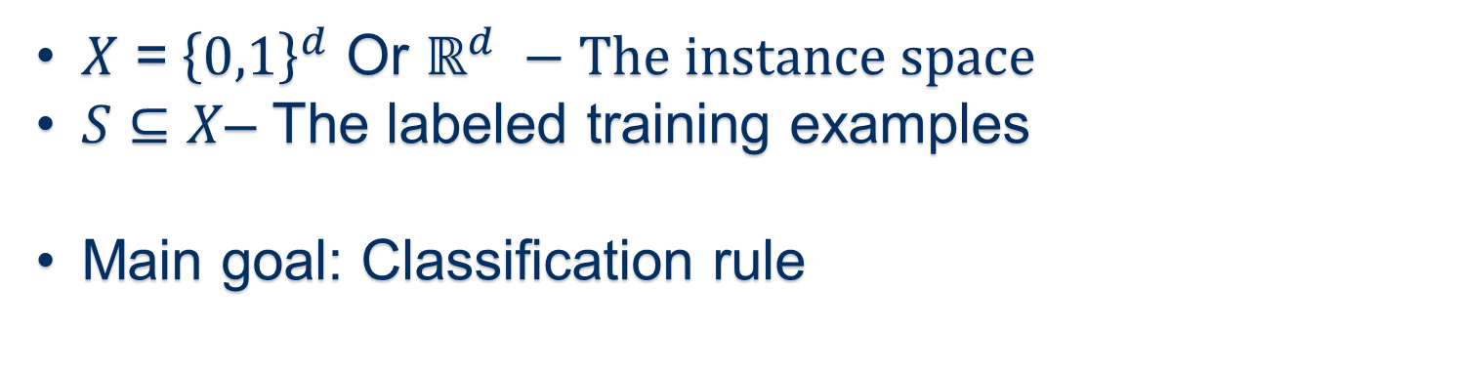
Core PROBLEM
$X$ =${ \left\{0,1\right\}}^{d}$ Or $ℝ^{d} −The instance space$
$S⊆X$– The labeled training examples
Main goal: Classification rule

Slide 5
DEFINITIONS
Distribution D over X.
S is taken independently at random from D.
Main goal : Predict well on new points that are also drawn from D.

Slide 6
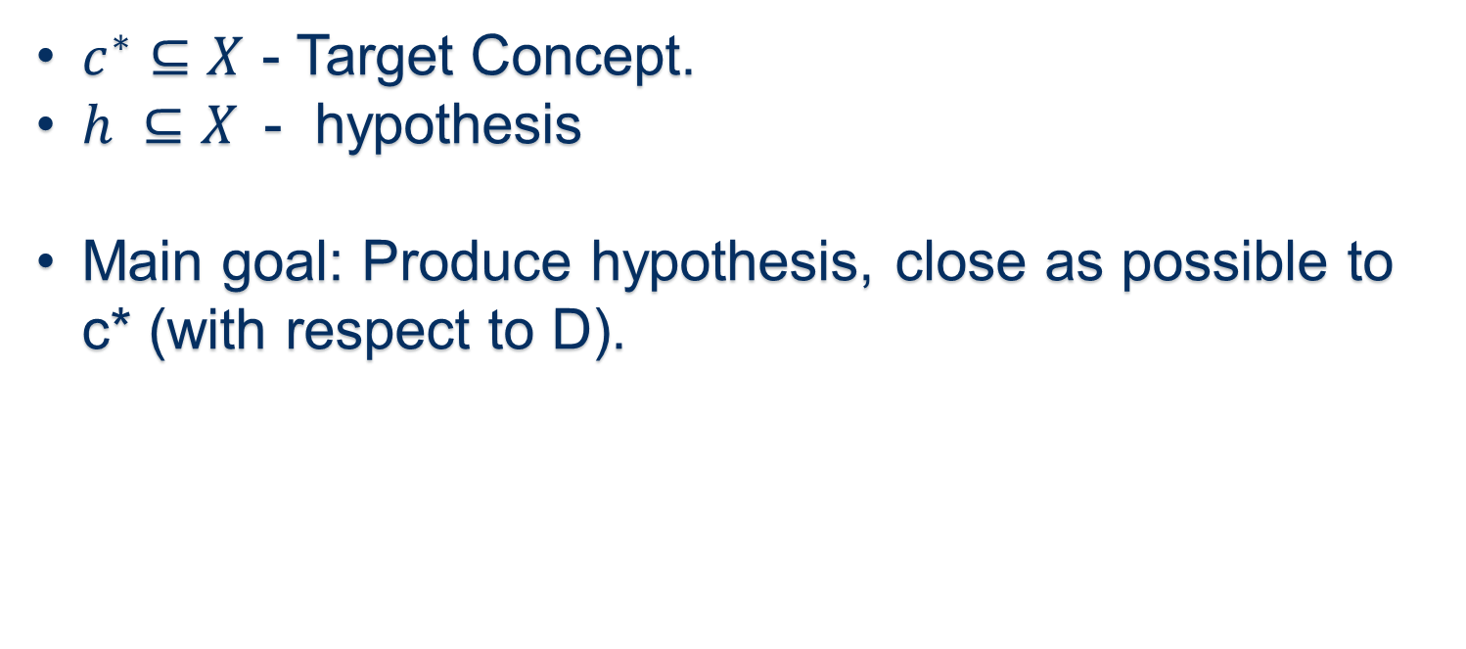
DEFINITIONS
$c^{∗}⊆X$ - Target Concept.
$h ⊆X$- hypothesis
Main goal: Produce hypothesis, close as possible to c* (with respect to D).

Slide 7
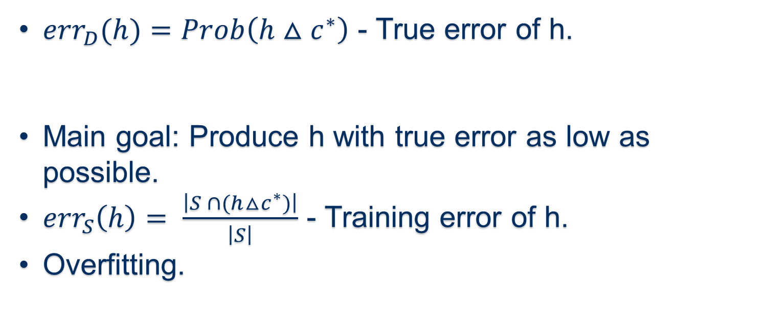
DEFINITIONS
${err}_{D}(h)=Prob\left(h△c^{∗}\right)$ - True error of h.
Main goal: Produce h with true error as low as possible.
${err}_{S}\left(h\right)= \frac{\left|S ∩(h△c^{∗})\right|}{\left|S\right|}$ - Training error of h.
Overfitting.

Slide 8
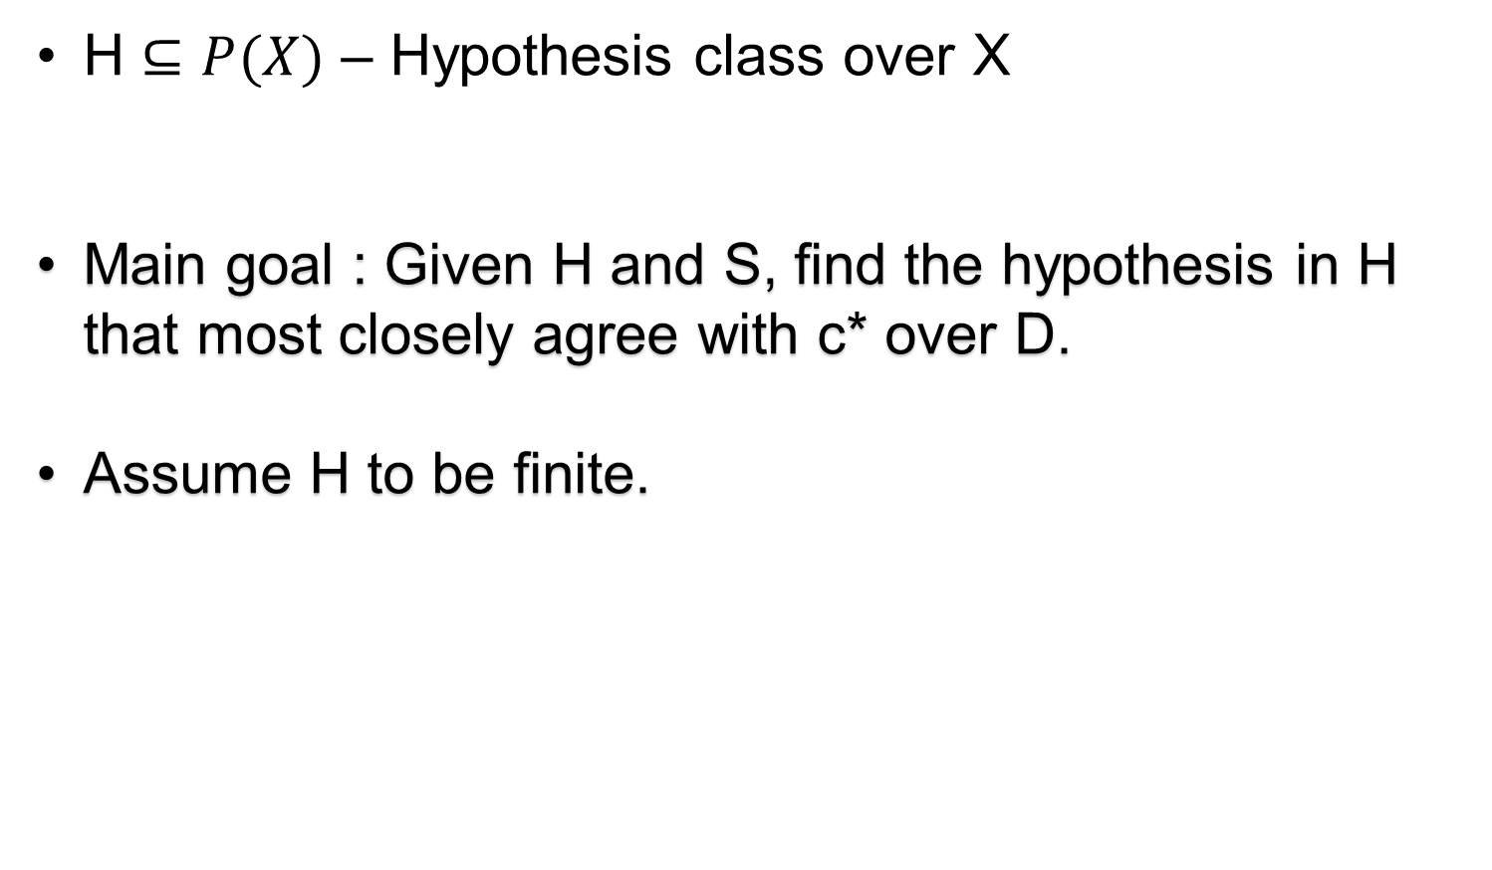
Formalizing the problem
H $⊆P(X)$ – Hypothesis class over X
Main goal : Given H and S, find the hypothesis in H that most closely agree with c* over D.
Assume H to be finite.

Slide 9
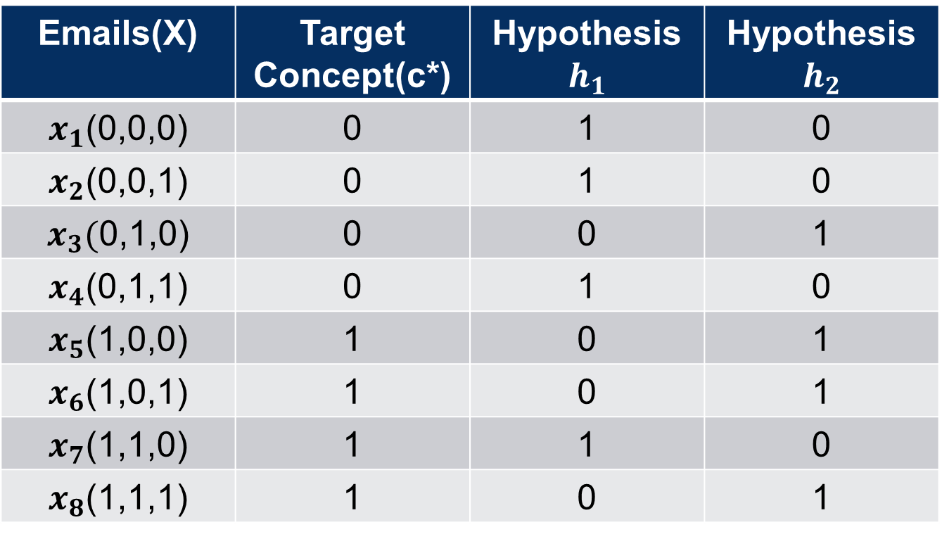
Emails(X) | Target Concept(c*) | Hypothesis $h_{1}$ | Hypothesis $h_{2}$
$x_{1}$(0,0,0) | 0 | 1 | 0
$x_{2}$(0,0,1) | 0 | 1 | 0
$x_{3}($0,1,0) | 0 | 0 | 1
$x_{4}$(0,1,1) | 0 | 1 | 0
$x_{5}$(1,0,0) | 1 | 0 | 1
$x_{6}$(1,0,1) | 1 | 0 | 1
$x_{7}$(1,1,0) | 1 | 1 | 0
$x_{8}$(1,1,1) | 1 | 0 | 1

Slide 10
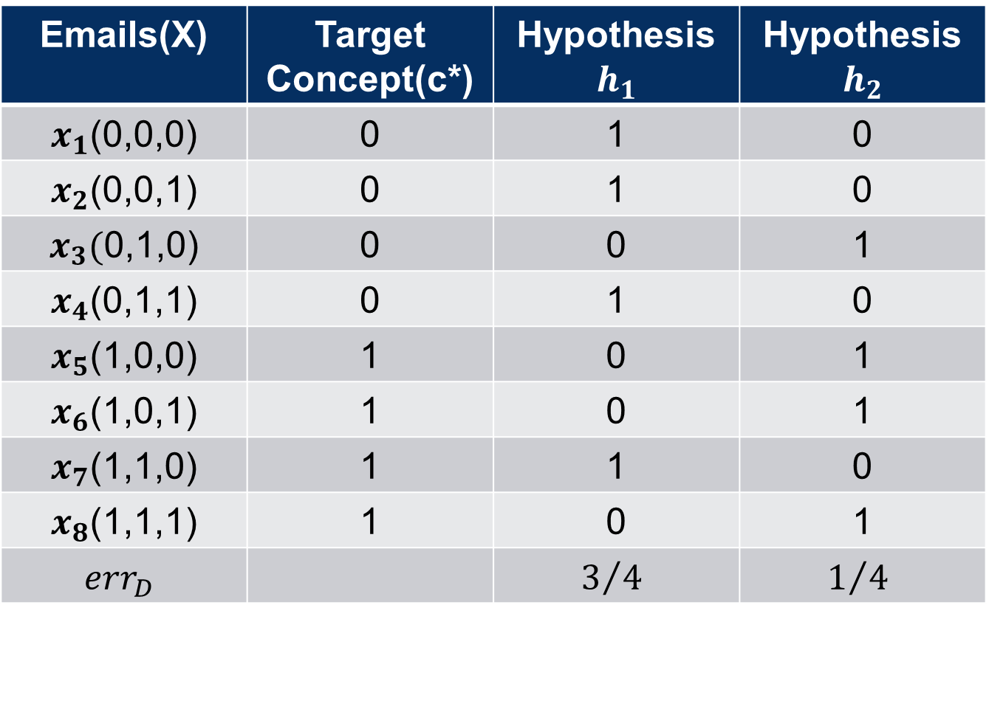
Emails(X) | Target Concept(c*) | Hypothesis $h_{1}$ | Hypothesis $h_{2}$
$x_{1}$(0,0,0) | 0 | 1 | 0
$x_{2}$(0,0,1) | 0 | 1 | 0
$x_{3}($0,1,0) | 0 | 0 | 1
$x_{4}$(0,1,1) | 0 | 1 | 0
$x_{5}$(1,0,0) | 1 | 0 | 1
$x_{6}$(1,0,1) | 1 | 0 | 1
$x_{7}$(1,1,0) | 1 | 1 | 0
$x_{8}$(1,1,1) | 1 | 0 | 1
$${err}_{D}$$ |  | $$3/4$$ | $$1/4$$

Slide 11
Emails(X) | Target Concept(c*) | Hypothesis $h_{1}$ | Hypothesis $h_{2}$
$x_{1}$(0,0,0) | 0 | 1 | 0
$x_{2}$(0,0,1) | 0 | 1 | 0
$x_{3}($0,1,0) | 0 | 0 | 1
$x_{4}$(0,1,1) | 0 | 1 | 0
$x_{5}$(1,0,0) | 1 | 0 | 1
$x_{6}$(1,0,1) | 1 | 0 | 1
$x_{7}$(1,1,0) | 1 | 1 | 0
$x_{8}$(1,1,1) | 1 | 0 | 1
$${err}_{D}$$ |  | $$3/4$$ | $$1/4$$

Slide 12
Emails(X) | Target Concept(c*) | Hypothesis $h_{1}$ | Hypothesis $h_{2}$
$x_{1}$(0,0,0) | 0 | 1 | 0
$x_{2}$(0,0,1) | 0 | 1 | 0
$x_{3}($0,1,0) | 0 | 0 | 1
$x_{4}$(0,1,1) | 0 | 1 | 0
$x_{5}$(1,0,0) | 1 | 0 | 1
$x_{6}$(1,0,1) | 1 | 0 | 1
$x_{7}$(1,1,0) | 1 | 1 | 0
$x_{8}$(1,1,1) | 1 | 0 | 1
$${err}_{D}$$ |  | $$3/4$$ | $$1/4$$

Slide 13
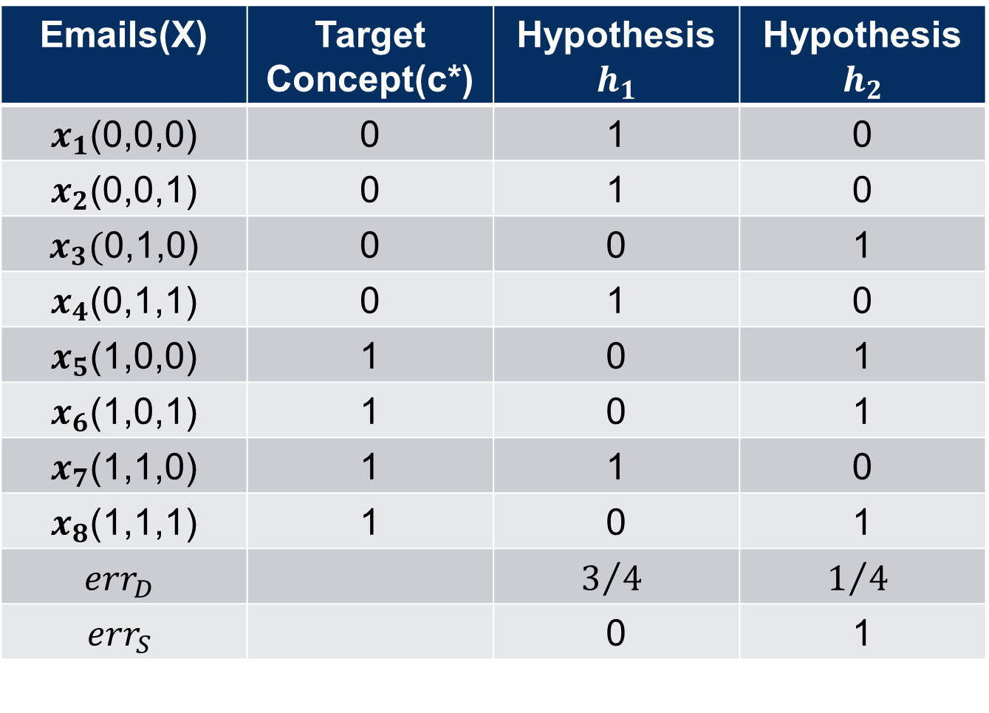
Emails(X) | Target Concept(c*) | Hypothesis $h_{1}$ | Hypothesis $h_{2}$
$x_{1}$(0,0,0) | 0 | 1 | 0
$x_{2}$(0,0,1) | 0 | 1 | 0
$x_{3}($0,1,0) | 0 | 0 | 1
$x_{4}$(0,1,1) | 0 | 1 | 0
$x_{5}$(1,0,0) | 1 | 0 | 1
$x_{6}$(1,0,1) | 1 | 0 | 1
$x_{7}$(1,1,0) | 1 | 1 | 0
$x_{8}$(1,1,1) | 1 | 0 | 1
$${err}_{D}$$ |  | $$3/4$$ | $$1/4$$
$${err}_{S}$$ |  | 0 | 1

Slide 14
Emails(X) | Target Concept(c*) | Hypothesis $h_{1}$ | Hypothesis $h_{2}$
$x_{1}$(0,0,0) | 0 | 1 | 0
$x_{2}$(0,0,1) | 0 | 1 | 0
$x_{3}($0,1,0) | 0 | 0 | 1
$x_{4}$(0,1,1) | 0 | 1 | 0
$x_{5}$(1,0,0) | 1 | 0 | 1
$x_{6}$(1,0,1) | 1 | 0 | 1
$x_{7}$(1,1,0) | 1 | 1 | 0
$x_{8}$(1,1,1) | 1 | 0 | 1
$${err}_{D}$$ |  | $$3/4$$ | $$1/4$$

Slide 15
Emails(X) | Target Concept(c*) | Hypothesis $h_{1}$ | Hypothesis $h_{2}$
$x_{1}$(0,0,0) | 0 | 1 | 0
$x_{2}$(0,0,1) | 0 | 1 | 0
$x_{3}($0,1,0) | 0 | 0 | 1
$x_{4}$(0,1,1) | 0 | 1 | 0
$x_{5}$(1,0,0) | 1 | 0 | 1
$x_{6}$(1,0,1) | 1 | 0 | 1
$x_{7}$(1,1,0) | 1 | 1 | 0
$x_{8}$(1,1,1) | 1 | 0 | 1
$${err}_{D}$$ |  | $$3/4$$ | $$1/4$$

Slide 16
Emails(X) | Target Concept(c*) | Hypothesis $h_{1}$ | Hypothesis $h_{2}$
$x_{1}$(0,0,0) | 0 | 1 | 0
$x_{2}$(0,0,1) | 0 | 1 | 0
$x_{3}($0,1,0) | 0 | 0 | 1
$x_{4}$(0,1,1) | 0 | 1 | 0
$x_{5}$(1,0,0) | 1 | 0 | 1
$x_{6}$(1,0,1) | 1 | 0 | 1
$x_{7}$(1,1,0) | 1 | 1 | 0
$x_{8}$(1,1,1) | 1 | 0 | 1
$${err}_{D}$$ |  | $$3/4$$ | $$1/4$$

Slide 17
Emails(X) | Target Concept(c*) | Hypothesis $h_{1}$ | Hypothesis $h_{2}$
$x_{1}$(0,0,0) | 0 | 1 | 0
$x_{2}$(0,0,1) | 0 | 1 | 0
$x_{3}($0,1,0) | 0 | 0 | 1
$x_{4}$(0,1,1) | 0 | 1 | 0
$x_{5}$(1,0,0) | 1 | 0 | 1
$x_{6}$(1,0,1) | 1 | 0 | 1
$x_{7}$(1,1,0) | 1 | 1 | 0
$x_{8}$(1,1,1) | 1 | 0 | 1
$${err}_{D}$$ |  | $$3/4$$ | $$1/4$$

Slide 18
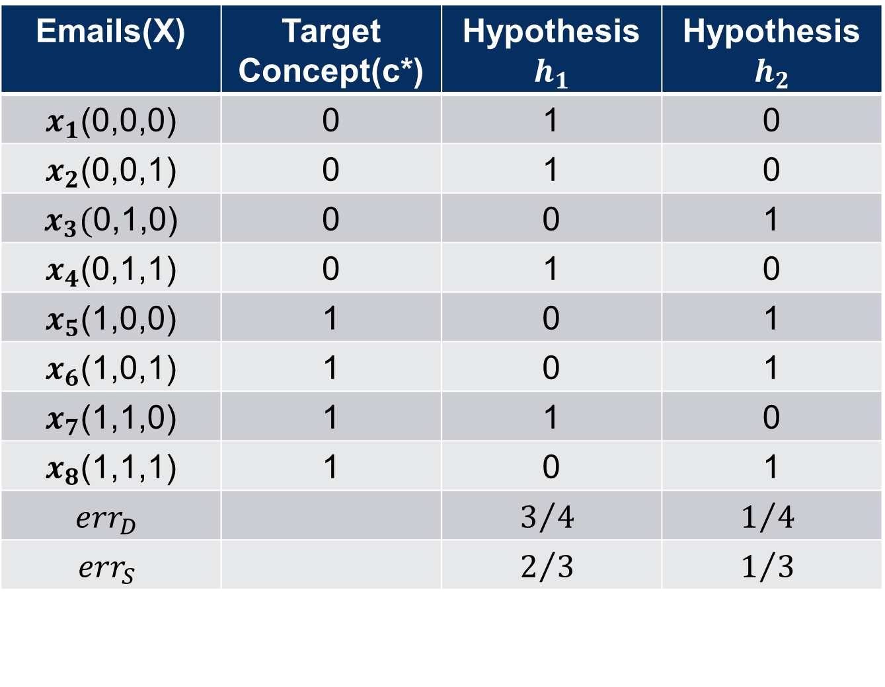
Emails(X) | Target Concept(c*) | Hypothesis $h_{1}$ | Hypothesis $h_{2}$
$x_{1}$(0,0,0) | 0 | 1 | 0
$x_{2}$(0,0,1) | 0 | 1 | 0
$x_{3}($0,1,0) | 0 | 0 | 1
$x_{4}$(0,1,1) | 0 | 1 | 0
$x_{5}$(1,0,0) | 1 | 0 | 1
$x_{6}$(1,0,1) | 1 | 0 | 1
$x_{7}$(1,1,0) | 1 | 1 | 0
$x_{8}$(1,1,1) | 1 | 0 | 1
$${err}_{D}$$ |  | $$3/4$$ | $$1/4$$
$${err}_{S}$$ |  | $$2/3$$ | $$1/3$$

Slide 19
overfitting
Good training error but bad true error
How big should the sample group be in order to promise good true error?

Slide 20
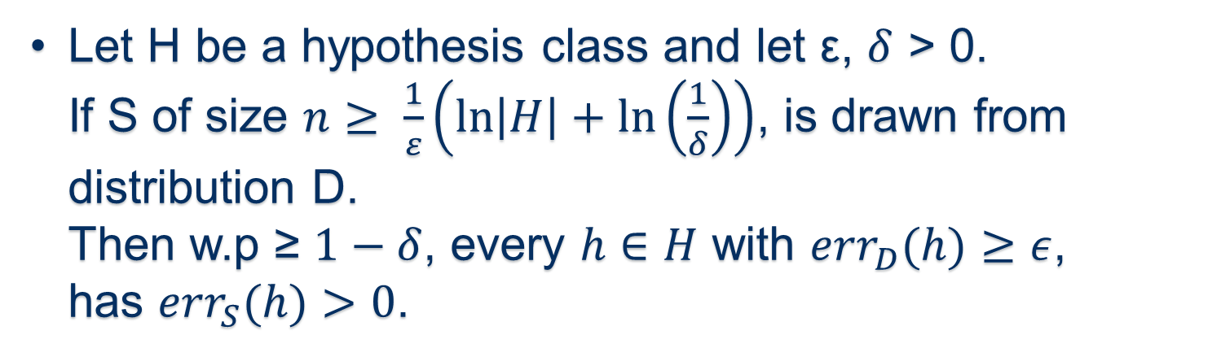
thEorEm 5.1
Let H be a hypothesis class and let ε, $δ$ > 0.
If S of size $n≥ \frac{1}{ε}\left(\ln\left|H\right|+\ln\left(\frac{1}{δ}\right)\right)$, is drawn from distribution D.
Then w.p ≥ $1−δ$, every $h∈H$ with ${err}_{D}(h)≥ε$,
has ${err}_{S}(h)>0$.

Slide 21
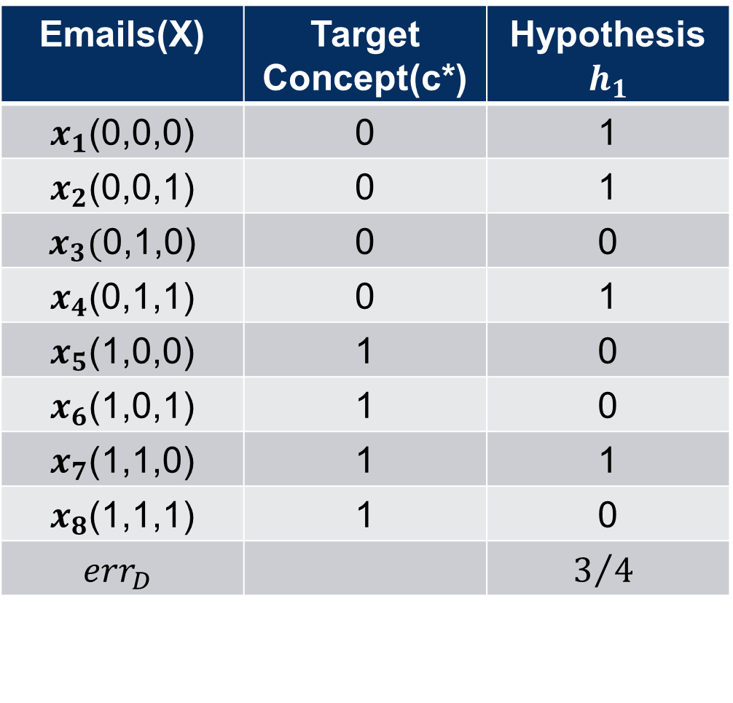
Emails(X) | Target Concept(c*) | Hypothesis $h_{1}$
$x_{1}$(0,0,0) | 0 | 1
$x_{2}$(0,0,1) | 0 | 1
$x_{3}($0,1,0) | 0 | 0
$x_{4}$(0,1,1) | 0 | 1
$x_{5}$(1,0,0) | 1 | 0
$x_{6}$(1,0,1) | 1 | 0
$x_{7}$(1,1,0) | 1 | 1
$x_{8}$(1,1,1) | 1 | 0
$${err}_{D}$$ |  | $$3/4$$

Slide 22
Emails(X) | Target Concept(c*) | Hypothesis $h_{1}$
$x_{1}$(0,0,0) | 0 | 1
$x_{2}$(0,0,1) | 0 | 1
$x_{3}($0,1,0) | 0 | 0
$x_{4}$(0,1,1) | 0 | 1
$x_{5}$(1,0,0) | 1 | 0
$x_{6}$(1,0,1) | 1 | 0
$x_{7}$(1,1,0) | 1 | 1
$x_{8}$(1,1,1) | 1 | 0
$${err}_{D}$$ |  | $$3/4$$

Slide 23
Emails(X) | Target Concept(c*) | Hypothesis $h_{1}$
$x_{1}$(0,0,0) | 0 | 1
$x_{2}$(0,0,1) | 0 | 1
$x_{3}($0,1,0) | 0 | 0
$x_{4}$(0,1,1) | 0 | 1
$x_{5}$(1,0,0) | 1 | 0
$x_{6}$(1,0,1) | 1 | 0
$x_{7}$(1,1,0) | 1 | 1
$x_{8}$(1,1,1) | 1 | 0
$${err}_{D}$$ |  | $$3/4$$

Slide 24
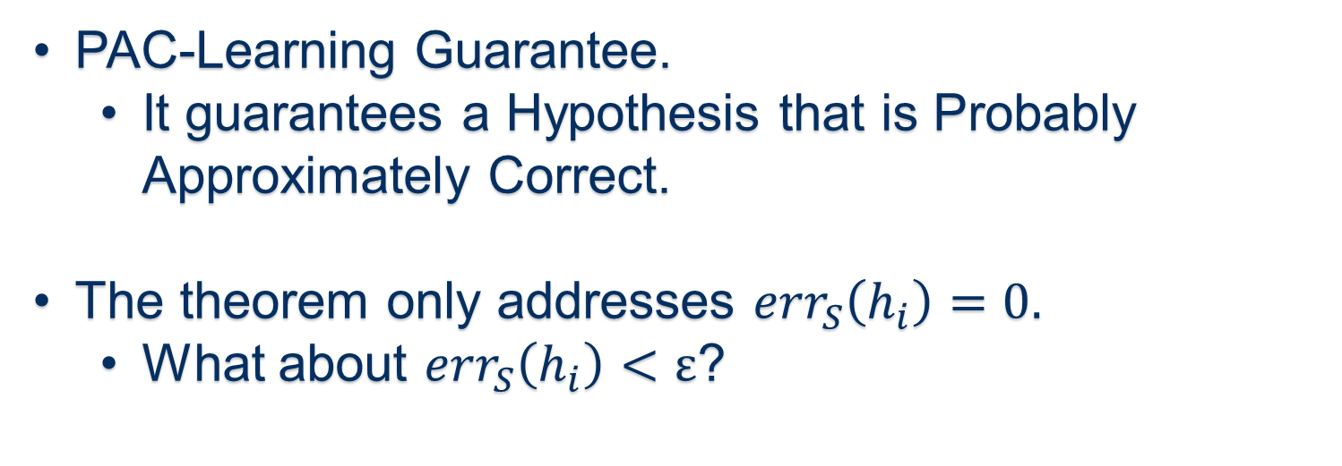
overfitting
PAC-Learning Guarantee.
  It guarantees a Hypothesis that is Probably Approximately Correct.
The theorem only addresses ${err}_{S}\left(h_{i}\right)=0.$
  What about ${err}_{S}\left(h_{i}\right)<ε$?

Slide 25
OVERFITTING
If S is Sufficiently large, with high Probability, Good Performance on S will Translate to Good Performance on D.

Slide 26
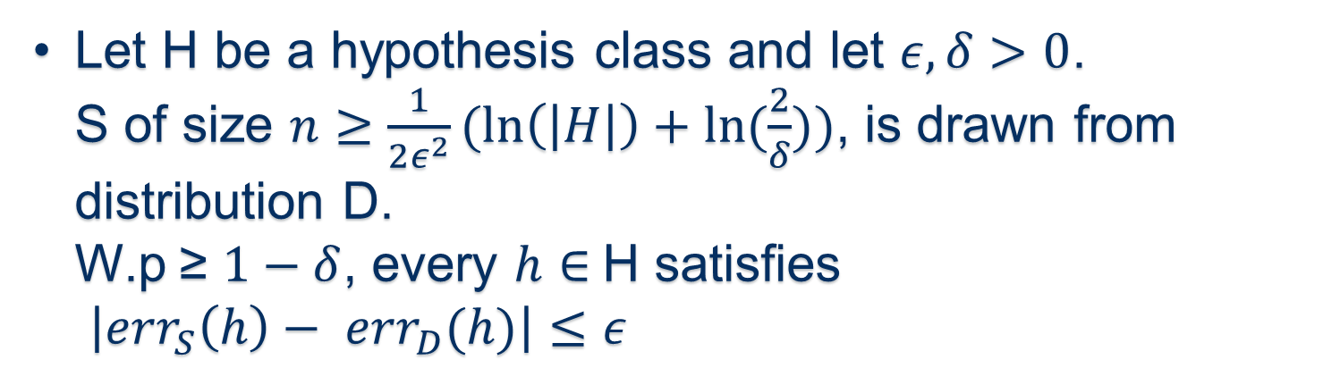
thEoREM 5.3
Let H be a hypothesis class and let $ε,δ>0$.
S of size $n≥\frac{1}{2ε^{2}}(\ln\left(\left|H\right|\right)+ln⁡(\frac{2}{δ}))$, is drawn from distribution D.
W.p ≥ $1−δ$, every $h∈$H satisfies
$\left|{err}_{S}\left(h\right)− {err}_{D}(h)\right|≤ε$

Slide 27
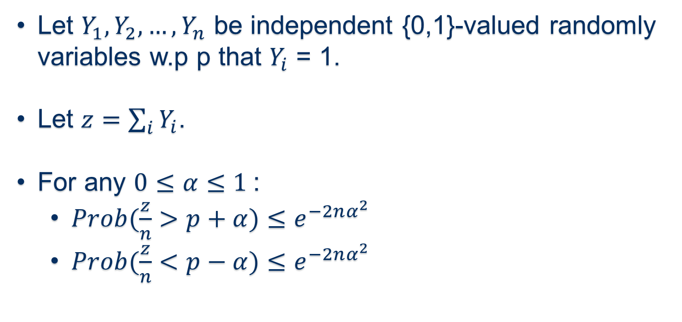
Hoeffding bound
Let $Y_{1}, Y_{2},…,Y_{n}$ be independent {0,1}-valued randomly variables w.p p that $Y_{i}$ = 1.
Let $z=\sum_{i}{Y_{i}}$.
For any $0≤α≤1$:
  $Prob(\frac{z}{n}>p+α)≤e^{−2nα^{2}}$
  $Prob(\frac{z}{n}<p−α)≤e^{−2nα^{2}}$

Slide 28
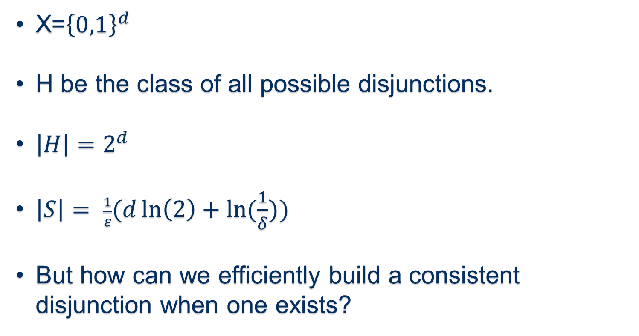
Learning disjunctions
X=${\left\{0,1\right\}}^{d}$
H be the class of all possible disjunctions.
$\left|H\right|=2^{d}$
$\left|S\right|= \frac{1}{ε}(d\ln\left(2\right)+ln⁡(\frac{1}{δ}))$
But how can we efficiently build a consistent disjunction when one exists?

Slide 29
Simple disjunction learner
Given sample S, discard all features that are set to 1 in any negative example in S.
Output the concept h that is the OR of all features that remain.

Slide 30
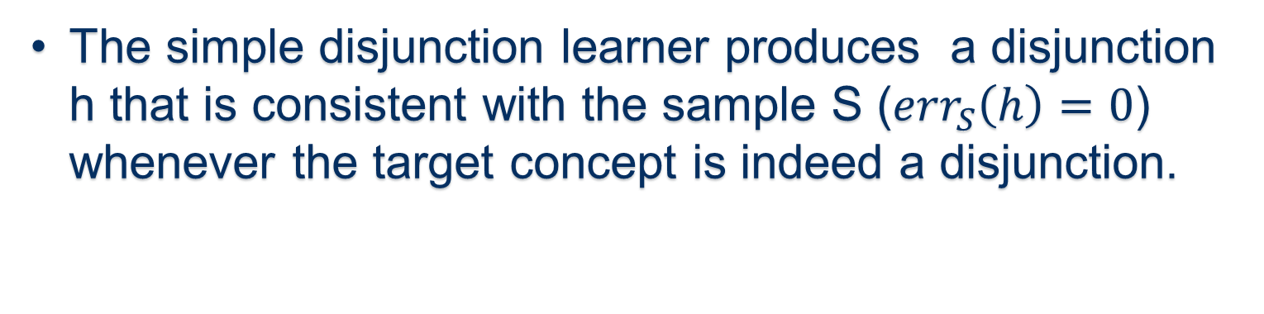
Simple disjunction learner
(Lemma 5.4)
  The simple disjunction learner produces a disjunction h that is consistent with the sample S (${err}_{S}\left(h\right)=0$) whenever the target concept is indeed a disjunction.

Slide 31
Simple disjunction learner
  And it is proven that this algorithm is efficient for PAC-Learning the class of disjunction.

Slide 32
Occam’s razor
One should prefer simpler explanations over more complicated ones.
But what does “Simple” mean?
  Fewer bits.

Slide 33
Occam’s razor
What is the most simple method?
  All in h or nothing in h.
  Just one bit.
  Bad performance on S.
What is the most complicated method?
  Specify any input in h.
  No training error.
  Bad true error.

Slide 34
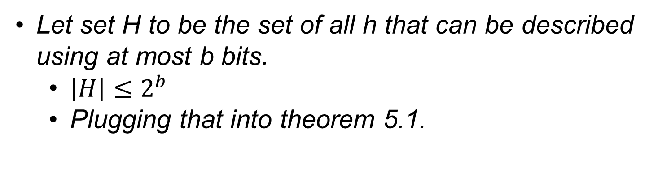
Occam’s razor
Let set H to be the set of all h that can be described using at most b bits.
  $\left|H\right|≤2^{b}$
  Plugging that into theorem 5.1.

Slide 35
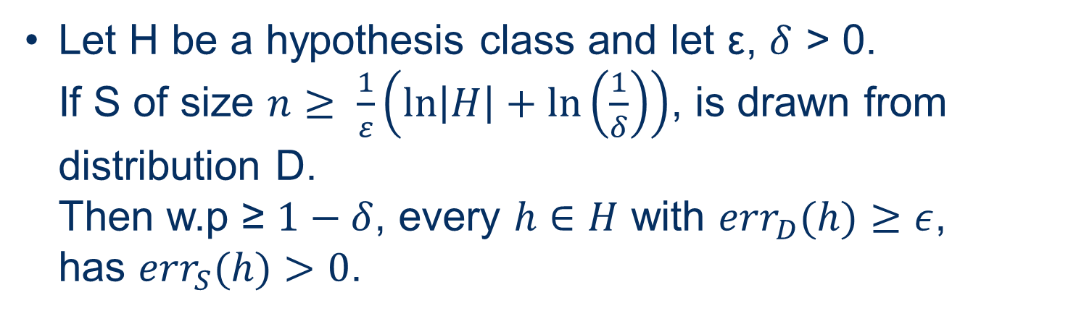
Reminder - thEorEm 5.1
Let H be a hypothesis class and let ε, $δ$ > 0.
If S of size $n≥ \frac{1}{ε}\left(\ln\left|H\right|+\ln\left(\frac{1}{δ}\right)\right)$, is drawn from distribution D.
Then w.p ≥ $1−δ$, every $h∈H$ with ${err}_{D}(h)≥ε$,
has ${err}_{S}(h)>0$.

Slide 36
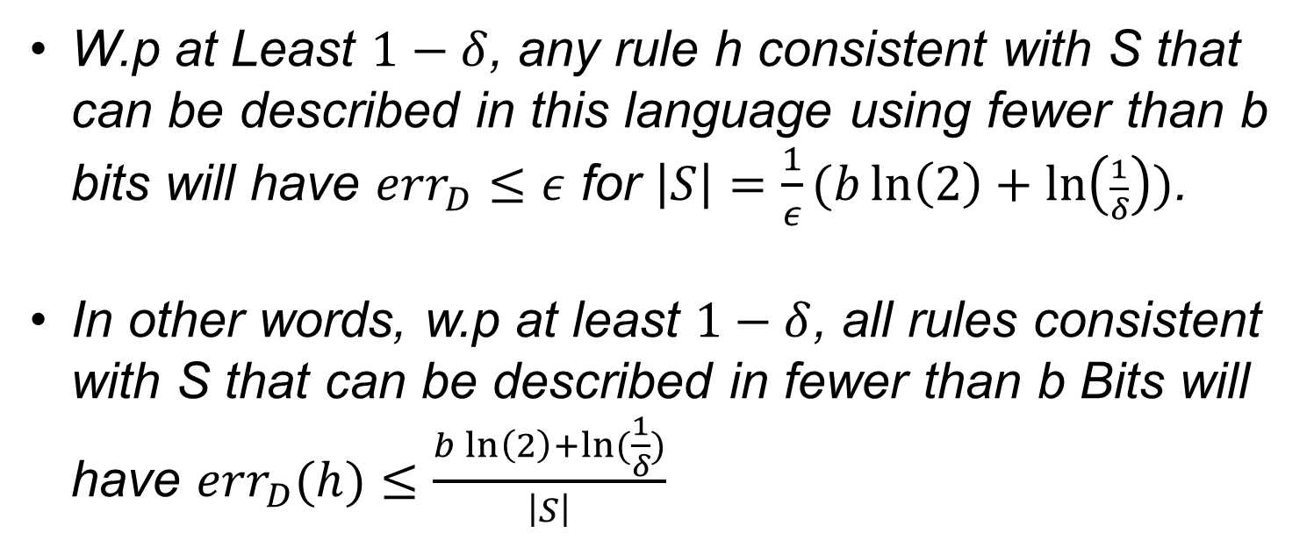
Occam’s razor
(theorem 5.5)
W.p at Least $1−δ$, any rule h consistent with S that can be described in this language using fewer than b bits will have ${err}_{D}≤ε$ for $\left|S\right|=\frac{1}{ε}(b\ln\left(2\right)+\ln\left(\frac{1}{δ}\right))$.
In other words, w.p at least $1−δ$, all rules consistent with S that can be described in fewer than b Bits will have ${err}_{D}(h)≤\frac{b\ln\left(2\right)+ln⁡(\frac{1}{δ})}{\left|S\right|}$

Slide 37
Occam’s razor
No matter what method of ordering the bits is being used, the theorem can be applied.
Good approach of picking good and simple rules.

Slide 38
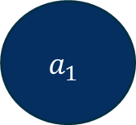
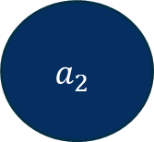
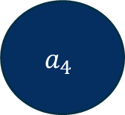

DECISION TREE
$$a_{2}$$
1
0
$$a_{1}$$
$$a_{3}$$
1
0
1
0
+
-
$$a_{4}$$
1
0
+
+

Slide 39
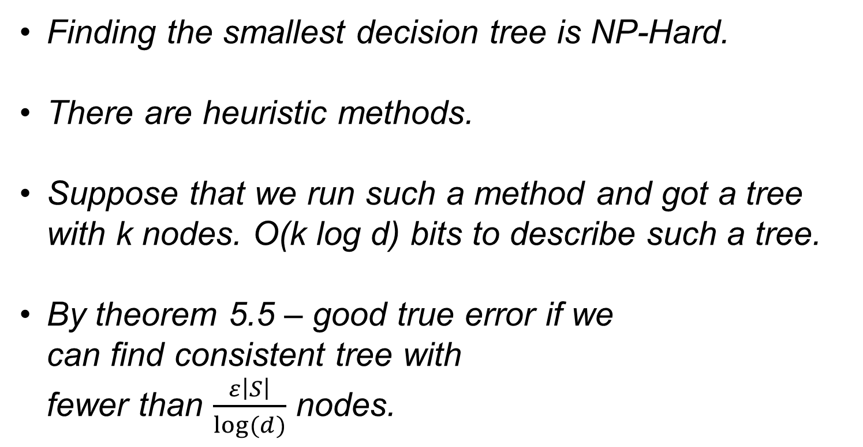
Learning decision trees
Finding the smallest decision tree is NP-Hard.
There are heuristic methods.
Suppose that we run such a method and got a tree with k nodes. O(k log d) bits to describe such a tree.
By theorem 5.5 – good true error if we
can find consistent tree with
fewer than $\frac{ε\left|S\right|}{log⁡(d)}$ nodes.

Slide 40
Regularization
Suppose we have very simple rule with training error of 20%, or a complicated rule with 10%.
We need something that’s called “Regularization”, also called “Complexity Penalization”.
In general, we need to penalize any complication.

Slide 41
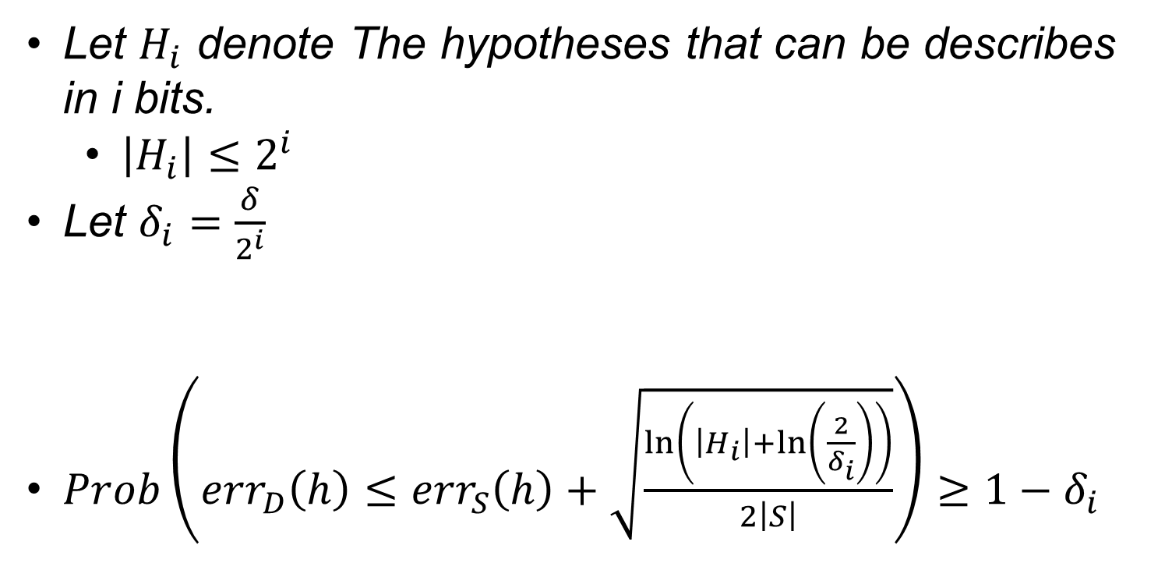
Regularization
Let $H_{i}$ denote The hypotheses that can be describes in i bits.
  $\left|H_{i}\right|≤2^{i}$
Let $δ_{i}=\frac{δ}{2^{i}}$
$Prob\left({err}_{D}\left(h\right)≤{err}_{S}\left(h\right)+\sqrt{\frac{\ln\left(\left|H_{i}\right|+\ln\left(\frac{2}{δ_{i}}\right)\right)}{2\left|S\right|}}\right)≥1−δ_{i}$

Slide 42
Reminder - thEoREM 5.3
Let H be a hypothesis class and let $ε,δ>0$.
S of size $n≥\frac{1}{2ε^{2}}(\ln\left(\left|H\right|\right)+ln⁡(\frac{2}{δ}))$, is drawn from distribution D.
W.p ≥ $1−δ$, every $h∈$H satisfies
$\left|{err}_{S}\left(h\right)− {err}_{D}(h)\right|≤ε$

Slide 43
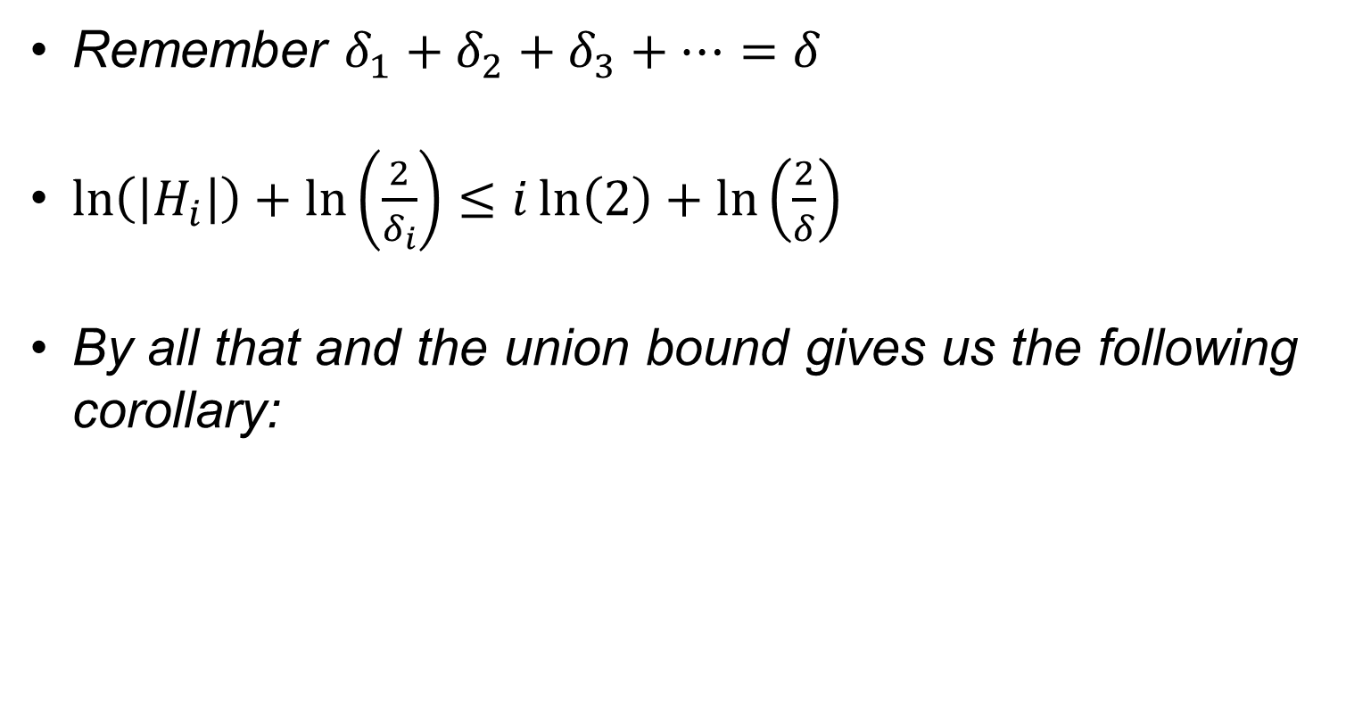
Regularization
Remember $δ_{1}+δ_{2}+δ_{3}+…=δ$
$\ln\left(\left|H_{i}\right|\right)+\ln\left(\frac{2}{δ_{i}}\right)≤i\ln\left(2\right)+\ln\left(\frac{2}{δ}\right)$
By all that and the union bound gives us the following corollary:

Slide 44
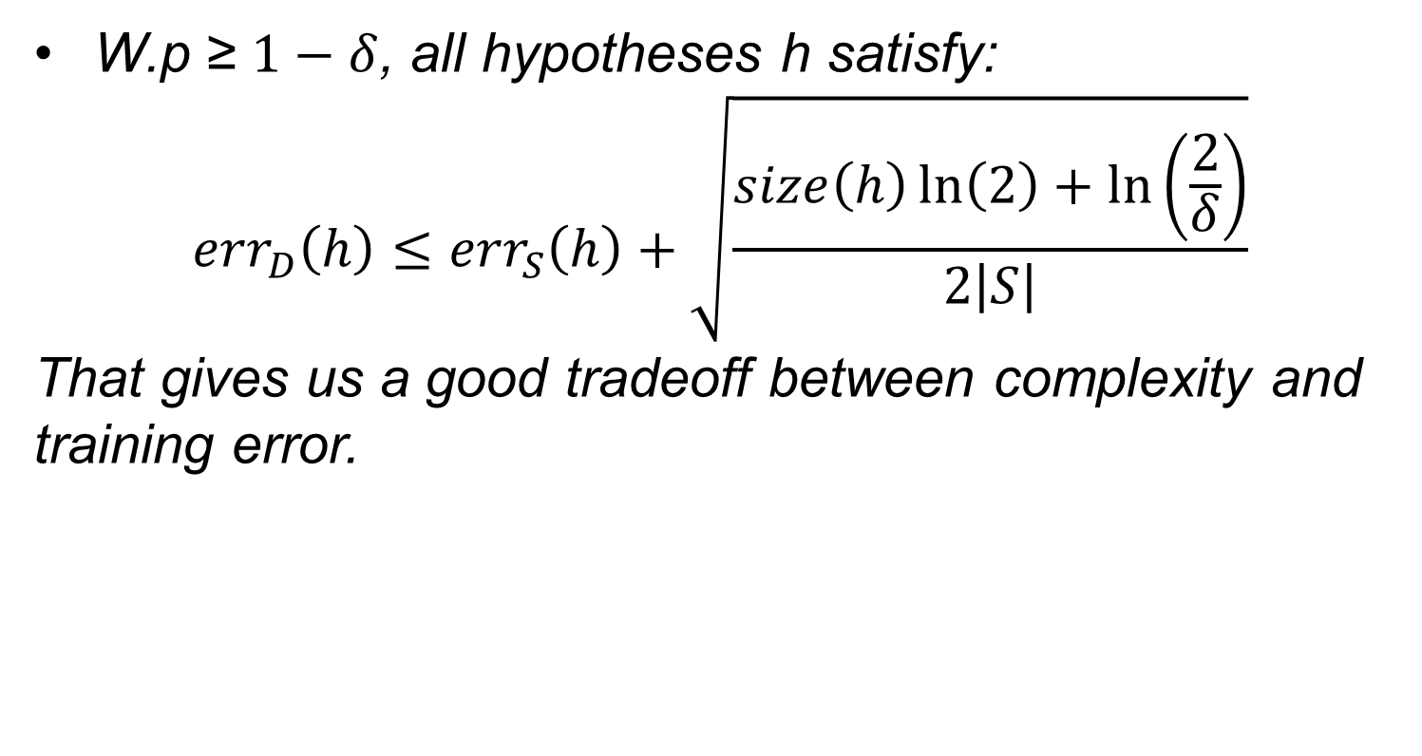
Regularization
(Corollary 5.6)
W.p ≥ $1−δ$, all hypotheses h satisfy:
${err}_{D}\left(h\right)≤{err}_{S}\left(h\right)+\sqrt{\frac{size\left(h\right)\ln\left(2\right)+\ln\left(\frac{2}{δ}\right)}{2\left|S\right|}}$
That gives us a good tradeoff between complexity and training error.

Slide 45
The END
Any Questions?

