Slide 1
Online Convex Optimization in the Bandit Setting: Gradient Descent without a Gradient
Aviv Rosenberg
10/01/18
Seminar on Experts and Bandits

Slide 2
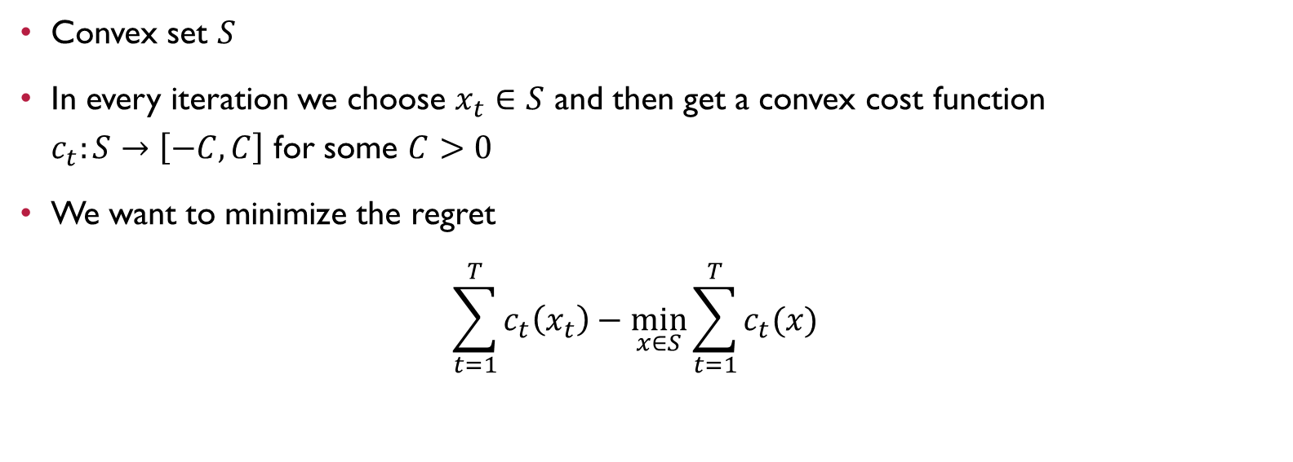
Online Convex Optimization Problem
Convex set $S$
In every iteration we choose $x_{t}∈S$ and then get a convex cost function
$c_{t}:S→\left[−C,C\right]$ for some $C>0$
We want to minimize the regret
$\sum_{t=1}^{T}{c_{t}\left(x_{t}\right)−\min_{x∈S}{\sum_{t=1}^{T}{c_{t}(x)}}}$

Slide 3
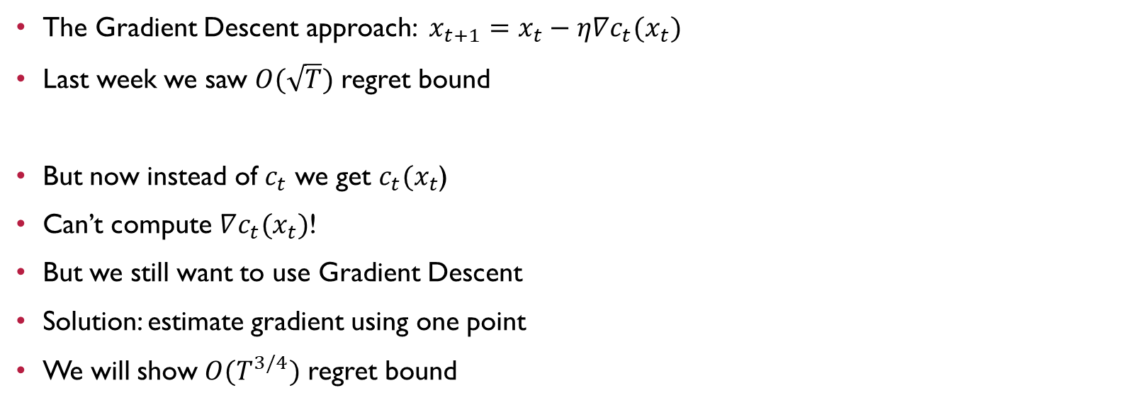
Bandit Setting
The Gradient Descent approach: $x_{t+1}=x_{t}−η∇c_{t}(x_{t})$
Last week we saw $O(\sqrt{T})$ regret bound
But now instead of $c_{t}$ we get $c_{t}(x_{t}$)
Can’t compute $∇c_{t}(x_{t})$!
But we still want to use Gradient Descent
Solution: estimate gradient using one point
We will show $O(T^{3/4})$ regret bound

Slide 4

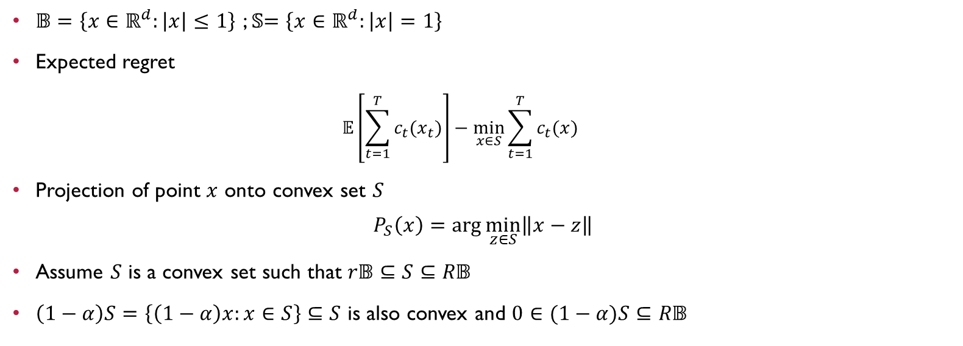
Notation and Assumptions
$𝔹=\left\{x∈ℝ^{d}:\left|x\right|≤1\right\}$ ; 𝕊$=\left\{x∈ℝ^{d}:\left|x\right|=1\right\}$
Expected regret
  $$𝔼\left[\sum_{t=1}^{T}{c_{t}(x_{t})}\right]−\min_{x∈S}{\sum_{t=1}^{T}{c_{t}(x)}}$$
Projection of point $x$ onto convex set $S$
$$P_{S}\left(x\right)=\arg{\min_{z∈S}\left\|x−z\right\|}$$
Assume $S$ is a convex set such that $r𝔹⊆S⊆R𝔹$
$\left(1−α\right)S=\left\{\left(1−α\right)x:x∈S\right\}⊆S$ is also convex and $0∈(1−α)S⊆R𝔹$
$$y∈\left(1−α\right)S$$
$$↓$$
$$y=\left(1−α\right)x=α0+\left(1−α\right)x∈S$$

Slide 5
Part 1
Gradient Estimation

Slide 6
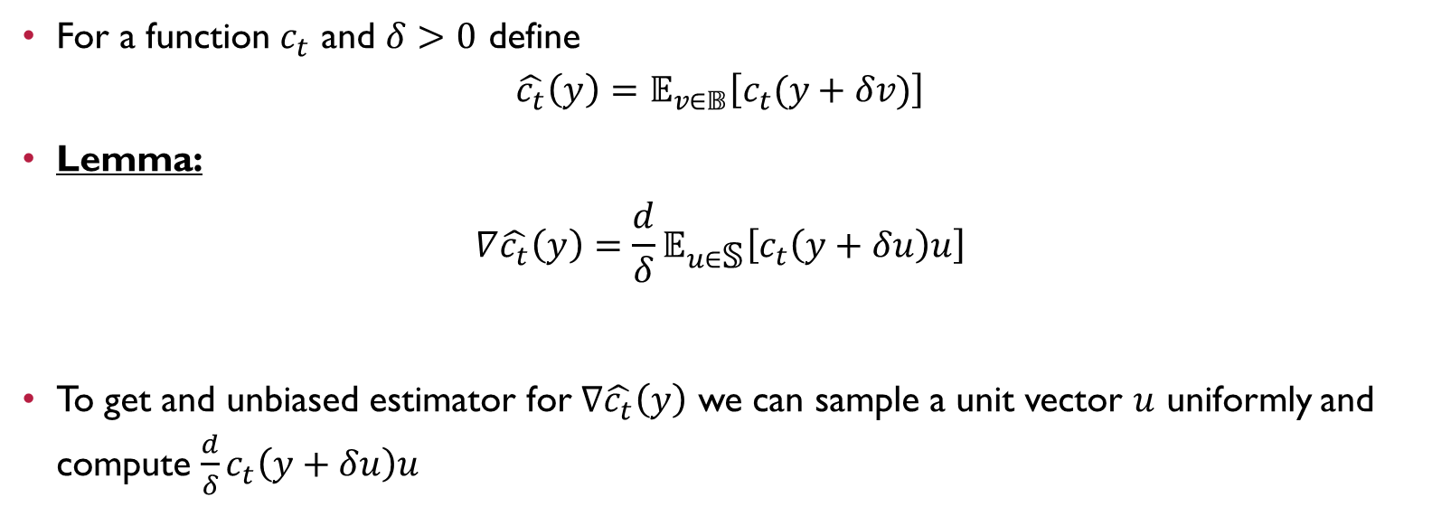
Gradient Estimation
For a function $c_{t}$ and $δ>0$ define
$$\hat{c_{t}}\left(y\right)=𝔼_{v∈𝔹}\left[c_{t}(y+δv)\right]$$
Lemma:
$$∇\hat{c_{t}}\left(y\right)=\frac{d}{δ}𝔼_{u∈\text{𝕊}}\left[c_{t}\left(y+δu\right)u\right]$$
To get and unbiased estimator for $∇\hat{c_{t}}\left(y\right)$ we can sample a unit vector $u$ uniformly and compute $\frac{d}{δ}c_{t}\left(y+δu\right)u$

Slide 7

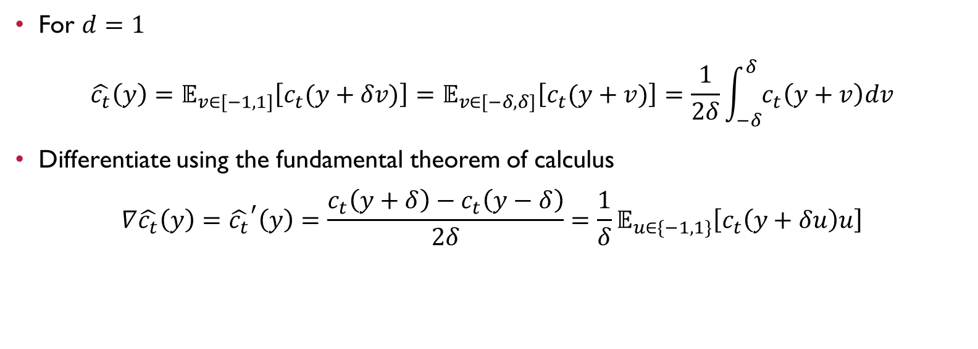
Proof
$$\hat{c_{t}}\left(y\right)=𝔼_{v∈𝔹}\left[c_{t}(y+δv)\right]$$
For $d=1$
$$\hat{c_{t}}\left(y\right)=𝔼_{v∈[−1,1]}\left[c_{t}(y+δv)\right]=𝔼_{v∈[−δ,δ]}\left[c_{t}(y+v)\right]=\frac{1}{2δ}\int_{−δ}^{δ}{c_{t}\left(y+v\right)dv}$$
Differentiate using the fundamental theorem of calculus
$$∇\hat{c_{t}}\left(y\right)={\hat{c_{t}}}^{′}\left(y\right)=\frac{c_{t}\left(y+δ\right)−c_{t}\left(y−δ\right)}{2δ}=\frac{1}{δ}𝔼_{u∈\{−1,1\}}\left[c_{t}\left(y+δu\right)u\right]$$

Slide 8
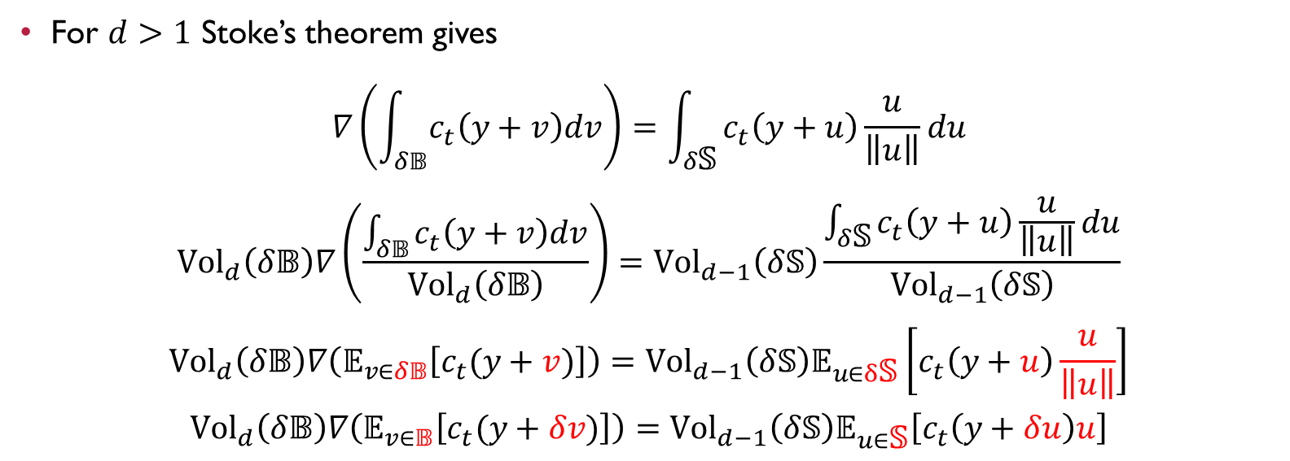
Proof Cont.
For $d>1$ Stoke’s theorem gives
$$∇\left(\int_{δ𝔹}{c_{t}\left(y+v\right)dv}\right)=\int_{δ\text{𝕊}}{c_{t}\left(y+u\right)\frac{u}{\left\|u\right\|}du}$$
$${Vol}_{d}\left(δ𝔹\right)∇\left(\frac{\int_{δ𝔹}{c_{t}\left(y+v\right)dv}}{{Vol}_{d}\left(δ𝔹\right)}\right)={Vol}_{d−1}\left(δ\text{𝕊}\right)\frac{\int_{δ\text{𝕊}}{c_{t}\left(y+u\right)\frac{u}{\left\|u\right\|}du}}{{Vol}_{d−1}\left(δ\text{𝕊}\right)}$$
$${Vol}_{d}\left(δ𝔹\right)∇\left(𝔼_{v∈δ𝔹}\left[c_{t}(y+v)\right]\right)={Vol}_{d−1}\left(δ\text{𝕊}\right)𝔼_{u∈δ\text{𝕊}}\left[c_{t}\left(y+u\right)\frac{u}{\left\|u\right\|}\right]$$
$${Vol}_{d}\left(δ𝔹\right)∇\left(𝔼_{v∈𝔹}\left[c_{t}(y+δv)\right]\right)={Vol}_{d−1}\left(δ\text{𝕊}\right)𝔼_{u∈\text{𝕊}}\left[c_{t}\left(y+δu\right)u\right]$$

Slide 9
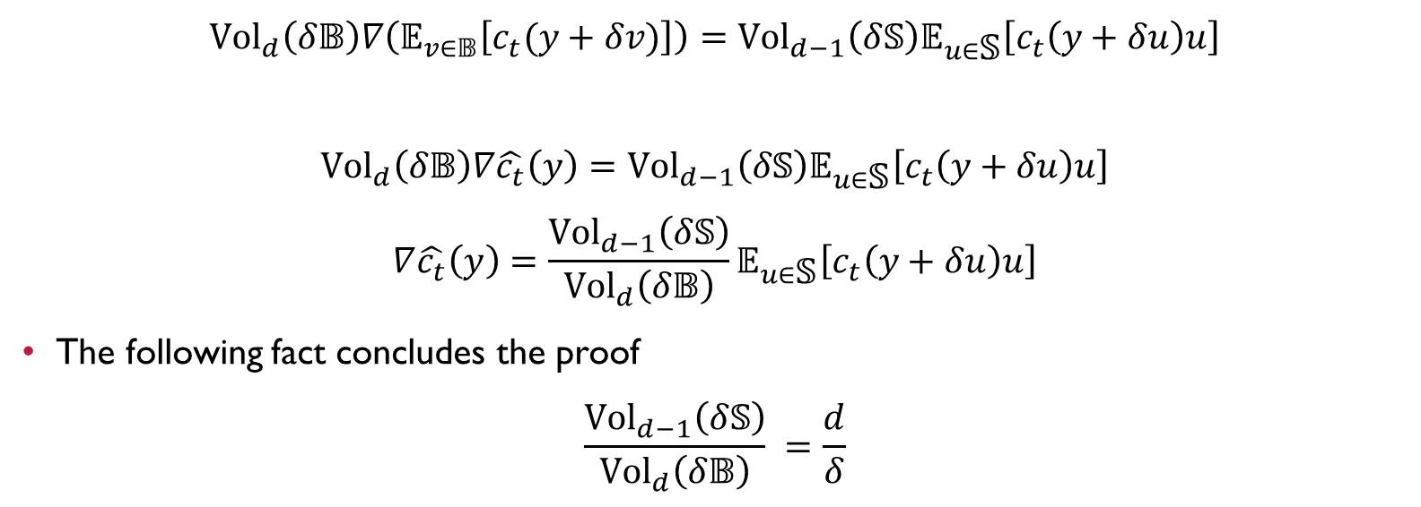

Proof Cont.
$$\hat{c_{t}}\left(y\right)=𝔼_{v∈𝔹}\left[c_{t}(y+δv)\right]$$
$${Vol}_{d}\left(δ𝔹\right)∇\left(𝔼_{v∈𝔹}\left[c_{t}(y+δv)\right]\right)={Vol}_{d−1}\left(δ\text{𝕊}\right)𝔼_{u∈\text{𝕊}}\left[c_{t}\left(y+δu\right)u\right]$$
$${Vol}_{d}\left(δ𝔹\right)∇\hat{c_{t}}\left(y\right)={Vol}_{d−1}\left(δ\text{𝕊}\right)𝔼_{u∈\text{𝕊}}\left[c_{t}\left(y+δu\right)u\right]$$
$$∇\hat{c_{t}}\left(y\right)=\frac{{Vol}_{d−1}\left(δ\text{𝕊}\right)}{{Vol}_{d}\left(δ𝔹\right)}𝔼_{u∈\text{𝕊}}\left[c_{t}\left(y+δu\right)u\right]$$
The following fact concludes the proof
$$\frac{{Vol}_{d−1}\left(δ\text{𝕊}\right)}{{Vol}_{d}\left(δ𝔹\right)} =\frac{d}{δ}$$
For example in $ℝ^{2}$:
$$\frac{2πδ}{πδ^{2}}=\frac{2}{δ}$$

Slide 10
Part 2
Regret Bound for
Estimated Gradients

Slide 11
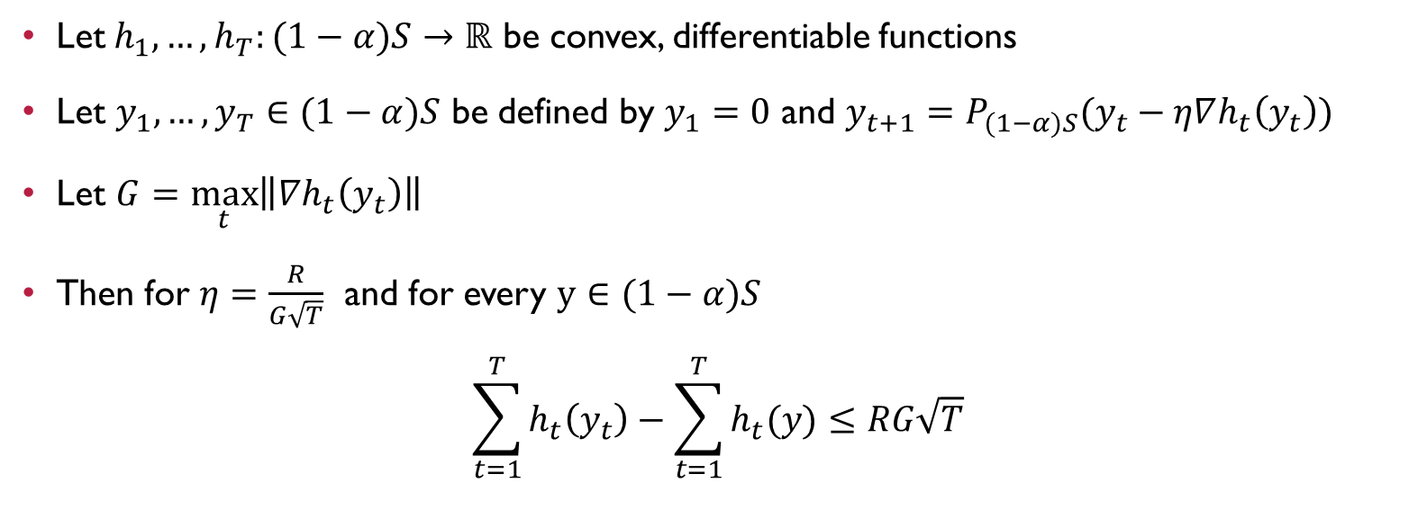
Zinkevich’s Theorem
Let$h_{1},…,h_{T}:(1−α)S→ℝ$ be convex, differentiable functions
Let $y_{1},…,y_{T}∈(1−α)S$ be defined by $y_{1}=0$ and $y_{t+1}=P_{(1−α)S}(y_{t}−η∇h_{t}\left(y_{t}\right))$
Let $G=\max_{t}\left\|∇h_{t}\left(y_{t}\right)\right\|$
Then for $η=\frac{R}{G\sqrt{T}}$ and for every $y∈(1−α)S$
$$\sum_{t=1}^{T}{h_{t}\left(y_{t}\right)−\sum_{t=1}^{T}{h_{t}(y)}}≤RG\sqrt{T}$$

Slide 12
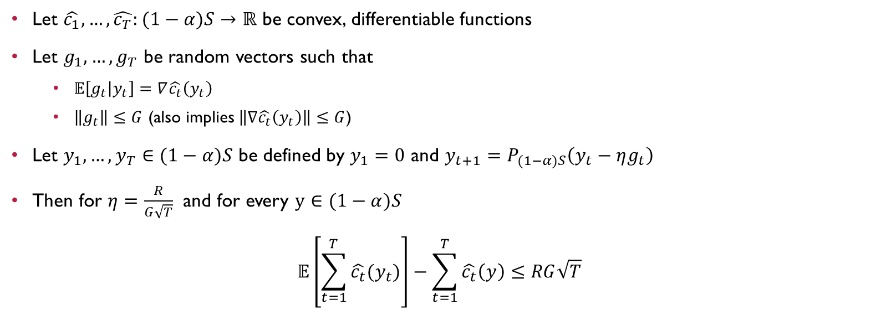
Expected Zinkevich’s Theorem
Let $\hat{c_{1}},…,\hat{c_{T}}:(1−α)S→ℝ$ be convex, differentiable functions
Let $g_{1},…,g_{T}$ be random vectors such that
  $𝔼\left[g_{t} | y_{t}\right]=∇\hat{c_{t}}\left(y_{t}\right)$
  $\left\|g_{t}\right\|≤G$ (also implies $\left\|∇\hat{c_{t}}\left(y_{t}\right)\right\|≤G$)
Let $y_{1},…,y_{T}∈(1−α)S$ be defined by $y_{1}=0$ and $y_{t+1}=P_{(1−α)S}\left(y_{t}−ηg_{t}\right)$
Then for $η=\frac{R}{G\sqrt{T}}$ and for every $y∈(1−α)S$
$$𝔼\left[\sum_{t=1}^{T}{\hat{c_{t}}(y_{t})}\right]−\sum_{t=1}^{T}{\hat{c_{t}}\left(y\right)}≤RG\sqrt{T}$$

Slide 13
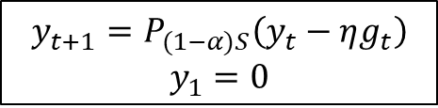
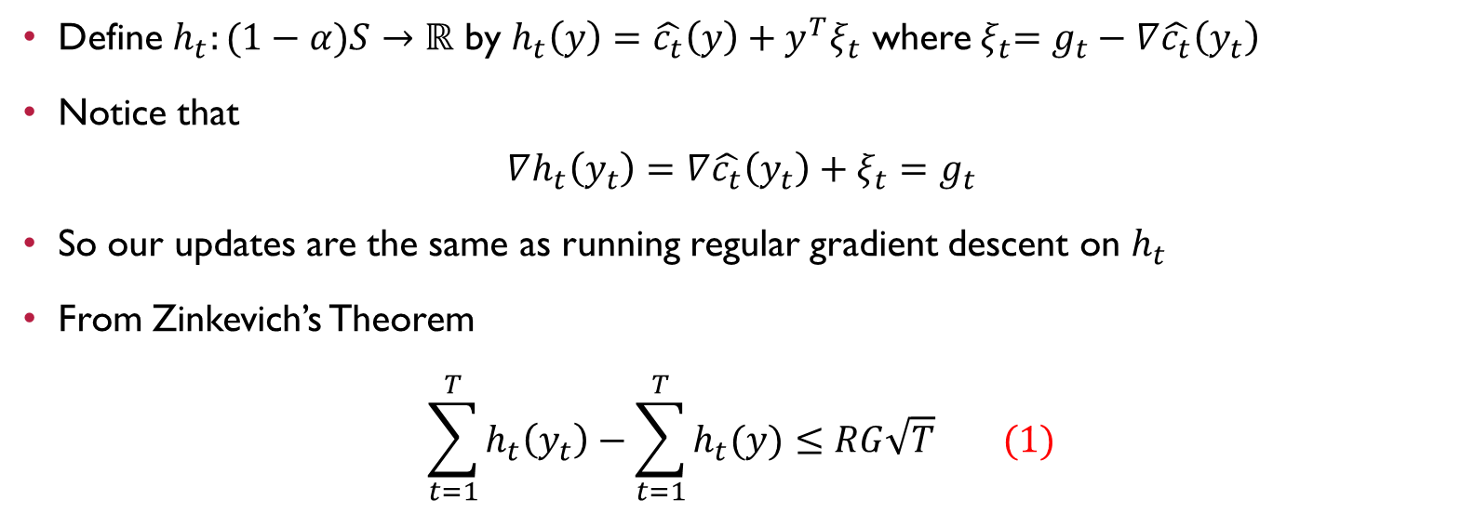
Proof
$$y_{t+1}=P_{(1−α)S}\left(y_{t}−ηg_{t}\right)$$
$$y_{1}=0$$
Define $h_{t}:(1−α)S→ℝ$ by $h_{t}\left(y\right)=\hat{c_{t}}\left(y\right)+y^{T}ξ_{t}$ where${ ξ}_{t}=g_{t}−∇\hat{c_{t}}\left(y_{t}\right)$
Notice that
$$∇h_{t}\left(y_{t}\right)=∇\hat{c_{t}}\left(y_{t}\right)+ξ_{t}=g_{t}$$
So our updates are the same as running regular gradient descent on $h_{t}$
From Zinkevich’s Theorem
$$\sum_{t=1}^{T}{h_{t}\left(y_{t}\right)−\sum_{t=1}^{T}{h_{t}(y)}}≤RG\sqrt{T} (1)$$

Slide 14

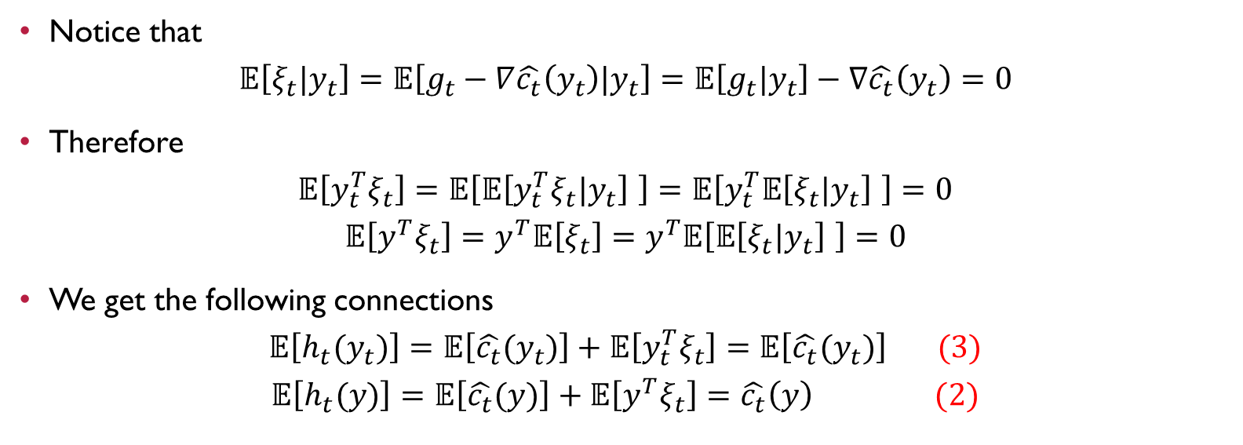
Proof Cont.
$$h_{t}\left(y\right)=\hat{c_{t}}\left(y\right)+y^{T}ξ_{t}$$
$${ ξ}_{t}=g_{t}−∇\hat{c_{t}}\left(y_{t}\right)$$
$$𝔼\left[g_{t} | y_{t}\right]=∇\hat{c_{t}}\left(y_{t}\right)$$
Notice that
$$𝔼\left[ξ_{t}|y_{t}\right]=𝔼\left[g_{t}−∇\hat{c_{t}}\left(y_{t}\right)|y_{t}\right]=𝔼\left[g_{t}|y_{t}\right]−∇\hat{c_{t}}\left(y_{t}\right)=0$$
Therefore
$$𝔼\left[{y_{t}^{T}ξ}_{t}\right]=𝔼\left[𝔼\left[{y_{t}^{T}ξ}_{t}|y_{t}\right] \right]=𝔼\left[y_{t}^{T}𝔼\left[ξ_{t}|y_{t}\right] \right]=0$$
$$𝔼\left[{y^{T}ξ}_{t}\right]=y^{T}𝔼\left[ξ_{t}\right]=y^{T}𝔼\left[𝔼\left[ξ_{t}|y_{t}\right] \right]=0$$
We get the following connections
$$𝔼\left[h_{t}(y_{t})\right]=𝔼\left[\hat{c_{t}}(y_{t})\right]+𝔼\left[{y_{t}^{T}ξ}_{t}\right]=𝔼\left[\hat{c_{t}}(y_{t})\right] (3)$$
$$𝔼\left[h_{t}(y)\right]=𝔼\left[\hat{c_{t}}(y)\right]+𝔼\left[{y^{T}ξ}_{t}\right]=\hat{c_{t}}\left(y\right) (2)$$

Slide 15


Proof Cont.
$$\left(1\right) \sum_{t=1}^{T}{h_{t}\left(y_{t}\right)−\sum_{t=1}^{T}{h_{t}(y)}}≤RG\sqrt{T}$$
$$\left(2\right) 𝔼\left[h_{t}(y)\right]=\hat{c_{t}}(y)$$
$\left(3\right)$ $𝔼\left[h_{t}(y_{t})\right]=𝔼\left[\hat{c_{t}}(y_{t})\right]$
$$𝔼\left[\sum_{t=1}^{T}{\hat{c_{t}}(y_{t})}\right]−\sum_{t=1}^{T}{\hat{c_{t}}\left(y\right)}=^{(3)}$$
$$\sum_{t=1}^{T}{𝔼\left[h_{t}\left(y_{t}\right)\right]−\sum_{t=1}^{T}{\hat{c_{t}}\left(y\right)}=^{(2)}𝔼\left[\sum_{t=1}^{T}{h_{t}\left(y_{t}\right)}\right]−\sum_{t=1}^{T}{𝔼\left[h_{t}\left(y\right)\right]}}=$$
$$𝔼\left[\sum_{t=1}^{T}{h_{t}\left(y_{t}\right)}−\sum_{t=1}^{T}{h_{t}\left(y\right)}\right]≤^{(1)}RG\sqrt{T}$$

Slide 16
Part 3
BGD Algorithm

Slide 17
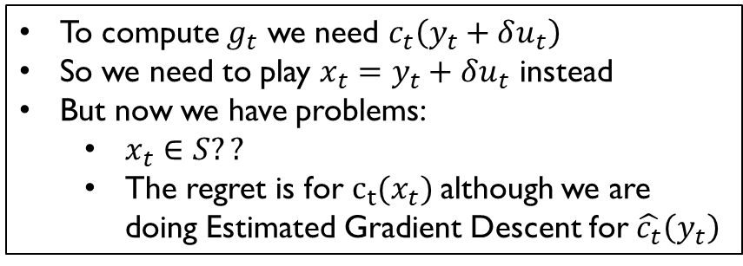


Ideal World Algorithm
$$g_{t}=\frac{d}{δ}c_{t}\left(y_{t}+δu_{t}\right)u_{t}$$
$$𝔼\left[g_{t} | y_{t}\right]=∇\hat{c_{t}}\left(y_{t}\right)$$
$y_{1}←0$
For $t∈\{1,…,T\}:$
  Select unit vector $u_{t}$ uniformly at random
  Play $y_{t}$ and observe cost $c_{t}\left(y_{t}\right)$
  Compute $g_{t}$ using $u_{t}$
  $y_{t+1}←P_{S}\left(y_{t}−ηg_{t}\right)$
To compute $g_{t}$ we need $c_{t}\left(y_{t}+δu_{t}\right)$
So we need to play $x_{t}=y_{t}+δu_{t}$ instead
But now we have problems:
  $x_{t}∈S??$
  The regret is for $c_{t}(x_{t})$although we are doing Estimated Gradient Descent for$\hat{c_{t}}\left(y_{t}\right)$

Slide 18


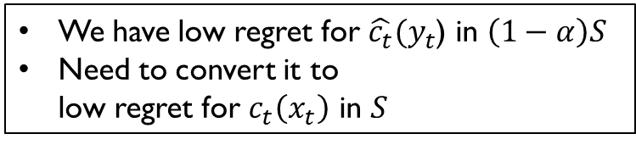

Bandit Gradient Descent Algorithm (BGD)
Parameters: $η>0,δ>0,0<α<1$
$y_{1}←0$
For $t∈\{1,…,T\}:$
  Select unit vector $u_{t}$ uniformly at random
  $x_{t}←y_{t}+δu_{t}$
  Play $x_{t}$ and observe cost $c_{t}\left(x_{t}\right)=c_{t}(y_{t}+δu_{t})$
  $g_{t}←\frac{d}{δ}c_{t}\left(x_{t}\right)u_{t}=\frac{d}{δ}c_{t}\left(y_{t}+δu_{t}\right)u_{t}$
  $y_{t+1}←P_{\left(1−α\right)S}\left(y_{t}−ηg_{t}\right)$
$y_{1}←0$
For $t∈\{1,…,T\}:$
  Select random unit vector $u_{t}$
  Play $y_{t}$ and observe $c_{t}\left(y_{t}\right)$
  Compute $g_{t}$ using $u_{t}$
  $y_{t+1}←P_{S}\left(y_{t}−ηg_{t}\right)$
$$x_{t}∈S?$$
We have low regret for $\hat{c_{t}}(y_{t}$) in $\left(1−α\right)S$
Need to convert it to
low regret for $c_{t}\left(x_{t}\right)$ in $S$

Slide 19

Observation 1
For any $x∈S$
$$\sum_{t=1}^{T}{c_{t}\left(\left(1−α\right)x\right)}≤\sum_{t=1}^{T}{c_{t}\left(x\right)}+2αCT$$
Proof. From convexity
$$c_{t}\left(\left(1−α\right)x\right)=c_{t}\left(α0+\left(1−α\right)x\right)≤$$
$${αc}_{t}\left(0\right)+\left(1−α\right)c_{t}\left(x\right)=c_{t}\left(x\right)+α\left(c_{t}\left(0\right)−c_{t}\left(x\right)\right)≤$$
$$c_{t}\left(x\right)+2αC$$

Slide 20

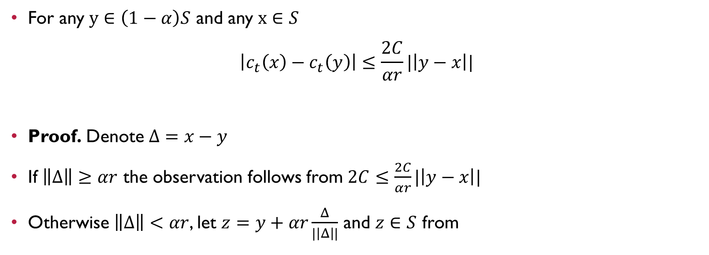
Observation 2
For any $y∈\left(1−α\right)S$ and any $x∈S$
$$\left|c_{t}\left(x\right)−c_{t}\left(y\right)\right|≤\frac{2C}{αr}|\left|y−x\right||$$
Proof. Denote $Δ=x−y$
If $\left\|Δ\right\|≥αr$ the observation follows from $2C≤\frac{2C}{αr}|\left|y−x\right||$
Otherwise $\left\|Δ\right\|<αr$, let $z=y+αr\frac{Δ}{|\left|Δ\right||}$ and $z∈S$ from
$$y∈\left(1−α\right)S$$
$$αr\frac{Δ}{\left\|Δ\right\|} ∈αr𝔹⊆αS$$
$$↓$$
$$z∈\left(1−α\right)S+αS⊆S$$

Slide 21

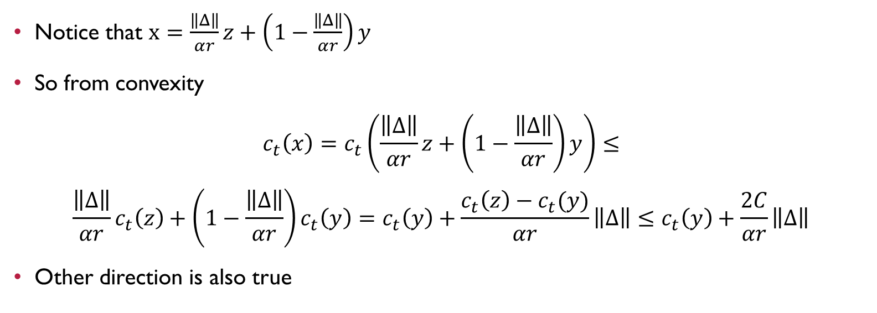
Proof Cont.
Notice that $x=\frac{\left\|Δ\right\|}{αr}z+\left(1−\frac{\left\|Δ\right\|}{αr}\right)y$
So from convexity
$$c_{t}\left(x\right)=c_{t}\left(\frac{\left\|Δ\right\|}{αr}z+\left(1−\frac{\left\|Δ\right\|}{αr}\right)y\right)≤$$
$$\frac{\left\|Δ\right\|}{αr}c_{t}\left(z\right)+\left(1−\frac{\left\|Δ\right\|}{αr}\right)c_{t}\left(y\right)=c_{t}\left(y\right)+\frac{c_{t}\left(z\right)−c_{t}(y)}{αr}\left\|Δ\right\|≤c_{t}\left(y\right)+\frac{2C}{αr}\left\|Δ\right\|$$
Other direction is also true
$$z=y+αr\frac{Δ}{\left\|Δ\right\|}$$
$$Δ=x−y$$

Slide 22
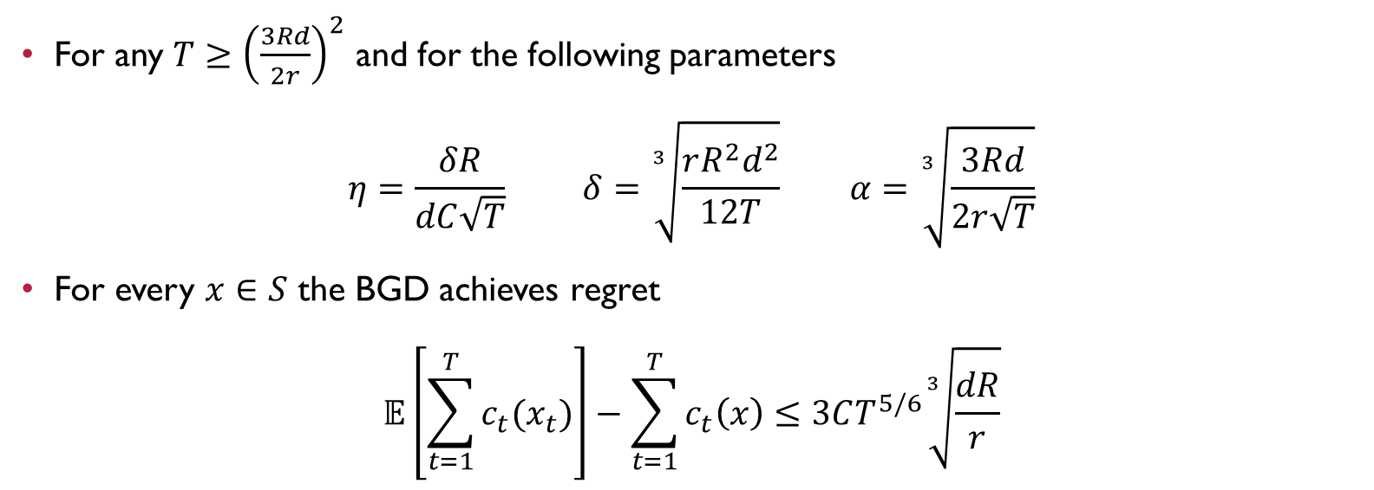
BGD Regret Theorem
For any $T≥{\left(\frac{3Rd}{2r}\right)}^{2}$ and for the following parameters
$$η=\frac{δR}{dC\sqrt{T}} δ=\sqrt[3]{\frac{rR^{2}d^{2}}{12T}} α=\sqrt[3]{\frac{3Rd}{2r\sqrt{T}}}$$
For every $x∈S$ the BGD achieves regret
$$𝔼\left[\sum_{t=1}^{T}{c_{t}(x_{t})}\right]−\sum_{t=1}^{T}{c_{t}\left(x\right)}≤3CT^{5/6}\sqrt[3]{\frac{dR}{r}}$$

Slide 23


Proof
$$g_{t}=\frac{d}{δ}c_{t}\left(x_{t}\right)u_{t}$$
$$x_{t}=y_{t}+δu_{t}$$
$$y_{t+1}=P_{\left(1−α\right)S}\left(y_{t}−ηg_{t}\right)$$
First we need to show that $x_{t}∈S$
Notice that $\left(1−α\right)S+αr𝔹⊆\left(1−α\right)S+αS⊆S$
Since $y_{t}∈\left(1−α\right)S$, we just need to show that $δ≤αr$
$$δ=\sqrt[3]{\frac{rR^{2}d^{2}}{12T}}$$
$$αr=\sqrt[3]{\frac{3Rd}{2r\sqrt{T}}}r=\sqrt[3]{\frac{3Rr^{2}d}{2\sqrt{T}}}$$
This is true because $T≥{\left(\frac{3Rd}{2r}\right)}^{2}$

Slide 24

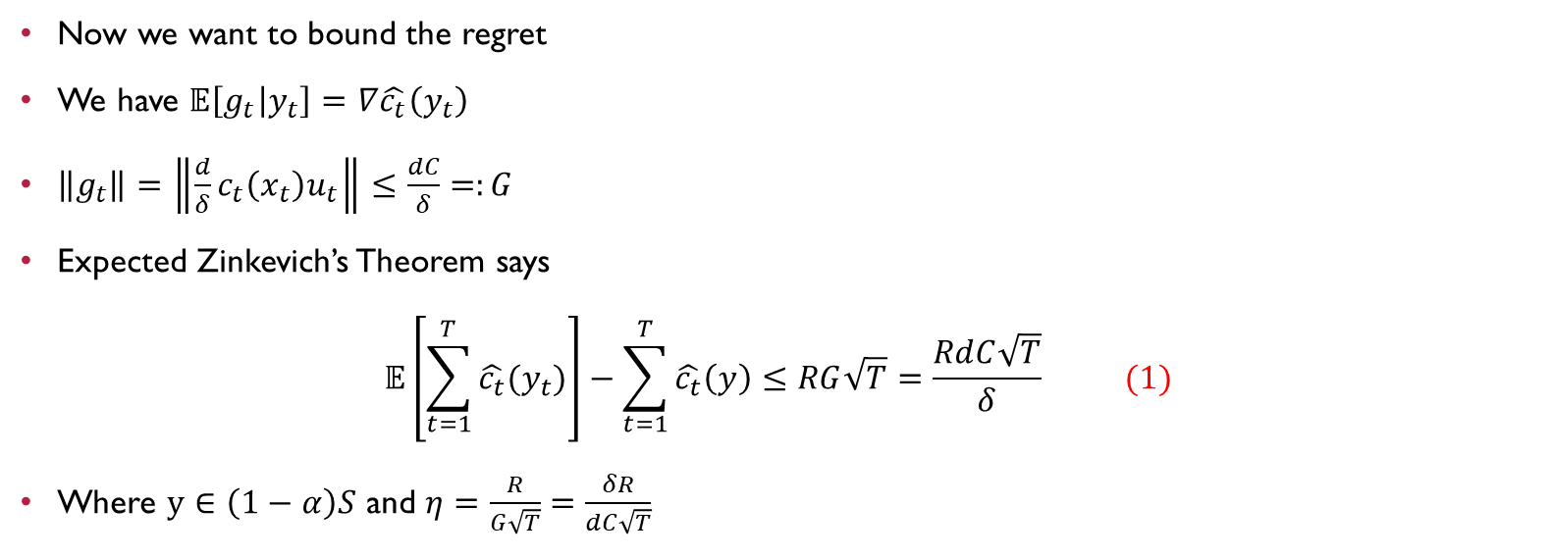
Proof Cont.
$$\hat{c_{t}}\left(y_{t}\right)=𝔼_{v∈𝔹}\left[c_{t}(y_{t}+δv)\right]$$
$$∇\hat{c_{t}}\left(y_{t}\right)=\frac{d}{δ}𝔼_{u∈\text{𝕊}}\left[c_{t}\left(y_{t}+δu\right)u\right]$$
$$g_{t}=\frac{d}{δ}c_{t}\left(x_{t}\right)u_{t}$$
$$x_{t}=y_{t}+δu_{t}$$
$$y_{t+1}=P_{\left(1−α\right)S}\left(y_{t}−ηg_{t}\right)$$
Now we want to bound the regret
We have $𝔼\left[g_{t} | y_{t}\right]=∇\hat{c_{t}}\left(y_{t}\right)$
$\left\|g_{t}\right\|=\left\|\frac{d}{δ}c_{t}\left(x_{t}\right)u_{t}\right\|≤\frac{dC}{δ}=:G$
Expected Zinkevich’s Theorem says
$$𝔼\left[\sum_{t=1}^{T}{\hat{c_{t}}(y_{t})}\right]−\sum_{t=1}^{T}{\hat{c_{t}}\left(y\right)}≤RG\sqrt{T}=\frac{RdC\sqrt{T}}{δ} (1)$$
Where $y∈\left(1−α\right)S$ and $η=\frac{R}{G\sqrt{T}}=\frac{δR}{dC\sqrt{T}}$

Slide 25

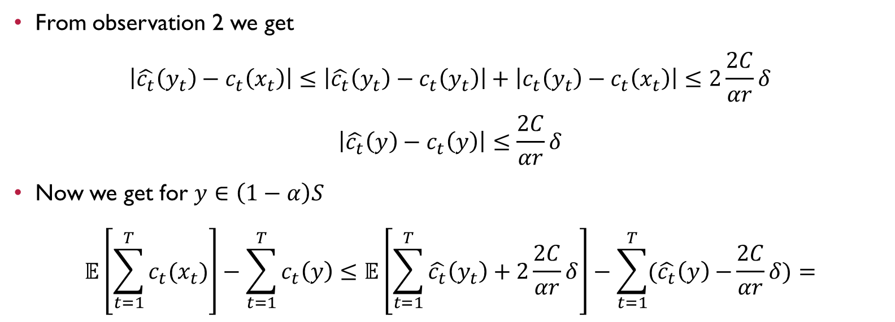
Proof Cont.
$$\left|c_{t}\left(y\right)−c_{t}\left(x\right)\right|≤\frac{2C}{αr}|\left|y−x\right||$$
For $y∈\left(1−α\right)S$
$$\hat{c_{t}}\left(y_{t}\right)=𝔼_{v∈𝔹}\left[c_{t}(y_{t}+δv)\right]$$
From observation 2 we get
$$\left|\hat{c_{t}}\left(y_{t}\right)−c_{t}\left(x_{t}\right)\right|≤\left|\hat{c_{t}}\left(y_{t}\right)−c_{t}\left(y_{t}\right)\right|+\left|c_{t}\left(y_{t}\right)−c_{t}\left(x_{t}\right)\right|≤2\frac{2C}{αr}δ$$
$$\left|\hat{c_{t}}\left(y\right)−c_{t}\left(y\right)\right|≤\frac{2C}{αr}δ$$
Now we get for $y∈\left(1−α\right)S$
$$𝔼\left[\sum_{t=1}^{T}{c_{t}(x_{t})}\right]−\sum_{t=1}^{T}{c_{t}\left(y\right)}≤𝔼\left[\sum_{t=1}^{T}{\hat{c_{t}}\left(y_{t}\right)+2\frac{2C}{αr}δ}\right]−\sum_{t=1}^{T}{(\hat{c_{t}}\left(y\right)−}\frac{2C}{αr}δ)=$$

Slide 26
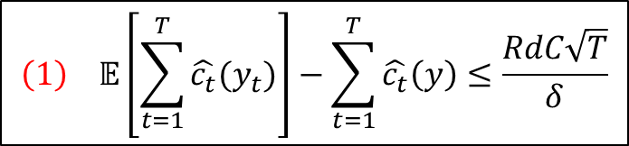
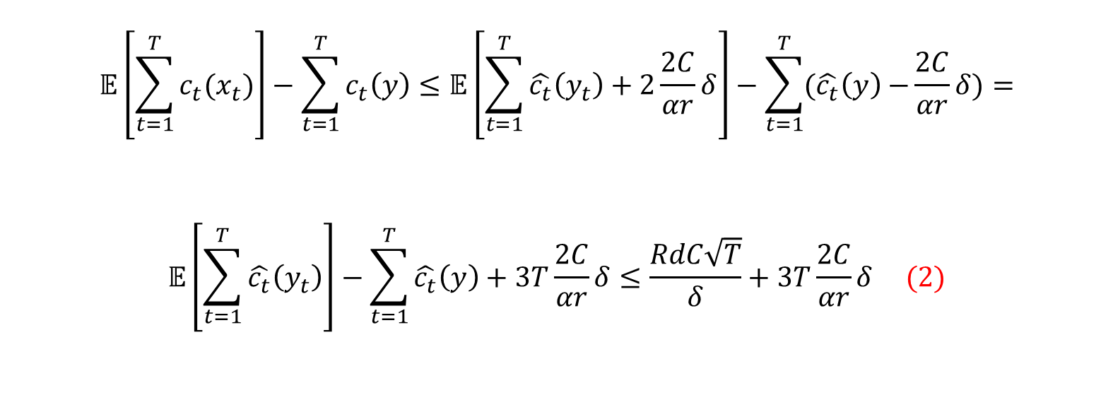
Proof Cont.
$$\left(1\right) 𝔼\left[\sum_{t=1}^{T}{\hat{c_{t}}(y_{t})}\right]−\sum_{t=1}^{T}{\hat{c_{t}}\left(y\right)}≤\frac{RdC\sqrt{T}}{δ}$$
$$𝔼\left[\sum_{t=1}^{T}{c_{t}(x_{t})}\right]−\sum_{t=1}^{T}{c_{t}\left(y\right)}≤𝔼\left[\sum_{t=1}^{T}{\hat{c_{t}}\left(y_{t}\right)+2\frac{2C}{αr}δ}\right]−\sum_{t=1}^{T}{(\hat{c_{t}}\left(y\right)−}\frac{2C}{αr}δ)=$$
$$𝔼\left[\sum_{t=1}^{T}{\hat{c_{t}}\left(y_{t}\right)}\right]−\sum_{t=1}^{T}{\hat{c_{t}}\left(y\right)}+3T\frac{2C}{αr}δ≤\frac{RdC\sqrt{T}}{δ}+3T\frac{2C}{αr}δ (2)$$

Slide 27
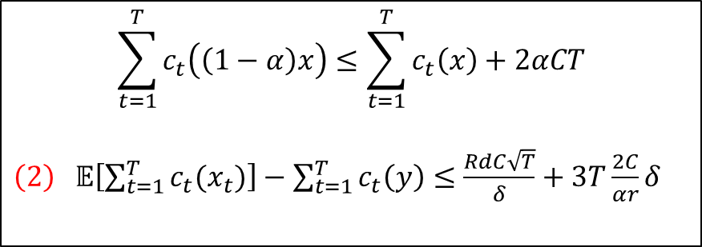
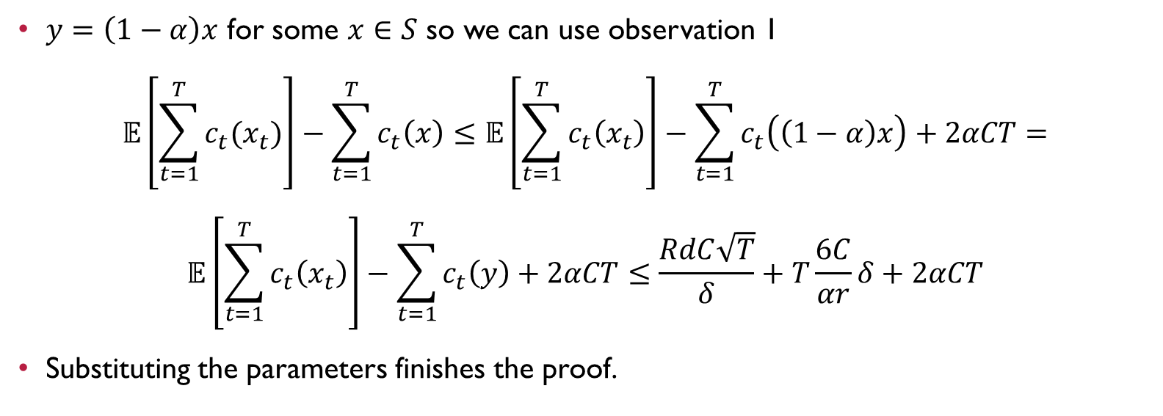
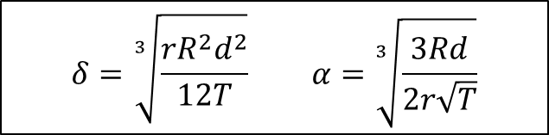
Proof Cont.
$$\sum_{t=1}^{T}{c_{t}\left(\left(1−α\right)x\right)}≤\sum_{t=1}^{T}{c_{t}\left(x\right)}+2αCT$$
$\left(2\right) 𝔼\left[\sum_{t=1}^{T}{c_{t}(x_{t})}\right]−\sum_{t=1}^{T}{c_{t}\left(y\right)}≤$ $\frac{RdC\sqrt{T}}{δ}+3T\frac{2C}{αr}δ$
$y=\left(1−α\right)x$ for some $x∈S$ so we can use observation 1
$$𝔼\left[\sum_{t=1}^{T}{c_{t}(x_{t})}\right]−\sum_{t=1}^{T}{c_{t}\left(x\right)}≤𝔼\left[\sum_{t=1}^{T}{c_{t}\left(x_{t}\right)}\right]−\sum_{t=1}^{T}{c_{t}\left(\left(1−α\right)x\right)}+2αCT=$$
$$𝔼\left[\sum_{t=1}^{T}{c_{t}\left(x_{t}\right)}\right]−\sum_{t=1}^{T}{c_{t}\left(y\right)}+2αCT≤\frac{RdC\sqrt{T}}{δ}+T\frac{6C}{αr}δ+2αCT$$
Substituting the parameters finishes the proof.
$$δ=\sqrt[3]{\frac{rR^{2}d^{2}}{12T}} α=\sqrt[3]{\frac{3Rd}{2r\sqrt{T}}}$$

Slide 28
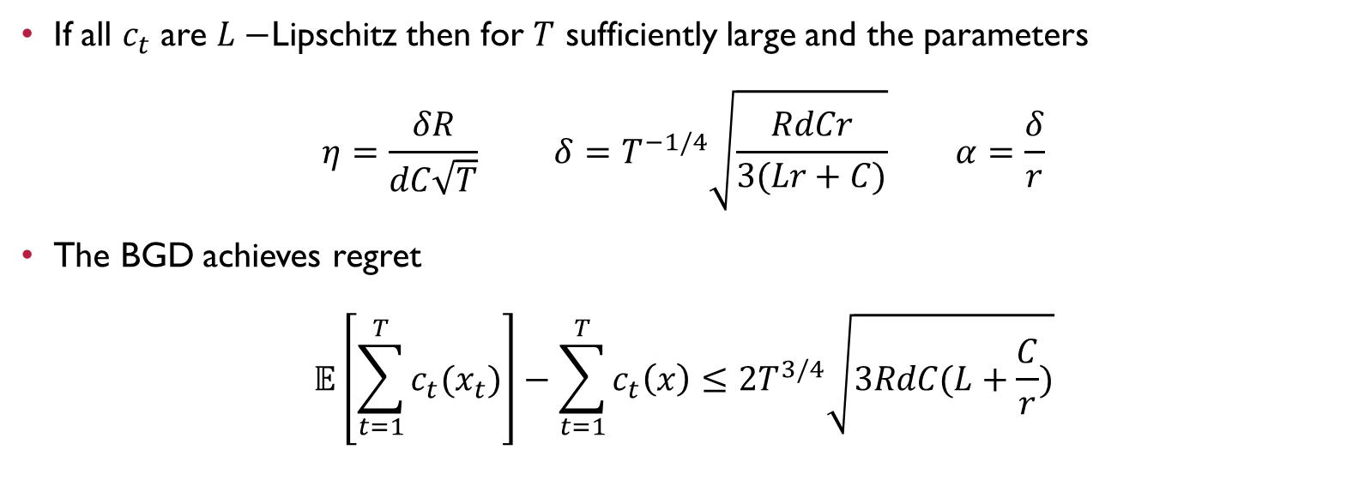
BGD with Lipschitz Regret Theorem
If all $c_{t}$ are $L−$Lipschitz then for $T$ sufficiently large and the parameters
$$η=\frac{δR}{dC\sqrt{T}} δ=T^{−1/4}\sqrt{\frac{RdCr}{3(Lr+C)}} α=\frac{δ}{r}$$
The BGD achieves regret
$$𝔼\left[\sum_{t=1}^{T}{c_{t}(x_{t})}\right]−\sum_{t=1}^{T}{c_{t}\left(x\right)}≤2T^{3/4}\sqrt{3RdC(L+\frac{C}{r})}$$

Slide 29
Part 4
Reshaping

Slide 30
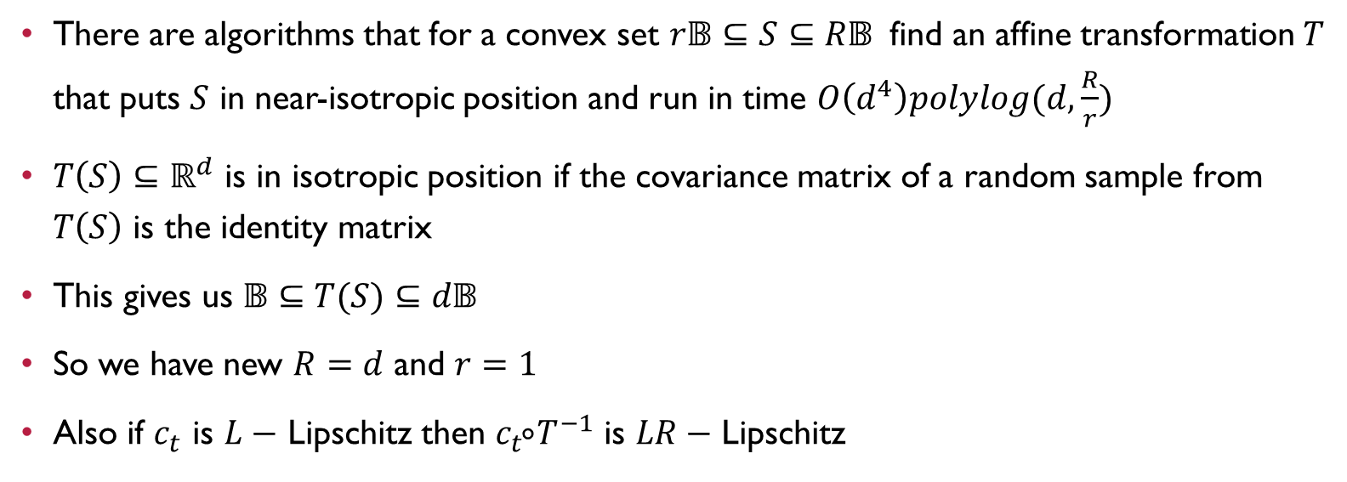

Removing Dependence in $1/r$
There are algorithms that for a convex set $r𝔹⊆S⊆R𝔹$ find an affine transformation $T$ that puts $S$ in near-isotropic position and run in time $O\left(d^{4}\right)polylog(d,\frac{R}{r})$
$T\left(S\right)⊆ℝ^{d}$ is in isotropic position if the covariance matrix of a random sample from $T\left(S\right)$ is the identity matrix
This gives us $𝔹⊆T(S)⊆d𝔹$
So we have new $R=d$ and $r=1$
Also if $c_{t}$ is $L−$ Lipschitz then $c_{t }⃘T^{−1}$ is $LR−$ Lipschitz

Slide 31
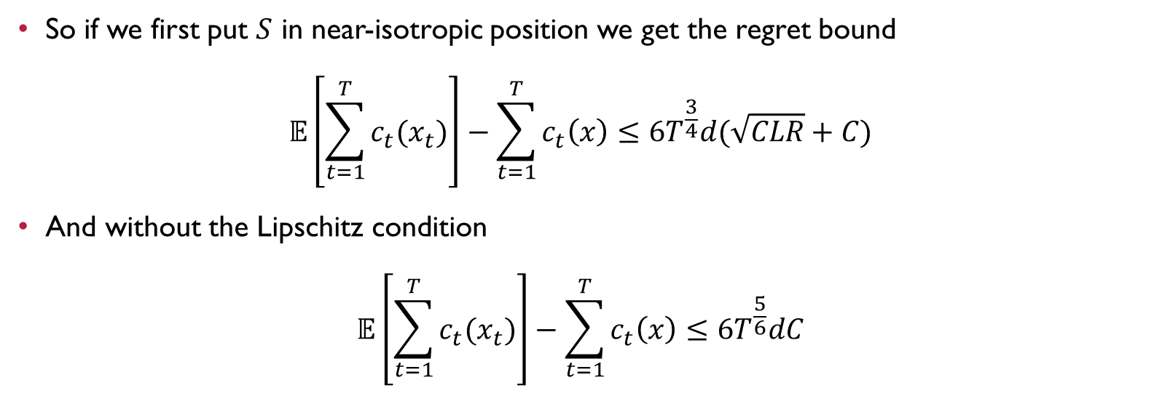


Removing Dependence in $1/r$
So if we first put $S$ in near-isotropic position we get the regret bound
$$𝔼\left[\sum_{t=1}^{T}{c_{t}(x_{t})}\right]−\sum_{t=1}^{T}{c_{t}\left(x\right)}≤6T^{\frac{3}{4}}d(\sqrt{CLR}+C)$$
And without the Lipschitz condition
$$𝔼\left[\sum_{t=1}^{T}{c_{t}(x_{t})}\right]−\sum_{t=1}^{T}{c_{t}\left(x\right)}≤6T^{\frac{5}{6}}dC$$
$$2T^{3/4}\sqrt{3RdC(L+\frac{C}{r})}$$
$$3CT^{5/6}\sqrt[3]{\frac{dR}{r}}$$

Slide 32
Part 5
Adaptive Adversary

Slide 33
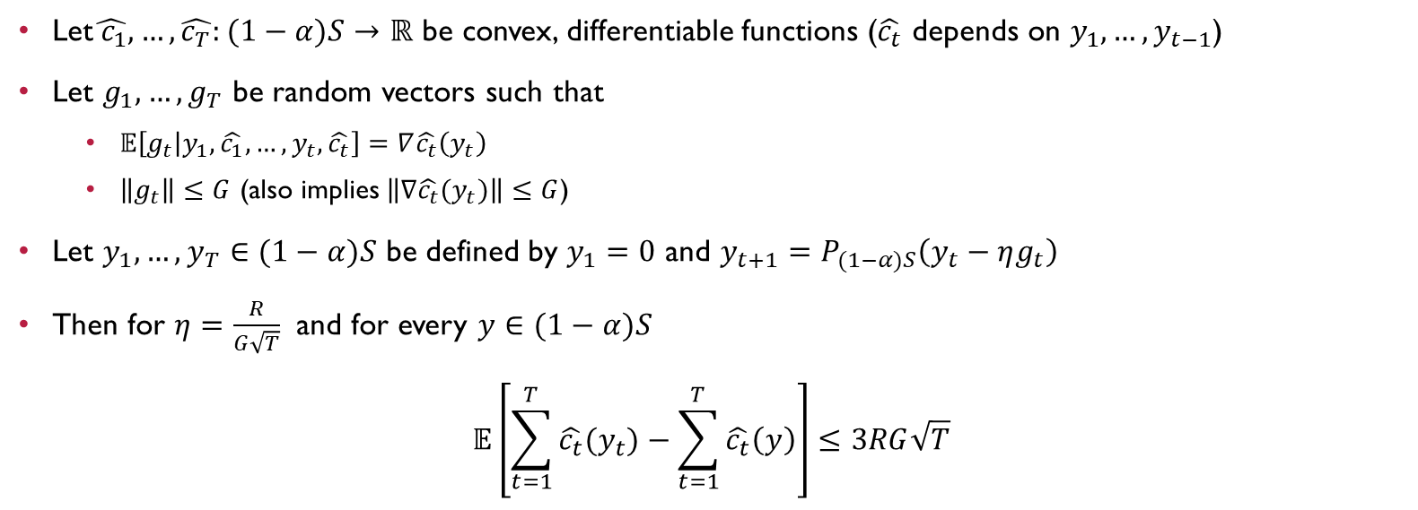
Expected Adaptive Zinkevich’s Theorem
Let$\hat{{ c}_{1}},…,\hat{c_{T}}:(1−α)S→ℝ$ be convex, differentiable functions ($\hat{c_{t}}$ depends on $y_{1},…,y_{t−1}$)
Let $g_{1},…,g_{T}$ be random vectors such that
  $𝔼\left[g_{t} | {y_{1},\hat{c_{1}},…,y}_{t},\hat{c_{t}}\right]=∇\hat{c_{t}}\left(y_{t}\right)$
  $\left\|g_{t}\right\|≤G$ (also implies $\left\|∇\hat{c_{t}}(y_{t})\right\|≤G$)
Let $y_{1},…,y_{T}∈(1−α)S$ be defined by $y_{1}=0$ and $y_{t+1}=P_{(1−α)S}\left(y_{t}−ηg_{t}\right)$
Then for $η=\frac{R}{G\sqrt{T}}$ and for every $y∈(1−α)S$
$$𝔼\left[\sum_{t=1}^{T}{\hat{c_{t}}(y_{t})}−\sum_{t=1}^{T}{\hat{c_{t}}\left(y\right)}\right]≤3RG\sqrt{T}$$

Slide 34
Proof
$$y_{t+1}=P_{(1−α)S}\left(y_{t}−ηg_{t}\right)$$
$$y_{1}=0$$
Define $h_{t}:(1−α)S→ℝ$ by $h_{t}\left(y\right)=\hat{c_{t}}\left(y\right)+y^{T}ξ_{t}$ where${ ξ}_{t}=g_{t}−∇\hat{c_{t}}\left(y_{t}\right)$
Notice that
$$∇h_{t}\left(y_{t}\right)=∇\hat{c_{t}}\left(y_{t}\right)+ξ_{t}=g_{t}$$
So our updates are the same as running regular gradient descent on $h_{t}$
From Zinkevich’s Theorem
$$\sum_{t=1}^{T}{h_{t}\left(y_{t}\right)−\sum_{t=1}^{T}{h_{t}(y)}}≤RG\sqrt{T} (1)$$

Slide 35

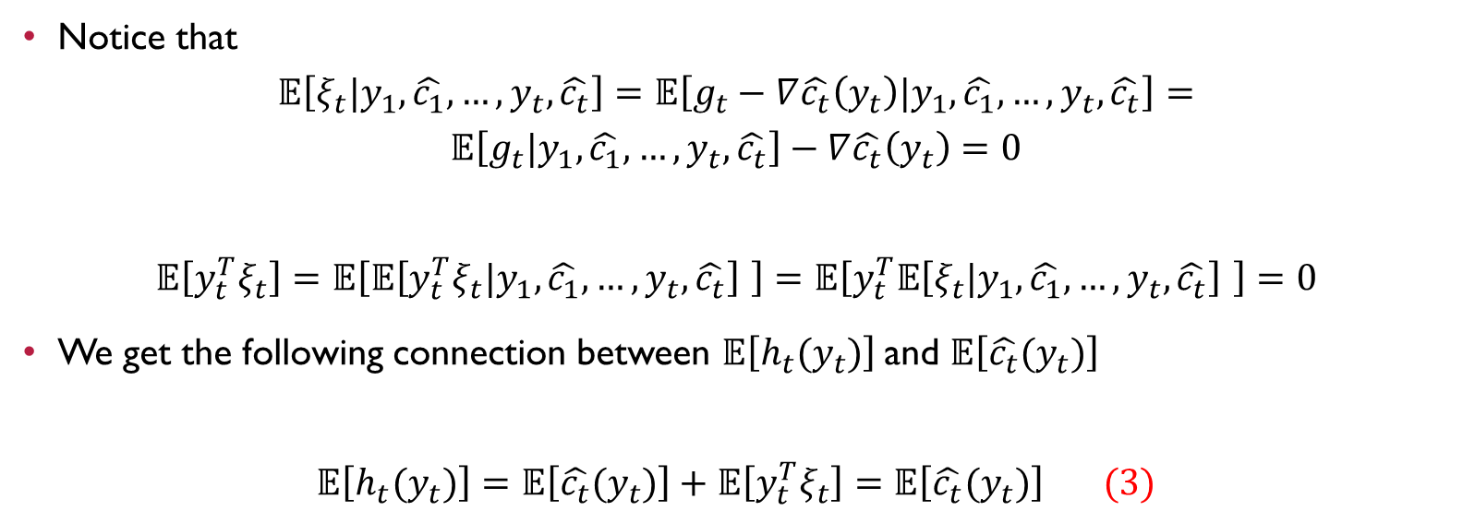
Proof Cont.
$$h_{t}\left(y\right)=\hat{c_{t}}\left(y\right)+y^{T}ξ_{t}$$
$${ ξ}_{t}=g_{t}−∇\hat{c_{t}}\left(y_{t}\right)$$
$$𝔼\left[g_{t} | {y_{1},\hat{c_{1}},…,y}_{t},\hat{c_{t}}\right]=∇\hat{c_{t}}\left(y_{t}\right)$$
Notice that
$$𝔼\left[ξ_{t}|{y_{1},\hat{c_{1}},…,y}_{t},\hat{c_{t}}\right]=𝔼\left[g_{t}−∇\hat{c_{t}}\left(y_{t}\right)|{y_{1},\hat{c_{1}},…,y}_{t},\hat{c_{t}}\right]=$$
$$𝔼\left[g_{t}|{y_{1},\hat{c_{1}},…,y}_{t},\hat{c_{t}}\right]−∇\hat{c_{t}}\left(y_{t}\right)=0$$
$$𝔼\left[{y_{t}^{T}ξ}_{t}\right]=𝔼\left[𝔼\left[{y_{t}^{T}ξ}_{t}|{y_{1},\hat{c_{1}},…,y}_{t},\hat{c_{t}}\right] \right]=𝔼\left[y_{t}^{T}𝔼\left[ξ_{t}|{y_{1},\hat{c_{1}},…,y}_{t},\hat{c_{t}}\right] \right]=0$$
We get the following connection between $𝔼\left[h_{t}(y_{t})\right]$ and $𝔼\left[\hat{c_{t}}(y_{t})\right]$
$$𝔼\left[h_{t}(y_{t})\right]=𝔼\left[\hat{c_{t}}(y_{t})\right]+𝔼\left[{y_{t}^{T}ξ}_{t}\right]=𝔼\left[\hat{c_{t}}(y_{t})\right] (3)$$

Slide 36

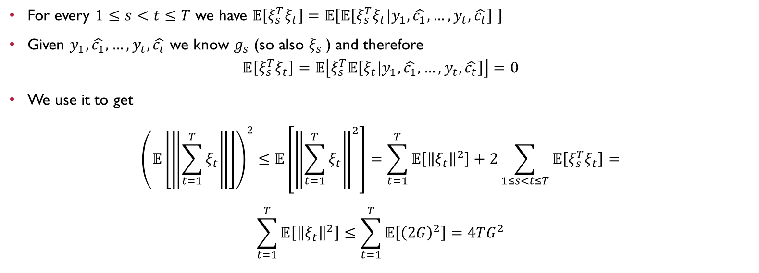
Proof Cont.
$$y_{t+1}=P_{(1−α)S}\left(y_{t}−ηg_{t}\right)$$
$$𝔼\left[g_{t} | {y_{1},\hat{c_{1}},…,y}_{t},\hat{c_{t}}\right]=∇\hat{c_{t}}\left(y_{t}\right)$$
$${ ξ}_{t}=g_{t}−∇\hat{c_{t}}\left(y_{t}\right)$$
$$\left\|ξ_{t}\right\|≤\left\|g_{t}\right\|+\left\|∇\hat{c_{t}}\left(y_{t}\right)\right\|≤2G$$
For every $1≤s<t≤T$ we have $𝔼\left[ξ_{s}^{T}ξ_{t}\right]=𝔼\left[𝔼\left[ξ_{s}^{T}ξ_{t}|{y_{1},\hat{c_{1}},…,y}_{t},\hat{c_{t}}\right] \right]$
Given ${y_{1},\hat{c_{1}},…,y}_{t},\hat{c_{t}}$ we know $g_{s}$ (so also $ξ_{s}$) and therefore
$$𝔼\left[ξ_{s}^{T}ξ_{t}\right]=𝔼\left[ξ_{s}^{T}𝔼\left[ξ_{t}|{y_{1},\hat{c_{1}},…,y}_{t},\hat{c_{t}}\right]\right]=0$$
We use it to get
$${\left(𝔼\left[\left\|\sum_{t=1}^{T}{ξ_{t}}\right\|\right]\right)}^{2}≤𝔼\left[{\left\|\sum_{t=1}^{T}{ξ_{t}}\right\|}^{2}\right]=\sum_{t=1}^{T}{𝔼\left[{\left\|ξ_{t}\right\|}^{2}\right]}+2\sum_{1≤s<t≤T}{𝔼\left[ξ_{s}^{T}ξ_{t}\right]}=$$
$$\sum_{t=1}^{T}{𝔼\left[{\left\|ξ_{t}\right\|}^{2}\right]}≤\sum_{t=1}^{T}{𝔼\left[{\left(2G\right)}^{2}\right]=4TG^{2}}$$

Slide 37


Proof Cont.
$$h_{t}\left(y\right)=\hat{c_{t}}\left(y\right)+y^{T}ξ_{t}$$
$$𝔼\left[\left\|\sum_{t=1}^{T}{ξ_{t}}\right\|\right]≤2G\sqrt{T}$$
$$S⊆R𝔹$$
Now we connect between $𝔼\left[h_{t}(y)\right]$ and $𝔼\left[\hat{c_{t}}(y)\right]$
$$\left|𝔼\left[\sum_{t=1}^{T}{h_{t}\left(y\right)}\right]−𝔼\left[\sum_{t=1}^{T}{\hat{c_{t}}(y)}\right]\right|≤𝔼\left[\left|\sum_{t=1}^{T}{h_{t}\left(y\right)−\hat{c_{t}}(y)}\right|\right]=$$
$$𝔼\left[\left|y^{T}\sum_{t=1}^{T}{ξ_{t}}\right|\right]≤𝔼\left[\left\|y\right\|\left\|\sum_{t=1}^{T}{ξ_{t}}\right\|\right]≤R𝔼\left[\left\|\sum_{t=1}^{T}{ξ_{t}}\right\|\right]≤2RG\sqrt{T} (2)$$

Slide 38


Proof Cont.
$$\left(1\right) \sum_{t=1}^{T}{h_{t}\left(y_{t}\right)−\sum_{t=1}^{T}{h_{t}(y)}}≤RG\sqrt{T}$$
$$\left(2\right)\left|𝔼\left[\sum_{t=1}^{T}{h_{t}\left(y\right)}\right]−𝔼\left[\sum_{t=1}^{T}{\hat{c_{t}}\left(y\right)}\right]\right|≤2RG\sqrt{T}$$
$\left(3\right)$ $𝔼\left[h_{t}(y_{t})\right]=𝔼\left[\hat{c_{t}}(y_{t})\right]$
$$𝔼\left[\sum_{t=1}^{T}{\hat{c_{t}}(y_{t})}−\sum_{t=1}^{T}{\hat{c_{t}}\left(y\right)}\right]=\sum_{t=1}^{T}{𝔼\left[\hat{c_{t}}\left(y_{t}\right)\right]−𝔼\left[\sum_{t=1}^{T}{\hat{c_{t}}\left(y\right)}\right]=^{(3)}}$$
$$\sum_{t=1}^{T}{𝔼\left[h_{t}\left(y_{t}\right)\right]−𝔼\left[\sum_{t=1}^{T}{\hat{c_{t}}\left(y\right)}\right]≤^{(2)}𝔼\left[\sum_{t=1}^{T}{h_{t}\left(y_{t}\right)}\right]−𝔼\left[\sum_{t=1}^{T}{h_{t}\left(y\right)}\right]+2}RG\sqrt{T}=$$
$$𝔼\left[\sum_{t=1}^{T}{h_{t}\left(y_{t}\right)}−\sum_{t=1}^{T}{h_{t}\left(y\right)}\right]+2RG\sqrt{T}≤^{(1)}3RG\sqrt{T}$$

