Slide 1

Point to point shortest paths
We want to `direct’ the search to $t$
s
t
S

Slide 2
Goal-directed Dijkstra (A*)
We want to `direct’ the search to $t$
s
S
t

Slide 3


Goal-directed Dijkstra (A*)
We want to `direct’ the search to $t$
Add a potential to each key: $key\left(v\right)=v.d+p_{t}(v)$
Want${ p}_{t}(v)$ to be small if $v$ is closer to $t$
s
S
$$v$$
t

Slide 4
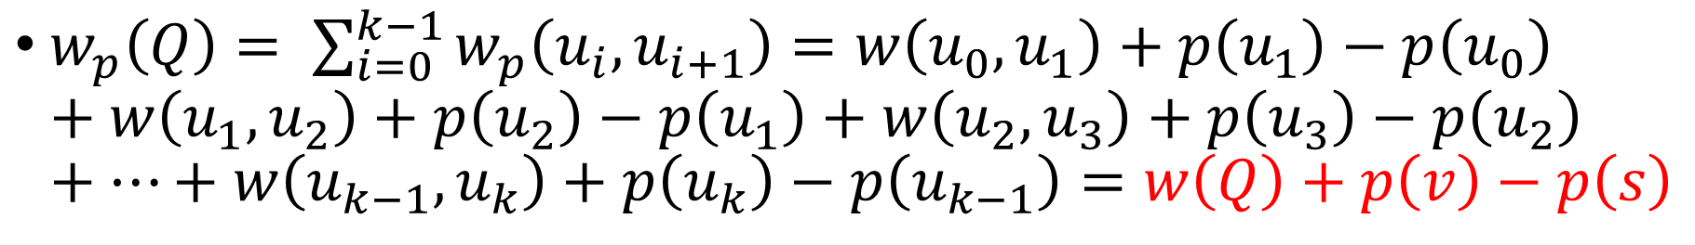




We can think of this modification as follows
$w_{p}\left(u,v\right)=w\left(u,v\right)+p\left(v\right)−p(u)$, $p=p_{t}$
$$Q$$
s
$$u_{1}$$
$$u_{k−1}$$
$$v$$
$w_{p}\left(Q\right)= \sum_{i=0}^{k−1}{w_{p}\left(u_{i},u_{i+1}\right)=w\left(u_{0},u_{1}\right)+p\left(u_{1}\right)−p\left(u_{0}\right) }+w\left(u_{1},u_{2}\right)+p\left(u_{2}\right)−p\left(u_{1}\right)+w\left(u_{2},u_{3}\right)+p\left(u_{3}\right)−p\left(u_{2}\right)+⋯+w\left(u_{k−1},u_{k}\right)+p\left(u_{k}\right)−p\left(u_{k−1}\right)=w\left(Q\right)+p\left(v\right)−p\left(s\right)$

Slide 5

Feasible potential
If $w_{p}\left(u,v\right)=w\left(u,v\right)+p\left(v\right)−p\left(u\right)≥0 ∀(u,v)$ then we say that $p$ is feasible
With feasible potentials we can run Dijkstra, and we will find the shortest path (by $w)$ from $s$ to every vertex

Slide 6

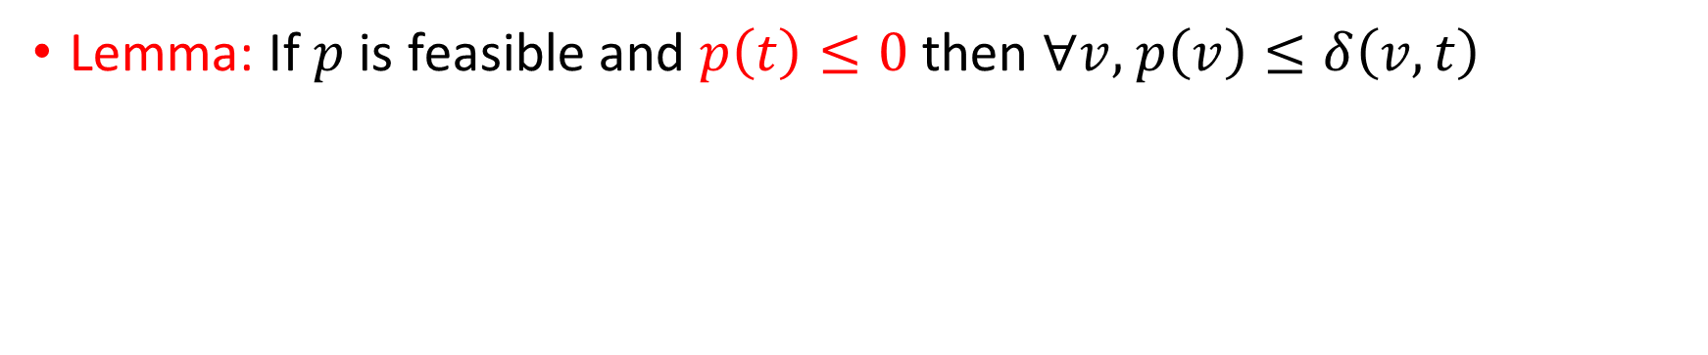

Potentials as lower bounds
Lemma: If $p$ is feasible and $p\left(t\right)≤0$ then $∀v,$ $p\left(v\right)≤δ\left(v,t\right)$
$$Q$$
y
$$u_{1}$$
$$u_{k−1}$$
$$t$$
$$w_{p}\left(Q\right)=w\left(Q\right)+p\left(t\right)−p(y)$$
Proof:
$${0≤w}_{p}\left(Q\right)=w\left(Q\right)+p\left(t\right)−p\left(y\right)≤w\left(Q\right)−p\left(y\right)$$
$$p\left(y\right)≤w\left(Q\right)$$

Slide 7

Making the potential lower bounds
$p′\left(v\right)=p\left(v\right)−p\left(t\right)$
$p′\left(t\right)=0$
$w_{p′}\left(u,v\right)=w\left(u,v\right)+p^{′}\left(v\right)−p^{′}\left(u\right)=w\left(u,v\right)+\left(p\left(v\right)−p\left(t\right)\right)−\left(p\left(u\right)−p\left(t\right)\right)=w\left(u,v\right)+p\left(u\right)−p\left(u\right)≥0$

Slide 8

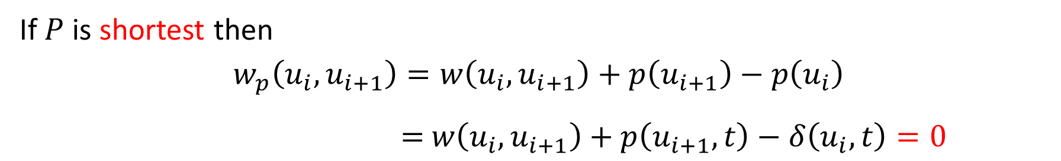




What happens if $p\left(v\right)=δ(v,t)$
$$P$$
s
$$u_{1}$$
$$u_{k−1}$$
$$t$$
If $P$ is shortest then
$w_{p}\left(u_{i},u_{i+1}\right)=w\left(u_{i},u_{i+1}\right)+p\left(u_{i+1}\right)−p\left(u_{i}\right)$
$=$ $w\left(u_{i},u_{i+1}\right)+p\left(u_{i+1},t\right)−δ\left(u_{i},t\right)=0$
Dijkstra will scan this path immediately if there are no other zero cost edges… and will find the shortest path from $s$ to $t$

Slide 9


Geographic potentials
If the graph is embedded in the plane take $p\left(v\right)=\left\|g\left(v\right)−g\left(t\right)\right\|$
Feasible ?
v
u
$$t$$

Slide 10

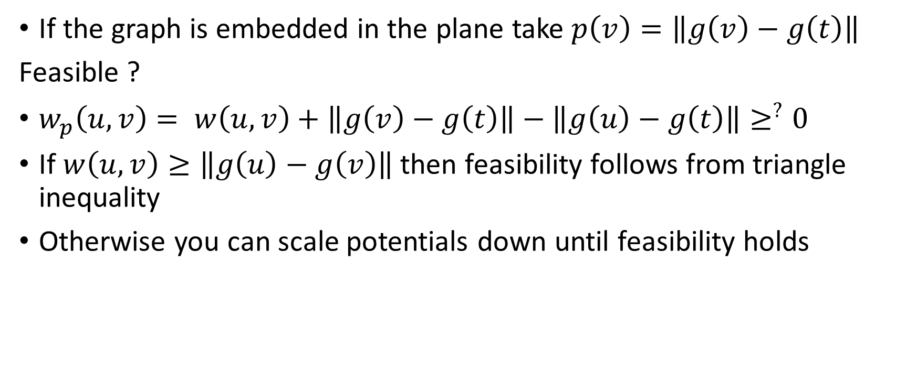
Geographic potentials
If the graph is embedded in the plane take $p\left(v\right)=\left\|g\left(v\right)−g\left(t\right)\right\|$
Feasible ?
$w_{p}\left(u,v\right)= w\left(u,v\right)+\left\|g\left(v\right)−g\left(t\right)\right\|−\left\|g\left(u\right)−g\left(t\right)\right\|≥^{?}0$
If $w\left(u,v\right)≥\left\|g\left(u\right)−g\left(v\right)\right\|$ then feasibility follows from triangle inequality
Otherwise you can scale potentials down until feasibility holds
v
u
$$t$$

Slide 11


Landmarks
Pick a node $ℓ$
Suppose you know or compute $d\left(v,ℓ\right) ∀v$
Define $p\left(v\right)=d\left(v,ℓ\right)−d\left(t,ℓ\right)$
$w_{p}\left(u,v\right)=w\left(u,v\right)+d\left(v,ℓ\right)−d\left(u,ℓ\right)≥0$ (triangle inequality)
v
u
t
$$ℓ$$

Slide 12

A bag of landmarks
Pick nodes $ℓ_{1},…,ℓ_{k}$
Suppose you know or compute $d\left(v,ℓ_{i}\right) ∀v,i$
Define $p\left(v\right)=\max_{i}{d\left(v,ℓ_{i}\right)−d\left(t,ℓ_{i}\right)}$
Check that it is still feasible
v
u
t
$$ℓ$$

Slide 13
Summary
Motivated by navigation apps
There has been many methods developed to speed up p2p shortest path queries
These methods preprocess the graph and store some additional information with it
Theory has also been developed: For which graph classes are these methods good (Highway Hierarchies) ? Analyze the methods on these graph classes

