Slide 1
All pair shortest paths (APSP)
Input: A matrix $W:$
$$W_{uv}=\left\{\begin{matrix}0 & u=v \\ w(u,v) & u≠v and \left(u,v\right)∈E \\ ∞ & u≠v and \left(u,v\right)∉E\end{matrix}\right.$$

Slide 2
All pair shortest paths (APSP)
We want to compute the distance between every pair of vertices
Output is a matrix $D$, $D_{uv}=δ(u,v)$
For the shortest paths themselves we also compute a matrix $Π,$ $Π_{uv}=x$ iff $(x,v)$ is in the shortest path tree rooted by $u$

Slide 3
Floyd-Warshall
A different DP algorithm
Assume $V=\left\{1,⋯,n\right\}$
$F_{uv}^{k}=$ The length of the shortest among paths from u to v with internal vertices from $\left\{1,…,k\right\}$
$$F^{0}=W$$
$$F_{uv}^{k}=\min\left\{F_{uv}^{k−1},F_{uk}^{k−1}+F_{kv}^{k−1}\right\}$$
$D=F^{n}$
Running time: $O\left(n^{3}\right)$

Slide 4
$D=F^{n}$
Running time: $O\left(n^{3}\right)$

Slide 5

Example
3
$$1$$
$$2$$
2
$$3$$
$$F^{0}=W=\left(\begin{matrix}0 & 8 & 5 \\ 3 & 0 & ∞ \\ ∞ & 2 & 0\end{matrix} \right)$$
8
5
5

Slide 6

Example
3
$$1$$
$$2$$
2
$$3$$
$$F^{0}=W=\left(\begin{matrix}0 & 8 & 5 \\ 3 & 0 & ∞ \\ ∞ & 2 & 0\end{matrix} \right)$$
$$F^{1}=\left(\begin{matrix}0 & 8 & 5 \\ 3 & 0 & 8 \\ ∞ & 2 & 0\end{matrix} \right)$$
8
5
5

Slide 7

Example
3
$$1$$
$$2$$
2
$$3$$
$$F^{0}=W=\left(\begin{matrix}0 & 8 & 5 \\ 3 & 0 & ∞ \\ ∞ & 2 & 0\end{matrix} \right)$$
$F^{1}=\left(\begin{matrix}0 & 8 & 5 \\ 3 & 0 & 8 \\ ∞ & 2 & 0\end{matrix} \right)$ ${ F}^{2}=\left(\begin{matrix}0 & 8 & 5 \\ 3 & 0 & 8 \\ 5 & 2 & 0\end{matrix} \right)$
8
5
5

Slide 8

Example
3
$$1$$
$$2$$
2
$$3$$
$$F^{0}=W=\left(\begin{matrix}0 & 8 & 5 \\ 3 & 0 & ∞ \\ ∞ & 2 & 0\end{matrix} \right)$$
$F^{1}=\left(\begin{matrix}0 & 8 & 5 \\ 3 & 0 & 8 \\ ∞ & 2 & 0\end{matrix} \right)$ ${ F}^{2}=\left(\begin{matrix}0 & 8 & 5 \\ 3 & 0 & 8 \\ 5 & 2 & 0\end{matrix} \right)$
$$F^{3}=\left(\begin{matrix}0 & 7 & 5 \\ 3 & 0 & 8 \\ 5 & 2 & 0\end{matrix} \right)$$
8
5
5

Slide 9
Finding the shortest paths
$$Π_{uv}^{0}=\left\{\begin{aligned}nil, u=v or w\left(u,v\right)=∞ \\ u, u≠v or w\left(u,v\right)<∞\end{aligned}\right.$$
$$Π_{uv}^{k}=\left\{\begin{aligned}Π_{uv}^{k−1}, { F}_{uv}^{k−1}≤F_{uk}^{k−1}+F_{kv}^{k−1} \\ Π_{kv}^{k−1},{ F}_{uv}^{k−1}>F_{uk}^{k−1}+F_{kv}^{k−1}\end{aligned}\right.$$
$$Π=Π^{n}$$

Slide 10
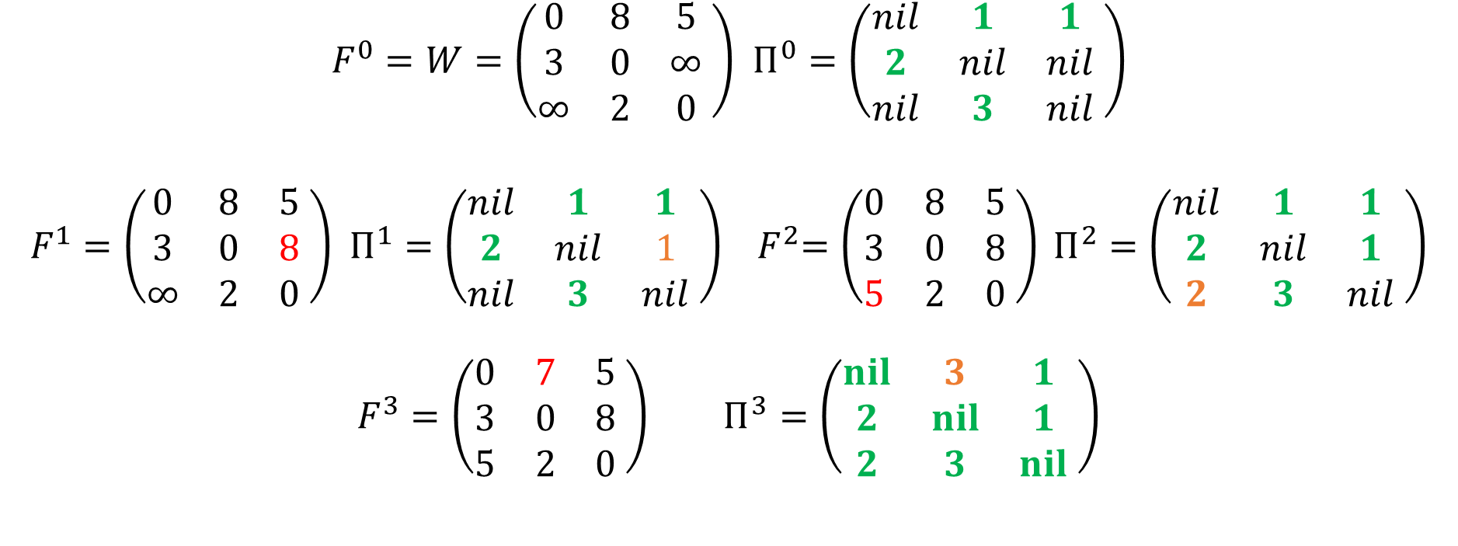
Example
3
$$1$$
$$2$$
2
$$3$$
8
5
$F^{0}=W=\left(\begin{matrix}0 & 8 & 5 \\ 3 & 0 & ∞ \\ ∞ & 2 & 0\end{matrix} \right)$ $Π^{0}=\left(\begin{matrix}nil & 1 & 1 \\ 2 & nil & nil \\ nil & 3 & nil\end{matrix} \right)$
$F^{1}=\left(\begin{matrix}0 & 8 & 5 \\ 3 & 0 & 8 \\ ∞ & 2 & 0\end{matrix} \right)$ $Π^{1}=\left(\begin{matrix}nil & 1 & 1 \\ 2 & nil & 1 \\ nil & 3 & nil\end{matrix} \right)$ ${ F}^{2}=\left(\begin{matrix}0 & 8 & 5 \\ 3 & 0 & 8 \\ 5 & 2 & 0\end{matrix} \right) Π^{2}=\left(\begin{matrix}nil & 1 & 1 \\ 2 & nil & 1 \\ 2 & 3 & nil\end{matrix} \right)$
$$F^{3}=\left(\begin{matrix}0 & 7 & 5 \\ 3 & 0 & 8 \\ 5 & 2 & 0\end{matrix} \right) Π^{3}=\left(\begin{matrix}nil & 3 & 1 \\ 2 & nil & 1 \\ 2 & 3 & nil\end{matrix} \right)$$
5

Slide 11
Summary
Very simple $O\left(n^{3}\right)$ algorithm for APSP
Detecting negative cycles ?

