Slide 1
Dynamic Programming (2)

Slide 2
DP-overview
A technique to speed up a recursive algorithm by storing partial results (tradeoff space for time)
Recipe:
  Start with a recursive algorithm (or definition)
  Identify if it re-computes some quantities (subproblems are shared)
  Avoid recomputation by storing partial results (memorization/caching)

Slide 3

Ex2: Binomial coefficients
Compute $\left({n \atop k}\right)$ ?
Easy recursive algorithm based on $\left({n \atop k}\right)=\left({n−1 \atop k−1}\right)+\left({n−1 \atop k}\right)$
Initial conditions $\left({k \atop k}\right)=1$ and $\left({k \atop 0}\right)=1$ for all $k$

Slide 4
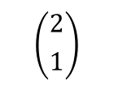
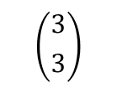
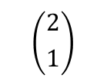
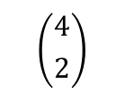
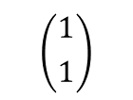
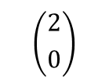
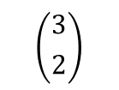

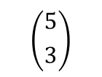
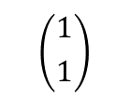
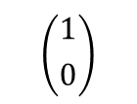
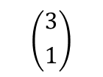
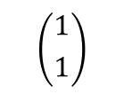
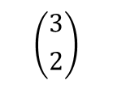
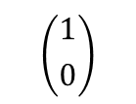
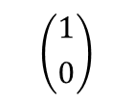
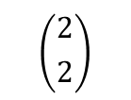
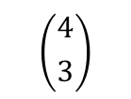
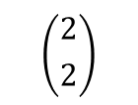
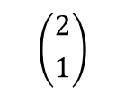
The tree of recursive calls
$$\left({5 \atop 3}\right)$$
$$\left({4 \atop 2}\right)$$
$$\left({4 \atop 3}\right)$$
$$\left({3 \atop 1}\right)$$
$$\left({3 \atop 2}\right)$$
$$\left({3 \atop 2}\right)$$
$$\left({3 \atop 3}\right)$$
$$\left({2 \atop 0}\right)$$
$$\left({2 \atop 1}\right)$$
$$\left({2 \atop 1}\right)$$
$$\left({2 \atop 2}\right)$$
$$\left({2 \atop 1}\right)$$
$$\left({2 \atop 2}\right)$$
$$\left({1 \atop 0}\right)$$
$$\left({1 \atop 1}\right)$$
$$\left({1 \atop 0}\right)$$
$$\left({1 \atop 1}\right)$$
$$\left({1 \atop 0}\right)$$
$$\left({1 \atop 1}\right)$$
Number of recursive calls is $O\left(\left({n \atop k}\right)\right)$

Slide 5
The DAG of recursive calls
$$\left({5 \atop 3}\right)$$
$$\left({4 \atop 2}\right)$$
$$\left({4 \atop 3}\right)$$
$$\left({3 \atop 1}\right)$$
$$\left({3 \atop 2}\right)$$
$$\left({3 \atop 3}\right)$$
$$\left({2 \atop 0}\right)$$
$$\left({2 \atop 1}\right)$$
$$\left({2 \atop 2}\right)$$
$$\left({1 \atop 0}\right)$$
$$\left({1 \atop 1}\right)$$
Number of recursive calls is $O\left(n^{2}\right)$

Slide 6
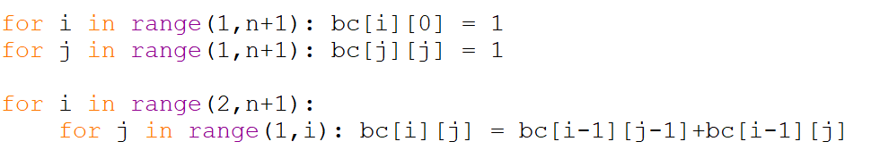
Binomial coefficient bottom-up
Once we understand the subproblems DAG, we can just compute the solutions to all subproblems bottom-up

Slide 7
Ex3: Max Ind. set in weighted paths
3
1
4
1
5
9
2
6
Find a subset of nonadjacent vertices of maximum total weight

Slide 8
A recursive procedure
def ind(k):
if k==1: return v[1]
If k==2: return max{v[1],v[2]}
return max{ ind(k-1) , v[k] + ind(k-2) }

Slide 9
The tree of recursive calls (for Ex1 (Fib))
F(6)
F(5)
F(4)
F(4)
F(3)
F(3)
F(2)
F(3)
F(2)
F(2)
F(1)
F(2)
F(1)
F(2)
F(1)

Slide 10
Our tree of recursive calls
[3,1,4,1,5,9]
I(6)
9
[3,1,4,1,5]
I(5)
[3,1,4,1]
I(4)
5
1
[3,1,4,1]
I(4)
[3,1,4]
I(3)
[3,1,4]
I(3)
[3,1]
I(2)
1
4
4
3
[3,1,4]
I(3)
[3,1]
I(2)
[3,1]
I(2)
[3]
I(1)
[3,1]
I(2)
[3]
I(1)
4
3
3
3
3
[3,1]
I(2)
[3]
I(1)
3
3
$O\left(Φ^{n}\right)$ time

Slide 11
The subproblems DAG
F(6)
F(5)
F(4)
F(3)
F(2)
F(1)

Slide 12
The subproblems DAG
I(6)
I(5)
I(4)
I(3)
I(2)
I(1)

Slide 13
Compute all solutions bottom-up
ind[1] = v[1]
ind[2] = max{v[1],v[2]}
for i in range(3,k): ind[k] = max{ ind[k-1] , v[k] + ind[k-2] }
$O\left(k\right)$ time

