Slide 1
Clustering
Haim Kaplan and Uri Zwick
Algorithms in Action
Tel Aviv University
2016
Last updated: April 30 2018

Slide 2
Metric space
A set $X$ and a function $d:X×X→ℝ^{≥0}$ such that
$$d\left(x,y\right)=0⇔x=y$$
$$d\left(x,y\right)=d(y,x)$$
$$d\left(x,y\right)≤d\left(x,z\right)+d\left(z,y\right)$$

Slide 3
Examples
$$L_{2}: d\left(x,y\right)=\sqrt{{\left(x_{1}−y_{1}\right)}^{2}+{\left(x_{2}−y_{2}\right)}^{2}}$$
$$L_{1}: d\left(x,y\right)=\left|x_{1}−y_{1}\right|+|x_{2}−y_{2}|$$
$$L_{∞}: d\left(x,y\right)=max\left\{\left|x_{1}−y_{1}\right|,|x_{2}−y_{2}|\right\}⁡$$

Slide 4
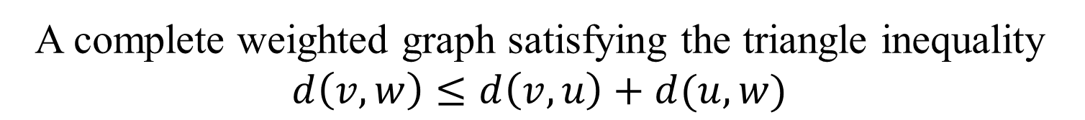
(Finite) Metric space
A complete weighted graph satisfying the triangle inequality $d\left(v,w\right)≤d\left(v,u\right)+d(u,w)$
v
2
1
u
2
w

Slide 5
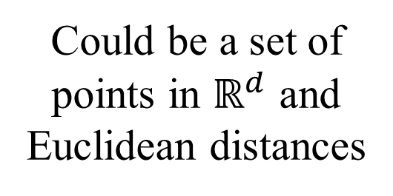
(Discrete) Metric space
A complete weighted graph satisfying the triangle inequality $d\left(v,w\right)≤d\left(v,u\right)+d(u,w)$
Could be a set of points in $ℝ^{d}$ and Euclidean distances
v
2
1
u
2
Could be vertices in a graph and the lengths of the shortest paths between them
w
u
v
w

Slide 6
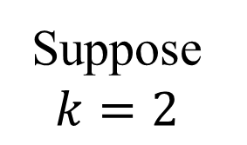
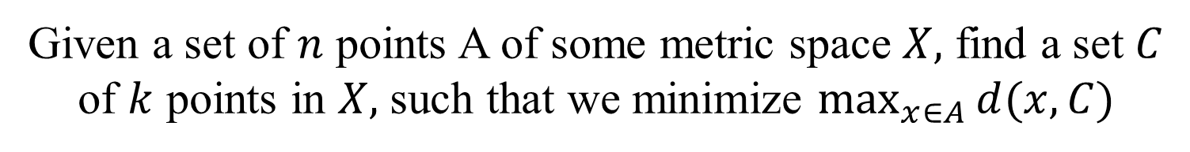
k-centers
Given a set of $n$ points A of some metric space $X,$ find a set $C$ of $k$ points in $X,$ such that we minimize $\max_{x∈A}{d(x,C)}$
Suppose $k=2$

Slide 7
k-centers
Given a set of $n$ points A of some metric space $X,$ find a set $C$ of $k$ points in $X,$ such that we minimize $\max_{x∈A}{d(x,C)}$
Suppose $k=2$

Slide 8
k-centers
Given a set of $n$ points A of some metric space $X,$ find a set $C$ of $k$ points in $X,$ such that we minimize $\max_{x∈A}{d(x,C)}$
Suppose $k=2$

Slide 9
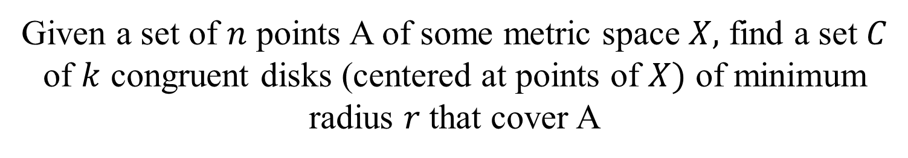
k-centers (alt. formulation)
Given a set of $n$ points A of some metric space $X,$ find a set $C$ of $k$ congruent disks (centered at points of $X)$ of minimum radius $r$that cover A

Slide 10
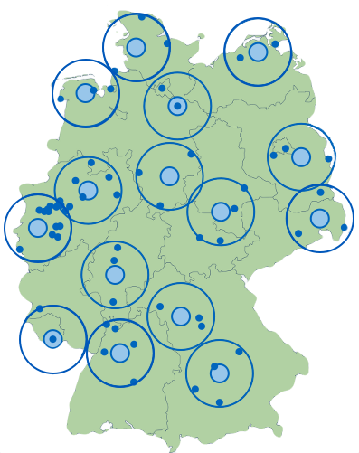
Another example

Slide 11
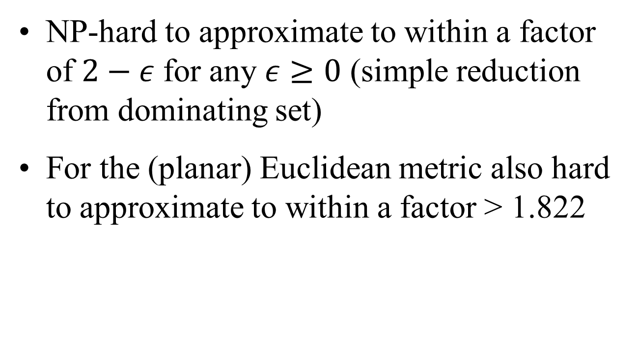
k-centers
NP-hard to approximate to within a factor of $2−ε$ for any $ε≥0$ (simple reduction from dominating set)
For the (planar) Euclidean metric also hard to approximate to within a factor > 1.822

Slide 12

Farthest fit
Pick an arbitrary point $x_{1}$ as the first center
Pick the point farthest away from $x_{1}$ as the second center $x_{2}$

Slide 13

Farthest fit
Pick an arbitrary point $x_{1}$ as the first center
For $j=2…k$ pick $x_{j}$ to be the point which is farthest away from $x_{1},…,x_{j−1}$

Slide 14
Example

Slide 15
Example

Slide 16
Example

Slide 17
Example

Slide 18
Example

Slide 19

Example
$$r$$

Slide 20
What can we say about this ?
Theorem: $OPT≥\frac{r}{2}$
$$r$$

Slide 21



Proof
Theorem: $OPT≥\frac{r}{2}$
$$≥r$$
$$r$$
$$≥r$$
$$≥r$$

Slide 22

Proof
Theorem: $OPT≥\frac{r}{2}$
$$≥r$$

Slide 23


Proof
Theorem: $OPT≥\frac{r}{2}$
$$≥r$$
$$≥r$$
$$≥r$$

Slide 24



Proof
Theorem: $OPT≥\frac{r}{2}$
$$≥r$$
$$≥r$$
$$≥r$$
$$≥r$$
$$≥r$$
$$≥r$$

Slide 25
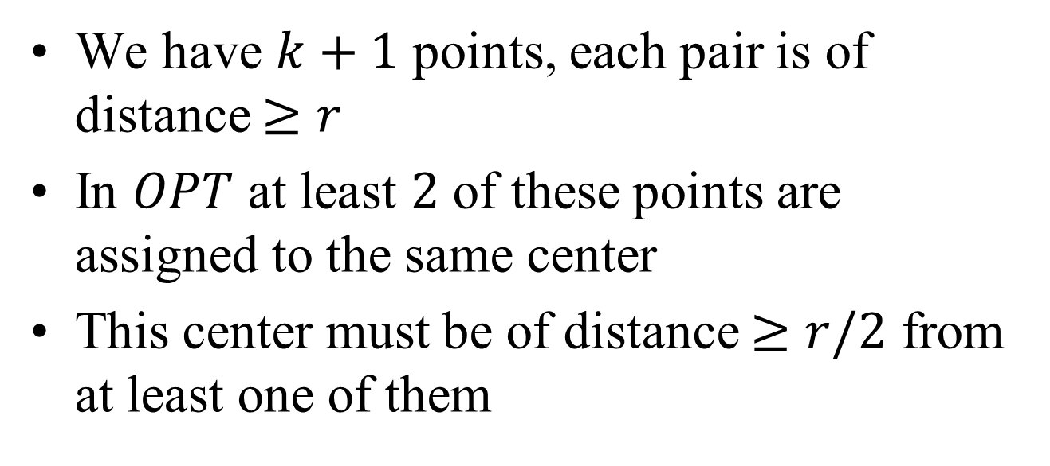

Proof
Theorem: $OPT≥\frac{r}{2}$
We have $k+1$ points, each pair is of distance $≥r$
In $OPT$ at least $2$ of these points are assigned to the same center
This center must be of distance $≥r/2$ from at least one of them
$$≥r$$

Slide 26
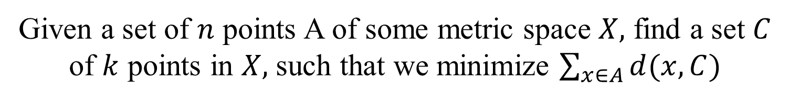
k-medians
Given a set of $n$ points A of some metric space $X,$ find a set $C$ of $k$ points in $X,$ such that we minimize $\sum_{x∈A}{d(x,C)}$
Suppose $k=2$

Slide 27
k-medians
Given a set of $n$ points A of some metric space $X,$ find a set $C$ of $k$ points in $X,$ such that we minimize $\sum_{x∈A}{d(x,C)}$
Suppose $k=2$

Slide 28
k-medians
Given a set of $n$ points A of some metric space $X,$ find a set $C$ of $k$ points in $X,$ such that we minimize $\sum_{x∈A}{d(x,C)}$
Suppose $k=2$

Slide 29
k-medians
Given a set of $n$ points A of some metric space $X,$ find a set $C$ of $k$ points in $X,$ such that we minimize $\sum_{x∈A}{d(x,C)}$
Suppose $k=2$

Slide 30
1-median on the line
The median
Where is the point that minimizes the sum of the distances ?

Slide 31
1-median on the line
All points here are 1-medians
Where is the point that minimizes the sum of the distances ?
In higher dimension its not related to the median anymore but we still use the name “k-median”

Slide 32
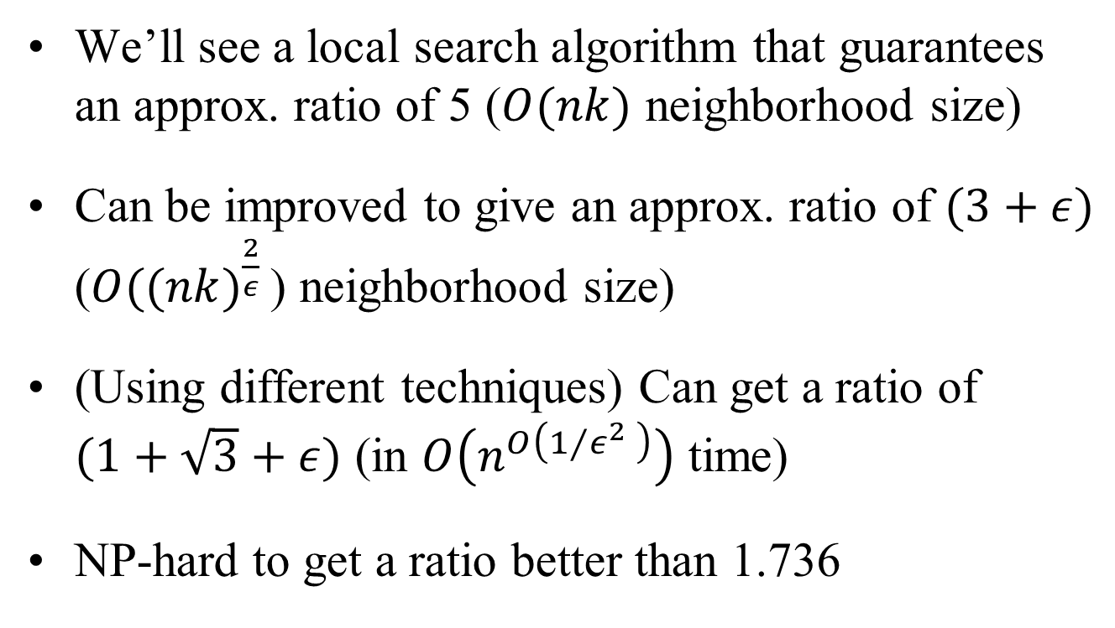
k-medians
We’ll see a local search algorithm that guarantees an approx. ratio of 5 ($O(nk)$ neighborhood size)
Can be improved to give an approx. ratio of $(3+ε)$ ($O(({nk)}^{\frac{2}{ε} }$) neighborhood size)
(Using different techniques) Can get a ratio of
$(1+\sqrt{3}+ε)$ (in $O\left(n^{O\left(1⁄ε^{2} \right)}\right)$ time)
NP-hard to get a ratio better than 1.736

Slide 33

Local search for k-medians
Start with an arbitrary set of $k$ centers
Swap a center with some point which is not a center if the sum of the distances decreases.
Notes:
Arya,Garg,Khandekar,Meyerson,Munagala, Pandit, Local search heuristics for facility location problems, SICOMP 2004
Gupta, Tangwongsam, Simpler analysis of local search algorithms, 2008

Slide 34
Analysis
o₁
o₂
o₃
o₄
The closest facility in Local for each facility in $OPT$

Slide 35
Analysis
o₁
o₂
o₃
o₄
Lets assume for simplicity that this is a matching

Slide 36
Analysis
o₁
o₂
o₃
o₄
Consider the swaps defined by this matching

Slide 37
Analysis
o₁
o₂
o₃
o₄
$$0≤cost\left(L− + o_{2}\right)−cost(L)≤ ?$$

Slide 38
Analysis
o₁
o₂
o₃
o₄
$$0≤cost\left(L− + o_{2}\right)−cost(L)≤ ?$$

Slide 39
Analysis
o₁
o₂
o₃
o₄
$$0≤cost\left(L− + o_{2}\right)−cost(L)≤ ?$$

Slide 40
Analysis
o₁
o₂
o₃
o₄
$$0≤cost\left(L− + o_{2}\right)−cost(L)≤ ?$$

Slide 41
Analysis
o₁
o₂
o₃
o₄
$$0≤cost\left(L− + o_{2}\right)−cost(L)≤ ?$$

Slide 42
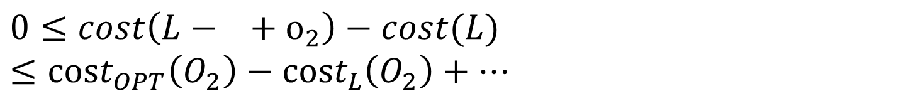
Analysis
o₁
o₂
$$O_{2}$$
o₃
o₄
$$0≤cost\left(L− + o_{2}\right)−cost(L)≤cost_{OPT}\left(O_{2}\right)−cost_{L}\left(O_{2}\right)+…$$

Slide 43


Analysis
o₁
$$N$$
$$A$$
o₂
$$O_{2}$$
o₃
o₄
$$N−A$$

Slide 44


Analysis
$$C$$
$$B$$
o₁
$$N$$
$$A$$
o₂
$$O_{2}$$
o₃
o₄
$$N−A≤B+C−A$$

Slide 45



Analysis
$$C$$
$$B$$
o₁
$$N$$
$$D$$
$$A$$
o₂
$$O_{2}$$
o₃
o₄
$$N−A≤B+C−A≤B+D−A$$

Slide 46
Analysis
$$C$$
$$B$$
o₁
$$N$$
$$D$$
$$A$$
o₂
$$O_{2}$$
o₃
o₄
$$N−A≤B+C−A≤B+D−A≤2B$$

Slide 47
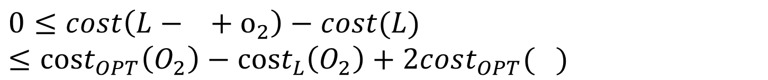
Analysis
o₁
o₂
$$O_{2}$$
o₃
o₄
$$0≤cost\left(L− + o_{2}\right)−cost(L)≤cost_{OPT}\left(O_{2}\right)−cost_{L}\left(O_{2}\right)+2cost_{OPT}( )$$

Slide 48
Analysis
o₁
o₂
o₃
o₄
$$0≤cost\left(L− + o_{1}\right)−cost(L)≤ ?$$

Slide 49
Analysis
o₁
o₂
o₃
o₄
$$0≤cost\left(L− + o_{1}\right)−cost(L)≤ ?$$

Slide 50
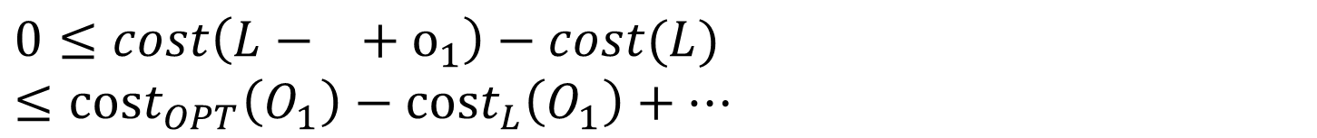
Analysis
o₁
$$O_{1}$$
o₂
o₃
o₄
$$0≤cost\left(L− + o_{1}\right)−cost(L)≤cost_{OPT}\left(O_{1}\right)−cost_{L}\left(O_{1}\right)+…$$

Slide 51
Analysis
o₁
$$O_{1}$$
o₂
o₃
o₄
$$0≤cost\left(L− + o_{1}\right)−cost(L)≤cost_{OPT}\left(O_{1}\right)−cost_{L}\left(O_{1}\right)+…$$

Slide 52
Analysis
o₁
$$O_{1}$$
o₂
o₃
o₄
$$0≤cost\left(L− + o_{1}\right)−cost(L)≤cost_{OPT}\left(O_{1}\right)−cost_{L}\left(O_{1}\right)+…$$

Slide 53
Analysis
o₁
$$O_{1}$$
o₂
o₃
o₄
$$0≤cost\left(L− + o_{1}\right)−cost(L)≤cost_{OPT}\left(O_{1}\right)−cost_{L}\left(O_{1}\right)+…$$

Slide 54
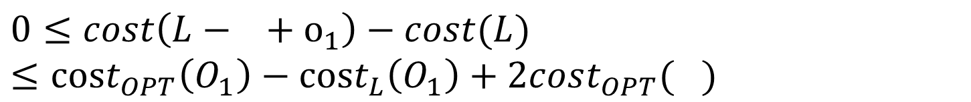
Analysis
o₁
$$O_{1}$$
o₂
o₃
o₄
$$0≤cost\left(L− + o_{1}\right)−cost(L)≤cost_{OPT}\left(O_{1}\right)−cost_{L}\left(O_{1}\right)+2cost_{OPT}( )$$

Slide 55
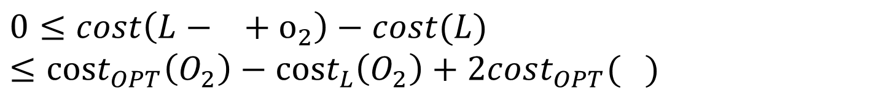
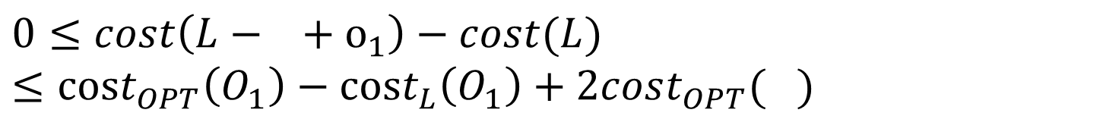


Analysis
$$0≤cost\left(L− + o_{2}\right)−cost(L)≤cost_{OPT}\left(O_{2}\right)−cost_{L}\left(O_{2}\right)+2cost_{OPT}( )$$
+
$$0≤cost\left(L− + o_{1}\right)−cost(L)≤cost_{OPT}\left(O_{1}\right)−cost_{L}\left(O_{1}\right)+2cost_{OPT}( )$$
$$……………$$
$$L≤3OPT$$

Slide 56
Analysis
o₁
o₂
o₃
o₄
What happens if this is not a matching ?

Slide 57
Analysis
o₁
o₂
o₃
o₄
Which swaps do we consider ?

Slide 58
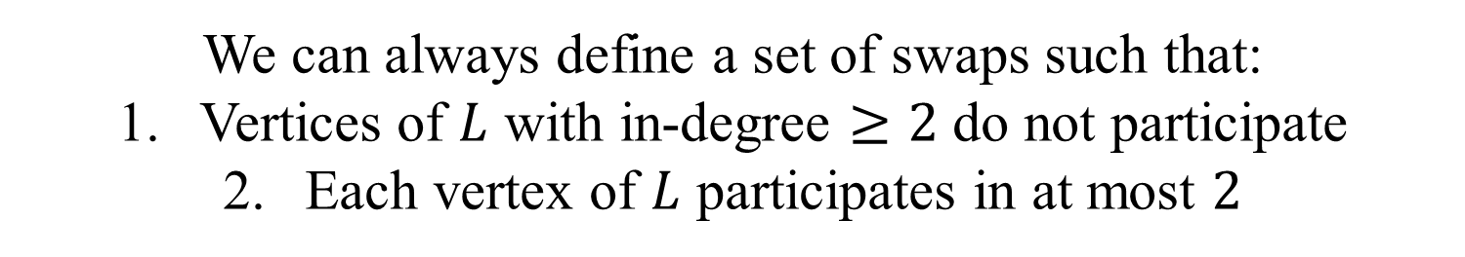
Analysis
o₁
o₂
o₃
o₄
We can always define a set of swaps such that:
Vertices of $L$ with in-degree $≥2$ do not participate
Each vertex of $L$ participates in at most $2$

Slide 59
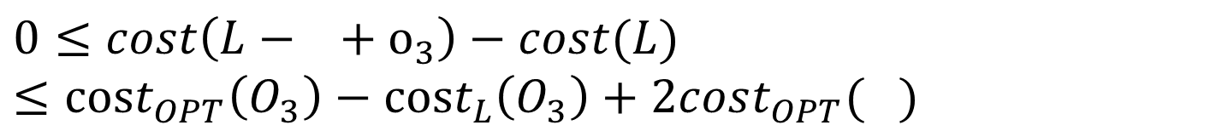
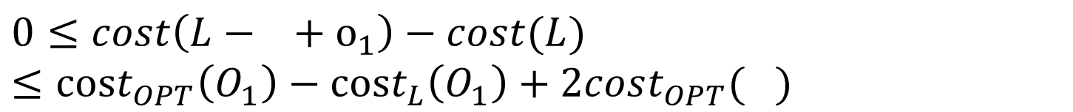
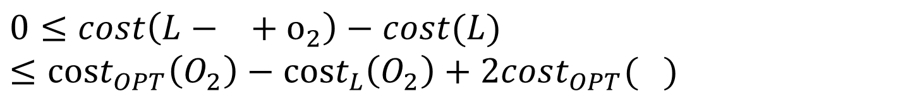
Analysis
$$0≤cost\left(L− + o_{3}\right)−cost(L)≤cost_{OPT}\left(O_{3}\right)−cost_{L}\left(O_{3}\right)+2cost_{OPT}( )$$
+
$$0≤cost\left(L− + o_{1}\right)−cost(L)≤cost_{OPT}\left(O_{1}\right)−cost_{L}\left(O_{1}\right)+2cost_{OPT}( )$$
$$0≤cost\left(L− + o_{2}\right)−cost(L)≤cost_{OPT}\left(O_{2}\right)−cost_{L}\left(O_{2}\right)+2cost_{OPT}( )$$
o₁
o₂
o₃
o₄

Slide 60
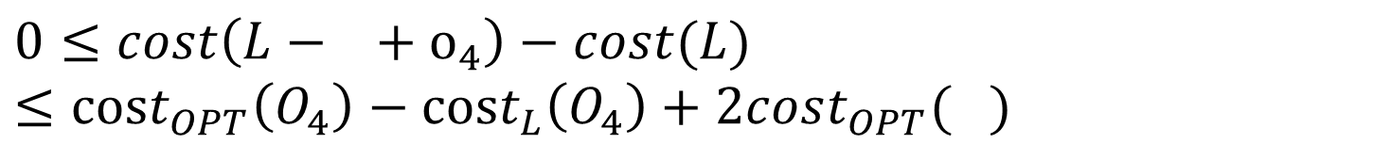

Analysis
$$0≤cost\left(L− + o_{3}\right)−cost(L)≤cost_{OPT}\left(O_{3}\right)−cost_{L}\left(O_{3}\right)+2cost_{OPT}( )$$
+
$$0≤cost\left(L− + o_{1}\right)−cost(L)≤cost_{OPT}\left(O_{1}\right)−cost_{L}\left(O_{1}\right)+2cost_{OPT}( )$$
$$0≤cost\left(L− + o_{2}\right)−cost(L)≤cost_{OPT}\left(O_{2}\right)−cost_{L}\left(O_{2}\right)+2cost_{OPT}( )$$
$$0≤cost\left(L− + o_{4}\right)−cost(L)≤cost_{OPT}\left(O_{4}\right)−cost_{L}\left(O_{4}\right)+2cost_{OPT}( )$$
$$L≤5OPT$$

Slide 61
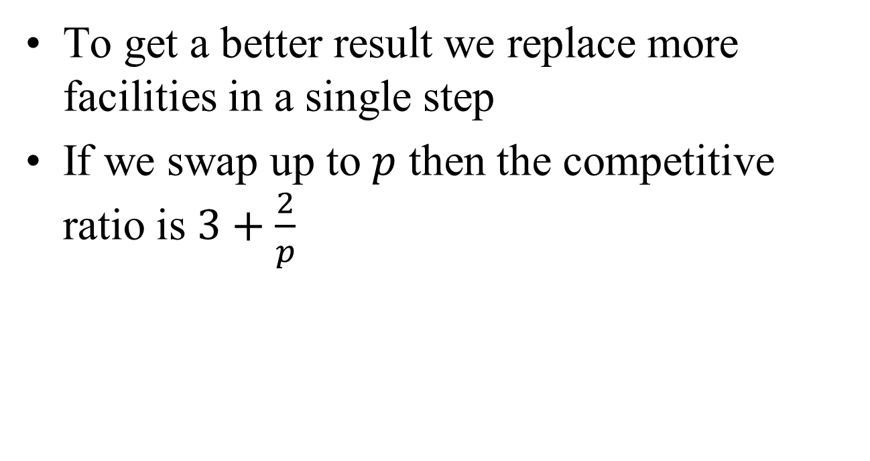
Summary
To get a better result we replace more facilities in a single step
If we swap up to $p$ then the competitive ratio is $3+\frac{2}{p}$

Slide 62
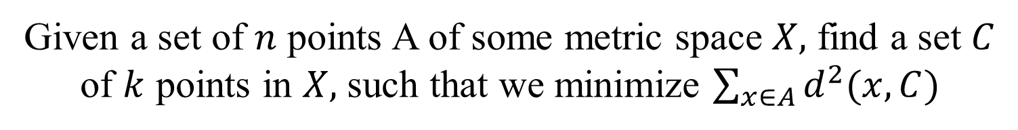
k-means
Given a set of $n$ points A of some metric space $X,$ find a set $C$ of $k$ points in $X,$ such that we minimize $\sum_{x∈A}{d^{2}(x,C)}$

Slide 63






k-means
Given a set of $n$ points A of some metric space $X,$ find a set $C$ of $k$ points in $X,$ such that we minimize $\sum_{x∈A}{d^{2}(x,C)}$
Can we use the previous algorithm ?
We can but the analysis breaks
$d^{2}\left(x,y\right)$ is not a metric
$$1$$
$$1$$
$$d^{2}\left(x,z\right)≥d^{2}\left(x,y\right)+d^{2}(y,z)$$
$x$
$y$
$z$

Slide 64
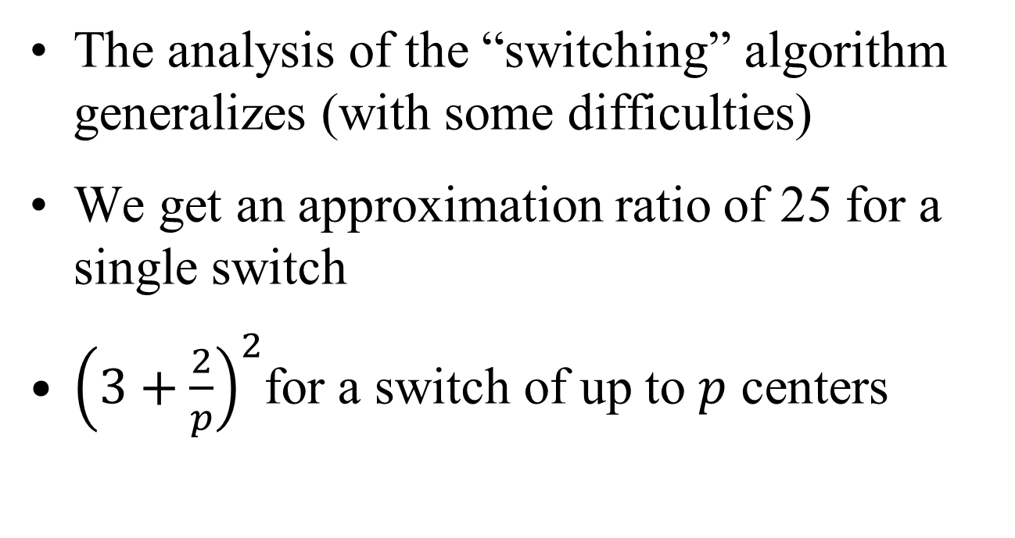
Local search
The analysis of the “switching” algorithm generalizes (with some difficulties)
We get an approximation ratio of 25 for a single switch
${\left(3+\frac{2}{p}\right)}^{2}$for a switch of up to $p$ centers

Slide 65
1-mean on the line
A
Where is the point that minimizes the sum of the squared distances ?
$$\min_{A}{{ \left(x_{1}−A\right)}^{2}+{\left(x_{2}−A\right)}^{2}+…+{\left(x_{7}−A\right)}^{2} ?}$$
$$A=\frac{x_{1}+x_{2}+…+x_{7}}{7}$$

Slide 66
1-mean in Euclidean space of higher dimension
It is the center of mass (mean)
We will focus on the Euclidean metric

Slide 67
2-means in the plane
Fix the partition → to minimize the sum of squared distances each center must be the mean of the points in its cluster

Slide 68
Lloyd’s algorithm
Most frequently used clustering algorithm
Related to the EM (Expectation Maximization) algorithm for learning Gaussians Mixtures Models (GMMs)

Slide 69
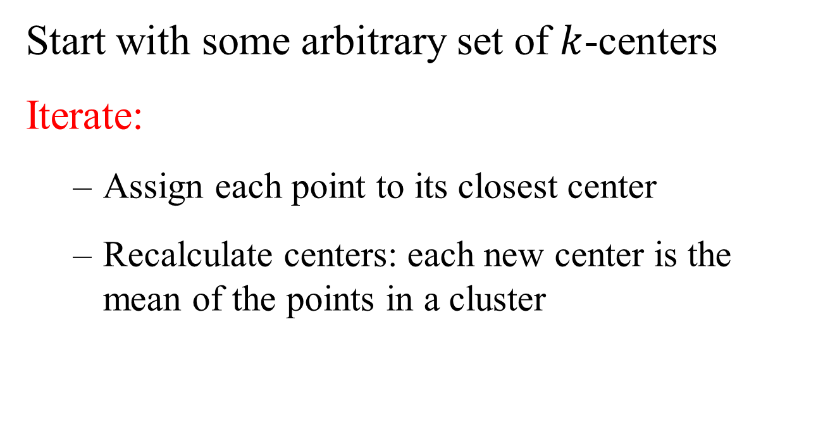
Lloyd’s algorithm
Start with some arbitrary set of $k$-centers
Iterate:
  Assign each point to its closest center
  Recalculate centers: each new center is the mean of the points in a cluster

Slide 70
Example (k=3)

Slide 71
Pick initial centers

Slide 72
Assign each point to its closest center

Slide 73
Replace centers by clusters’ means

Slide 74
Assign each point to its closest center

Slide 75
Replace centers by clusters’ means

Slide 76
Assign each point to its closest center

Slide 77
Replace centers by clusters’ means
No changes → terminate

Slide 78
Properties
Very easy to implement
Sum of squared distances always decreases (like local search)

Slide 79







Quality of the local opt ?
$$k=3$$
$$y$$
$$z$$
$$x$$
$$OPT$$
$$L$$
$$\frac{2\frac{y^{2}}{4}}{2\frac{x^{2}}{4}}=\frac{y^{2}}{x^{2}}$$
Can be made as large as we want

Slide 80
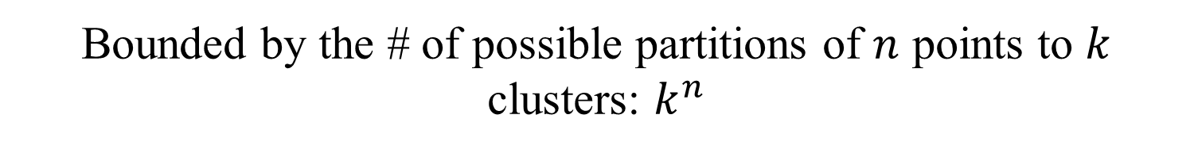
Running time
Each step we have a partition of the points -- by the closest center
We cannot repeat a partition in 2 different iterations
Bounded by the # of possible partitions of $n$ points to $k$ clusters: $k^{n}$
Is this tight ? Say for $k=2$ ?

Slide 81

Voronoi diagram
The Voronoi diagram of a set of points $p_{1},p_{2},…,p_{n}$ is a partition of the plane to $n$ cells, cell $i$ contains all points closest to $p_{i}$

Slide 82
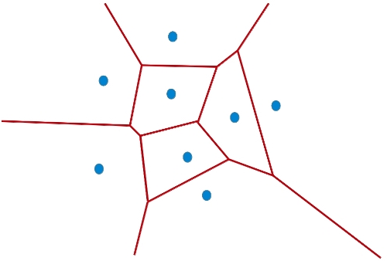
Voronoi diagram

Slide 83
Voronoi partition
There exist centers such that the partition is consistent with their Voronoi diagram
Each part consists of all points in the Voronoi cell of a center (Voronoi partition)

Slide 84
Assign each point to its closest center

Slide 85


Voronoi partitions of 2-centers
Is this a Voronoi partition ?
$$c_{1}$$
$$c_{2}$$

Slide 86
Voronoi partitions of 2-centers
This is not a Voronoi partition

Slide 87
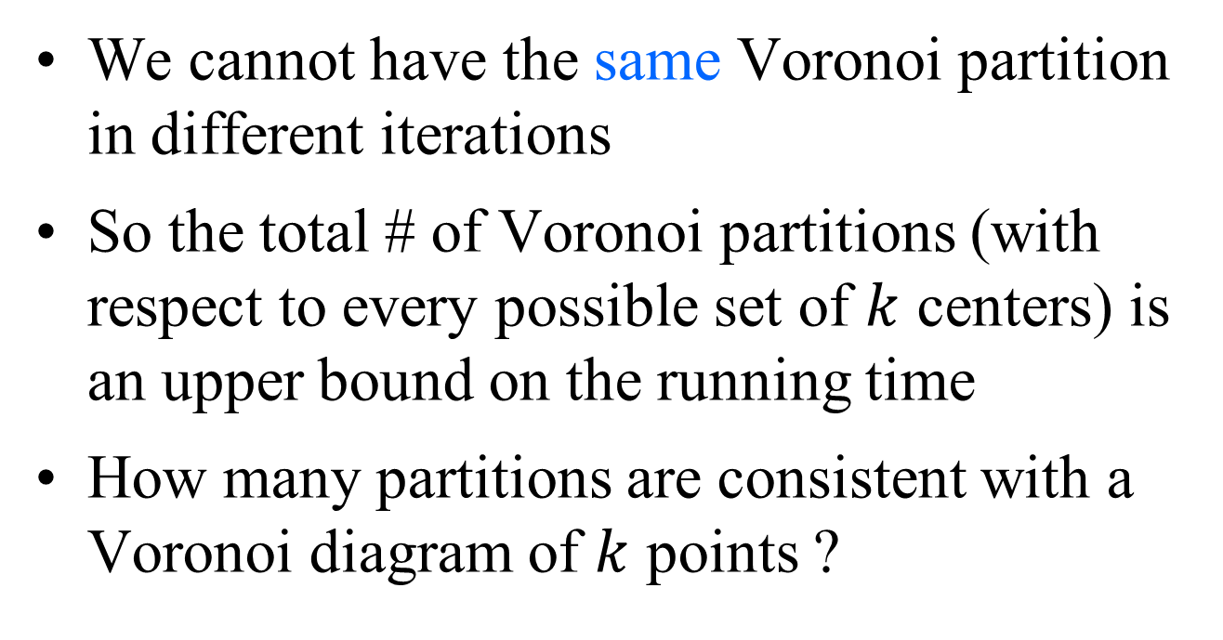
Voronoi partition
We cannot have the same Voronoi partition in different iterations
So the total # of Voronoi partitions (with respect to every possible set of $k$ centers) is an upper bound on the running time
How many partitions are consistent with a Voronoi diagram of $k$ points ?

Slide 88
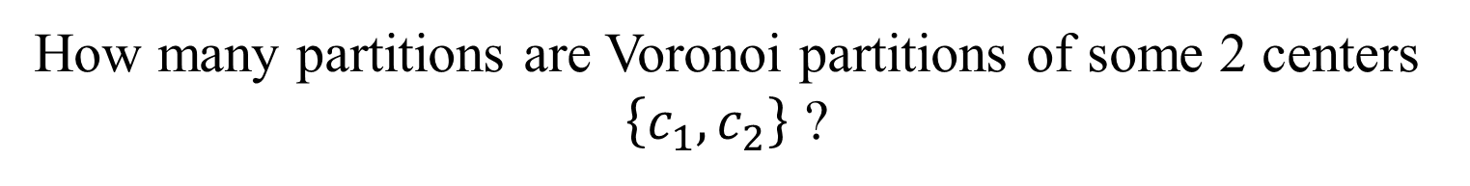
Voronoi partitions of 2-centers
How many partitions are Voronoi partitions of some 2 centers $\left\{c_{1},c_{2}\right\}$ ?
$$c_{1}$$
$$c_{2}$$

Slide 89
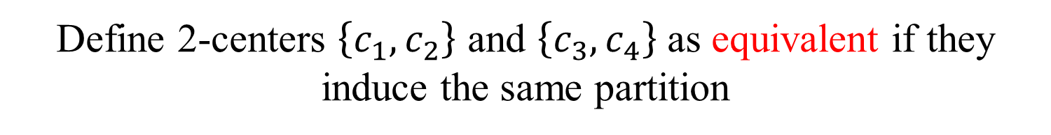
Voronoi partitions
Define 2-centers $\left\{c_{1},c_{2}\right\}$ and $\left\{c_{3},c_{4}\right\}$ as equivalent if they induce the same partition

Slide 90



Voronoi partitions
Here is a pair of equivalent 2 centers
$$c_{1}$$
$$c_{3}$$
$$c_{4}$$
$$c_{2}$$

Slide 91
Counting Voronoi partitions
The number of equivalence classes of this relation equals to the number of Voronoi partitions
So we want an upper bound on the number of equivalence classes of this relation

Slide 92
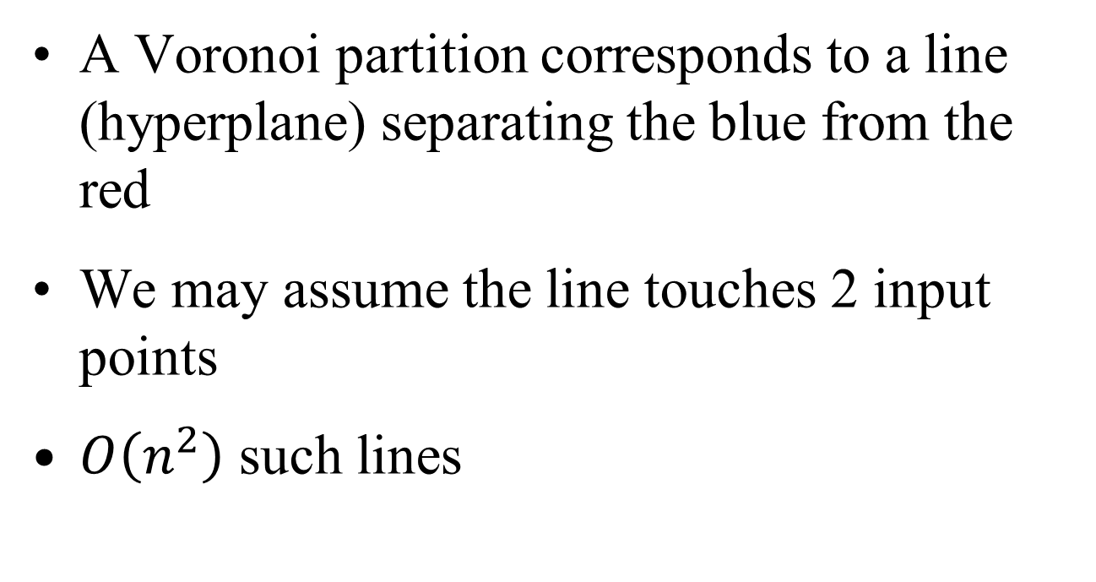
2 centers
A Voronoi partition corresponds to a line (hyperplane) separating the blue from the red
We may assume the line touches 2 input points
$O\left(n^{2}\right)$ such lines

Slide 93
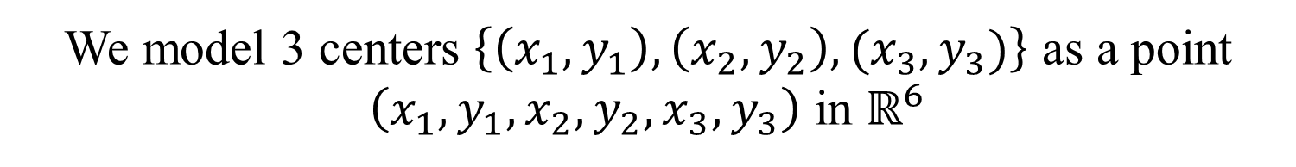
General technique
We model 3 centers $\left\{\left(x_{1},y_{1}\right),\left(x_{2},y_{2}\right),(x_{3},y_{3})\right\}$ as a point $\left(x_{1},y_{1},x_{2},y_{2},x_{3},y_{3}\right)$ in $ℝ^{6}$

Slide 94
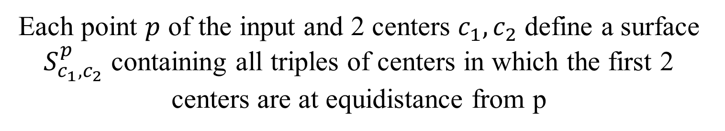
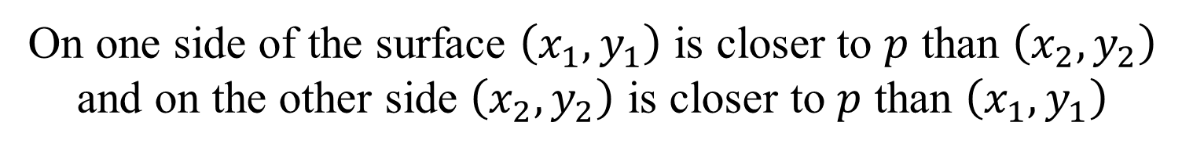
Counting Voronoi partitions
Each point $p$ of the input and 2 centers $c_{1},c_{2}$ define a surface $S_{c_{1},c_{2}}^{p}$ containing all triples of centers in which the first 2 centers are at equidistance from p
$S_{c_{1},c_{2}}^{p}$ consists of all points$\left(x_{1},y_{1},x_{2},y_{2},x_{3},y_{3}\right)$ in $ℝ^{6}$ that satisfy:
$${\left(p_{x}−x_{1}\right)}^{2}+{\left(p_{y}−y_{1}\right)}^{2}={\left(p_{x}−x_{2}\right)}^{2}+{\left(p_{y}−y_{2}\right)}^{2}$$
On one side of the surface $\left(x_{1},y_{1}\right)$ is closer to $p$ than $\left(x_{2},y_{2}\right)$ and on the other side $\left(x_{2},y_{2}\right)$ is closer to $p$ than $\left(x_{1},y_{1}\right)$

Slide 95
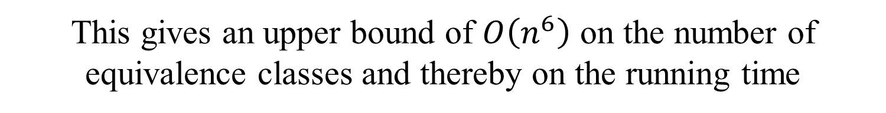
Counting Voronoi partitions
We get $n\left({3 \atop 2}\right)$surfaces, one per a point in the input and 2 centers
These surfaces partition $ℝ^{6}$ into $O\left(n^{6}\right)$ cells
In a cell the relative order of each point from all centers is fixed
All points in a cell correspond to equivalent centers
This gives an upper bound of $O\left(n^{6}\right)$ on the number of equivalence classes and thereby on the running time

Slide 96


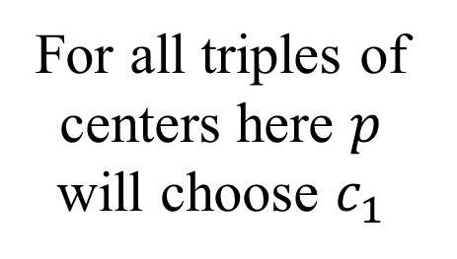
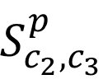
Counting Voronoi partitions
$$S_{c_{1},c_{3}}^{p}$$
$$S_{c_{1},c_{2}}^{p}$$
For all triples of centers here $p$ will choose $c_{1}$
$$S_{c_{2},c_{3}}^{p}$$

Slide 97
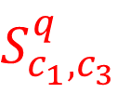

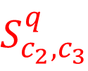
Counting Voronoi partitions
$$S_{c_{1},c_{3}}^{q}$$
$$S_{c_{1},c_{2}}^{q}$$
$$S_{c_{2},c_{3}}^{q}$$

Slide 98
Counting Voronoi partitions

Slide 99
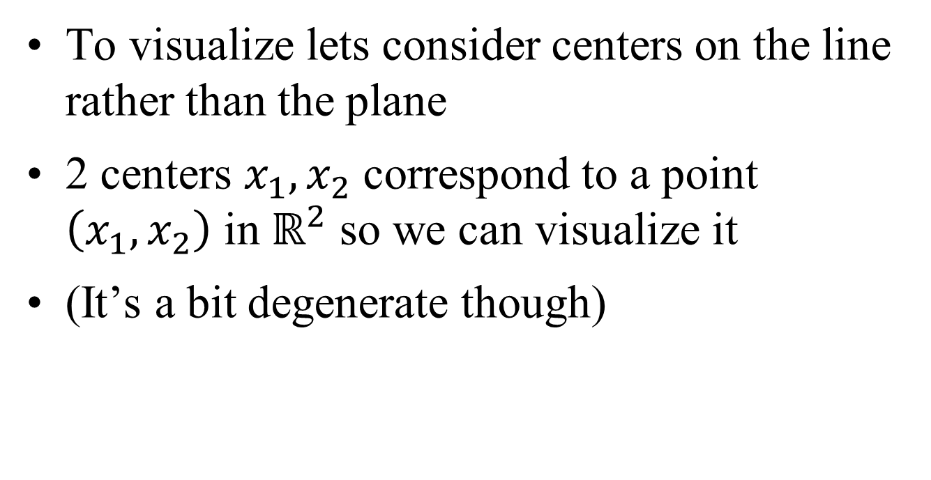
2-centers on the line
To visualize lets consider centers on the line rather than the plane
2 centers $x_{1},x_{2}$ correspond to a point $\left(x_{1},x_{2}\right)$ in $ℝ^{2}$ so we can visualize it
(It’s a bit degenerate though)

Slide 100

Example on the line
$$0$$

Slide 101
Example on the line
$$0$$

Slide 102
Example on the line

Slide 103
Example on the line

Slide 104

Voronoi partitions
This argument works for any $k$ and $d$
We get that the complexity is $O\left({\left(n\left({k \atop 2}\right)\right)}^{kd}\right)$

Slide 105
Summary
Very powerful in practice – one of the most common clustering algorithms
A lot of effort has been made to speed it up

Slide 106

Speeding up using triangle inequality
Each iteration we compute $nk$ distances
How do we reduce the # of distances that we compute ?

Slide 107


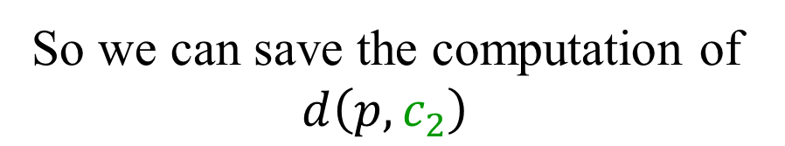

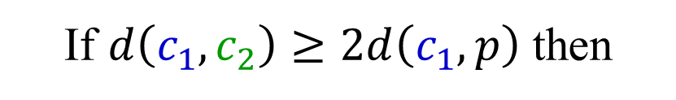
Speeding up using triangle inequality (ver 1)
At the beginning of an iteration compute all distances between centers
If $d\left(c_{1},c_{2}\right)≥2d\left(c_{1},p\right)$ then
$$d\left(c_{1},p\right)≤d\left(p,c_{2}\right)$$
So we can save the computation of $d\left(p,c_{2}\right)$
p
$$d\left(c_{1},c_{2}\right)≤d\left(c_{1},p\right)+d\left(p,c_{2}\right)$$
$$d\left(c_{1},c_{2}\right)−d\left(c_{1},p\right)≤d\left(p,c_{2}\right)$$

Slide 108
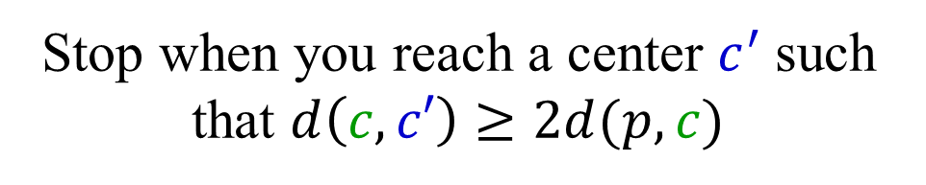
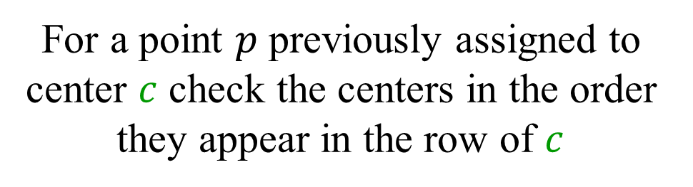
Speeding up using triangle inequality (ver 2)
At the beginning of an iteration compute all distances between centers
Sort each row of this distance matrix
For a point $p$ previously assigned to center $c$ check the centers in the order they appear in the row of $c$
Stop when you reach a center $c^{′}$such that $d\left(c,c′\right)≥2d(p,c)$

Slide 109
Results
A data set from a satellite image: 2370686 points, each has 6 brightness levels

Slide 110
Results
Average number of comparisons per point per iteration

Slide 111
Results
Total running time

Slide 112
Results
Average # of comparisons per point in all iterations and in the last iteration

