Slide 1
Bayes Nash Implementation
TexPoint fonts used in EMF.
Read the TexPoint manual before you delete this box.: AAAAAAAA

Slide 2
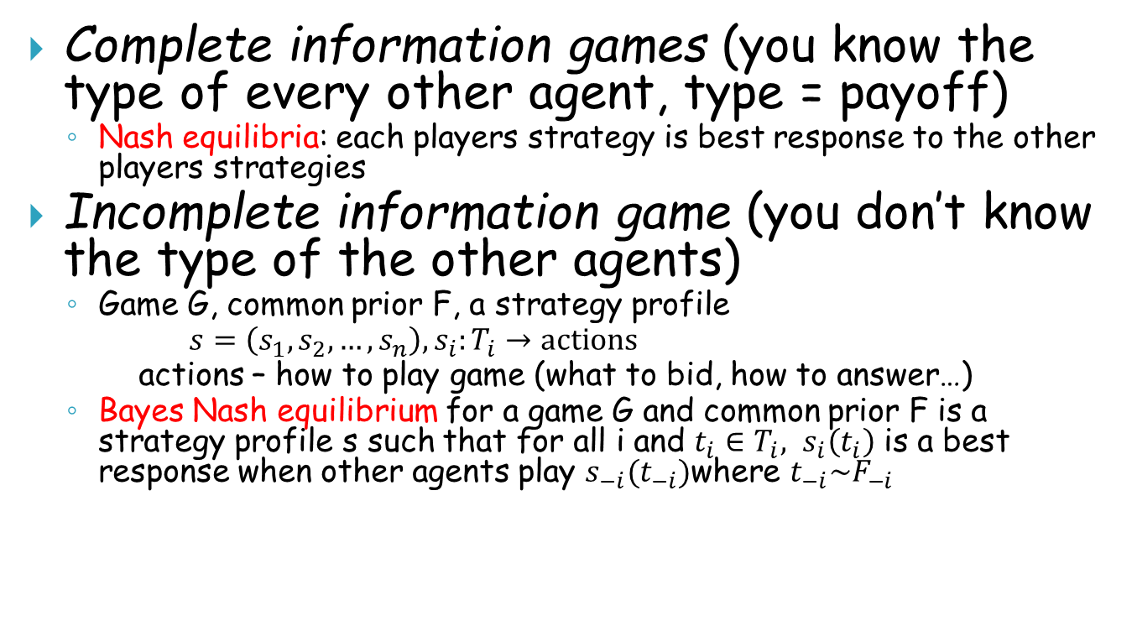
Complete vs. Incomplete
Complete information games (you know the type of every other agent, type = payoff)
  Nash equilibria: each players strategy is best response to the other players strategies
Incomplete information game (you don’t know the type of the other agents)
  Game G, common prior F, a strategy profile
  $s=\left(s_{1},s_{2},…, s_{n}\right), s_{i}:T_{i}→\text{actions}$
  actions – how to play game (what to bid, how to answer…)
  Bayes Nash equilibrium for a game G and common prior F is a strategy profile s such that for all i and $t_{i}∈T_{i},$ $s_{i}\left(t_{i}\right)$ is a best response when other agents play $s_{−i}(t_{−i})$where $t_{−i}\sim F_{−i}$

Slide 3
Bayes Nash Implementation
There is a distribution D_{i} on the types T_{i} of Player i
It is known to everyone
The actual type of agent i, t_{i} 2_{Di}T_{i} is the private information i knows
A profile of strategis s_{i} is a Bayes Nash Equilibrium if for i all t_{i} and all t’_{i}
E_{d-i}[u_{i}(t_{i}, s_{i}(t_{i}), s_{-i}(t_{-i}) )] ¸ E_{d-i}[u_{i}(t’_{i}, s_{-i}(t_{-i})) ]

Slide 4
Bayes Nash: First Price Auction
First price auction for a single item with two players.
Private values (types) t₁ and t₂ in T₁=T₂=[0,1]
Does not make sense to bid true value – utility 0.
There are distributions D₁ and D₂
Looking for s₁(t₁) and s₂(t₂) that are best replies to each other
Suppose both D₁ and D₂ are uniform.
Claim: The strategies s₁(t₁) = t_{i}/2 are in Bayes Nash Equilibrium
t₁
Win half the time
Cannot win

Slide 5
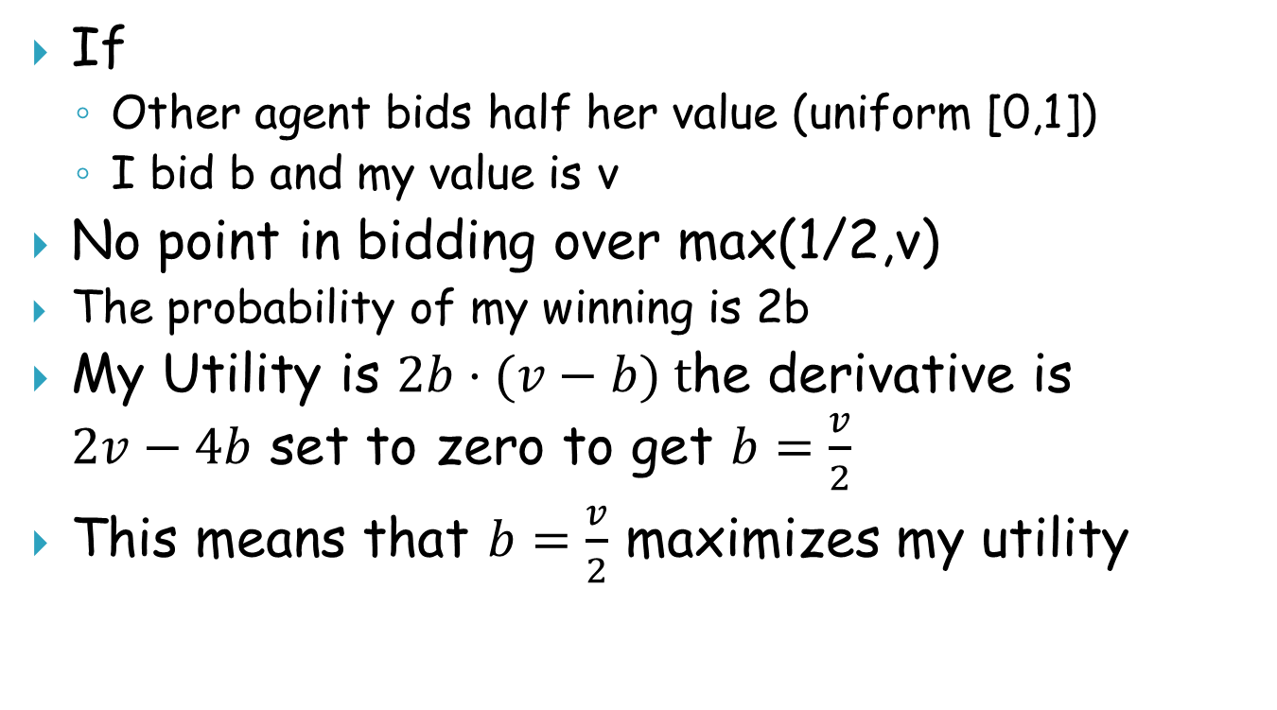
First Price, 2 agents, Uniform [0,1]
If
  Other agent bids half her value (uniform [0,1])
  I bid b and my value is v
No point in bidding over max(1/2,v)
  The probability of my winning is 2b
My Utility is $2b⋅(v−b) t$he derivative is $2v−4b$ set to zero to get $b=\frac{v}{2}$
This means that $b=\frac{v}{2}$ maximizes my utility

Slide 6
Solution concepts for mechanisms and auctions (speical case of mechanisms) (?)
Bayes Nash equilibria (assumes priors)
  Today: characterization
Special case: Dominant strategy equilibria (VCG), problem: over “full domain” with 3 options in range (Arrow? GS? New: Roberts) – only affine maximizers (generalization of VCG) possible.
Implementation in undominated strategies: Not Bayes Nash, not dominant strategy, but assumes that agents are not totally stupid

Slide 7
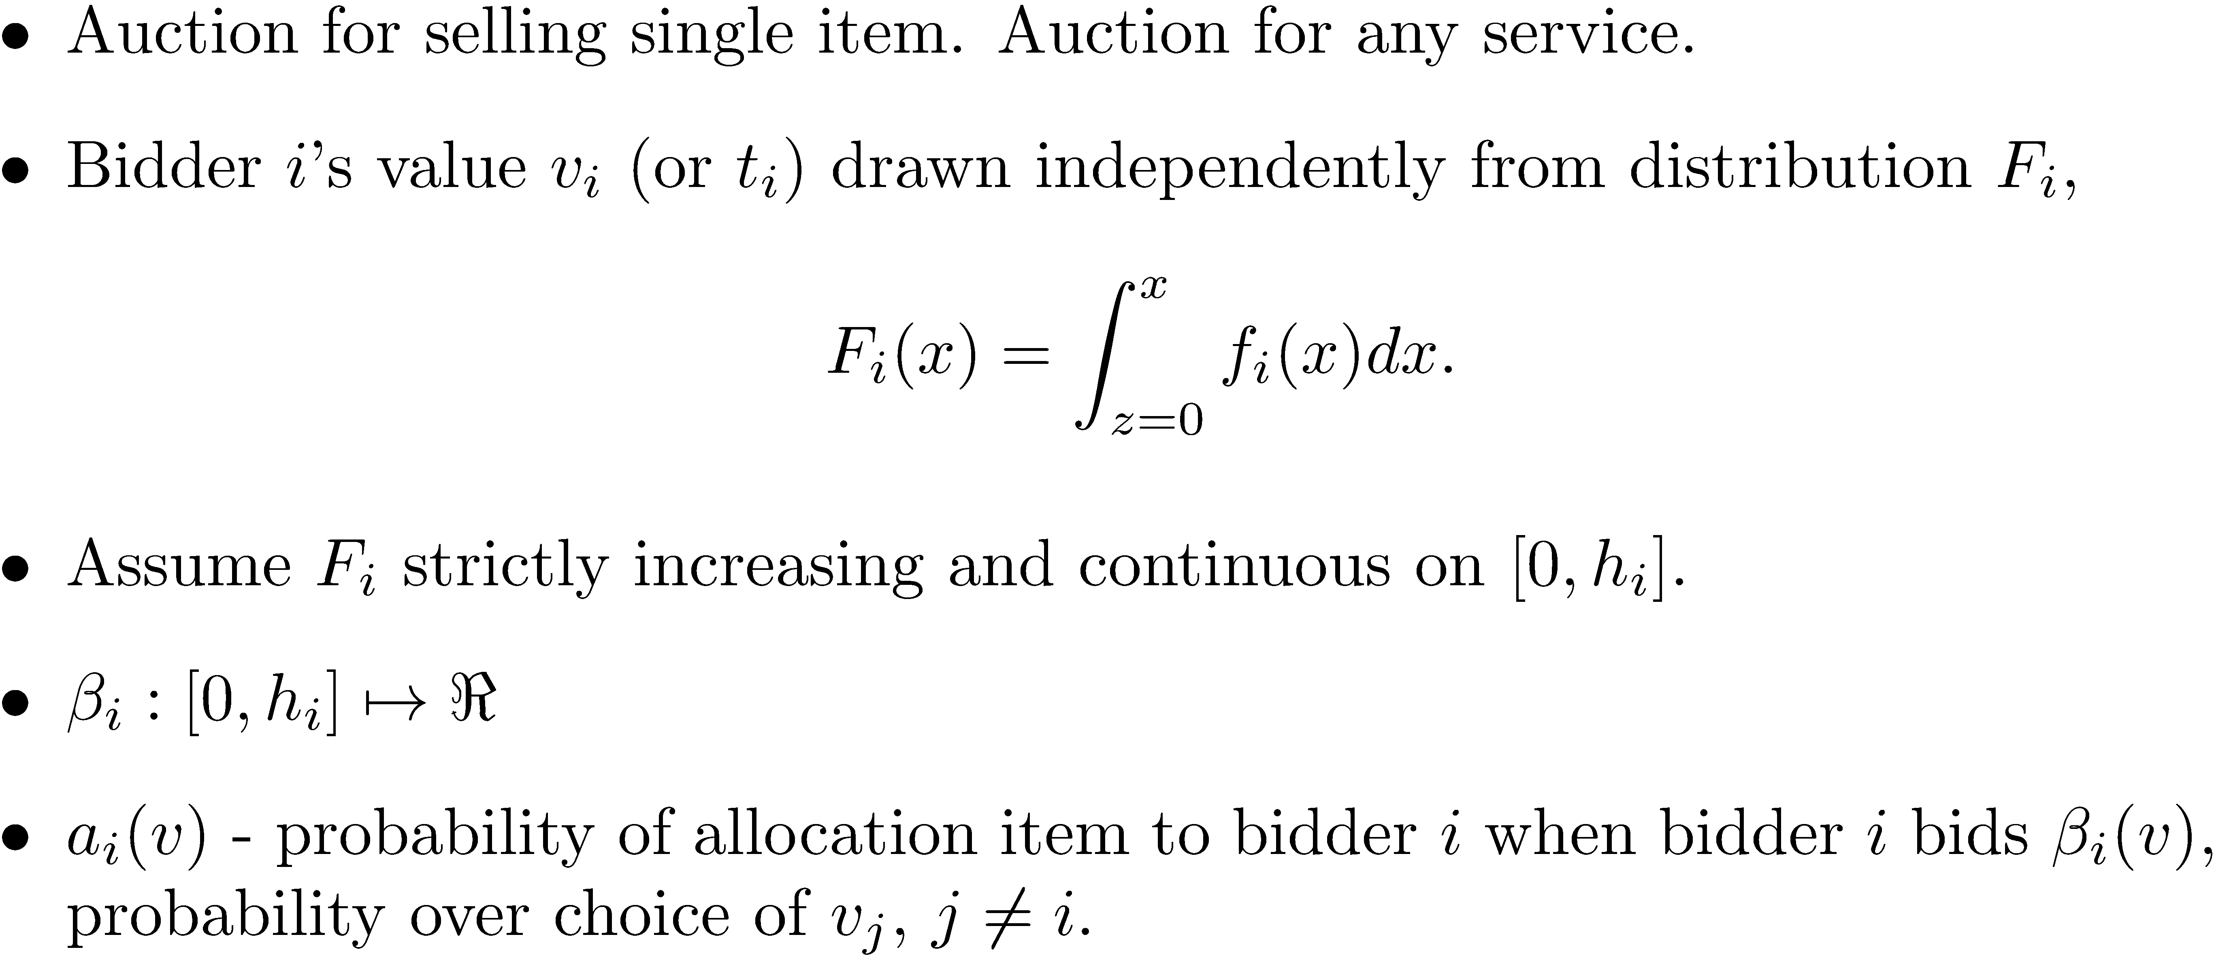
Characterization of Equilibria

Slide 8
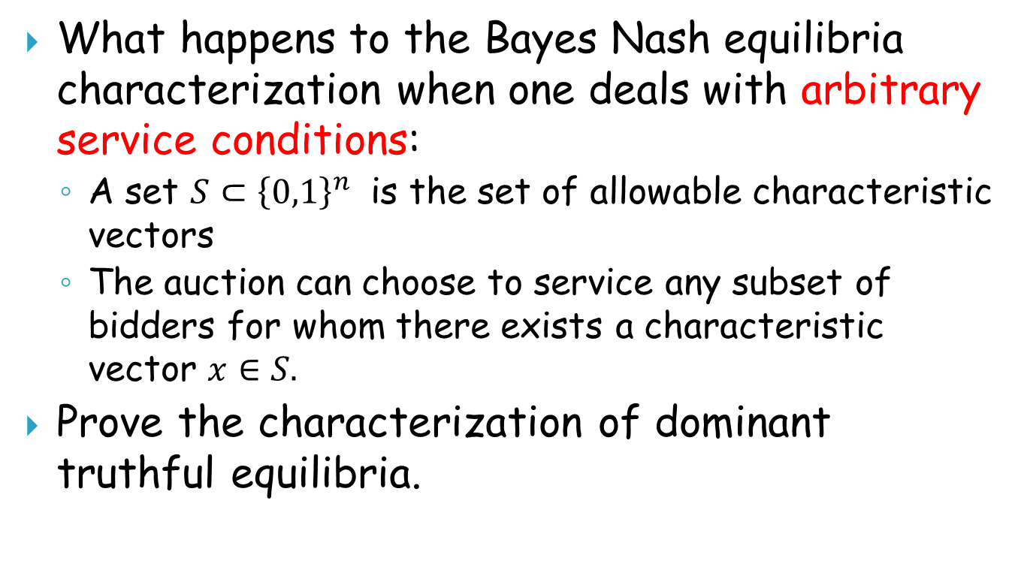
Homework #1
What happens to the Bayes Nash equilibria characterization when one deals with arbitrary service conditions:
  A set $S⊂{\left\{0,1\right\}}^{n}$ is the set of allowable characteristic vectors
  The auction can choose to service any subset of bidders for whom there exists a characteristic vector $x∈S.$
Prove the characterization of dominant truthful equilibria.

Slide 9
Characterization of Equilibria

Slide 10
Claim 1 proof: Monotonic

Slide 11
Claim 1 proof: Convex
The supremum of a family of convex functions is convex
Ergo, is convex

Slide 12
Claim 1 proof: u’(v)=a(v), u(v) = int(a(z), z=0..v)

Slide 13
Claim 1, end
Since

Slide 14
Characterization: Claim 2 proof

Slide 15

Bayes Nash Incentive Compatible Auctions
If bidding truthfully ($β_{i}\left(v\right)=v$ for all i) is a Bayes Nash equilibrium for auction A then A is said to be Bayes Nash incentive compatible

Slide 16
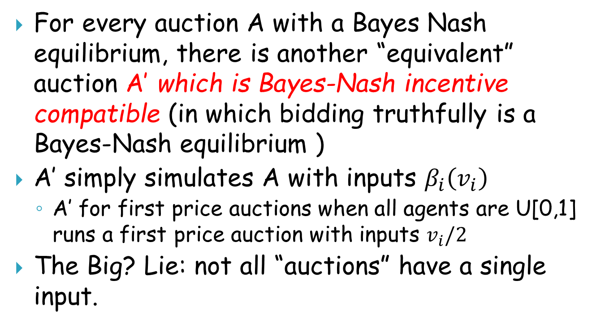
The Revelation Principle
For every auction A with a Bayes Nash equilibrium, there is another “equivalent” auction A’ which is Bayes-Nash incentive compatible (in which bidding truthfully is a Bayes-Nash equilibrium )
A’ simply simulates A with inputs $β_{i}\left(v_{i}\right)$
  A’ for first price auctions when all agents are U[0,1] runs a first price auction with inputs $v_{i}/2$
The Big? Lie: not all “auctions” have a single input.

Slide 17
Dominant strategy truthful equilibria
Dominant strategy truthful: Bidding truthfully maximizes utility irrespective of what other bids are. Special case of Bayes Nash incentive compatible.

Slide 18
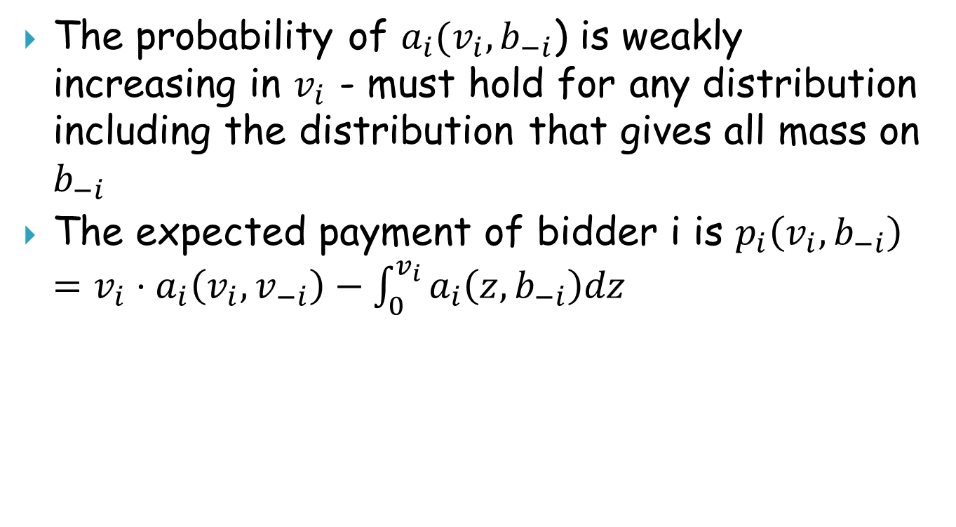
Dominant strategy truthful auctions
The probability of $a_{i}(v_{i},b_{−i}$) is weakly increasing in $v_{i}$ - must hold for any distribution including the distribution that gives all mass on $b_{−i}$
The expected payment of bidder i is $p_{i}\left(v_{i},b_{−i}\right)=v_{i}⋅a_{i}\left(v_{i},v_{−i}\right)−\int_{0}^{v_{i}}{a_{i}\left(z,b_{−i}\right)dz}$
over internal randomization

Slide 19
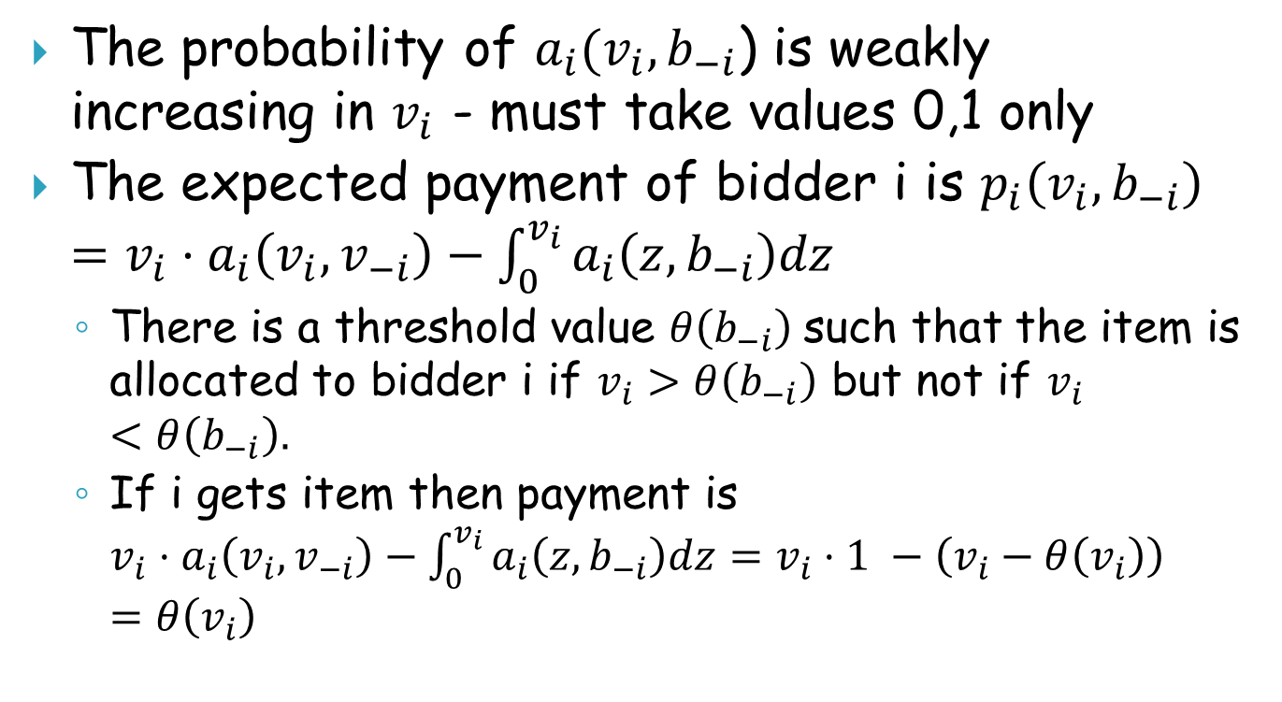
Deterministic dominant truthful auctions
The probability of $a_{i}(v_{i},b_{−i}$) is weakly increasing in $v_{i}$ - must take values 0,1 only
The expected payment of bidder i is $p_{i}\left(v_{i},b_{−i}\right)=v_{i}⋅a_{i}\left(v_{i},v_{−i}\right)−\int_{0}^{v_{i}}{a_{i}\left(z,b_{−i}\right)dz}$
  There is a threshold value $θ\left(b_{−i}\right)$such that the item is allocated to bidder i if $v_{i}>θ\left(b_{−i}\right)$ but not if $v_{i}<θ\left(b_{−i}\right).$
  If i gets item then payment is $v_{i}⋅a_{i}\left(v_{i},v_{−i}\right)−\int_{0}^{v_{i}}{a_{i}\left(z,b_{−i}\right)dz}=v_{i}⋅1 −\left(v_{i}−θ\left(v_{i}\right)\right)=θ\left(v_{i}\right)$

Slide 20
Expected Revenues
Expected Revenue:
  For first price auction: max(T₁/2, T₂/2) where T₁ and T₂ uniform in [0,1]
  For second price auction min(T₁, T₂)
  Which is better?
  Both are 1/3.
  Coincidence?
Theorem [Revenue Equivalence]: under very general conditions, every two Bayesian Nash implementations of the same social choice function
  if for some player and some type they have the same expected payment then
  All types have the same expected payment to the player
  If all player have the same expected payment: the expected revenues are the same

Slide 21
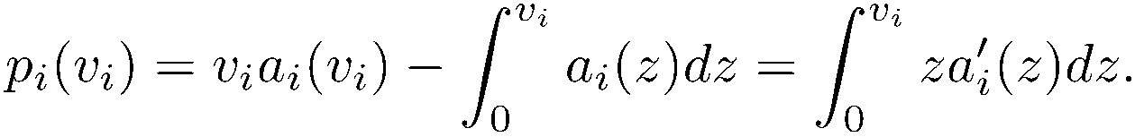

Revenue Equivalence
If A and A’ are two auctions with the same allocation rule in Bayes Nash equilibrium $a_{i}^{A}\left(v_{i}\right)=a_{i}^{A^{′}}\left(v_{i}\right)$then for all bidders i and values $v_{i}$we have that $p_{i}^{A}\left(v_{i}\right)=p_{i}^{A^{′}}\left(v_{i}\right).$

Slide 22
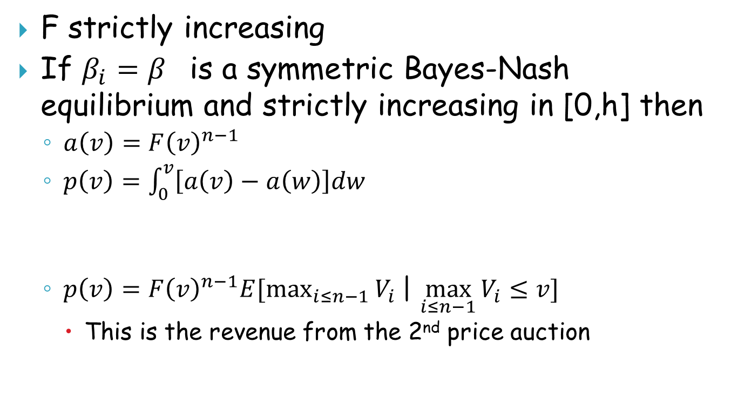
IID distributions highest bidder wins
F strictly increasing
If $β_{i}=β$ is a symmetric Bayes-Nash equilibrium and strictly increasing in [0,h] then
  $a\left(v\right)=F{\left(v\right)}^{n−1}$
  $p\left(v\right)=\int_{0}^{v}{\left[a\left(v\right)−a\left(w\right)\right]dw}$
  $p\left(v\right)=F{\left(v\right)}^{n−1}E[\max_{i≤n−1}{V_{i} }$| $\max_{i≤n−1}{V_{i}≤v]}$
    This is the revenue from the 2nd price auction

Slide 23
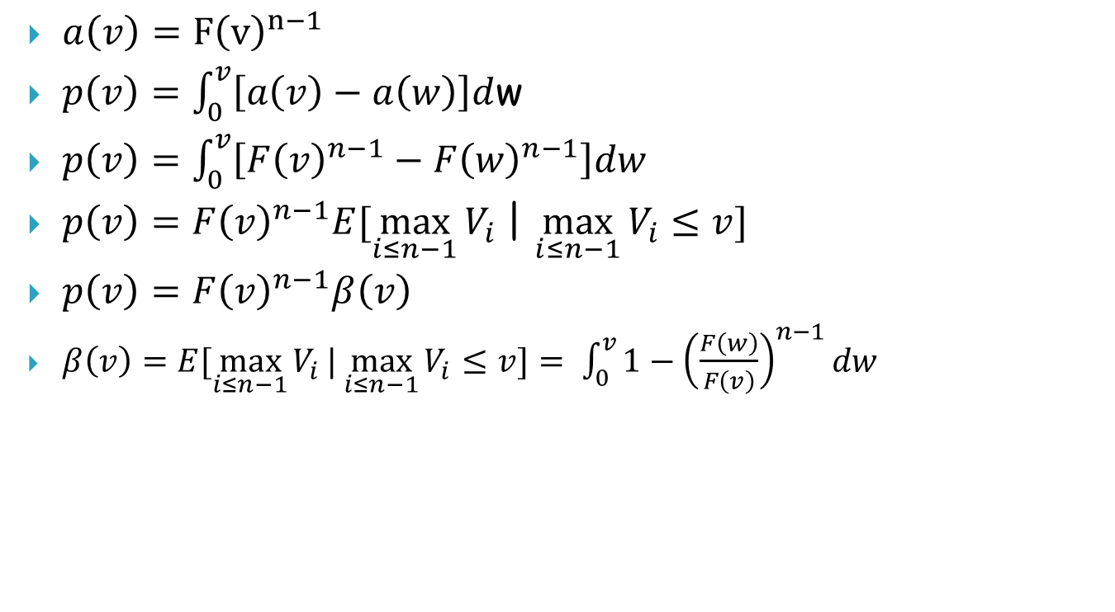
First price auctions
  $a\left(v\right)=F{\left(v\right)}^{n−1}$
  $p\left(v\right)=\int_{0}^{v}{\left[a\left(v\right)−a\left(w\right)\right]d}$w
  $p\left(v\right)=\int_{0}^{v}{\left[F{\left(v\right)}^{n−1}−F{\left(w\right)}^{n−1}\right]dw}$
  $p\left(v\right)=F{\left(v\right)}^{n−1}E[\max_{i≤n−1}{V_{i} }$| $\max_{i≤n−1}{V_{i}≤v]}$
  $p\left(v\right)=F{\left(v\right)}^{n−1}β\left(v\right)$
  $β\left(v\right)=E[\max_{i≤n−1}{V_{i}}|\max_{i≤n−1}{V_{i}}≤v]= \int_{0}^{v}{1−{\left(\frac{F\left(w\right)}{F\left(v\right)}\right)}^{n−1}dw}$

Slide 24
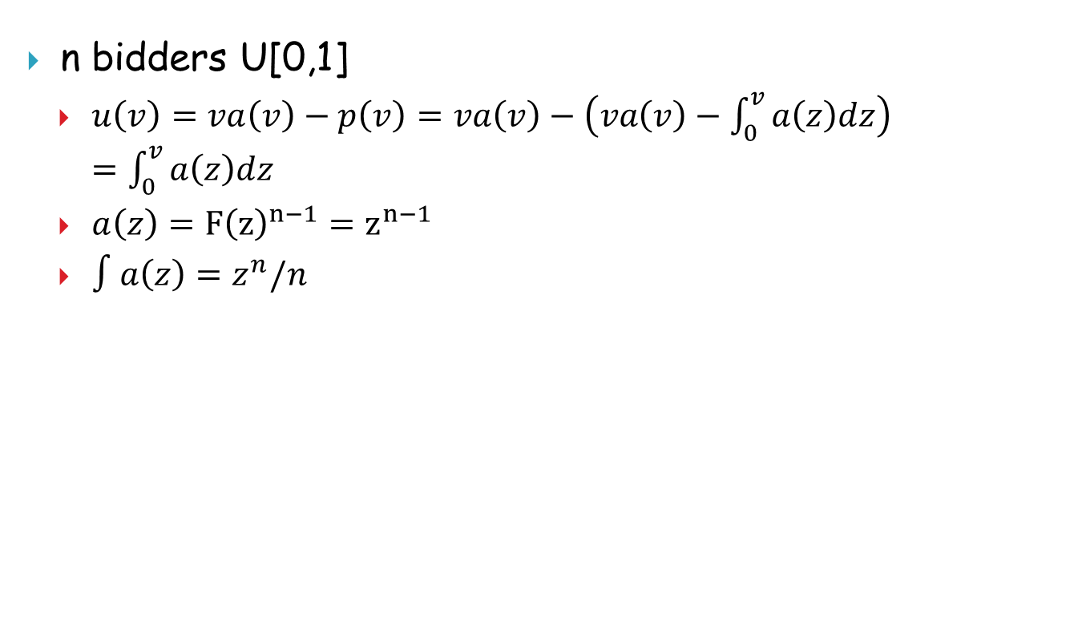
  n bidders U[0,1]
    $u\left(v\right)=va\left(v\right)−p\left(v\right)=va\left(v\right)−\left(va\left(v\right)−\int_{0}^{v}{a\left(z\right)dz}\right)=\int_{0}^{v}{a\left(z\right)dz}$
    $a\left(z\right)=F{\left(z\right)}^{n−1}=z^{n−1}$
    $∫a\left(z\right)=z^{n}/n$

