Slide 1
Introduction to Quantum Key Distribution
Gonen Krak

Slide 2
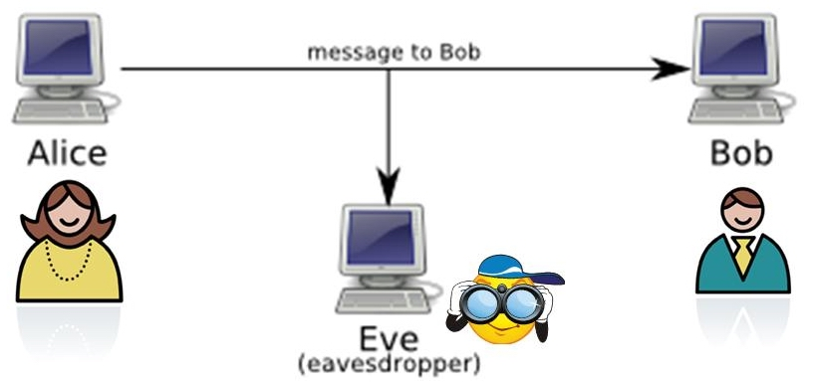
Classical Cryptography
Suppose Alice and Bob wish to communicate in the presence on an eavesdropper Eve
A provably secure classical scheme exists for this, called the one-time pad

Slide 3
The One-Time Pad
The one-time pad requires Alice and Bob
to share a secret key : $k∈{\{0,1\}}^{n}$ uniformly distributed.
- When Alice wishes to send the message $m$ to Bob, she computes $c=m⊕k$ and sends it to Bob.
- When Bob receives $c$ he computes $c⊕k=\left(m⨁k\right)⨁k=m⨁\left(k⨁k\right)=m⨁0=m$ to get the original message.

Slide 4
One-time Pad Security
This protocol achieves perfect security, since given constant string $c∈{\{0,1\}}^{n}$, for every message $m$ we have
$${Pr}_{k}\left[m⊕k=c\right]=\frac{1}{2^{n}}$$
It is important to note that for security, Alice and Bob must never re-use the same key twice, since then Eve can learn information about the original messages:
$$\left(c⨁c^{′}\right)=\left(m⨁k\right)⨁\left(m^{′}⨁k\right)=m⨁\left(k⨁k^{′}\right)⨁m^{′}=m⨁m′$$

Slide 5
The Key Distribution Problem
Problem : How do Alice and Bob share the secret key between them before sending the message?
Most abstractly in the classical world, a key distribution protocol can be based on any trapdoor one-way function.
Such a function is a mathematical function that can create two strings s1 and s2 that share a mathematical relation such that given s2, it is very hard to calculate s1.

Slide 6
The Key Distribution Problem
Usually “hard” means that there is no known polynomial-time algorithm to calculate s1.
Given such trapdoor one-way function, Alice and Bob can use this function to create for both of them a private key(s1) and a public key(s2).
When Alice wishes to send a message to Bob she encrypts it with Bob’s public key and then Bob decrypts it with his private key.

Slide 7
The Key Distribution Problem
There are several problems with the classical scheme of the key distribution problem.
First, their security is based on the fact that there are no known algorithms for mathematical problems which might have an efficient solution.
Second, usually such mathematical problems(such as factoring large integers) have an efficient solution on quantum computers.

Slide 8
Quantum Key Distribution
A quantum key-distribution protocol is a protocol that uses the quantum mechanical model that enables Alice and Bob to set up a secret key provided they have :
A quantum channel where Eve can read and modify messages
An authenticated classical channel, where Eve can read messages but not modify them

Slide 9
Quantum Key Distribution
There are several proposed protocols for QKD. In this lecture we will talk about two of them :
The BB84 protocol : This is first protocol proposed for QKD. This protocol is easier to implement in reality but harder to analyze and prove its security
The Lo and Chau protocol : This is the first protocol which have been proved to be secure. Harder to implement but easier to analyze

Slide 10
The BB84 Protocol
The BB84 protocol works as follows :
At the beginning Alice decides on a random string $x∈{\{0,1\}}^{n}$
Alice uses two alphabets to encode $x$ :
$|0>,|1>$ and $|+>,|−>$ where
$|+>$ = $\frac{1}{\sqrt{2}}\left[|0>+|1>\right]$
$|−>$ = $\frac{1}{\sqrt{2}}\left[|0>−|1>\right]$

Slide 11
The BB84 Protocol
For every bit Alice wants to send, she randomly choses alphabet(basis) in which to encode the bit and sends the corresponding state to Bob
When Bob receives the message, for each bit he randomly choses alphabet and performs the corresponding measurement
Note that if Eve do not modify the message, Bob will have 75% of the message correct

Slide 12
The BB84 Protocol
After Bob has preformed his measurements, he compares with Alice on the classical channel the bases he chose for each bit
Then Alice and Bob drop all the bits that Bob used the wrong basis to measure them. Now Alice and bob remain with two strings that should be identical

Slide 13
The BB84 Protocol
To ensure consistency, Alice and bob choose a random subset of $m$ bits and compare them. If they are indeed consistent they take the remaining bits as a secret key
Since Eve can modify the qubits that Alice sends to Bob, she can supply Bob qubits in any state she wants.
In the next slides, we will focus on the simple case when she just measures the bits and sends them forward to Bob

Slide 14
The BB84 Protocol
Note that since Eve doesn’t know which bases Alice chose, she needs to guess.
Thus, after Alice and Bob compared the bases and stayed only with the bits they measured in the same basis, the only way for a random bit to be different in Alice and Bob’s strings is if Eve had measured it in the wrong basis (Pr = $\frac{1}{2}$) and Bob got the opposite result when he measured it in the correct basis (Pr = $\frac{1}{2})$. That’s happen in probability $\frac{1}{2}∙\frac{1}{2}=\frac{1}{4}$

Slide 15
The BB84 Protocol
Now, when Alice and Bob choose $m$ bits for consistency check, each pair of corresponding bits is indeed identical with probability (1-1/4) = ¾
Thus, the probability for Eve to go undetected is ${\left(\frac{3}{4}\right)}^{m}$ which is exponentially small.

Slide 16
The BB84 Protocol
The interesting case is what happens when Eve supply to Bob qubits in arbitrary state in order to reveal some information about the key
It is possible to show that the more information Eve acquires about the key, the less the probability for Eve to go undetected is.

Slide 17
The BB84 Protocol
Overall, this protocol is relatively easy to implement, and even though its hard to analyze its security, it was proved that it is secure. These reasons make this protocol the most common protocol for QKD
In the next slides will talk about a different protocol for QKD and analyze its security

Slide 18
The Lo and Chau Protocol
Notice the Bell state $|ψ^{−}>$ = $\frac{|01>−|10>}{\sqrt{2}}$
If Alice and Bob share this pair of qubits and both of them preform local measurement in the computational basis they will get correlated(opposite) result.
Idea : Alice and Bob can share a series of Bell states $|ψ^{−}>|ψ^{−}>|ψ^{−}>..$ between them and then just preform measurements and NOT gates to obtain a secret key.

Slide 19
The Lo and Chau Protocol
Problem : Eve can access the quantum channel and change the qubits. Thus we may assume that Eve supplies the qubits for both Alice and Bob.
Therefore, the task of Alice and Bob is, in fact, to verify using local operations and classical communication only if the state of the qubits they share is indeed is a series of $|ψ^{−}>$ states.
Notice that they can’t simply perform a measurement along the Bell basis since such measurement requires both qubits

Slide 20
The Lo and Chau Protocol
Let’s denote the Ball basis vectors by
$|φ^{+}>$ = $\frac{|00>+|11>}{\sqrt{2}}$=$|\tilde{0}\tilde{0}>$
$|ψ^{+}>$ = $\frac{|01>+|10>}{\sqrt{2}}$=$|\tilde{0}\tilde{1}>$
$|φ^{−}>$ = $\frac{|00>−|11>}{\sqrt{2}}$=$|\tilde{1}\tilde{0}>$
$|ψ^{−}>$ = $\frac{|01>−|10>}{\sqrt{2}}$=$|\tilde{1}\tilde{1}>$
For now, let’s assume that Eve supplies Alice and Bob $N$ pairs of qubits such that each pair is a Bell basis vector. Thus, the state of the whole system can be represented by a bit string $x∈{\{\tilde{0},\tilde{1}\}}^{2N}$

Slide 21
The Lo and Chau Protocol
In this notation, Alice’s and Bob’s goal is to verify that the state string $x$ is all $\tilde{1}$’s.
Remember that Alice and Bob can only perform local operations on their qubits and communicate classical bits.
Our goal is to try and investigate which properties of this bit string Alice and Bob can verify under these limitations.

Slide 22
The Lo and Chau Protocol
For example, Alice and Bob can’t verify if two consecutive bits are $\tilde{0}\tilde{0}$ , $\tilde{0}\tilde{1}$ , $\tilde{1}\tilde{0}$ , $\tilde{1}\tilde{1}$ since this corresponds to a measurement in the Bell basis.
Note that Alice and Bob can verify if the right bit of each pair is $\tilde{0}$ or $\tilde{1}$ by performing a local measurement in the computational basis and then comparing the results (parallel or anti-parallel)

Slide 23
The Lo and Chau Protocol
So, the question here is whether can Alice and Bob verify a few properties about the state string while sacrificing small number of qubits and guess with high probability whether the state string is all $\tilde{1}$’s or not.
The answer turns out to be yes, as we will see in the next slides.

Slide 24
The Lo and Chau Protocol
Let’s look at the property of whether the parity (the number of 1’s) in a subset of bits is odd or even.
Let $k$ be a subset of bits (indexes) of $2N$-bit string $x$. The probability that another random bit string $y$ has the same parity on $k$ equals to $\frac{2^{\left|k\right|−1}∙2^{2N−\left|k\right|}}{2^{2N}}=\frac{1}{2}$
Thus the probability that another bit string $y$ has the same parity on $m$ randomly-chosen independent subsets equals to $\frac{1}{2^{m}}$

Slide 25
The Lo and Chau Protocol
Hence, if Alice and Bob are able to verify the parity of random subsets of bits without sacrificing many qubits, they can verify with high probability whether the state string $x$ is all $\tilde{1}$’s or not.

Slide 26
The Lo and Chau Protocol
Note that calculating the parity of a subset $m$ of a bit string $x$ equals to the modulo-2 product of $s∙x$ where $s$ is an index string defined by $s_{i}=1$ iff $i∈m$.
For example, if $x=1011$ and $m=\{1,3\}$ then $s=0101$ and $s∙x=1$ with accordance that there are odd numbers of 1’s in the subset $m$ of $x$

Slide 27
The Lo and Chau Protocol
So now, all what we have to look for is a way for Alice and Bob to calculate $s∙x$ for any $2N$-bit string $s$ (which can be chosen using the classical communication channel).
Note the following 3 unitary transformations defined in terms of our previous notation :

Slide 28
The Lo and Chau Protocol
The transformation on two qubits that swaps the bits ( $|\tilde{i}\tilde{j}>$ -> $|\tilde{j}\tilde{i}>$)
The transformation on two qubits that
XOR’s the left bit into the right bit
($|\tilde{i}\tilde{j}>$ -> $|\tilde{i}\tilde{i⨁j}>$)
3. The transformation on four qubits (two
pairs) that performs the action
$|\tilde{i}\tilde{j}>⊗|\tilde{l}\tilde{k}>$ -> $|\tilde{i⊕l}\tilde{j}>⊗|\tilde{l}\tilde{j⊕k}>$
These transformations U1 , U2 and U3 are easily seen unitary since they permute a basis

Slide 29
The Lo and Chau Protocol
Note that if Alice and Bob were able to use these transformations, they could compute $s∙x$ in the following way :
In the first stage, put the parity required from each pair in its right bit
This means, if the corresponding index
bits in $s$ are 01 then do nothing on this
pair. If the bits are 10 then use U1 on
the pair to swap the bits. Finally, if the
the bits are 11 then use U2 on this pair
to put the XOR (parity) of both bits into
the right bit of the pair

Slide 30
The Lo and Chau Protocol
2. In the second stage, use the U3 transformation on all the required pairs with the same target pair to gain the XOR of all the required bits in the right bit of the target pair.
For example, if $s=00011011$ then we ignore the first pair, do nothing to the second pair, use U1 on the third pair, use U2 on the fourth pair and finally use U3 on the second and third pair and then on the second and fourth pair.

Slide 31
The Lo and Chau Protocol
After all this, the required parity will be represented in the right bit of the second pair. All left to do now is to check whether the right bit of the second pair is $\tilde{1}$, and this is indeed possible as noted earlier
We showed that if Alice and Bob can create these transformations using local operations only, then they could also calculate the required parity of any subset

Slide 32
The Lo and Chau Protocol
Well, it turns out that any of these transformations has a simple tensor product representation! (the calculation is left for you to verify..)
U1 = $B_{y}⊗B_{y}$ where $B_{y}=\frac{1}{\sqrt{2}}\left[\begin{matrix}1 & −1 \\ 1 & 1\end{matrix}\right]$
U2 = $B_{x}σ_{x}⊗B_{x}σ_{x}$ where $B_{x}=\frac{1}{\sqrt{2}}\left[\begin{matrix}1 & −i \\ −i & 1\end{matrix}\right]$
U3 = $CNOT⊗CNOT$ where each CNOT acts
on the left/right bits of both pairs.

Slide 33
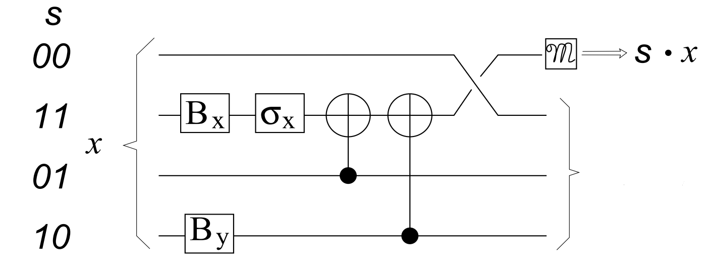
The Lo and Chau Protocol
For example, if Alice and Bob decided on $s=00011011$ then they both need to execute the following circle on their pairs

Slide 34
The Lo and Chau Protocol
Note that for each chosen subset $s$, only one pair is measured and thus “destroyed”.
It is possible for Alice and Bob to apply “fixes” on the other pairs which took place in the circuit and transform them back to their original state based on the measurement results. (Good exercise at home..)
Thus for every subset Alice and Bob need to sacrifice only one pair.

Slide 35
The Lo and Chau Protocol
We showed until now that if Eve performs the qubits in a tensor product state of the Bell basis vectors, Alice and Bob can verify in very high probability whether they share a series of $|ψ^{−}>$ states or not
But note that Eve may use a super-position of these states or even more general - to entangle some of the qubits with her own qubits hoping to create correlations that will reveal information about the key during the computation

Slide 36
The Lo and Chau Protocol
The most general state Eve can supply is
$|u>$ $=\sum_{i_{1},i_{2},..,i_{N}}{\sum_{j}{a_{i_{1},i_{2},..,i_{N},j}|i_{1},i_{2},..,i_{N}>⊗}}|j>$
Where i1,..,iN run on {00 , 01 , 10 , 11} and $|j>$ is some orthonormal basis for Eve’s private qubits.
Note that the measurements preformed by Alice and Bob during the protocol can be represented by the observables
$Q_{s}=\sum{\left(s∙w\right)|w><w|}$ for each subset $s$

Slide 37
The Lo and Chau Protocol
Denote by $W$ the observable corresponding
to a measurement in the $N$-Bell basis, i.e. $W=\sum{w}|w><w|$
All the above operators refer to a single basis (the the $N$-Bell basis), and since all the operators diagonalizable with respect to that basis they commute with $W$

Slide 38
The Lo and Chau Protocol
Therefore, any of the $Q_{s}$ values are not affected by a prior measurement of $W$
In other words, for any state $|u>$ Eve might have supplied, the sequence of subset parities measured in the verification stage would not have been affected if Eve had pre-measured $|u>$in the Bell basis (i.e. made a measurement of W) before handing the state to Alice and Bob

Slide 39
The Lo and Chau Protocol
A measurement of $W$ would make the state $|u>$ collapse into one of the $N$-Bell basis states and thus our previous analysis is valid for this case as well
*Note that this is still not a complete formal proof, but it should give you the idea behind it.

Slide 40
The Lo and Chau Protocol
An important idea behind this quantum-to-classical reduction is that a quantum mechanical experiment has a classical interpretation whenever observables that
refer to only one basis are considered.
This guarantees that one can apply standard results in the classical world (such as probability theory and statistics theory) to the original quantum problem

