Slide 1
Noncommutative rational identity testing (over the rationals)
Ankit Garg
Princeton Univ.
Joint work with
Leonid Gurvits Rafael Oliveira
CCNY Princeton Univ.
Avi Wigderson
IAS

Slide 2
Outline
Introduction to PIT/RIT.
Symbolic matrices
Algorithm
Conclusion/Open problems

Slide 3






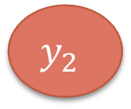





Commutative Polynomial Identity Testing (PIT)
$F[y1 , y2 ,…, ym]$: polynomials in commuting variables over $F$ and their representations.
Example: $y_{1}y_{2}+y_{1}+y_{2}^{2}+y_{2}$
$$×$$
$$×$$
$$+$$
$$+$$
$$+$$
$$+$$
$$y_{1}$$
$$y_{2}$$
$$1$$
$$y_{1}$$
$$y_{2}$$
$$y_{3}$$
$$1$$
Arithmetic Circuit
Arithmetic Formula

Slide 4
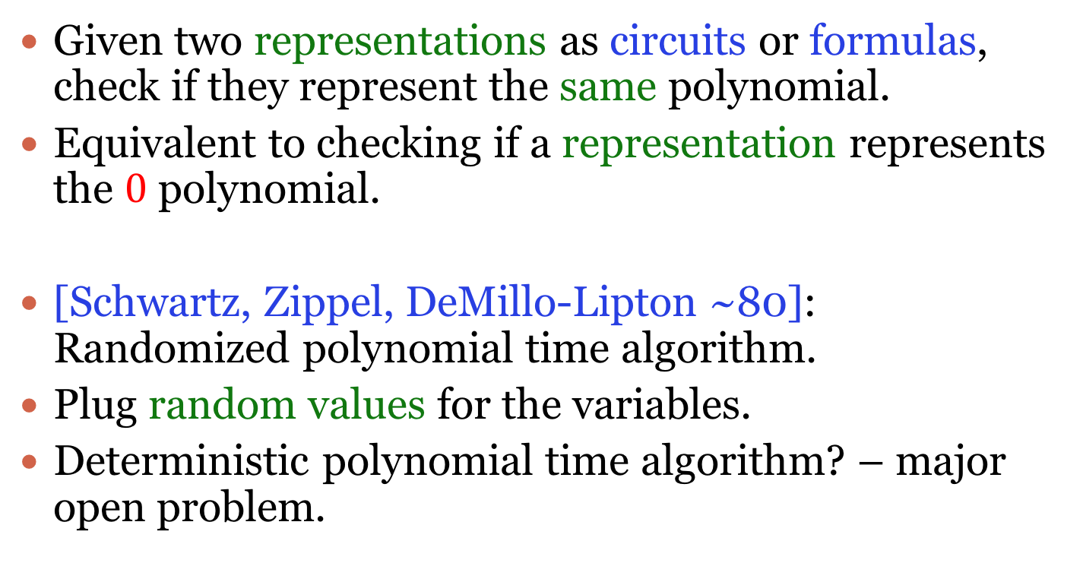
Commutative Polynomial Identity Testing
Given two representations as circuits or formulas, check if they represent the same polynomial.
Equivalent to checking if a representation represents the $0$ polynomial.
[Schwartz, Zippel, DeMillo-Lipton ~80]: Randomized polynomial time algorithm.
Plug random values for the variables.
Deterministic polynomial time algorithm? – major open problem.
Notes:
From now on mostly talk about the zero testing problem.

Slide 5






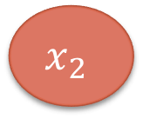





Non-commutative PIT
$F<x1 , x2 ,…, xm>$: polynomials in non-commuting variables over $F$ and their representations.
Examples: $x_{1}x_{2}−x_{2}x_{1}$ , $x_{1}x_{2}+x_{1}+x_{2}^{2}+x_{2}$
$$×$$
$$×$$
$$+$$
$$+$$
$$+$$
$$+$$
$$x_{1}$$
$$x_{2}$$
$$1$$
$$x_{1}$$
$$x_{2}$$
$$x_{3}$$
$$1$$
Arithmetic Circuit
Arithmetic Formula
Notes:
7 minutes

Slide 6
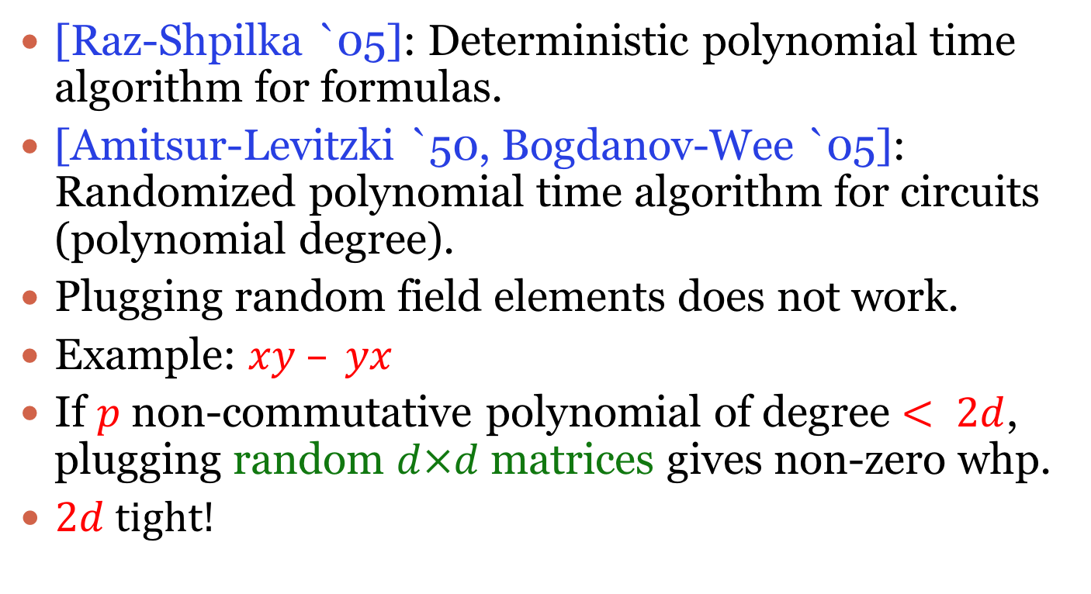
Non-commutative PIT
[Raz-Shpilka `05]: Deterministic polynomial time algorithm for formulas.
[Amitsur-Levitzki `50, Bogdanov-Wee `05]: Randomized polynomial time algorithm for circuits (polynomial degree).
Plugging random field elements does not work.
Example: $xy – yx$
If $p$ non-commutative polynomial of degree $< 2d$, plugging random $d×d$ matrices gives non-zero whp.
$2d$ tight!
Deterministic polynomial time algorithm for circuits open.

Slide 7









Commutative Rational identity testing (RIT)
$F(y1 , y2 ,…, y_{m})$: rational functions in commuting variables and their representations.
Example: $\frac{y_{1}+y_{2}y_{3}}{y_{1}y_{3}−y_{2}}$
$$+$$
$$×$$
$$+$$
$$+$$
INV
$$y_{1}$$
$$y_{2}$$
$$y_{3}$$
$$1$$
$$y_{1}$$
Notes:
Probably never heard of this problem. For good reasons. Again repsented by a circuit or a formula.

Slide 8
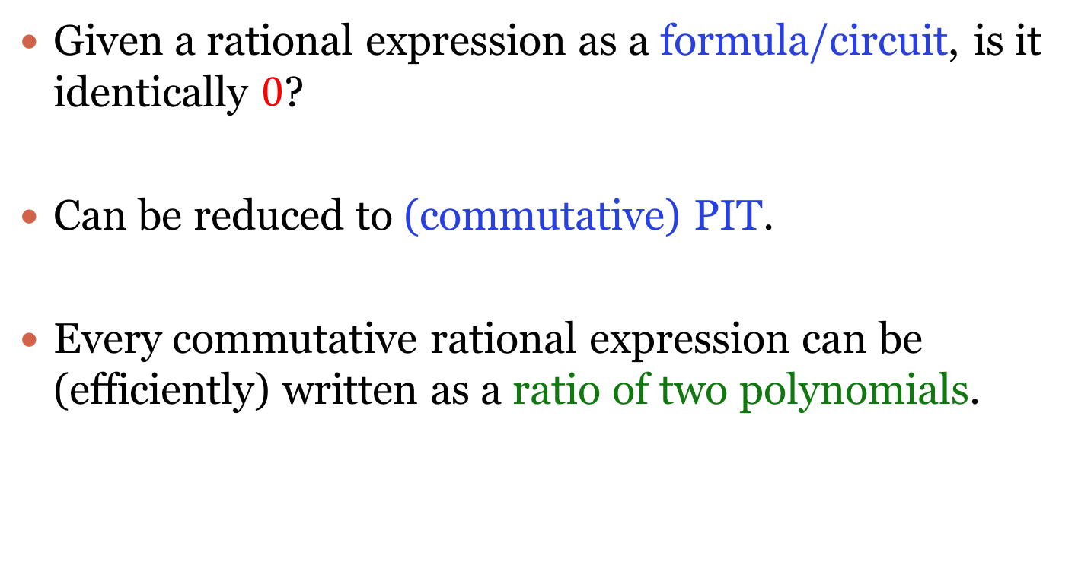
Commuting RIT
Given a rational expression as a formula/circuit, is it identically $0$?
Can be reduced to (commutative) PIT.
Every commutative rational expression can be (efficiently) written as a ratio of two polynomials.

Slide 9









Non-commutative rational identity testing
$F≮x_{1},x_{2},…,x_{m}≯$: non-commutative rational functions and their representations.
Example: ${{({(x}_{1}x_{2}^{−1}+x_{3}^{−1})}^{−1}+x_{4})}^{−1}$
No easy canonical form.
$$+$$
$$×$$
$$+$$
$$+$$
INV
$$x_{1}$$
$$x_{2}$$
$$x$$
$$1$$
$$x_{1}$$
Notes:
Not every expression can be written as a ratio of 2 polynomials. Formulas or circuits.

Slide 10
Non-commutative RIT
Given two non-commutative rational expressions as formulas/circuits, determine if they represent the same element.
What does it mean for two expressions represent the same element? – No easy canonical form.
Operational definition [Amitsur `66].

Slide 11
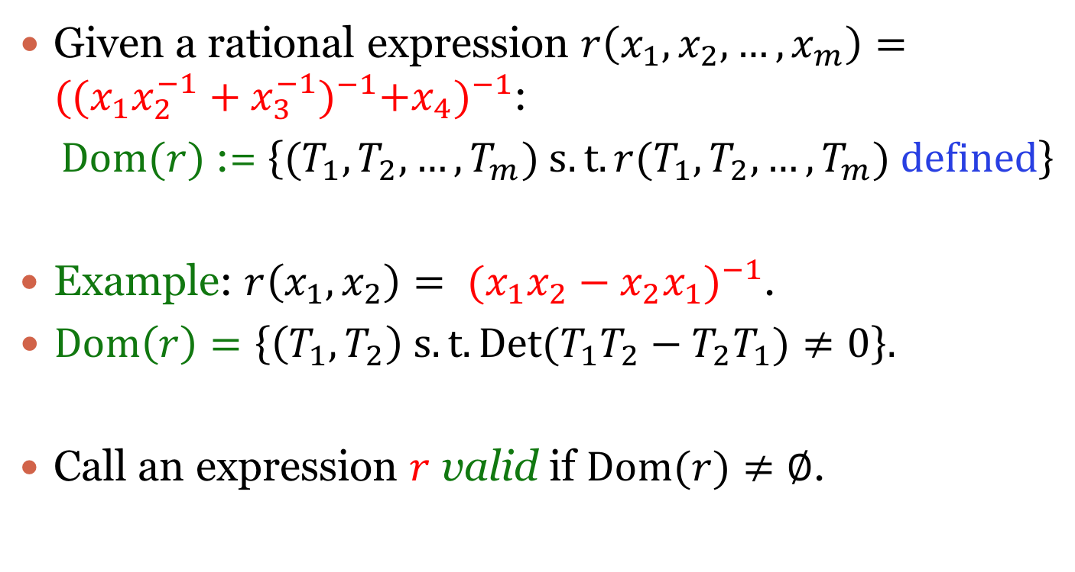
Free Skew Field
Given a rational expression $r\left(x_{1},x_{2},…,x_{m}\right)={{({(x}_{1}x_{2}^{−1}+x_{3}^{−1})}^{−1}+x_{4})}^{−1}$:
$Dom(r)$ := $\left\{{(T}_{1},T_{2},…,T_{m}) s.t. r(T_{1},T_{2},…,T_{m}) defined\right\}$
Example: $r\left(x_{1},x_{2}\right)= {{(x}_{1}x_{2}−x_{2}x_{1})}^{−1}$.
$Dom\left(r\right)=\left\{\left(T_{1},T_{2}\right) s.t. Det(T_{1}T_{2}−T_{2}T_{1})≠0\right\}.$
Call an expression $r$ valid if $Dom(r)≠∅$.

Slide 12
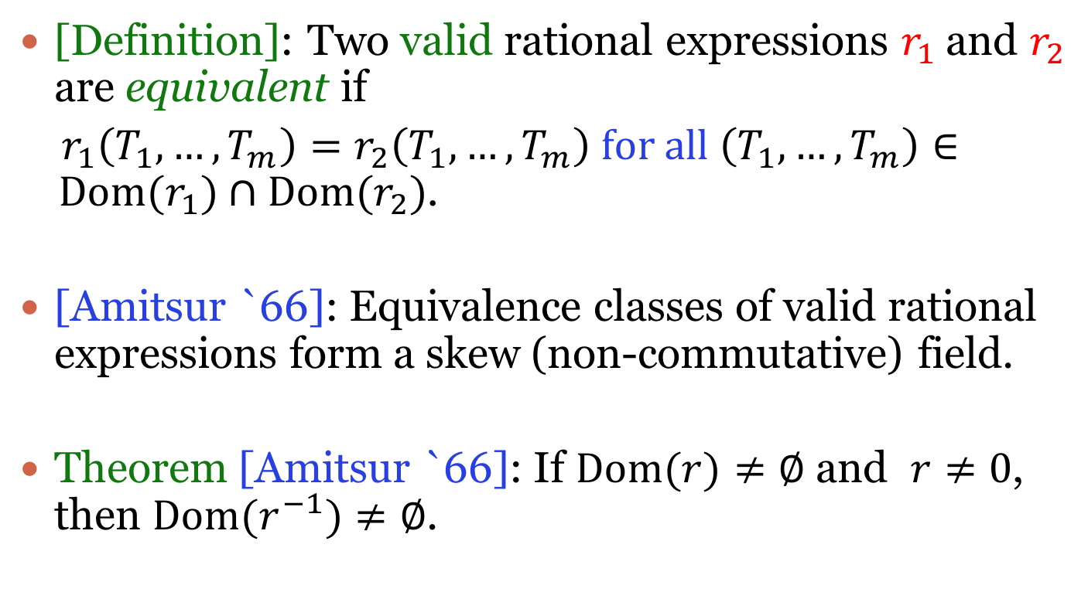
Free Skew Field
[Definition]: Two valid rational expressions $r_{1}$ and $r_{2}$ are equivalent if
$r_{1}\left(T_{1},…,T_{m}\right)=r_{2}\left(T_{1},…,T_{m}\right) for all \left(T_{1},…,T_{m}\right)∈ Dom(r_{1})∩Dom(r_{2})$.
[Amitsur `66]: Equivalence classes of valid rational expressions form a skew (non-commutative) field.
Theorem [Amitsur `66]: If $Dom(r)≠∅$ and $r≠0$, then $Dom(r^{−1})≠∅$.
Notes:
By r not equal to 0, mean r not equivalent to 0.

Slide 13
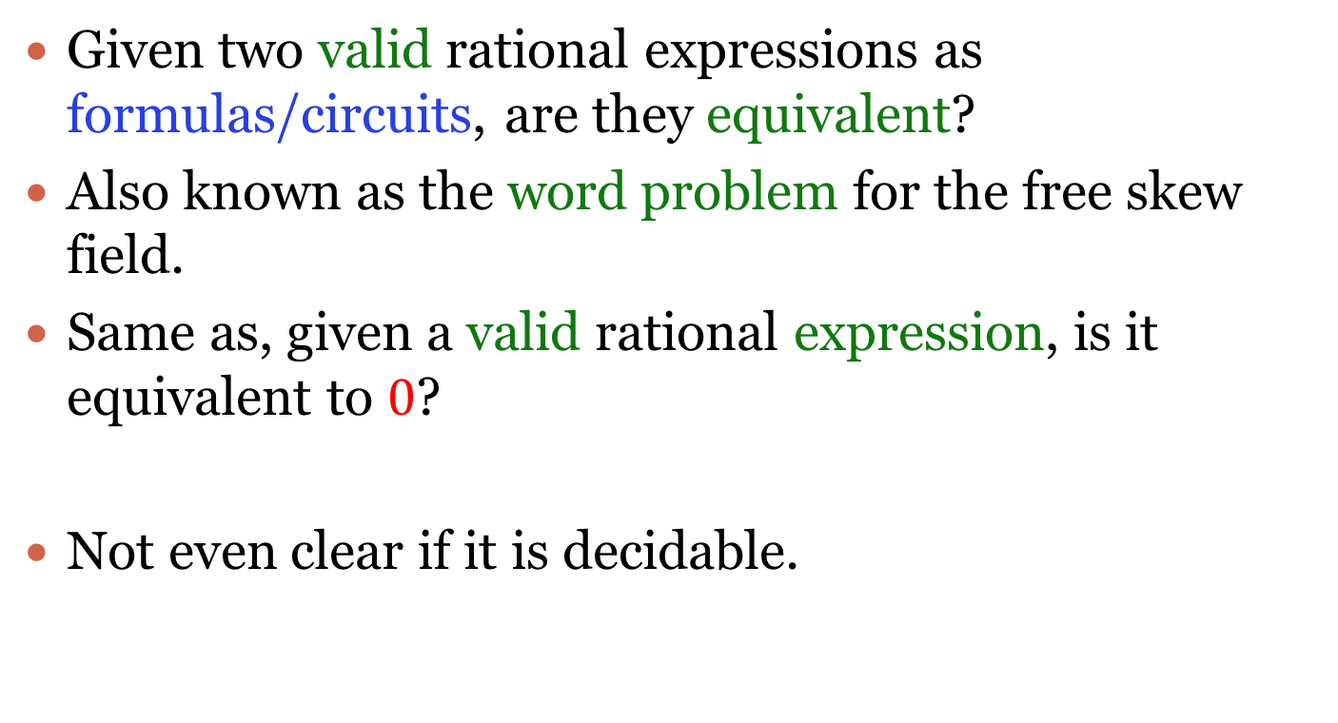
Non-commutative rational identity testing
Given two valid rational expressions as formulas/circuits, are they equivalent?
Also known as the word problem for the free skew field.
Same as, given a valid rational expression, is it equivalent to $0$?
Not even clear if it is decidable.

Slide 14
Non-commutative rational identity testing
[Cohn-Reutenauer `99]: Reduce to solving a system of (commutative) polynomial equations (for formula representations).
Can also be deduced from structural results in
[Cohn `71].
Several other algorithms but all exponential time (with or without randomness).

Slide 15
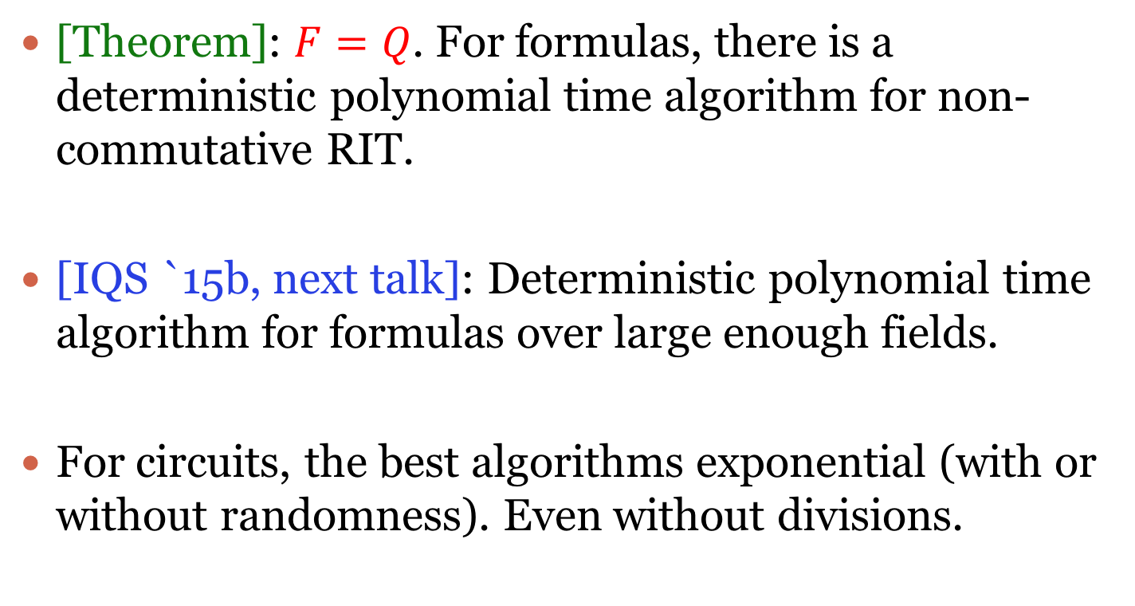
Non-commutative rational identity testing
[Theorem]: $F=Q$. For formulas, there is a deterministic polynomial time algorithm for non-commutative RIT.
[IQS `15b, next talk]: Deterministic polynomial time algorithm for formulas over large enough fields.
For circuits, the best algorithms exponential (with or without randomness). Even without divisions.

Slide 16
Outline
Introduction to PIT/RIT.
Symbolic matrices
Algorithm
Conclusion/Open problems

Slide 17
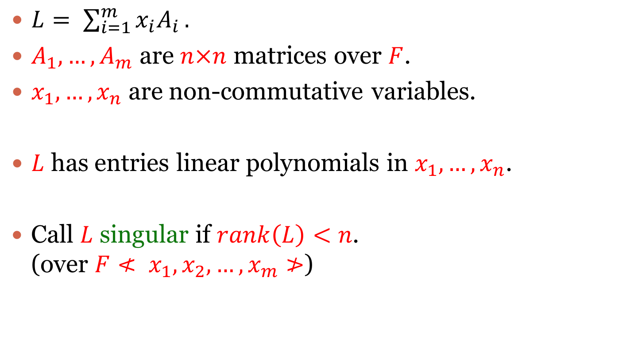
Symbolic matrices
$L= \sum_{i=1}^{m}{x_{i}A_{i}}.$
$A_{1},…,A_{m}$ are $n×n$ matrices over $F$.
$x_{1},…,x_{n}$ are non-commutative variables.
$L$ has entries linear polynomials in $x_{1},…,x_{n}$.
Call $L$ singular if $rank\left(L\right)<n$. (over $F≮ x_{1},x_{2},…,x_{m}≯$)

Slide 18
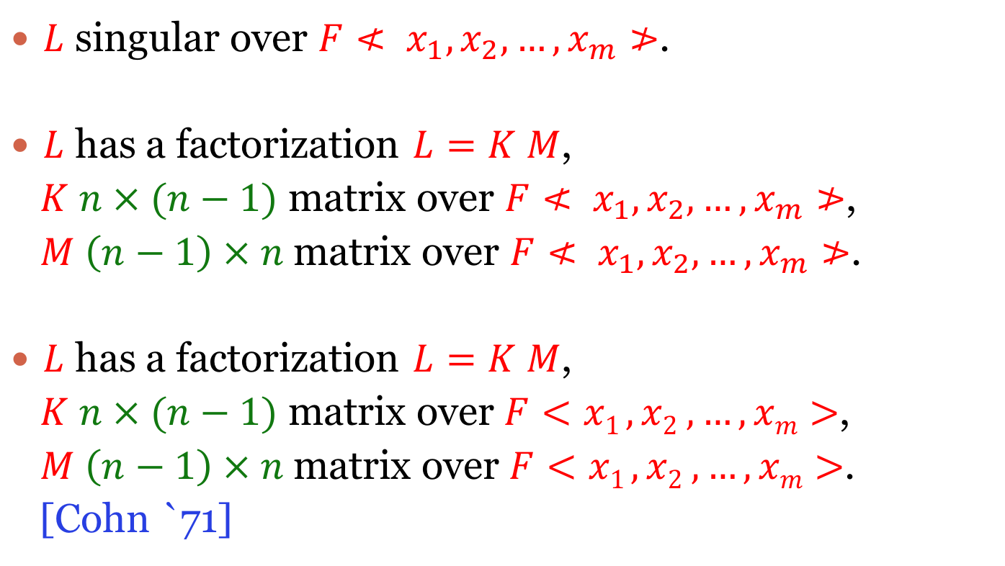
Symbolic matrices
$L$ singular over $F≮ x_{1},x_{2},…,x_{m}≯$.
$L$ has a factorization $L=K M$,
$K$ $n × (n−1)$ matrix over $F≮ x_{1},x_{2},…,x_{m}≯$,
$M$ $\left(n−1\right) × n$ matrix over $F≮ x_{1},x_{2},…,x_{m}≯$.
$L$ has a factorization $L=K M$,
$K$ $n × (n−1)$ matrix over$F<x1 , x2 ,…, xm>$,
$M$ $\left(n−1\right) × n$ matrix over$F<x1 , x2 ,…, xm>$.
[Cohn `71]
Not true in the commutative setting!
Notes:
Write the 3*3 skew symmetric matrix example on the board.

Slide 19
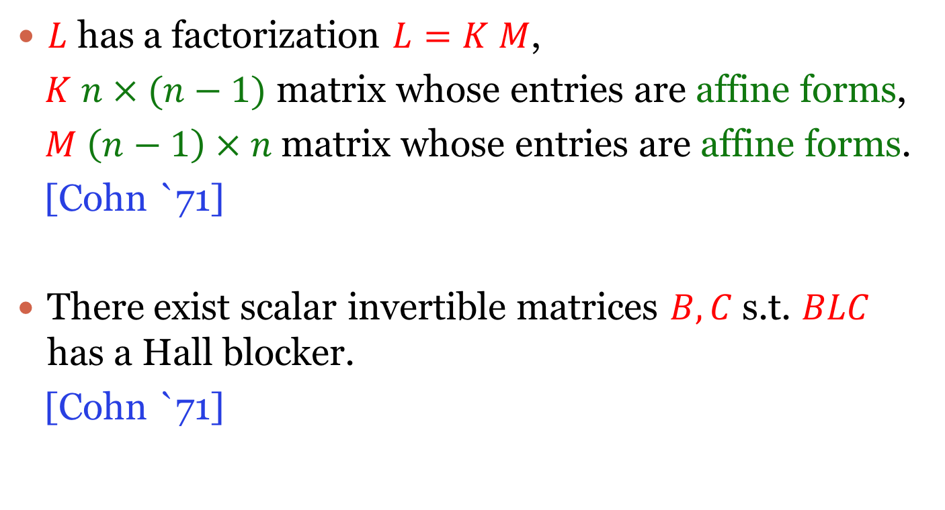
Symbolic matrices
$L$ has a factorization $L=K M$,
$K$ $n × (n−1)$ matrix whose entries are affine forms,
$M$ $\left(n−1\right) × n$ matrix whose entries are affine forms.
[Cohn `71]
There exist scalar invertible matrices $B,C$ s.t. $BLC$ has a Hall blocker.
[Cohn `71]

Slide 20



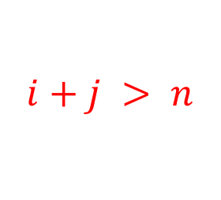

Symbolic matrices
There exist scalar invertible matrices $B,C$ s.t. $BLC$ has a Hall blocker.
$BLC=$
$$i$$
$$i+j > n$$
$0$
$$j$$

Slide 21
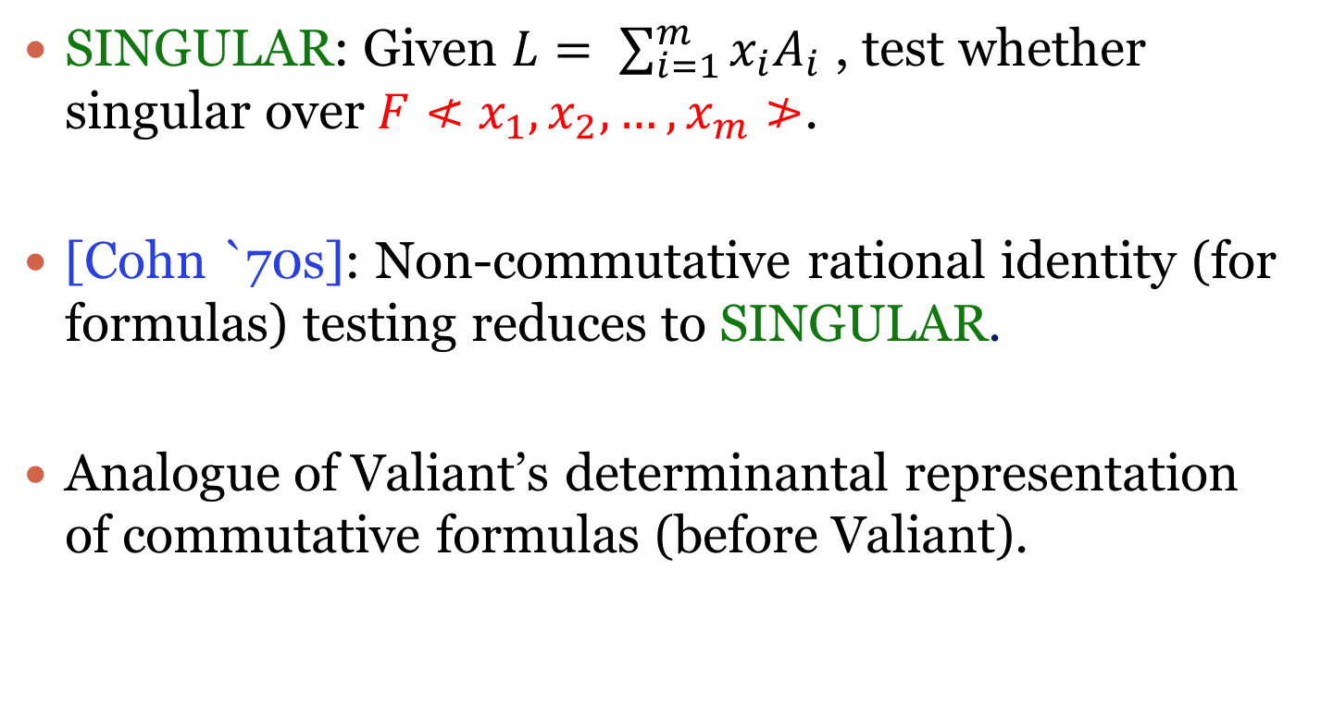
SINGULAR
SINGULAR: Given $L= \sum_{i=1}^{m}{x_{i}A_{i}}$ , test whether singular over $F≮x_{1},x_{2},…,x_{m}≯$.
[Cohn `70s]: Non-commutative rational identity (for formulas) testing reduces to SINGULAR.
Analogue of Valiant’s determinantal representation of commutative formulas (before Valiant).

Slide 22
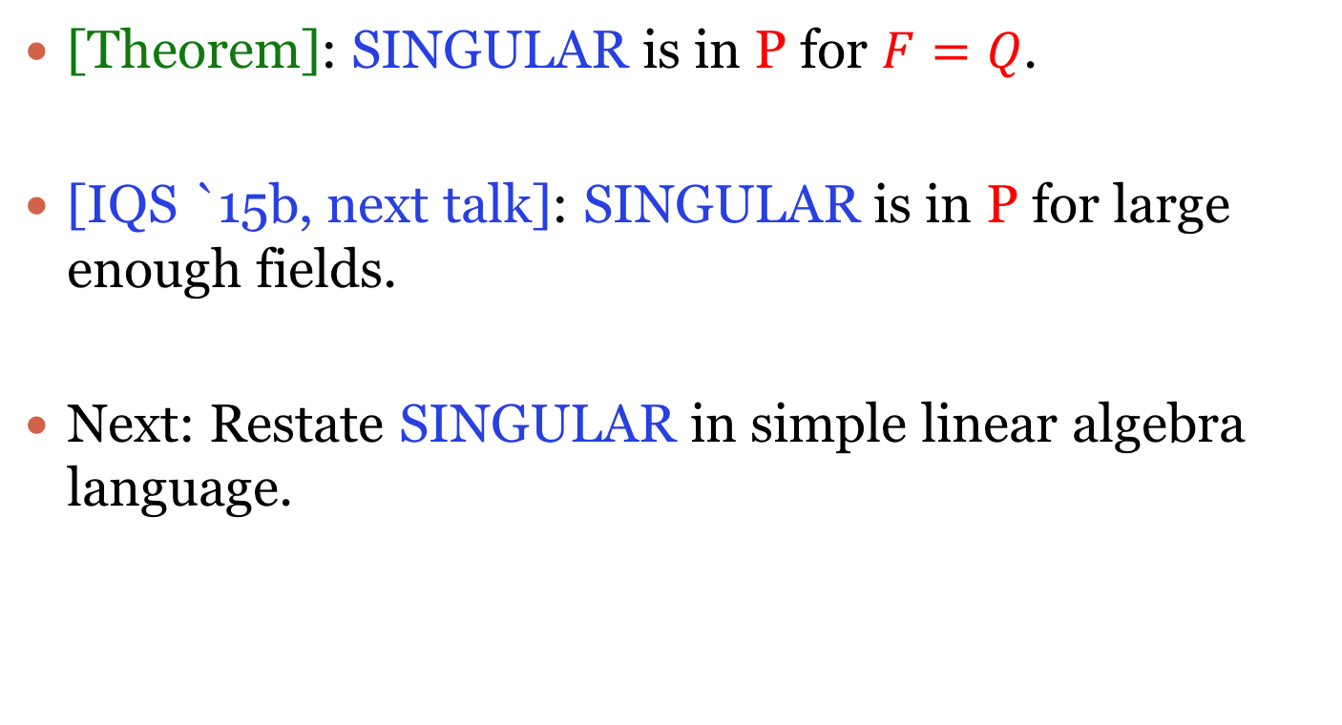
SINGULAR
[Theorem]: SINGULAR is in P for $F=Q$.
[IQS `15b, next talk]: SINGULAR is in P for large enough fields.
Next: Restate SINGULAR in simple linear algebra language.

Slide 23
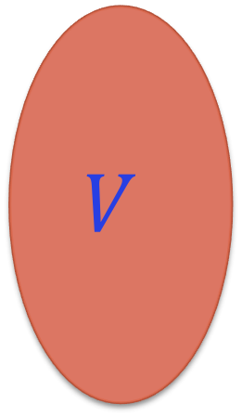



Shrunk Subspaces
[Definition]: A subspace $V of Fn$is shrunk by $A1 ,…,A_{m}$if there exists a subspace $W with dim⁡(W) < dim⁡(V)$ and $each Ai maps V into W$.
$$V$$
$$Ai$$
$$W$$

Slide 24
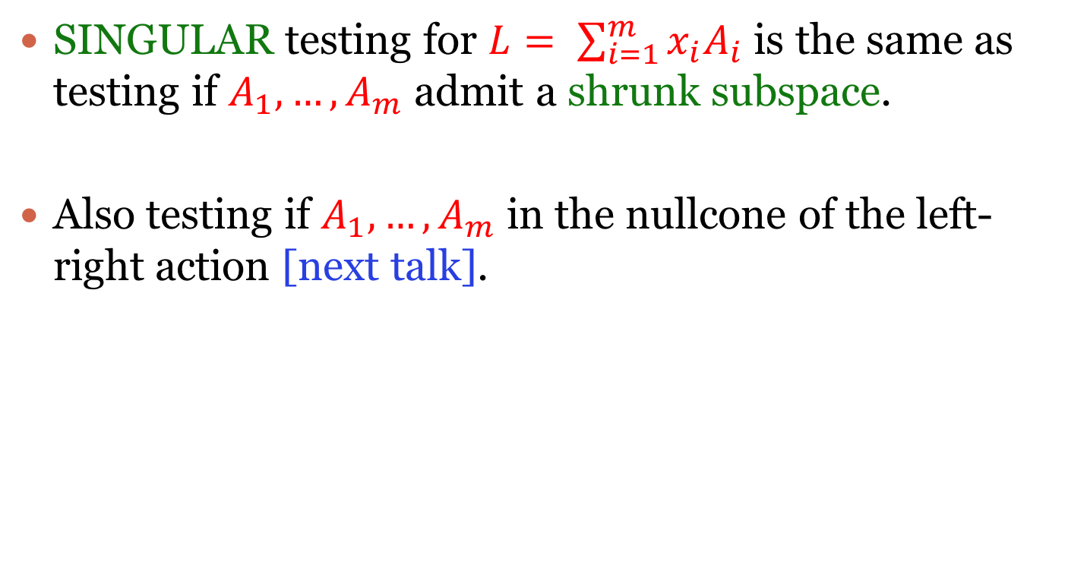
Shrunk Subspaces
SINGULAR testing for $L= \sum_{i=1}^{m}{x_{i}A_{i}}$ is the same as testing if $A_{1},…,A_{m}$ admit a shrunk subspace.
Also testing if $A_{1},…,A_{m}$ in the nullcone of the left-right action [next talk].

Slide 25
Outline
Introduction to PIT/RIT.
Symbolic matrices
Algorithm
Conclusion/Open problems

Slide 26
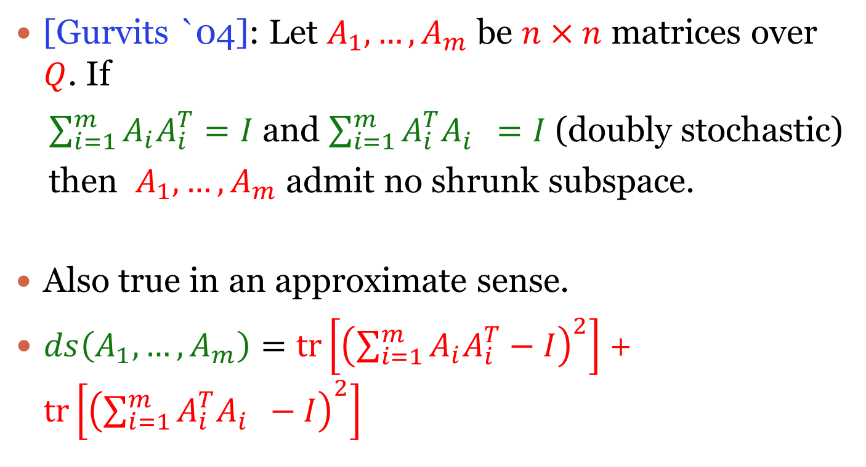
Doubly stochastic operators
[Gurvits `04]: Let $A_{1},…,A_{m}$ be $n × n$ matrices over $Q$. If
$\sum_{i=1}^{m}{A_{i}A_{i}^{T}}=I$ and $\sum_{i=1}^{m}{A_{i}^{T}A_{i}^{}}=I$ (doubly stochastic)
then $A_{1},…,A_{m}$ admit no shrunk subspace.
Also true in an approximate sense.
$ds\left(A_{1},…,A_{m}\right)=tr\left[{\left(\sum_{i=1}^{m}{A_{i}A_{i}^{T}}−I\right)}^{2}\right]$ + $tr\left[{\left(\sum_{i=1}^{m}{A_{i}^{T}A_{i}^{}}−I\right)}^{2}\right]$

Slide 27
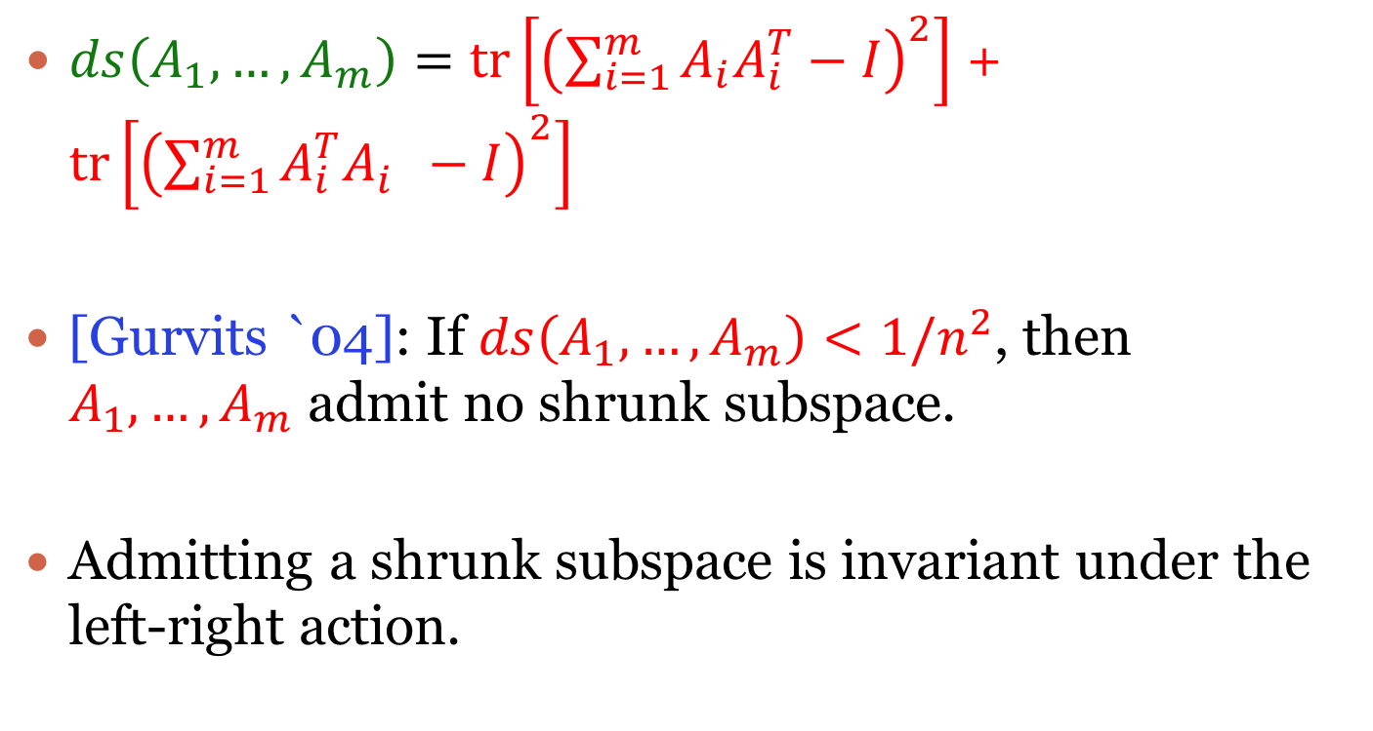
Doubly stochastic operators
$ds\left(A_{1},…,A_{m}\right)=tr\left[{\left(\sum_{i=1}^{m}{A_{i}A_{i}^{T}}−I\right)}^{2}\right]$ + $tr\left[{\left(\sum_{i=1}^{m}{A_{i}^{T}A_{i}^{}}−I\right)}^{2}\right]$
[Gurvits `04]: If $ds\left(A_{1},…,A_{m}\right)<1/n^{2}$, then $A_{1},…,A_{m}$ admit no shrunk subspace.
Admitting a shrunk subspace is invariant under the left-right action.

Slide 28
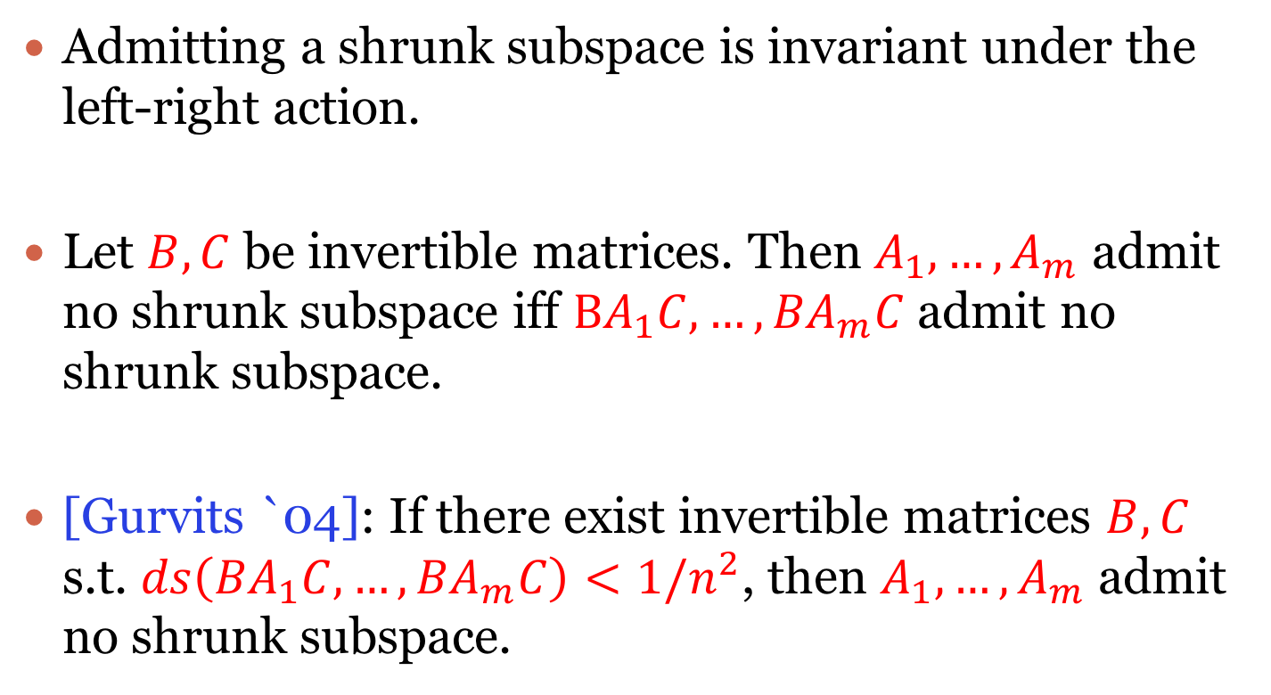
Doubly stochastic operators
Admitting a shrunk subspace is invariant under the left-right action.
Let $B,C$ be invertible matrices. Then $A_{1},…,A_{m}$ admit no shrunk subspace iff $BA_{1}C,…,{BA}_{m}C$ admit no shrunk subspace.
[Gurvits `04]: If there exist invertible matrices $B,C$ s.t. $ds\left({BA}_{1}C,…,{BA}_{m}C\right)<1/n^{2}$, then $A_{1},…,A_{m}$ admit no shrunk subspace.

Slide 29
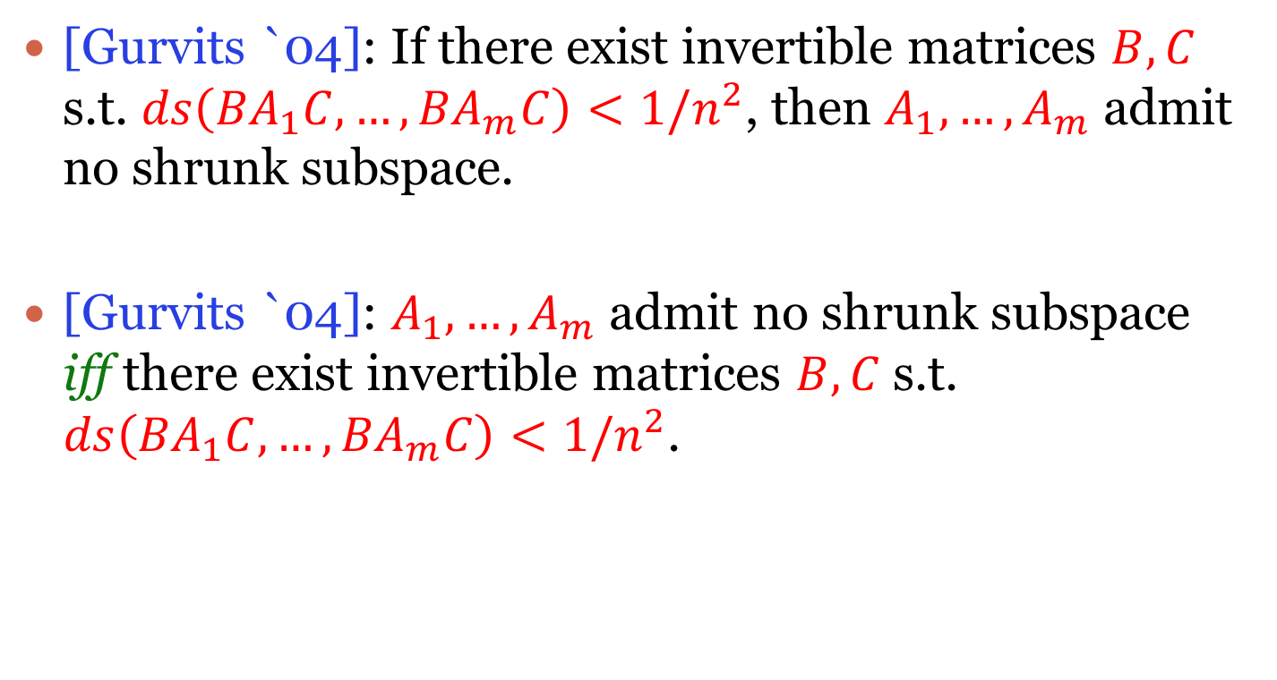
Doubly stochastic operators
[Gurvits `04]: If there exist invertible matrices $B,C$ s.t. $ds\left({BA}_{1}C,…,{BA}_{m}C\right)<1/n^{2}$, then $A_{1},…,A_{m}$ admit no shrunk subspace.
[Gurvits `04]: $A_{1},…,A_{m}$ admit no shrunk subspace iff there exist invertible matrices $B,C$ s.t. $ds\left({BA}_{1}C,…,{BA}_{m}C\right)<1/n^{2}$.

Slide 30
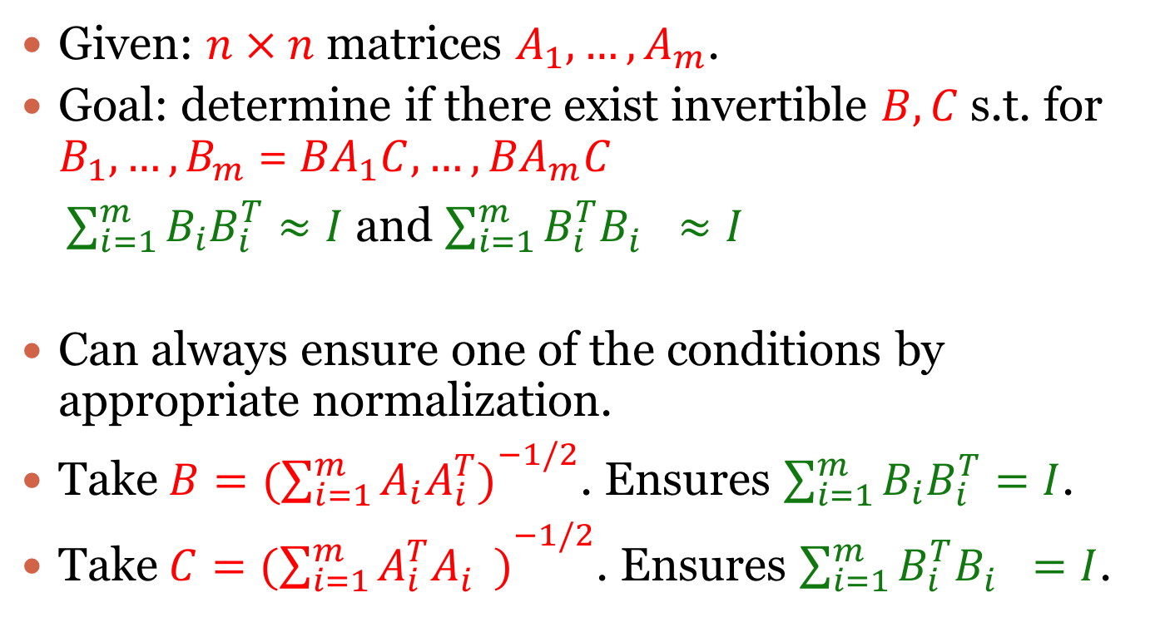
Algorithm G
Given: $n × n$ matrices $A_{1},…,A_{m}$.
Goal: determine if there exist invertible $B,C$ s.t. for $B_{1},…,B_{m}$ = ${BA}_{1}C,…,{BA}_{m}C$
$\sum_{i=1}^{m}{B_{i}B_{i}^{T}}≈I$ and $\sum_{i=1}^{m}{B_{i}^{T}B_{i}^{}}≈I$
Can always ensure one of the conditions by appropriate normalization.
Take$B=({\sum_{i=1}^{m}{A_{i}A_{i}^{T})}}^{−1/2}$. Ensures $\sum_{i=1}^{m}{B_{i}B_{i}^{T}}=I$.
Take$C=({\sum_{i=1}^{m}{A_{i}^{T}A_{i}^{})}}^{−1/2}$. Ensures $\sum_{i=1}^{m}{B_{i}^{T}B_{i}^{}}=I$.

Slide 31
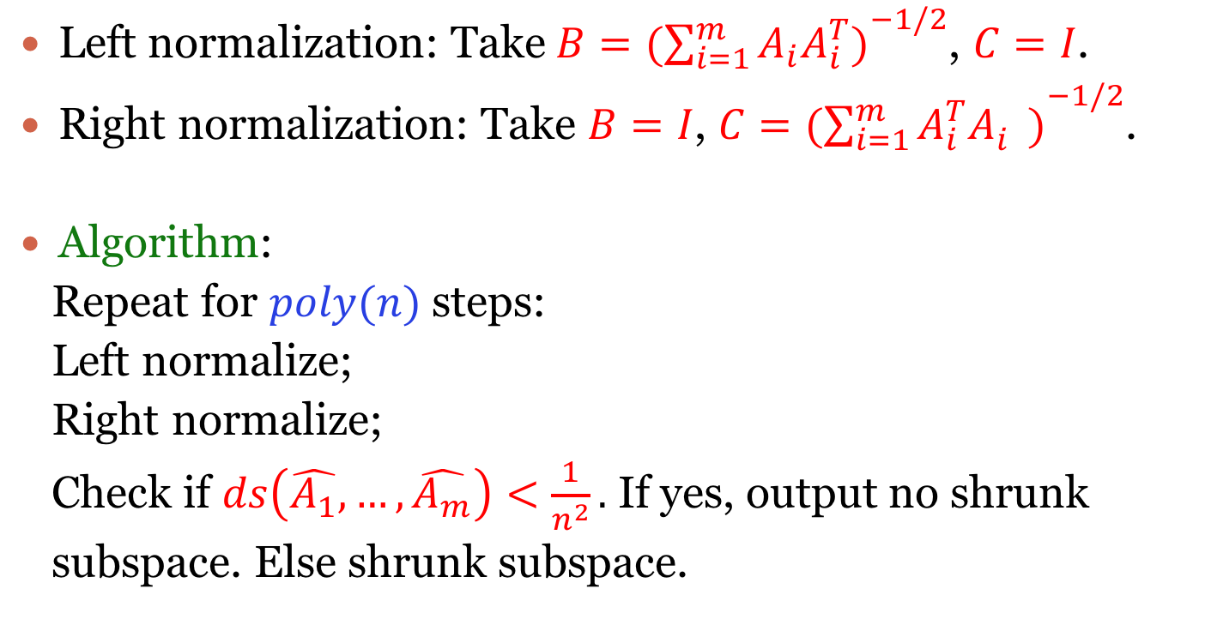
Algorithm G
Left normalization: Take$B=({\sum_{i=1}^{m}{A_{i}A_{i}^{T})}}^{−1/2}$, $C=I$.
Right normalization: Take $B=I$, $C=({\sum_{i=1}^{m}{A_{i}^{T}A_{i}^{})}}^{−1/2}$.
Algorithm:
Repeat for $poly(n)$ steps:
Left normalize;
Right normalize;
Check if $ds\left(\hat{A_{1}},…,\hat{A_{m}}\right)<\frac{1}{n^{2}}.$ If yes, output no shrunk
subspace. Else shrunk subspace.

Slide 32
Algorithm G
Algorithm already suggested in [Gurvits `04].
Our contribution: prove that it works!
“Non-commutative extension” of matrix scaling algorithms [Sinkhorn `64, LSW ‘98].

Slide 33
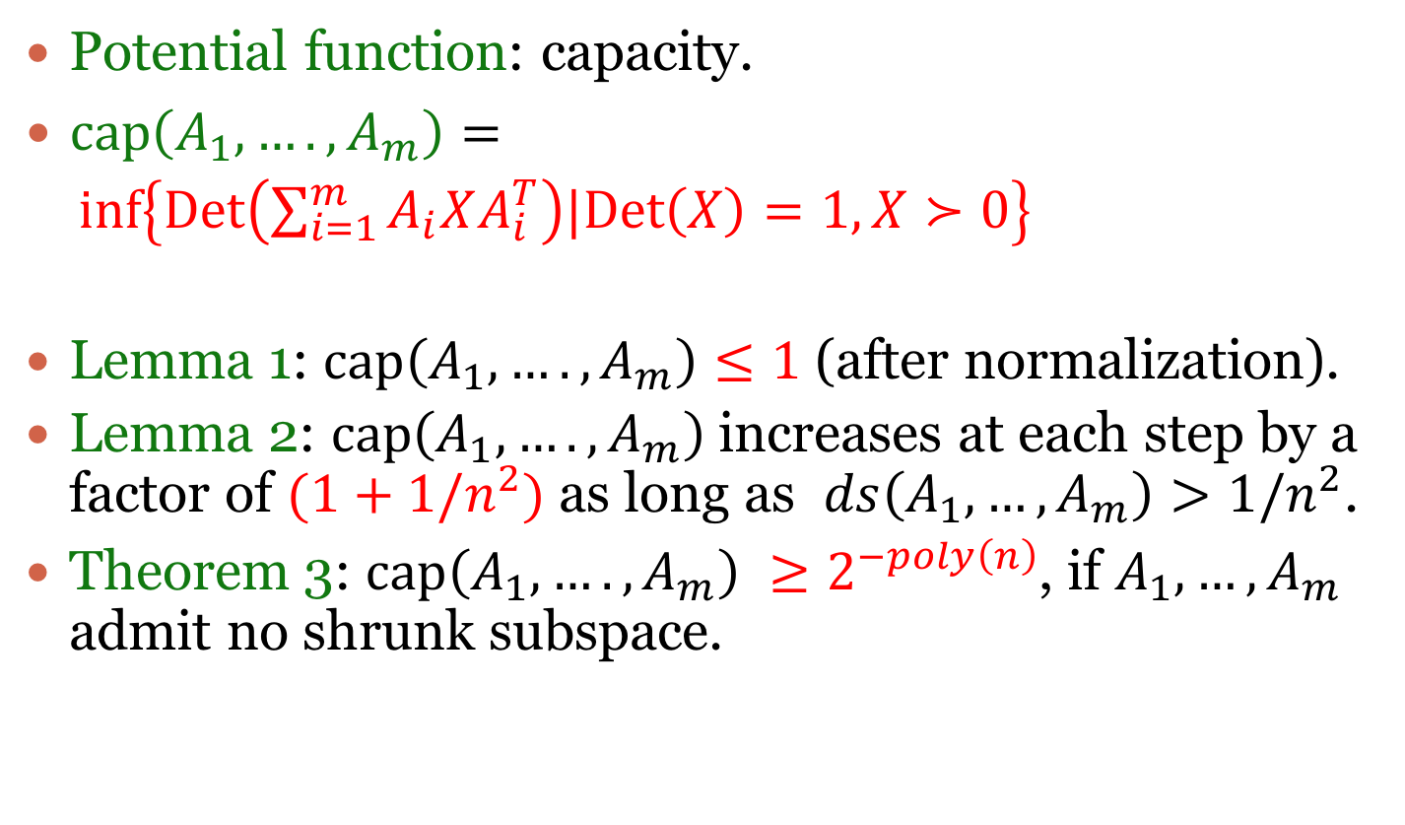
Analysis - Capacity
Potential function: capacity.
$cap\left(A_{1},….,A_{m}\right)=$
$inf\left\{Det\left(\sum_{i=1}^{m}{A_{i}XA_{i}^{T}}\right)|Det\left(X\right)=1, X≻0\right\}$
Lemma 1: $cap\left(A_{1},….,A_{m}\right)≤1$ (after normalization).
Lemma 2: $cap\left(A_{1},….,A_{m}\right)$ increases at each step by a factor of $(1+1/n^{2})$ as long as $ds\left(A_{1},…,A_{m}\right)>1/n^{2}$.
Theorem 3: $cap\left(A_{1},….,A_{m}\right) ≥2^{−poly\left(n\right)}$, if $A_{1},…,A_{m}$ admit no shrunk subspace.
Main contribution

Slide 34
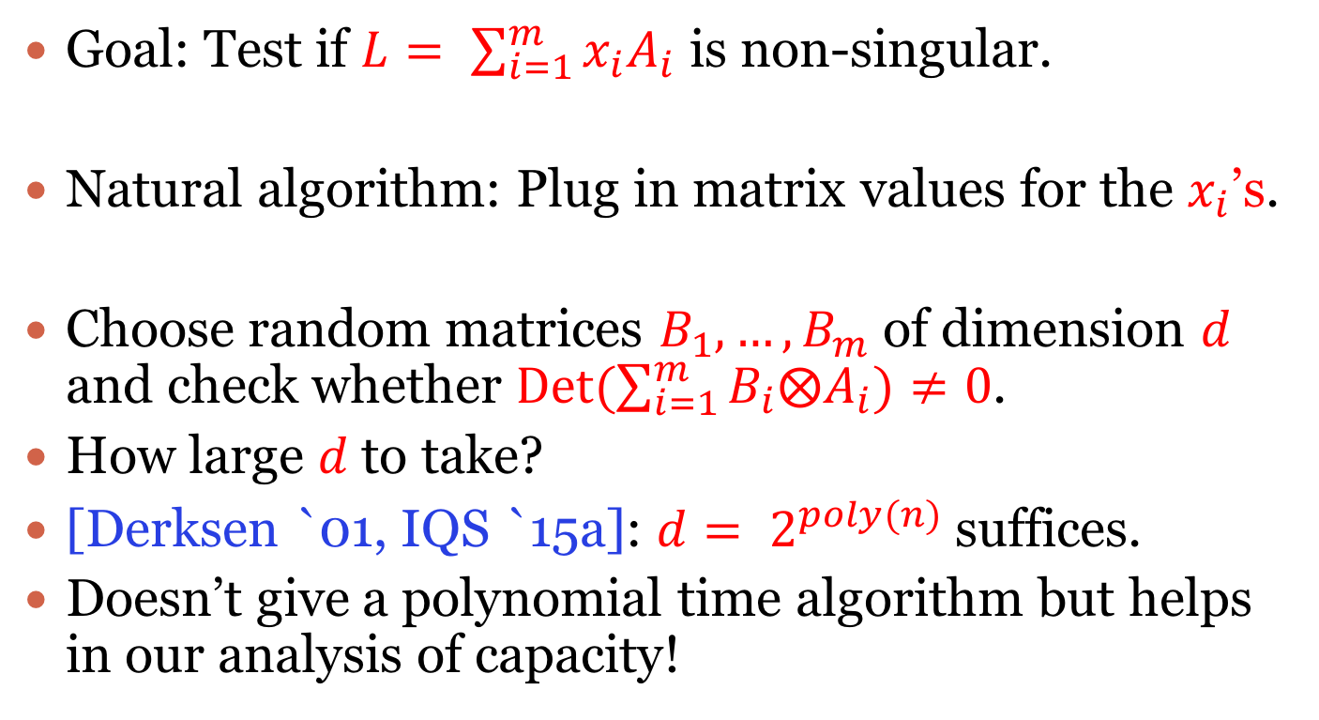
Fullness dimension
Goal: Test if $L= \sum_{i=1}^{m}{x_{i}A_{i}}$ is non-singular.
Natural algorithm: Plug in matrix values for the $x_{i}$’s.
Choose random matrices $B_{1},…,B_{m}$ of dimension $d$ and check whether $Det(\sum_{i=1}^{m}{B_{i}⨂A_{i}})≠0$.
How large $d$ to take?
[Derksen `01, IQS `15a]: $d= 2^{poly(n)}$ suffices.
Doesn’t give a polynomial time algorithm but helps in our analysis of capacity!

Slide 35
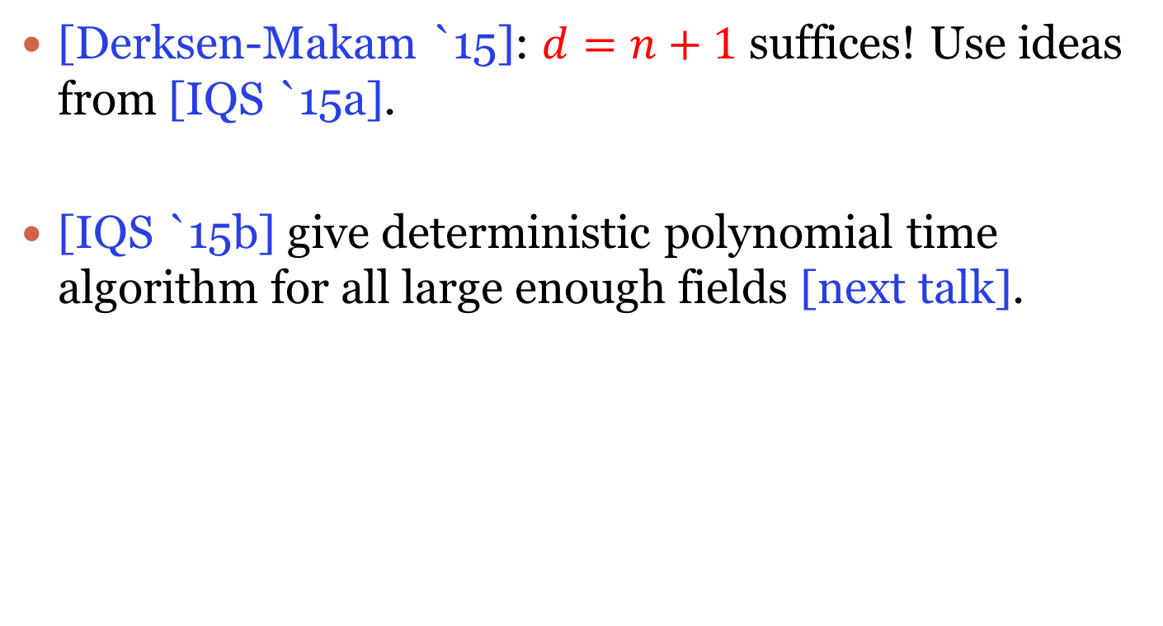
Fullness dimension
[Derksen-Makam `15]: $d=n+1$ suffices! Use ideas from [IQS `15a].
[IQS `15b] give deterministic polynomial time algorithm for all large enough fields [next talk].

Slide 36
Outline
Introduction to PIT/RIT.
Symbolic matrices
Algorithm
Conclusion/Open problems

Slide 37
Conclusion
Analytic algorithm for a purely algebraic problem!
Polynomial degree bounds not essential to put algebraic geometric problems in P.
Not essential for this specific problem [next talk].

Slide 38
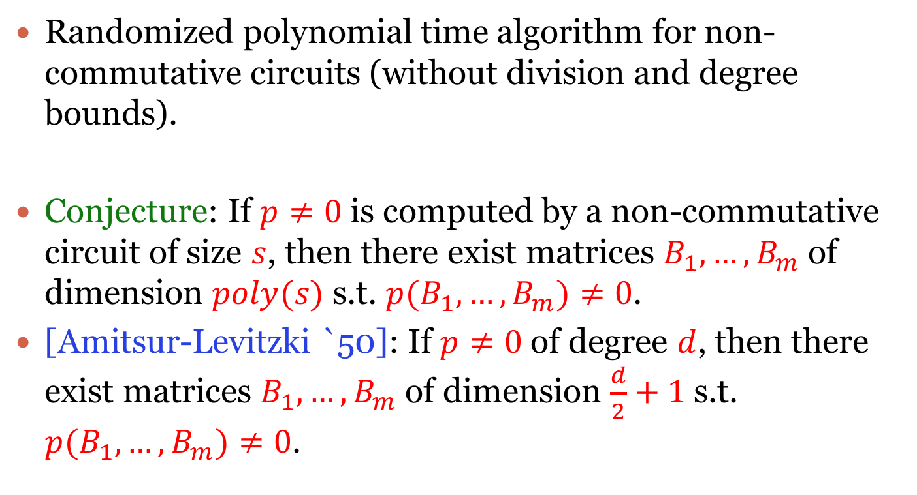
Open Problems
Randomized polynomial time algorithm for non-commutative circuits (without division and degree bounds).
Conjecture: If $p≠0$ is computed by a non-commutative circuit of size $s$, then there exist matrices $B_{1},…,B_{m}$ of dimension $poly(s)$ s.t. $p(B_{1},…,B_{m})≠0$.
[Amitsur-Levitzki `50]: If $p≠0$ of degree $d$, then there exist matrices $B_{1},…,B_{m}$ of dimension $\frac{d}{2}+1$ s.t. $p(B_{1},…,B_{m})≠0$.

Slide 39
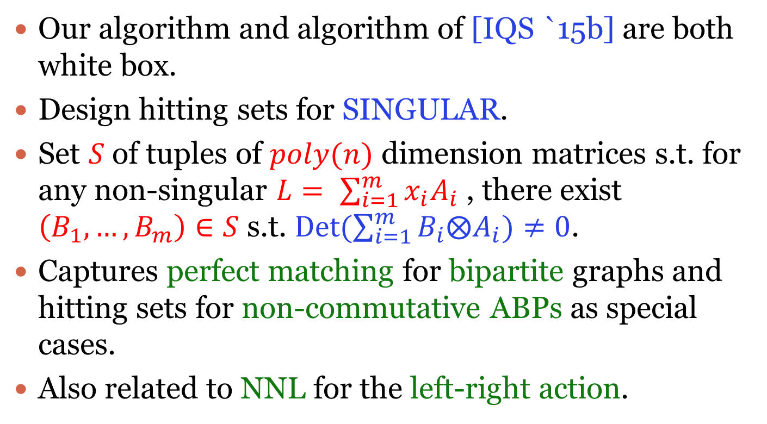
Open Problems
Our algorithm and algorithm of [IQS `15b] are both white box.
Design hitting sets for SINGULAR.
Set $S$ of tuples of $poly(n)$ dimension matrices s.t. for any non-singular $L= \sum_{i=1}^{m}{x_{i}A_{i}}$ , there exist $\left(B_{1},…,B_{m}\right)∈S$ s.t. $Det(\sum_{i=1}^{m}{B_{i}⨂A_{i}})≠0$.
Captures perfect matching for bipartite graphs and hitting sets for non-commutative ABPs as special cases.
Also related to NNL for the left-right action.

Slide 40
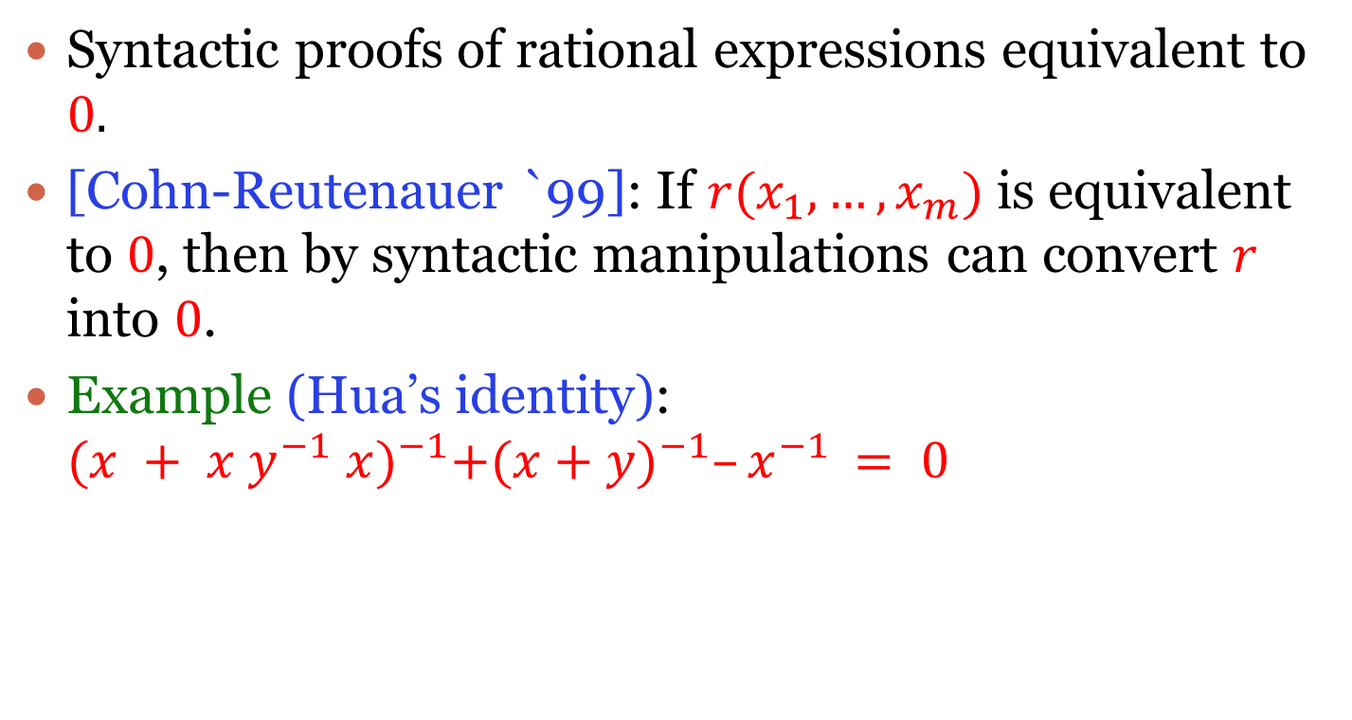
Open Problems
Syntactic proofs of rational expressions equivalent to $0.$
[Cohn-Reutenauer `99]: If $r(x_{1},…,x_{m})$ is equivalent to $0$, then by syntactic manipulations can convert $r$ into $0$.
Example (Hua’s identity): ${(x + x y^{−1} x)}^{−1}+{(x+y)}^{−1}–x^{−1} = 0$

Slide 41
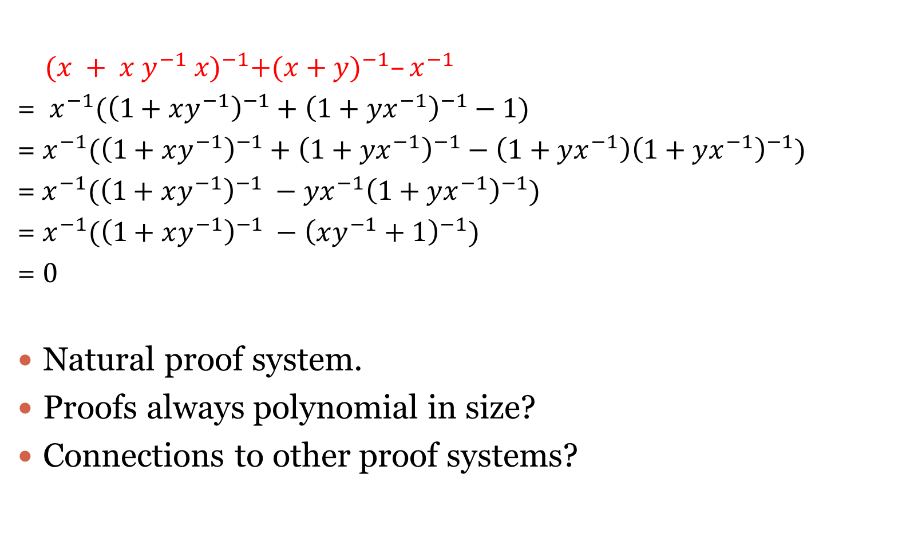
Open Problems
${(x + x y^{−1} x)}^{−1}+{(x+y)}^{−1}–x^{−1}$
= $x^{−1}({\left(1+xy^{−1}\right)}^{−1}+{\left(1+yx^{−1}\right)}^{−1}−1)$
= $x^{−1}({\left(1+xy^{−1}\right)}^{−1}+{\left(1+yx^{−1}\right)}^{−1}−{\left(1+yx^{−1}\right)\left(1+yx^{−1}\right)}^{−1})$
=$x^{−1}({\left(1+xy^{−1}\right)}^{−1} −yx^{−1}{\left(1+yx^{−1}\right)}^{−1})$
= $x^{−1}({\left(1+xy^{−1}\right)}^{−1} −{\left(xy^{−1}+1\right)}^{−1})$
= $0$
Natural proof system.
Proofs always polynomial in size?
Connections to other proof systems?
Notes:
Axioms used: a^-1 b^-1 = ba^-1, addition is commutative etc. Also replace 1 by g g^-1.
Mention the issue about gg^-1 = 1. Of course g has to be a non-zero expression and the proof has to certify that as well.

Slide 42
Thank You

