Slide 1
Methods for
Proving
Termination

Slide 2
Termination
1. Termination

Slide 3
Software Correctness
Outputs Are Correct
Terminates (or Doesn’t)
Resource issues
Accuracy Issues
Timing Issues

Slide 4
Termination
Algorithm Halts for All (Specified) Inputs
  Iterative Loops
  Nested Loops
  Recursive Loops
  Symbolic Computation

Slide 5
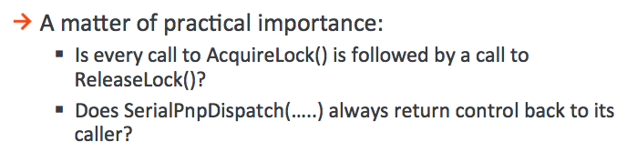
Microsoft: Liveness

Slide 6
Plan
Termination is Undecidable
The Easy Cases
The Hard Cases

Slide 7
Requirements
Attendance and participation
Readings and discussions
Try to solve assignments
final exam or term paper or system (tbd)

Slide 8
Readings
Turing, 1936
Strachey, 1965
Katz & Manna, 1975

Slide 9
History
Euclid
Alan Turing
Bob Floyd
Zohar Manna

Slide 10
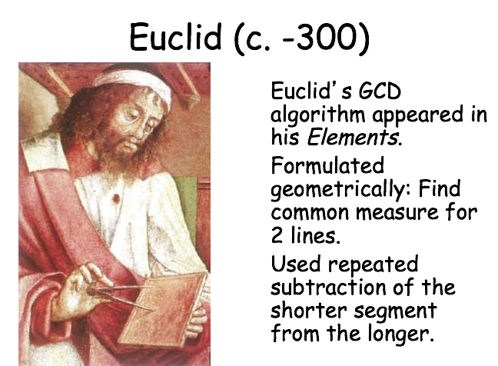

Slide 11
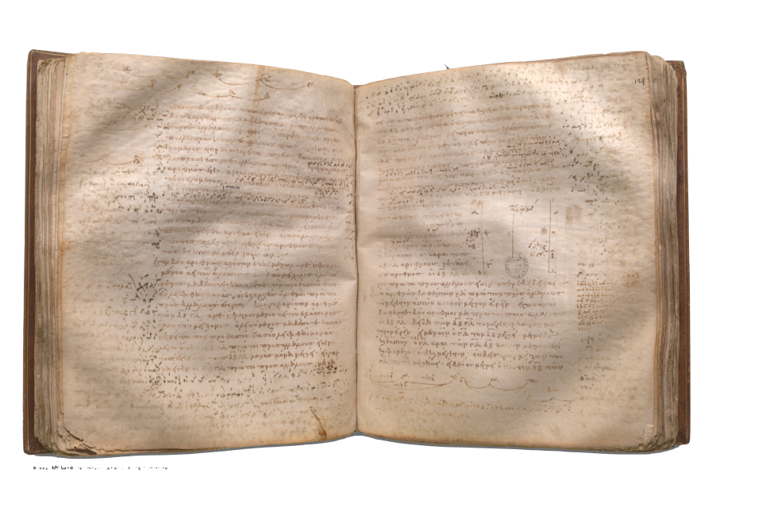
Antique Algorithm
Image courtesy of the Clay Mathematics Institute

Slide 12
Antenaresis
Δύο ἀριθμῶν ἀνίσων ἐκκειμένων, ἀνθυφαιρουμένου δὲ ἀεὶ τοῦ ἐλάσσονος ἀπὸ τοῦ μείζονος, ἐὰν ὁ λειπόμενος μηδέποτε καταμετρῇ τὸν πρὸ ἑαυτοῦ, ἕως οὗ λειφθῇ μονάς, οἱ ἐξ ἀρχῆς ἀριθμοὶ πρῶτοι πρὸς ἀλλήλους ἔσονται
When two unequal numbers are set out, and the less is continually subtracted in turn from the greater, if the number which is left never measures the one before it until a unit is left, then the original numbers are relatively prime.

Slide 13
Greatest Common Divisor
repeat
if m=n then return n
if m<n then n := n-m
if m>n then m := m-n

Slide 14
^{Hailstones}
Loop until x=1
if 2|x
then x := x/2
else x := 3x+1

Slide 15
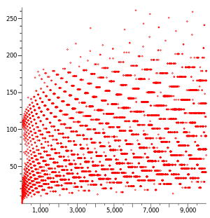

Slide 16
A 2-MINUTE PROOF
OF THE
2nd-MOST IMPORTANT THEOREM
OF THE
2nd MILLENNIUM
by Doron Zeilberger
Written: Oct. 4, 1998

Slide 17
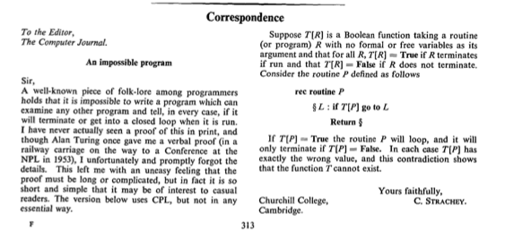

Slide 19
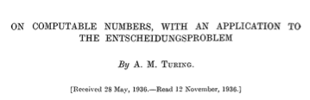


Slide 20
Proof
Imagine some program halt(p,x) that answers “yes” when p(x) halts and “no” otherwise.
Construct the program
alan(p) = if halt(p,p) says “yes”
then “do nothing” forever
otherwise answer “yes”
Consider the question halt(alan,alan).

Slide 21
Proof
Imagine some program halt(p,x) that answers “yes” when p(x) halts and “no” otherwise.
Consider halt(alan,alan)
alan(alan) = if halt(alan,alan) says “yes”
then “do nothing” forever
otherwise answer “yes”
halt(alan,alan)?

Slide 22
Proof
Imagine some program halt(p,x) that answers “yes” when p(x) halts and “no” otherwise.
Consider halt(alan,alan)
alan(alan) = if halt(alan,alan) says “yes”
then “do nothing” forever
otherwise answer “yes”
No answer: BAD

Slide 23
Proof
Imagine some program halt(p,x) that answers “yes” when p(x) halts and “no” otherwise.
Consider halt(alan,alan)
alan(alan) = if halt(alan,alan) says “yes”
then “do nothing” forever
otherwise answer “yes”
Yes: alan(alan) = do nothing forever: BAD

Slide 24
Proof
Imagine some program halt(p,x) that answers “yes” when p(x) halts and “no” otherwise.
Consider halt(alan,alan)
alan(alan) = if halt(alan,alan) says “yes”
then “do nothing” forever
otherwise answer “yes”
No: alan(alan) = yes: BAD

Slide 25
Size Proof
Imagine some program halt(p,x) that answers “yes” when p(x) halts and “no” otherwise -- provided |p|,|x| < n
Consider halt(alan,alan)
alan(x) = if halt(x,x) says “yes”
then “do nothing” forever
otherwise answer “yes”
|alan| = |halt|+c > n

Slide 26
Size Proof
Imagine some program halt(p,x) that answers “yes” when p(x) halts and “no” otherwise -- provided |p|,|x| < n
Consider halt(alan,alan)
alan(x) = if halt(x,x) says “yes”
then “do nothing” forever
otherwise answer “yes”
|halt| > n-c

Slide 27
Size Proof
Imagine some program halt(p,x) that answers “yes” when p(x) halts and “no” otherwise -- provided |p|,|x| < n
Consider halt(alan,alan)
alan(x) = if halt(x,x) says “yes”
then “do nothing” forever
otherwise answer “yes”
assuming almost nothing

Slide 28
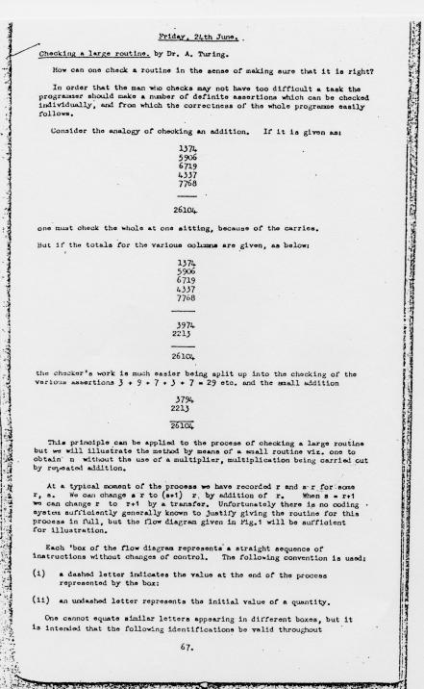

Slide 29
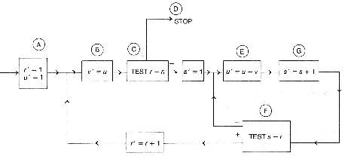

Slide 30
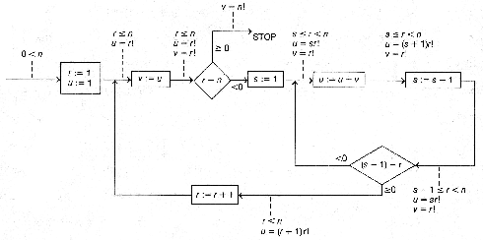
Invariants

Slide 31
Invariants
r := 1
u := 1
loop v := u
    until r≥n
    s := 1
    loop u := u+v
        s := s+1
        while s≤r
        repeat
    r := r+1
    repeat
1≤r≤n
1≤s≤r+1

Slide 32
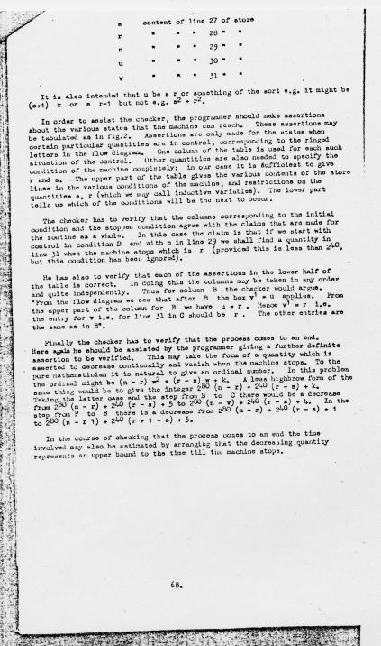

Slide 33
Turing’s Proof
The checker has to verify that the process comes to an end. Here again he should be assisted by the programmer giving a further definite assertion to be verified. This may take the form of a quantity which is asserted to decrease continually and vanish when the machine stops. To the pure mathematician it is natural to give an ordinal number. In this problem the ordinal might be (n - r)ω² + (r - s)ω + k. A less highbrow form of the same thing would be to give the integer 2⁸⁰(n - r) + 2⁴⁰(r - s) + k.

Slide 34
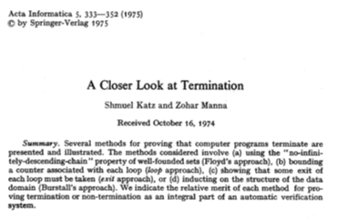

Slide 35
Greatest Common Divisor
repeat
if m=n then return n
if m<n then n := n-m
if m>n then m := m-n

Slide 36
Method
Find a measure that decreases with each iteration
And cannot decrease forever

Slide 37
Loop Invariants
Need to know that m and n are nonnegative

Slide 38
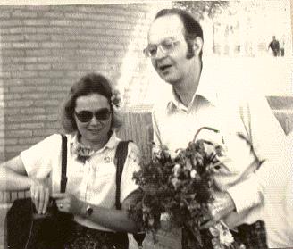
Knuth (1966)
A computational
method
comprises
a set of states…
In this way we can divorce abstract algorithms from particular programs that represent them.

Slide 39
states
initial
terminal

Slide 40
Transition System
I
Q
O

Slide 41
Discrete Steps
An algorithm is a discrete state-transition system.
Its transitions are a binary relation on states.

Slide 42
Hartley Rogers, Jr.
  For any given input, the computation is carried out in a discrete stepwise fashion, without use of continuous methods or analogue devices.
  Computation is carried forward deterministically, without resort to random methods or devices, e.g., dice.

Slide 43
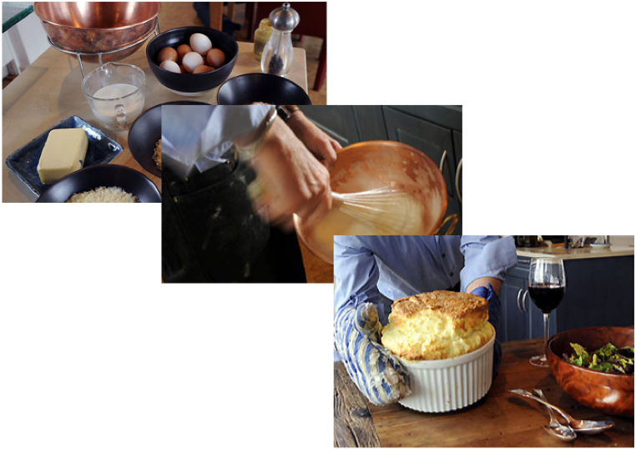
Non-Example
Notes:
souffle

Slide 44
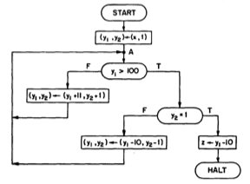

Slide 45
91
int mccarthy (int n)
{int c;
for (c = 1; c != 0; ) {
if (n > 100) {
n = n - 10;
c--;
} else {
n = n + 11;
c++;
}
}
return n;
}

Slide 46
Solve for Decrease
Suppose measure is a linear combination of the variables
n > 100: an+bc > a(n-10)+b(c-1)
n < 99: an+bc > a(n+11)+b(c+1)
  11a+b < 0 < 10a+b
  a = -2; b = 21
  add 2max(input,111) to keep positive

Slide 47
Artificial Variables
int mccarthy (int n)
{int c; i=0; j=0;
for (c = 1; c != 0; ) {
if (n > 100) {
n = n - 10;
c--; i++;
} else {
n = n + 11;
c++; j++;
}
}
return n;
}

Slide 48
Infer Invariants
c = j-i+1
...

Slide 49
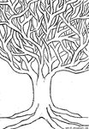
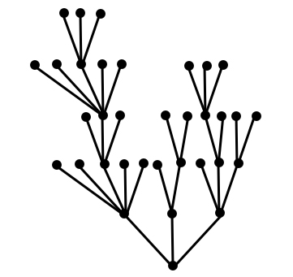

Slide 50
König’s Lemma
A tree is finite (has finitely many edges)
if and only if
    all nodes have finite degree
    and
    all branches (simple paths) have finite length.

Slide 51
Binary Search (x=y[l])
l := a
r := b
loop until l=r
  m := [(l+r)÷2]
  if y[m] ≥ x
    then r := ??
    else l := ???
    given:
      a ≤ b
      y[j] ≤ y[j+1]
      x=y[i], a ≤ i ≤ b
    unbounded integers

Slide 52
Binary Search (x=y[l])
l := a
r := b
loop until l=r
  m := [(l+r)÷2]
  if y[m] ≥ x
    then r := m
    else l := m+1
    given:
      a ≤ b
      y[j] ≤ y[j+1]
      x=y[i], a ≤ i ≤ b
    unbounded integers
    invariants:
      a ≤ l ≤ r ≤ b
      y[l] ≤ x ≤ y[r]

Slide 53
Binary Search is Hard
Don Knuth: the idea is comparatively straightforward; the details can be surprisingly tricky.
Jon Bentley assigned it as a problem in a course for professional programmers. 90% failed even after several hours.
accurate code is only found in 5 out of 20 textbooks.
Bentley's own implementation (in his Programming Pearls) contains an error that went undetected for over 20 years.

Slide 54
Termination
2. Games

Slide 55
Readings
Floyd, “Assigning Meaning to Programs”
“Proving Termination with Multiset Orderings”

Slide 56
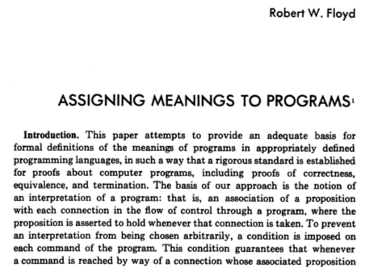

Slide 57
Invariants
r := 1
u := 1
loop v := u
    until r≥n
    s := 1
    loop u := u+v
        s := s+1
        while s≤r
        repeat
    r := r+1
    repeat
1≤r≤n
1≤s≤r+1

Slide 58
Double Induction
Inner loop
Outer loop

Slide 59
Orderings
Partial ordering
  Irreflexive
  Transitive
  Asymmetric

Slide 60
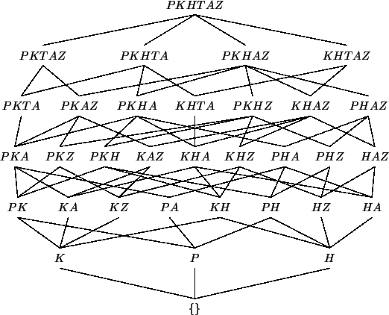
Hasse Diagram

Slide 61
Orderings (Well-founded)
Partial ordering
  Irreflexive
  Transitive
  Asymmetric
Well-founded
  No infinite decreasing chains

Slide 62
Well-Founded Orderings
N, >
Z⁻, <
Z, ???
Finite trees, subtree
NxN, lexicographic
∑*, subword
∑*, lexicographic ???

Slide 63
Couples
(a,b) > (a’,b’)
Component-wise: a>a’ & b≥b’ or a≥a’ & b>b’
Lexicographic: a>a’ or a=a’ & b>b’
Reverse lexicographic: a>a’ & b=b’ or b>b’
Pairs of pairs: (1,0) > (0,(1,0)) > ...

Slide 64
Mixed Couples
If V and W are well-founded, then their pairs VxW are well-founded lexicographically.

Slide 65
Ackermann
Termination of recursion
  Induction on (m,n)

Slide 66
Turing’s Program
r := 1
u := 1
loop v := u
    until r≥n
    s := 1
    loop u := u+v
        s := s+1
        while s≤r
        repeat
    r := r+1
    repeat
(n-r,r-s)

Slide 67
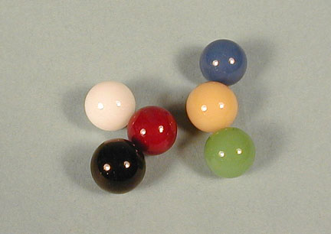
67

Slide 68
Dutch National Flag

Slide 69
Dutch National Flag

Slide 70
Flag Problem

Slide 71
Dutch National Flag

Slide 72
Dutch National Flag

Slide 73
Dutch National Flag

Slide 74
Dutch National Flag

Slide 75
Dutch National Flag

Slide 76
Dutch National Flag

Slide 77
Dutch National Flag

Slide 78
Dutch National Flag

Slide 79
Dutch National Flag

Slide 80
Dutch National Flag

Slide 81
Dutch National Flag

Slide 82
Dutch National Flag

Slide 83
Dutch National Flag

Slide 84
Dutch National Flag

Slide 85
Dutch National Flag

Slide 86
Ackermann’s Function
A(0,n) = n+1
A(m+1,0) = a(m,1)
a(m+1,n+1) = a(m,a(m+1,n))

Slide 87
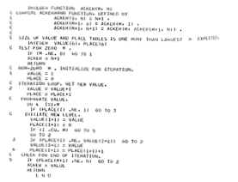
Ackermann

Slide 88
Ackermann
a(4,4) = 2↑7-3
Computation is much longer
Fact: a(m,n) > m+n ≥ m,n

Slide 89
Double Induction
Call by value termination
Assume terminating for smaller m
  Assume terminating for same m and smaller n

Slide 90
Primitive Recursion
  0
  +1
  projections
  composition
  f(x,n) := if n=0 then g(x) else h(f(x,n-1),x,n-1)

Slide 91
Ackermann’s Function
  A(0,n) = n+1
  A(m+1,0) = A(m,1)
  A(m+1,n+1) = A(m,A(m+1,n))

Slide 92
A(m,n) > m+n
  Induction on (m,n)
    A(0,n) = n+1 > n
    A(m+1,0) = A(m,1) > m+1
    A(m+1,n+1) = A(m,A(m+1,n)) > m+A(m+1,n) ≥ m+n+2

Slide 93
x>y ⇒ A(m,x) > A(m,y)
  Induction on (m,x)
    A(0,x) = x+1 > y+1 = A(0,y)
    A(m+1,x+1) = A(m,A(m+1,x)) > A(m,A(m+1,y)) = A(m+1,y+1)

Slide 94
x>y ⇒ A(x,n) > A(y,n)
  Induction on (x,n)
    A(x,n) > x+n > n = A(0,n)
    A(x+1,0) = A(x,1) > A(y,1) = A(y+1,0)
    A(x+1,n+1) = A(x,A(x+1,n)) > A(y,A(x+1,n)) > A(y,A(y+1,n)) = A(y+1,n+1)

Slide 95
A(m+n+2,x) > A(m,A(n,x))
  Induction (m+n,x)
    A(n+2,x) > A(n+1,x) ≥ A(n,x)+1 = A(0,A(n,x))
    A(m+n+2,0) = A(m+n+1,1) > A(m,A(n-1,1)) = A(m,A(n,0))
    A(m+n+2,x+1) = A(m+n+1,A(n+m+2,x)) > A(m,A(n,A(m,x))) > A(m,A(n,x+m)) ≥ A(m,A(n,x+1))

Slide 96
A isn’t Primitive Recursive
Denote x = x1,...,xk and xm = max xj
Say Ai > g if A(i,xm) > g(x) for all x
Easy: A0 > 0; A1 > +1; A0 > proji
Suppose f(x) = h(g1x,...,gkx), As > g1,...,gk,h
  A2s+2 > f: A(2s+2,x) > A(s,A(s,x)) > A(s,max{gjx}) > h(g1x,...,gkx)

Slide 97
A isn’t Primitive Recursive
Suppose As > g,h and f(x,n)=if n=0 then g(x) else h(f(x,n-1),x,n-1)
A(r,n+xm) > f(x,n), r = 2s+1, by induction on n:
  f(x,0) = g(x) < A(s,xm) < A(r,0+xm)
  f(x,n+1) = h(f(x,n),x,n) < A(s,max{f(x,n),n,xm}) < A(s,A(r,n+xm)) < A(2s,A(r,n+xm)) = A(r,n+1+xm)
f(x,n) < A(r,n+xm) < A(r,2N+3)= A(r,A(2,N))< A(r+4,N) where N = max{n,xm}

Slide 98
Basic A(m,n)
DIM s(tsize + 1)
t = 1: s(t) = m
DO
c = c + 1
m = s(t): t = t - 1
IF m = 0 THEN
n = n + 1
ELSEIF n = 0 THEN
t = t + 1: s(t) = m - 1
n = 1
ELSE
t = t + 1: s(t) = m - 1
t = t + 1: s(t) = m
n = n - 1
END IF
IF t > d THEN
d = t
IF d > tsize THEN
PRINT "failure": END
END IF
END IF
LOOP UNTIL t = 0
A = n
END FUNCTION

Slide 99
Basic A(m,n)
DIM s(tsize + 1)
t = 1: s(t) = m
DO
c = c + 1
m = s(t): t = t - 1
IF m = 0 THEN
n = n + 1
ELSEIF n = 0 THEN
t = t + 1: s(t) = m - 1
n = 1
ELSE
t = t + 1: s(t) = m - 1
t = t + 1: s(t) = m
n = n - 1
END IF
IF t > d THEN
d = t
IF d > tsize THEN
PRINT "failure": END
END IF
END IF
LOOP UNTIL t = 0
A = n
END FUNCTION

Slide 100
Basic A(m,n)
DIM s(tsize + 1)
t = 1: s(t) = m
DO
c = c + 1
m = s(t): t = t - 1
IF m = 0 THEN
n = n + 1
ELSEIF n = 0 THEN
t = t + 1: s(t) = m - 1
n = 1
ELSE
t = t + 1: s(t) = m - 1
t = t + 1: s(t) = m
n = n - 1
END IF
IF t > d THEN
d = t
IF d > tsize THEN
PRINT "failure": END
END IF
END IF
LOOP UNTIL t = 0
A = n
END FUNCTION
s(1:tsize) lexicographically

Slide 101
Sequences
(a,b,c,...) > (a’,b’,c’,d’,...)
Lex is bad : 10 > 010 > 0010 > ...
Length-lex: 0010 > 010 > 001 > 10 > 01

Slide 102
Unbounded Sequences
Sorted-lex: 221 > 211110000 > 2111000000 > ...
Sorted-lex: ∞∞21 > ∞88880 > 9998888000 > ...

Slide 103
Sorted Sequences
s11 ≥ s12 ≥ s13 ≥ ... ≥ s1j ≥ ...
s21 ≥ s22 ≥ s23 ≥ ... ≥ s2j ≥ ...
etc. ...
Let j be first unstable column, changing at i
s_1,1 = s_i,1 ≥ s_i,j > s_i+1,j
Consider rest: s[i+1..∞,j..∞] and continue
Gives infinite descending sequence of elements

Slide 104
Harder A(m,n)
t := 1
s[t] := m
loop
c := c + 1
m := s[t]
t := t - 1
if m = 0
then
n := n + 1
elseif n = 0
then
t := t + 1
s[t] := m - 1
n := 1
else
t := t + 2
s[t-1] := m - 1
s[t] := m
n := n - 1
until t = 0
s can grow and grow
(sorted) lex doesn’t work

Slide 105
Harder A(m,n)
t := 1
s[t] := m
loop
c := c + 1
m := s[t]
t := t - 1
if m = 0
then
n := n + 1
elseif n = 0
then
t := t + 1
s[t] := m - 1
n := 1
else
t := t + 2
s[t-1] := m - 1
s[t] := m
n := n - 1
until t = 0
N:=a(m,n)
{
N
n
Ns[j]+
∑ 3

Slide 106
Well-Orderings
a b c ...
a b c ... ∞
a b c ... 0 1 2 ...
a0 a1 a2 ... b0 b1 b2 ... c0 c1 c2 ... ...
000 001 002 ... 010 011 ... 020 ... 100 101 ...

Slide 107
Chocolate Bar
Yumm (click here)

Slide 108
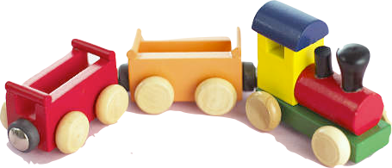
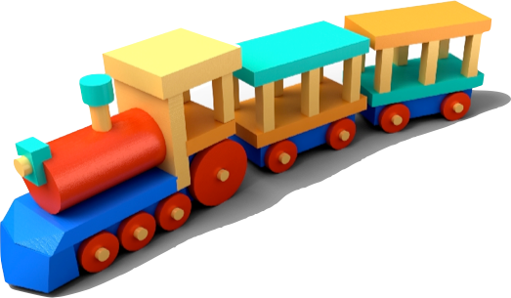
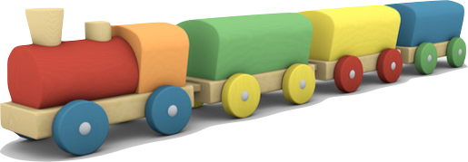

Slide 109
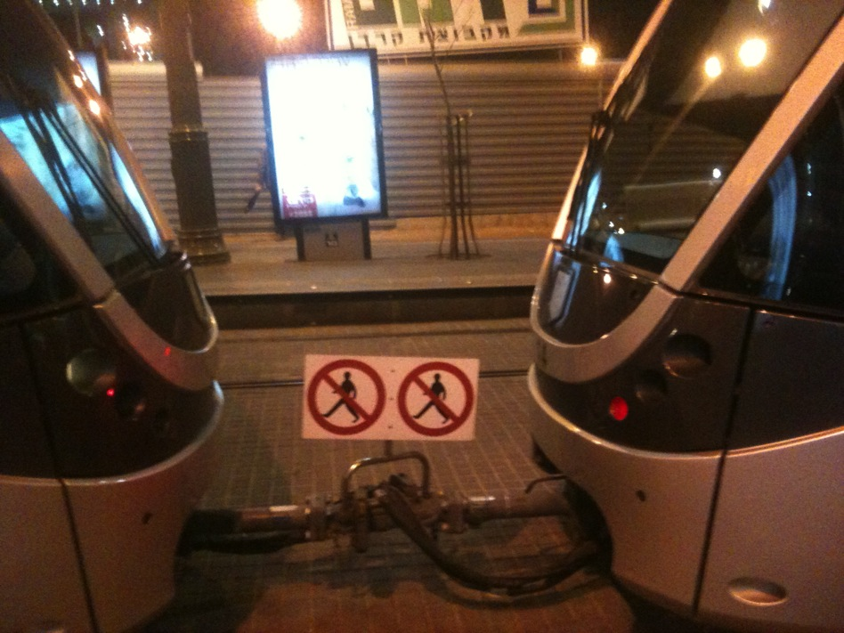

Slide 110
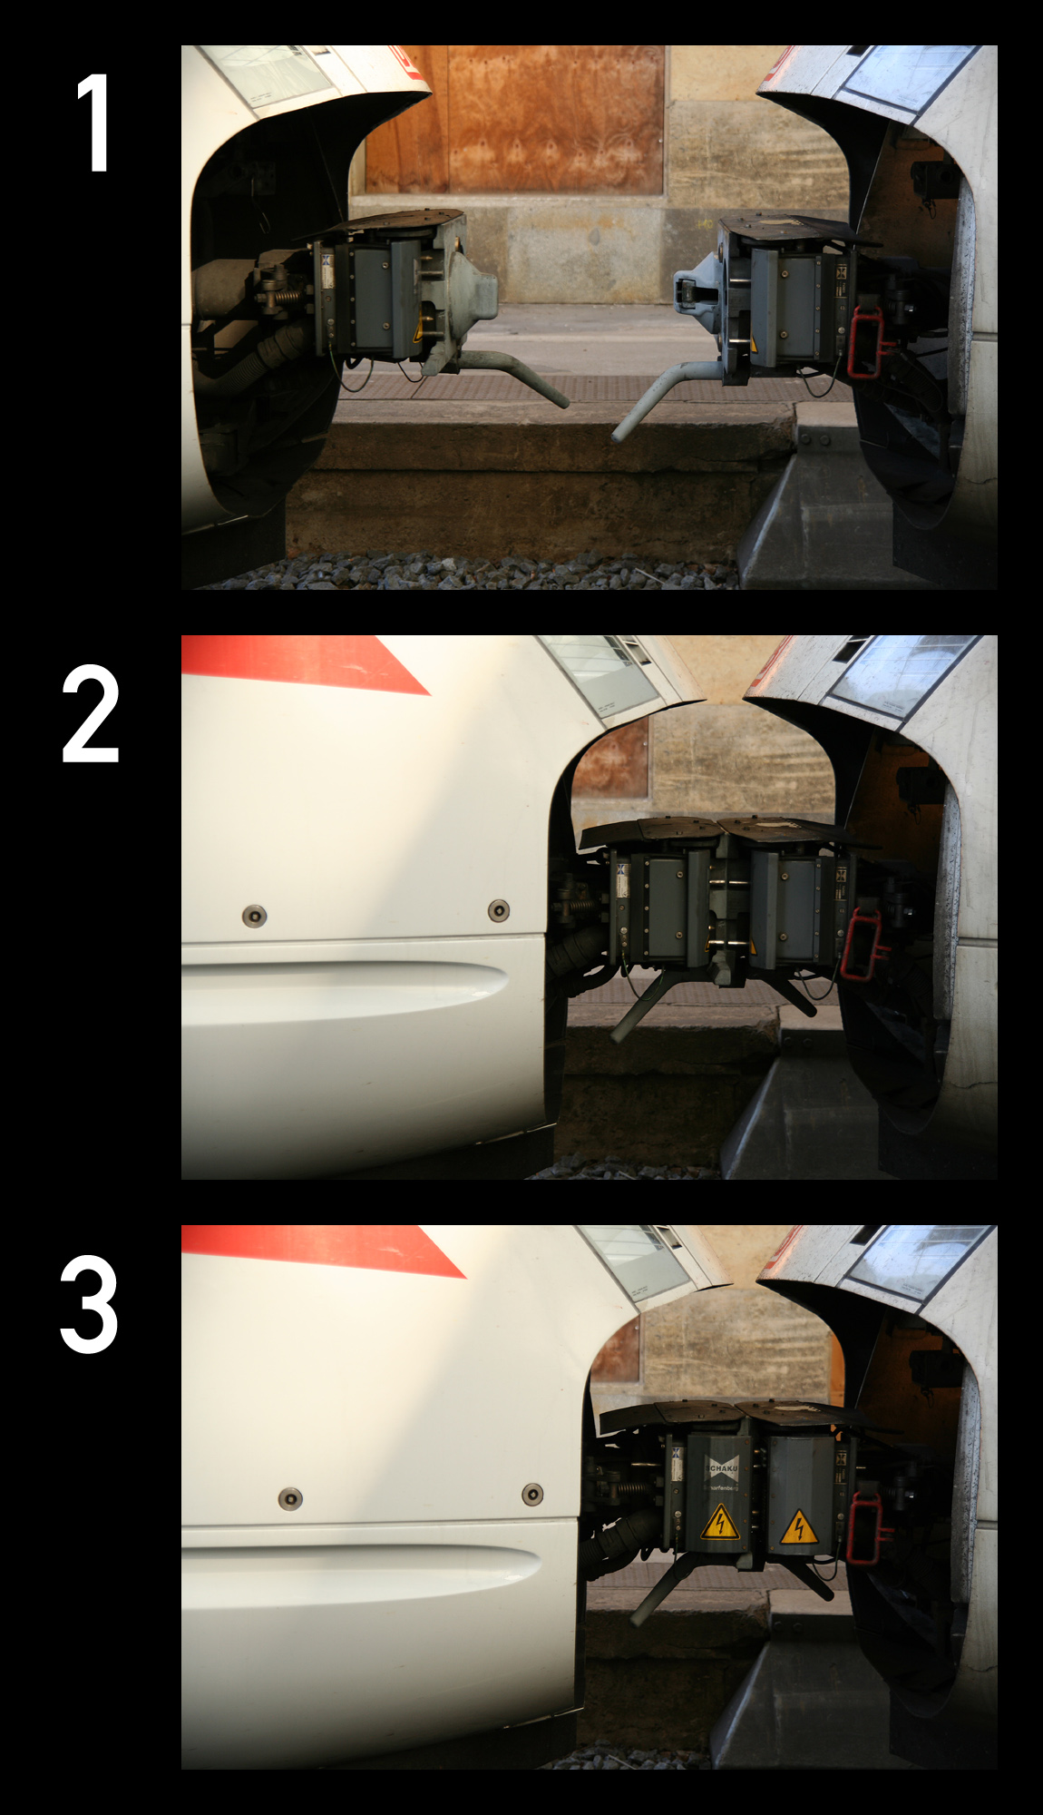

Slide 112
Before & After
n ↝ ⎣n/2⎦ , ⎡n/2⎤ (n>1)

Slide 113
Before & After
1 ↝
n ↝ ⎣n/2⎦ , ⎡n/2⎤ (n>1)

Slide 114
Before & After
1 ↝
n ↝ 1 , n-1 (n>1)

Slide 115
Before & After
1 ↝
n ↝ i , n-i (n>1, i>0)

Slide 116
Before & After
m ↝
n ↝ n-1 , n-1 (n>1, i>0)

Slide 117
Proof by Cases
A[x]
-----------------
A[true], A[false]

Slide 118
Before & After
1 ↝
n ↝ i , j (0<i,j<n)

Slide 119
Before & After
1 ↝
n ↝ i , j , k (0<i,j,k<n)

Slide 120
Before & After
1 ↝
n ↝ n1 , n2 , ..., nk (0<ni<n)

Slide 121

Konig’s Lemma
A tree is finite (has finitely many edges)
if and only if
    all nodes have finite degree
    and
    all branches (simple paths) have finite length.

Slide 122
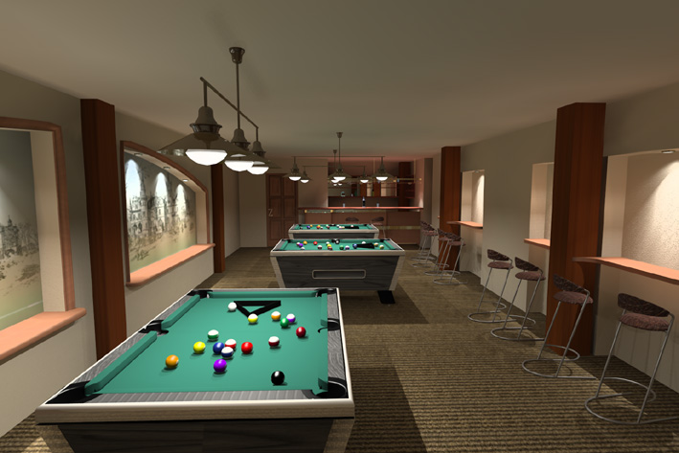
Billiards

Slide 123
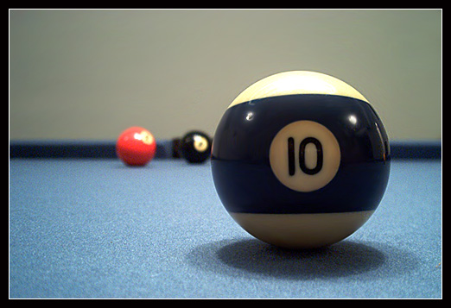
Smullyan’s Billiards

Slide 124
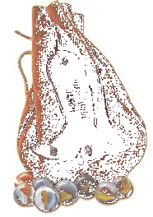
Multiset (Bag) Ordering
>
>

Slide 125
Multiset (Bag) Ordering
>
Well-founded
by
König’s Lemma
>

Slide 126
Harder A(m,n)
t := 1
s[t] := m
loop
c := c + 1
m := s[t]
t := t - 1
if m = 0
then
n := n + 1
elseif n = 0
then
t := t + 1
s[t] := m - 1
n := 1
else
t := t + 2
s[t-1] := m - 1
s[t] := m
n := n - 1
until t = 0
Bag of pairs
(s[i],∞) i<t
(s[t],n)

Slide 127
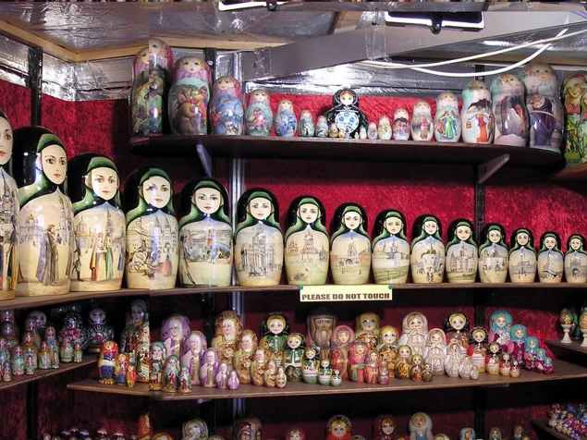
Nested Matryoshka Dolls

Slide 128
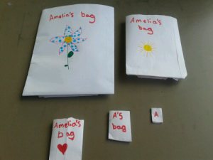
Nested Bags

Slide 129
Nested Ordering
>
>

Slide 130
Nested Ordering
>
>

Slide 131

Hydra

Slide 132
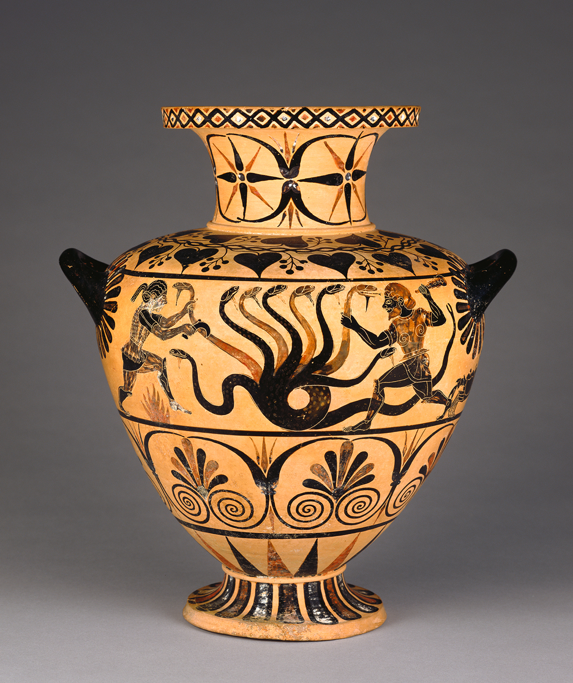


Slide 133
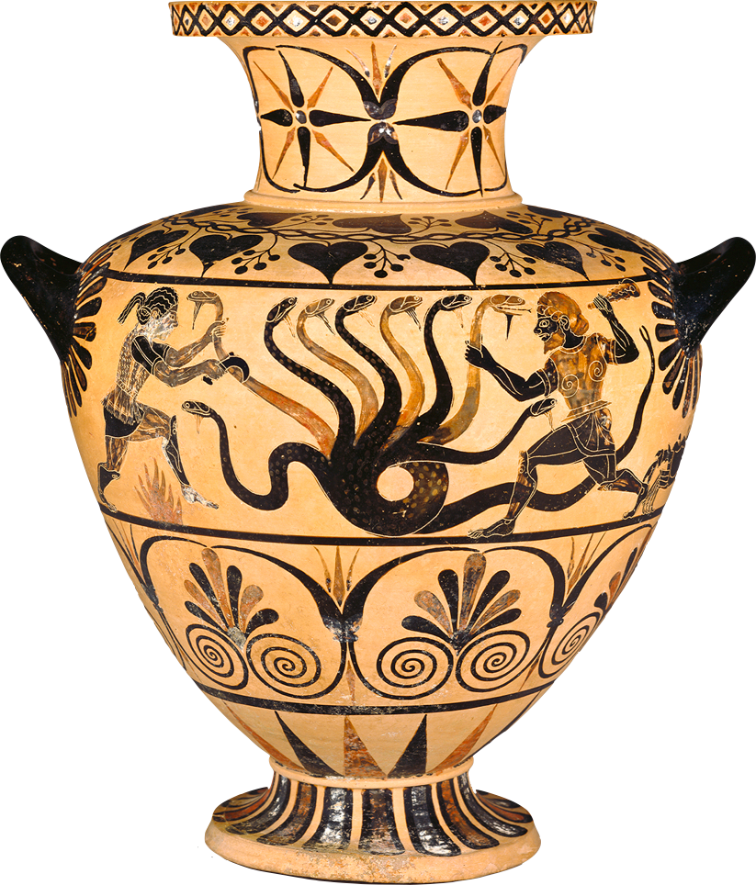
Hercules’ Second Labor

Slide 134
Each time Hercules bashed one of Hydra's heads, Iolaus held a torch to the headless neck.
After destroying eight mortal heads, Hercules chopped off the ninth, immortal head, which he buried at the side of the road from Lerna to Elaeus, and covered with a heavy rock.

Slide 135
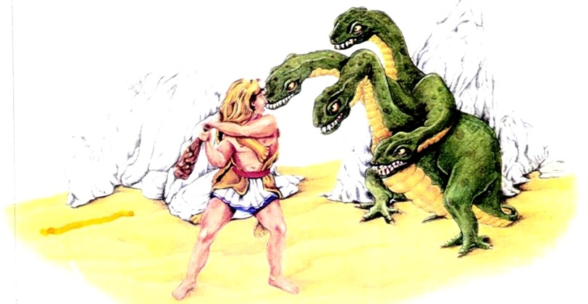

Slide 136
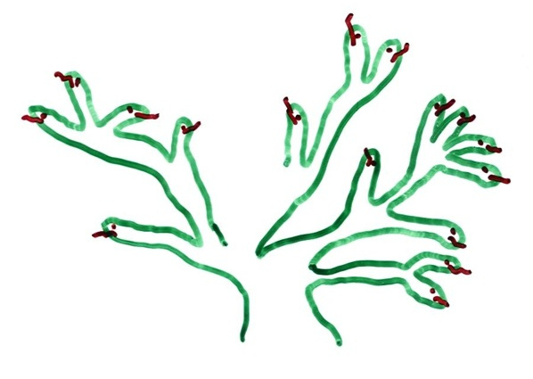
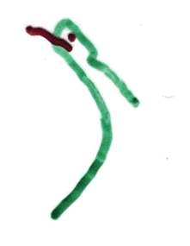
Hydra vs. Hercules

Slide 137

Hydra vs. Hercules

Slide 138
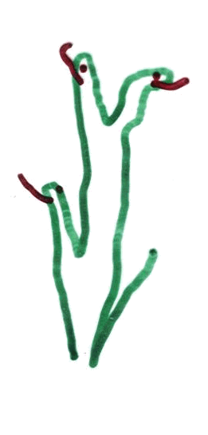
Hydra vs. Hercules

Slide 139
Hercules > Hydra
>

Slide 140
Hercules > Hydra
>

Slide 141
Hercules > Hydra
>
{{o{{ooo}o} {oo{oo}} {o{oooo}o} {oo}} > {{o{{ooo}o} {o{oo}} {o{oo}} {o{oo}} {o{oooo}o} {oo}}

Slide 142
Hercules Defeats Hydra
Cannot be proved in Peano Arithmetic [Paris & Kirby]
Requires induction up to ε₀
Natural numbers do not suffice
Sophisticated variants require more powerful systems [Friedman]
142

Slide 143
Termination
3. Bigger & Bigger

Slide 144
>
Well-founded
by
König’s Lemma
>

Slide 145
>
>

Slide 146
Well-Founded Induction
∀x. [∀y<x. P(y)] ⇒ P(x)
∀x. P(x)

Slide 147
Ordinals
0 < 1 < 2 < ...
< ω < ω+1 < ω+2 < ...
< ω2 < ω2+1 < ... < ω3 < ... < ω4 < ...
< ω² < ω²+1 < ... < ω²+ω < ω²+ω+1 < ...
< ω³ < ω³+1 < ... < ω⁴ < ... < ω⁵ <...
< ω^{ω} < ... < ω^{ω} < ... < ω^{ω} <...
^{x}
^{ω}
^{ω}
^{ω}

Slide 148
Bags of Bags
An empty bag is worth 0
A bag containing bags worth αi, is worth ∑ω^{αi}

Slide 149
Goodstein Step
Increment base & decrement number
  4 : 2²
  26 : 3³ -1 = 27-1 = 26 = 3² + 3² + 3 + 3 + 2
  41 : 4² + 4² + 4 + 4 + 1

Slide 150
Goodstein 4
4, 26, 41, 60, 83, 109, 139, 173, 211, 253, 299, 348, 401, 458, 519, 584, 653, 726, 803, 884, 969, 1058, 1151, 1222, 1295, 1370, 1447, 1526, 1607, 1690, 1775, 1862, 1951, 2042, 2135, 2230, 2327, 2426, 2527, 2630, 2735, 2842, 2951, 3062, 3175, 3290, 3407,..., 11115, 11327,..., 40492,40895,..., 154349,
162129585780031489, 162129586585337855, 3⋅2 ⁴⁰²⁶⁵³²¹⁰−1, ......................, 2, 1, 0

Slide 151
Goodstein 19
19, 7625597484990, ~1.3x10¹⁵⁴, ...

Slide 152
Goodstein Step
Increment base & decrement number
  4 : 2²
  26 : 3³ -1 = 27-1 = 26 = 3² + 3² + 3 + 3 + 2
  41 : 4² + 4² + 4 + 4 + 1

Slide 153
Goodstein Step
Base is a bag (and the whole thing is in a bag)
  2² is {{{}}}
  3² + 3² + 3 + 3 + 2 is {{2},{2},{},{},2}
  4² + 4² + 4 + 4 + 1 is {{2},{2},{},{},1}

Slide 154
Goodstein 16
g16(2) = 16 = 2^{2^2}
g16(3) = 3^{3^3}-1 = 2∙3^{2∙3^2 + 2∙3 + 2} + 2∙3^{2∙3^2 + 2∙3 + 1} + 2∙3^{2∙3^2 + 2∙3} + 2∙3^{2∙3^2 + 1∙3 + 2} + 2∙3^{2∙3^2 + 1∙3 + 1} + 2∙3^{2∙3^2 + 1∙3} + 2∙3^{2∙3^2 + 2} + 2∙3^{2∙3^2 + 1} + 2∙3^{2∙3^2} + 2∙3^{3^2 + 2∙3 + 2} + 2∙3^{3^2 + 2∙3 + 1} + 2∙3^{3^2 + 2∙3} + 2∙3^{3^2 + 1∙3 + 2} + 2∙3^{3^2 + 1∙3 + 1} + 2∙3^{3^2 + 1∙3} + 2∙3^{3^2 + 2} + 2∙3^{3^2 + 1} + 2∙3^{3^2} + 2∙3^{2∙3 + 2} + 2∙3^{2∙3 + 1} + 2∙3^{2∙3} + 2∙3^{1∙3 + 2} + 2∙3^{1∙3 + 1} + 2∙3^{1∙3} + 2∙3² + 2∙3¹ + 2 = 7625597484986
a(4) = 50973998591214355139406377.

Slide 155
Goodstein 16
g16(2) = 16 = 2^{2^2}
g16(3) = 3^{[1000]}-1 = 2∙3^{[222]} + 2∙3^{[221]} + 2∙3^{[220]} + 2∙3^{[212]} + 2∙3^{[211]} + 2∙3^{[210]} + 2∙3^{[202]} + 2∙3^{[201]} + 2∙3^{[200]} + 2∙3^{[122]} + 2∙3^{[121]} + 2∙3^{[120]} + 2∙3^{[112]} + 2∙3^{[111]} + 2∙3^{[110]} + 2∙3^{[102]} + 2∙3^{[101]} + 2∙3^{[100]} + 2∙3^{[022]} + 2∙3^{[021]} + 2∙3^{[020]} + 2∙3^{[012]} + 2∙3^{[011]} + 2∙3^{[010]} + 2∙3^{[002]} + 2∙3^{[001]} + 2∙3^{[000]} = 7625597484986
where [abc] is the base 3 representation

Slide 156
Goodstein 16
g16(2) = ω^{ω^ω}
g16(3) = 2∙ω^{2∙ω^2 + 2∙ω + 2} + 2∙ω^{2∙ω^2 + 2∙ω + 1} + 2∙ω^{2∙ω^2 + 2∙ω} + 2∙ω^{2∙ω^2 + 1∙ω + 2} + 2∙ω^{2∙ω^2 + 1∙ω + 1} + 2∙ω^{2∙ω^2 + 1∙ω} + 2∙ω^{2∙ω^2 + 2} + 2∙ω^{2∙ω^2 + 1} + 2∙ω^{2∙ω^2} + 2∙ω^{ω^2 + 2∙ω + 2} + 2∙ω^{ω^2 + 2∙ω + 1} + 2∙ω^{ω^2 + 2∙ω} + 2∙ω^{ω^2 + 1∙ω + 2} + 2∙ω^{ω^2 + 1∙ω + 1} + 2∙ω^{ω^2 + 1∙ω} + 2∙ω^{ω^2 + 2} + 2∙ω^{ω^2 + 1} + 2∙ω^{ω^2} + 2∙ω^{2∙ω + 2} + 2∙ω^{2∙ω + 1} + 2∙ω^{2∙ω} + 2∙ω^{1∙ω + 2} + 2∙ω^{1∙ω + 1} + 2∙ω^{1∙ω} + 2∙ω² + 2∙ω¹ + 2

Slide 157
Goodstein
Cannot be proved terminating in Peano Arithmetic

Slide 158


>

Slide 159
Hercules Defeats Hydra
Cannot be proved in Peano Arithmetic [Paris & Kirby]
Requires induction up to ε₀
Natural numbers do not suffice
Sophisticated variants require more powerful systems [Friedman]

Slide 160
Hydra Step
Every head is an empty bag
Every node (including the ground) is a bag of its children
Each step replaces some internal bag with some number of smaller bags

Slide 161
Hydra Step
Heads are worth 0
Every node (including the ground), with children worth αi, is worth ∑ω^{αi}
The kth step replaces a term ω^{α+1} with ω^{α}k
But if a head sprouting from the ground is cut, the total decreases by 1

Slide 162
Hercules Defeats Hydra
Cannot be proved in Peano Arithmetic [Paris & Kirby]
Requires induction up to ε₀
Natural numbers do not suffice
Sophisticated variants require more powerful systems [Friedman]

Slide 163
Termination
4. Well-Founded Orderings

Slide 164
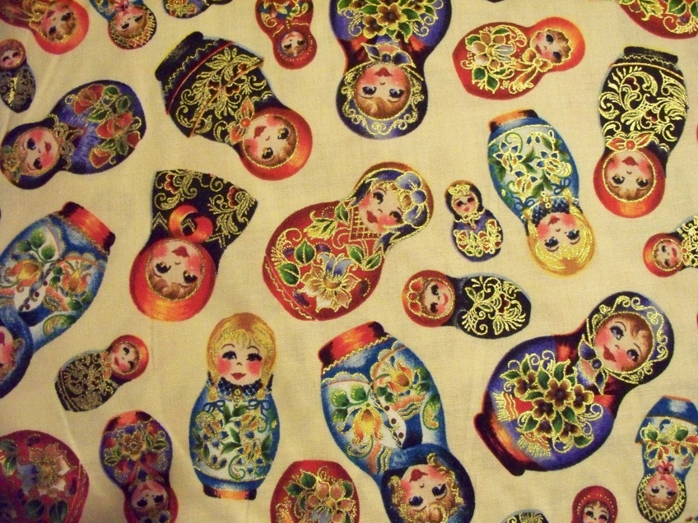

Slide 165
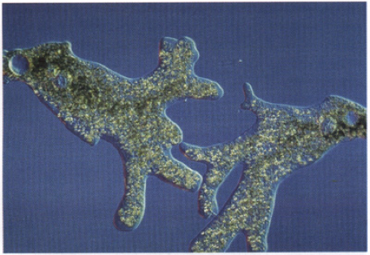

Slide 166
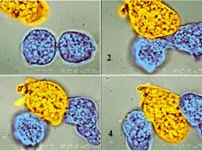

Slide 167

Amoebae

Slide 168

Fission

Slide 169
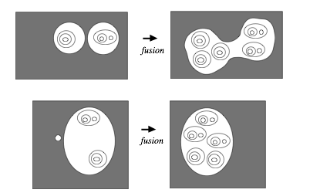

Slide 170
Colony Dies Out
depth(o) = 0
depth( a1 ... an ) = 1+max{depth{ai}}
{ (depth(a),|a|) : subcolony a }
outer fission: depth decreases
fusion: size decreases

Slide 171
Colony Dies Out
d(a) = depth(a)
#d(a) = number in a of depth d
{ (d(a), #d(a)(a), #d(a)-1(a),...) : colony a }
fission: depth decreases
fusion: size decreases

Slide 172
Big Picture
Programs are state-transition systems
Choose a well-founded order on states
Show that transitions are decreases

Slide 173
Real Picture
Programs are state-transition systems
Choose a function for “ranking” states
Choose a well-founded order on ranks
Show that transitions always decrease rank

Slide 174
Imaginary Picture
Programs are state-transition systems
Choose a function for “ranking” states
Choose a well-founded order on ranks
Show that transitions eventually decrease rank

Slide 175
Nested Loops
r := 1
u := 1
loop v := u
    until r≥n
    s := 1
    loop u := u+v
        s := s+1
        while s≤r
        repeat
    r := r+1
    repeat
ω² (n - r) + ω(r - s) + k

Slide 176
Per Iteration
r := 1
u := 1
loop v := u
    until r≥n
    s := 1
    loop u := u+v
        s := s+1
        while s≤r
        repeat
    r := r+1
    repeat
ω(n-r)+r+1-s

Slide 177
Lexicographic
r := 1
u := 1
loop v := u
    until r≥n
    s := 1
    loop u := u+v
        s := s+1
        while s≤r
        repeat
    r := r+1
    repeat
(n-r,r+1-s)

Slide 178
Invariants
r := 1
u := 1
loop v := u
    until r≥n
    s := 1
    loop u := u+v
        s := s+1
        while s≤r
        repeat
    r := r+1
    repeat
1≤r≤n
1≤s≤r+1

Slide 179
Well-Founded Orderings
No infinite descending sequences
x1 > x2 > x3 > ...

Slide 180
Well-Founded Induction
∀x∈X. [∀y<x. P(y)] ⇒ P(x)
∀x∈X. P(x)
> is a wfo of X
Why?

Slide 181
David Gries
Under the reasonable assumption that nondeterminism is bounded, the two methods are equivalent…. In this situation, we prefer using strong termination.

Slide 183
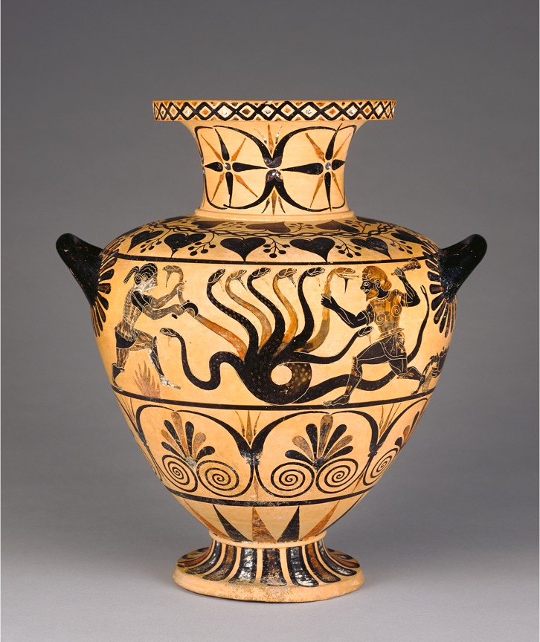

Slide 184
Contra-Gries
To prove terminating with a natural (strong) ranking function requires ε₀-induction

Slide 185
All-Purpose Ranks
0 < 1 < 2 < ...
< ω < ω+1 < ω+2 < ...
< ω2 < ω2+1 < ... < ω3 < ... < ω4 < ...
< ω² < ω²+1 < ... < ω²+ω < ω²+ω+1 < ...
< ω³ < ω³+1 < ... < ω⁴ < ... < ω⁵ <...
< ω^{ω} < ... < ω^{ω} < ... < ω^{ω} <...
^{x}
^{ω}
^{ω}
^{ω}

Slide 186
Ordinals
0, 1, 2, ...,
ω, ω+1, ω+2, ...,
ω2, ω2+1, ..., ω3, ...,
ω², ..., ω²+ω2+3, ..., ω³, ...,
ω^{ω}, ..., ω^{ωω}, ...,
ε₀, ε₀+1, ..., ε₀2+ω^{ω}+ω2+3, ...,
ε₁, ..., ε_{ε0}, ...,
...

Slide 187
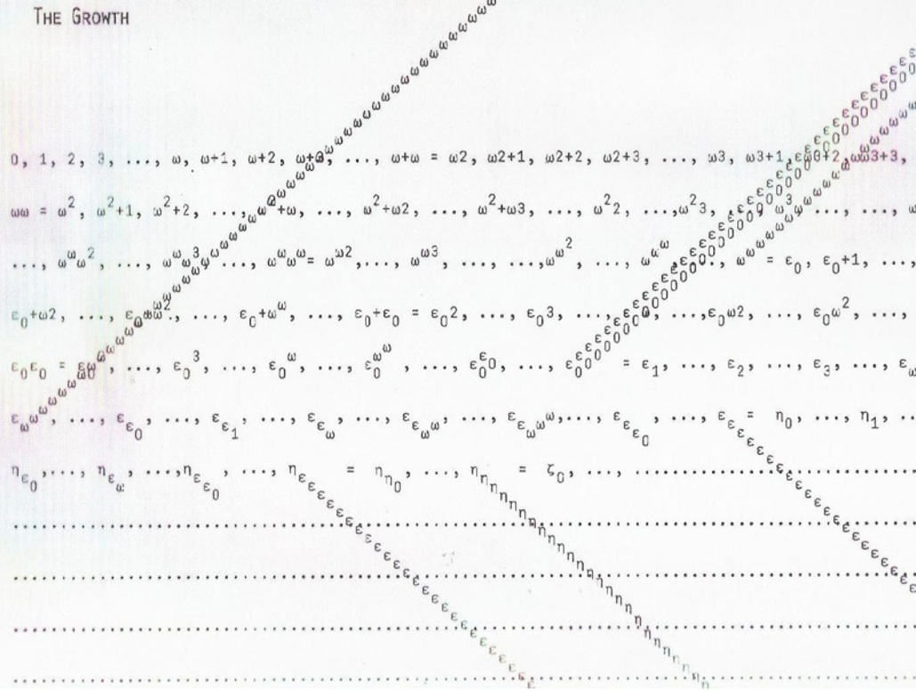

Slide 188

Transition System
State
Transition

Slide 189
Discrete Transition System
Q0
Q
QF

Slide 190
Well-Founded Method
States Q
Algorithm R ⊆ QxQ
Well-founded order > on Q
R ⊆ >

Slide 191
All-Purpose Ranking
r : Q → Ord
r(x) = sup { r(y)+1 : x → y }

Slide 192
Computation

Slide 193
Abstraction

Slide 194
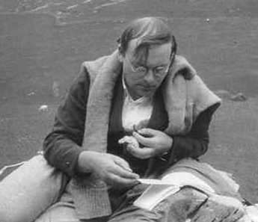
Frank Ramsey

Slide 195
Ramsey’s Theorem
Infinite complete graph
Finitely colored edges
Monochrome infinite clique

Slide 196
Closure

Slide 197
Proof

Slide 198
Proof

Slide 199
Proof

Slide 200
Disjunctive Orders
States Q
Algorithm R ⊆ QxQ
Transitive closure R⁺
Well-founded orders > and ⊐ on Q
R⁺ ⊆ > ∪ ⊐

Slide 201
Ranking Method
States Q
Algorithm R ⊆ QxQ
Well-founded order ≻ on W
Ranking function r : Q → W
Define X > Y if r(X) ≻ r(Y)
R ⊆ >

Slide 202
Invariants
States Q
Algorithm R ⊆ QxQ
Well-founded order ≻ on W
Ranking function r : Q → W
Define X > Y if r(X) ≻ r(Y)
R ⊆ >

Slide 203
Algorithmic System
Program
State
Transition

Slide 204
Classical Algorithms
Every algorithm can be expressed precisely as a set of conditional assignments, executed in parallel repeatedly.
    if c then f(s1,...,sn) := t
    if c then f(s1,...,sn) := t
    if c then f(s1,...,sn) := t

Slide 205
Practical Method
States Q
Algorithm R ⊆ QxQ
Well-founded order ≻ on W
Ranking function r : Q → W
Define X > Y if r(X) ≻ r(Y)
R ⊆ >

Slide 206


Slide 207
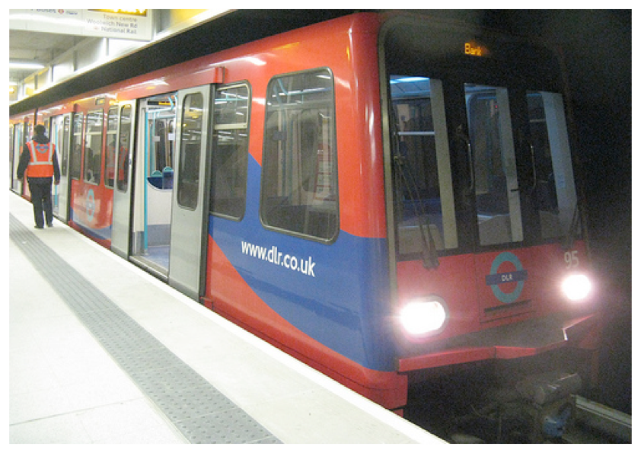

Slide 208
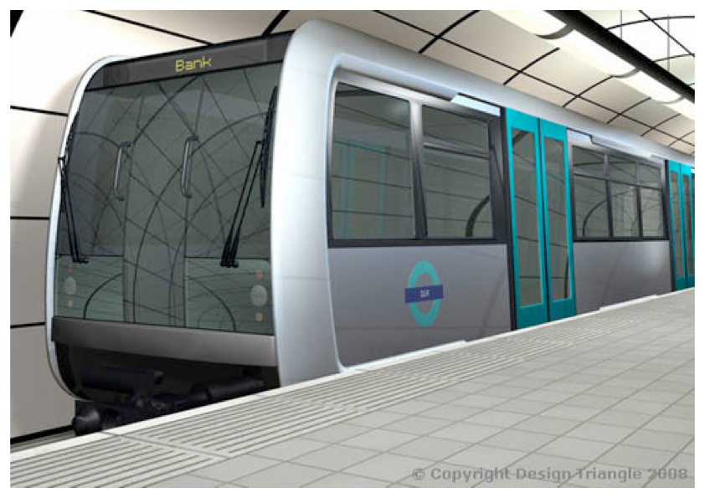

Slide 209
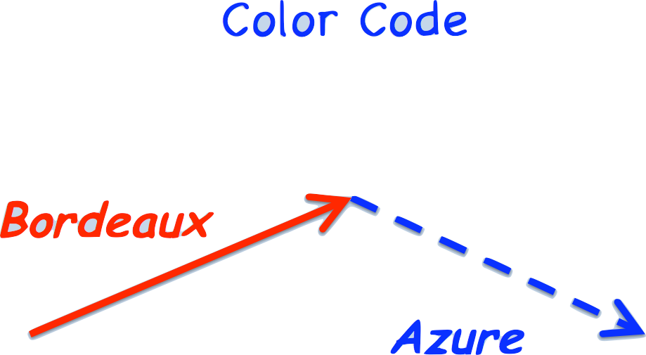

Slide 210
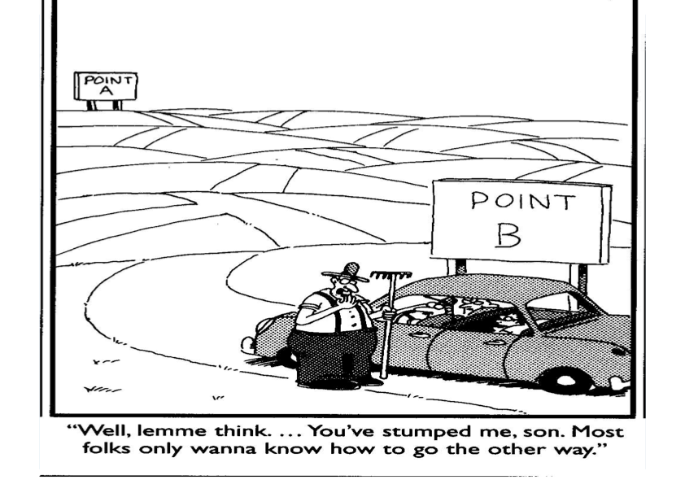

Slide 211
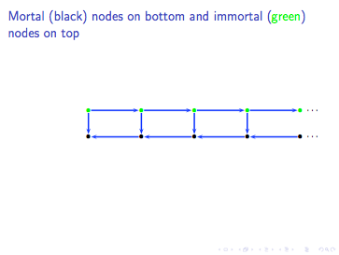

Slide 212
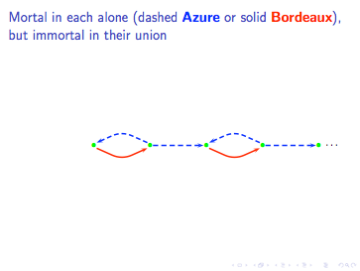

Slide 213
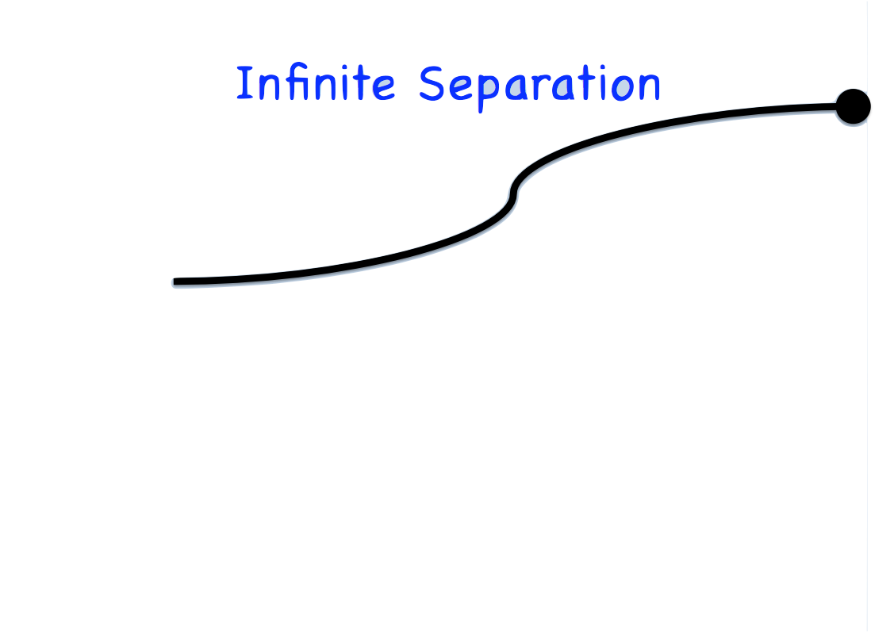

Slide 214


Slide 215
Enough?

Slide 216
Enough?

Slide 217
Enough?

Slide 218

Jumping

Slide 219

Jumping

Slide 220


Slide 221

Jumping

Slide 222

Jumping

Slide 223

Jumping

Slide 224
Termination
5. Well-Quasi Orderings

Slide 225
Dt = 1
Dc = 0
D(x+y) = Dx+Dy
D(xy) = yDx+xDy
D(D(tt)) = D(tDt+tDt) = D(tDt) + D(tDt) =...
Dc

Slide 226


Slide 227


Slide 228
Disjunctiveness
while c do
    A | B
a,b wfo
(A∪B)⁺ ⊆ a ∪ b

Slide 229
Disjunctiveness
while x > 0 and y > 0 do
    x := x-1 | y := y-1
    y := ? |
xi > xj ∨ yi > yj for i>j
    need xi ≥ xj

Slide 230
Jumping
while c do
    A | B
while c do A while c do B
BA ⊆ A(A∪B)* ∪ B

Slide 231
Jumping
while x > 0 and y > 0 do
    x := x-1 | y := y-1
    y := ? |
BA ⊆ A

Slide 232
Jumping
while x > 0 and y > 0 do
    x := x-1 | y := y-1
    y := x+y |
BA ⊆ AB

Slide 233
Disjunctiveness
while x > 0 and y > 0 do
    x := x-1 | y := y-1
    y := xy |
BA ⊆ AB*

Slide 234
Fairness
s := true
n := 0
while s do
    n := n+1 | s := false

Slide 235
Fairness
s := ?
n := 0
while s>0 do
    n := n+1 | s := s-1
fair ⇒ no AAAAAAAAAAA...

Slide 236
Grid Game
Given (upper-right) grid coordinates (x0,y0)
Choose (xj,yj) to prolong game s.t.
  xj < xi OR yj < yi for all i<j

Slide 237
Grid Game

Slide 238
Grid Game

Slide 239
Grid Game

Slide 240
Grid Game

Slide 241
Grid Game

Slide 242
Tricolor
Color pairs i<j of points
  Purple if xi > xj and yi > yj
  Blue if only xi > xj
  Red if only yi > yj
Consider sequence of points
  Ramsey contradicts well-foundedness

Slide 243
Ramsey’s Theorem
Two colors: yes and no
Extend yes as long as possible
If can forever, then done (all yes)
If not, then repeat
If repeats forever, then done (all no)

Slide 244
Ramsey’s Theorem
Reduce more than 2 colors to 2 (color-blindness). Repeat.
For 2: Form sequence of nodes a1 a2 a3 ... by repeatedly taking monochromatically-connected subsets

Slide 245


Slide 246


Slide 247
Ramsey’s Theorem
Infinite complete multi-graph
Finitely colored multi-edges
Monochrome infinite clique
can have multiple multi-edges

Slide 248
Quasi-ordering
Greater or equivalent
  Transitive
  Reflexive

Slide 249
Quasi-ordering
  Equivalence (both directions)
  Strict part (only one)

Slide 250
Well-quasi-ordering
Well-founded
  no infinite strictly-descending sequences
No infinite anti-chains

Slide 251

Wqo

Slide 252


Slide 253


Slide 254
Equivalent Properties
Wqo
Every infinite sequence has an ordered pair

Slide 255

Well-Quasi-Order

Slide 256
Equivalent Properties
Standard: wf and no inf antichain
Simple: Every infinite sequence has an ordered pair
Useful: Every infinite sequence contains an infinite non-decreasing chain
  Why? -- Ramsey

Slide 257
Properties
Every refinement (more order) is also wqo
Every linearization (refinement s.t. all equivalence classes are comparable) is well-ordered

Slide 258
Dickson’s Lemma
Order (n-) tuples in product ordering
  All components are in order
Tuples of wqos are wqo

Slide 259
Good
A pair is good if it is ordered
A sequence is good if it has a good pair
A set is good (wqo) if all sequences are good

Slide 260
Bad
A sequence is bad if there is no good pair
It is good if it has at least one pair

Slide 261
Good & Bad
A qo is a wqo if all sequences are good
A sequence is bad if it is not good
If a set is not good, then there is a minimal counterexample (bad sequence)

Slide 262
Higman’s Lemma
Every infinite sequence of words (over a finite alphabet) includes an embedding.

Slide 263

Homeomorphic Embedding

Slide 264
Higman’s Lemma
Suppose a finite or infinite alphabet is wqo
Extend order to string embedding
  letters map in order to bigger or equivalent ones
Strings are wqo

Slide 265
Precedence
Example, Σ
a0<a1<a2<...
b0<b1<b2<...
...
z0<z1<...

Slide 266
Minimal Bad Sequence
acd eef afda ...
afda ab acd ...
ab eef afda ...
ab acd eef afda ...
ab afda acd ...
...

Slide 267
Minimal Bad Sequence
acd eef afda ...
afda ab acd ...
ab eef afda ...
ab acd eef afda ...
ab afda acd ...
...

Slide 268
Minimal Bad Sequence
ab eef afda ...
ab acd eef afda ...
ab afda acd ...
...

Slide 269
Minimal Bad Sequence
ab eef afda ...
ab acd eef afda ...
ab afda acd ...
...

Slide 270
Minimal Bad Sequence
ab acd eef afda ...

Slide 271
Minimal Bad Sequence
ab acd eef afda ...

Slide 272
Minimal Bad Sequence
ab acd afda ...

Slide 273
Proof
Consider minimal bad sequence
  α1x1 α2x2 α3x3 ... αixi ... αjxj ...
Extract subsequence with first letters αi1 αi2 αi3 ... ordered
Consider rests xi1 xi2 xi3 ...

Slide 274
Tails (or substrings) of minimal bad sequence are good
  Why?
  Suppose bad tails x9 ... x3 x18 ...
  Consider x3 x18 ... (where 3 min index)
  α1x1 α2x2 x3 x18 ... would be smaller than min bad

Slide 275
Contradiction
ab acd afda ... aacafad ...

Slide 276
Corollary: Bag Ordering
Given wfo ≻ on elements X, consider bag order
Extend (by Zorn’s Lemma) to total well-order >; X is wqo by ≥
By Higman, sequences X* are wqo
Were there an infinite descending sequence {bi} of multisets wrt ≻, it would be decreasing wrt >
By Higman, there’s a pair bj ≤ bk; by bag order bj > bk

Slide 277
Termination
6. Tree Orderings

Slide 278
Symbolic Computation
Dt = 1
Dc = 0
D(x+y) = Dx + Dy
D(xy) = xDy + yDx
...

Slide 279
Exponential Interpretation
[Dx] = 3^{[x]}
[t] = [c] = 3
[x+y] = ... = [xy] = [x] + [y]

Slide 280
WQO
Standard: wf and no inf antichain
Simple: Every infinite sequence has an ordered pair
Useful: Every infinite sequence contains an infinite non-decreasing chain
  Why? -- Ramsey

Slide 281
Corollary
Multiset ordering
Bounded-arity tree ordering

Slide 282

Tree Embedding

Slide 283
Kruskal’s Tree Theorem
Every infinite sequence of trees (over a wqo alphabet) includes an embedding.

Slide 284

Good Sequence

Slide 285


Slide 286


Slide 287


Slide 288


Slide 289


Slide 290


Slide 291


Slide 292

Labels

Slide 293


Gremlins

Slide 294


Gremlins

Slide 295
Multiset Path Order
s = f(s1,...,sm) t = g(t1,...,tn)
s > t if si ≳ t for some i
s > t if
  (f,{s1,...,sm}) >lex (g,{t1,...,tn})
  and s > tj for all j

Slide 296
Symbolic Computation
Dt = 1
Dc = 0
D(x+y) = Dx + Dy
D(xy) = xDy + yDx
...

Slide 297
Distributivity
x(y+z) = xy + xz

Slide 298
DNF
¬ ¬x = x
¬(x∨y) = (¬ x)∧(¬ y)
¬(x∧y) = (¬ x)∨(¬ y)
x∧(y∨z) = (x∧y)∨(x∧z)
(y∨z)∧x = (y∧x)∨(z∧x)

Slide 299
Simplification Order
f(...,si,...) > si
si > ti ⇒ f(...,si,...) > f(...,ti,...)
Finite alphabet

Slide 300
Simplification Order
f(...,si,...) > si
si > ti ⇒ f(...,si,...) > f(...,ti,...)
f > g ⇒ f(...,si,...) > g(...,si,...)

Slide 301
Lexicographic Path Order
s = f(s1,...,sm) t = g(t1,...,tn)
s > t if si ≳ t for some i
s > t if
  (f,s1,...,sm) >lex (g,t1,...,tn)
  and s > tj for all j

Slide 302
Recursive Path Order
s = f(s1,...,sm) t = g(t1,...,tn)
s > t if si ≳ t for some i
s > t if
  (f,s1,...,{si,...,sm}) >lex (g,t1,...,{ti,...,tn})
  and s > tj for all j

Slide 303
Weak
Simplification Order
f(...,si,...) ≳ si
si ≳ ti ⇒ f(...,si,...) ≳ f(...,ti,...)

Slide 304
Simplification Ordering
(Weakly) Monotonic
(Weakly) Subterm
They are well-quasi-orders

Slide 305
Termination
7. Rewriting

Slide 306
Fission

Slide 308
Better
d(a) = depth(a)
{ {d(a) : a in A} : colony A }
fission: depth decreases
fusion: one deep item removed

Slide 309
DNF0
¬ ¬x ➯ x
¬(x∨y) ➯ (¬ x)∧(¬ y)
¬(x∧y) ➯ (¬ x)∨(¬ y)
x∧(y∨z) ➯ (x∧y)∨(x∧z)
(y∨z)∧x ➯ (y∧x)∨(z∧x)

Slide 310
DNF1
¬ ¬x ➯ x
¬(x∨y) ➯ (¬ x)∧(¬ y)
¬(x∧y) ➯ (¬ x)∨(¬ y)
x∧(y∧z) ➯ (x∧y)∧z
x∨(y∨z) ➯ (x∨y)∨z
x∧(y∨z) ➯ (x∧y)∨(x∧z)
(y∨z)∧x ➯ (y∧x)∨(z∧x)

Slide 311
DNF2
¬ ¬x ➯ x
¬(x∨y) ➯ (¬ x)∧(¬ y)
¬(x∧y) ➯ (¬ x)∨(¬ y)
(x∧y)∧z ➯ x∧(y∧z)
x∨(y∨z) ➯ (x∨y)∨z
x∧(y∨z) ➯ (x∧y)∨(x∧z)
(y∨z)∧x ➯ (y∧x)∨(z∧x)

Slide 312
DNF3
¬ ¬x ➯ x
¬(x∨y) ➯ (¬ ¬ ¬ x)∧(¬ ¬ ¬ y)
¬(x∧y) ➯ (¬ ¬ ¬ x)∨(¬ ¬ ¬ y)
x∧(y∨z) ➯ (x∧y)∨(x∧z)
(y∨z)∧x ➯ (y∧x)∨(z∧x)

Slide 313
DNF3
¬ ¬x ➯ x
¬(x∨y) ➯ (¬ ¬ ¬ x)∧(¬ ¬ ¬ y)
¬(x∧y) ➯ (¬ ¬ ¬ x)∨(¬ ¬ ¬ y)
x∧(y∨z) ➯ (x∧y)∨(x∧z)
(y∨z)∧x ➯ (y∧x)∨(z∧x)
¬ ¬(a∧(b∨c))

Slide 314
DNF4
¬ ¬x ➯ x
¬(x∨y) ➯ (¬ x)∧(¬ y)
¬(x∧y) ➯ (¬ x)∨(¬ y)
x∧(y∨z) ➯ (x∧y)∨(x∧z)∨(x∧y)∨(x∧z)
(y∨z)∧x ➯ (x∧y)∨(x∧z)∨(x∧y)∨(x∧z)
x∨x ➯ x

Slide 315
DNF5
¬ ¬x ➯ x
¬(x∨y) ➯ (¬ x)∧(¬ y)∧(¬ x)∧(¬ y)
¬(x∧y) ➯ (¬ x)∨(¬ y)∨(¬ x)∨(¬ y)
x∧(y∨z) ➯ (x∧y)∨(x∧z)
(y∨z)∧x ➯ (x∧y)∨(x∧z)
x∨x ➯ x
x∧x ➯ x

Slide 316
DNF6
¬ ¬x ➯ x
¬(x∨y) ➯ (¬ ¬ ¬ x)∧(¬ ¬ ¬ y)∧(¬ ¬ ¬ x)∧(¬ ¬ ¬ y)
¬(x∧y) ➯ (¬ ¬ ¬ x)∨(¬ ¬ ¬ y)∨(¬ ¬ ¬ x)∨(¬ ¬ ¬ y)
x∨x ➯ x
x∧x ➯ x

Slide 317
DNF7
¬ ¬x ➯ x
¬(x∨y) ➯ (¬ x)∧(¬ y)∧(¬ x)∧(¬ y)
¬(x∧y) ➯ (¬ x)∨(¬ y)∨(¬ x)∨(¬ y)
x∨x ➯ x
x∧x ➯ x

Slide 318
Symbolic Computation
Dt = 1
Dc = 0
D(x+y) = Dx + Dy
D(xy) = xDy + yDx
...

Slide 319
Rewriting
Dt ➯ 1
Dc ➯ 0
D(x+y) ➯ Dx + Dy
D(xy) ➯ xDy + yDx
...

Slide 320
Factorial
x+0 ➯ x
x+s(y) ➯ s(x+y)
x*0 ➯ 0
x*s(y) ➯ y + x*y
f(0) ➯ s(0)
f(s(x)) ➯ s(x)*f(x)

Slide 321
Factorial
x+0 ➯ x
x+s(y) ➯ s(x+y)
x*0 ➯ 0
x*s(y) ➯ y + x*y
f(0) ➯ s(0)
f(s(x)) ➯ s(x)*f(p(s(x)))
p(s(x)) ➯ x

Slide 322
Termination
If s[x] ➯ t[x] is a rule
then c[s[v]] ➯ c[t[v]] is a rewrite
Want c[s[v]] > c[t[v]] in some wfo
Want monotonicity
  s > t ⇒ f(...,s,...) > f(...,t,...)

Slide 323
Exponential Interpretation
[Dx] = 3^{[x]}
[t] = [c] = 3
[x+y] = ... = [xy] = [x] + [y]

Slide 324
Polynomial Interpretation
[Dx] = [x]²
[x+y] = ... = [xy] = [x] + [y]
Eventually positive
  x² + y² + 2xy - x² - y² - x - y = 2xy - x - y
  Derivatives: 2x-1; 2y-1

Slide 325
Multiset Path Order
s = f(s1,...,sm) t = g(t1,...,tn)
s > t if si ≳ t for some i
s > t if
  (f,{s1,...,sm}) >lex (g,{t1,...,tn})
  and s > tj for all j

Slide 326
Lexicographic Path Order
s = f(s1,...,sm) t = g(t1,...,tn)
s > t if si ≳ t for some i
s > t if
  (f,s1,...,sm) >lex (g,t1,...,tn)
  and s > tj for all j

Slide 327
Boyer & Moore
if(if(x,y,z),u,v) ➯ if(x,if(y,u,v),if(z,u,v))

Slide 328
Recursive Path Order
s = f(s1,...,sm) t = g(t1,...,tn)
s > t if si ≳ t for some i
s > t if
  (f,s1,...,{si,...,sm}) >lex (g,t1,...,{ti,...,tn})
  and s > tj for all j

Slide 329
Simplification Order
Suppose finite vocabulary
Subterm: f(...,s,...) > s
Monotonic: s > t ⇒ f(...,s,...) > f(...,t,...)
Must be well-founded

Slide 330
Weak Simplification Order
Weak subterm: f(...,si,...) ≳ si
Weak monotonicity: si ≳ ti ⇒ f(...,si,...) ≳ f(...,ti,...)
Well-quasi-order by Kruskal
Enough for termination of rewriting
  Why?

Slide 331
Total Order
Suppose finite vocabulary
Monotonic: s > t ⇒ f(...,s,...) > f(...,t,...)
Well-founded iff subterm

Slide 332
Semantic Path Order
s = f(s1,...,sm) t = g(t1,...,tn) >
s > t if si ≳ t for some i
s > t if
  (s,s1,...,sm) >lex (t,t1,...,tn)
  and s > tj for all j
require s ➯ t ⇒ f(...s...) ≥ f(...t...)

Slide 333
Proof
Extend base order to a total w.f. order
Consider minimal bad sequence
Subterms are well-founded
No use of si ≳ t case
So base order decreases and stabilizes

Slide 334
Termination
8. Semantic Path Order

Slide 335
DNF3
¬ ¬x ➯ x
¬(x∨y) ➯ (¬ ¬ ¬ x)∧(¬ ¬ ¬ y)
¬(x∧y) ➯ (¬ ¬ ¬ x)∨(¬ ¬ ¬ y)
x∧(y∨z) ➯ (x∧y)∨(x∧z)
(y∨z)∧x ➯ (y∧x)∨(z∧x)
¬ ¬(a∧(b∨c))

Slide 336
DNF4
¬ ¬x ➯ x
¬(x∨y) ➯ (¬ x)∧(¬ y)
¬(x∧y) ➯ (¬ x)∨(¬ y)
x∧(y∨z) ➯ (x∧y)∨(x∧z)∨(x∧y)∨(x∧z)
(y∨z)∧x ➯ (x∧y)∨(x∧z)∨(x∧y)∨(x∧z)
x∨x ➯ x

Slide 337
DNF5
¬ ¬x ➯ x
¬(x∨y) ➯ (¬ x)∧(¬ y)∧(¬ x)∧(¬ y)
¬(x∧y) ➯ (¬ x)∨(¬ y)∨(¬ x)∨(¬ y)
x∧(y∨z) ➯ (x∧y)∨(x∧z)
(y∨z)∧x ➯ (x∧y)∨(x∧z)
x∨x ➯ x
x∧x ➯ x

Slide 338
DNF6
¬ ¬x ➯ x
¬(x∨y) ➯ (¬ ¬ ¬ x)∧(¬ ¬ ¬ y)∧(¬ ¬ ¬ x)∧(¬ ¬ ¬ y)
¬(x∧y) ➯ (¬ ¬ ¬ x)∨(¬ ¬ ¬ y)∨(¬ ¬ ¬ x)∨(¬ ¬ ¬ y)
x∨x ➯ x
x∧x ➯ x

Slide 339
DNF6
¬ ¬x ➯ x
¬(x∨y) ➯ (¬ ¬ ¬ x)∧(¬ ¬ ¬ y)∧(¬ ¬ ¬ x)∧(¬ ¬ ¬ y)
¬(x∧y) ➯ (¬ ¬ ¬ x)∨(¬ ¬ ¬ y)∨(¬ ¬ ¬ x)∨(¬ ¬ ¬ y)
x∨x ➯ x
x∧x ➯ x
¬ ¬(x∨y)

Slide 340
Labeling
ffx ➯ fgfx
ffx ➯ fgfx
fffx ➯ ffgfx

Slide 341
Semantic Path Order
Given a well-founded term order ≿
s = f(s1,...,sm) t = g(t1,...,tn)
s > t if si ≳ t for some i
s > t if (s,s1,...,sm) >lex (t,t1,...,tn)
  and s > tj for all j
s ≈ t iff (s,s1,...,sm) ≈ (t,t1,...,tn)

Slide 342
Semantic Path Order
require s ➯ t ⇒ f(...s...) ≥ f(...t...)

Slide 343
Proof
Extend base order to a total w.f. order
Consider minimal bad sequence
Subterms are well-founded
No use of si ≳ t case
So base order decreases and stabilizes

Slide 344
Jumping
Let P = R∪B
If s R u B t
  then s R t
  or s B v1 P v2 P ... P vn P t
In short RB ⊆ R ∪ BP*
Hence (induction) RB* ⊆ R ∪ BP*

Slide 345
Constricting
Let P = R∪B
If there is an immortal purple chain s1 P s2 P s3 P...
then there is an immortal constricting chain s1 BB...B t1 R u1 BB...B t2 R...
  R only when “necessary”
  if ti B v, then v is mortal

Slide 346
Jumping

Slide 347
Jumping

Slide 348
Jumping

Slide 349
Constricted Jumping
Constricted s1 BB...B t2 R t3 BB...B t4 R...
Jumping RB* ⊆ R ∪ BP*
Jumping RB* ⊆ R
s1 BB...B t2 R t4 R...

Slide 350
Jumping Union
If B jumps over R
then union well-founded iff both are
s1 BB...B t1 RB* t2 RB* t2 RB* ...
  s1 BB...B t1 R t2 R t3 R ...
s1 BB...B t1 RB* t2 RB* t2 RBBBB...
  s1 BB...B t1 R R R uk BBBB...

Slide 351
Lifting
For any immortal red chain s1 R s2 R s3 R...
there is also an immortal purple chain after taking an immediate blue turn s1 B t1 P t2 P...
Example: R is multiset; B is subset

Slide 352
Lifting Union
If B jumps over R
and B lifts to R
then union well-founded iff B is
  s1 BB...B t1 R t2 R t3 R ... XXX
  s1 BB...B t1 R R R uk BBBB...

Slide 353
Nested Multisets
subset jumps over multiset
subset lifts to multiset
well-founded since subset is

Slide 354
Escaping
For any immortal red chain s1 R s2 R s3 R...
there is also an immortal purple chain after some blue turn s1 R s2 R ... R sk B t1 P t2 P...

Slide 355

Jumping

Slide 356

Jumping

Slide 357
Escaping Union
If B jumps over R
and B escapes from R
then union well-founded iff B is
  s1 BB...B t1 R t2 R t3 R ... XXX
  s1 BB...B t1 R R R uk BBBB...

Slide 358
Termination
9. Dependencies

Slide 359
Assumption
Simplification orders
Assume fixed or bounded arity
Otherwise need another condition
  f(...s...) ≳ f(... ...)

Slide 360
Substitutions
substitution {xi ↦ ui}
apply t{xi ↦ ui}, replace each occurrence of variable xi in t with term ui
compose {xi ↦ ui}σ = {xi ↦ uiσ}

Slide 361
Unifiers
substitution σ unifies terms s and t if sσ = tσ
substitution μ more general than σ if there’s a τ (not a renaming) such that σ = μ τ
if there is a unifier, then there is a unique most general one μ (unique up to renaming)

Slide 362
Unifiers
  x,y distinct variables
  f,g distinct symbols
mgu(x,x) = ∅; mgu(x,y) = {x↦y}
mgu(x,t) = {x↦t}, t does not contain x
mgu(x,t) = fail, t contains x (but isn’t x)
mgu(f(s),g(t)) = fail; mgu(f(),f()) = ∅
mgu(f(u,s),f(v,t)) = μ ∪ mgu(f(sμ),f(tμ)) where μ = mgu(u,v)

Slide 363
Non-termination
  Can use most general unifier to look for examples of nontermination
    Given two derivations s ⇢ t and u ⇢ v
      renamed so that the two have distinct variables
      rules are one-step derivations
    extend (if possible) by mgu μ of u and nonvariable subterm of t
      sμ ⇢ tμ = rμ[uμ] ⇢ rμ[vμ]

Slide 364
Jumping
Let P = R∪B
If s R u B t
  then s R t
  or s B v1 P v2 P ... P vn P t
In short RB ⊆ R ∪ BP*
Hence (induction) RB* ⊆ R ∪ BP*

Slide 365
Jumping Union
If B jumps over R
then union well-founded iff both are
s1 BB...B t1 RB* t2 RB* t2 RB* ...
  s1 BB...B t1 R t2 R t3 R ...
s1 BB...B t1 RB* t2 RB* t2 RBBBB...
  s1 BB...B t1 R R R uk BBBB...

Slide 366
Escaping
For any immortal red chain s1 R s2 R s3 R...
there is also an immortal purple chain after some blue turn s1 R s2 R ... R sk B t1 P t2 P...

Slide 367
Escaping Union
If B jumps over R
and B escapes from R
then union well-founded iff B is
  s1 BB...B t1 R t2 R t3 R ... XXX
  s1 BB...B t1 R R R uk BBBB...

Slide 368
Top & Not
Two parts to rewriting ➯
  instance of rule ➯top
  within a context ➯in

Slide 369
Top | Not
Immediate subterm: f(...t...) ⊳ t
If s1 ➯ s2 ➯ s3 ➯ ...
  Either si ➯top ... sj ➯top ... sk ➯top
  Or s1 ➯ ... ➯ sk ⊳t1 ➯ t2 ➯ ...

Slide 370
Facts
f(...s...u...) ➯in f(...t...u...) ⊳ t
  f(...s...u...) ⊳ s ➯ t
f(...s...u...) ➯in f(...t...u...) ⊳ u
  f(...s...u...) ⊳ u

Slide 371
Dependencies
Let ➤ be ➯top ⊳*
Rule s ➯ t[u]
  s ➤ u
  exclude variable u

Slide 372
Dependency Pairs
R rewrite step
T top step
I inner step (not at top)
D dependency pair (includes top step)
A subterm

Slide 373
Dependencies
B = D ∪ I
R ⊆ B
DA ⊆ D ∪ A⁺ ⊆ B ∪ A⁺
IA ⊆ A ∪ AR ⊆ A ∪ AB
BA ⊆ B ∪ A⁺ ∪ AB
A jumps over B (D∪I)

Slide 374
Dependencies
Show B = D ∪ I is terminating
D ⊆ >
I ⊆ ≳
> well-founded
≳ > ⊆ > “compatible”

Slide 375
Proof
Infinite D & I, with infinitely many Ds
A escapes from I and jumps over I
Can’t have infinite tail of only I
So show I*D terminates
I*D ⊆ ≳ > ⊆ >

Slide 376
Advantage
Must have infinitely many D steps at top
So enough to show other steps ≳

Slide 377
Quotient
x - 0 ➯ x
sx - sy ➯ x - y
0 ÷ sy ➯ 0
sx ÷ sy ➯ s( [x-y] ÷ sy )

Slide 378
Rules
x - 0 ≳ x
sx - sy ≳ x - y
0 ÷ sy ≳ 0
sx ÷ sy ≳ s( [x-y] ÷ sy )

Slide 379
Drop Subtrahend
LPO with only first argument of -
-x ≳ x
-sx ≳ -x
0 ÷ sy ≳ 0
sx ÷ sy ≳ s( -x ÷ sy )

Slide 380
Pairs
sx - sy > x - y
sx ÷ sy > (x-y) ÷ sy
sx ÷ sy > x-y

Slide 381
Pairs
-sx > -x
sx ÷ sy > -x ÷ sy
sx ÷ sy > -x

Slide 382

Dependency Graph

Slide 383
Termination
10. Recursion

Slide 384


Slide 385


Slide 386


Slide 387


Slide 388
Apply
apply(t,σ) :=
if var?(t)
then if σ ={}
then t
else let {x↦u}∪σ’=σ in
if t=x
then u
else apply(t,σ’)
else let f(t1,...,tn)=t in
f(apply(t1,σ),...,apply(tn,σ))

Slide 389
Occur?
occur?(x,t) :=
if var?(t)
then (x=t)
else let f(t1,...,tn)=t in
occur?(x,t1) ∨...∨ occur?(x,tn)

Slide 390
Unify
unify(s,t) :=
if var?(s)
then if var?(t)
then if s=t then {} else {s↦t}
else if occur?(s,t)
then fail
else {s↦t}
else let f(s1,...,sm) = s & g(t1,...,tn) = t in
if f≠g
then fail
else if m=0 [assuming m=n]
then {}
else let σ = unify(s1,t1) in
let τ = unify(apply(f(s2,...,sm), σ),apply(f(t2,...,tn), σ)) in
τ ∪ στ [composition of substitutions....]

Slide 391
Primitive Recursion
f(n,x,...,z) :=
if n=0
then g(x,...,z)
else h(f(n-1,x,...,z),n-1,x,...,z)

Slide 392
Inductive Definitions
Constructors
  0, s(0), s(s(0)), ...
  e, a(e), b(e), a(a(e)), ...
  e, b(e,e), b(b(e,e),e), ...

Slide 393
Structural Induction
a(x,y) := if x=() then y else c(hd(x),a(tl(x),y))
r(x) := if x=() then () else a(r(tl(x)),c(hd(x),()))

Slide 394
Functions
Basic (e.g. arithmetic, boolean)
Constructors (e.g. lists, trees)
Conditional (if c then a else b)
Defined (recursively, perhaps)

Slide 395
Definitions
f(x,y,...,z) := t[x,y,...,z]
e(m,n) := if n=0 then 1 else m×e(m,n−1)

Slide 396
Evaluations
if(T,x,y) ➯ x
if(F,x,y) ➯ y
if(c,x,y) ➯ if(c’,x,y)
f(x,y) ➯ t[x,y]
f(x,y) ➯ f(x’,y)
f(x,y) ➯ f(x,y’)

Slide 397
Inner/Outer
if(T,x,y) ➯ x
if(F,x,y) ➯ y
if(c,x,y) ➯ if(c’,x,y)
f(x,y) ➯ t[x,y]
f(x,y) ➯ f(x’,y)
f(x,y) ➯ f(x,y’)

Slide 398
Inner & Outer
N: normative; nothing above
A: applicative; nothing below
I: inner; something above (not normal)
O: outer; something below

Slide 399
91 Example
f(x) := if x>100
then x-10
else f(f(x+11))

Slide 400
Example
f(x,y) := if x=0
then 2
else f(x-1,f(x+y,y))

Slide 401
Example
f(x,y) := if x=0
then 0
else if x=1
then f(0,f(1,y))
else f(x-2,y+1)

Slide 402
Example
f(1,1) = f(0,f(1,1)) = ???

Slide 403
In vs. Out
If any computation is terminating, then outermost (normal order) is terminating.
If any computation is non-terminating, then innermost (applicative order) is non-terminating.

Slide 404
Normal is Very Good
Suppose not
Consider minimal counterexample
u NNNNINNIINNNNIII v ; v value
I N = I O ⊆ N A*
So: u N...N I...I v
But can’t have Iv, so u N* v

Slide 405
Applicative is Very Bad
If u O v, then
  there are u’ v’ v’’ such that
  u A! u’ A v’ A! v’’
  v A* v’ A! v’’
  A! means as much as possible

Slide 406
Termination
11. Eventuality

Slide 407
Transformation

Slide 408
Transitions
Program: s1 ⤳ s2 ⤳ s3 ⤳ ...
Transformation si ↦ si
Schema: s1 ⤳ s2 ⤳ s3 ⤳ ...
s ⤳ s’ if s ⤳ s’

Slide 409
Homework

Slide 410
Example
x - 0 ➯ x
sx - sy ➯ x - y
0 ÷ sy ➯ 0
sx ÷ sy ➯ s((x-y)÷ sy)
0 + y ➯ y
sx + y ➯ s(x+y)
(x-y) - z ➯ x - (y+z)

Slide 411
Easy Rules
x - 0 ➯ x
0 ÷ sy ➯ 0
0 + y ➯ y

Slide 412
Precedence
÷ , + > s > - (lr?)

Slide 413


Hard Rule
sx ÷ sy ➯ s((x-y)÷ sy)

Slide 414
Solution
sx ÷ sy ➯ s((x-y)÷ sy)
X

Slide 415
Problem
sx ÷ sy ➯ s((x-y)÷ sy) ➯ s((u+v)÷ sy)

Slide 416
Pairs
sx - sy ➯ x - y
sx ÷ sy ➯ (x-y)÷ sy sx ÷ sy ➯ x-y
sx + y ➯ x + y
(x-y) - z ➯ x - (y+z) (x-y) - z ➯ y + z

Slide 417
Pairs - Colored
sx - sy ➯ x - y
sx ÷ sy ➯ (x-y)÷ sy sx ÷ sy ➯ x-y
sx + y ➯ x + y
(x-y) - z ➯ x - (y+z) (x-y) - z ➯ y + z

Slide 418



Pairs - Separated
sx - sy ➯ x - y
sx ÷ sy ➯ (x-y)÷ sy sx ÷ sy ➯ x-y
sx + y ➯ x + y
(x-y) - z ➯ x - (y+z) (x-y) - z ➯ y + z

Slide 419
Pairs - Separated
sx + y ➯ x + y

Slide 420
Pairs - Separated
sx ÷ sy ➯ (x-y)÷ sy sx ÷ sy ➯ x-y

Slide 421
Pairs - Separated
sx ÷ sy ➯ x- ÷ sy sx ÷ sy ➯ x -

Slide 422
Pairs - Separated
sx - sy ➯ x - y
(x-y) - z ➯ x - (y+z) (x-y) - z ➯ y + z

Slide 423
Rules
x - 0 ➯ x
sx - sy ➯ x - y
0 ÷ sy ➯ 0
sx ÷ sy ➯ s((x-y)÷ sy)
0 + y ➯ y
sx + y ➯ s(x+y)
(x-y) - z ➯ x - (y+z)

Slide 424
Rules -
x - ➯ x
sx - ➯ x -
0 ÷ sy ➯ 0
sx ÷ sy ➯ s((x- )÷ sy)
0 + y ➯ y
sx + y ➯ s(x+y)
(x-) - ➯ x -

Slide 425
Rules ≳
x - ≳ x
sx - ≳ x -
0 ÷ sy ≳ 0
sx ÷ sy ≳ s((x- )÷ sy)
0 + y ≳ y
sx + y ≳ s(x+y)
(x-) - ≳ x -

Slide 426
0 ≤ y ➯ T
sx ≤ 0 ➯ F
sx ≤ sy ➯ x ≤ y
0 - y ➯ 0
sx - y ➯ if(sx≤y,sx,y)
if(T,sx,y) ➯ 0
if(F,sx,y) ➯ s(x-y)
0 ÷ sy ➯ 0
sx ÷ sy ➯ s((x-y)÷ sy)

Slide 427
0 ≤ y ➯ T
sx ≤ y ➯ F
sx ≤ sy ➯ x ≤ y
psx ➯ x
x - 0 ➯ x
x - sy ➯ p(x-y)
gcd(sx,0) ➯ s(x)
gcd(sx,sy) ➯ if(y≤x,sx,sy)
if(T,sx,sy) ➯ gcd(x-y,sy)
if(F,sx,sy) ➯ gcd(y-x,sx)

Slide 429
Dataflow

Slide 430
Top Graph
Pierre Réty & al. (1987): Narrowing
Jürgen Giesl & al. (2000): Rewriting

Slide 431
Argument Graph
Shuki Sagiv & al. (1991): Logic languages
Neil Jones & al. (2000): Functional languages

Slide 432
Induction

Slide 433
Leaves
leaves(t) :=
if leaf(t)
then 1
else leaves(left(t)) + leaves(right(t))

Slide 434
Counting Leaves
s := push(t,empty)
n := 0
loop while s ≠ empty
h := top(s)
s := pop(s)
if leaf(h)
then n := n + 1
else s := push(left(h),push(right(h),s))

Slide 435
Correctness
if s=t.e and n=0
then eventually s=e and n=#(t)

Slide 436
Lemma
if s=t.r and n=k
then eventually s=r and n=k+#(t)

Slide 437
Induction (1)
if s=leaf.r and n=k
then eventually s=r and n=k+#(leaf)
then eventually s=r and n=k+1

Slide 438
Induction (2)
if s=b(lt,rt).r and n=k
then s=lt.rt.r and n=k
then eventually s=rt.r and n=k+#(lt)
then eventually s=r and n=k+#(lt)+#(rt)
then eventually s=r and n=k+#b(lt,rt)

Slide 439
Termination
if s=t.e
then eventually s=e

Slide 440
Lemma
if s=t.r
then eventually s=r

Slide 441
Ackermann
t := 1
s[t] := m
loop m := s[t]
t := t-1
if m=0
then n := n+1
else if n=0
then t := t+1
s[t] := m-1
n := 1
else t := t+2
s[t-1] := m-1
s[t] := m
n := n-1
until t=0

Slide 442
Termination
If t=k then eventually t=k-1 and s[0:k-1] same
Induction on (m,n) just after m := s[t]
Case I, m=0: t’ = t-1
Case 2, m>0, n=0: t’ = t; m’ = m-1
Case 3, m,n>0: t’ = t+1; m’ = m; n’ = n-1; s[t’] = m-1
By induction, eventually t’’=t; m’’ = m-1

Slide 443
Termination
12. Typing

Slide 444
Grades
10% - participation & exercises
90% - term paper

Slide 445

Alonzo Church (1903-1995)
  invented lambda calculus (1932)
  first programming-language researcher (sans computers)
  Turing’s advisor

Slide 446

free and bound variables

Slide 447

symbols do not have pre-conceived meanings

Slide 448

symbols do not have pre-conceived meanings

Slide 449

Proof terms, well-formed objects

Slide 450
Lambda Calculus
Everything is a function
For example, λx.x is the identity function
λy.λx.x is a constant function, always returning identity

Slide 451
Lambda Terms
Constants C; Variables X
L = constant | variable | application | abstraction
L ::= C | X | (LL) | λX.L

Slide 452
Positions
Dewey decimal system
Number children, left to right
Path to position gives “address”

Slide 453
Free Occurrences
Constants C; Variables X
L := C | X | (LL) | λX.L
Fx(c) = {} Fx(x) = {e}
Fx(st) = 0.Fx(s) ∪ 1.Fx(t)
Fx(λx.s) = {}
Fx(λy.s) = 1.Fx(s)

Slide 454
Lambda Calculus
β-rule: (λx.s)t ➙ s[x↦t]
Replace (all free) x in s with t

Slide 455
Substitution
x[x↦t] = t
y[x↦t] = y
c[x↦t] = c
(su)[x↦t] = s[x↦t] u[x↦t]
(λx.s)[x↦t] = λx.s
(λy.s)[x↦t] = λy. s[x↦t]

Slide 456
Beta Immortality
λx.x(x) λx.x(x) ➙ λx.x(x) λx.x(x)

Slide 457
Completeness
Every recursive function can be simulated by a pure lambda expression.
Church numerals represent the naturals.
Termination is undecidable.

Slide 458
Church Numerals
n
λf,x.f^{n}(x)

Slide 459
Church Numerals
T
F
if(c,a,b)
0
n++
n--
n=0
λx,y.x
λx,y.y
λc,a,b.c(a,b)
λf,x.x
λf,x.f(n(f,x))
hard
n(λx.F,T)

Slide 460
Synagogue Numerals
T
F
if(c,a,b)
0
n++
n--
n=0
λx,y.x
λx,y.y
λc,a,b.c(a,b)
λx.x
λx.x(F,n)
n(F)
n(T)

Slide 461
Scheme
(((lambda (x y) (y x)) (lambda (z) z) (lambda (z) (z z))) 5)
(((lambda (z) (z z)) (lambda (z) z)) 5)
(((lambda (z) z) (lambda (z) z)) 5)
((lambda (z) z) 5)
5

Slide 462
Inner vs. Outer
Scheme uses innermost
Haskell uses outermost

Slide 463
Recursor
Y := (λx.(λy.x(y(y)))(λy.x(y(y))))
Y(b): recursive function with body b
fixpoint: Y(b) = b(Y(b))
(Y(λf.λm,n.if(n=0,m,(f(m,n--))++))))(3,4)

Slide 464
Currying
λx.λy.A[x,y] instead of λx,y.A[x,y]
+ is the binary addition function
+(3) adds 3 to any number
+(3)(4) evaluates to 7

Slide 465
Arithmetic (Rosser)
0
n++
m+n
mn
m^{n}
λf.λx.x
λf.λx.n(f)(f(x))
λf.λx.m(f)((n(f))(x))
λf.m(n(f))
λf.n(m)(f)

Slide 466


Slide 467
Simple Types
Base types B (e.g. Nat)
Arrow types [e.g. Nat → (Nat → Bool)]
Each constant/variable has a type
Type(λx:σ. s:τ) = σ→τ
Type(s:σ→τ t:σ) = τ

Slide 468

Typing Rules

Slide 469
Typed Lambda Calculus
β-rule: (λx:σ. s:τ)t:σ ➙ s[x:σ ↦t:σ]:τ

Slide 470
Typed Beta Mortality
λx:σ→τ.(x:σ→τ x:σ):(σ→τ)→τ

Slide 471
Termination
Turing gave first proof
Tait’s proof
  Induction on term structure
  Induction on type structure

Slide 472


Slide 473


Slide 474
Predicates
S[t]: t is “terminating” (no infinite paths)
C[t]: t is “computable” (typed terminating)
N[t]: t is “normalizing” (has a normal form)

Slide 475
Facts
S[t] & t ➙ u ⇒ S[u]
S[t] & t ⊳ u ⇒ S[u]
{ ∀u. t ➙ u ⇒ S[u] } ⇒ S[t]

Slide 476
Desiderata
C[t] ⇒ S[t]
C[s] & s ➙ t ⇒ C[t]
C[x] C[c]
∀t { u(v) ➙ t ⇒ C[t] } ⇒ C[u(v)]
C[u] ⇔ ∀v { C[v] ⇒ C[u(v)] }

Slide 477


Slide 478
Termination
13. Higher-Order Orderings

Slide 479
Predicates
  S[t]: t is terminating
  C[t]: t is computable

Slide 480
Computability
Inductive definition of C[t]:
  Basic t: C[t] if S[t]
  Arrow t: C[t] if C[t(s)] for all computable s (of the right type)

Slide 481
Lemmas
0. Reducts of computable terms are computable
1. Computable terms are terminating
2. Applications are computable if all reducts are
Main. Computable substitutions yield computable terms

Slide 482
Lemma 0
Reducts of computable terms are computable
    C[t] & t ➙ u ⇒ C[u]

Slide 483
Proof of Lemma 0
    C[t] & t ➙ u ⇒ C[u]
Induction on type
Basic t: C[u] if S[u] if S[t] if C[t]
Arrow t:σ→τ: By def, C[t(s):τ] for all computable s. By ind, C[u(s):τ], for all s. By def, C[u].

Slide 484
Lemma 1
Computable terms are terminating
  C[t] ⇒ S[t]

Slide 485
Proof of Lemma 1
C[t] ⇒ S[t]
Induction on type
Basic t: By definition
Arrow t:σ→τ
By def, C[t(s)] for all computable s:σ. By ind, S[t(s):τ]. It must be that S[t], too.

Slide 486
Neutrality
applying creates no new redexes
t neutral: redexes of t(s) are in t or s
computable if reducts are
C[t] if C[r] for all r s.t. t ➙ r

Slide 487
Lemma 2
Applications are neutral:
C[s(t)] if C[r] for all r s.t. s(t) ➙ r

Slide 488
Proof of Lemma 2
C[s(t)] if ∀r. s(t)➙r ⇒ C[r]
Induction on type of s(t)
Basic: S[s(t)] iff S[r] ∀r
Arrow: Show C[s(t)(u)] for each computable u. By ind, C[r(u)] ∀r suffices, which is just C[r].

Slide 489
Corollary
C[(λx.s)(t)] if C[s{x↦t}] & C[t]
By well-founded induction on s,t

Slide 490
Proof of Corollary
C[s{x↦t}] & C[t] ⇒ C[(λx.s)(t)]
By L0, S[s] & S[t]. Let s ➙ s’, t ➙ t’
So C[s’{x↦t}] & C[t] ⇒ C[(λx.s’)(t)]
C[s{x↦t}] & C[t’] ⇒ C[(λx.s)(t’)]
By L2, C[(λx.s)(t)] if C[(λx.s’)(t)] & C[(λx.s)(t’)] & C[s{x↦t}]
But C[t]⇒C[t’] and C[s{x↦t}]⇒C[s’{x↦t}]

Slide 491
Lemma 3
S[t1] & ... & S[tn] ⇒ C[x(t1)(t2)...(tn)]
Induction on type of t = x(t1)(t2)...(tn)
Basic t: Since only reducible inside terminating ti, S[t]. By def, C[t].
Arrow t:σ→τ. For any computable s:σ, S[s] by L1. By ind, C[t(s):τ]. By def, C[t].

Slide 492
Main Lemma
Computable substitutions yield computable terms
Main: C[uσ] for all u and computable σ
    where C[σ] if C[t] for all x↦t in σ

Slide 493
Proof of Main Lemma
C[uσ] for computable σ
Structural induction on u
u constant: u=uσ is basic and terminating; so C[u] by def.
u is variable x: If xσ=x, L3 applies; otherwise xσ is computable.
u=t(s): uσ=tσ(sσ). By ind, C[tσ]; by def, C[tσ(sσ)], since C[sσ] by ind.
u=λx.s: For computable t, let σ’=σ-{x↦xσ}∪{x↦t}. By ind, C[sσ’]. By L2c, C[((λx.s)σ)(t)], as (λx.s)σ = λx.s(σ-{x↦xσ}) and s(σ-{x↦xσ}){x↦t} = sσ’. By def, C[(λx.s)σ].

Slide 494
Theorem
All typed terms are terminating
  C[t] for all t
    Main lemma (empty substitution)
  S[t] for all t
    By Lemma 1

Slide 495

Frédéric

Slide 496
Functional
D(λx.y) ➙ λx.0
D(λx.x) ➙ λx.1
D(λx.sin(F(x))) ➙ λx.D(F(x))∙cos(F(x))

Slide 497
Higher-Order Rewriting
map(F,e) ➙ e
map(F,x:y) ➙ F(x):map(F,y)

Slide 498
System T
rec(0,u,F) ➙ u
rec(s(x),u,F) ➙ F(x,rec(x,u,F)))
n! ➙ rec(n,1, λy,z.s(y)∙z)

Slide 499
Mixing Problem
f(c(x)) ➙ x
  f: A→(A→B) c: (A→B)→A x: A→B
w = λz:A.f(z)(z)
  w(c(w)) ➙ f(c(w))(c(w)) ➙ w(c(w)) ➙

Slide 500
Explicit Application
@(s,t) for s(t)
@(F,t) for F(t)

Slide 501
System T
rec(0,u,F) ➙ u
rec(s(x),u,F) ➙ @(F,x,rec(x,u,F)))

Slide 502
Eta
λx.f(x) =η f (for x∉f)
eta long: λx.f(x)

Slide 503
Higher-Order RPO
precedence >
  @ minimal
  assume total (for simplicity)
type order >
  various conditions

Slide 504
Example Type Order
  σ→τ > τ
  σ→τ > a ⇔ τ ≥ a (base a)
  σ→τ > σ’→τ’ ⇔ τ>τ’ V σ ≥ σ’→τ’
  well-founded even when enriched with σ→τ > σ

Slide 505
Higher-Order RPO
  ≻ = ≻∅
  ≻^{X} (keep track of variables X)
  ≻^{X} = ≻^{X} ∩ ≥

Slide 506
Plain Cases
s = f(s1,...,sm) ≻^{X} g(t1,...,tn)
  if f>g & s ≻^{X} t1,...,tn
s = f(s1,...,sm) ≻^{X} f(t1,...,tn)
  if {s1,...,sm} ≻ {t1,...,tn} and s ≻^{X} t1,...,tn
s = f(s1,...,sm) ≻^{X} t
  if some si ≳^{X} t

Slide 507
Variable Case
s ≻^{{...x...}} x
  if s ≠ x

Slide 508
Lambda Cases
λx:α.w[x] ≻^{X} t
  if w[z:α] ≳^{X} t
s ≻^{X} λy:β.w[y]
  if s ≻^{X∪{z:β}} w[z]

Slide 509
Beta-Eta Cases
λx.@(v,x) ≻^{X} t
  if x ∉ v, v ≳^{X} t
@(λx.w[x],v) ≻^{X} t
  if w[v] ≳^{X} t

Slide 510
Lambda-Lambda
λx:α.u[x] ≻^{X} λy:α.w[y]
  if u[z:α] ≻^{X} w[z]
s = λx:α.u[x] ≻^{X} λy:β.w[y]
  if α ≠ β & s ≻^{X} w[z:β]

Slide 511
System T
rec(0,u,F) ➙ u
rec(s(x),u,F) ➙ @(F,x,rec(x,u,F)))

Slide 512
Brower Ordinals
rec(0,U,V,W) ➙ U
rec(s(X),U,V,W) ➙ @(V,X,rec(X,U,V,W))
rec(lim(F ), U, V, W ) ➙ @(W, F, λn.rec(@(F, n), U, V, W ))
a little more needed

Slide 513
Termination
14. Terminate

Slide 514
ε₀
0, 1, 2, ..., ω, ω+1, ω+2, ..., ω2, ω2+1, ..., ω3, ..., ω², ..., ω²+ω2+3, ..., ω³, ..., ω^{ω}, ..., ω^{ωω}, ...

Slide 515
Ordinal Indexing
f0, ..., f100, ..., fω, ..., fω2, ..., fε0, ....

Slide 516

Defenestration

Slide 517


Graduate
Students

Slide 518
“Binary” Search
1
p
0
0 1 2 3 z

Slide 519
Unbounded Search
Cost c(z): number of queries p(i) when answer is z
There is a transfinite sequence of algorithms, each dramatically better than its predecessor.

Slide 520


Slide 522
Iterated Ackermann
A1(n) := A(n,n)
A2(n) := A1(n) = A1(A1(A1(...(n))))
...
Ak(n) := A k-1(n)
n
n

Slide 523
Knuth’s Arrows
m↑n = m^{n}
m↑↑n = m↑(m↑(m↑(m↑...↑m)))
m↑^{k+1}n = m↑^{k}(m↑^{k}(m↑^{k}(m↑^{k}...↑^{k}m)))

Slide 524
Cantor Normal Form
0, α+β, ω^{α}
  n = ω⁰ +ω⁰ +ω⁰ + ... +ω⁰
  ω^{α}n = ω^{α} +ω^{α} +ω^{α} + ... + ω^{α}
cnf: ω^{α}n + β
  α,β in cnf; ω^{α}n > β
  ω^{α1} +ω^{α2} + ... + ω^{αn ;} α1 ≥ α2 ≥ ... ≥ αn

Slide 525
Fundamental Sequence
limn→ω λ[n] = λ
  (α+β)[n] := α+β[n]
  ω^{α+1}[n] := ω^{α}n
  ω^{λ}[n] := ω^{λ[n]}

Slide 526
Fast Grzegorczyk
G0(n) := n+1
Gα+1(n) := Gα (n)
Gλ(n) := Gλ[n](n) (λ limit)
n+1

Slide 527
Hardy
H0(n) := n
Hα+1(n) := Hα(n+1)
Hλ(n) := Hλ[n](n) (λ limit)

Slide 528
Slow-Growing
g 0(n) := 0
g α+1(n) := g α (n)+1
g λ(n) := g λ[n](n) (λ limit)

Slide 529
Gödel
For any consistent axiomatization of arithmetic, there are true unprovable sentences.

Slide 530
Peano Arithmetic
FO logic w/ =
Numbers 0 and its successors
∀n ¬(s(n)=0)
∀m,n s(m)=s(n) ⇒ m=n
P(0) ∧ ∀n(P(n)⇒P(s(n)) ⇒ ∀n P(n)

Slide 531
Definable
F(x,z) defines f(x) in L if
  z=f(x) iff F(x,z)
  and these are provable:
    ∀x∃z. F(x,z)
    ∀x,z,z’ . F(x,z) & F(x,z’) ⇒ z=z’

Slide 532
Gentzen
The Peano axioms are consistent
  Proof by ε₀ induction

Slide 533

Cut Elimination

Slide 534
Conclusion
There are true sentences about arithmetic that are not provable from the Peano axioms.
  Hercules beats Hydra
  Finitized Kruskal Theorem
  Finitized Ramsey Theorem

Slide 535
Paris-Harrington
∀ n,k,m>0, ∃ N s.t. if we color each n-element subset of S = {1, 2, 3,..., N} with one of k colors, then ∃ Y ⊆ S , |Y| ≥ m, such that all n element subsets of Y are monochrome, and |Y| ≥ min Y.

Slide 536
Finite Tree Theorem
∀n∃m s.t. for trees T1,...,Tm, where each Tk has k+n nodes, then Ti ↬ Tj for some i < j.

Slide 537
Colored Finite Tree Theorem
∀n∃m s.t. for trees T1,...,Tm, where each Tk has up to k nodes, labeled in n colors, then Ti ↬ Tj for some i < j.

Slide 538
Kruskal Bound
Tree(1) = 1 [length of sequence, 1 color]
Tree(2) = 3
Tree(3) > 2↑↑↑↑↑↑↑↑↑↑↑↑↑↑↑↑↑↑↑↑ ↑↑↑↑↑↑↑↑↑↑↑↑↑↑↑↑↑↑↑↑↑↑↑↑↑↑↑↑↑↑↑↑↑↑↑↑↑↑↑↑↑↑↑↑↑↑↑↑↑↑↑↑↑↑↑↑↑↑↑↑↑↑↑↑↑↑↑↑↑↑↑↑↑↑↑↑↑↑↑↑↑↑↑↑↑↑↑↑↑↑↑↑↑↑↑↑↑↑↑↑↑↑↑...

Slide 539
Γ0
0, α+β, φα(β)
  φ0(β) = ω^{β}
  φα+1(β) = {ɣ : φα(ɣ) = ɣ}β
  φλ(β) = limα<λ φα(β)

Slide 540
Division
A,B binary relations
A/B is the relation s.t.
  (A/B)∘B ⊆ A
  s (A/B) t if s A u for all u s.t. t B u

Slide 541
MPO
(f,{b1,...,bm}) ⊳ b1,...,bm
(f,{})
s > t if
  s ⊳≥ t or
  s >lex t and s >/⊳ t

Slide 542
Abstract Path Order
s > t if
  s ⊳≥ t or
  s ≫ t and s >/⊳ t
⊳ wfo
⊳ wfo escapes from ≫

Slide 543
Level i Subterm
⊳i
Subterm with i in node just above and >i from root to there

Slide 544
Ordinal Diagrams
triples ⟨f,i,{b1,...,bm}⟩; think tree
f: countably many, linearly ordered >
level i: 1..N, linearly ordered >
{...bi...} multiset of diagrams, ms order

Slide 545
Lexicographic Level
>0 is lexicographic
(f,i,x) >0 (g,j,y) if
  f>g
  f=g, i>j
  f=g, i=j, x >i y

Slide 546
Higher Levels
s >k t (k>0) if
  s ⊳k ≥k t or
  s >k-1 t and s >k/⊳k t

Slide 547

Conditionals

Slide 548


Slide 549

It’s a Wrap

Slide 550

Kepler Conjecture

Slide 551

This is really the end

