Slide 1
Property Directed
Abstract Interpretation
Noam Rinetzky Sharon Shoham

Slide 2
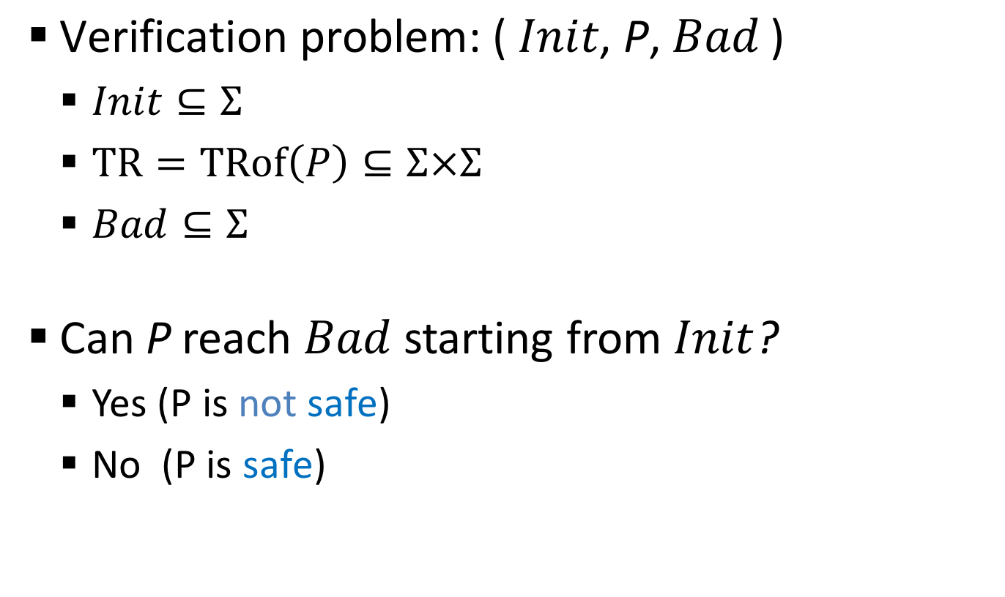
Safety Verification
$\text{Verification} \text{problem}\text{: (} Init\text{, }\text{P}\text{,} Bad \text{)}$
  $Init⊆Σ$
  $TR=TRof\left(P\right)⊆Σ×Σ$
  $Bad⊆Σ$
Can P reach $Bad$ starting from $Init$?
  Yes (P is not safe)
  No (P is safe)

Slide 3

Inductive Invariants
  $F⊆Σ$is an inductive invariant if:
  $Init⊆F$
  $TR(F)⊆F$
  $F∩Bad=∅$
$\text{P}$ is safe ⇔∃inductive invariant
Bad
Reach-able
TR
𝚺
F
Init

Slide 4
Property Directed Reachability (PDR)
IC3 [Bradley, VMCAI’11]
PDR [Een, Mishchenko & Brayton, FMCAD’11]
IC3/PDR algorithm
  Infers inductive invariants
  SAT-based
  Iterative
Notes:
5 years ago, Bradely proposed a new technique for verifying safety properties of programs
inference of invariants

Slide 5
Property Directed Reachability (PDR)
[Bradley, VMCAI’11]
[Een, Mishchenko & Brayton, FMCAD’11]
“Dynamic” abstraction
  Over-approximates bounded executions
  Abstraction refined as bound grows
  No spurious cex s.t. |cex| ≤ bound
Output
  Inductive invariant
  cex
Notes:
No fixed scheme to lose information

Slide 6
PDR-based Algorithms
[Bradley, VMCAI’11]
[Een, Mishchenko & Brayton, FMCAD’11]
[Cimatti & Griggio, CAV’12]
[Hoder & Bjorner, SAT’12]
[Bjorner & Gurfinkel, VMCAI’15]
[Karbyshev, Bjorner, Itzhaky, R & Shoham, CAV’15]
…
Successfully applied to software & hardware
Varied algorithmic details
Notes:
Successfully software - hardware

Slide 7
Our Goal
Extract essence of PDR
  Hide algorithmic details
  Show commonality
  A unified proof of soundness

Slide 8
Technical Attack
Abstract Interpretation (AI)
  Hide algorithmic details
  Analysis = abstract semantics
    Over-approximate concrete
    semantics
  Sound by construction
Our approach: formulate PDR using AI
(A, α, 𝛾, C)
TR
c
c’
𝛾
α
TR#
a
a’’
⊒
a’

Slide 9
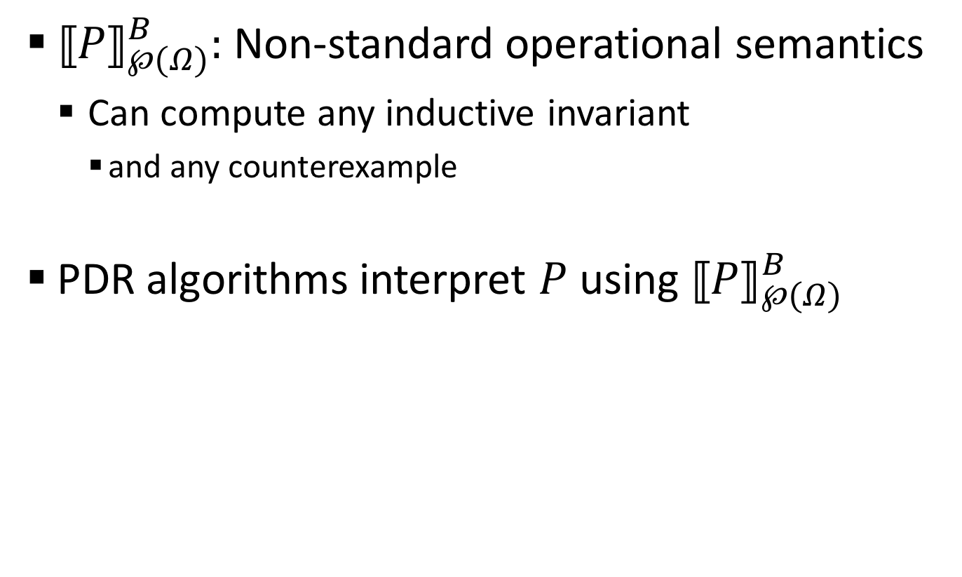
Main Results
${⟦P⟧}_{℘(Ω)}^{B}:$Non-standard operational semantics
  Can compute any inductive invariant
    and any counterexample
PDR algorithms interpret $P$ using ${⟦P⟧}_{℘(Ω)}^{B}$

Slide 10

Plan
PDR
${⟦P⟧}_{℘(Ω)}^{B}$
PDR as AI using ${⟦P⟧}_{℘(Ω)}^{B}$
*No SAT in this presentation

Slide 11
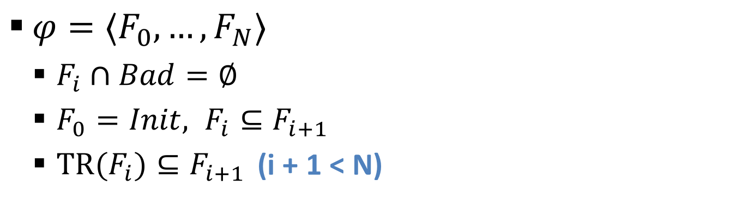




PDR: Intermediate Forward Reachability Sequences
$φ=〈F_{0},…,F_{N}〉$
  $F_{i}∩Bad=∅$
  $F_{0}=Init, F_{i}⊆F_{i+1}$
  ${TR(F}_{i})⊆F_{i+1 }$ (i + 1 < N)
Frames
Bad
F₃
F₄
Σ
F₂
$$⊆$$
F₁
$$⊆$$
$$⊆$$
$$⊆$$
N = 4
F₀ = Init

Slide 12
PDR: Intermediate Forward Reachability Sequences
$φ=〈F_{0},…,F_{N}〉$
  $F_{i}∩Bad=∅$
  $F_{0}=Init, F_{i}⊆F_{i+1}$
  ${TR(F}_{i})⊆F_{i+1 }$ (i + 1 < N)
Bad
✘
F₃
F₄
Σ
✘
✘
F₂
F₁
N = 4
F₀ = Init

Slide 13

PDR: Obligation Queue
$φ=〈F_{0},…,F_{N}〉$
  $F_{i}∩Bad=∅$
  $F_{0}=Init, F_{i}⊆F_{i+1}$
  ${TR(F}_{i})⊆F_{i+1 }$ (i + 1 < N)
Q =[ (𝜎’’,2) (𝜎,3) ]
Bad
F₃
F₄
𝜎
F₂
F₁
N = 4
F₀ = Init

Slide 14
PDR: Queue Initialization
$φ=〈F_{0},…,F_{N}〉$
  $F_{i}∩Bad=∅$
  $F_{0}=Init, F_{i}⊆F_{i+1}$
  ${TR(F}_{i})⊆F_{i+1 }$ (i + 1 < N)
Q =[ (𝜎’’,2) (𝜎,3) ]
Bad
F₃
F₄
𝜎
F₂
F₁
N = 4
F₀ = Init

Slide 15
PDR: Backward Step
$φ=〈F_{0},…,F_{N}〉$
  $F_{i}∩Bad=∅$
  $F_{0}=Init, F_{i}⊆F_{i+1}$
  ${TR(F}_{i})⊆F_{i+1 }$ (i + 1 < N)
Q =[ (𝜎’’,2) (𝜎,3) ]
Bad
F₃
F₄
𝜎’
𝜎
F₂
𝜎’’
𝜎’’’
F₁
N = 4
F₀ = Init

Slide 16
PDR: Blocking
$φ=〈F_{0},…,F_{N}〉$
  $F_{i}∩Bad=∅$
  $F_{0}=Init, F_{i}⊆F_{i+1}$
  ${TR(F}_{i})⊆F_{i+1 }$ (i + 1 < N)
Q =[ (𝜎’’,2) (𝜎,3) ]
Bad
F₃
F₄
𝜎’
𝜎
×
F₂
𝜎’’
𝜎’’’
F₁
N = 4
F₀ = Init

Slide 17

PDR: Generalization
$φ=〈F_{0},…,F_{N}〉$
  $F_{i}∩Bad=∅$
  $F_{0}=Init, F_{i}⊆F_{i+1}$
  ${TR(F}_{i})⊆F_{i+1 }$ (i + 1 < N)
S = Gen(F_{i-1},𝜎):
S ∩ Init = $∅$
S ∩ TR(F_{i-1}) = $∅$
Q =[ (𝜎’’,2) (𝜎,3) ]
Bad
F₃
F₄
𝜎’
𝜎
×
S
F₂
𝜎’’
𝜎’’’
F₁
N = 4
F₀ = Init

Slide 18
PDR: Generalization
$φ=〈F_{0},…,F_{N}〉$
  $F_{i}∩Bad=∅$
  $F_{0}=Init, F_{i}⊆F_{i+1}$
  ${TR(F}_{i})⊆F_{i+1 }$ (i + 1 < N)
S = Gen(F_{i-1},𝜎):
S ∩ Init = $∅$
S ∩ TR(F_{i-1}) = $∅$
Q =[ (𝜎’’,2) (𝜎,3) ]
Bad
F₃
F₄
𝜎’
𝜎
×
F₂
𝜎’’
𝜎’’’
F₁
N = 4
F₀ = Init

Slide 19
PDR: Generalization
$φ=〈F_{0},…,F_{N}〉$
  $F_{i}∩Bad=∅$
  $F_{0}=Init, F_{i}⊆F_{i+1}$
  ${TR(F}_{i})⊆F_{i+1 }$ (i + 1 < N)
S = Gen(F_{i-1},𝜎):
S ∩ Init = $∅$
S ∩ TR(F_{i-1}) = $∅$
Q =[ (𝜎’’,2) (𝜎,3) ]
Bad
F₃
F₄
𝜎’
𝜎
×
F₂
𝜎’’
𝜎’’’
F₁
N = 4
F₀ = Init

Slide 20
PDR: Backward Step
$φ=〈F_{0},…,F_{N}〉$
  $F_{i}∩Bad=∅$
  $F_{0}=Init, F_{i}⊆F_{i+1}$
  ${TR(F}_{i})⊆F_{i+1 }$ (i + 1 < N)
Q =[ (𝜎 (𝜎’’’,2) ’’,2) (𝜎,3) ]
(𝜎’’’’,1)
Bad
F₃
F₄
𝜎’
𝜎
×
×
×
F₂
𝜎’’
𝜎’’
𝜎’’’
F₁
N = 4
F₀ = Init
𝜎’’’’

Slide 21
PDR: Counterexample
$φ=〈F_{0},…,F_{N}〉$
  $F_{i}∩Bad=∅$
  $F_{0}=Init, F_{i}⊆F_{i+1}$
  ${TR(F}_{i})⊆F_{i+1 }$ (i + 1 < N)
Q =[ (𝜎 (𝜎’’’,2) ’’,2) (𝜎,3) ]
(𝜎’’’’,1)
Bad
F₃
F₄
𝜎’
𝜎
×
×
×
F₂
𝜎’’
𝜎’’
𝜎’’’
F₁
N = 4
F₀ = Init
𝜎’’’’

Slide 22
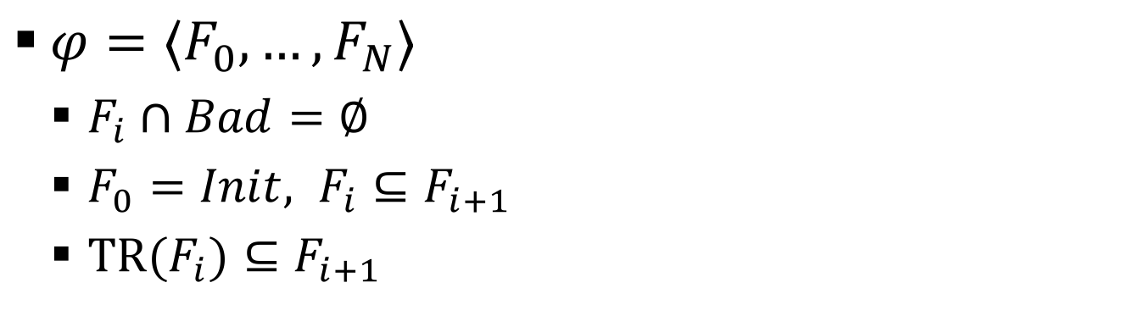
PDR: Forward Reachability Sequence
$φ=〈F_{0},…,F_{N}〉$
  $F_{i}∩Bad=∅$
  $F_{0}=Init, F_{i}⊆F_{i+1}$
  ${TR(F}_{i})⊆F_{i+1 }$
Q =[ (𝜎 (𝜎’’’,2) ’’,2) (𝜎,3) ]
Bad
F₄
✘
F₃
F₂
F₁
N = 4
F₀ = Init

Slide 23
PDR: Fixpoint
$φ=〈F_{0},…,F_{N}〉$
  $F_{i}∩Bad=∅$
  $F_{0}=Init, F_{i}⊆F_{i+1}$
  ${TR(F}_{i})⊆F_{i+1 }$
``
F₂
inductive invariant
Q =[ (𝜎 (𝜎’’’,2) ’’,2) (𝜎,3) ]
Bad
F₄
✘
F₂
F₃
=
F₁
N = 4
F₀ = Init

Slide 24
PDR: Unfolding
$φ=〈F_{0},…,F_{N}〉$
  $F_{i}∩Bad=∅$
  $F_{0}=Init, F_{i}⊆F_{i+1}$
  ${TR(F}_{i})⊆F_{i+1 }$
Q =[ (𝜎 (𝜎’’’,2) ’’,2) (𝜎,3) ]
Bad
F₄
✘
F₃
F₂
F₁
N = 4
F₀ = Init

Slide 25
PDR: Unfolding
$φ=〈F_{0},…,F_{N}〉$
  $F_{i}∩Bad=∅$
  $F_{0}=Init, F_{i}⊆F_{i+1}$
  ${TR(F}_{i})⊆F_{i+1 }$ (i + 1 < N)
Q =[ (𝜎 (𝜎’’’,2) ’’,2) (𝜎,3) ]
Bad
F₄
F₅
F₃
F₂
F₁
N = 5
F₀ = Init

Slide 26
PDR Operations
Unfolding
Queue initialization
Backward step
Blocking
Generalization
Termination: Counterexample / Invariant
Obligation lifting
Inductive generalization
Forward propagation
Pushing obligation forward

Slide 27
PDR & Abstract Interpretation
AI & PDR compute inductive invariants
  AI: Systematic
  PDR: Specialized
How can we formulate PDR using AI?
  Abstractions
  Transformers

Slide 28
Where to start?
What concrete semantics does PDR abstract?
Q =[ (𝜎 (𝜎’’’,2) ’’,2) (𝜎,3) ]
(𝜎’’’’,1)
Bad
F₃
F₄
𝜎
F₂
𝜎’’’
F₁
F₀ = Init
𝜎’’’’

Slide 29
Where to start?
What concrete semantics does PDR abstracts?
Q =[ (𝜎 (𝜎’’’,2) ’’,2) (𝜎,3) ]
(𝜎’’’’,1)
Bad
F₃
F₄
𝜎
F₂
𝜎’’’
F₁
F₀ = Init
𝜎’’’’

Slide 30

Collecting (Backward) Trace Semantics
Verification problem: ( $Init$, P, $Bad$)
${⟦P⟧}_{℘(Σ^{∗})}^{B} =\text{evil} \text{traces} ⊆Σ^{∗}$
$=\left\{π∈Σ^{∗} ∣ π_{0}∈Bad∧{∀i. π}_{i}\underset{→}{TR^{−1}}π_{i+1}\right\}$

Slide 31
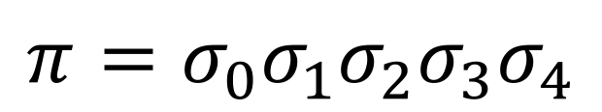
Collecting (Backward) Trace Semantics
Verification problem: ( $Init$, P, $Bad$)
${⟦P⟧}_{℘(Σ^{∗})}^{B} =\text{evil} \text{traces} ⊆Σ^{∗}$
$=\left\{π∈Σ^{∗} ∣ π_{0}∈Bad∧{∀i. π}_{i}\underset{→}{TR^{−1}}π_{i+1}\right\}$
$$π=σ_{0}σ_{1}σ_{2}σ_{3}σ_{4}$$

Slide 32





Collecting (Backward) Trace Semantics
Verification problem: ( $Init$, P, $Bad$)
${⟦P⟧}_{℘(Σ^{∗})}^{B} =\text{evil} \text{traces} ⊆Σ^{∗}$
$=\left\{π∈Σ^{∗} ∣ π_{0}∈Bad∧{∀i. π}_{i}\underset{→}{TR^{−1}}π_{i+1}\right\}$
$$π=σ_{0}σ_{1}σ_{2}σ_{3}σ_{4}$$
Bad
$$σ_{2}$$
$$σ_{1}$$
$$σ_{0}$$
$$σ_{4}$$
$$σ_{3}$$

Slide 33

















Collecting (Backward) Transitions
Verification problem: ( $Init$, P, $Bad$)
${TR}_{℘(Σ^{∗})}^{B}⊆$ $℘\left(Σ^{∗}\right)×℘(Σ^{∗})$
$$σ_{4}$$
$$σ_{2}$$
$$σ_{1}$$
$$σ_{0}$$
$$σ_{4}\underset{→}{TR}σ_{2}$$
$$σ_{2}$$
$$\underset{→}{{TR}_{℘(Σ^{∗})}^{B}}$$
$$σ_{1}$$
$$σ_{0}$$
$$σ_{2}$$
$$σ_{0}$$
$$σ_{1}$$
$$σ_{5}\underset{→}{TR}σ_{2}$$
$$σ_{1}$$
$$σ_{0}$$
$$σ_{0}$$
$$σ_{3}$$
$$σ_{3}$$
$$σ_{1}$$
$$σ_{4}$$
$$σ_{0}$$
$$σ_{4}$$
$$σ_{0}$$
$$σ_{9}\underset{→}{TR}σ_{2}$$

Slide 34









How to abstract?
$$σ_{2}$$
$$σ_{1}$$
$$σ_{1}$$
$$σ_{2}$$
$$σ_{2}$$
$$σ_{5}$$
$$σ_{2}$$
$$σ_{0}$$
$$σ_{3}$$
$$σ_{4}$$
$$σ_{3}$$
$$σ_{1}$$
$$σ_{6}$$
$$σ_{6}$$
$$σ_{5}$$
$$σ_{0}$$
$$σ_{1}$$
What would PDR do?

Slide 35
1. Cartesian Abstraction
$$σ_{1}$$
$$σ_{1}$$
$$σ_{1}$$
$$σ_{2}$$
$$σ_{1}$$
$$σ_{2}$$
$$σ_{2}$$
$$σ_{2}$$
$$σ_{0}$$
$$σ_{2}$$
$$σ_{0}$$
$$σ_{5}$$
$$σ_{2}$$
$$σ_{5}$$
$$σ_{3}$$
$$σ_{4}$$
$$σ_{3}$$
$$σ_{4}$$
$$σ_{1}$$
$$σ_{6}$$
$$σ_{6}$$
$$σ_{5}$$
$$σ_{0}$$
$$σ_{1}$$
$$σ_{1}$$
ω₄
ω₃
ω₂
ω₁
ω₀
ω =
$$ω=ω_{0}ω_{1}ω_{2}ω_{3}ω_{4}∈Ω={𝒫\left(Σ\right)}^{∗}$$

Slide 36

Cartesian Traces
$ω=ω_{0}ω_{1}ω_{2}ω_{3}ω_{4}∈Ω={𝒫\left(Σ\right)}^{∗}$
Anti-Frames
ω₄
ω₃
ω₂
ω₁
ω₀
F₃
F₄
Σ
F₂
F₁
F₀ =
Trace grows this way

Slide 37








2. Init-Sensitive Abstraction
Cartesian abstraction allows to capture only states occurring in evil traces
$ω$₄
$ω$₃
$ω$₂
$ω$₁
$ω$₀
$$σ_{4}$$
$$σ_{2}$$
$$σ_{1}$$
$$σ_{2}$$
$$σ_{0}$$
ω =
$$σ_{4}$$
$$σ_{1}$$
$$σ_{5}$$
$$σ_{2}$$
Σ
$$σ_{3}$$
$$σ_{6}$$

Slide 38
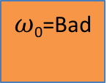
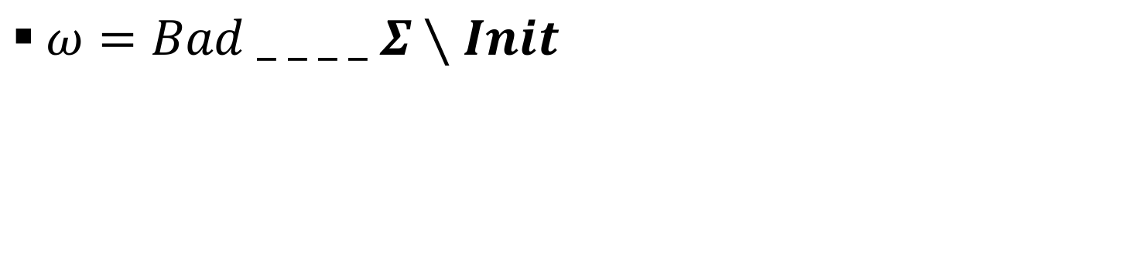
2. Init-Sensitive Abstraction
$ω=Bad _ _ _ _ Σ∖Init$
ω₄=
Σ \ Init
$ω$₂
$ω$₁
$ω$₀=Bad
$ω$₄
$ω$₃
$$σ_{2}$$
$$σ_{1}$$
$$σ_{2}$$
ω =
$$σ_{4}$$
$$σ_{5}$$
$$σ_{2}$$
Σ
$$σ_{3}$$
$$σ_{6}$$
Init

Slide 39
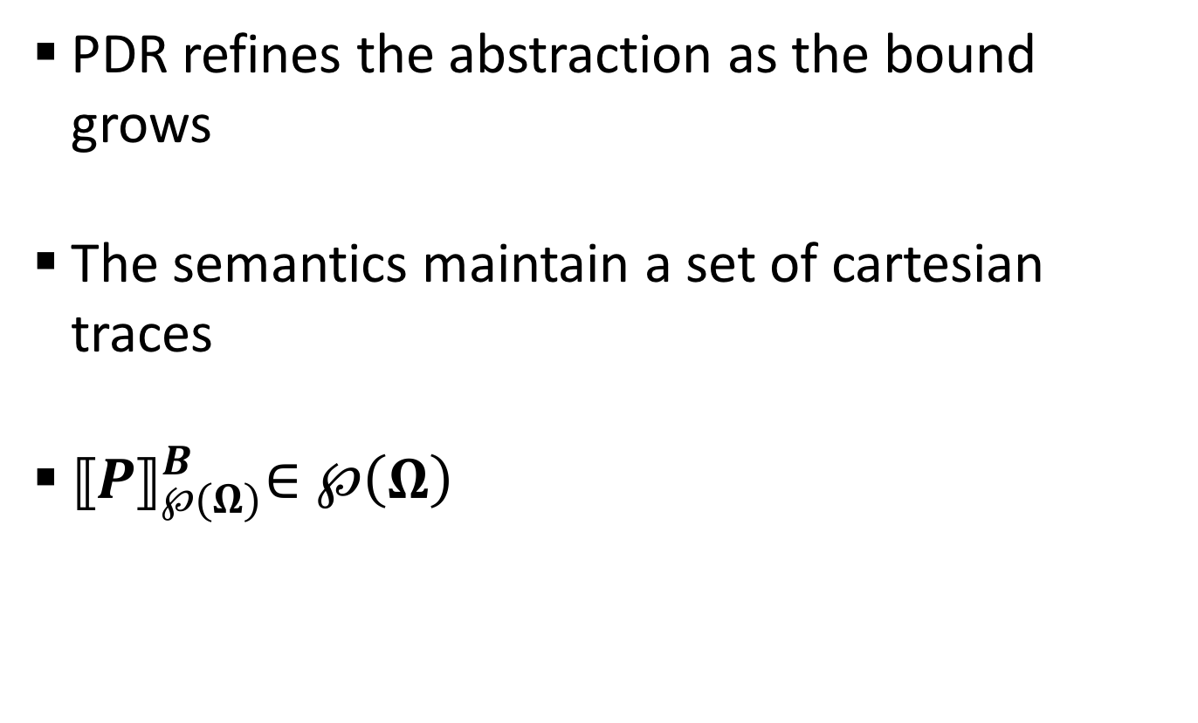
3. Bound-Sensitive Abstraction
PDR refines the abstraction as the bound grows
The semantics maintain a set of cartesian traces
${⟦P⟧}_{℘(Ω)}^{B}∈℘\left(Ω\right)$

Slide 40
What about Transformers?

Slide 41
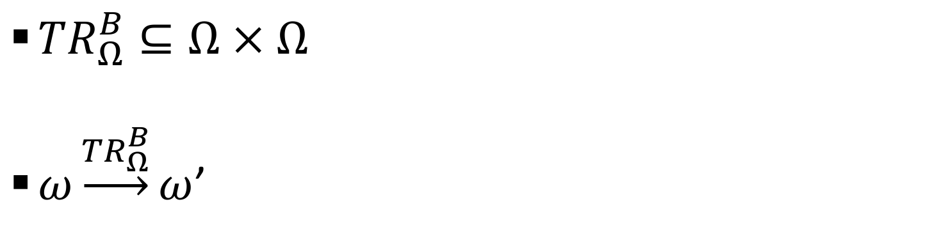
Backward Transitions
${TR}_{Ω}^{B}⊆Ω × Ω$
$ω\underset{→}{{TR}_{Ω}^{B}}ω$’
S’
S
ω₄=
Σ \ Init
$ω$₂
$ω$₁
$ω$₀=Bad
$ω$₄
ω₃
$$σ_{2}$$
$$σ_{1}$$
$$σ_{2}$$
ω =
$$σ_{4}$$
$$σ_{5}$$
$$σ_{2}$$
$$σ_{3}$$
$$σ_{6}$$
Init

Slide 42





Backward Transitions
${TR}_{Ω}^{B}⊆Ω × Ω$
$ω\underset{→}{{TR}_{Ω}^{B}}ω$’
S’
S
ω₄=
Σ \ Init
$ω$₂
$ω$₁
$ω$₀=Bad
$ω$₄
ω₃
$$σ_{2}$$
$$σ_{1}$$
$$σ_{2}$$
ω =
$$σ_{4}$$
$$σ_{5}$$
$$σ_{2}$$
$$σ_{3}$$
$$σ_{6}$$
$$σ_{5}$$
$$Y$$
$${TR}^{−1}\left(S\right)$$
Init
$$σ_{8}$$
$$σ_{7}$$

Slide 43

Backward Transitions
${TR}_{Ω}^{B}⊆Ω × Ω$
$ω\underset{→}{{TR}_{Ω}^{B}}ω$’
S’
S
ω₄=
Σ \ Init
$ω$₂
$ω$₁
$ω$₀=Bad
$ω$₄
ω₃
$$σ_{2}$$
$$σ_{1}$$
$$σ_{2}$$
ω’ =
$$σ_{4}$$
$$σ_{5}$$
$$σ_{2}$$
$$σ_{3}$$
$$σ_{6}$$
$$σ_{5}$$
$$σ_{8}$$
$${Y⊆TR}^{−1}\left(S\right)$$
Init
$$Y$$

Slide 44




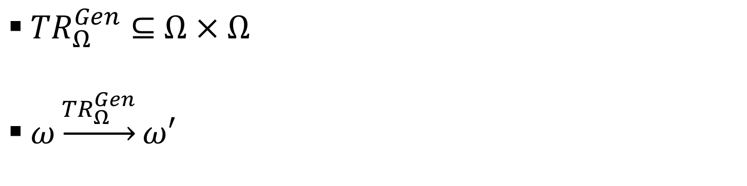
Generalization Transitions
${TR}_{Ω}^{Gen}⊆$ $Ω × Ω$
$ω\underset{→}{{TR}_{Ω}^{Gen}}ω′$
S
ω₄=
Σ \ Init
$ω$₂
$ω$₁
$ω$₀=Bad
$ω$₄
$ω$₃
$$σ_{2}$$
$$σ_{1}$$
$$σ_{2}$$
ω =
$$σ_{4}$$
$$σ_{5}$$
$$σ_{2}$$
$$σ_{3}$$
$$σ_{6}$$
$$σ_{8}$$
$$Y∩Init=∅$$
$$σ_{7}$$
$$Y$$
Init
S

Slide 45


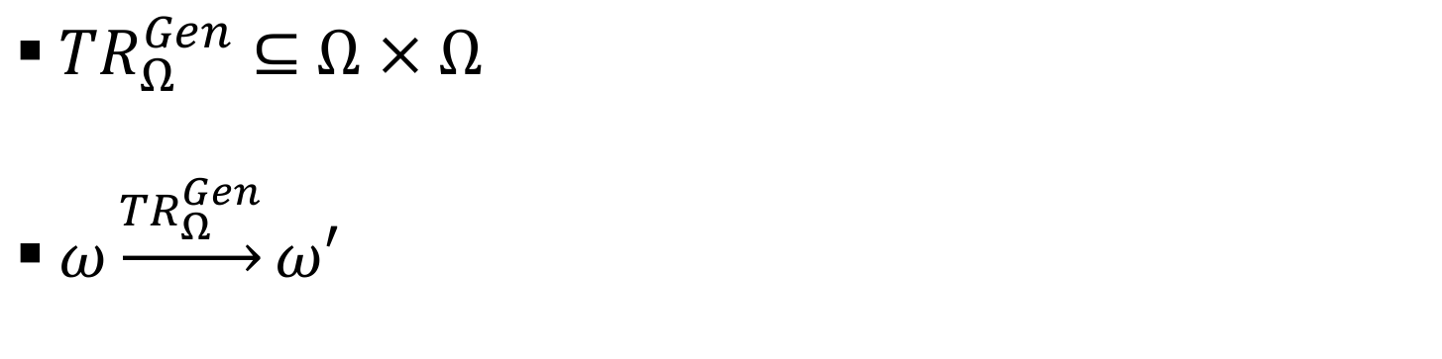
Generalization Transitions
${TR}_{Ω}^{Gen}⊆$ $Ω × Ω$
$ω\underset{→}{{TR}_{Ω}^{Gen}}ω′$
S’
S
ω₄=
Σ \ Init
$ω$₂
$ω$₁
$ω$₀=Bad
$ω$₄
$ω$₃
$$σ_{2}$$
$$σ_{1}$$
$$σ_{2}$$
ω =
$$σ_{4}$$
✘
$$σ_{5}$$
$$σ_{2}$$
$$σ_{3}$$
$$σ_{6}$$
$$σ_{8}$$
$$Y∩Init=∅$$
$$σ_{7}$$
$$Y$$
✘
Init
$${TR}^{−1}\left(Y\right)$$
$$S^{′}⊇{TR}^{−1}\left(Y\right)$$

Slide 46
Generalization Transitions
${TR}_{Ω}^{Gen}⊆$ $Ω × Ω$
$ω\underset{→}{{TR}_{Ω}^{Gen}}ω′$
S’
S
ω₄=
Σ \ Init
$ω$₂
$ω$₁
$ω$₀=Bad
$ω$₄
$ω$₃
$$σ_{2}$$
$$σ_{1}$$
$$σ_{2}$$
ω =
$$σ_{4}$$
$$σ_{5}$$
$$σ_{2}$$
$$σ_{3}$$
$$σ_{6}$$
$$σ_{8}$$
$$Y∩Init=∅$$
$$σ_{7}$$
$$Y$$
Init
$$S^{′}⊇{TR}^{−1}\left(Y\right)$$

Slide 47









Small step collecting property-guided cartesian trace semantics
Σ \ Init
Bad
$ω$₄
Init
${⟦P⟧}_{℘(Ω)}^{B}∈℘\left(Ω\right)$
${⟦P⟧}_{℘(Ω)}^{B}=\{ ω^{′}∣ω∈\hat{Ω}∧ω {\underset{→}{{{TR}_{Ω}^{B}∪TR}_{Ω}^{Gen\left(B\right)}}}^{ ∗}ω^{′}\}$
$\hat{Ω}=\left\{ω=Bad ∅…∅ \left(Σ∖Init\right) \right| 2≤\left|ω\right| \}$
$=\{$ , , , … }
Σ \ Init
Bad
Σ \ Init
Bad
Σ \ Init
Bad
$ω$₄
$ω$₄
$ω$₄
Init
Init
Init

Slide 48
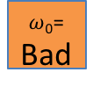







Safety
$P$ is safe iff
ω₄=
Σ \ Init
$ω$₃
$ω$₄
ω₃
$ω$₂
$ω$₁
$ω$₀=
Bad
ω₂
ω₁
$${∉⟦P⟧}_{℘(Ω)}^{B}$$
Init

Slide 49






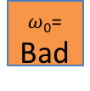
Safety
$P$ is safe iff
$F$ is inductive
invariant iff
ω₄=
Σ \ Init
$ω$₃
$ω$₄
ω₃
$ω$₂
$ω$₁
$ω$₀=
Bad
ω₂
ω₁
$${∉⟦P⟧}_{℘(Ω)}^{B}$$
Init
ω₄=
Σ \ Init
$ω$₃
$ω$₄
⊇
ω₃
⊇
$ω$₂
⊇
$ω$₁
⊇
$ω$₀=
Bad
ω₂
ω₁
$${∈⟦P⟧}_{℘(Ω)}^{B}$$
✘
✘
$$F$$
✘
✘
$$F$$
Init

Slide 50







PDR as Abstract Interpretation
PDR as interpretation using ${∈⟦P⟧}_{℘(Ω)}^{B}$
$${TR}_{℘\left(Ω\right)}^{B}$$
$${TR}_{℘\left(Ω\right)}^{B}$$
$${TR}_{℘\left(Ω\right)}^{B}$$
$${TR}_{℘\left(Ω\right)}^{B}$$
$${TR}_{℘\left(Ω\right)}^{B}$$
O
O’
compatibility
compatibility
$$PDR Operation$$
PDR
config
PDR
config’
Stuttering Simulation

Slide 51

Proof-Compatibility
An intermediate forward sequence $\left\langle F_{0},..,F_{N}\right\rangle$ is proof-compatible with $ω∈Ω$ if
  $\left|ω\right|=N+1$
  $∀i. F_{i}=Σ∖ω(N−i)$
ω₄=
Σ\Init
ω₃
ω₂
ω₁
ω₀=
Bad
F₄
F₃
F₂
F₁
N = 4
F₀ = Init

Slide 52


CEX-Compatibility
An obligation $\left(σ,i\right)$ is cex-compatible with $ω∈Ω$ if
  $\left|ω\right|≥i+1$
  $σ∈ω(\left|ω\right|−i−1)$
Q =[ (𝜎 (𝜎,3) ’’,2 ]
ω₄=
Σ\Init
ω₃
ω₂
ω₁
ω₀=
Bad
$$σ$$

Slide 53

Compatibility
A PDR configuration $\left\langle N, \left\langle F_{0},..,F_{N}\right\rangle ,q\right\rangle$ is compatible with $O⊆Ω$ if
  $∃ω∈O$ s.t.$\left\langle F_{0},..,F_{N}\right\rangle$ is proof compatible with $ω$
  $∀\left(σ,i\right)∈q$ , $∃$a cex-compatible $ω∈O$

Slide 54

PDR as Abstract Interpretation
Σ \ Init
Bad
$ω$₄
Init
PDR Algorithms interpret the program using ${⟦P⟧}_{℘(Ω)}^{B}$
Stop at
  Counterexample
  Inductive invariant

Slide 55
PDR: Generalization
S = Gen(F_{i-1},𝜎):
S ∩ Init = $∅$
S ∩ TR(F_{i-1}) = $∅$
ω₄=
Σ\Init
ω₃
ω₀=
Bad
ω₂
ω₁
Bad
F₃
F₄
F₂
F₁
N = 4
F₀ = Init

Slide 56
PDR: Generalization
S = Gen(F_{i-1},𝜎):
S ∩ Init = $∅$
S ∩ TR(F_{i-1}) = $∅$
ω₄=
Σ\Init
ω₃
ω₀=
Bad
ω₂
ω₁
Bad
F₃
F₄
F₂
F₁
N = 4
F₀ = Init

Slide 57
PDR: Generalization
S = Gen(F_{i-1},𝜎):
S ∩ Init = $∅$
S ∩ TR(F_{i-1}) = $∅$
ω₄=
Σ\Init
ω₃
ω₀=
Bad
ω₂
ω₁
Bad
F₃
F₄
F₂
F₁
N = 4
F₀ = Init

Slide 58
PDR: Generalization
S = Gen(F_{i-1},𝜎):
S ∩ Init = $∅$
S ∩ TR(F_{i-1}) = $∅$
ω₄=
Σ\Init
ω₃
ω₀=
Bad
ω₂
ω₁
Bad
F₃
F₄
F₂
F₁
N = 4
F₀ = Init

Slide 59
PDR: Generalization
S = Gen(F_{i-1},𝜎):
S ∩ Init = $∅$
S ∩ TR(F_{i-1}) = $∅$
ω₄=
Σ\Init
ω₃
ω₀=
Bad
ω₂
ω₁
Bad
F₃
F₄
F₂
F₁
N = 4
F₀ = Init

Slide 60
Conclusions
PDR algorithms can be explained as abstract interpretation using a non standard semantics
  2 key operations
New proof technique for soundness of future PDR algorithms

Slide 61
F₁ is Where the Action Starts
Bad
F₄
F₃
F₂
F₁
N = 4
F₀ = Init

Slide 62
Thank you!

